Slide 1
Chapter 10 – Intermediate HTML 4
Outline
10.1 Introduction
10.2 Unordered Lists
10.3 Nested and Ordered Lists
10.4 Basic HTML Tables
10.5 Intermediate HTML Tables and Formatting
10.6 Basic HTML Forms
10.7 More Complex HTML Forms
10.8 Internal Linking
10.9 Creating and Using Image Maps
10.10 <META> Tags
10.11 <FRAMESET> Tag
10.12 Nested <FRAMESET> Tags

Slide 2
10.1 Introduction
In this Chapter
  Lists
  Tables
  Internal linking
  Image maps
  Frames

Slide 3
10.2 Unordered Lists
Unordered list element
  Creates a list in which every line begins with a bullet mark
  <UL>…</UL> tags
  Each item in unordered list inserted with the <LI> (list item) tag
    Closing </LI> tag optional

Slide 4
1<HTML>
3<!-- Fig. 10.1: links.html -->
4<!-- Unordered Lists -->
5
Unordered list
1.1 List items
6<HEAD>
7<TITLE>Internet and WWW How to Program - Links</TITLE>
8</HEAD>
9
10<BODY>
11
12<CENTER>
13<H2>Here are my favorite Internet Search Engines</H2>
14<P><STRONG>Click on the Search Engine address to go to that
15page.</STRONG></P>
16
17<!-- <UL> creates a new unordered (bullet) list -->
18<!-- <LI> inserts a new entry into the list -->
19<UL>
20<LI>Yahoo: <A HREF = "http://www.yahoo.com">
21http://www.yahoo.com</A></LI>
22
23<LI>Alta Vista: <A HREF = "http://www.altavista.com">
24http://www.alta-vista.com</A></LI>
25
26<LI>Ask Jeeves: <A HREF = "http://www.askjeeves.com">
27http://www.askjeeves.com</A></LI>
28
29<LI>WebCrawler: <A HREF = "http://www.webcrawler.com">
30http://www.webcrawler.com</A></LI>
31</UL>
32</CENTER>
33</BODY>
34</HTML>

Slide 5
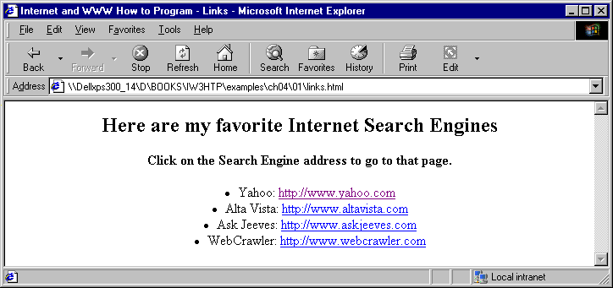
Unordered lists with HTML

Slide 6
10.3 Nested and Ordered Lists
Nested list
  Contained in another list element
  Nesting the new list inside the original
    Indents list one level and changes the bullet type to reflect the nesting
Browsers
  Insert a line of whitespace after every closed list
Indent each level of a nested list
  Makes the code easier to edit and debug

Slide 7
1 <HTML>
2
3 <!-- Fig. 10.2: list.html -->
4 <!-- Advanced Lists: nested and ordered -->
Nested lists
1.1 Three levels of nesting
1.2 Close </UL> tags in appropriate places
5
6 <HEAD>
7 <TITLE>Internet and WWW How to Program - List</TITLE>
8 </HEAD>
9
10 <BODY>
11
12 <CENTER>
13 <H2><U>The Best Features of the Internet</U></H2>
14 </CENTER>
15
16 <UL>
17 <LI>You can meet new people from countries around
18 the world.</LI>
19 <LI>You have access to new media as it becomes public:</LI>
20
21 <!-- This starts a nested list, which uses a modified -->
22 <!-- bullet. The list ends when you close the <UL> tag -->
23 <UL>
24 <LI>New games</LI>
25 <LI>New applications </LI>
26
27 <!-- Another nested list, there is no nesting limit -->
28 <UL>
29 <LI>For business</LI>
30 <LI>For pleasure</LI>

Slide 8
31 </UL> <!-- This ends the double nested list -->
32 <LI>Around the clock news</LI>
33 <LI>Search engines</LI>
34 <LI>Shopping</LI>
2. Ordered list
35 <LI>Programming</LI>
36 <UL>
37 <LI>HTML</LI>
38 <LI>Java</LI>
39 <LI>Dynamic HTML</LI>
40 <LI>Scripts</LI>
41 <LI>New languages</LI>
42 </UL>
43 </UL> <!-- This ends the first level nested list -->
44 <LI>Links</LI>
45 <LI>Keeping in touch with old friends</LI>
46 <LI>It is the technology of the future!</LI>
47 </UL> <!-- This ends the primary unordered list -->
48
49 <BR><CENTER><H2>My 3 Favorite <EM>CEO's</EM></H2></CENTER>
50
51 <!-- Ordered lists are constructed in the same way as -->
52 <!-- unordered lists, except their starting tag is <OL> -->
53 <OL>
54 <LI>Bill Gates</LI>
55 <LI>Steve Jobs</LI>
56 <LI>Michael Dell</LI>
57 </OL>
58
59 </BODY>
60 </HTML>

Slide 9
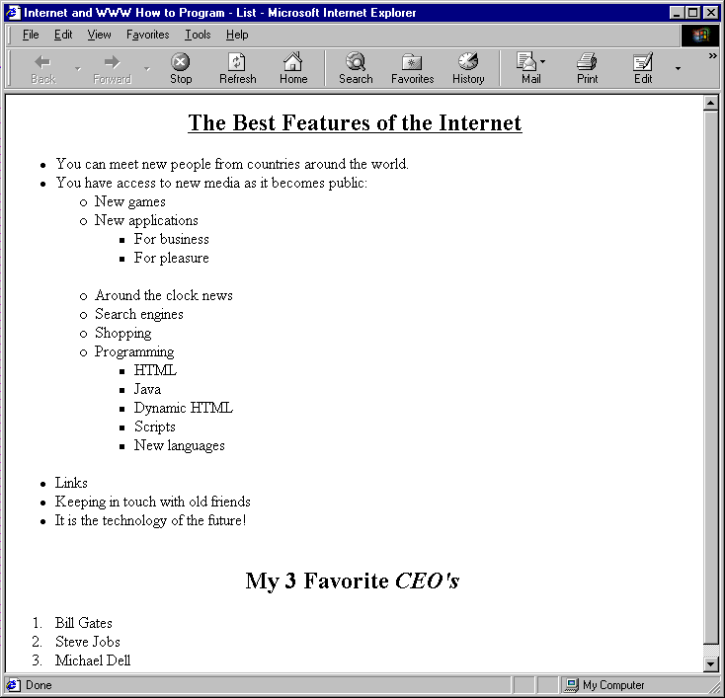
Nested and ordered lists in HTML

Slide 10
10.3 Nested and Ordered Lists
Ordered list element
  <OL>…</OL> tags
  By default, ordered lists use decimal sequence numbers
    (1, 2, 3, …)
  To change sequence type, use TYPE attribute in <OL> opening tag
    TYPE = “1” (default)
      Decimal sequence (1, 2, 3, …)
    TYPE = “I”
      Uppercase Roman numerals (I, II, III, …)
    TYPE = “i”
      Lowercase Roman numerals (i, ii, iii, …)
    TYPE = “A”
      Uppercase alphabetical (A, B, C, …)
    TYPE = “a”
      Lowercase alphabetical (a, b, c, …)

Slide 11
1<HTML>
2
3<!-- Fig. 10.3: list.html -->
4<!-- Different Types of Ordered Lists -->
1. OL element
1.1 TYPE attribute
5
6<HEAD>
7<TITLE>Internet and WWW How to Program - List</TITLE>
8</HEAD>
9
10<BODY>
11
12<CENTER>
13<H2>Web Site Outline</H2>
14</CENTER>
15
16<!-- Change the character style by specifying it in -->
17<!-- <OL TYPE = "style"> OR <LI TYPE = "style"> as -->
18<!-- decimal=1, uppercase Roman=I, lowercase Roman=i -->
19<!-- uppercase Latin=A, lowercase Latin=a -->
20<OL>
21<LI>Home page</LI>
22<LI>Links page</LI>
23 <OL TYPE = "I">
24 <LI>Links to search engines</LI>
25 <LI>Links to information sites</LI>
26 <OL TYPE = "A">
27 <LI>News sites</LI>
28 <OL>
29 <LI TYPE = "i">TV based</LI>
30 <OL TYPE = "a">

Slide 12
31 <LI>CNN</LI>
32 <LI>Headline News</LI>
33 </OL>
34 <LI TYPE = "i">Text based</LI>
1.1 TYPE attribute
35 <OL TYPE = "a">
36 <LI>New York Times</LI>
37 <LI>Washington Post</LI>
38 </OL>
39 </OL>
40 <LI>Stock sites</LI>
41 </OL>
42 <LI>Links to "fun" sites</LI>
43 </OL>
44 <LI>Feedback page</LI>
45 <LI>Contact page</LI>
46 <LI>HTML Example Pages</LI>
47 </OL>
48
49 </BODY>
50 </HTML>

Slide 13
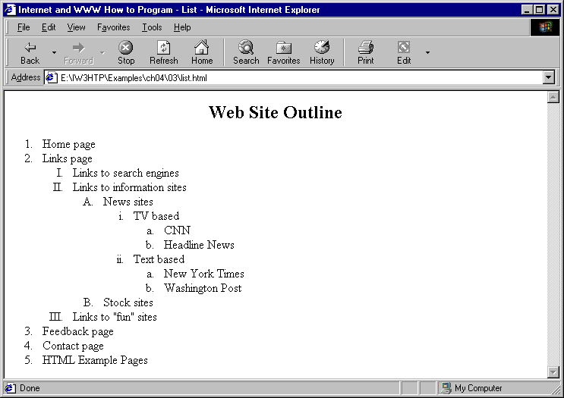
Different types of ordered lists

Slide 14
10.4 Basic HTML Tables
Tables
  Organize data into rows and columns
  All tags and text that apply to the table go inside <TABLE>…</TABLE> tags
  TABLE element
    Attributes
      BORDER lets you set the width of the table’s border in pixels
      ALIGN: left, right or center
      WIDTH: pixels (absolute) or a percentage
    CAPTION element is inserted directly above the table in the browser window
      Helps text-based browsers interpret table data

Slide 15
10.4 Basic HTML tables
  TABLE element (cont.)
    THEAD element
      Header info
      For example, titles of table and column headers
    TR element
      Table row element used for formatting the cells of individual rows
    TBODY element
      Used for formatting and grouping purposes
    Smallest area of the table we are able to format is data cells
      Two types of data cells
        In the header: <TH>…</TH> suitable for titles and column headings
        In the table body: <TD>…</TD>
      Aligned left by default

Slide 16
1 <HTML>
2
3 <!-- Fig. 10.4: table.html -->
4 <!-- Basic table design -->
TABLE element
1.1 BORDER attribute
1.2 CAPTION element
1.3 THEAD element
1.4 TH element
5
6 <HEAD>
7 <TITLE>Internet and WWW How to Program - Tables</TITLE>
8 </HEAD>
9
10 <BODY>
11
12 <CENTER><H2>Table Example Page</H2></CENTER>
13
14 <!-- The <TABLE> tag opens a new table and lets you put in -->
15 <!-- design options and instructions -->
16 <TABLE BORDER = "1" ALIGN = "center" WIDTH = "40%">
17
18 <!-- Use the <CAPTION> tag to summarize the table's contents -->
19 <!-- (this helps the visually impaired) -->
20 <CAPTION>Here is a small sample table.</CAPTION>
21
22 <!-- The <THEAD> is the first (non-scrolling) horizontal -->
23 <!-- section.Use it to format the table header area. -->
24 <!-- <TH> inserts a header cell and displays bold text -->
25 <THEAD>
26 <TR><TH>This is the head.</TH></TR>
27 </THEAD>
28
29 <!-- All of your important content goes in the <TBODY>. -->
30 <!-- Use this tag to format the entire section -->
31 <!-- <TD> inserts a data cell, with regular text -->

Slide 17
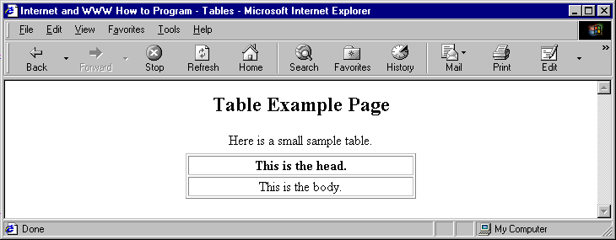
32 <TBODY>
33 <TR><TD ALIGN = "center">This is the body.</TD></TR>
34 </TBODY>
35
1.5 TBODY element
1.6 TD element
2. Page rendered by browser
36 </TABLE>
37
38 </BODY>
39 </HTML>

Slide 18
10.5 Intermediate HTML Tables and Formatting
COLGROUP element
  Used to group and format columns
Each COL element
  In the <COLGROUP>…</COLGROUP> tags
  Can format any number of columns (specified by the SPAN attribute)
Background color or image
  Add to any row or cell
  Use BGCOLOR and BACKGROUND attributes

Slide 19
10.5 Intermediate HTML Tables and Formatting
Possible to make some data cells larger than others
  ROWSPAN attribute inside any data cell
    Value extends the data cell to span the specified number of cells
  COLSPAN attribute
    Value extends the data cell to span the specified number of cells
  Modified cells will cover the areas of other cells
    Reduces number of cells in that row or column
VALIGN attribute
  top, middle, bottom and baseline
  Default is middle

Slide 20
1<HTML>
2
3<!-- Fig. 10.5: table.html -->
4<!-- Intermediate table design -->
1. Small simple table
5
6<HEAD>
7<TITLE>Internet and WWW How to Program - Tables</TITLE>
8</HEAD>
9<BODY>
10
11<H2 ALIGN = "center">Table Example Page</H2>
12
13<TABLE BORDER = "1" ALIGN = "center" WIDTH = "40%">
14 <CAPTION>Here is a small sample table.</CAPTION>
15
16 <THEAD>
17 <TR>
18 <TH>This is the Head.</TH>
19 </TR>
20 </THEAD>
21
22 <TBODY>
23 <TR>
24 <TD ALIGN = "center">This is the Body.</TD>
25 </TR>
26 </TBODY>
27
28</TABLE>
29
30<BR><BR>

Slide 21
30<BR><BR>
31
32<TABLE BORDER = "1" ALIGN = "center">
33
34 <CAPTION>Here is a more complex sample table.</CAPTION>
1.1 COLGROUP element
1.2 COL element
1.3 ROWSPAN and COLSPAN attributes
1.4 BGCOLOR attribute
1.5 WIDTH attribute
1.6 VALIGN attribute
35
36 <!-- <COLGROUP> and <COL> are used to format entire -->
37 <!-- columns at once. SPAN determines how many columns -->
38 <!-- the COL tag effects. -->
39 <COLGROUP>
40 <COL ALIGN = "right">
41 <COL SPAN = "4" ALIGN = "center">
42 </COLGROUP>
43
44 <THEAD>
45
46 <!-- ROWSPANs and COLSPANs combine the indicated number -->
47 <!-- of cells vertically or horizontally -->
48 <TR BGCOLOR = "#8888FF">
49 <TH ROWSPAN = "2">
50 <IMG SRC = "deitel.gif" WIDTH = "200" HEIGHT = "144"
51 ALT = "Harvey and Paul Deitel">
52 </TH>
53 <TH COLSPAN = "4" VALIGN = "top">
54 <H1>Camelid comparison</H1><BR>
55 <P>Approximate as of 8/99</P>
56 </TH>
57 </TR>
58
59 <TR BGCOLOR = "khaki" VALIGN = "bottom">
60 <TH># of Humps</TH>

Slide 22
61 <TH>Indigenous region</TH>
62 <TH>Spits?</TH>
63 <TH>Produces Wool?</TH>
64 </TR>
65
66 </THEAD>
67
68 <TBODY>
69
70 <TR>
71 <TH>Camels (bactrian)</TH>
72 <TD>2</TD>
73 <TD>Africa/Asia</TD>
74 <TD ROWSPAN = "2">Llama</TD>
75 <TD ROWSPAN = "2">Llama</TD>
76 </TR>
77
78 <TR>
79 <TH>Llamas</TH>
80 <TD>1</TD>
81 <TD>Andes Mountains</TD>
82 </TR>
83
84 </TBODY>
85 </TABLE>
86
87 </BODY>
88 </HMTL>

Slide 23
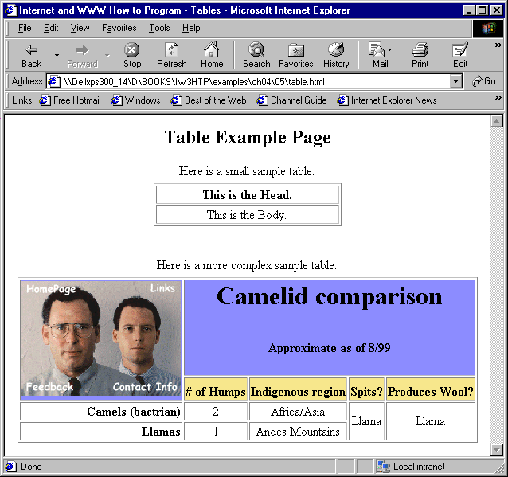
A complex table with formatting and color

Slide 24
10.6 Basic HTML Forms
Forms
  Collect information from people viewing your site
FORM element
  METHOD attribute indicates the way the Web server will organize and send you form output
    Web server: machine that processes browser requests
    METHOD = “post” in a form that causes changes to server data
    METHOD = “get” in a form that does not cause any changes in server data
  Form data sent to server as an environment variable
    Processed by scripts
  ACTION attribute
    Path to a script (a CGI script written in Perl, C or other languages)

Slide 25
10.6 Basic HTML Forms
INPUT element
  Attributes:
    TYPE (required)
      Hidden inputs always have TYPE = “hidden”
      Defines the usage of the INPUT element
        TYPE = “text” inserts a one-line text box
    NAME provides a unique identification for INPUT element
    VALUE indicates the value that the INPUT element sends to the server upon submission
    SIZE
      For TYPE = “text”, specifies the width of the text input, measured in characters
    MAXLENGTH
      For TYPE = “text”, specifies the maximum number of characters that the text input will accept

Slide 26
10.6 Basic HTML Forms
INPUT element (cont.)
  Include textual identifier adjacent to INPUT element
  2 types of INPUT elements that should be inserted into every form:
    TYPE = “submit” inserts a button that submits data to the server
      VALUE attribute changes the text displayed on the button (default is “Submit”)
    TYPE = “reset” inserts a button that clears all entries the user entered into the form
      VALUE attribute changes the text displayed on the button (default is “Reset”)

Slide 27
1<HTML>
2
3<!-- Fig. 10.6: form.html -->
4<!-- Introducing Form Design -->
FORM element
1.1 Specify METHOD attribute
1.2 Hidden input elements
5
6<HEAD>
7<TITLE>Internet and WWW How to Program - Forms</TITLE>
8</HEAD>
9
10<BODY>
11<H2>Feedback Form</H2>
12
13<P>Please fill out this form to help us improve our site.</P>
14
15<!-- This tag starts the form, gives the method of sending -->
16<!-- information and the location of form scripts. -->
17<!-- Hidden inputs give the server non-visual information -->
18<FORM METHOD = "POST" ACTION = "/cgi-bin/formmail">
19
20<INPUT TYPE = "hidden" NAME = "recipient"
21 VALUE = "deitel@deitel.com">
22<INPUT TYPE = "hidden" NAME = "subject"
23 VALUE = "Feedback Form">
24<INPUT TYPE = "hidden" NAME = "redirect"
25 VALUE = "main.html">
26
27<!-- <INPUT type = "text"> inserts a text box -->

Slide 28
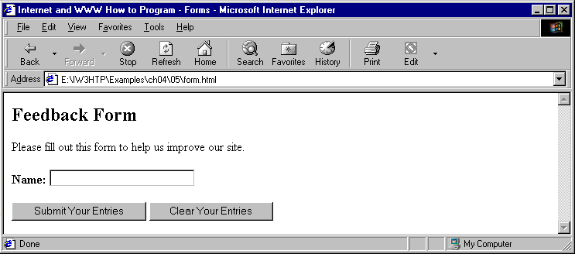
28<P><STRONG>Name:</STRONG>
29<INPUT NAME = "name" TYPE = "text" SIZE = "25"></P>
30
31<!-- Input types "submit" and "reset" insert buttons -->
1.3 Text box INPUT element
1.4 “submit” and “reset” INPUT TYPEs
2. Page rendered by browser
32<!-- for submitting or clearing the form's contents -->
33<INPUT TYPE = "submit" VALUE = "Submit Your Entries">
34<INPUT TYPE = "reset" VALUE = "Clear Your Entries">
35</FORM>
36
37</BODY>
38</HTML>

Slide 29
10.7 More Complex HTML Forms
TEXTAREA element
  Inserts a scrollable text box into FORM
  ROWS and COLS attributes specify the number of character rows and columns
INPUT element
  TYPE = “password”
  Inserts a text box where data displayed as asterisks
    Actual data submitted to server

Slide 30
10.7 More Complex HTML Forms
INPUT element (cont.)
  TYPE = “checkbox” creates a checkbox
    Used individually or in groups
    Each checkbox in a group should have same NAME
    Make sure that the checkboxes within a group have different VALUE attribute values
      Otherwise, browser will cannot distinguish between them
    CHECKED attribute checks boxes initially
  TYPE = “radio”
    Radio buttons similar in function and usage to checkboxes
    Only one radio button in a group can be selected
    CHECKED attribute indicates which radio button is selected initially

Slide 31
10.7 More Complex Forms
SELECT element
  Places a selectable list of items inside FORM
    Include NAME attribute
  Add an item to list
    Insert an OPTION element in the <SELECT>…</SELECT> tags
    Closing OPTION tag optional
  SELECTED attribute applies a default selection to list
  Change the number of list options visible
    Including the SIZE = “x” attribute inside the <SELECT> tag
    x number of options visible

Slide 32
1<HTML>
2
3<!-- Fig. 10.7: form.html -->
4<!-- Form Design Example 2 -->
1.1 TEXTAREA element
5
6<HEAD>
7<TITLE>Internet and WWW How to Program - Forms</TITLE>
8</HEAD>
9
10<BODY>
11<H2>Feedback Form</H2>
12
13<P>Please fill out this form to help us improve our site.</P>
14
15<FORM METHOD = "POST" ACTION = "/cgi-bin/formmail">
16
17<INPUT TYPE = "hidden" NAME = "recipient"
18 VALUE = "deitel@deitel.com">
19<INPUT TYPE = "hidden" NAME = "subject"
20 VALUE = "Feedback Form">
21<INPUT TYPE = "hidden" NAME = "redirect"
22 VALUE = "main.html">
23
24<P><STRONG>Name: </STRONG>
25<INPUT NAME = "name" TYPE = "text" SIZE = "25"></P>
26
27<!-- <TEXTAREA> creates a textbox of the size given -->
28<P><STRONG>Comments:</STRONG>
29<TEXTAREA NAME = "comments" ROWS = "4" COLS = "36"></TEXTAREA>
30</P>

Slide 33
31
32<!-- <INPUT TYPE = "password"> inserts a textbox whose -->
33<!-- readout will be in *** instead of regular characters -->
34<P><STRONG>Email Address:</STRONG>
1.2 “password” TYPE
1.3 “checkbox” TYPE
1.4 Checkboxes in same group must have same NAME, but different VALUE attributes
35<INPUT NAME = "email" TYPE = "password" SIZE = "25"></P>
36
37<!-- <INPUT TYPE = "checkbox"> creates a checkbox -->
38<P><STRONG>Things you liked:</STRONG><BR>
39
40Site design
41<INPUT NAME = "things" TYPE = "checkbox" VALUE = "Design">
42Links
43<INPUT NAME = "things" TYPE = "checkbox" VALUE = "Links">
44Ease of use
45<INPUT NAME = "things" TYPE = "checkbox" VALUE = "Ease">
46Images
47<INPUT NAME = "things" TYPE = "checkbox" VALUE = "Images">
48Source code
49<INPUT NAME = "things" TYPE = "checkbox" VALUE = "Code">
50</P>
51
52<INPUT TYPE = "submit" VALUE = "Submit Your Entries">
53<INPUT TYPE = "reset" VALUE = "Clear Your Entries">
54</FORM>
55
56</BODY>
57</HTML>

Slide 34
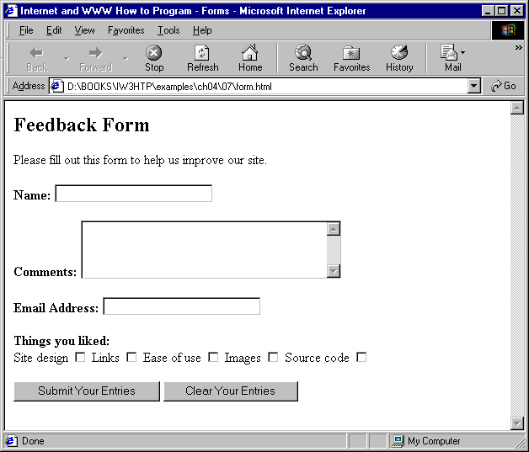
Form including textareas, password boxes and checkboxes

Slide 35
1<HTML>
2
3<!-- Fig. 10.8: form.html -->
4<!-- Form Design Example 3 -->
5
6<HEAD>
7<TITLE>Internet and WWW How to Program - Forms</TITLE>
8</HEAD>
9
10<BODY>
11<H2>Feedback Form</H2>
12
13<P>Please fill out this form to help us improve our site.</P>
14
15<FORM METHOD = "POST" ACTION = "/cgi-bin/formmail">
16
17<INPUT TYPE = "hidden" NAME = "recipient"
18 VALUE = "deitel@deitel.com">
19<INPUT TYPE = "hidden" NAME = "subject"
20 VALUE = "Feedback Form">
21<INPUT TYPE = "hidden" NAME = "redirect"
22 VALUE = "main.html">
23
24<P><STRONG>Name: </STRONG>
25<INPUT NAME = "name" TYPE = "text" SIZE = "25"></P>
26
27<P><STRONG>Comments:</STRONG>
28<TEXTAREA NAME = "comments" ROWS = "4" COLS = "36"></TEXTAREA>
29</P>
30

Slide 36
31<P><STRONG>Email Address:</STRONG>
32<INPUT NAME = "email" TYPE = "password" SIZE = "25"></P>
33
34<P><STRONG>Things you liked:</STRONG><BR>
1.1 TYPE = “radio” creates a radio button
1.2 Only one radio button in a group can be selected
1.3 CHECKED attribute specifies which radio button is selected by default
35
36Site design
37<INPUT NAME = "things" TYPE = "checkbox" VALUE = "Design">
38Links
39<INPUT NAME = "things" TYPE = "checkbox" VALUE = "Links">
40Ease of use
41<INPUT NAME = "things" TYPE = "checkbox" VALUE = "Ease">
42Images
43<INPUT NAME = "things" TYPE = "checkbox" VALUE = "Images">
44Source code
45<INPUT NAME = "things" TYPE = "checkbox" VALUE = "Code">
46</P>
47
48<!-- <INPUT TYPE="radio"> creates a radio button. The -->
49<!-- difference between radio buttons and checkboxes is -->
50<!-- that only one radio button in a group can be selected -->
51<P><STRONG>How did you get to our site?:</STRONG><BR>
52
53Search engine
54<INPUT NAME = "how get to site" TYPE = "radio"
55 VALUE = "search engine" CHECKED>
56Links from another site
57<INPUT NAME = "how get to site" TYPE = "radio"
58 VALUE = "link">

Slide 37
59Deitel.com Web site
60<INPUT NAME = "how get to site" TYPE = "radio"
61 VALUE = "deitel.com">
62Reference in a book
63<INPUT NAME = "how get to site" TYPE = "radio"
1.4 SELECT element
1.5 Create menu items with OPTION elements
1.6 SELECTED attribute specifies which option is displayed by default
64 VALUE = "book">
65Other
66<INPUT NAME = "how get to site" TYPE = "radio"
67 VALUE = "other">
68</P>
69
70<!-- The <select> tag presents a drop down menu with -->
71<!-- choices indicated by the <option> tags -->
72<P><STRONG>Rate our site (1-10):</STRONG>
73<SELECT NAME = "rating">
74<OPTION SELECTED>Amazing:-)
75<OPTION>10
76<OPTION>9
77<OPTION>8
78<OPTION>7
79<OPTION>6
80<OPTION>5
81<OPTION>4
82<OPTION>3
83<OPTION>2
84<OPTION>1
85<OPTION>The Pits:-(
86</SELECT></P>
87
88<INPUT TYPE = "submit" VALUE = "Submit Your Entries">
89<INPUT TYPE = "reset" VALUE = "Clear Your Entries">
90</FORM>
92</BODY>
93</HTML>

Slide 38
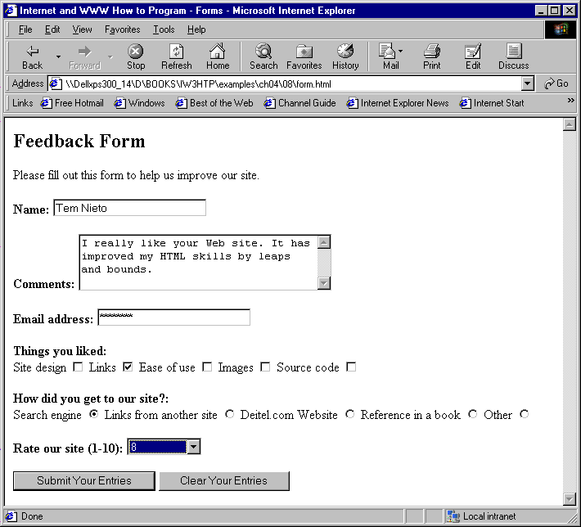
HTML form including radio buttons and pulldown lists

Slide 39
10.8 Internal Linking
Internal linking
  Assign location name to individual point in an HTML file
  Location name can then be added to the page’s URL
    Link to specific point on the page
  Location marked by including a NAME attribute in an A (anchor) element
    Ex. <A NAME = “features”></A> in list.html
  URL of location
    Format: page.html#name
    Ex. list.html#features

Slide 40
1 <HTML>
2
3 <!-- Fig. 10.9: list.html -->
4 <!-- Internal Linking -->
1.1 Create an internal link using the NAME attribute in an A element
5
6 <HEAD>
7 <TITLE>Internet and WWW How to Program - List</TITLE>
8 </HEAD>
9
10 <BODY>
11
12 <CENTER>
13 <!-- <A NAME = ".."></A> makes an internal hyperlink -->
14 <A NAME = "features"></A>
15 <H2><U>The Best Features of the Internet</U></H2>
16
17 <!-- An internal link's address is "xx.html#linkname" -->
18 <H3><A HREF = "#ceos">Go to <EM>Favorite CEO's</EM></A></H3>
19 </CENTER>
20
21 <UL>
22 <LI>You can meet new people from countries around the world.
23 <LI>You have access to new media as it becomes public:
24 <UL>
25 <LI>New games
26 <LI>New applications
27 <UL>
28 <LI>For Business
29 <LI>For Pleasure
30 </UL>

Slide 41
31 <LI>Around the Clock news
32 <LI>Search Engines
33 <LI>Shopping
34 <LI>Programming
1.2 Access internal link using HREF = “#features”
35 <UL>
36 <LI>HTML
37 <LI>Java
38 <LI>Dynamic HTML
39 <LI>Scripts
40 <LI>New languages
41 </UL>
42 </UL>
43 <LI>Links
44 <LI>Keeping In touch with old friends
45 <LI>It is the technology of the future!
46 </UL><BR><BR>
47
48 <A NAME = "ceos"></A>
49 <CENTER><H2>My 3 Favorite <EM>CEO's</EM></H2>
50 <H3><A HREF = "#features">Go to <EM>Favorite Features</EM></A>
51 </H3></CENTER>
52
53 <OL>
54 <LI>Bill Gates
55 <LI>Steve Jobs
56 <LI>Michael Dell
57 </OL>
58
59 </BODY>
60
61 </HTML>

Slide 42
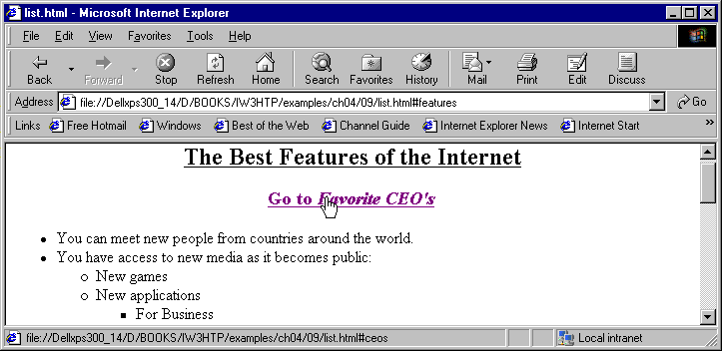
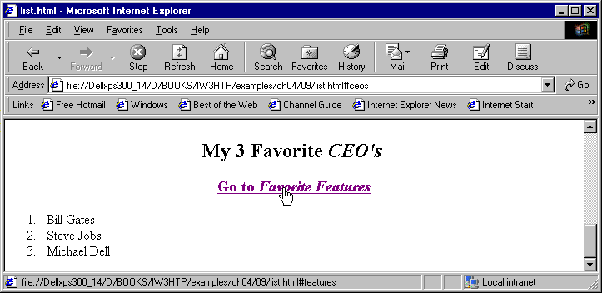
Using internal hyperlinks to make your page more navigable

Slide 43
10.9 Creating and Using Image Maps
Image maps
  Designate certain sections of an image as hotspots
  Use hotspots as anchors for linking
  All elements of image map inside <MAP>…</MAP> tags
  <MAP> tag requires NAME attribute
    Ex. <MAP NAME = “picture”>
Hotspots designated with AREA element
  AREA attributes:
    HREF sets the target for the link on that spot
    SHAPE and COORDS set the characteristics of the AREA
    ALT provides alternate textual description

Slide 44
10.9 Creating and Using Image Maps
AREA element (continued)
  SHAPE = “rect”
    Causes rectangular hotspot to be drawn around the coordinates given in the COORDS attribute
    COORDS - pairs of numbers corresponding to the x and y axes
      x axis extends horizontally from upper-left corner
      y axis extends vertically from upper-left corner
    Ex. <AREA HREF = “form.html” SHAPE = “rect” COORDS = “3, 122, 73, 143” ALT = “Go to the form”>
      Rectangular hotspot with upper-left corner of rectangle at (3, 122) and lower-right corner at (73, 143)

Slide 45
10.9 Creating and Using Image Maps
AREA element (continued)
  SHAPE = “poly”
    Causes a hotspot to be created around specified coordinates
    Ex. <AREA HREF = “mailto:deitel@deitel.com” SHAPE = “poly” COORDS = “28, 22, 24, 68, 46, 114, 84, 111, 99, 56, 86, 13” ALT = “Email the Deitels”>
  SHAPE = “circle”
    Creates a circular hotspot
    Coordinates of center of circle and radius of circle, in pixels
    Ex. <AREA HREF = “mailto:deitel@deitel.com” SHAPE = “circle” COORDS = “146, 66, 42” ALT = “Email the Deitels”>

Slide 46
10.9 Creating and Using Image Maps
To use the image map with an IMG element
  Insert the USEMAP = “#name” attribute into the IMG element
  name - value of the NAME attribute in the MAP element
  Ex. <IMG SRC = "deitel.gif" WIDTH = "200" HEIGHT="144" BORDER="1" ALT = "Harvey and Paul Deitel" USEMAP = "#picture">

Slide 47
1<HTML>
2
3<!-- Fig. 10.10: picture.html -->
4<!-- Creating and Using Image Maps -->
1. MAP element
1.1 NAME attribute
1.2 SHAPE = “rect”
1.3 “rect”COORDS
1.4 SHAPE = “poly”
1.5 “poly” COORDS
5
6<HEAD>
7<TITLE>Internet and WWW How to Program - List</TITLE>
8</HEAD>
9
10<BODY BACKGROUND = "bckgrnd.gif">
11
12<CENTER>
13<!-- <MAP> opens and names an image map formatting area -->
14<!-- and to be referenced later -->
15<MAP NAME = "picture">
16
17<!-- The "SHAPE = rect indicates a rectangular area, with -->
18<!-- coordinates of the upper-left and lower-right corners -->
19<AREA HREF = "form.html" SHAPE = "rect"
20 COORDS = "3, 122, 73, 143" ALT = "Go to the form">
21<AREA HREF = "contact.html" SHAPE = "rect"
22 COORDS = "109, 123, 199, 142" ALT = "Go to the contact page">
23<AREA HREF = "main.html" SHAPE = "rect"
24 COORDS = "1, 2, 72, 17" ALT = "Go to the homepage">
25<AREA HREF = "links.html" SHAPE = "rect"
26 COORDS = "155, 0, 199, 18" ALT = "Go to the links page">
27
28<!-- The "SHAPE = polygon" indicates an area of cusotmizable -->
29<!-- shape, with the coordinates of every vertex listed -->
30<AREA HREF = "mailto:deitel@deitel.com" SHAPE = "poly"

Slide 48
31 COORDS = "28, 22, 24, 68, 46, 114, 84, 111, 99, 56, 86, 13"
32 ALT = "Email the Deitels">
33
34<!-- The "SHAPE = circle" indicates a circular area with -->
1.6 SHAPE = “circle”
1.7 Use image map with IMG element via USEMAP attribute
35<!-- center and radius listed -->
36<AREA HREF = "mailto:deitel@deitel.com" SHAPE = "circle"
37 COORDS = "146, 66, 42" ALT = "Email the Deitels">
38</MAP>
39
40<!-- <IMG SRC=... USEMAP = "#name"> says that the indicated -->
41<!-- image map will be used with this image -->
42<IMG SRC = "deitel.gif" WIDTH = "200" HEIGHT = "144" BORDER = "1"
43 ALT = "Harvey and Paul Deitel" USEMAP = "#picture">
44</CENTER>
45
46</BODY>
47</HTML>

Slide 49
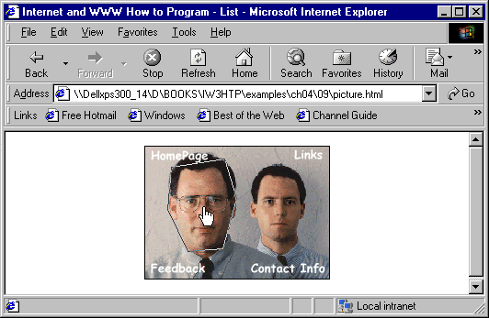
A picture with links anchored to an image map

Slide 50
10.10 <META> Tags
Search engines
  Catalog sites by following links from page to page
  Save identification and classification info
<!DOCTYPE HTML PUBLIC "-//W3C//DTD HTML 4.0 Transitional//EN">
  Tells browser that HTML conforms to a Transitional subset of HTML version 4.0
META tag
  Main HTML element that interacts with search engines

Slide 51
10.10 <META> Tags
META tags
  Contain two attributes that should always be used:
  NAME identifies type of META tag
  CONTENT provides info the search engine will catalog about your site
    CONTENT of a META tag with NAME = “keywords”
      Provides search engines with a list of words that describe key aspects of your site
    CONTENT of a META tag with NAME = “description”
      Should be 3 to 4 lines
      Used by search engines to catalog and display your site
META elements
  Not visible to users of the site
  Should be placed inside header section

Slide 52
1<!DOCTYPE HTML PUBLIC "-//W3C//DTD HTML 4.0 Transitional//EN">
2<HTML>
3
4<!-- Fig. 10.11: main.html -->
1. META tags
1.1 NAME = “keywords”
1.2 NAME = “description”
5<!-- <META> and <!DOCTYPE> tags -->
6
7<HEAD>
8<!-- <META> tags give search engines information they need -->
9<!-- to catalog your site -->
10<META NAME = "keywords" CONTENT = "Webpage, design, HTML,
11 tutorial, personal, help, index, form, contact, feedback,
12 list, links, frame, deitel">
13
14<META NAME = "description" CONTENT = "This Web site will help
15 you learn the basics of HTML and Webpage design through the
16 use of interactive examples and instruction.">
17
18<TITLE>Internet and WWW How to Program - Welcome</TITLE>
19</HEAD>
20
21<BODY>
22
23<H1 ALIGN = "center"><U>Welcome to Our Web Site!</U></H1>
24
25<P><FONT COLOR = "red" SIZE = "+1" FACE = "Arial">We have
26designed this site to teach about the wonders of
27<EM>HTML</EM>.</FONT>
28
29<FONT COLOR = "purple" SIZE = "+2" FACE = "Verdana">We have been
30using <EM>HTML</EM> since <U>version<STRONG> 2.0</STRONG></U>,

Slide 53
31and we enjoy the features that have been added recently.</FONT>
32
33<FONT COLOR = "blue" SIZE = "+1" FACE = "Helvetica">It
34seems only a short time ago that we read our first <EM>HTML</EM>
35book.</FONT>
36
37<FONT COLOR = "green" SIZE = "+2" FACE = "Times">Soon you will
38know about many of the great new feature of HTML 4.0.</FONT></P>
39
40<H2 ALIGN = "center">Have Fun With the Site!</H2></P>
41
42</BODY>
43</HTML>

Slide 54
10.11 <FRAMESET> Tag
Frames
  Display more than one HTML file at a time
  If used properly, frames make your site more readable and usable
<!DOCTYPE> tag
  Uses Frameset instead of Transitional
  Tell the browser that you are using frames
<FRAMESET> tags
  Tell the browser the page contains frames
  Details for frames contained within <FRAMESET>…</FRAMESET> tags
  COLS or ROWS attribute gives the width or height of each frame
    In pixels or a percentage

Slide 55
10.11 <FRAMESET> Tag
FRAME elements
  Specify what files will make up frameset
  FRAME attributes:
    NAME - identifies specific frame, enabling hyperlinks to load in their intended frame
  TARGET attribute of A element
      Ex. <A HREF = “links.html” TARGET = “main”>
      TARGET = “_blank” loads page in a new blank browser window
      TARGET = “_self” loads page in the same window as anchor element
      TARGET = “_parent” loads page in the parent FRAMESET
      TARGET = _top” loads page in the full browser window
  SRC
    Gives the URL of the page that will be displayed in the specified frame

Slide 56
10.11 <FRAMESET> Tag
Not all browsers support frames
  Use the NOFRAMES element inside the FRAMESET
  Direct users to a non-framed version
  Provide links for downloading a frames-enabled browser
Use of frames
  Do not use frames if you can accomplish same with tables or other, simpler HTML formatting

Slide 57
1<!DOCTYPE HTML PUBLIC "-//W3C//DTD HTML 4.0 Frameset//EN">
2<HTML>
3
4<!-- Fig. 10.12: index.html -->
1.1 <!DOCTYPE> declares Frameset
1.2 FRAMESET tag gives the dimensions of your frame using COLS or ROWS
1.3 COLS = “110,*” indicates that the first frame extends 110 pixels from left side and the second frame fills the remainder of the screen
1.4 FRAME elements
1.5 NOFRAMES element
5<!-- HTML Frames I -->
6
7<HEAD>
8<META NAME = "keywords" CONTENT = "Webpage, design, HTML,
9 tutorial, personal, help, index, form, contact, feedback,
10 list, links, frame, deitel">
11
12<META NAME = "description" CONTENT = "This Web site will help
13 you learn the basics of HTML and Webpage design through the
14 use of interactive examples and instruction.">
15
16<TITLE>Internet and WWW How to Program - Main</TITLE>
17</HEAD>
18
19<!-- The <FRAMESET> tag gives the dimensions of your frame -->
20<FRAMESET COLS = "110,*">
21
22 <!-- The individual FRAME elements specify which pages -->
23 <!-- appear in the given frames -->
24 <FRAME NAME = "nav" SRC = "nav.html">
25 <FRAME NAME = "main" SRC = "main.html">
26
27 <NOFRAMES>
28 <P>This page uses frames, but your browser does not support
29 them.</P>
30 <P>Get Internet Explorer 5 at the

Slide 58
31 <A HREF = "http://www.microsoft.com/">
32 Microsoft Web Site</A></P>
33 </NOFRAMES>
34
2. Page rendered by browser
35 </FRAMESET>
36 </HTML>

Slide 59
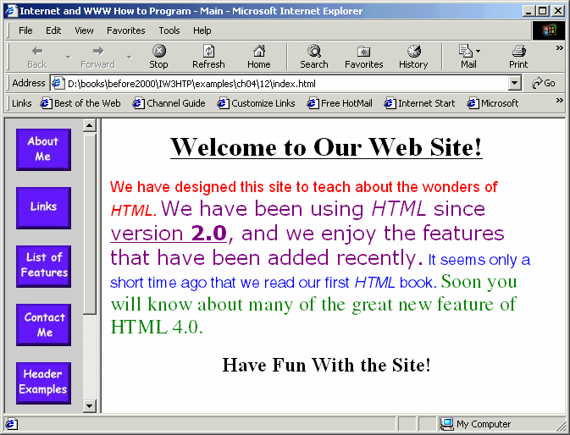
Web Site with two frames

Slide 60
10.12 Nested <FRAMESET> Tags
FRAME element
  SCROLLING attribute
    Set to “no” to prevent scroll bars
  NORESIZE attribute prevents user from resizing the frame
Nesting frames
  Include the correct number of FRAME elements inside FRAMESET
  Using nested FRAMESET elements
    Indent every level of FRAME tag
    Makes page clearer and easier to debug

Slide 61
1<!DOCTYPE html PUBLIC "-//W3C//DTD HTML 4.0 Frameset//EN">
2<HTML>
3
4<!-- Fig. 10.13: index.html -->
1. Nested FRAMESET elements
1.1 Indent each level of FRAMESET and FRAME elements
1.2 Provide NOFRAMES element
5<!-- HTML Frames II -->
6
7<HEAD>
8
9<META NAME = "keywords" CONTENT = "Webpage, design, HTML,
10 tutorial, personal, help, index, form, contact, feedback,
11 list, links, frame, deitel">
12
13<META NAME = "description" CONTENT = "This Web site will help
14 you learn the basics of HTML and Webpage design through the
15 use of interactive examples and instruction.">
16
17<FRAMESET COLS = "110,*">
18 <FRAME NAME = "nav" SCROLLING = "no" SRC = "nav.html">
19
20 <!-- Nested Framesets are used to change the formatting -->
21 <!-- and spacing of the frameset as a whole -->
22 <FRAMESET ROWS = "175,*">
23 <FRAME NAME = "picture" SRC = "picture.html" NORESIZE>
24 <FRAME NAME = "main" SRC = "main.html">
25 </FRAMESET>
26
27 <NOFRAMES>
28 <P>This page uses frames, but your browser doesn't
29 support them.</P>

Slide 62
30 <P>Get Internet Explorer 5 at the
31 <A HREF = "http://www.microsoft.com/">Microsoft
32 Web-Site</A></P>
33
2. Page rendered by browser
34 </NOFRAMES>
35
36 </FRAMESET>
37 </HTML>

Slide 63
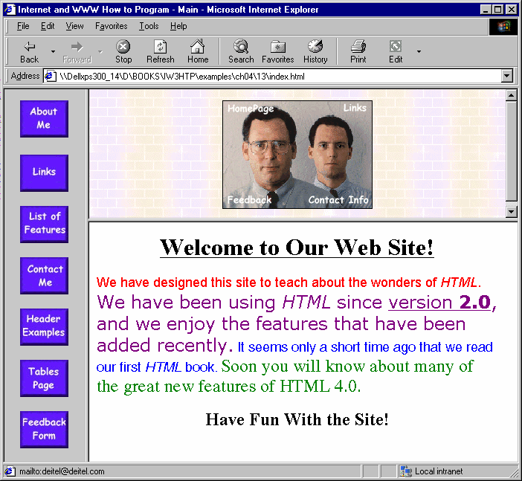
Framed Web site with a nested frameset

