Slide 1
Ultimate Paint
Outline
11.1 Introduction
11.2 Image Basics
11.3 File Formats: GIF or JPEG?
11.4 Tool Palette
11.5 Brushes
11.6 Effects

Slide 2
11.1 Introduction
Web pages more than HTML
Megalux’s Ultimate Paint
  Graphics design software
        www.ultimatepaint.com

Slide 3
11.2 Image Basics
Icon bar
  Each icon represents basic drawing function
  Brush tool
  Text tool
Fast palette
  Select new colors
  Store custom created colors
Two active colors
  Drawing color (foreground)
  Background color

Slide 4
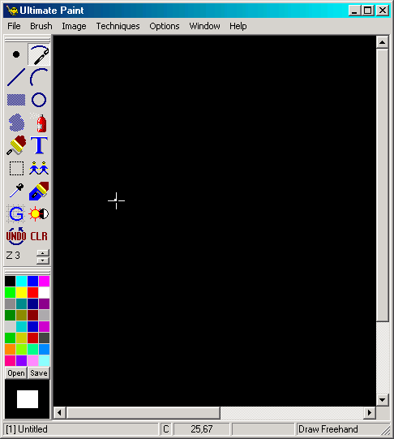
11.2 Image Basics
Brush tool
Text tool
Icon bar
Fast palette
Background color box
Drawing color box
Cursor coordinates
Drawing mode
    Courtesy of Megalux Light Techniques, Ltd.

Slide 5
11.2 Image Basics
Select Drawing Color dialog
  Create custom color
  Add to fast palette via Preferences dialog
Text tool
  Used for creating text
  Text tool properties bar
    Select font, style, size
  Anti-aliasing
    Smooths edges of scalable fonts
  Drop-shadow effect
    Creates 3-d illusion

Slide 6
11.3 File Formats: GIF or JPEG?
File formats
  GIF (Graphics Interchange Format)
    256 colors
    Good for sharp edges
    Supports background transparency
    Lossless – does not lose data
    Interlaced – loads gradually while downloaded
  JPEG (Joint Photographic Experts Group)
    16.7 million colors
    Good for photographs and continuous tones
    Lossy – loses data to minimize file size
    Also interlaced

Slide 7
11.3 File Formats: GIF or JPEG?
  PNG (Portable Network Graphics)
    RGBA encoding
    Alpha transparency
      Helps transparency
    Lossless
    More colors than JPEG
    More information at:
      www.w3.org/Graphics/PNG

Slide 8

11.4 Tool Palette
Icon bar
  Tool deactivated by selecting another tool
  Options are repeatable
Change Brush size
Draw freehand
Draw line
Draw curve
Draw box
Draw circle
Draw filled region
Aerosol
Fill region
Text
Cut brush
Clone
Get color
Change color
Draw grid
Filters
Undo last action
Clear image
Zoom
Courtesy of Megalux Light Techniques, Ltd.

Slide 9
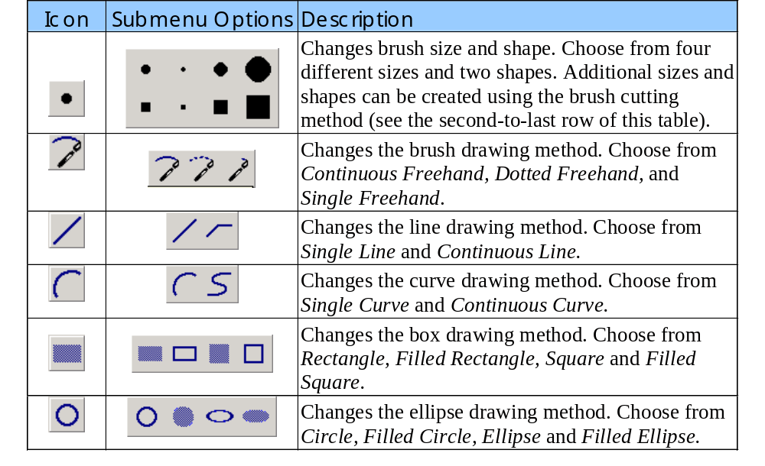
11.4 Tool Palette
Toolbox submenus

Slide 10
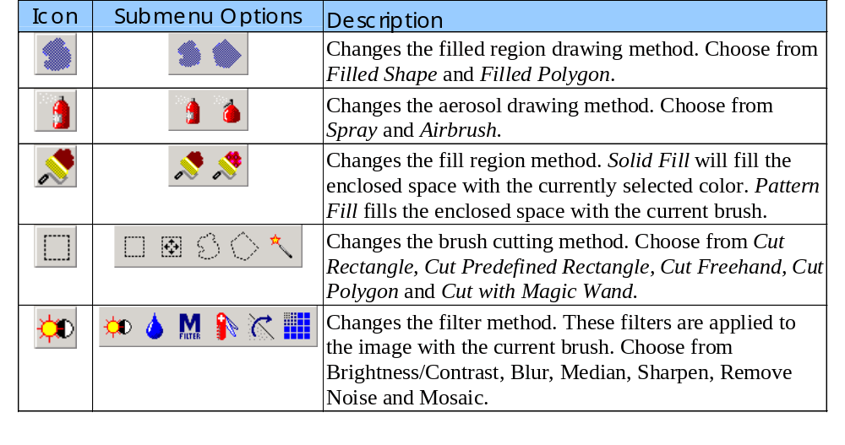
11.4 Tool Palette
Toolbox submenus
  Continued from previous slide

Slide 11
11.4 Tool Palette
Tools
  Fill region
    Fills background with selected color
  Get color
    Matches a color from your picture
  Zoom
  Filters
    Paint a filter over your image
  Grid
    Constrain shapes to an invisible grid

Slide 12
11.5 Brushes
Custom brushes
  Can create a brush of any shape, size and color
  Used for drawing, copying and editing
  Four circle and four square default brushes
  Create with the cut brush tool

Slide 13
11.6 Effects
Image menu
  Stretch, mirror or rotate
  Nine other options for pre-defined effects

Slide 14
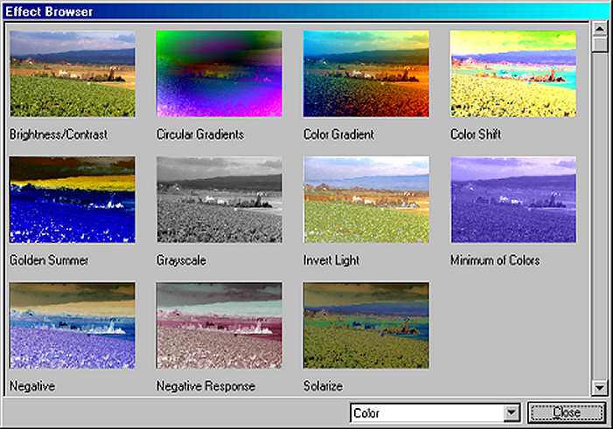
11.6 Effects
Examples of effects
    Courtesy of Megalux Light Techniques, Ltd.

