Slide 1
Chapter 12 – Microsoft FrontPage Express
Outline
12.1 Introduction
12.2 Microsoft FrontPage Express
12.3 Text Styles
12.4 Images and Links
12.5 Symbols and Lines
12.6 Tables
12.7 Forms
12.8 Marquees and Scripts

Slide 2
12.1 Introduction
Graphics-based HTML editing programs
  Should only be used as aids
  Often disrupt indentation
  Often insert unnecessary tags
  No substitute for in-depth knowledge of HTML
Microsoft FrontPage Express
  Insert text and font changes
  Create tables, forms, frames, etc.

Slide 3
12.2 Microsoft FrontPage Express
WYSIWYG display
  What You See Is What You Get
  Renders HTML elements exactly as a browser would
To view or edit HTML directly
  View menu → HTML…
  Color coded HTML
    Can be turned off

Slide 4
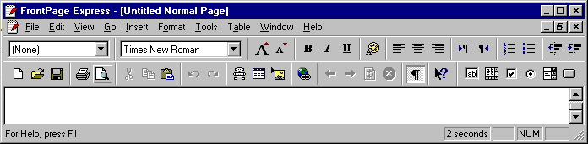
A FrontPage Express window
Text Styles
Change Font
Text Color
Alignment options
Create List
Insert Indent
File options
Insert Table
Insert Image
Insert Hyperlink
Form options

Slide 5
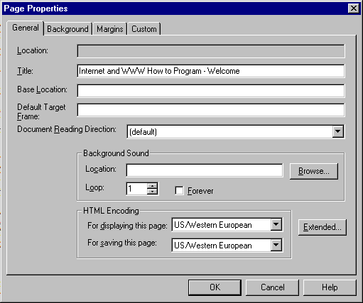
Setting overall Page Properties
Background properties
Page Title
Base URL

Slide 6
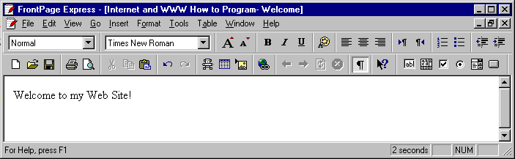
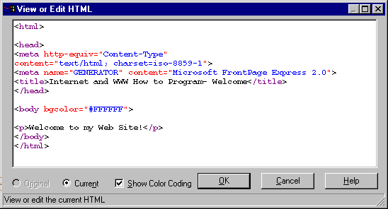
Using FrontPage Express for an example
Version toggle
Color Coding checkbox

Slide 7
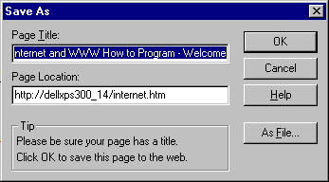
Saving your HTML file
Title
Location on server
Save locally

Slide 8
12.3 Text Styles
Drop-down menu for changing text styles
  Header tags
  List tags
  Alignment
Text
  Increase/decrease size
  Color
FrontPage Express
  Prone to producing inefficient code

Slide 9
12.3 Text Styles
Font dialog box
  Highlight text
    Select Font… from Format menu, or
  Right-click text
Enter
  <P>…</P>
Shift + Enter
  <BR>
Definition list
  <DT> - defined term
  <DD> - definition

Slide 10
1 <html>
2 <head>
3
4 <meta http-equiv="Content-Type"
Resulting HTML produced by FrontPage Express after applying headers
5 content="text/html; charset=iso-8859-1">
6 <meta name="GENERATOR" content="Microsoft FrontPage Express 2.0">
7 <title>Untitled Normal Page</title>
8 </head>
9
10 <body bgcolor="#FFFFFF">
11
12 <h1 align="center">Level 1 Header</h1>
13
14 <h2 align="center">Level 2 Header</h2>
Inefficient coding
15
16 <h3 align="center">Level 3 Header</h3>
17
18 <h4 align="center">Level 4 Header</h4>
19
20 <h5 align="center">Level 5 Header</h5>
21
22 <h6 align="center">Level 6 Header</h6>
23 </body>
24 </html>

Slide 11
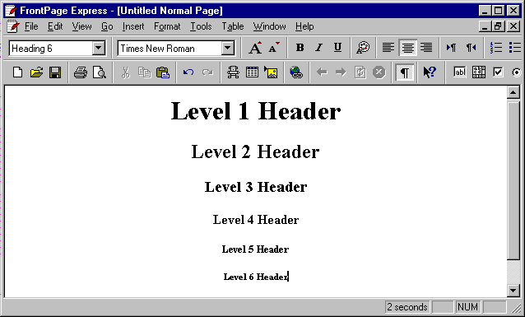
Applying header tags and centering using FrontPage Express

Slide 12
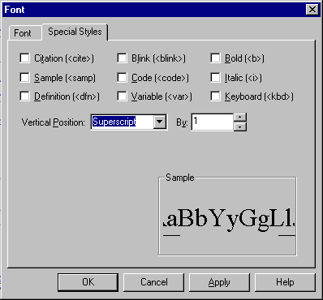
Changing Font settings and adding special styles
Code checkbox
Height selector
Vertical position pull-down list

Slide 13
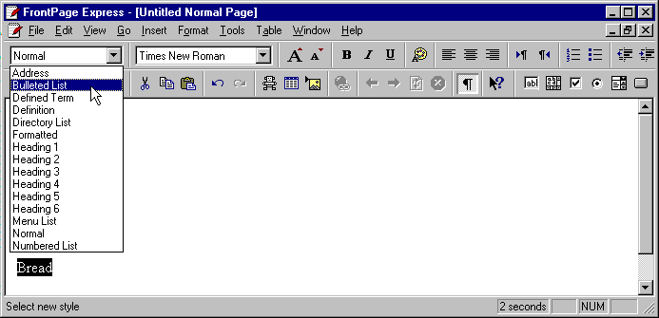
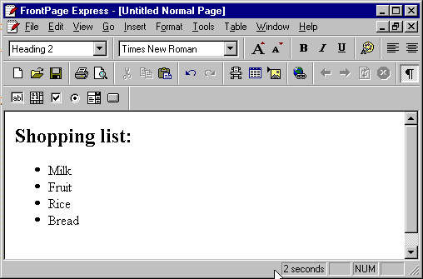
Applying an unordered list and a header to text

Slide 14
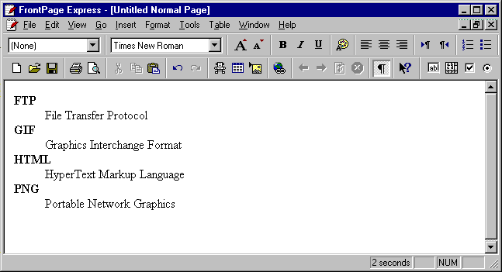
1 <dl>
2 <dt><strong>FTP</strong></dt>
3 <dd>File Transfer Protocol</dd>
4 <dt><strong>GIF</strong></dt>
HTML code produced by FrontPage Express after applying definition list
Page rendered
5 <dd>Graphics Interchange Format</dd>
6 <dt><strong>HTML</strong></dt>
7 <dd>HyperText Markup Language</dd>
8 <dt><strong>PNG</strong></dt>
9 <dd>Portable Network Graphics</dd>
10 </dl>

Slide 15
12.4 Images and Links
Insert menu → Image…
  Browse… hard drive
    FrontPage Express sets absolute path
      C:/images/deitel.gif
      Need relative path for Web
        images/deitel.gif
  Select From Location to use image from Web
Hyperlinks
  Insert menu → Hyperlink…
  http, mailto, https (Secure HyperText Transfer Protocol), etc.

Slide 16
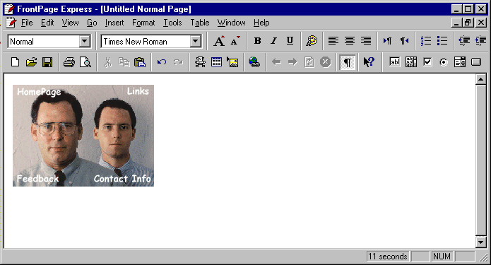
Inserting an image into a Web page

Slide 17
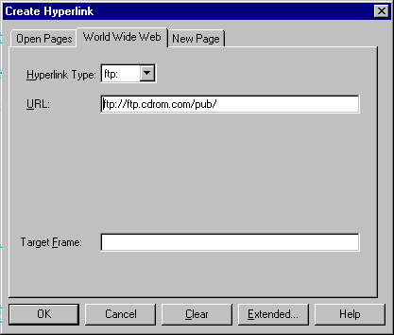
Inserting a Hyperlink in a Web page

Slide 18
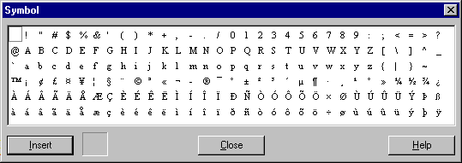
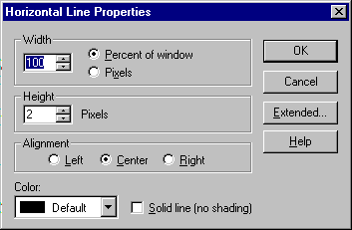
12.5 Symbols and Lines
Insert menu → Symbol…
Insert menu → Horizontal Line
  Right-click line → Horizontal Line Properties…
Edit the width
Edit the height

Slide 19
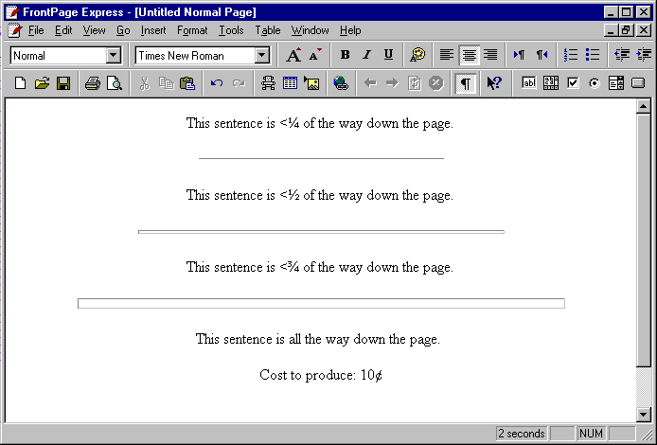
Demonstrating symbols and horizontal lines on one page

Slide 20
12.6 Tables
Hard to code tables in HTML
  FrontPage Express makes it easier
Table menu → Insert Table…
  Select number rows and columns
  Delete to remove a cell
  Merge Cells…
  Split Cells…
  Insert Caption
  Table Properties…
  Cell Properties…

Slide 21
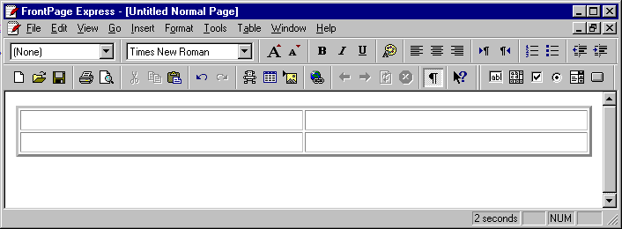
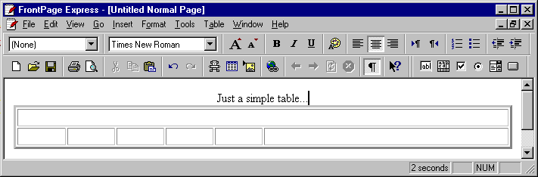
Example Tables
A default table
A basic table

Slide 22
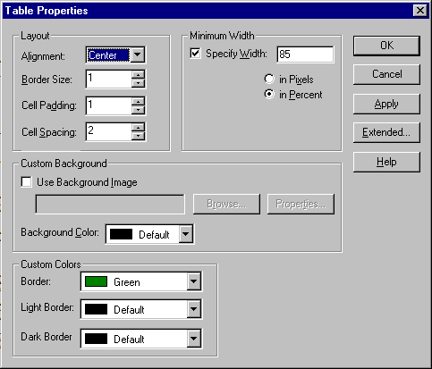
Adjusting table colors and alignment in Table Properties
Table width
Table alignment and formatting
Table Background
Table colors

Slide 23
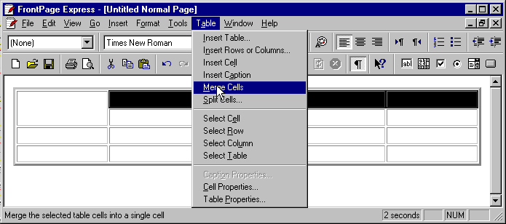
A 4x5 table with the top left cell expanded

Slide 24
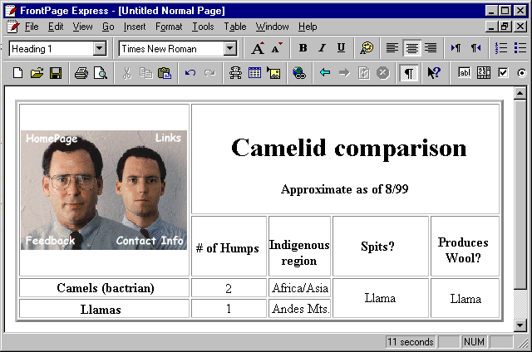
An almost completed table

Slide 25
12.7 Forms
Text box
  One-Line Text Box button on toolbar, or
  One-Line Text Box in Form Field submenu of Insert menu
  Right-click/double-click for Form Field Properties…
Drop-down menu
  Form Field submenu
Radio buttons
  Change group name in Form Field Properties…
Reset and Submit buttons
  Push Button in Form section on toolbar
Right-click form
  ACTION and METHOD attributes

Slide 26
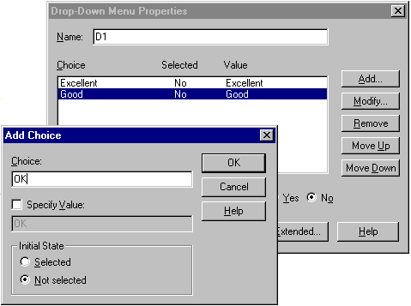
Adding a new item to a drop-down form menu
Add new menu items
Modify new menu items
Remove new menu items
Move items up/down
Choice name
Choice value
Default value toggle

Slide 27
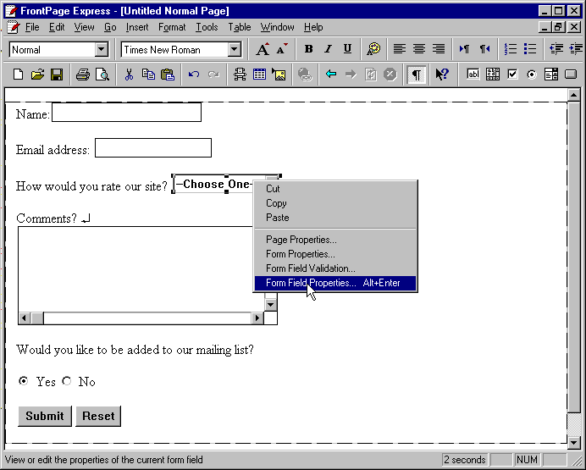
A brief form for user input

Slide 28
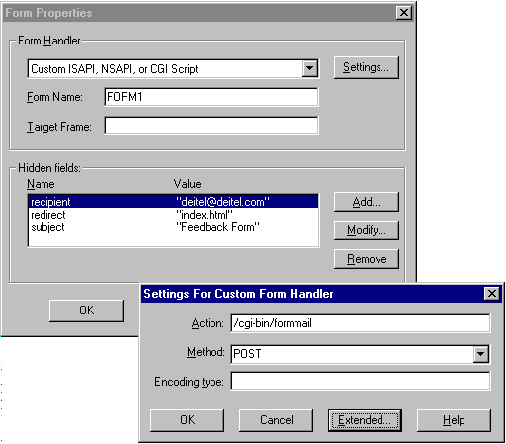
Using the Form Properties dialog box

Slide 29
12.8 Marquees and Scripts
Marquees
  <MARQUEE> tag only supported by Microsoft Internet Explorer
    Text inside MARQUEE element scrolls slowly across screen
    Insert menu → Marquee…
      Text, Direction, Speed, etc.
Scripts
  Not much support in FrontPage Express
  Insert menu → Script…
    Type in complete script in JavaScript or VBScript

Slide 30
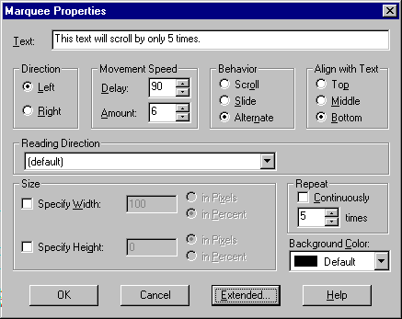
Inserting a <MARQUEE> element for scrolling Web page text
Marquee Text
Text Direction
Box alignment
Text Speed
Box Size/Width
Number of repetitions
Background color

Slide 31
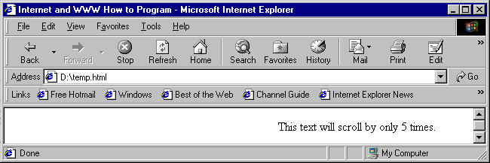
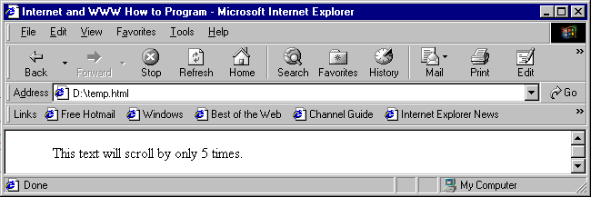
The MARQUEE element in action

Slide 32
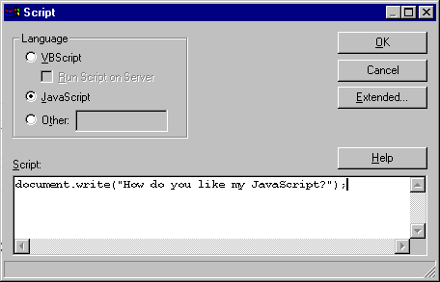
Adding a script to the HTML file
Script Language
Script text

