Slide 1
Chapter 13 - JavaScript/JScript: Introduction to Scripting
Outline
13.1 Introduction
13.2 A Simple Program: Printing a Line of Text in a Web Page
13.3 Another JavaScript Program: Adding Integers
13.4 Memory Concepts
13.5 Arithmetic
13.6 Decision Making: Equality and Relational Operators
13.7 JavaScript Internet and World Wide Web Resources

Slide 2
13.1 Introduction
JavaScript scripting language
  Originally created by Netscape
  Facilitates disciplined approach to designing computer programs
  Enhances functionality and appearance of Web pages
Jscript
  Microsoft’s version of JavaScript

Slide 3
13.2 A Simple Program: Printing a Line of Text in a Web Page
Browser includes JavaScript Interpreter
  Processes JavaScript commands
Whitespace
  Blank lines, space characters, tab characters
  Generally ignored by browser
  Used for readability and clarity
<SCRIPT>…</SCRIPT> tag:
  Encloses entire script
  Attribute LANGUAGE = “JavaScript”
    Indicates scripting language (JavaScript default in IE5 & Netscape)
  Tag must be closed at the end of the script

Slide 4
13.2 A Simple Program: Printing a Line of Text in a Web Page
Correct method call syntax:
  object.method( “string”, “[additional arguments]” );
document.writeln( “<H1>argument</H1>” );
  Case-sensitive, like all JavaScript functions
  Uses the writeln method in the browser’s document object
  Prints the string, which can consist of any text and HTML tags
  String must be surrounded by quotation marks (“…”)
Statement terminators
  All statements must end with semi-colons (;)

Slide 5
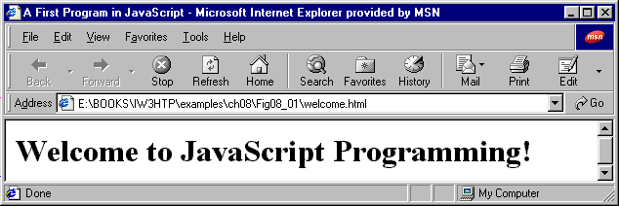
1 <!DOCTYPE html PUBLIC "-//W3C//DTD HTML 4.0 Transitional//EN">
2 <!-- Fig. 13.1: welcome.html -->
3
4 <HTML>
1.1 Open scripting area
2.1 Call writeln method
2.2 Give arguments
2.3 Execute statement
2.4 Close scripting area
5.1 Close HTML document
5 <HEAD>
6 <TITLE>A First Program in JavaScript</TITLE>
7
8 <SCRIPT LANGUAGE = "JavaScript">
9 document.writeln(
10 "<H1>Welcome to JavaScript Programming!</H1>" );
11 </SCRIPT>
12
13 </HEAD><BODY></BODY>
14 </HTML>

Slide 6
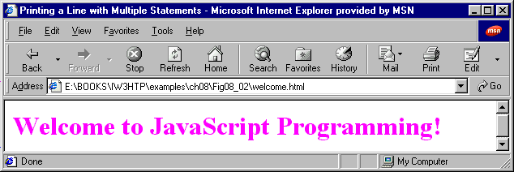
1 <!DOCTYPE html PUBLIC "-//W3C//DTD HTML 4.0 Transitional//EN">
2 <HTML>
3 <!-- Fig. 13.2: welcome.html -->
4
1.1 Call first statement
1.2 Execute statement
1.3 Call second statement
1.4 Execute statement
5 <HEAD>
6 <TITLE>Printing a Line with Multiple Statements</TITLE>
7
8 <SCRIPT LANGUAGE = "JavaScript">
9 document.write( "<FONT COLOR='magenta'><H1>Welcome to " );
10 document.writeln( "JavaScript Programming!</H1></FONT>" );
11 </SCRIPT>
12
13 </HEAD><BODY></BODY>
14 </HTML>

Slide 7
13.2 A Simple Program: Printing a Line of Text in a Web Page
Object: document methods:
  writeln
    Positions output cursor on next line when finished
  write
    Leaves the output cursor where it is when done executing
  Both begin output where previous statement stopped
  Line breaks inserted in two ways:
    document.writeln( “Have a<br>Nice Day!” )
    document.writeln( “Have a\nNice Day!” )

Slide 8
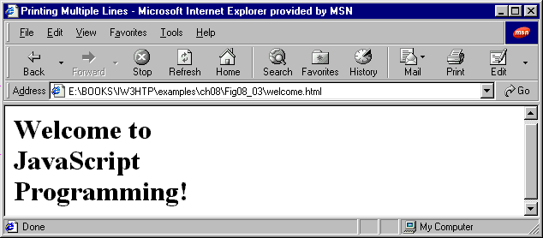
1 <!DOCTYPE html PUBLIC "-//W3C//DTD HTML 4.0 Transitional//EN">
2 <HTML>
3 <!-- Fig. 13.3: welcome.html -->
4
1.1 Call writeln method
1.2 Format text inside argument as desired
1.3 Execute statement
5 <HEAD><TITLE>Printing Multiple Lines</TITLE>
6
7 <SCRIPT LANGUAGE = "JavaScript">
8 document.writeln(
9 "<H1>Welcome to<BR>JavaScript<BR>Programming!</H1>" );
10 </SCRIPT>
11
12 </HEAD><BODY></BODY>
13 </HTML>

Slide 9
13.2 A Simple Program: Printing a Line of Text in a Web Page
Methods in window object
  Call on-screen windows
  window.alert( “argument” );
    Method calls alert window with window text "argument"
    Outputs button with text and ‘OK’ button
  window.prompt(“”);
    Prompts user for string (discussed later)
Scripts restart when page reloaded/refreshed

Slide 10
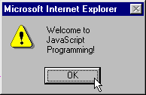
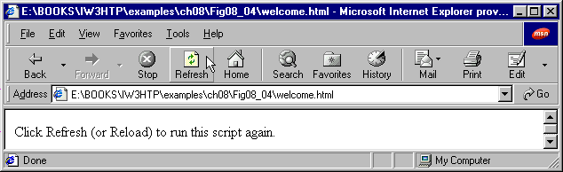
1 <!DOCTYPE HTML PUBLIC "-//W3C//DTD HTML 4.0 Transitional//EN">
2 <HTML>
3 <!-- Fig. 13.4: welcome.html -->
4 <!-- Printing multiple lines in a dialog box -->
1.1 Call window.alert(); method
2.1 Give instructions for script restart
5
6 <HEAD>
7
8 <SCRIPT LANGUAGE = "JavaScript">
9 window.alert( "Welcome to\nJavaScript\nProgramming!" );
10 </SCRIPT>
11
12 </HEAD>
13
14 <BODY>
15 <P>Click Refresh (or Reload) to run this script again.</P>
16 </BODY>
17 </HTML>

Slide 11
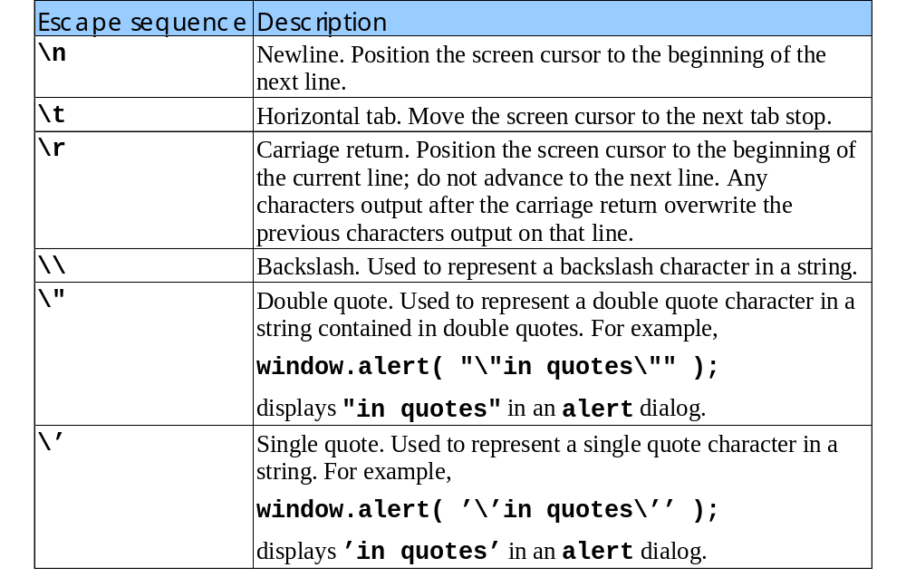
13.2 A Simple Program: Printing a Line of Text in a Web Page
Common Escape Sequences

Slide 12
13.3 Another JavaScript Program: Adding Integers
Variables
  Location in memory where values are stored
  Variable name can be any valid identifier
    Identifier = series of characters
      Letters, digits, underscores (‘_’) and dollar signs (‘$’)
      Cannot begin with a digit
    Valid identifiers:
    Welcome, $value, _value, m_inputField1, C3PO and R2D2
    Invalid identifiers: 7button, Say\Hello and field#5
  Identifiers are case-sensitive

Slide 13
13.3 Another JavaScript Program: Adding Integers
Variable name convention
  Begin with lowercase first letter
  Every following word has first letter capitalized
    goRedSox, bostonUniversityRules
Declarations
  var name1, name2
  Indicate that name1 and name2 are program variables

Slide 14
13.3 Another JavaScript Program: Adding Integers
Method window.prompt( “arg1”, “arg2” )
  Calls window that allows user to enter value to use in the script
  arg1 : text that will appear in window
  arg2 : text that will initially appear in input line
firstNumber = window.prompt();
  Assigns value entered by the user in prompt window to variable first
  "=" a binary operator
    Assigns value of right operand to left operand

Slide 15
13.3 Another JavaScript Program: Adding Integers
Good programmers write many comments
  Helps other programmers decode script
  Aids debugging
  Comment Syntax:
    One-line comment: // [text]
    Multi-line comment: /* [text] */
parseInt();
  Function accepts a string and returns an integer value
    Not a method because we do not refer to an object name
  number1 = parseInt( firstNumber );
  Operates right-to-left (due to the "=" sign)

Slide 16
13.3 Another JavaScript Program: Adding Integers
sum = number1 + number2;
  Adds number1 and number2
  Assigns result to variable sum
String concatenation:
  Combines string and another data type
    Other data type can be another string
  Example:
    If age = 20,
  document.writeln( “I am ” + age + “years old!” );
    Prints: I am 20 years old!

Slide 17
1 <!DOCTYPE html PUBLIC "-//W3C//DTD HTML 4.0 Transitional//EN">
2 <HTML>
3 <!-- Fig. 13.6: Addition.html -->
4
1.1 Declare strings
1.2 Insert comments
2.1 Prompt for strings & store values
3.1 Convert strings to integers
3.2 Calculate sum of variables
4.1 Display result (concatenate strings)
5 <HEAD>
6 <TITLE>An Addition Program</TITLE>
7
8 <SCRIPT LANGUAGE = "JavaScript">
9 var firstNumber, // first string entered by user
10 secondNumber, // second string entered by user
11 number1, // first number to add
12 number2, // second number to add
13 sum; // sum of number1 and number2
14
15 // read in first number from user as a string
16 firstNumber = window.prompt( "Enter first integer", "0" );
17
18 // read in second number from user as a string
19 secondNumber = window.prompt( "Enter second integer", "0" );
20
21 // convert numbers from strings to integers
22 number1 = parseInt( firstNumber );
23 number2 = parseInt( secondNumber );
24
25 // add the numbers
26 sum = number1 + number2;
27
28 // display the results
29 document.writeln( "<H1>The sum is " + sum + "</H1>" );
30 </SCRIPT>

Slide 18
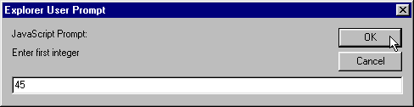
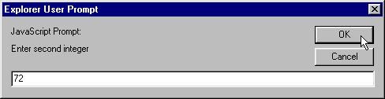
31
32 </HEAD>
33 <BODY>
34 <P>Click Refresh (or Reload) to run the script again</P>
35 </BODY>
36 </HTML>
User Input

Slide 19
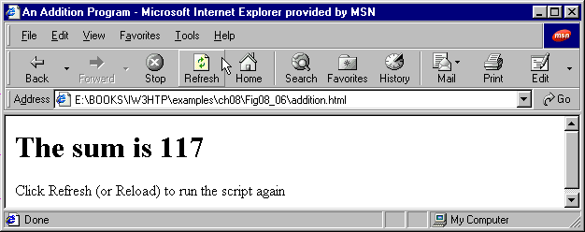
Script Output

Slide 20
13.4 Memory Concepts
Variables:
  Name corresponds to location in memory
  Have 3 attributes:
    Name
    Type
    Value
Memory
  When a value assigned to a variable, it overwrites any previous value
  Reading values is non-destructive
    sum = number1 + number2
    Does not change number1 or number2

Slide 21
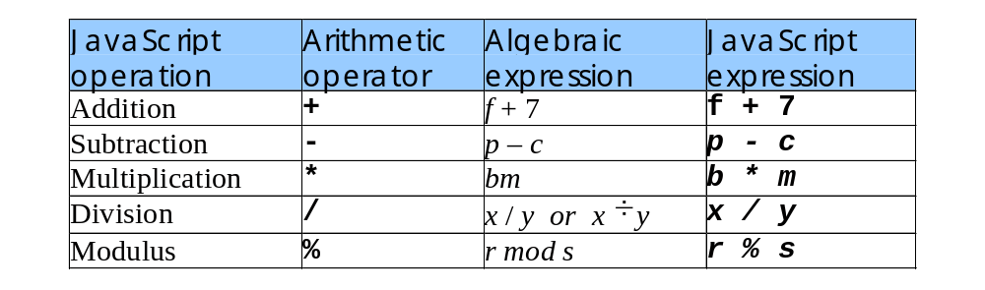
13.5 Arithmetic
Binary Operators
  Used in arithmetic operations
Modulus operator (%)
  Yields remainder after division
  Examples:
    43 % 5 = 3
    8.7 % 3.4 = 1.9
    24 % 6 = 0

Slide 22
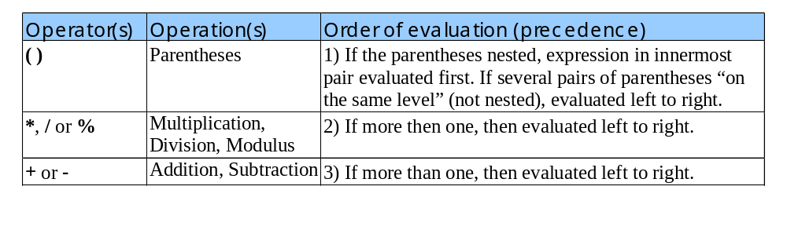
13.5 Arithmetic
Arithmetic operations
  Operate right to left (like the ‘=’ sign)
Rules of operator precedence
Operations execute in a specific order

Slide 23
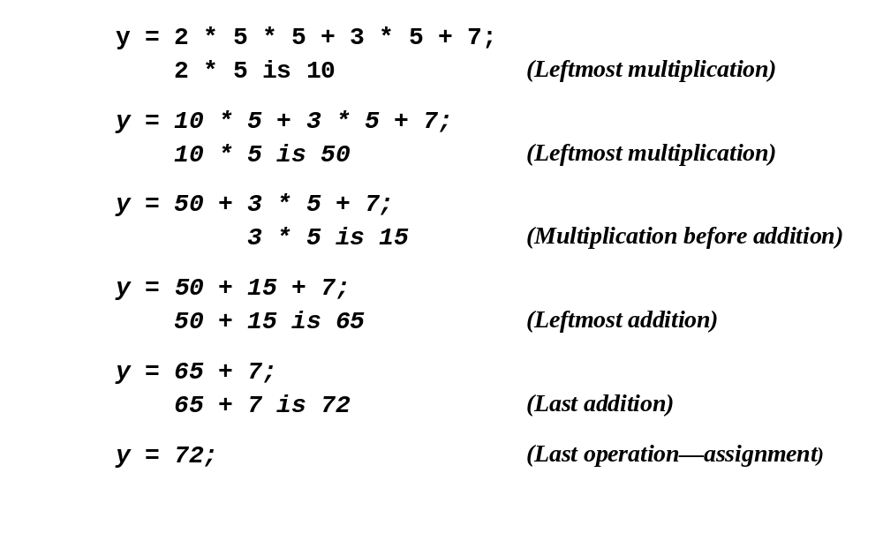
13.5 Arithmetic
Order of evaluation
Step 1.
Step 2.
Step 3.
Step 4.
Step 5.
Step 6.

Slide 24
13.6 Decision Making: Equality and Relational Operators
if structure:
  Program makes decision based on truth or falsity of condition
    If condition met (true)
      Statement(s) in body of structure executed
    If condition not met (false)
      Statement(s) in body of structure skipped
Format:
    if (condition) {
    statement;
    (additional statements);
    }
    Semi-colon (‘;’)
      Do not place after condition
      Place after every statement in body of structure

Slide 25
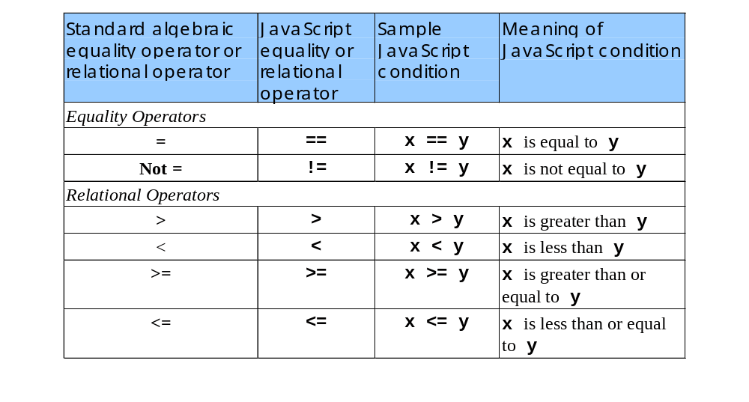
13.6 Decision Making: Equality and Relational Operators
Equality and Relational Operators:

Slide 26
1 <!DOCTYPE html PUBLIC "-//W3C//DTD HTML 4.0 Transitional//EN">
2 <HTML>
3 <!-- Fig. 13.14: comparison.html -->
4 <!-- Using if statements, relational operators, -->
1.1 Initialize variables
2.1 Prompt for values
2.2 Initialize table
3.1 Execute if structures
5 <!-- and equality operators -->
6
7 <HEAD>
8 <TITLE>Performing Comparisons</TITLE>
9
10 <SCRIPT LANGUAGE = "JavaScript">
11 var first, // first string entered by user
12 second; // second string entered by user
13
14 // read first number from user as a string
15 first = window.prompt( "Enter first integer:", "0" );
16
17 // read second number from user as a string
18 second = window.prompt( "Enter second integer:", "0" );
19
20 document.writeln( "<H1>Comparison Results</H1>" );
21 document.writeln( "<TABLE BORDER = '1' WIDTH = '100%'>" );
22
23 if ( first == second )
24 document.writeln( "<TR><TD>" + first + " == " + second +
25 "</TD></TR>" );
26
27 if ( first != second )
28 document.writeln( "<TR><TD>" + first + " != " + second +
29 "</TD></TR>" );
30
31 if ( first < second )
32 document.writeln( "<TR><TD>" + first + " < " + second +

Slide 27
33 "</TD></TR>" );
34
35 if ( first > second )
36 document.writeln( "<TR><TD>" + first + " > " + second +
3.2 Complete if structures
4.1 Display results
37 "</TD></TR>" );
38
39 if ( first <= second )
40 document.writeln( "<TR><TD>" + first + " <= " + second +
41 "</TD></TR>" );
42
43 if ( first >= second )
44 document.writeln( "<TR><TD>" + first + " >= " + second +
45 "</TD></TR>" );
46
47 // Display results
48 document.writeln( "</TABLE>" );
49 </SCRIPT>
50
51 </HEAD>
52 <BODY>
53 <P>Click Refresh (or Reload) to run the script again</P>
54 </BODY>
55 </HTML>

Slide 28
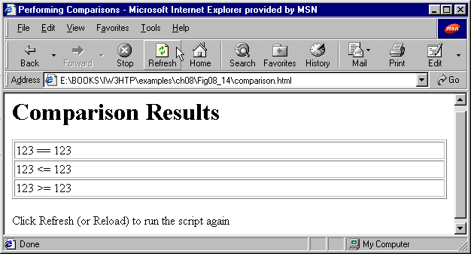
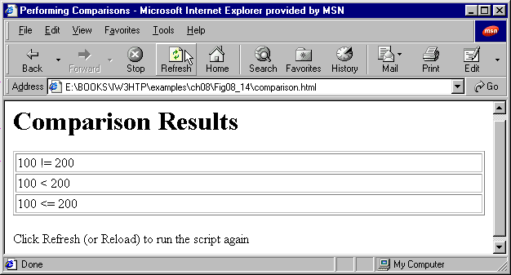

If: First Integer = 123
Second Integer = 123
If: First Integer = 100
Second Integer = 200
If: First Integer = 200
Second Integer = 100

