Slide 1
Chapter 14 - JavaScript/JScript: Control Structures I
Outline
14.1 Introduction
14.2 Algorithms
14.3 Pseudocode
14.4 Control Structures
14.5 The if Selection Structure
14.6 The if/else Selection Structure
14.7 The while Repetition Structure
14.8 Formulating Algorithms:
Case Study 1 (Counter-Controlled Repetition)
14.9 Formulating Algorithms with Top-Down, Stepwise Refinement:
Case Study 2 (Sentinel-Controlled Repetition)
14.10 Formulating Algorithms with Top-Down, Stepwise Refinement:
Case Study 3 (Nested Control Structures)

Slide 2
Chapter 14 - JavaScript/JScript: Control Structures I
Outline
14.11 Assignment Operators
14.12 Increment and Decrement Operators
14.13 A Note on Data Types

Slide 3
14.1 Introduction
Before programming a script have a
  Thorough understanding of problem
  Carefully planned approach to solve it
When writing a script, important to
  Understand types of building blocks and tools available
  Employ proven program construction principles

Slide 4
14.2 Algorithms
Algorithm: Procedure for solving problem
  1. Actions to be executed
  2. Order in which actions are executed
Order of elements of algorithm very important
  Even if order appears insignificant, errors can have far-reaching results

Slide 5
14.3 Pseudocode
Pseudocode
  Artificial and informal language similar to everyday English
  Helps programmers develop algorithms
    Forces programmer to “think-out” algorithm before composition
  Not actual computer programming language
  Easily converted to JavaScript
  Describes only executable statements (not declarations)

Slide 6
14.4 Control Structures
Sequential execution
  Execution of statements one after the other in order written
  Normal programming employs sequential execution
  Various JavaScript statements enable out of order statement execution
    Transfer of control
Programming in 1960’s utilized the goto statement
  Structured programming
  Root of most programming difficulties in 60’s
  Does not exist in JavaScript

Slide 7
14.4 Control Structures
Research of Bohm and Jacopini
  All programs can be written in terms of three control structures
    1. Sequence structure
      Built into JavaScript
      Method of default
    2. Selection structure
    3. Repetition structure

Slide 8
14.4 Control Structures
Flowchart
  Graphical representation of algorithm or portion of algorithm
  Uses symbols to indicate types decisions of actions
    Symbols connected by flowlines
      Rectangle: any action
      Oval: start/end of algorithm
      Diamond: decision
Sample Flowchart – Sequence Structure
add 1 to counter
total = total + grade;
add grade to total
counter = counter + 1;

Slide 9
14.4 Control Structures
3 Types of selection structures
  if
    Single-selection structure
      Selects or ignores a single action or group of actions
  if/else
    Double-selection structure
      Selects between two actions or groups of actions
  switch
    Multiple-selection structure
      Selects among many actions or groups of actions

Slide 10
14.4 Control Structures
Four types of repetition structures
  while
  do/while
  for
  for/in
Two ways to combine structures
  Control-structure stacking
    Single-entry/single-exit structures
  Control-structure nesting

Slide 11
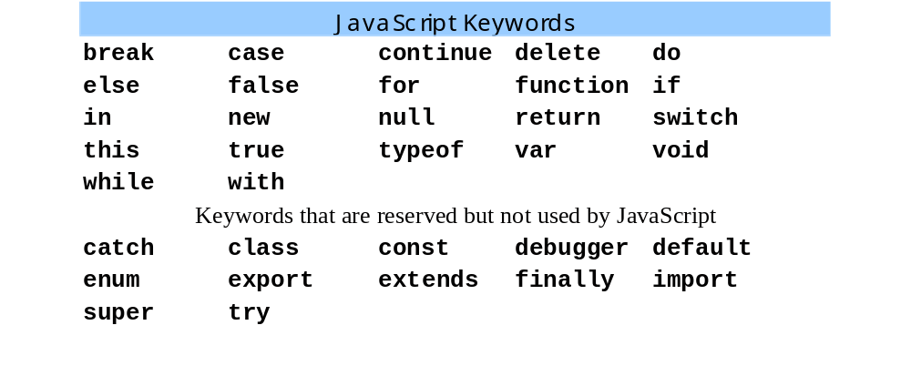
14.4 Control Structures
All control structure names are keywords
  Reserved by language for feature implementation
May not be used as variable names

Slide 12
14.5 The if Selection Structure
Pseudocode:
  If student’s grade is greater than or equal to 60
  Print “Passed”
JavaScript statement:
  if( grade >= 60 )
  document.writeln( “Passed” );
    Proper syntax: indent all lines within structure
Flowchart:
grade >= 60
True
print “Passed”
False

Slide 13
14.5 The if Selection Structure
Conditions which evaluate to true
  True condition
  Non-zero numeric value
  String containing at least one character
Conditions which evaluate to false
  False condition
  Numeric value = 0
  Empty string
  Variable with no assigned value

Slide 14
14.6 The if/else Selection Structure
Pseudocode:
  If student’s grade is greater than or equal to 60
  Print “Passed”
  else
  Print “Failed”
JavaScript statement:
  if ( grade >= 60 )
  document.writeln( “Passed” );
  else
  document.writeln( “Failed” );

Slide 15
14.6 The if/else Selection Structure
Flowchart
False
grade >= 60
True
print “Failed”
print “Passed”

Slide 16
14.6 The if/else Selection Structure
Conditional Operator (?:)
  JavaScript’s only ternary operator
  Takes three operands
    1. Boolean expression
    2. Value for conditional expression if true
    3. Value for conditional expression if false
  Example
    document.writeln(
    studentGrade >= 60 ? “Passed” : “Failed” );
    Same operation as preceding if/else statement

Slide 17
14.6 The if/else Selection Structure
Pseudocode for a nested if/else:
  If student’s grade is greater than or equal to 90
  Print “A”
  else
  If Student’s grade is greater than or equal to 80
  Print “B”
  else
  If student’s grade is greater than or equal to 70
  Print “C”
  else
  If student’s grade is greater than or equal to 60
  Print “D”
  else
  Print “F”

Slide 18
14.6 The if/else Selection Structure
JavaScript statement for nested if/else:
  if ( studentGrade >= 90 )
  document.writeln( “A” );
  else
  if ( studentGrade >= 80 )
  document.writeln( “B” );
  else
  if ( studentGrade >= 70 )
  document.writeln( “C” );
  else
  if ( studentGrade >= 60 )
  document.writeln( “D” );
  else
  document.writeln( “F” );

Slide 19
14.6 The if/else Selection Structure
Identical JavaScript statement using else if:
  if ( studentGrade >= 90 )
  document.writeln( “A” );
  else if ( studentGrade >= 80 )
  document.writeln( “B” );
  else if ( studentGrade >= 70 )
  document.writeln( “C” );
  else if ( studentGrade >= 60 )
  document.writeln( “D” );
  else
  document.writeln( “F” );
  This form preferred by many because avoids deep indent

Slide 20
14.6 The if/else Selection Structure
  JavaScript interpreter
    Associates else statement with previous if statement unless indicated otherwise by braces ({})
  Example:
      if ( x > 5 )
        if ( y > 5 )
        document.writeln( “x and y are > 5” );
      else
        document.writeln( “x is <= 5” );
    Because of indent, appears that else statement applies to first if statement

Slide 21
14.6 The if/else Selection Structure
  JavaScript interpreter really reads it as:
    if ( x > 5 )
        if ( y > 5 )
        document.writeln( “x and y are > 5” );
      else
        document.writeln( “x is <= 5” );

Slide 22
14.6 The if/else Selection Structure
To have JavaScript interpret the structure correctly, utilize braces ({})
    if ( x > 5 ) {
      if ( y > 5 )
      document.writeln( “x and y are > 5” );
    }
    else
      document.writeln( “x is <= 5” );
  else statement now applies to first if statement

Slide 23
14.6 The if/else Selection Structure
Compound Statement:
  Statement contained inside braces ( { and } )
  Does not end with a semi-colon
    All statements inside should end with semi-colons
Example:
  if ( grade >= 60 )
  document.writeln( “Passed” );
  else {
  document.writeln( “Failed<BR>” );
  document.writeln( “You must take the course again.” );
  }
  JavaScript interpreter executes both writeln statements inside braces if the if condition is false
  Without braces, last writeln statement outside if/else structure and will always execute

Slide 24
14.7 The while Repetition Structure
Program segment: find first power of 2 larger than 1000
Pseudocode:
  While product is less than 1000
  multiply product by 2
JavaScript statement:
  var product = 2;
  while ( product <= 1000 )
  product = 2 * product;
Flowchart:
product <= 1000
True
product = 2 * product
False

Slide 25
14.8 Formulating Algorithms:
Case Study 1
Counter-Controlled Repetition:
  Uses a while repetition structure
    Tests if variable counter has reached the target value using relative condition
    counter incremented or decremented a set amount every loop
    Structure concludes when condition becomes false (i.e.: counter reaches target value)
  Used
    With or without user input
    When there is a known number of loops

Slide 26
1 <!DOCTYPE html PUBLIC "-//W3C//DTD HTML 4.0 Transitional//EN">
2 <HTML>
3 <!-- Fig. 14.7: average.html -->
4
1.1 Initialize variables
1.2 Initialize variable values
2.1 Begin while repetition structure
2.2 Set repetition condition
2.3 Start control structure
2.4 Set control structure actions
2.5 Set counter increment factor
2.6 End loop
5 <HEAD>
6 <TITLE>Class Average Program</TITLE>
7
8 <SCRIPT LANGUAGE = "JavaScript">
9 var total, // sum of grades
10 gradeCounter, // number of grades entered
11 gradeValue, // grade value
12 average, // average of all grades
13 grade; // grade typed by user
14
15 // Initialization Phase
16 total = 0; // clear total
17 gradeCounter = 1; // prepare to loop
18
19 // Processing Phase
20 while ( gradeCounter <= 10 ) { // loop 10 times
21
22 // prompt for input and read grade from user
23 grade = window.prompt( "Enter integer grade:", "0" );
24
25 // convert grade from a String to an integer
26 gradeValue = parseInt( grade );
27
28 // add gradeValue to total
29 total = total + gradeValue;
30
31 // add 1 to gradeCounter
32 gradeCounter = gradeCounter + 1;
33 }

Slide 27
34
35 // Termination Phase
36 average = total / 10; // calculate the average
37
3.1 Perform operations
4.1 Print result
38 // display average of exam grades
39 document.writeln(
40 "<H1>Class average is " + average + "</H1>" );
41 </SCRIPT>
42
43 </HEAD>
44 <BODY>
45 Click Refresh (or Reload) to run the script again
46 </BODY>
47 </HTML>

Slide 28
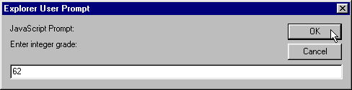


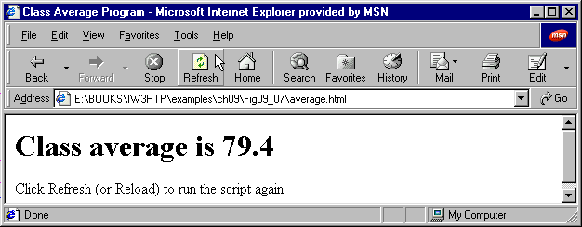
Sample User Inputs:
With user input values:
100, 88, 93, 55, 68, 77, 83, 95, 73, 62
Script Output:

Slide 29
14.9 Formulating Algorithms with Top-Down, Stepwise Refinement: Case Study 2
Sentinel-Controlled Repetition:
  Uses a while repetition structure
    Tests if variable counter has been set to sentinel value using equality condition
    When user inputs string equal to sentinel value, condition will be false next time tested
  Used when
    User is input is incorporated into structure
    Final number of loops unknown – indefinite repetition
  First user input should occur before while structure begins
    Be sure to account for possibility of user initially entering sentinel value
  Sentinel value chosen so not confused with an acceptable input value
    -1 is a common sentinel value

Slide 30
1 <!DOCTYPE html PUBLIC "-//W3C//DTD HTML 4.0 Transitional//EN">
2 <HTML>
3 <!-- Fig. 14.9: Average2.html -->
4
1.1 Initialize variables & values
2.1 Prompt use for input, inform of sentinel value
3.1 Start while control structure & test for sentinel value
3.2 Enter control structure actions
5 <HEAD>
6 <TITLE>Class Average Program:
7 Sentinel-controlled Repetition</TITLE>
8
9 <SCRIPT LANGUAGE = "JavaScript">
10 var gradeCounter, // number of grades entered
11 gradeValue, // grade value
12 total, // sum of grades
13 average, // average of all grades
14 grade; // grade typed by user
15
16 // Initialization phase
17 total = 0; // clear total
18 gradeCounter = 0; // prepare to loop
19
20 // Processing phase
21 // prompt for input and read grade from user
22 grade = window.prompt(
23 "Enter Integer Grade, -1 to Quit:", "0" );
24
25 // convert grade from a String to an integer
26 gradeValue = parseInt( grade );
27
28 while ( gradeValue != -1 ) {
29 // add gradeValue to total
30 total = total + gradeValue;
31
32 // add 1 to gradeCounter

Slide 31
33 gradeCounter = gradeCounter + 1;
34
35 // prompt for input and read grade from user
36 grade = window.prompt(
3.3 Prompt user for input
3.4 Close control structure
4.1 Test if sentinel value entered before while control structure began
5.1 Print result
37 "Enter Integer Grade, -1 to Quit:", "0" );
38
39 // convert grade from a String to an integer
40 gradeValue = parseInt( grade );
41 }
42
43 // Termination phase
44 if ( gradeCounter != 0 ) {
45 average = total / gradeCounter;
46
47 // display average of exam grades
48 document.writeln(
49 "<H1>Class average is " + average + "</H1>" );
50 }
51 else
52 document.writeln( "<P>No grades were entered</P>" );
53 </SCRIPT>
54 </HEAD>
55
56 <BODY>
57 <P>Click Refresh (or Reload) to run the script again</P>
58 </BODY>
59 </HTML>

Slide 32
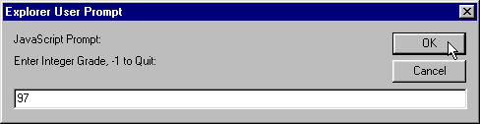
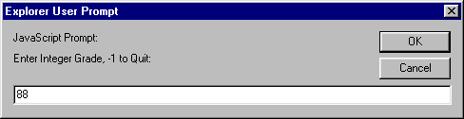


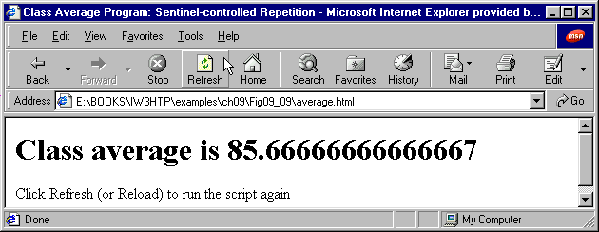
User Input:
Script Output:

Slide 33
14.10 Formulating Algorithms with Top-Down, Stepwise Refinement: Case Study 3
Nested Control Structures
  Control structures may be placed inside other control structures
  May be done as many times as necessary
  Can accomplish goals of program faster and with fewer complications
  Be sure to
    Map out your algorithm with pseudocode and/or flowchart before programming
    Insert comments into program to aid debugging
Variable initialization
  Values may be assigned to variables in initialization statement
  If variable not introduced, will be automatically initialized by JavaScript

Slide 34
1 <!DOCTYPE html PUBLIC "-//W3C//DTD HTML 4.0 Transitional//EN">
2 <HTML>
3 <!-- Fig. 14.11: analysis.html -->
4
5 <HEAD>
1.1 Initialize variables and set values
2.1 Start first control structure
2.2 Set control structure actions
3.1 Start and close additional control structures
3.2 Close first control structure
4.1 Print results
6 <TITLE>Analysis of Examination Results</TITLE>
7
8 <SCRIPT LANGUAGE = "JavaScript">
9 // initializing variables in declarations
10 var passes = 0, // number of passes
11 failures = 0, // number of failures
12 student = 1, // student counter
13 result; // one exam result
14
15 // process 10 students; counter-controlled loop
16 while ( student <= 10 ) {
17 result = window.prompt(
18 "Enter result (1=pass,2=fail)", "0" );
19
20 if ( result == "1" )
21 passes = passes + 1;
22 else
23 failures = failures + 1;
24
25 student = student + 1;
26 }
27
28 // termination phase
29 document.writeln( "<H1>Examination Results</H1>" );
30 document.writeln(
31 "Passed: " + passes + "<BR>Failed: " + failures );
32
33 if ( passes > 8 )

Slide 35
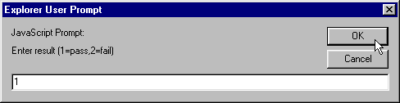

34 document.writeln( "<BR>Raise Tuition" );
35 </SCRIPT>
36
37 </HEAD>
4.2 Finish printing results
38 <BODY>
39 <P>Click Refresh (or Reload) to run the script again</P>
40 </BODY>
41 </HTML>
Sample User Inputs:

Slide 36
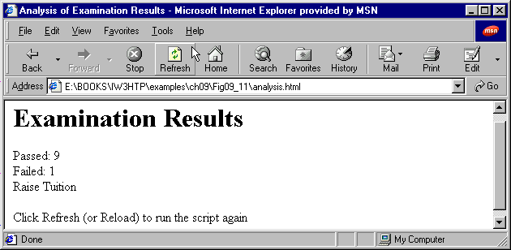
Program Execution #1
User Input:
Entered string “1” nine times
Entered string “2” once
Script Output:

Slide 37
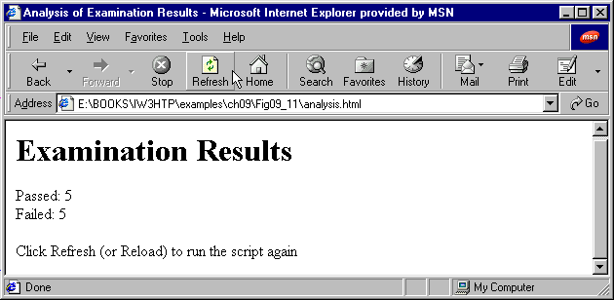
Program Execution #2
User Input:
Entered string “1” five times
Entered string “2” five times
Script Output:

Slide 38
14.11 Assignment Operators
Assignment operations with identical results can be written different ways
  Example 1:
    c = c + 3;
  Example 2:
    c += 3;
Both ways add 3 to the value of c
Example 2 executes faster
  Small difference for individual operations
  Significant over large number of operations

Slide 39
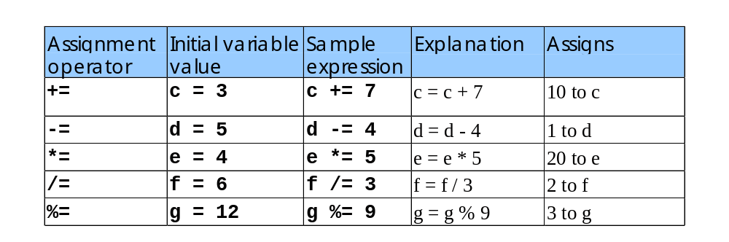
14.11 Assignment Operators
Arithmetic Assignment Operators

Slide 40
14.12 Increment and Decrement Operators
Increment operator (++)
  Example:
  c++; is identical to c += 1; is identical to c = c + 1;
Decrement operator (--)
  Example:
  c--; is identical to c -= 1; is identical to c = c - 1;
Faster operation –
  Save time over many repetitions
Can be preincremented/decremented or postincremented/decremented
  Only makes a difference when variable appears in context of larger expression

Slide 41
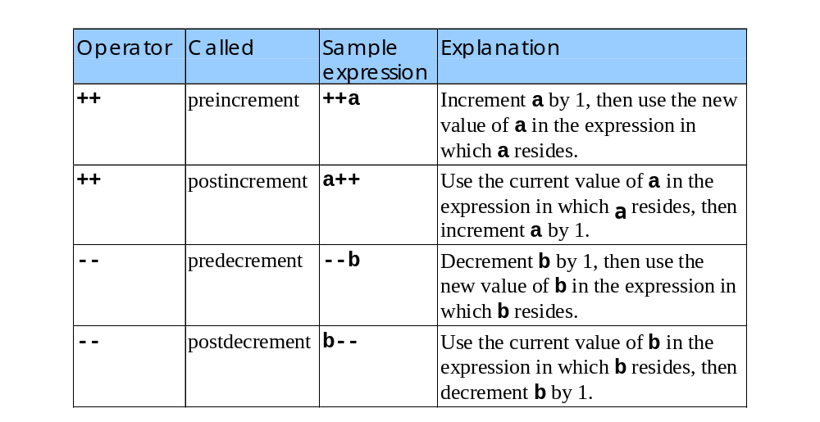
14.12 Increment and Decrement Operators
Increment and Decrement Operators

Slide 42
1 <!DOCTYPE html PUBLIC "-//W3C//DTD HTML 4.0 Transitional//EN">
2 <HTML>
3 <!-- Fig. 14.14: increment.html -->
4
5 <HEAD>
1.1 Initialize variables
2.1 Print Postincrement example
2.2 Print Preincrement example
6 <TITLE>Preincrementing and Postincrementing</TITLE>
7
8 <SCRIPT LANGUAGE = "JavaScript">
9 var c;
10
11 c = 5;
12 document.writeln( "<H3>Postincrementing</H3>" );
13 document.writeln( c ); // print 5
14 document.writeln( "<BR>" + c++ ); // print 5 then increment
15 document.writeln( "<BR>" + c ); // print 6
16
17 c = 5;
18 document.writeln( "<H3>Preincrementing</H3>" );
19 document.writeln( c ); // print 5
20 document.writeln( "<BR>" + ++c ); // increment then print 6
21 document.writeln( "<BR>" + c ); // print 6
22 </SCRIPT>
23
24 </HEAD><BODY></BODY>
25 </HTML>

Slide 43
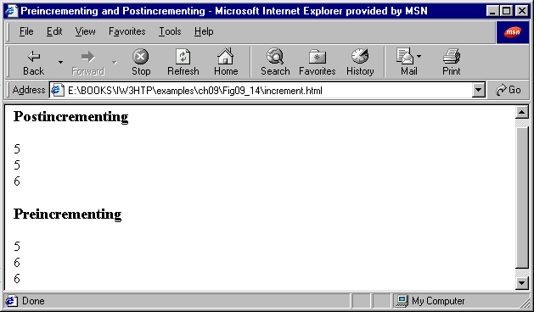
Script Output

Slide 44
14.12 Increment and Decrement Operators
The following return identical results:
Assignment statements
  passes = passes + 1;
Assignment operators
  passes += 1;
Preincrement operators
  ++passes;
Postincrement operators
  passes++;

Slide 45
14.13 A Note on Data Types
JavaScript - loosely typed language
  Does not require variable to have type before use in program (unlike other languages)
  Variable can contain a value of any data type
  JavaScript often converts between values of different types automatically
When declaring variables
  If not given value, variable has undefined value
  To indicate variable has no value, assign it null

