Slide 1
Chapter 15 - JavaScript/JScript:
Control Structures II
Outline
15.1 Introduction
15.2 Essentials of Counter-Controlled Repetition
15.3 The for Repetition Structure
15.4 Examples using the for Structure
15.5 The switch Multiple Selection Structure
15.6 The do/while Repetition Structure
15.7 The break and continue Statements
15.8 The Labeled break and continue statements
15.9 Logical Operators
15.10 Structured Programming Summary

Slide 2
15.1 Introduction
Before programming a script have a
  Thorough understanding of problem
  Carefully planned approach to solve it
When writing a script, important to
  Understand types of building blocks and tools available
  Employ proven program construction principles

Slide 3
15.2 Essentials of Counter-Controlled Repetition
Counter-controlled repetition requires:
  1. Name of control variable (or loop counter)
  2. Initial Value of control variable
  3. Increment (or decrement) of control variable per loop
  4. Condition that tests for final value of control variable
Program readability:
  Indent statements in body of each control structure
  Blank line before and after each major control structure
  Avoid more than three levels of nesting

Slide 4
1 <!DOCTYPE html PUBLIC "-//W3C//DTD HTML 4.0 Transitional//EN">
2 <HTML>
3 <!-- Fig. 15.1: WhileCounter.html -->
4
1.1 Initialize variable
2.1 Start while control structure
2.2 Executable statements
2.3 Counter increment
2.4 Close control structure
5 <HEAD>
6 <TITLE>Counter-Controlled Repetition</TITLE>
7
8 <SCRIPT LANGUAGE = "JavaScript">
9 var counter = 1; // initialization
10
11 while ( counter <= 7 ) { // repetition condition
12 document.writeln( "<P><FONT SIZE = '" + counter +
13 "'>HTML font size " + counter + "</FONT></P>" );
14 ++counter; // increment
15 }
16 </SCRIPT>
17
18 </HEAD><BODY></BODY>
19 </HTML>

Slide 5
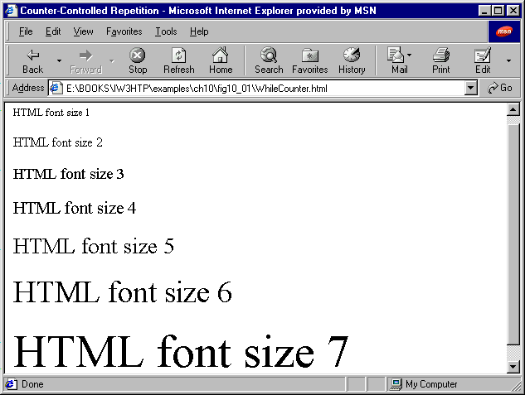
Script Output

Slide 6
15.3 The for Repetition Structure
for repetition structure:
  Handles all details of counter-controlled repetition
JavaScript statement:
  for ( var num = 1 ; i <= 7 ; i++ )
  document.writeln( “<P><FONT SIZE =” + num + “>HTML Font size ” + num + “</FONT>” );

Slide 7
15.3 The for Repetition Structure
Equivalent Structures
for structure:
  for ( initialization; loopContinuationTest ; increment )
  statement;
while structure:
  initialization;
  while ( loopContinuationTest ) {
  statement;
  increment;
  }

Slide 8
15.3 The for Repetition Structure
Flowchart:
var num = 1
True
  document.writeln( “<P><FONT SIZE =” + num + “>HTML Font
  size ” + num + “</FONT>” );
counter <= 7
False

Slide 9
15.3 The for Repetition Structure
Three expressions in for structure are optional
  If loopContinuationTest omitted JavaScript assumes condition is true
    Leads to infinite loop
  Can omit initialization expression if variable initialized elsewhere in program
  Can omit increment statement if incrementation occurs inside structure
If loop-continuation condition initially false, body of for structure not executed
Delay loop
  for structure empty except for semi-colon
  Loop still runs specified number of times
  Useful for slowing down programs, but more efficient techniques exist (Chapter 15)

Slide 10
1 <!DOCTYPE html PUBLIC "-//W3C//DTD HTML 4.0 Transitional//EN">
2 <HTML>
3 <!-- Fig. 15.2: ForCounter.html -->
4
1.1 Start for structure
1.2 State expressions
1.3 Structure actions
5 <HEAD>
6 <TITLE>Counter-Controlled Repetition</TITLE>
7
8 <SCRIPT LANGUAGE = "JavaScript">
9 // Initialization, repetition condition and incrementing
10 // are all included in the for structure header.
11 for ( var counter = 1; counter <= 7; ++counter )
12 document.writeln( "<P><FONT SIZE = '" + counter +
13 "'>HTML font size " + counter + "</FONT></P>" );
14 </SCRIPT>
15
16 </HEAD><BODY></BODY>
17 </HTML>

Slide 11
Script Output

Slide 12
15.4 Examples Using the for Structure
Different methods for varying control variable in for structure
Examples
  Control variable: 1 to 100, increments of 1:
    for ( var i = 1; i <= 100; ++i );
  Control variable: 100 to 1, increments of –1 (decrements of 1):
    for ( var i = 100; i >= 1; --i );
  Control variable 7 to 77: , steps of 7:
    for ( var i = 7; i <= 77; i += 7 );
  Control variable over sequence of values: 99, 88, 77, 66, 55, 44, 33, 22, 11, 0
    for ( var k = 99; k >= 0; k -= 11 );

Slide 13
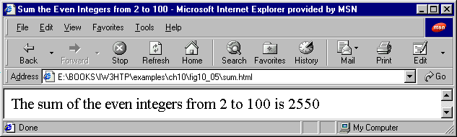
1 <!DOCTYPE html PUBLIC "-//W3C//DTD HTML 4.0 Transitional//EN">
2 <HTML>
3 <!-- Fig. 15.5: Sum.html -->
4
1.1 Initialize variables
2.1 Start for structure
2.2 State expressions
2.3 Write control structure actions
5 <HEAD>
6 <TITLE>Sum the Even Integers from 2 to 100</TITLE>
7
8 <SCRIPT LANGUAGE = "JavaScript">
9 var sum = 0;
10
11 for ( var number = 2; number <= 100; number += 2 )
12 sum += number;
13
14 document.writeln( "<BIG>The sum of the even integers " +
15 "from 2 to 100 is " + sum + "</BIG>" );
16 </SCRIPT>
17
18 </HEAD><BODY></BODY>
19 </HTML>

Slide 14
15.4 Examples Using the for Structure
Math Object
Math.pow( x, y );
  Calculates x raised to the y^{th} power
Math.round();
  Rounds the inputted value to the nearest integer
  To output a number with to the second decimal place, use formula:
    Math.round( amount * 100 ) / 100
    Example:
    Math.round( 3.1415 * 100 ) / 100 = 314/100 = 3.14
JavaScript represents all numbers as floating-point numbers
  When floating-point numbers rounded, result may not be totally correct (especially when used in equations with other rounded values)

Slide 15
1 <!DOCTYPE html PUBLIC "-//W3C//DTD HTML 4.0 Transitional//EN">
2 <HTML>
3 <!-- Fig. 15.6: interest.html -->
4
1.1 Initialize Variables
2.1 Print HTML TABLE elements
3.1 Start for control structure
3.2 State expressions
3.2 Write structure actions
5 <HEAD>
6 <TITLE>Calculating Compound Interest</TITLE>
7
8 <SCRIPT LANGUAGE = "JavaScript">
9 var amount, principal = 1000.0, rate = .05;
10
11 document.writeln( "<TABLE BORDER = '1' WIDTH = '100%'>" );
12 document.writeln( "<TR><TD WIDTH = '100'><B>Year</B></TD>" );
13 document.writeln(
14 "<TD><B>Amount on deposit</B></TD></TR>" );
15
16 for ( var year = 1; year <= 10; ++year ) {
17 amount = principal * Math.pow( 1.0 + rate, year );
18 document.writeln( "<TR><TD>" + year + "</TD><TD>" +
19 Math.round( amount * 100 ) / 100 + "</TD></TR>" );
20 }
21
22 document.writeln( "</TABLE>" );
23 </SCRIPT>
24
25 </HEAD><BODY></BODY>
26 </HTML>

Slide 16
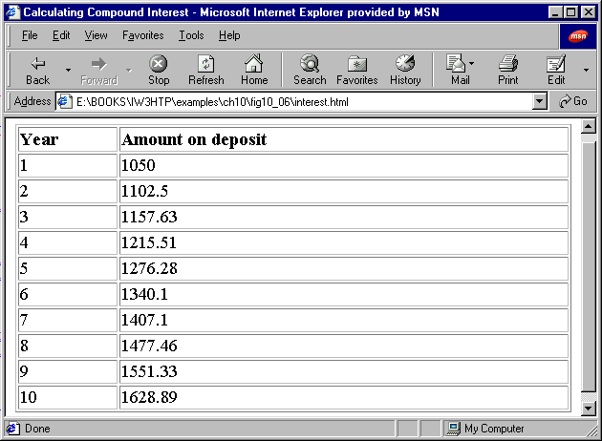
Script Output

Slide 17
15.5 The switch Multiple-Selection Structure
switch control structure
  Contains multiple substructures
  Actions executed depend on variable value
  Works well classifying user inputs
break statement
  Skips to end of switch structure
  Should be at the end of every case sub-structure
  If left out, JavaScript will continue to test user input against cases

Slide 18
15.5 The switch Multiple-Selection Structure
default case
  Is executed if variable did not match any of the cases
Good practices:
  Test if user entered valid value
  Indent all lines of structure

Slide 19
15.5 The switch Multiple-Selection Structure
JavaScript statement:
  var choice;
  choice = window.prompt();
  switch ( choice ) {
  case “a”:
  actions
  case “b”:
  actions
  case “z”:
  actions
  default:
  actions
  }

Slide 20
15.5 The switch Multiple-Selection Structure
Flowchart:
case a
true
case a action(s)
break
false
true
case b
case a action(s)
break
false
true
case z
case a action(s)
break
false
break action(s)

Slide 21
1 <!DOCTYPE html PUBLIC "-//W3C//DTD HTML 4.0 Transitional//EN">
2 <HTML>
3 <!-- Fig. 15.7: SwitchTest.html -->
4
1.1 Initialize Variables
2.1 Prompt user input
3.1 Open switch control structure
3.2 State case entries
3.3 State case actions
5 <HEAD>
6 <TITLE>Switching between HTML List Formats</TITLE>
7
8 <SCRIPT LANGUAGE = "JavaScript">
9 var choice, // user’s choice
10 startTag, // starting list item tag
11 endTag, // ending list item tag
12 validInput = true, // indicates if input is valid
13 listType; // list type as a string
14
15 choice = window.prompt( "Select a list style:\n" +
16 "1 (bullet), 2 (numbered), 3 (lettered)", "1" );
17
18 switch ( choice ) {
19 case "1":
20 startTag = "<UL>";
21 endTag = "</UL>";
22 listType = "<H1>Bullet List</H1>"
23 break;
24 case "2":
25 startTag = "<OL>";
26 endTag = "</OL>";
27 listType = "<H1>Ordered List: Numbered</H1>"
28 break;
29 case "3":
30 startTag = "<OL TYPE = 'A'>";
31 endTag = "</OL>";
32 listType = "<H1>Ordered List: Lettered</H1>"

Slide 22
33 break;
34 default:
35 validInput = false;
36 }
37
3.4 State default case
4.1 Test if user entered valid input
38 if ( validInput == true ) {
39 document.writeln( listType + startTag );
40
41 for ( var i = 1; i <= 3; ++i )
42 document.writeln( "<LI>List item " + i + "</LI>" );
43
44 document.writeln( endTag );
45 }
46 else
47 document.writeln( "Invalid choice: " + choice );
48 </SCRIPT>
49
50 </HEAD>
51 <BODY>
52 <P>Click Refresh (or Reload) to run the script again</P>
53 </BODY>
54 </HTML>

Slide 23
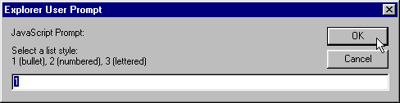
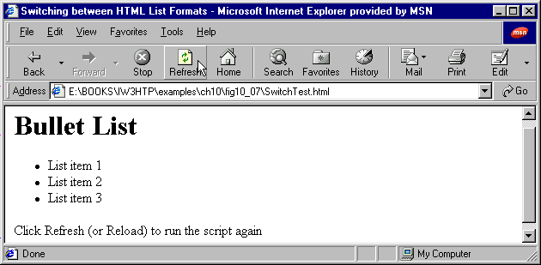
User Input: 1
Script Output

Slide 24
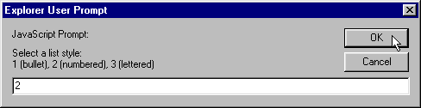
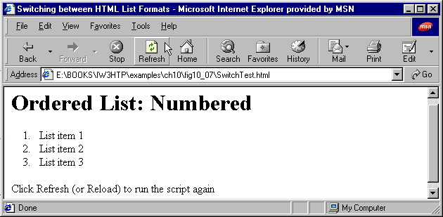
User Input: 2
Script Output

Slide 25
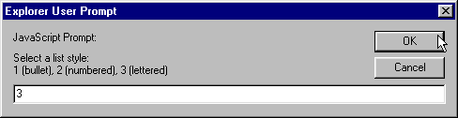
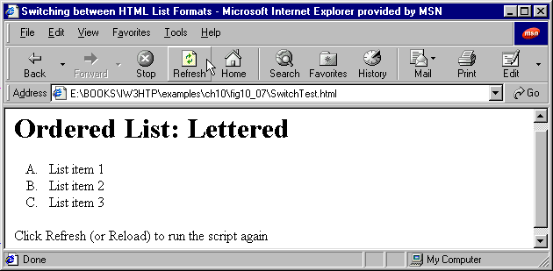
User Input: 3
Script Output

Slide 26
15.6 The do/while Repetition Structure
Similar to while control structure
Difference
  while: structure only executes if condition is initially true
    JavaScript statement:
    while ( condition ) {
    statement
    }
  do/while: structure always executes at least once
    JavaScript statement:
    do {
    statement
    } while ( condition );

Slide 27
15.6 The do/while Repetition Structure
Flowchart:
action(s)
true
condition
false

Slide 28
1 <!DOCTYPE html PUBLIC "-//W3C//DTD HTML 4.0 Transitional//EN">
2 <HTML>
3 <!-- Fig. 15.9: DoWhileTest.html -->
4
1.1 Initialize variable
2.1 Start do structure
2.2 Enter do structure statements
2.3 Close do structure
3.1 Enter while structure & condition
5 <HEAD>
6 <TITLE>Using the do/while Repetition Structure</TITLE>
7
8 <SCRIPT LANGUAGE = "JavaScript">
9 var counter = 1;
10
11 do {
12 document.writeln( "<H" + counter + ">This is an H" +
13 counter + " level head" + "</H" + counter + ">" );
14
15 ++counter;
16 } while ( counter <= 6 );
17 </SCRIPT>
18
19 </HEAD><BODY></BODY>
20 </HTML>

Slide 29
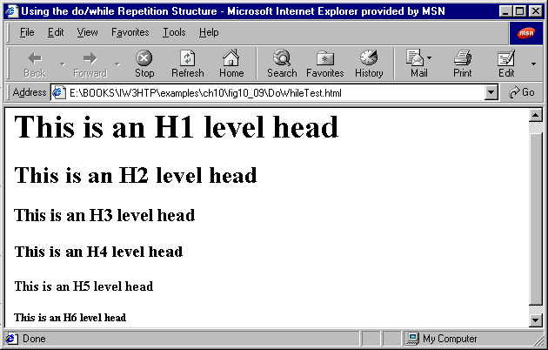
Script Output

Slide 30
15.7 The break and continue Statements
Alter flow of control
break;
  Exits structure
continue;
  Skips remaining statements in structure; continues with next loop iteration
When used properly
  Performs faster than the corresponding structured techniques

Slide 31
1 <!DOCTYPE html PUBLIC "-//W3C//DTD HTML 4.0 Transitional//EN">
2 <HTML>
3 <!-- Fig. 15.11: BreakTest.html -->
4
1.1 Begin for structure
2.1 Nest if structure
2.2 If if condition true, break executes
3.1 Print results
5 <HEAD>
6 <TITLE>Using the break Statement in a for Structure</TITLE>
7
8 <SCRIPT LANGUAGE = "JavaScript">
9 for ( var count = 1; count <= 10; ++count ) {
10 if ( count == 5 )
11 break; // break loop only if count == 5
12
13 document.writeln( "Count is: " + count + "<BR>" );
14 }
15
16 document.writeln( "Broke out of loop at count = " + count );
17 </SCRIPT>
18
19 </HEAD><BODY></BODY>
20 </HTML>

Slide 32
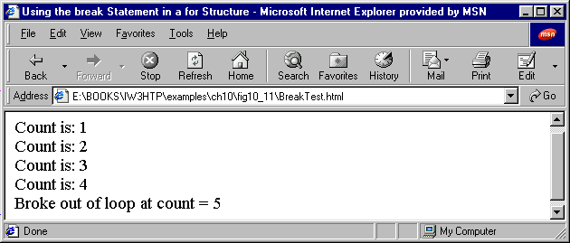
Script Output

Slide 33
1 <!DOCTYPE html PUBLIC "-//W3C//DTD HTML 4.0 Transitional//EN">
2 <HTML>
3 <!-- Fig. 15.12: ContinueTest.html -->
4
1.1 Begin for structure
2.1 Nest if structure
2.2 If if condition true, continue executes
3.1 Print results
5 <HEAD>
6 <TITLE>Using the continue Statement in a for Structure</TITLE>
7
8 <SCRIPT LANGUAGE = "JavaScript">
9 for ( var count = 1; count <= 10; ++count ) {
10 if ( count == 5 )
11 continue; // skip remaining code in loop
12 // only if count == 5
13
14 document.writeln( "Count is: " + count + "<BR>" );
15 }
16
17 document.writeln( "Used continue to skip printing 5" );
18 </SCRIPT>
19
20 </HEAD><BODY></BODY>
21 </HTML>

Slide 34
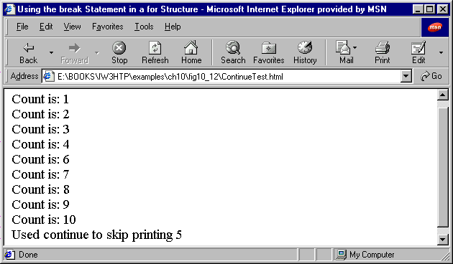
Script Output

Slide 35
15.8 The Labeled break and continue Statements
break statement
  Breaks out of immediately enclosing repetition control structure
To break out of nested structures
  Use labeled break statements
  Begins with a label (identifier followed by colon)
  Enclose structures to be broken out of within braces ({})
    Called labeled compound statement
  When executing break statement, follow format:
    break label;

Slide 36
15.8 The Labeled break and continue Statements
Use of labeled continue statement
  Follows same syntax and rules
  After execution, continues with next iteration of enclosing labeled repetition structure
Good practice to enter output statement to test if labeled statement executed properly

Slide 37
1 <!DOCTYPE html PUBLIC "-//W3C//DTD HTML 4.0 Transitional//EN">
2 <HTML>
3 <!-- Fig. 15.13: BreakLabelTest.html -->
4
1.1 Write label and opening brace
2.1 Enter control structures to be enclosed
2.2 Enter labeled break statement
2.3 Close compound statement
3.1 Print output
3.2 Enter output line to test if break statement executed
5 <HEAD>
6 <TITLE>Using the break Statement with a Label</TITLE>
7
8 <SCRIPT LANGUAGE = "JavaScript">
9 stop: { // labeled compound statement
10 for ( var row = 1; row <= 10; ++row ) {
11 for ( var column = 1; column <= 5 ; ++column ) {
12
13 if ( row == 5 )
14 break stop; // jump to end of stop block
15
16 document.write( "* " );
17 }
18
19 document.writeln( "<BR>" );
20 }
21
22 // the following line is skipped
23 document.writeln( "This line should not print" );
24 }
25
26 document.writeln( "End of script" );
27 </SCRIPT>
28
29 </HEAD><BODY></BODY>
30 </HTML>

Slide 38
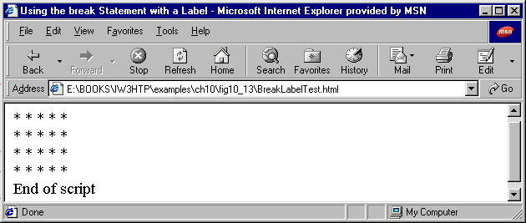
Script Output

Slide 39
1 <!DOCTYPE html PUBLIC "-//W3C//DTD HTML 4.0 Transitional//EN">
2 <HTML>
3 <!-- Fig. 15.14: ContinueLabelTest.html -->
4
1.1 Write label and opening brace
2.1 Enter control structures to be enclosed
2.2 Enter labeled continue statement
2.3 Close compound statement
3.1 Print output
5 <HEAD>
6 <TITLE>Using the continue Statement with a Label</TITLE>
7
8 <SCRIPT LANGUAGE = "JavaScript">
9 nextRow: // target label of continue statement
10 for ( var row = 1; row <= 5; ++row ) {
11 document.writeln( "<BR>" );
12
13 for ( var column = 1; column <= 10; ++column ) {
14
15 if ( column > row )
16 continue nextRow; // next iteration of
17 // labeled loop
18
19 document.write( "* " );
20 }
21 }
22 </SCRIPT>
23
24 </HEAD><BODY></BODY>
25 </HTML>

Slide 40
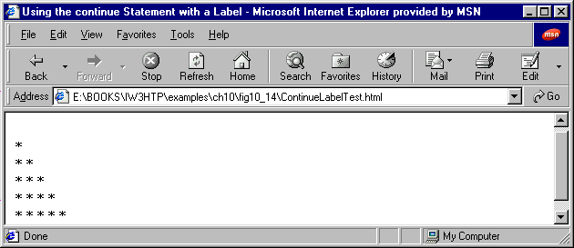
Script Output

Slide 41
15.9 Logical Operators
Logical operators
  Used to form more complex conditions by combining simple conditions
Logical operators are
  && (logical AND)
  || (logical OR)
  ! (logical NOT or logical negation)

Slide 42
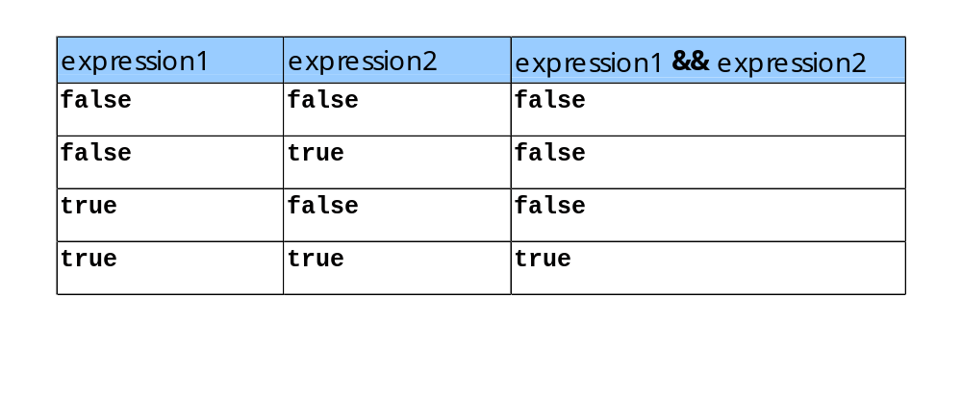
15.9 Logical Operators
&& (logical AND)
All statements connected by && operators in a condition must be true for condition to be true

Slide 43
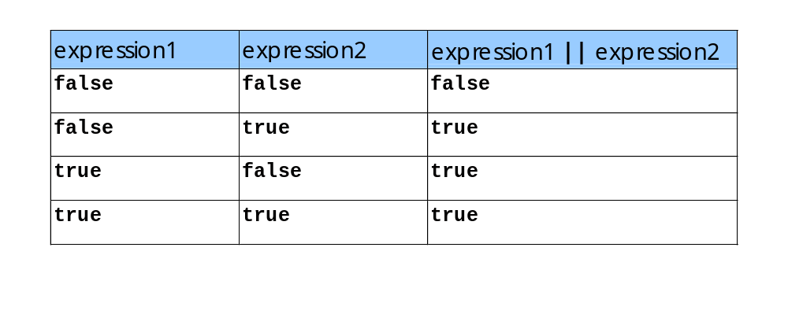
15.9 Logical Operators
|| (logical OR)
Any statement connected by || operators in a condition must be true for condition to be true

Slide 44
15.9 Logical Operators
! (logical NOT or logical negation)
! operator in front of a condition reverses the meaning of the condition.
  A true value becomes false
  A false value becomes true

Slide 45
1 <!DOCTYPE html PUBLIC "-//W3C//DTD HTML 4.0 Transitional//EN">
2 <HTML>
3 <!-- Fig. 15.18: LogicalOperators.html -->
4
5 <HEAD>
1.1 Initialize HTML TABLE
2.1 Print && logical operator examples
2.2 Print || logical operator examples
2.3 Print ! logical operator examples
3.1 Close TABLE
6 <TITLE>Demonstrating the Logical Operators</TITLE>
7
8 <SCRIPT LANGUAGE = "JavaScript">
9 document.writeln( "<TABLE BORDER = '1' WIDTH = '100%'>" );
10
11 document.writeln(
12 "<TR><TD WIDTH = '25%'>Logical AND (&&)</TD>" +
13 "<TD>false && false: " + ( false && false ) +
14 "<BR>false && true: " + ( false && true ) +
15 "<BR>true && false: " + ( true && false ) +
16 "<BR>true && true: " + ( true && true ) + "</TD>" );
17
18 document.writeln(
19 "<TR><TD WIDTH = '25%'>Logical OR (||)</TD>" +
20 "<TD>false || false: " + ( false || false ) +
21 "<BR>false || true: " + ( false || true ) +
22 "<BR>true || false: " + ( true || false ) +
23 "<BR>true || true: " + ( true || true ) + "</TD>" );
24
25 document.writeln(
26 "<TR><TD WIDTH = '25%'>Logical NOT (!)</TD>" +
27 "<TD>!false: " + ( !false ) +
28 "<BR>!true: " + ( !true ) + "</TD>" );
29
30 document.writeln( "</TABLE>" );
31 </SCRIPT>
32
33 </HEAD><BODY></BODY>
34 </HTML>

Slide 46
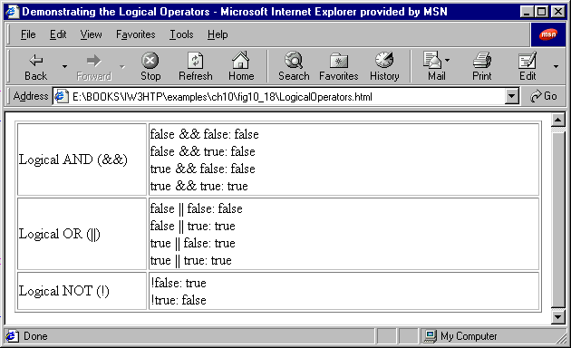
Script Output

Slide 47
15.10 Structured Programming Summary
Rules for Forming Structured Programs
Begin with the “simplest flowchart”
Any rectangle (action) can be replaced by two rectangles (actions) in sequence
Any rectangle (action) can be replaced by any control structure (sequence, if, if/else, switch, do/while or for)
Rules 2 and 3 may be applied as often as you like and in any order

Slide 48
15.10 Structured Programming Summary
Repeatedly Applying Rule 2 to the Simplest Flowchart
Rule 2
Rule 2
Rule 2

Slide 49
15.10 Structured Programming Summary
Applying Rule 3 to the Simplest Flowchart
Rule 3
Rule 3
Rule 3

Slide 50
15.10 Structured Programming Summary
Structured approach: 7 single-entry/single-exit pieces
  Selection control structures
    if structure (single selection)
    if/else structure (double selection)
    switch structure (multiple selection)
  Repetition control structures
    while structure
    do/while structure
    for structure
    for/in structure (Chap 12)

Slide 51
15.10 Structured Programming Summary
Any form of control in JavaScript can be expressed through
  if structure (selection)
  while structure (repetition)
Control structures combined in two ways
  Stacking
  Nesting

