Slide 1
Chapter 16 – JavaScript/Jscript:
Functions
Outline
16.1 Introduction
16.2 Program Modules in JavaScript
16.3 Programmer-Defined Functions
16.4 Function Definitions
16.5 Random Number Generation
16.6 Example: A Game of Chance
16.7 Duration of Identifiers
16.8 Scope Rules
16.9 JavaScript Global Functions

Slide 2
16.1 Introduction
Programs that solve real-world programs
  More complex than programs from previous chapters
Best way to develop & maintain large program:
  Construct from small, simple pieces called modules
  Technique called divide and conquer

Slide 3
16.2 Program Modules in JavaScript
functions – JavaScript modules
JavaScript programs written by combining
  Functions programmer writes
  “prepackaged” functions and objects in JavaScript
    These functions often called methods
    Implies function belongs to particular object
JavaScript provides several rich objects for performing
  Common mathematical operations
  String manipulation
  Date and time manipulation
  Manipulations of arrays

Slide 4
16.2 Program Modules in JavaScript
Programmer-defined functions
  Written by programmer to define specific tasks
  Statements defining functions written once
  Statements are hidden from other functions
Function is invoked by a function call
  Specifies function name
  Provides information (or arguments) function needs for execution
Function call syntax:
  functionName( argument );

Slide 5
16.3 Programmer-Defined Functions
Functions allow program modularization
Variables declared in function are local variables
  Only known inside function in which defined
Most functions have list of parameters
  Means for communicating info between functions & function calls
  Local variables
  When function called, arguments assigned to parameters in function definition

Slide 6
16.3 Programmer-Defined Functions
Motives for modularizing a program with functions
  Makes program development more manageable
  Allows software reusability
    Programs can be created from standard functions instead of being built from customized code
    Example: parseInt(), parseFloat
    Functions should be limited to performing a single, well-defined task
  Avoid repeating code in program
    Do not re-invent the wheel
    Save time

Slide 7
16.3 Programmer-Defined Functions
Naming functions
  Choose concise names which describe what function does
  If not possible to describe briefly, your function is too complex

Slide 8
16.4 Function Definitions
Function-definition format
  function function-name ( parameter-list )
  {
  Declarations and Statements
  }
  Function name - any valid identifier
  Parameter list - comma-separated list containing names of parameters received by the function when it is called
  If function does not receive values, parameter-list is left empty

Slide 9
16.4 Function Definitions
Function body or block:
  declarations and statements within braces
Control
  Returned to the point at which function was called
  If function does not return a result
    When right-brace is reached return statement is executed
  If function returns a result
    When return expression; is executed
      Returns value of expressions to caller
One argument in function call for each parameter in function definition

Slide 10
1 <!DOCTYPE html PUBLIC "-//W3C//DTD HTML 4.0 Transitional//EN">
2 <HTML>
3 <!-- Fig. 16.2: SquareInt.html -->
4
1.1 Output HTML
2.1 Open for control structure
2.2 Call square user-defined function
3.1 Define square function
3.2 Return result
5 <HEAD>
6 <TITLE>A Programmer-Defined square Function</TITLE>
7
8 <SCRIPT LANGUAGE = "JavaScript">
9 document.writeln(
10 "<H1>Square the numbers from 1 to 10</H1>" );
11
12 // square the numbers from 1 to 10
13 for ( var x = 1; x <= 10; ++x )
14 document.writeln( "The square of " + x + " is " +
15 square( x ) + "<BR>" );
16
17 // The following square function's body is executed only
18 // when the function is explicitly called.
19
20 // square function definition
21 function square( y )
22 {
23 return y * y;
24 }
25 </SCRIPT>
26
27 </HEAD><BODY></BODY>
28 </HTML>

Slide 11
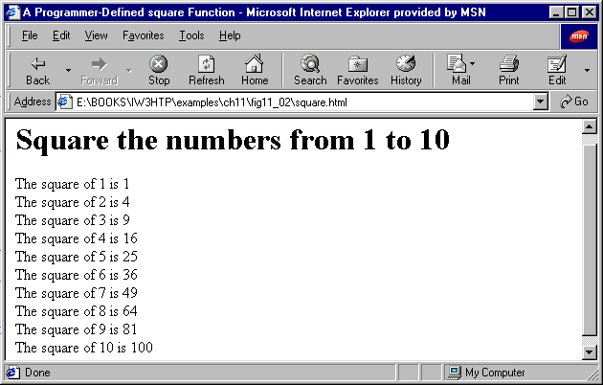
Script Output

Slide 12
16.4 Function Definitions
Method Math.max( y, z )
  Returns larger of the two values inputted
When writing a function, do not
  Forget to return a value if function is supposed to return a value
  Forget to surround the function body with braces
  Pass an argument to function that is not compatible with expected data type

Slide 13
1 <!DOCTYPE html PUBLIC "-//W3C//DTD HTML 4.0 Transitional//EN">
2 <HTML>
3 <!-- Fig. 16.3: maximum.html -->
4
1.1 Define variables and prompt user for values
1.2 Convert strings to integers
2.1 Execute user-defined function maxValue
3.1 Print results
4.1 Define function maxValue
5 <HEAD>
6 <TITLE>Finding the Maximum of Three Values</TITLE>
7
8 <SCRIPT LANGUAGE = "JavaScript">
9 var input1 = window.prompt( "Enter first number", "0" );
10 var input2 = window.prompt( "Enter second number", "0" );
11 var input3 = window.prompt( "Enter third number", "0" );
12
13 var value1 = parseFloat( input1 );
14 var value2 = parseFloat( input2 );
15 var value3 = parseFloat( input3 );
16
17 var maxValue = maximum( value1, value2, value3 );
18
19 document.writeln( "First number: " + value1 +
20 "<BR>Second number: " + value2 +
21 "<BR>Third number: " + value3 +
22 "<BR>Maximum is: " + maxValue );
23
24 // maximum method definition (called from line 17)
25 function maximum( x, y, z )
26 {
27 return Math.max( x, Math.max( y, z ) );
28 }
29 </SCRIPT>

Slide 14
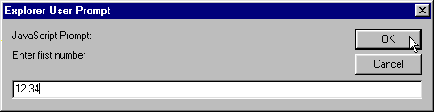
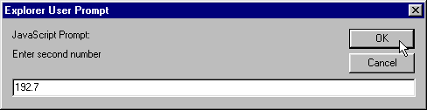
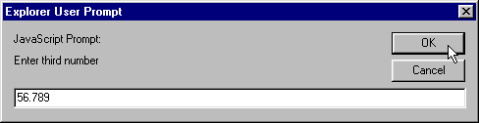
30
31 </HEAD>
32 <BODY>
33 <P>Click Refresh (or Reload) to run the script again</P>
34 </BODY>
35 </HTML>
User Input

Slide 15
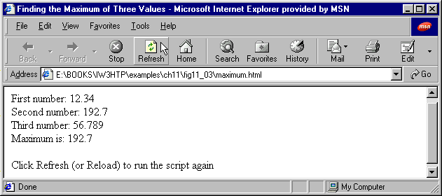
Script Output

Slide 16
16.5 Random Number Generation
Commonly used in simulations and gaming
Method Math.random
  Returns floating-point value between 0 and 1, inclusive
  Every value in the range has an equal chance (or probability) of being chosen each time random called
Math.floor( argument );
  Rounds down the argument to the next integer

Slide 17
16.5 Random Number Generation
Format for range of consecutive integers:
  For a value in a specific range of consecutive integers, use following format:
  Math.floor( a + Math.random() * b );
  a is the shifting value
    Equal to the first number in the desired range
  b is the scaling factor
    Equal to the width of the desired range
  Also possible to choose from sets of values other than ranges of consecutive integers

Slide 18
1 <!DOCTYPE html PUBLIC "-//W3C//DTD HTML 4.0 Transitional//EN">
2 <HTML>
3 <!-- Fig. 16.4: RandomInt.java -->
4
1.1 Initialize variable
2.1 Initialize HTML TABLE
3.1 Start for structure
3.2 Set value to random value
3.2.1 Call Math.random
3.2.2 Set desired range for random number generation
3.3.3 Call Math.floor
4.1 Print results
5 <HEAD>
6 <TITLE>Shifted and Scaled Random Integers</TITLE>
7
8 <SCRIPT LANGUAGE = "JavaScript">
9 var value;
10
11 document.writeln( "<H1>Random Numbers</H1>" +
12 "<TABLE BORDER = '1' WIDTH = '50%'><TR>" );
13
14 for ( var i = 1; i <= 20; i++ ) {
15 value = Math.floor( 1 + Math.random() * 6 );
16 document.writeln( "<TD>" + value + "</TD>" );
17
18 if ( i % 5 == 0 && i != 20 )
19 document.writeln( "</TR><TR>" );
20 }
21
22 document.writeln( "</TR></TABLE>" );
23 </SCRIPT>
24
25 </HEAD>
26 <BODY>
27 <P>Click Refresh (or Reload) to run the script again</P>
28 </BODY>
29 </HTML>

Slide 19
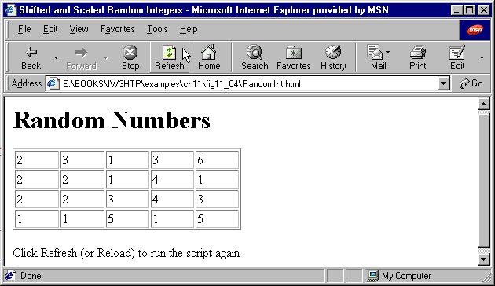

Script Outputs

Slide 20
1 <!DOCTYPE html PUBLIC "-//W3C//DTD HTML 4.0 Transitional//EN">
2 <HTML>
3 <!-- Fig. 16.5: RollDie.html -->
4
5 <HEAD>
1.1 Initialize variable and set values
2.1 Start for structure
2.2 set face to random integer between 1-6
3.1 Start switch structure
3.2 Enter case for every possible dice roll
6 <TITLE>Roll a Six-Sided Die 6000 Times</TITLE>
7
8 <SCRIPT LANGUAGE = "JavaScript">
9 var frequency1 = 0, frequency2 = 0,
10 frequency3 = 0, frequency4 = 0,
11 frequency5 = 0, frequency6 = 0, face;
12
13 // summarize results
14 for ( var roll = 1; roll <= 6000; ++roll ) {
15 face = Math.floor( 1 + Math.random() * 6 );
16
17 switch ( face ) {
18 case 1:
19 ++frequency1;
20 break;
21 case 2:
22 ++frequency2;
23 break;
24 case 3:
25 ++frequency3;
26 break;
27 case 4:
28 ++frequency4;
29 break;
30 case 5:
31 ++frequency5;
32 break;
33 case 6:

Slide 21
34 ++frequency6;
35 break;
36 }
37 }
4.1 Close switch structure
4.2 Close for structure
5.1 Print results in HTML TABLE
38
39 document.writeln( "<TABLE BORDER = '1' WIDTH = '50%'>" );
40 document.writeln( "<TR><TD><B>Face</B></TD>" +
41 "<TD><B>Frequency</B></TD></TR>" );
42 document.writeln( "<TR><TD>1</TD><TD>" + frequency1 +
43 "</TD></TR>" );
44 document.writeln( "<TR><TD>2</TD><TD>" + frequency2 +
45 "</TD></TR>" );
46 document.writeln( "<TR><TD>3</TD><TD>" + frequency3 +
47 "</TD></TR>" );
48 document.writeln( "<TR><TD>4</TD><TD>" + frequency4 +
49 "</TD></TR>" );
50 document.writeln( "<TR><TD>5</TD><TD>" + frequency5 +
51 "</TD></TR>" );
52 document.writeln( "<TR><TD>6</TD><TD>" + frequency6 +
53 "</TD></TR></TABLE>" );
54 </SCRIPT>
55
56 </HEAD>
57 <BODY>
58 <P>Click Refresh (or Reload) to run the script again</P>
59 </BODY>
60 </HTML>

Slide 22
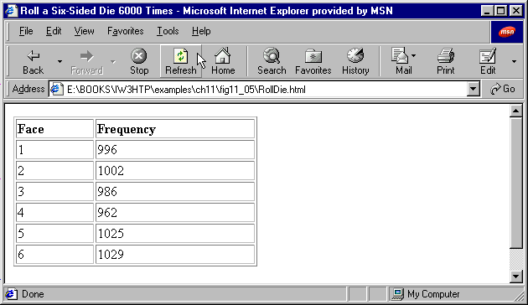
Script Output from First Execution

Slide 23

Script Output from Second Execution

Slide 24
16.6 Example: A Game of Chance
Program can also receive input from user through forms (discussed in HTML chapters)
GUI - Graphical User Interface
  Any user interaction with a GUI is called an event
  Event handling – JavaScript execution in response to an event
  GUI’s are located in the BODY of the HTML document

Slide 25
16.6 Example: A Game of Chance
GUI Setup:
  GUI is enclosed inside an HTML Form
  <FORM NAME=“formName”>…<FORM> tags
  Every GUI output is defined with the INPUT element
  <INPUT NAME = “inputName” TYPE = “text”>
  Enter as many <INPUT> tags as needed
  Clicking on GUI button element causes an action
  <INPUT TYPE = “button” VALUE = “buttonLabel” ONCLICK = “javaScriptFunctionName”>
    Function indicated executed when button clicked

Slide 26
16.6 Example: A Game of Chance
  Output data to form elements
    Within a function, write a statement in the following format:
  formName.inputName.value = variableToBeOutput;
  Browser status bar
    Print text by typing
  window.status = “text to be printed”;
    GUI’s can also be used for user input (discussed in 11.10)

Slide 27
16.6 Example: A Game of Chance
Rules of “craps”
  Player rolls 2 dice (6 faces/die, range: 1-6)
  Sum of spots on two upward faces calculate
    If sum equals 7 or 11 – player wins ☺
    If sum equals 2, 3 or 12 on first throw (called “craps”) – player loses ☹
    If sum equals 4, 5, 6, 8, 9 or 10 on first throw – sum is players “point”
  If game not over after first roll, player continues rolling
    If rolls sum equal to his “point” – player wins ☺
    if rolls 7 before matching his “point” – player loses ☹
  Player continues rolling until game over

Slide 28
1 <!DOCTYPE html PUBLIC "-//W3C//DTD HTML 4.0 Transitional//EN">
2 <HTML>
3 <!-- Fig. 16.6: Craps.html -->
4
5 <HEAD>
1.1 Initialize variables
and set values
2.1 Define function play()
2.2 Start if structure
2.3 Start switch structure
2.4 Define switch case actions
2.4.1 Print values of dice rolled
6 <TITLE>Program that Simulates the Game of Craps</TITLE>
7
8 <SCRIPT LANGUAGE = "JavaScript">
9 // variables used to test the state of the game
10 var WON = 0, LOST = 1, CONTINUE_ROLLING = 2;
11
12 // other variables used in program
13 var firstRoll = true, // true if first roll
14 sumOfDice = 0, // sum of the dice
15 myPoint = 0, // point if no win/loss on first roll
16 gameStatus = CONTINUE_ROLLING; // game not over yet
17
18 // process one roll of the dice
19 function play()
20 {
21 if ( firstRoll ) { // first roll of the dice
22 sumOfDice = rollDice();
23
24 switch ( sumOfDice ) {
25 case 7: case 11: // win on first roll
26 gameStatus = WON;
27 craps.point.value = ""; // clear point field
28 break;
29 case 2: case 3: case 12: // lose on first roll
30 gameStatus = LOST;
31 craps.point.value = ""; // clear point field
32 break;
33 default: // remember point

Slide 29
34 gameStatus = CONTINUE_ROLLING;
35 myPoint = sumOfDice;
36 craps.point.value = myPoint;
37 firstRoll = false;
38 }
2.5 Plan all possible dice rolls
2.6 Plan for player to continue rolling indefinitely
3.1 Define function rollDice()
39 }
40 else {
41 sumOfDice = rollDice();
42
43 if ( sumOfDice == myPoint ) // win by making point
44 gameStatus = WON;
45 else
46 if ( sumOfDice == 7 ) // lose by rolling 7
47 gameStatus = LOST;
48 }
49
50 if ( gameStatus == CONTINUE_ROLLING )
51 window.status = "Roll again";
52 else {
53 if ( gameStatus == WON )
54 window.status = "Player wins. " +
55 "Click Roll Dice to play again.";
56 else
57 window.status = "Player loses. " +
58 "Click Roll Dice to play again.";
59
60 firstRoll = true;
61 }
62 }
63
64 // roll the dice
65 function rollDice()
66 {

Slide 30
67 var die1, die2, workSum;
68
69 die1 = Math.floor( 1 + Math.random() * 6 );
70 die2 = Math.floor( 1 + Math.random() * 6 );
71 workSum = die1 + die2;
3.2 Calculate random dice rolls
3.3 Print dice rolls
3.4 Return dice value to function call
4.1 Set FORM GUI structure
4.2 Define INPUT fields
4.3 Define BUTTON element and ONCLICK attribute
72
73 craps.firstDie.value = die1;
74 craps.secondDie.value = die2;
75 craps.sum.value = workSum;
76
77 return workSum;
78 }
79</SCRIPT>
80
81</HEAD>
82<BODY>
83<FORM NAME = "craps">
84 <TABLE BORDER = "1">
85 <TR><TD>Die 1</TD>
86 <TD><INPUT NAME = "firstDie" TYPE = "text"></TD></TR>
87 <TR><TD>Die 2</TD>
88 <TD><INPUT NAME = "secondDie" TYPE = "text"></TD></TR>
89 <TR><TD>Sum</TD>
90 <TD><INPUT NAME = "sum" TYPE = "text"></TD></TR>
91 <TR><TD>Point</TD>
92 <TD><INPUT NAME = "point" TYPE = "text"></TD></TR>
93 <TR><TD><INPUT TYPE = "button" VALUE = "Roll Dice"
94 ONCLICK = "play()"></TD></TR>
95 </TABLE>
96</FORM>
97</BODY>
98</HTML>

Slide 31
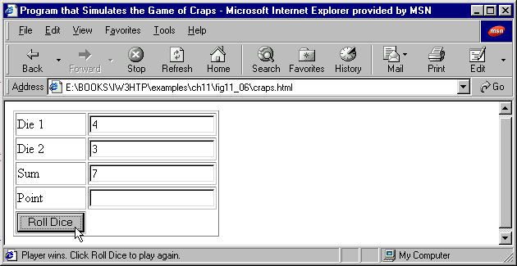
Script Output 1 (player wins first roll)

Slide 32
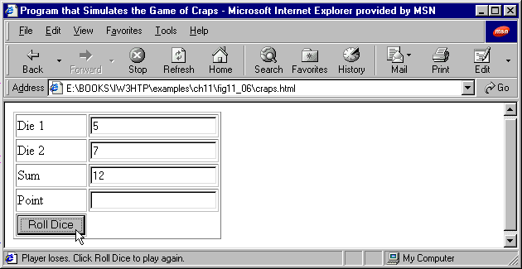
Script Output 2 (player loses first roll)

Slide 33
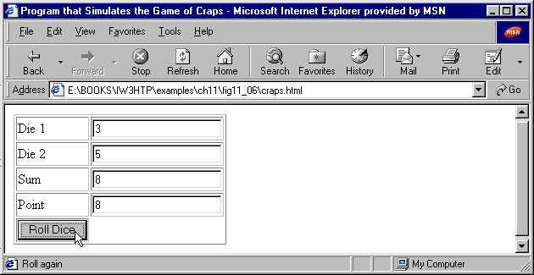

Script Output 3 (player wins on second roll)
Roll 1
Roll 2

Slide 34


Script Output 4 (player loses on second roll)
Roll 1
Roll 2

Slide 35
16.7 Duration of Identifiers
Each identifier has duration and scope
  Duration (or lifetime) is the period during which identifier exists in memory.
    Some identifiers exist briefly
    Some identifiers are repeatedly created and destroyed
    Some identifiers exist for entire execution of the program
Identifiers which represent local variables in a function have automatic duration
  Automatically created when program control enters function
  Exist while function is active
  Automatically destroyed when function is exited
  Referred to as local variables

Slide 36
16.7 Duration of Identifiers
JavaScript also has identifiers of static duration
  Typically defined in <HEAD> section of HTML document
  Exist from point at which declared until browsing session over
  Even though they exist after <HEAD> section terminates, cannot necessarily be used throughout the script
  Referred to as global variables or script-level variables

Slide 37
16.8 Scope Rules
Scope of identifier is portion of program in which identifier can be referenced
  Local variable declared in a function can be used only in that function
Identifiers declared inside a function have function (or local) scope
  Begins with opening brace ({) of function
  Ends with closing brace(}) of function
  Function parameters also have local scope
  If local variable has same name as global variable, global variable “hidden” from body of function

Slide 38
1 <!DOCTYPE html PUBLIC "-//W3C//DTD HTML 4.0 Transitional//EN">
2 <HTML>
3 <!-- Fig. 16.7: scoping.html -->
4
1.1 Initialize variable
2.1 Define start() function
2.2 State start function actions
2.3 Call user defined functions
2.4 Print results
3.1 Define function functionA()
5 <HEAD>
6 <TITLE>A Scoping Example</TITLE>
7
8 <SCRIPT LANGUAGE = "JavaScript">
9 var x = 1; // global variable
10
11 function start()
12 {
13 var x = 5; // variable local to function start
14
15 document.writeln( "local x in start is " + x );
16
17 functionA(); // functionA has local x
18 functionB(); // functionB uses global variable x
19 functionA(); // functionA reinitializes local x
20 functionB(); // global variable x retains its value
21
22 document.writeln(
23 "<P>local x in start is " + x + "</P>" );
24 }
25
26 function functionA()
27 {
28 var x = 25; // initialized each time functionA is called
29

Slide 39
30 document.writeln( "<P>local x in functionA is " + x +
31 " after entering functionA" );
32 ++x;
33 document.writeln( "<BR>local x in functionA is " + x +
3.2 Demonstrate function scope
4.1 Define functionB()
4.2 Demonstrate global scope
34 " before exiting functionA</P>" );
35 }
36
37 function functionB()
38 {
39 document.writeln( "<P>global variable x is " + x +
40 " on entering functionB" );
41 x *= 10;
42 document.writeln( "<BR>global variable x is " + x +
43 " on exiting functionB</P>" );
44 }
45 </SCRIPT>
46
47 </HEAD>
48 <BODY ONLOAD = "start()"></BODY>
49 </HTML>

Slide 40
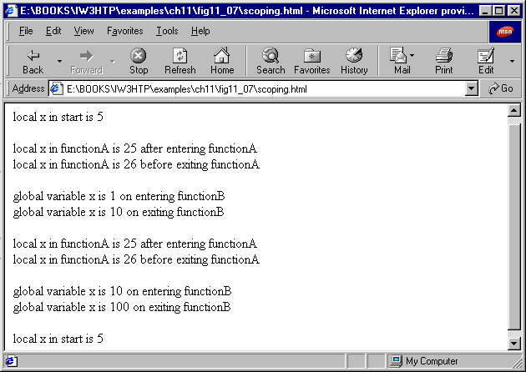
Script Output:

Slide 41
16.9 JavaScript Global Functions
Global functions are part of JavaScript’s Global object
  Contains all global variables in the script
  Some programmers refer to these functions as methods
    Global functions and user-defined functions part of Global object
You do not need to use the Global object directly
  JavaScript does this for you

Slide 42
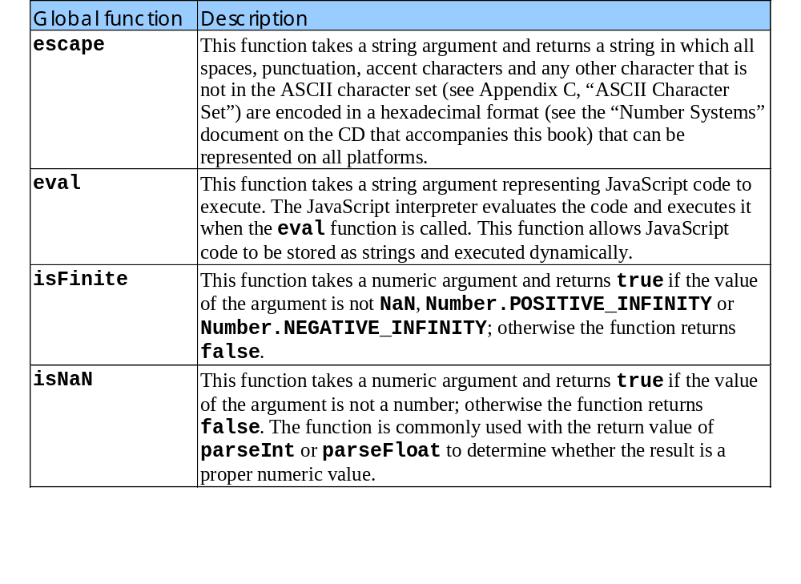
16.9 JavaScript Global Functions

Slide 43
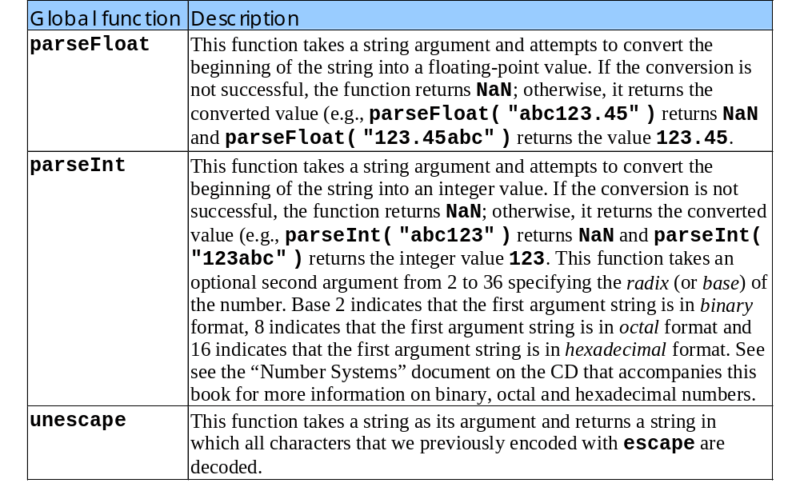
16.9 JavaScript Global Functions
Continued from previous slide

