Slide 1
Chapter 17 – JavaScript/Jscript: Arrays
Outline
17.1 Introduction
17.2 Arrays
17.3 Declaring and Allocating Arrays
17.4 Examples Using Arrays
17.5 References and Reference Parameters
17.6 Passing Arrays to Functions
17.7 Sorting Arrays
17.8 Searching Arrays: Linear
17.9 Multiple-Subscripted Arrays

Slide 2
17.1 Introduction
Arrays
  Data structures consisting of related data items (collections of data items)
JavaScript arrays are “dynamic” entities
  Can change size after being created

Slide 3
17.2 Arrays
Array - group of memory locations that
  All have the same name
  Are normally of the same type (though not required)
To refer to particular element in array, specify
  The name of the array
  The position number of the particular element in the array
  Example (to identify the 5th element in array c): c[4]
Position number in brackets called a subscript (or index)
  If program uses an expression as a subscript, expression is evaluated first to determine the subscript

Slide 4
17.2 Arrays
First element in every array is the zeroth (0th) element
  Therefore, element n will have a subscript value of (n-1)
Length of an Array determined by the expression
  arrayName.length
Brackets
  Used to enclose the subscript of an array
  Have same precedence in JavaScript operations as parentheses

Slide 5
17.2 Arrays
Name of array (Note that all
elements of this array have the
same name, c)
c[0]
45
c[1]
6
c[2]
0
c[3]
72
c[4]
1543
c[5]
-
89
c[6]
0
c[7]
62
c[8]
-
3
c[9]
1
c[10]
4563
c[11]
78
Position number of the element
within array c

Slide 6
17.3 Declaring and Allocating Arrays
An array in JavaScript is an Array object
Operator new creates an object as the program executes
  Obtains enough memory to store an object of the type specified
Process of creating objects also known as
  Creating an instance or
  Instantiating an object
new
  Dynamic memory allocation operator

Slide 7
17.3 Declaring and Allocating Arrays
To allocate 12 elements for integer array c
  var c = new Array( 12 );
  This can also be performed in 2 steps:
    var c;
    c = new Array( 12 );
  When arrays allocated, elements not initialized
Reserving memory
  Use a single declaration:
  var b = new Array( 100 ), x = new Array( 27 );
  Reserves 100 elements for array b, 27 elements for array x

Slide 8
17.4 Examples Using Arrays
Arrays can be initialized with existing elements
  var n1 = new Array( 5 );
  Initializes array n1 with 5 elements
Arrays can also be initialized with no elements
  Grow dynamically to accommodate new elements
  var n2 = new Array();
  Initializes empty array n2
Element values can be printed using the regular writeln method
  document.writeln( “The value is “ + n2[2] );

Slide 9
1 <!DOCTYPE HTML PUBLIC "-//W3C//DTD HTML 4.0 Transitional//EN">
2 <HTML>
3 <!-- Fig. 17.3: InitArray.html -->
4
1.1 Define initializeArrays function
1.2 Initialize variables, and create new arrays
1.3 Assign values to each element in Array n1
1.4 Create and initialize five elements in Array n2
1.5 Use function outputArray to display contents of Arrays n1 and n2
5 <HEAD>
6 <TITLE>Initializing an Array</TITLE>
7
8 <SCRIPT LANGUAGE = "JavaScript">
9 // this function is called when the <BODY> element's
10 // ONLOAD event occurs
11 function initializeArrays()
12 {
13 var n1 = new Array( 5 ); // allocate 5-element Array
14 var n2 = new Array(); // allocate empty Array
15
16 // assign values to each element of Array n1
17 for ( var i = 0; i < n1.length; ++i )
18 n1[ i ] = i;
19
20 // create and initialize five-elements in Array n2
21 for ( i = 0; i < 5; ++i )
22 n2[ i ] = i;
23
24 outputArray( "Array n1 contains", n1 );
25 outputArray( "Array n2 contains", n2 );
26 }
27

Slide 10
28 // output "header" followed by a two-column table
29 // containing subscripts and elements of "theArray"
30 function outputArray( header, theArray )
31 {
2.1 Define outputArray function
2.2 Open HTML TABLE
2.3 Print contents of the array inside the table
2.4 Close the TABLE
3.1 Set BODY element to execute function initializeArrays when the page loads
32 document.writeln( "<H2>" + header + "</H2>" );
33 document.writeln( "<TABLE BORDER = '1' WIDTH = '100%'>" );
34 document.writeln( "<TR><TD WIDTH = '100'><B>Subscript</B>"
35 + "<TD><B>Value</B></TR>" );
36
37 for ( var i = 0; i < theArray.length; i++ )
38 document.writeln( "<TR><TD>" + i + "<TD>" +
39 theArray[ i ] + "</TR>" );
40
41 document.writeln( "</TABLE>" );
42 }
43 </SCRIPT>
44
45 </HEAD><BODY ONLOAD = "initializeArrays()"></BODY>
46 </HTML>

Slide 11
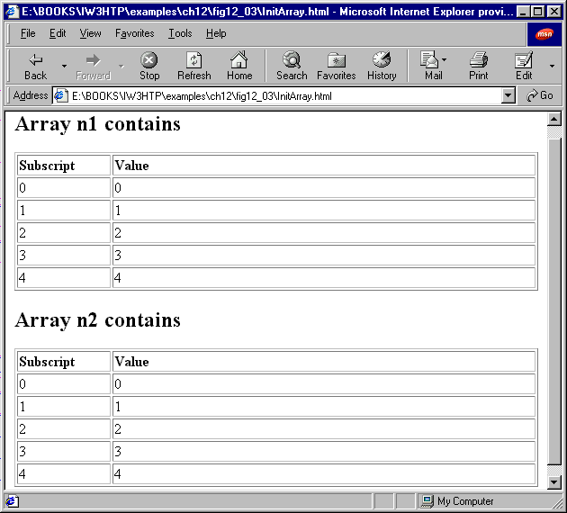
Script Output

Slide 12
17.4 Examples Using Arrays
The elements of an Array can be allocated and initialized in the array declaration
This can be done in two ways
  To initialize array n with five known elements:
  var n = [ 10, 20, 30, 40, 50 ];
  Uses a comma-separated initializer list enclosed in square brackets
  var n = new Array( 10, 20, 30, 40, 50 );

Slide 13
17.4 Examples Using Arrays
To reserve a space in an Array for an unspecified value
  Use a comma as a place holder in the initializer list
  var n = [ 10, 20, , 40, 50 ];
  Creates five element array with no value specified for n[2]
  n[2] will appear undefined until a value for it is initialized

Slide 14
1 <!DOCTYPE HTML PUBLIC "-//W3C//DTD HTML 4.0 Transitional//EN">
2 <HTML>
3 <!-- Fig. 17.4: InitArray.html -->
4
1.1 Define start function
1.2 Initialize and set element values for arrays colors, integers1 and integers2
1.3 Use outputArray function to print the array’s contents
2.1 Define outputArray function
2.2 open HTML TABLE
5 <HEAD>
6 <TITLE>Initializing an Array with a Declaration</TITLE>
7
8 <SCRIPT LANGUAGE = "JavaScript">
9 function start()
10 {
11 // Initializer list specifies number of elements and
12 // value for each element.
13 var colors = new Array( "cyan", "magenta",
14 "yellow", "black" );
15 var integers1 = [ 2, 4, 6, 8 ];
16 var integers2 = [ 2, , , 8 ];
17
18 outputArray( "Array colors contains", colors );
19 outputArray( "Array integers1 contains", integers1 );
20 outputArray( "Array integers2 contains", integers2 );
21 }
22
23 // output "header" followed by a two-column table
24 // containing subscripts and elements of "theArray"
25 function outputArray( header, theArray )
26 {
27 document.writeln( "<H2>" + header + "</H2>" );
28 document.writeln( "<TABLE BORDER = '1' WIDTH = '100%'>" );
29 document.writeln( "<TR><TD WIDTH = '100'><B>Subscript</B>"
30 + "<TD><B>Value</B></TR>" );
31

Slide 15
32 for ( var i = 0; i < theArray.length; i++ )
33 document.writeln( "<TR><TD>" + i + "<TD>" +
34 theArray[ i ] + "</TR>" );
35
2.3 Print the contents of array inside the table
2.4 Close TABLE
3.1 Set BODY element to execute function initializeArrays when the page loads
36 document.writeln( "</TABLE>" );
37 }
38 </SCRIPT>
39
40 </HEAD><BODY ONLOAD = "start()"></BODY>
41 </HTML>

Slide 16
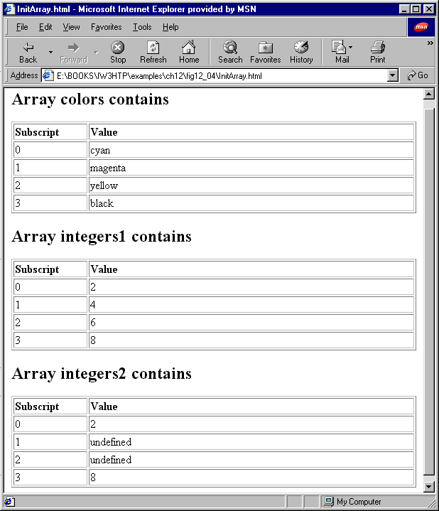
Script Output

Slide 17
17.4 Examples Using Arrays
for/in repetition structure
  Enables a script to perform a task for each element in an array
  Also known as iterating over the array elements
Format:
  for ( var element in theArray )
  total2 += theArray[ element ];
  Adds the value every element in array theArray to total2
  Structure ends after an iteration has been done for every element in theArray

Slide 18
1 <!DOCTYPE HTML PUBLIC "-//W3C//DTD HTML 4.0 Transitional//EN">
2 <HTML>
3 <!-- Fig. 17.5: SumArray.html -->
4
5 <HEAD>
1.1 define start function
1.2 Initialize variables and arrays theArray
1.3 Use for structure to calculate sum of all elements in theArray
1.4 Print results
1.5 Use for/in structure to calculate sum of all elements in theArray
1.6 Print results
2.1 Set BODY element to call start when page loads
6 <TITLE>Sum the Elements of an Array</TITLE>
7
8 <SCRIPT LANGUAGE = "JavaScript">
9 function start()
10 {
11 var theArray = [ 1, 2, 3, 4, 5, 6, 7, 8, 9, 10 ];
12 var total1 = 0, total2 = 0;
13
14 for ( var i = 0; i < theArray.length; i++ )
15 total1 += theArray[ i ];
16
17 document.writeln( "Total using subscripts: " + total1 );
18
19 for ( var element in theArray )
20 total2 += theArray[ element ];
21
22 document.writeln( "<BR>Total using for/in: " + total2 );
23 }
24 </SCRIPT>
25
26 </HEAD><BODY ONLOAD = "start()"></BODY>
27 </HTML>

Slide 19
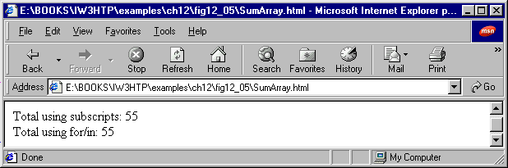
Script Output

Slide 20
1<!DOCTYPE HTML PUBLIC "-//W3C//DTD HTML 4.0 Transitional//EN">
2<HTML>
3<!-- Fig. 17.6: RollDie.html -->
4
1.1 Declare and initialize arrays
1.2 Calculate frequencies
1.3 Output results
5<HEAD>
6<TITLE>Roll a Six-Sided Die 6000 Times</TITLE>
7
8<SCRIPT LANGUAGE = "JavaScript">
9 var face, frequency = [ , 0, 0, 0, 0, 0, 0 ];
10
11 // summarize results
12 for ( var roll = 1; roll <= 6000; ++roll ) {
13 face = Math.floor( 1 + Math.random() * 6 );
14 ++frequency[ face ];
15 }
16
17 document.writeln( "<TABLE BORDER = '1' WIDTH = '100%'>" );
18 document.writeln( "<TR><TD WIDTH = '100'><B>Face</B>" +
19 "<TD><B>Frequency</B></TR>" );
20
21 for ( face = 1; face < frequency.length; ++face )
22 document.writeln( "<TR><TD>" + face + "<TD>" +
23 frequency[ face ] + "</TR>" );
24
25 document.writeln( "</TABLE>" );
26</SCRIPT>
27
28</HEAD>
29<BODY>
30<P>Click Refresh (or Reload) to run the script again</P>
31</BODY>
32</HTML>

Slide 21
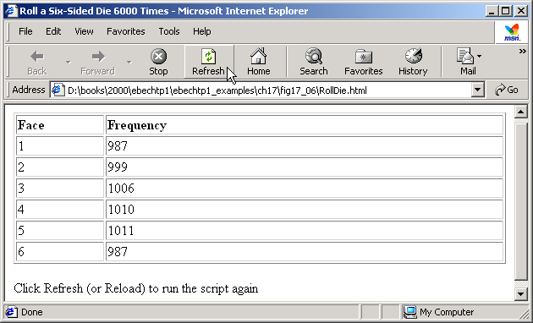
Script Output

Slide 22
1 <!DOCTYPE HTML PUBLIC "-//W3C//DTD HTML 4.0 Transitional//EN">
2 <HTML>
3 <!-- Fig. 17.7: Histogram.html -->
4
5 <HEAD>
1.1 Define start function
1.2 Initialize array theArray
2.1 Print TABLE header
3.1 Use for/in structure to print element info
3.2 Use for structure to print histogram
4.1 Close TABLE
5.1 Set BODY element to call start when loaded
6 <TITLE>Histogram Printing Program</TITLE>
7
8 <SCRIPT LANGUAGE = "JavaScript">
9 function start()
10 {
11 var theArray = [ 19, 3, 15, 7, 11, 9, 13, 5, 17, 1 ];
12
13 document.writeln( "<TABLE BORDER = '1' WIDTH = '100%'>" );
14 document.writeln( "<TR><TD WIDTH = '100'><B>Element</B>" +
15 "<TD WIDTH = '100'><B>Value</B>" +
16 "<TD><B>Histogram</B></TR>" );
17
18 for ( var i in theArray ) {
19 document.writeln( "<TR><TD>" + i +
20 "<TD>" + theArray[ i ] + "<TD>" );
21
22 // print a bar
23 for ( var j = 1; j <= theArray[ i ]; ++j )
24 document.writeln( "*" );
25
26 document.writeln( "</TR>" );
27 }
28
29 document.writeln( "</TABLE>" );
30 }
31 </SCRIPT>
32
33 </HEAD><BODY ONLOAD = "start()"></BODY>
34 </HTML>

Slide 23
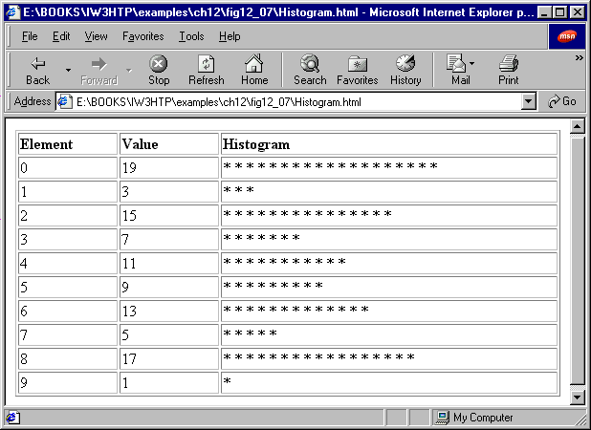
Script Output

Slide 24
1 <!DOCTYPE HTML PUBLIC "-//W3C//DTD HTML 4.0 Transitional//EN">
2 <HTML>
3 <!-- Fig. 17.8: RollDie.html -->
4
5 <HEAD>
1.1 Initialize variables, array frequency
2.1 Use for structure to roll dice 6000 times and input statistics into array frequency
3.1 Open HTML TABLE
4.1 Use for structure to input array data into table
4.2 Close TABLE
6 <TITLE>Roll a Six-Sided Die 6000 Times</TITLE>
7
8 <SCRIPT LANGUAGE = "JavaScript">
9 var face, frequency = [ , 0, 0, 0, 0, 0, 0 ];
10
11 // summarize results
12 for ( var roll = 1; roll <= 6000; ++roll ) {
13 face = Math.floor( 1 + Math.random() * 6 );
14 ++frequency[ face ];
15 }
16
17 document.writeln( "<TABLE BORDER = '1' WIDTH = '100%'>" );
18 document.writeln( "<TR><TD WIDTH = '100'><B>Face</B>" +
19 "<TD><B>Frequency</B></TR>" );
20
21 for ( face = 1; face < frequency.length; ++face )
22 document.writeln( "<TR><TD>" + face + "<TD>" +
23 frequency[ face ] + "</TR>" );
24
25 document.writeln( "</TABLE>" );
26 </SCRIPT>
27
28 </HEAD>
29 <BODY>
30 <P>Click Refresh (or Reload) to run the script again</P>
31 </BODY>
32 </HTML>

Slide 25
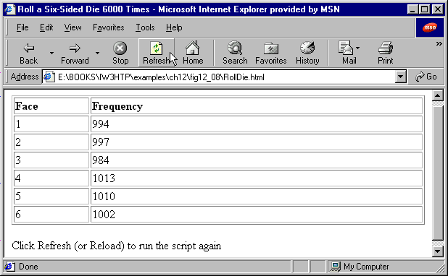
Script Output

Slide 26
17.5 References and Reference Parameters
Two ways to pass arguments to functions
  Call-by-value / pass-by-value
  When used to pass argument, copy of value is made and passed to called function
  Takes up more space, uses more power, but more secure and eliminates many potential problems
  Used in JavaScript for numbers or boolean values
  Call-by-reference / pass-by-reference
  When used to pass argument, location in memory / address of argument is passed to called function
  Takes up less space, uses less power, but less secure and allows many potential problems to occur
  Used in JavaScript for objects, including Arrays

Slide 27
17.6 Passing Arrays to Functions
To pass an array to a function
  Specify the name of the array without brackets as a parameter
  You do not need to separately pass the size of the array
Individual numeric and boolean array elements are
  Passed exactly as simple numeric and boolean variables: call-by-value
  Simple single pieces of data are called scalars or scalar qualities
  Are passed using subscripted name of the array element

Slide 28
17.6 Passing Arrays to Functions
For function to receive Array through a function call
  Must specify parameter that will be used to refer to the array in the body of the function
  JavaScript does not provide a special syntax for this purpose
arrayName.join( x );
  Creates string containing all elements in arrayName
  Takes argument – string containing separator – used to separate elements of the array in the string when returned
  If argument left empty – empty string used as separator

Slide 29
1 <!DOCTYPE HTML PUBLIC "-//W3C//DTD HTML 4.0 Transitional//EN">
2 <HTML>
3 <!-- Fig. 17.7: PassArray.html -->
4
5 <HEAD>
1.1 Define start function
1.2 Initialize array a, set element values
1.3 Print results
1.4 Call outputArray function
1.5 Call modifyArray function
1.6 Print results
1.7 Run modifyElement function
6 <TITLE>Passing Arrays and Individual Array
7 Elements to Functions</TITLE>
8
9 <SCRIPT LANGUAGE = "JavaScript">
10 function start()
11 {
12 var a = [ 1, 2, 3, 4, 5 ];
13
14 document.writeln( "<H2>Effects of passing entire " +
15 "array call-by-reference</H2>" );
16 outputArray(
17 "The values of the original array are: ", a );
18
19 modifyArray( a ); // array a passed call-by-reference
20
21 outputArray(
22 "The values of the modified array are: ", a );
23
24 document.writeln( "<H2>Effects of passing array " +
25 "element call-by-value</H2>" +
26 "a[3] before modifyElement: " + a[ 3 ] );
27
28 modifyElement( a[ 3 ] );
29
30 document.writeln(
31 "<BR>a[3] after modifyElement: " + a[ 3 ] );
32 }

Slide 30
17.7 Sorting Arrays
Sorting data is one of most important computing scripts
  Virtually every organization must sort data in some amount
Array object in Javascript has built-in function sort
  No arguments
    Uses string comparisons to determine sorting order
  With optional arguments
    Takes the name of a function called the comparator function
    Comparator function takes two arguments and returns
      A negative value if the first argument is less than the second
      Zero if the arguments are equal
      A positive value if the first argument is greater than the second

Slide 31
1<!DOCTYPE html PUBLIC "-//W3C//DTD HTML 4.0 Transitional//EN">
2<HTML>
3<!-- Fig. 17.8: sort.html -->
4
5<HEAD>
1.1 Define start function
1.2 Initialize array
1.3 Output original array
1.4 call function sort
1.5 Output sorted array
2.1 Define outputArray function
3.1 Define CompareIntegers function
6<TITLE>Sorting an Array with Array Method sort</TITLE>
7
8<SCRIPT LANGUAGE = "JavaScript">
9 function start()
10 {
11 var a = [ 10, 1, 9, 2, 8, 3, 7, 4, 6, 5 ];
12
13 document.writeln( "<H1>Sorting an Array</H1>" );
14 outputArray( "Data items in original order: ", a );
15 a.sort( compareIntegers ); // sort the array
16 outputArray( "Data items in ascending order: ", a );
17 }
18
19 // outputs "header" followed by the contents of "theArray"
20 function outputArray( header, theArray )
21 {
22 document.writeln( "<P>" + header +
23 theArray.join( " " ) + "</P>" );
24 }
25
26 // comparison function for use with sort
27 function compareIntegers( value1, value2 )
28 {
29 return parseInt( value1 ) - parseInt( value2 );
30 }
31</SCRIPT>
32
33</HEAD><BODY ONLOAD = "start()"></BODY>
34</HTML>

Slide 32
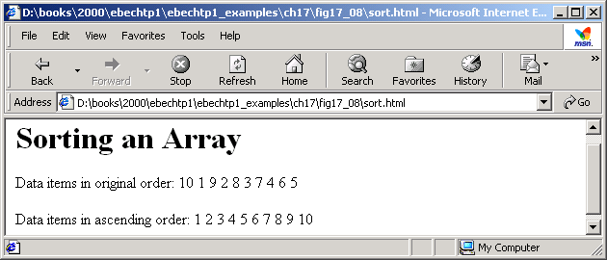
Script Output

Slide 33
17.8 Searching Arrays: Linear Search
When working with large amounts of data
  May be necessary to determine whether an array contains a value that matches a certain key value
  Searching – process of locating particular element value in an array
Linear searching
  Compares each element in an array with a search key
  Goes in order of elements in array
    If array unsorted, just as likely value will be found in first element as the last element
  Works well for small arrays or unsorted arrays
  Inefficient for large arrays

Slide 34
1 <!DOCTYPE HTML PUBLIC "-//W3C//DTD HTML 4.0 Transitional//EN">
2 <HTML>
3 <!-- Fig. 17.9: LinearSearch.html -->
4
1.1 Create array a and fill with integer values
2.1 define buttonPressed function
2.2 Initialize variables to inputted values
2.3 Set if/else structure for result output
5 <HEAD>
6 <TITLE>Linear Search of an Array</TITLE>
7
8 <SCRIPT LANGUAGE = "JavaScript">
9 var a = new Array( 100 ); // create an Array
10
11 // fill Array with even integer values from 0 to 198
12 for ( var i = 0; i < a.length; ++i )
13 a[ i ] = 2 * i;
14
15 // function called when "Search" button is pressed
16 function buttonPressed()
17 {
18 var searchKey = searchForm.inputVal.value;
19
20 // Array a is passed to linearSearch even though it
21 // is a global variable. Normally an array will
22 // be passed to a method for searching.
23 var element = linearSearch( a, parseInt( searchKey ) );
24
25 if ( element != -1 )
26 searchForm.result.value =
27 "Found value in element " + element;
28 else
29 searchForm.result.value = "Value not found";
30 }

Slide 35
31
32 // Search "theArray" for the specified "key" value
33 function linearSearch( theArray, key )
34 {
3.1 Define linearSearch function
3.2 Set search action
3.3 Return result
4.1 Open HTML FORM
4.2 Insert INPUT elements
4.4 Insert button and define ONCLICK action
4.3 Close FORM
35 for ( var n = 0; n < theArray.length; ++n )
36 if ( theArray[ n ] == key )
37 return n;
38
39 return -1;
40 }
41</SCRIPT>
42
43</HEAD>
44
45<BODY>
46<FORM NAME = "searchForm">
47 <P>Enter integer search key<BR>
48 <INPUT NAME = "inputVal" TYPE = "text">
49 <INPUT NAME = "search" TYPE = "button" VALUE = "Search"
50 ONCLICK = "buttonPressed()"><BR></P>
51
52 <P>Result<BR>
53 <INPUT NAME = "result" TYPE = "text" SIZE = "30"></P>
54</FORM>
55</BODY>
56</HTML>

Slide 36
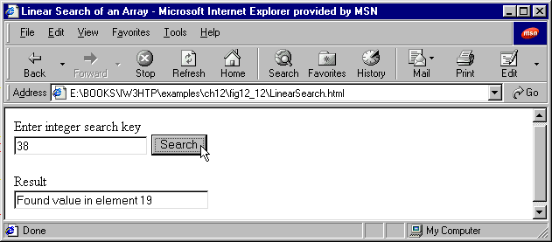
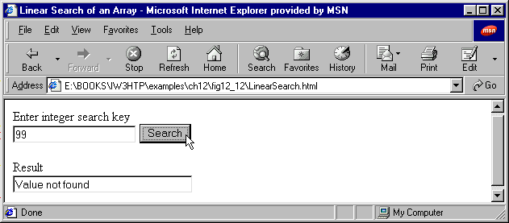
Script Outputs

Slide 37
17.9 Multiple-Subscripted Arrays
Multiple-Subscripted Arrays with two subscripts
  Often represent tables of values consisting of info arranged in rows and columns
Double-subscripted array (or two-dimensional arrays)
  Require two subscripts to identify a particular element
    First subscript identifies element’s row
    Second subscript identifies element’s column
m-by-n array
  An array with m rows and n columns

Slide 38
17.9 Multiple-Subscripted Arrays
Double-scripted array with three rows and four columns
Column 0
Column 1
Column 2
Column 3
Row 0
a[0][0]
a[0][1]
a[0][2]
a[0][3]
Row 1
a[1][0]
a[1][1]
a[1][2]
a[1][3]
Row 2
a[2][0]
a
[2]
[1]
a[2][2]
a[2][3]
Column subscript
Row subscript
Array name

Slide 39
17.9 Multiple-Subscripted Arrays
Initialization
  Declared like a single-scripted array
  Double scripted array b with two rows and two columns could be declared and initialized with
  var b = [ [ 1, 2 ], [ 3, 4, 5 ] ];
  Compiler determines number of elements in row/column
    By counting number of initializer values in sub-initializer list for that row/column
Can have a different number of columns in each row
for and for/in loops used to traverse the arrays
  Manipulate every element of the array

Slide 40
1 <!DOCTYPE html PUBLIC "-//W3C//DTD HTML 4.0 Transitional//EN">
2 <HTML>
3 <!-- Fig. 17.11: InitArray.html -->
4
1.1 Define start function
1.2 Initialize and set element values for multidimensional arrays array1 and array2
1.3 Call outputArray function for each array
2.1 Define outputArray function
2.2 Print header
2.3 Use nested for/in structures to traverse the arrays and output their contents
5 <HEAD>
6 <TITLE>Initializing Multidimensional Arrays</TITLE>
7
8 <SCRIPT LANGUAGE = "JavaScript">
9 function start()
10 {
11 var array1 = [ [ 1, 2, 3 ], // first row
12 [ 4, 5, 6 ] ]; // second row
13 var array2 = [ [ 1, 2 ], // first row
14 [ 3 ], // second row
15 [ 4, 5, 6 ] ]; // third row
16
17 outputArray( "Values in array1 by row", array1 );
18 outputArray( "Values in array2 by row", array2 );
19 }
20
21 function outputArray( header, theArray )
22 {
23 document.writeln( "<H2>" + header + "</H2><TT>" );
24
25 for ( var i in theArray ) {
26
27 for ( var j in theArray[ i ] )
28 document.write( theArray[ i ][ j ] + " " );
29
30 document.writeln( "<BR>" );
31 }

Slide 41
32
33 document.writeln( "</TT>" );
34 }
35 </SCRIPT>
3.1 Set BODY element ONCLICK action
36
37 </HEAD><BODY ONLOAD = "start()"></BODY>
38 </HTML>

Slide 42
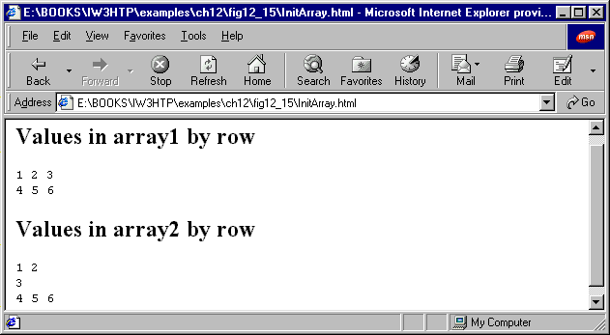
Script Output

Slide 43
17.9 Multiple-Subscripted Arrays
Different array manipulations using for and for/in:
for ( int col = 0; col < a[ 2 ].length; ++col )
a[ 2 ][ col ] = 0;
identical to
for ( var col in a[ 2 ] )
a[ 2 ][ col ] = 0
Both statements set all elements in third row of array a to zero

Slide 44
17.9 Multiple-Subscripted Arrays
Different array manipulations using for and for/in
var total = 0;
for (var row = 0; row < a.length; ++row )
for (var col = 0; col < a[ row ].length; ++col )
total += a[ row ][ col ];
  identical to
var total = 0;
for (var row in a )
for (var col in a[ row ] )
total += a[ row ][ col ];
  Both statements total the elements of the array, one row at a time

