Slide 1
Chapter 18 – JavaScript/Jscript: Objects
Outline
18.1 Introduction
18.2 Thinking About Objects
18.3 Math Object
18.4 String Object
18.4.1 Fundamentals of Characters and Strings
18.4.1 Methods of the String Object
18.4.3 Character Processing Methods
18.4.4 Searching Methods
18.4.5 Splitting Strings and Obtaining Substrings
18.4.6 HTML Markup Methods
18.5 Date Object
18.6 Boolean and Number Objects

Slide 2
18.1 Introduction
Up till now
  JavaScript used to illustrate basic programming concepts
JavaScript can also
  Manipulate every element of an HTML document from a script
In this chapter
  Provide more formal treatment of objects
  Overview and serve as reference for
    Several of JavaScript’s built-in objects
    Demonstrates their capabilities

Slide 3
18.2 Thinking About Objects
JavaScript - object-based programming language
Objects
  Two categories
    Animate
    Inanimate
  Attributes
  Behaviors
  Encapsulate data and methods
  Property: Information hiding
  Communicate with programs through interfaces
Most future software will be built by combining objects

Slide 4
18.2 Thinking About Objects
JavaScript uses objects to
  Interact with elements (or objects) of an HTML document
    window object
      Enables script to manipulate browser window
      window.status
      window.alert
    document object
      Provides access to every element of an HTML document
  Encapsulate various capabilities in a script
    array object
    Enables script to manipulate a collection of data

Slide 5
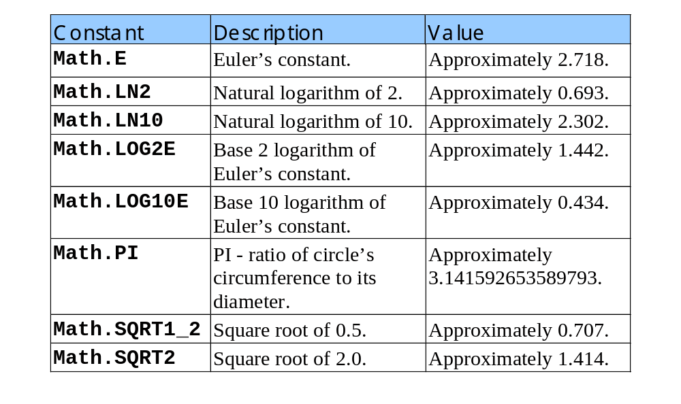
18.3 Math Object
Math object’s methods
  Allow programmer to perform many common mathematical calculations
Properties of the Math object

Slide 6
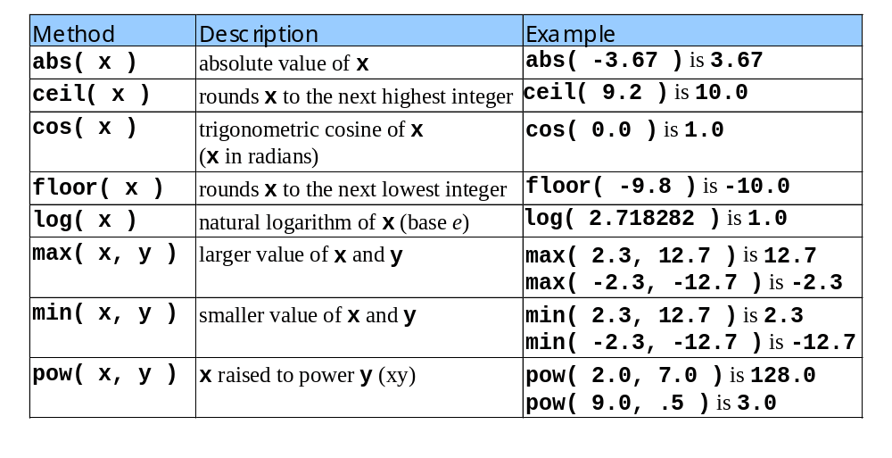
18.3 Math Object
Commonly Used Math Object Methods

Slide 7
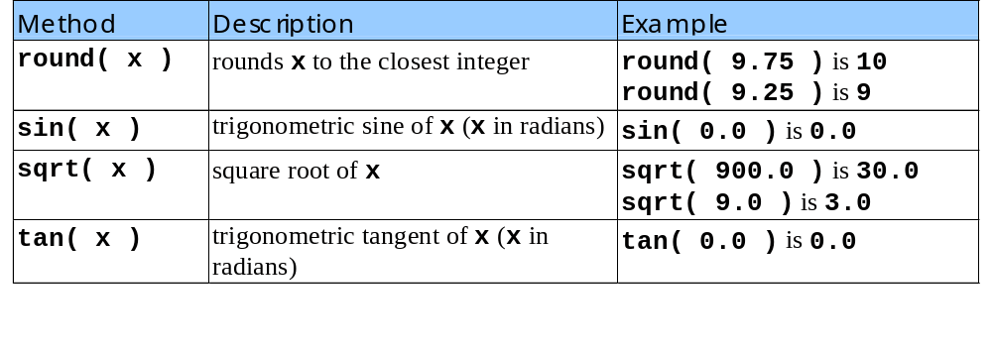
18.3 Math Object
Commonly used Math object methods
  Continued from previous slide

Slide 8
18.4 String Object
String Object
  JavaScript’s string and character processing capabilities
Appropriate for developing
  Text editors
  Word processors
  Page layout software
  Computerized typesetting systems
  Other kinds of text-processing software

Slide 9
18.4.1 Fundamentals of Characters and Strings
Characters
  Fundamental building blocks of JavaScript programs
String
  Series of Characters treated as a single unit
  May include
    Letters
    Digits
    Special Characters
    +, _, /, $, etc.

Slide 10
18.4.1 Fundamentals of Characters and Strings
String literals / string constant
  Written as sequence of characters in single or double quotation marks
Strings may be assigned to variables in declarations
  var color = “blue”;
Strings may be compared with
  Relational operators
  Equality operators

Slide 11
18.4.2 Methods of the String Object
String object
  Encapsulates the attributes and behaviors of a string of characters
Format for calling methods (except in certain cases)
  stringName.methodName( );
Provides methods for
  Selecting characters from a string
  Combining strings (concatenation)
  Obtaining substrings of a string
  Searching for substrings within a string
  Tokenizing a string
  Converting strings to all uppercase or lowercase
  Generate HTML tags

Slide 12
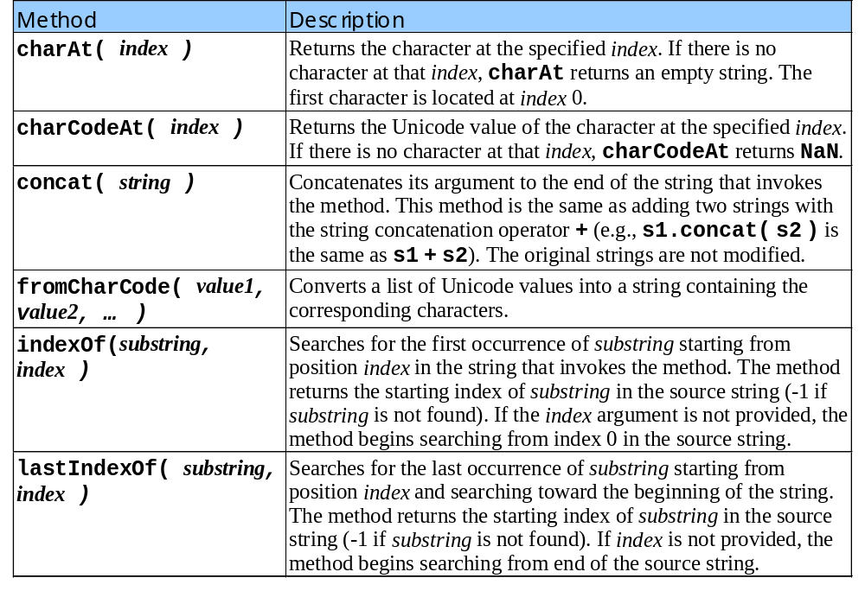
18.4.2 Methods of the String Object

Slide 13
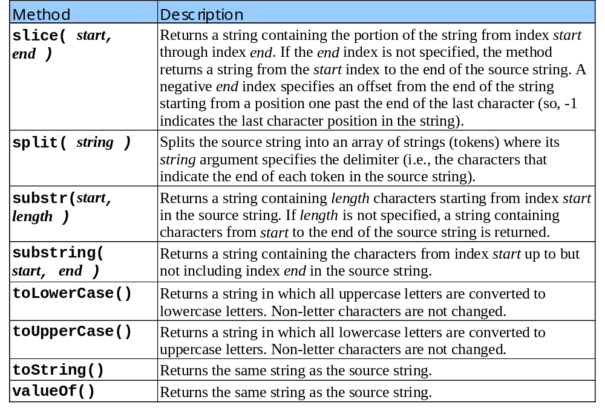
18.4.2 Methods of the String Object

Slide 14
1 <!DOCTYPE HTML PUBLIC "-//W3C//DTD HTML 4.0 Transitional//EN">
2 <HTML>
3 <!-- Fig. 18.4: CharacterProcessing.html -->
4
1.1 Initialize and assign strings to variables
2.1 Print text and call charAt method
3.1 Print text and call charCodeAt method
4.1 Print text and call String.fromCharCode method
5.1 Print text and call toLowerCase method
6.1 Print text and call toUppercase method
5 <HEAD>
6 <TITLE>Character Processing Methods</TITLE>
7
8 <SCRIPT LANGUAGE = "JavaScript">
9 var s = "ZEBRA";
10 var s2 = "AbCdEfG";
11
12 document.writeln( "<P>Character at index 0 in '" +
13 s + "' is " + s.charAt( 0 ) );
14 document.writeln( "<BR>Character code at index 0 in '" +
15 s + "' is " + s.charCodeAt( 0 ) + "</P>" );
16
17 document.writeln( "<P>'" +
18 String.fromCharCode( 87, 79, 82, 68 ) +
19 "' contains character codes 87, 79, 82 and 68</P>" )
20
21 document.writeln( "<P>'" + s2 + "' in lowercase is '" +
22 s2.toLowerCase() + "'" );
23 document.writeln( "<BR>'" + s2 + "' in uppercase is '" +
24 s2.toUpperCase() + "'</P>" );
25 </SCRIPT>
26
27 </HEAD><BODY></BODY>
28 </HTML>

Slide 15
18.4.3 Character Processing Methods
String object’s character processing methods
  charAt
    Returns the character at a specific position
  charCodeAt
    Returns the Unicode value of the character at a specific position
  fromCharCode
    Creates a string from a list of Unicode values
  toLowerCase
    Returns the lowercase version of a string
  toUppercase
    Returns the uppercase version of a string

Slide 16
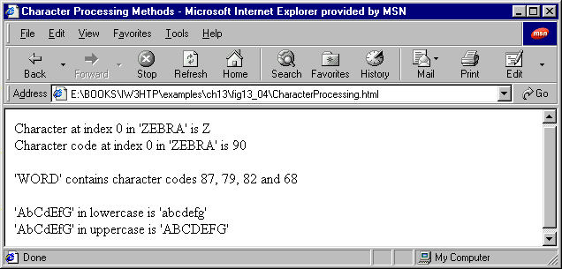
Script Output

Slide 17
18.4.4 Searching Methods
Often useful to search for character or sequence of characters in a string
String object’s searching methods
  Indexof and lastindexof
    Search for a specified substring in a string

Slide 18
1 <!DOCTYPE HTML PUBLIC "-//W3C//DTD HTML 4.0 Transitional//EN">
2 <HTML>
3 <!-- Fig. 18.5: SearchingStrings.html -->
4
1.1 Initialize and assign string to variable
2.1 Define buttonPressed function
2.2 Run indexOf method and output result
2.3 Run lastIndexOf method and ouput result
2.4 Run indexOf method with index arg. and ouput result
2.5 Run lastIndexOf method with index arg. and ouput result
5 <HEAD>
6 <TITLE>Searching Strings with indexOf and lastIndexOf</TITLE>
7
8 <SCRIPT LANGUAGE = "JavaScript">
9 var letters = "abcdefghijklmnopqrstuvwxyzabcdefghijklm";
10
11 function buttonPressed()
12 {
13 searchForm.first.value =
14 letters.indexOf( searchForm.inputVal.value );
15 searchForm.last.value =
16 letters.lastIndexOf( searchForm.inputVal.value );
17 searchForm.first12.value =
18 letters.indexOf( searchForm.inputVal.value, 12 );
19 searchForm.last12.value =
20 letters.lastIndexOf( searchForm.inputVal.value, 12 );
21 }
22 </SCRIPT>
23
24 </HEAD>
25<BODY>
26<FORM NAME = "searchForm">
27 <H1>The string to search is:<BR>
28 abcdefghijklmnopqrstuvwxyzabcdefghijklm</H1>
29 <P>Enter substring to search for
30 <INPUT NAME = "inputVal" TYPE = "text">

Slide 19
31 <INPUT NAME = "search" TYPE = "button" VALUE = "Search"
32 ONCLICK = "buttonPressed()"><BR></P>
33
34 <P>First occurrence located at index
3.1 Print text
3.2 Insert and define searching INPUT elements
3.3 Insert and define output INPUT elements
3.4 Close FORM
35 <INPUT NAME = "first" TYPE = "text" SIZE = "5">
36 <BR>Last occurrence located at index
37 <INPUT NAME = "last" TYPE = "text" SIZE = "5">
38 <BR>First occurrence from index 12 located at index
39 <INPUT NAME = "first12" TYPE = "text" SIZE = "5">
40 <BR>Last occurrence from index 12 located at index
41 <INPUT NAME = "last12" TYPE = "text" SIZE = "5"></P>
42</FORM>
43</BODY>
44</HTML>

Slide 20
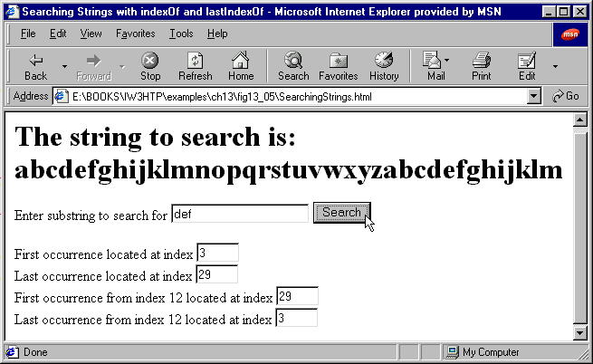
Script Output 1

Slide 21
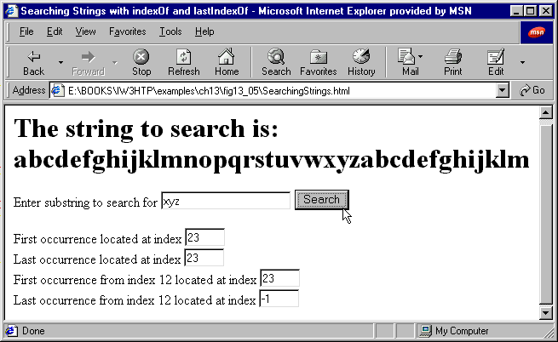
Script Output 2

Slide 22
18.4.5 Splitting Strings and Obtaining Substrings
When you read a sentence
  Break it into individual words or tokens
Process of breaking string into tokens is tokenization
  Also done by interpreters
Tokens separated by delimiters
  Typically white-space characters
  Other characters can be used
Results of tokenization are displayed in HTML TEXTAREA GUI component

Slide 23
18.4.5 Splitting Strings and Obtaining Substrings
String object’s split method
  Breaks a string into its component tokens
String object’s substring method
  Returns a portion of a string

Slide 24
1 <!DOCTYPE HTML PUBLIC "-//W3C//DTD HTML 4.0 Transitional//EN">
2 <HTML>
3 <!-- Fig. 18.6: SplitAndSubString.html -->
4
1.1 Define splitButtonPressed function
1.2 Initialize variable with split method
1.3 Output results
1.4 Run substring method and output results
2.1 Open HTML FORM
2.2 Enter text and INPUT elements to be run by script
2.3 Enter text and INPUT elements to display results
5 <HEAD>
6 <TITLE>String Method split and substring</TITLE>
7
8 <SCRIPT LANGUAGE = "JavaScript">
9 function splitButtonPressed()
10 {
11 var strings = myForm.inputVal.value.split( " " );
12 myForm.output.value = strings.join( "\n" );
13
14 myForm.outputSubstring.value =
15 myForm.inputVal.value.substring( 0, 10 );
16 }
17 </SCRIPT>
18 </HEAD>
19
20<BODY>
21<FORM NAME = "myForm">
22 <P>Enter a sentence to split into words<BR>
23 <INPUT NAME = "inputVal" TYPE = "text" SIZE = "40">
24 <INPUT NAME = "splitButton" TYPE = "button" VALUE = "Split"
25 ONCLICK = "splitButtonPressed()"></P>
26
27 <P>The sentence split into words is<BR>
28 <TEXTAREA NAME = "output" ROWS = "8" COLS = "34">
29 </TEXTAREA></P>

Slide 25
30
31 <P>The first 10 characters of the input string are
32 <INPUT NAME = "outputSubstring" TYPE = "text" SIZE = "15">
33 </P>
2.4 Close FORM
34</FORM>
35</BODY>
36</HTML>

Slide 26
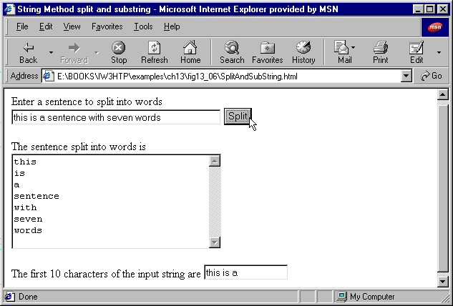
Script Output

Slide 27
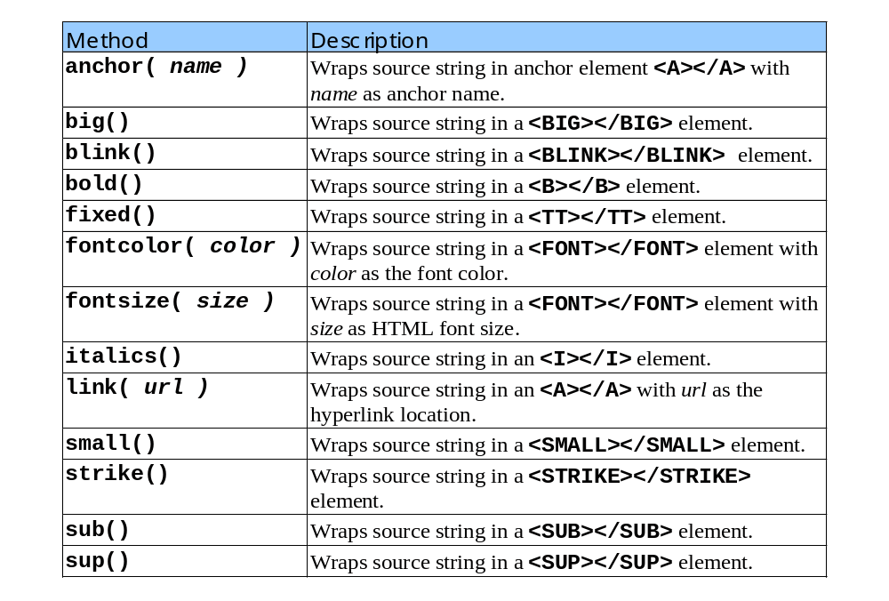
18.4.6 HTML Markup Methods

Slide 28
1 <!DOCTYPE HTML PUBLIC "-//W3C//DTD HTML 4.0 Transitional//EN">
2 <HTML>
3 <!-- Fig. 18.7: MarkupMethods.html -->
4
1.1 Initialize and assign strings to variables
2.1 Print modified string variables using string methods
5 <HEAD>
6 <TITLE>HTML Markup Methods of the String Object</TITLE>
7
8 <SCRIPT LANGUAGE = "JavaScript">
9 var anchorText = "This is an anchor",
10 bigText = "This is big text",
11 blinkText = "This is blinking text",
12 boldText = "This is bold text",
13 fixedText = "This is monospaced text",
14 fontColorText = "This is red text",
15 fontSizeText = "This is size 7 text",
16 italicText = "This is italic text",
17 linkText = "Click here to go to anchorText",
18 smallText = "This is small text",
19 strikeText = "This is strike out text",
20 subText = "subscript",
21 supText = "superscript";
22
23 document.writeln( anchorText.anchor( "top" ) );
24 document.writeln( "<BR>" + bigText.big() );
25 document.writeln( "<BR>" + blinkText.blink() );
26 document.writeln( "<BR>" + boldText.bold() );
27 document.writeln( "<BR>" + fixedText.fixed() );
28 document.writeln(
29 "<BR>" + fontColorText.fontcolor( "red" ) );
30 document.writeln( "<BR>" + fontSizeText.fontsize( 7 ) );

Slide 29
31 document.writeln( "<BR>" + italicText.italics() );
32 document.writeln( "<BR>" + smallText.small() );
33 document.writeln( "<BR>" + strikeText.strike() );
34 document.writeln(
2.1 Print modified string variables using string methods
35 "<BR>This is text with a " + subText.sub() );
36 document.writeln(
37 "<BR>This is text with a " + supText.sup() );
38 document.writeln( "<BR>" + linkText.link( "#top" ) );
39 </SCRIPT>
40
41 </HEAD><BODY></BODY>
42 </HTML>

Slide 30
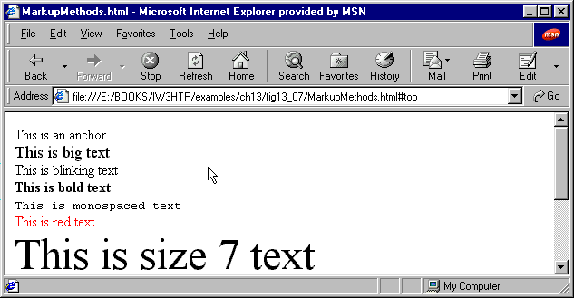
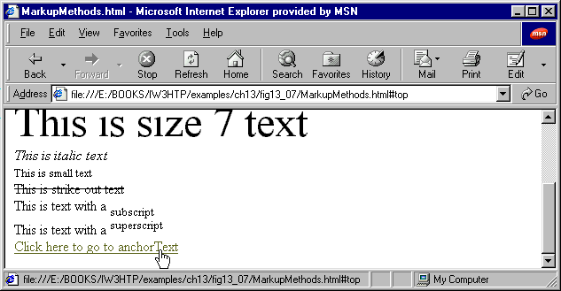
Script Output

Slide 31
18.5 Date Object
JavaScript’s Date object
  Provides methods for date and time manipulation
Date and time processing can be performed based on
  Local time zone
  Universal Coordinated Time (UTC) /
  Greenwich Mean Time (GMT)
  Most methods in Date object have local time zone and UTC versions
When using Date object
  Initialize Date object with current date and time
  var current = new Date();
  Allocates memory for object, calls Date object constructor
    Constructor – initializer method for an object

Slide 32
18.5 Date Object
New Date object creation
  new Date( year, month, date, hours, minutes, seconds, milliseconds );
  Hours, minutes, seconds and milliseconds are optional
  If argument to the right is specified, all arguments to the left must also be specified
  Month represented internally as integers from 0-11
    Therefore, March is indicated by 2, November by 10, etc.
Write out years in 4-digit form (i.e. ‘2000’, not ’00’)
  Avoid potential Y2K problems

Slide 33
18.5 Date Object
Two other methods can be called without creating new Date object
  Both methods return number of milliseconds between midnight, January 1, 1970 and date specified by argument
Date.parse( argument );
  Argument
    Short dates
      MM-DD-YY, MM-DD-YYYY, MM/DD/YY, MM/DD/YYYY
    Long dates
      Month (at least first two letters), date and year
      Time in either 12 or 24 hour clocks
      Text and days of the week are ignored

Slide 34
18.5 Date Object
Date.UTC( argument );
  Argument - same for as date construct
  ( Y, M, D, H, M, S, M )
  Either method can be converted to a Date object
  var theDate = new Date( numberOfMilliseconds );
  numberOfMilliseconds equals the result of Date.UTC or Date.Parse
For listing of Date object methods, see Figure 13.8

Slide 35
1 <!DOCTYPE HTML PUBLIC "-//W3C//DTD HTML 4.0 Transitional//EN">
2 <HTML>
3 <!-- Fig. 18.9: DateTime.html -->
4
5 <HEAD>
1.1 Call Date constructor with no arguments and assign to variable
2.1 Print date and time info using methods from the Date object
2.2 Print methods for local time zone
6 <TITLE>Date and Time Methods</TITLE>
7
8 <SCRIPT LANGUAGE = "JavaScript">
9 var current = new Date();
10
11 document.writeln(
12 "<H1>String representations and valueOf</H1>" );
13 document.writeln( "toString: " + current.toString() +
14 "<BR>toLocaleString: " + current.toLocaleString() +
15 "<BR>toUTCString: " + current.toUTCString() +
16 "<BR>valueOf: " + current.valueOf() );
17
18 document.writeln(
19 "<H1>Get methods for local time zone</H1>" );
20 document.writeln( "getDate: " + current.getDate() +
21 "<BR>getDay: " + current.getDay() +
22 "<BR>getMonth: " + current.getMonth() +
23 "<BR>getFullYear: " + current.getFullYear() +
24 "<BR>getTime: " + current.getTime() +
25 "<BR>getHours: " + current.getHours() +
26 "<BR>getMinutes: " + current.getMinutes() +
27 "<BR>getSeconds: " + current.getSeconds() +
28 "<BR>getMilliseconds: " + current.getMilliseconds() +
29 "<BR>getTimezoneOffset: " +
30 current.getTimezoneOffset() );
31

Slide 36
32 document.writeln(
33 "<H1>Specifying arguments for a new Date</H1>" );
34 var anotherDate = new Date( 1999, 2, 18, 1, 5, 0, 0 );
35 document.writeln( "Date: " + anotherDate );
3.1 Set new Date
3.2 Print new Date information
4.1 Set methods for local time zone
4.2 Print modified date for local time zone
36
37 document.writeln(
38 "<H1>Set methods for local time zone</H1>" );
39 anotherDate.setDate( 31 );
40 anotherDate.setMonth( 11 );
41 anotherDate.setFullYear( 1999 );
42 anotherDate.setHours( 23 );
43 anotherDate.setMinutes( 59 );
44 anotherDate.setSeconds( 59 );
45 document.writeln( "Modified date: " + anotherDate );
46 </SCRIPT>
47
48 </HEAD><BODY></BODY>
49 </HTML>

Slide 37
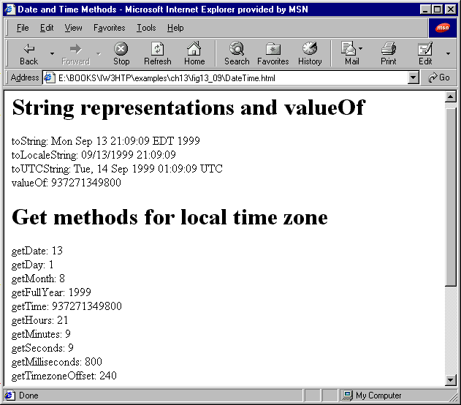
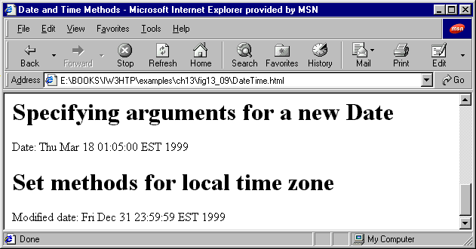
Script Output

Slide 38
18.6 Boolean and Number Objects
Boolean and Number objects
  Provided as object wrappers for
    Boolean true/false values
    Numbers
  Wrappers define methods and properties useful in manipulating boolean values and numbers
Number object
  JavaScript automatically creates Number objects to store numeric values
  Programmers can create a Number object with
    var n = new Number( numericValue );
  For other Number object methods, see figure 13.11

Slide 39
18.6 Boolean and Number Objects
Boolean object
  When boolean value required in a program, automatically created by JavaScript to store the value using Boolean object
  Programmers can create Boolean objects explicitly
    var b = new Boolean( booleanValue );
  If booleanvalue equals false, 0, null, Number.NaN or empty string (“ ”)
    Boolean object contains false
  Otherwise
    Boolean Object contains true

Slide 40
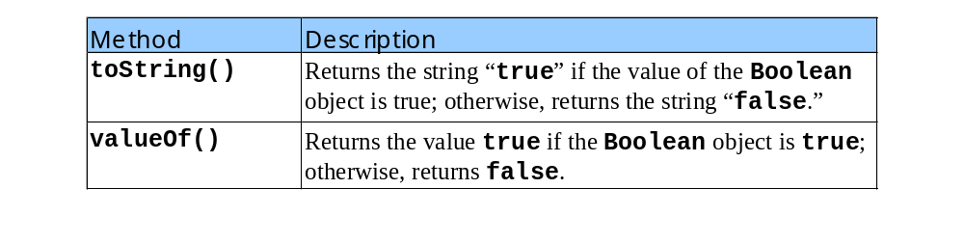
18.6 Boolean and Number Objects
Methods of Boolean object

Slide 41
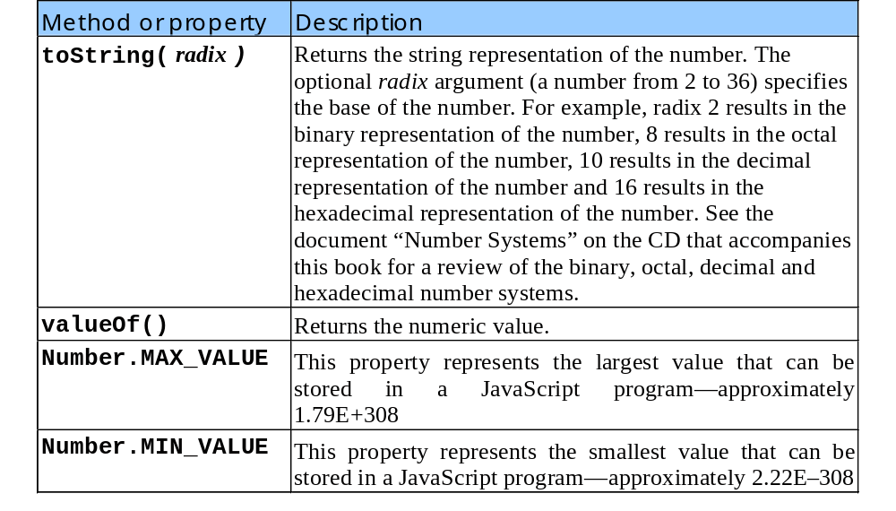
18.6 Boolean and Number Objects
Methods of Number object

Slide 42
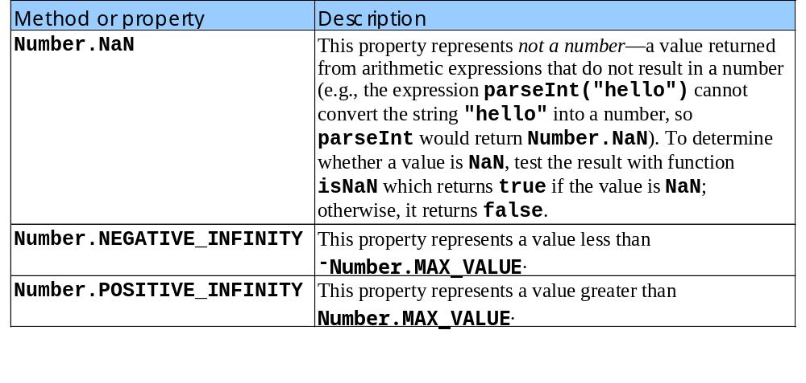
18.6 Boolean and Number Objects
Methods of Number object
  Continued from previous slide

