Slide 1
Chapter 19 – Dynamic HTML: Cascading Style Sheets™ (CSS)
Outline
19.1 Introduction
19.2 Inline Styles
19.3 Creating Style Sheets with the STYLE Element
19.4 Conflicting Styles
19.5 Linking External Style Sheets
19.6 Positioning Elements
19.7 Backgrounds
19.8 Element Dimensions
19.9 Text Flow and the Box Model
19.10 User Style Sheets

Slide 2
19.1 Introduction
Cascading Style Sheets (CSS)
  Specify the style of your page elements
  Spacing, margins, etc.
Separate from the structure of your document
  Section headers, body text, links, etc.
Separation of structure from content
  Greater manageability
  Easier to change style of document

Slide 3
19.2 Inline Styles
Inline styles
  Individual element’s style declared using the STYLE attribute
  Each CSS property followed by a colon and the value of that attribute
  Multiple properties separated by semicolons
  <P STYLE = “font-size: 20 pt; color: #0000FF”>
  Inline styles override any other styles

Slide 4
1 <!DOCTYPE html PUBLIC "-//W3C//DTD HTML 4.0 Transitional//EN">
2 <HTML>
3
4 <!-- Fig. 19.1: inline.html -->
1. STYLE attribute
1.1 Separate multiple styles with a semicolon
5 <!-- Using inline styles -->
6
7 <HEAD><TITLE>Inline Styles</TITLE></HEAD>
8
9 <BODY>
10
11 <P>Here is some text</P>
12
13 <!-- The STYLE attribute allows you to declare inline -->
14 <!-- styles. Separate multiple styles with a semicolon. -->
15 <P STYLE = "font-size: 20pt">Here is some more text</P>
16 <P STYLE = "font-size: 20pt; color: #0000FF">Even more text</P>
17
18 </BODY>
19 </HTML>

Slide 5
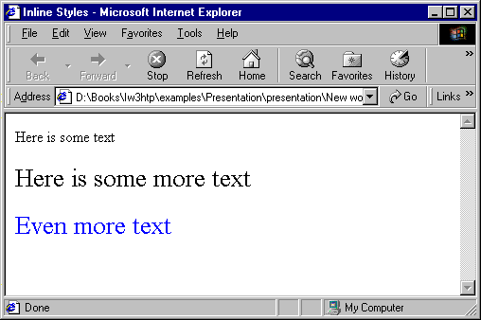
Inline styles

Slide 6
19.3 Creating Style Sheets with the STYLE Element
Style sheet in header section
  Begins with <STYLE TYPE = “text/css”>
    Styles placed here apply to the whole document
    TYPE attribute specifies the MIME type
      MIME is a standard for specifying the format of content
        Other MIME types include text/html, image/gif and text/javascript
Without style sheets
  Browser completely controls the look and feel of Web pages
With style sheets
  Designer can specify the look and feel of Web pages

Slide 7
19.3 Creating Style Sheets with the STYLE Element
Declare CSS rules within STYLE element
  Each rule body begins and ends with a curly brace ({ and })
  Class declarations are preceded with a period and applied to elements only of that specific class
  Each property is followed by a colon and the value of the property
  Multiple properties are separated by semicolons

Slide 8
19.3 Creating Style Sheets with the STYLE Element
Generic font families
  Allow you to specify a type of font instead of a specific font
Font-size property
  Relative sizes: xx-small, x-small, small, smaller, medium, large, larger, x-large and xx-large
Styles applied to an element (the parent element)
  Also apply to the elements inside that element (child elements)

Slide 9
1 <!DOCTYPE html PUBLIC "-//W3C//DTD HTML 4.0 Transitional//EN">
2 <HTML>
3
4 <!-- Fig. 19.2: declared.html -->
Begin style sheet section
1.1 CSS rules inside curly braces
1.2 Property name followed by colon and property value
1.3 Properties separated by semicolon
1.4 background-color specifies the background color of the element
1.5 font-family property:
Arial specifies the name of the font
sans-serif is a generic font family
Applying styles
2.1 CLASS attribute
5 <!-- Declaring a style sheet in the header section. -->
6
7 <HEAD>
8 <TITLE>Style Sheets</TITLE>
9
10 <!-- This begins the style sheet section. -->
11 <STYLE TYPE = "text/css">
12
13 EM { background-color: #8000FF;
14 color: white }
15
16 H1 { font-family: Arial, sans-serif }
17
18 P { font-size: 18pt }
19
20 .blue { color: blue }
21
22 </STYLE>
23 </HEAD>
24
25 <BODY>
26
27 <!-- This CLASS attribute applies the .blue style -->
28 <H1 CLASS = "blue">A Heading</H1>
29 <P>Here is some text. Here is some text. Here is some text.
30 Here is some text. Here is some text.</P>

Slide 10
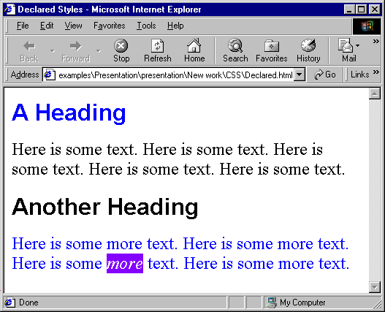
31
32 <H1>Another Heading</H1>
33 <P CLASS = "blue">Here is some more text. Here is some more text.
34 Here is some <EM>more</EM> text. Here is some more text.</P>
35
3. Page rendered by browser
36 </BODY>
37 </HTML>

Slide 11
19.4 Conflicting Styles
Inheritance and specificity
text-decoration property
  Applies decorations to text within an element
  none
  overline
  line-through
  blink
    Browsers are not required to support blink
Pseudo-classes
  Give the author access to content not specifically declared in the document
  Ex. hover pseudo-class

Slide 12
19.4 Conflicting Styles
px: pixel is a relative-length measurement
  Varies in size based on screen resolution
Other relative-lengths
  em: the size of the font
  ex: the “x-height” of the font, usually set to the height of a lowercase x
  Percentages
    E.g. margin-left: 10%
Absolute-length measurements
  in: inches
  cm: centimeters
  mm: millimeters
  pt: points (1 pt = 1/72 in)
  pc: picas (1 pc = 12 pt)
Use relative length over absolute

Slide 13
19.4 Conflicting Styles
Three possible sources for style sheets
  Browser defaults
  Preset user styles
  Author styles
Author styles have a greater precedence than preset user styles

Slide 14
1 <!DOCTYPE html PUBLIC "-//W3C//DTD HTML 4.0 Transitional//EN">
2 <HTML>
3
4 <!-- Fig 19.3: advanced.html -->
1.1 text-decoration property
1.2 hover pseudo-class
1.3 Declare style for EM elements that are children of LI elements
1.4 Declare a style for all nested lists
5 <!-- More advanced style sheets -->
6
7 <HEAD>
8 <TITLE>More Styles</TITLE>
9 <STYLE TYPE = "text/css">
10
11 A.nodec { text-decoration: none }
12
13 A:hover { text-decoration: underline;
14 color: red;
15 background-color: #CCFFCC }
16
17 LI EM { color: red;
18 font-weight: bold }
19
20 UL { margin-left: 75px }
21
22 UL UL { text-decoration: underline;
23 margin-left: 15px }
24
25 </STYLE>
26 </HEAD>
27
28 <BODY>
29
30 <H1>Shopping list for <EM>Monday</EM>:</H1>

Slide 15
31 <UL>
32 <LI>Milk</LI>
33 <LI>Bread
34 <UL>
35 <LI>White bread</LI>
36 <LI>Rye bread</LI>
37 <LI>Whole wheat bread</LI>
38 </UL></LI>
39 <LI>Rice</LI>
40 <LI>Potatoes</LI>
41 <LI>Pizza <EM>with mushrooms</EM></LI>
42 </UL>
43
44 <P><A CLASS = "nodec" HREF = "http://food.com">Go to the Grocery
45 store</A></P>
46
47 </BODY>
48 </HTML>

Slide 16
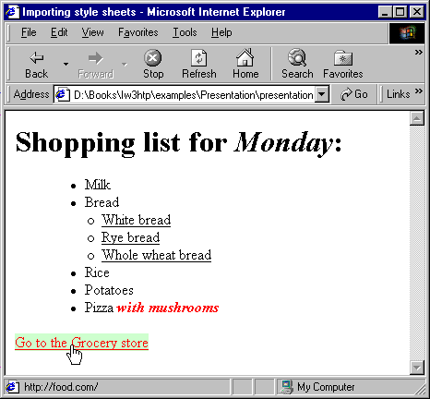
Inheritance in style sheets
Hovering over a link

Slide 17
19.5 Linking External Style Sheets
External linking
  Separate pages can all use same style sheet
  Only modify a single file to change styles across your site
LINK element
  Specifies a relationship (REL attribute) between current document and another document
  <LINK REL = “stylesheet” TYPE = “text/css”
  HREF = “styles.css”>
  LINK element can only be placed in header
  Other REL values
    next, previous allow you to link a series of documents
      Print all linked documents option
Style sheets are reusable

Slide 18
1A { text-decoration: none }
2
3A:hover { text-decoration: underline;
4 color: red;
External style sheet (styles.css)
5 background-color: #CCFFCC }
6
7LI EM { color: red;
8 font-weight: bold}
9
10UL { margin-left: 2cm }
11
12UL UL { text-decoration: underline;
13 margin-left: .5cm }

Slide 19
1<!DOCTYPE html PUBLIC "-//W3C//DTD HTML 4.0 Transitional//EN">
2<HTML>
3
4<!-- Fig. 19.5: imported.html -->
2. LINK element
2.1 REL attribute
5<!-- Linking external style sheets -->
6
7<HEAD>
8<TITLE>Importing style sheets</TITLE>
9<LINK REL = "stylesheet" TYPE = "text/css" HREF = "styles.css">
10</HEAD>
11
12<BODY>
13
14<H1>Shopping list for <EM>Monday</EM>:</H1>
15<UL>
16<LI>Milk</LI>
17<LI>Bread
18 <UL>
19 <LI>White bread</LI>
20 <LI>Rye bread</LI>
21 <LI>Whole wheat bread</LI>
22 </UL></LI>
23<LI>Rice</LI>
24<LI>Potatoes</LI>
25<LI>Pizza <EM>with mushrooms</EM></LI>
26</UL>
27
28<A HREF = "http://food.com">Go to the Grocery store</A>
29
30</BODY>
31</HTML>

Slide 20
Linking an external style sheet

Slide 21
19.6 Positioning Elements
CSS position property
  Absolute positioning
    Specifying an element’s position as absolute removes it from the normal flow of elements on the page
    Position the element according to distance from top, left, right or bottom margins of parent element
  z-index attribute
    Allows you to properly layer overlapping elements
    Elements with higher z-index are displayed in front of elements with lower z-index

Slide 22
1<!DOCTYPE html PUBLIC "-//W3C//DTD HTML 4.0 Transitional//EN">
2<HTML>
3
4<!-- Fig 19.6: positioning.html -->
position property
1.1 absolute positioning
1.2 z-index
5<!-- Absolute positioning of elements -->
6
7<HEAD>
8<TITLE>Absolute Positioning</TITLE>
9</HEAD>
10
11<BODY>
12
13<IMG SRC = "i.gif" STYLE = "position: absolute; top: 0px;
14 left: 0px; z-index: 1">
15<H1 STYLE = "position: absolute; top: 50px; left: 50px;
16 z-index: 3">Positioned Text</H1>
17<IMG SRC = "circle.gif" STYLE = "position: absolute; top: 25px;
18 left: 100px; z-index: 2">
19
20</BODY>
21</HTML>

Slide 23
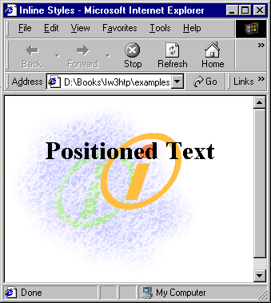
Positioning elements with CSS

Slide 24
19.6 Positioning Elements
CSS position property (cont.)
  Relative positioning
    Browser lays out the element on the page
    Then offsets the element by specified top, bottom, left or right values
    Keeps elements in the general flow of elements on the page
    Be careful to avoid unintentionally overlapping text

Slide 25
1 <!DOCTYPE html PUBLIC "-//W3C//DTD HTML 4.0 Transitional//EN">
2 <HTML>
3
4 <!-- Fig 19.7: positioning2.html -->
1. relative positioning
5 <!-- Relative positioning of elements -->
6
7 <HEAD>
8 <TITLE>Relative Positioning</TITLE>
9
10 <STYLE TYPE = "text/css">
11
12 P { font-size: 2em;
13 font-family: Verdana, Arial, sans-serif }
14
15 SPAN { color: red;
16 font-size: .6em;
17 height: 1em }
18
19 .super { position: relative;
20 top: -1ex }
21
22 .sub { position: relative;
23 bottom: -1ex }
24
25 .shiftl { position: relative;
26 left: -1ex }
27
28 .shiftr { position: relative;
29 right: -1ex }
30 </STYLE>

Slide 26
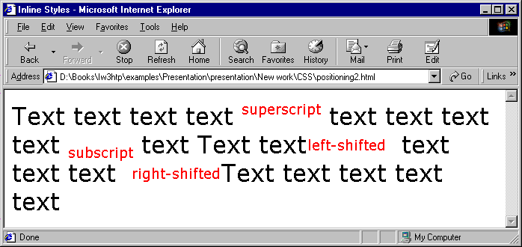
31 </HEAD>
32
33 <BODY>
34
2. Page rendered by browser
35 <P>
36 Text text text text <SPAN CLASS = "super">superscript</SPAN>
37 text text text text <SPAN CLASS = "sub">subscript</SPAN>
38 text Text text <SPAN CLASS = "shiftl">left-shifted</SPAN>
39 text text text <SPAN CLASS = "shiftr">right-shifted</SPAN>
40 Text text text text text
41 </P>
42
43 </BODY>
44 </HTML>

Slide 27
19.7 Backgrounds
background-image property
  Specifies the URL
background-position property
  Positions the image on the page
  Top, bottom, center, left or right
  Ex. background-position: 50% 30px;
    Position image centered vertically (50% of the distance across the screen) and 30 pixels from the top
background-repeat property controls tiling
  no-repeat, repeat, x-repeat, y-repeat
background-attachment property
  fixed: scrolling the browser window will not move the image
  scroll: moves the image as the user scrolls the window (default)
text-indent property
  Indents first line of text by specified amount

Slide 28
19.7 Backgrounds
font-weight property
  specifies the “boldness” of affected text
  bold
  normal
  bolder
  lighter
  Multiples of 100 from 100 to 900
font-style property
  none
  italic
  oblique
    Will default to italic if system does not have separate font file for oblique

Slide 29
19.7 Backgrounds
SPAN element: generic grouping element
  Does not apply any inherent formatting
  Main use is to apply styles or ID attributes to block of text
  Inline element
DIV element
  Similar to SPAN, but block-level element
    Displayed on own line with margins above and below

Slide 30
1<!DOCTYPE html PUBLIC "-//W3C//DTD HTML 4.0 Transitional//EN">
2<HTML>
3
4<!-- Fig. 19.8: background.html -->
Use CSS to add a background image
1.1 background-image property
1.2 background-position property
1.3 background-repeat property
1.4 background-attachment property
1.5 text-indent property
1.6 font-weight property
5<!-- Adding background images and indentation -->
6
7<HEAD>
8<TITLE>Background Images</TITLE>
9
10<STYLE TYPE = "text/css">
11
12 BODY { background-image: url(watermark.gif);
13 background-position: bottom right;
14 background-repeat: no-repeat;
15 background-attachment: fixed }
16
17 P { font-size: 2em;
18 color: #AA5588;
19 text-indent: 1em;
20 font-family: Arial, sans-serif }
21
22 .dark { font-weight: bold }
23
24</STYLE>
25</HEAD>
26
27<BODY>
28
29<P>
30This is some sample text to fill in the page.
31<SPAN CLASS = "dark">This is some sample

Slide 31
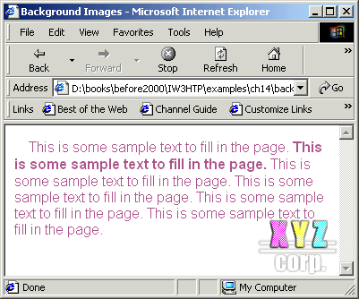
32 text to fill in the page.</SPAN>
33 This is some sample text to fill in the page.
34 This is some sample text to fill in the page.
2. Page rendered by browser
35 This is some sample text to fill in the page.
36 This is some sample text to fill in the page.
37 </P>
38
39 </BODY>
40 </HTML>

Slide 32
19.8 Element Dimensions
width property
  Ex. <DIV STYLE = “width: 20%”>
height property
  Relative and absolute lengths for width and height properties
text-align property
  center, left or right
overflow property
  scroll adds scrollbars if the text overflows the boundaries

Slide 33
1<!DOCTYPE html PUBLIC "-//W3C//DTD HTML 4.0 Transitional//EN">
2<HTML>
3
4<!-- Fig. 19.9: width.html -->
Dimensions in DIV element
1.1 width property
1.2 height property
1.3 text-align property
5<!-- Setting box dimensions and aligning text -->
6
7<HEAD>
8<TITLE>Box Dimensions</TITLE>
9<STYLE TYPE = "text/css">
10
11 DIV { background-color: #FFCCFF;
12 margin-bottom: .5em }
13
14</STYLE>
15</HEAD>
16
17<BODY>
18
19<DIV STYLE = "width: 20%">Here is some
20text that goes in a box which is
21set to stretch across twenty precent
22of the width of the screen.</DIV>
23
24<DIV STYLE = "width: 80%; text-align: center">
25Here is some CENTERED text that goes in a box
26which is set to stretch across eighty precent of
27the width of the screen.</DIV>
28

Slide 34
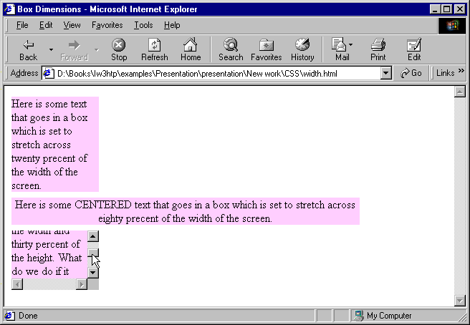
29<DIV STYLE = "width: 20%; height: 30%; overflow: scroll">
30This box is only twenty percent of
31the width and thirty percent of the height.
32What do we do if it overflows? Set the
2. Page rendered by browser
33overflow property to scroll!</DIV>
34
35 </BODY>
36 </HTML>

Slide 35
19.9 Text Flow and the Box Model
Floating
  Allows you to move an element to one side of the screen
  Other content in the document flows around the floated element
  Float to the left or right of a document
Each block-level element is “boxed”
  Box model allows properties of box to be easily adjusted
    Padding
    Border
    Margins

Slide 36
1<!DOCTYPE html PUBLIC "-//W3C//DTD HTML 4.0 Transitional//EN">
2<HTML>
3
4<!-- Fig. 19.10: floating.html -->
Floating elements
Setting box dimensions
5<!-- Floating elements and element boxes -->
6
7<HEAD>
8<TITLE>Flowing Text Around Floating Elements</TITLE>
9<STYLE TYPE = "text/css">
10
11 DIV { background-color: #FFCCFF;
12 margin-bottom: .5em;
13 font-size: 1.5em;
14 width: 50% }
15
16</STYLE>
17</HEAD>
18
19<BODY>
20
21<DIV STYLE = "text-align: center">Centered text</DIV>
22<DIV STYLE = "text-align: right">Right-aligned text</DIV>
23
24<DIV STYLE = "float: right; margin: .5em">This is some floated
25text, floated text, floated text, floated text.</DIV>
26<P>
27Here is some flowing text, flowing text, flowing text.
28Here is some flowing text, flowing text, flowing text.
29Here is some flowing text, flowing text, flowing text.
30Here is some flowing text, flowing text, flowing text.

Slide 37
31Here is some flowing text, flowing text, flowing text.
32Here is some flowing text, flowing text, flowing text.
33Here is some flowing text, flowing text, flowing text.
34Here is some flowing text, flowing text, flowing text.
Interrupt flow of text around a floated element by setting the clear property to the same direction the element is floated
35</P>
36
37<P><DIV STYLE ="float: right; padding: .5em">This is some floated
38text, floated text, floated text, floated text.</DIV>
39Here is some flowing text, flowing text, flowing text.
40Here is some flowing text, flowing text, flowing text.
41Here is some flowing text, flowing text, flowing text.
42<SPAN STYLE = "clear: right">Here is some unflowing text.
43Here is some unflowing text.</SPAN>
44</P>
45
46</BODY>
47</HTML>

Slide 38
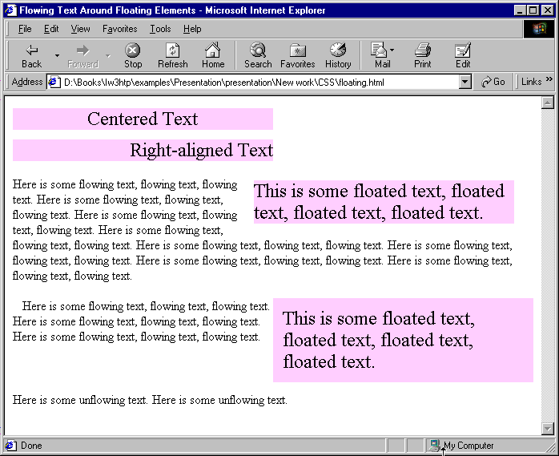
Floating elements, aligning text and setting box dimensions
.5 em margin
.5 em padding

Slide 39
19.9 Text Flow and the Box Model
Box model border
  border-width
  border-style
    E.g. border-top-style
    none
    hidden
    dotted
    dashed
    solid
    double
    groove
    ridge
    inset
    outset
  border-color
    E.g. border-left-color

Slide 40
1<!DOCTYPE html PUBLIC "-//W3C//DTD HTML 4.0 Transitional//EN">
2<HTML>
3
4<!-- Fig. 19.12: borders.html -->
Box model border properties
5<!-- Setting borders of an element -->
6
7<HEAD>
8<TITLE>Borders</TITLE>
9<STYLE TYPE = "text/css">
10
11 BODY { background-color: #CCFFCC }
12
13 DIV { text-align: center;
14 margin-bottom: 1em;
15 padding: .5em }
16
17 .thick { border-width: thick }
18
19 .medium { border-width: medium }
20
21 .thin { border-width: thin }
22
23 .groove { border-style: groove }
24
25 .inset { border-style: inset }
26
27 .outset { border-style: outset }
28
29 .red { border-color: red }

Slide 41
30
31 .blue { border-color: blue }
32
33</STYLE>
34</HEAD>
35
36<BODY>
37
38<DIV CLASS = "thick groove">This text has a border</DIV>
39<DIV CLASS = "medium groove">This text has a border</DIV>
40<DIV CLASS = "thin groove">This text has a border</DIV>
41
42<P CLASS = "thin red inset">A thin red line...</P>
43<P CLASS = "medium blue outset">And a thicker blue line</P>
44
45</BODY>
46</HTML>

Slide 42
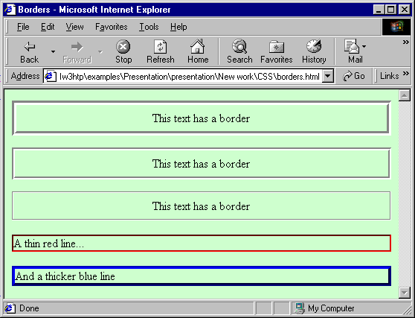
Applying borders to elements

Slide 43
1<!DOCTYPE html PUBLIC "-//W3C//DTD HTML 4.0 Transitional//EN">
2<HTML>
3
4<!-- Fig. 19.13: borders2.html -->
Creating borders with border-style property
5<!-- Various border-styles -->
6
7<HEAD>
8<TITLE>Borders</TITLE>
9
10<STYLE TYPE = "text/css">
11
12 BODY { background-color: #CCFFCC }
13
14 DIV { text-align: center;
15 margin-bottom: .3em;
16 width: 50%;
17 position: relative;
18 left: 25%;
19 padding: .3em }
20</STYLE>
21</HEAD>
22
23<BODY>
24
25<DIV STYLE = "border-style: solid">Solid border</DIV>
26<DIV STYLE = "border-style: double">Double border</DIV>
27<DIV STYLE = "border-style: groove">Groove border</DIV>
28<DIV STYLE = "border-style: ridge">Ridge border</DIV>
29<DIV STYLE = "border-style: inset">Inset border</DIV>
30<DIV STYLE = "border-style: outset">Outset border</DIV>
31</BODY>
32</HTML>

Slide 44
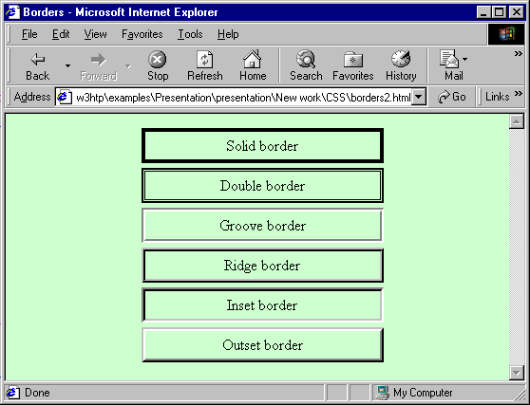
Various border-styles

Slide 45
19.10 User Style Sheets
Important issue when adding style sheets:
  What kind of users will be using your site?
Users can define their own user style sheets
CSS specification gives precedence to author styles over user styles
Use relative measurements
Add a user style sheet in IE5
  Tools menu → Internet Options…
    Accessibility…
      Check Format documents using my style sheet

Slide 46
1<!DOCTYPE html PUBLIC "-//W3C//DTD HTML 4.0 Transitional//EN">
2<HTML>
3
4<!-- Fig. 19.14: user.html -->
1.1 Use em measurement to modify text size
5<!-- User styles -->
6
7<HEAD>
8<TITLE>User Styles</TITLE>
9
10<STYLE TYPE = "text/css">
11
12 .note { font-size: 1.5em }
13
14</STYLE>
15</HEAD>
16
17<BODY>
18
19<P>Thanks for visiting my Web site. I hope you enjoy it.</P>
20<P CLASS = "note">Please Note: This site will be moving soon.
21Please check periodically for updates.</P>
22
23</BODY>
24</HTML>

Slide 47
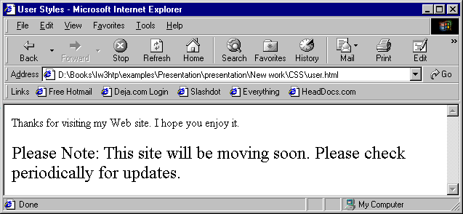
Modifying text size with the em measurement

Slide 48
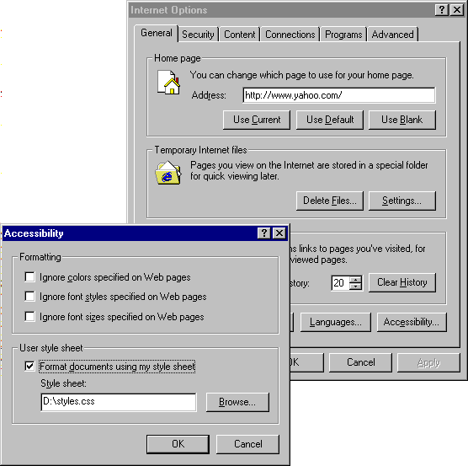
Adding a user style sheet in Internet Explorer 5

Slide 49
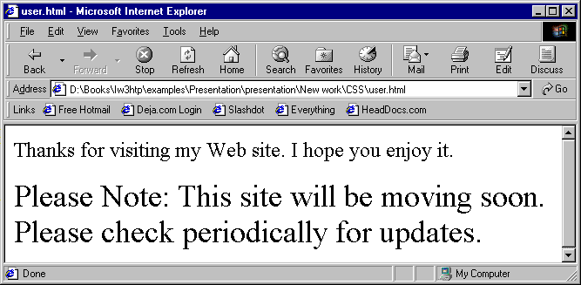
1BODY { font-size: 20pt;
2 background-color: #CCFFCC }
3A { color: red }
A sample user style sheet
A Web page with user styles enabled

