Slide 1
Chapter 20 – Dynamic HTML: Object Model and Collections
Outline
20.1 Introduction
20.2 Object Referencing
20.3 Collections all and children
20.4 Dynamic Styles
20.5 Dynamic Positioning
20.6 Using the frames Collection
20.7 navigator Object
20.8 Summary of the DHTML Object Model

Slide 2
20.1 Introduction
Dynamic HTML object model
  Great control over presentation of pages
    Access to all elements on the page
  Whole web page (elements, forms, frames, tables, etc.) represented in an object hierarchy
HTML elements treated as objects
  Attributes of these elements treated as properties of those objects
    Objects identified with an ID attribute can be scripted with languages like JavaScript, JScript and VBScript

Slide 3
20.2 Object Referencing
Simplest way to reference an element is by its ID attribute
Changing the text displayed on screen
  Example of a Dynamic HTML ability called dynamic content

Slide 4
1<!DOCTYPE html PUBLIC "-//W3C//DTD HTML 4.0 Transitional//EN">
2<HTML>
3
4<!-- Fig. 20.1: example1.html -->
1.1 innerText property
Object pText refers to the P element whose ID is set to pText (line 22)
innertext property refers to text contained in element
5<!-- Object Model Introduction -->
6
7<HEAD>
8<TITLE>Object Model</TITLE>
9
10<SCRIPT LANGUAGE = "JavaScript">
11 function start()
12 {
13 alert( pText.innerText );
14 pText.innerText = "Thanks for coming.";
15 }
16</SCRIPT>
17
18</HEAD>
19
20<BODY ONLOAD = "start()">
21
22<P ID = "pText">Welcome to our Web page!</P>
23
24</BODY>
25</HTML>

Slide 5
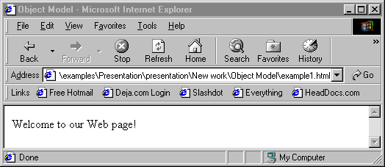

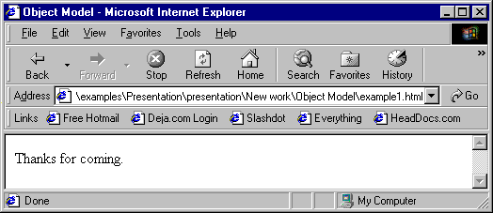
Object referencing with the Dynamic HTML Object Model

Slide 6
20.3 Collections all and children
Collections are basically arrays of related objects on a page
all
  Collection of all the HTML elements in a document in the order in which they appear
length property
  Specifies the number of elements in the collection
tagName property of an element
  Determines the name of the element
Every element has its own all collection, consisting of all the elements contained within that element

Slide 7
1<!DOCTYPE html PUBLIC "-//W3C//DTD HTML 4.0 Transitional//EN">
2<HTML>
3
4<!-- Fig 20.2: all.html -->
5<!-- Using the all collection -->
Document’s all collection
1.1 Loop through the collection and list the element names
2. <!DOCTYPE> and <!--> tags both have ! as their tagName
6
7<HEAD>
8<TITLE>Object Model</TITLE>
9
10<SCRIPT LANGUAGE = "JavaScript">
11 var elements = "";
12
13 function start()
14 {
15 for ( var loop = 0; loop < document.all.length; ++loop )
16 elements += "<BR>" + document.all[ loop ].tagName;
17
18 pText.innerHTML += elements;
19 }
20</SCRIPT>
21</HEAD>
22
23<BODY ONLOAD = "start()">
24
25<P ID = "pText">Elements on this Web page:</P>
26
27</BODY>
28</HTML>

Slide 8
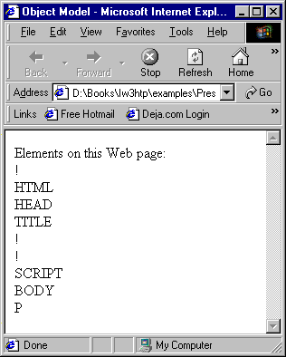
Looping through the all collection

Slide 9
20.3 Collections all and children
The children collection
  Contains only those elements that are direct child elements of that element
  An HTML element has only two children: the HEAD element and the BODY element

Slide 10
1 <!DOCTYPE html PUBLIC "-//W3C//DTD HTML 4.0 Transitional//EN">
2 <HTML>
3
4 <!-- Fig 20.3: children.html -->
Document’s children collection
1.1 Loop recursively through the children collections
5 <!-- The children collection -->
6
7 <HEAD>
8 <TITLE>Object Model</TITLE>
9
10 <SCRIPT LANGUAGE = "JavaScript">
11 var elements = "<UL>";
12
13 function child( object )
14 {
15 var loop = 0;
16
17 elements += "<LI>" + object.tagName + "<UL>";
18
19 for ( loop = 0; loop < object.children.length; loop++ ) {
20
21 if ( object.children[loop].children.length )
22 child( object.children[ loop ] );
23 else
24 elements += "<LI>" + object.children[ loop ].tagName
25 + "</LI>";
26 }
27
28 elements += " </UL> ";
29 }
30 </SCRIPT>

Slide 11
31</HEAD>
32
33<BODY ONLOAD = "child( document.all[ 1 ] );
34 myDisplay.outerHTML += elements;">
2. outerHTML property includes enclosing HTML tags as well as the content inside
35
36<P>Welcome to our <STRONG>Web</STRONG> page!</P>
37
38<P ID = "myDisplay">
39Elements on this Web page:
40</P>
41
42</BODY>
43</HTML>

Slide 12
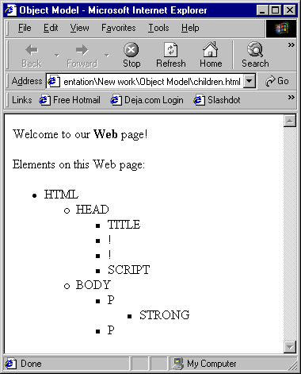
Navigating the object hierarchy using collection children

Slide 13
20.4 Dynamic Styles
Refer to the background color of a page as document.body.style.backgroundColor
Dynamic HTML object model allows you to change the CLASS attribute of an element

Slide 14
1<!DOCTYPE html PUBLIC "-//W3C//DTD HTML 4.0 Transitional//EN">
2<HTML>
3
4<!-- Fig. 20.4: dynamicstyle.html -->
1.1 Function start prompt’s the user to enter a color name, then sets the background color to that value
5<!-- Dynamic Styles -->
6
7<HEAD>
8<TITLE>Object Model</TITLE>
9
10<SCRIPT LANGUAGE = "JavaScript">
11 function start()
12 {
13 var inputColor = prompt( "Enter a color name for the " +
14 "background of this page", "" );
15 document.body.style.backgroundColor = inputColor;
16 }
17</SCRIPT>
18</HEAD>
19
20<BODY ONLOAD = "start()">
21
22<P>Welcome to our Web site!</P>
23
24</BODY>
25</HTML>

Slide 15
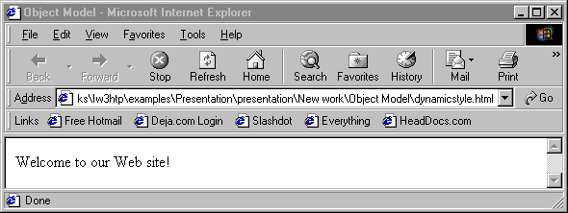
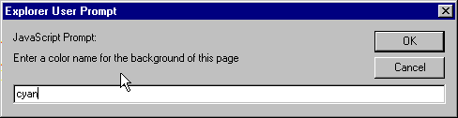
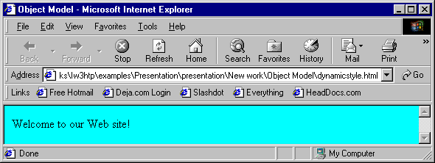
Dynamic styles

Slide 16
1<!DOCTYPE html PUBLIC "-//W3C//DTD HTML 4.0 Transitional//EN">
2<HTML>
3
4<!-- Fig. 20.5: dynamicstyle2.html -->
5<!-- More Dynamic Styles -->
1.1 Define style classes
1.2 Function start prompt’s the user for a class name and dynamically changes the font to reflect the user’s choice
6
7<HEAD>
8<TITLE>Object Model</TITLE>
9
10<STYLE>
11
12 .bigText { font-size: 3em;
13 font-weight: bold }
14
15 .smallText { font-size: .75em }
16
17</STYLE>
18
19<SCRIPT LANGUAGE = "JavaScript">
20 function start()
21 {
22 var inputClass = prompt( "Enter a className for the text "
23 + "(bigText or smallText)", "" );
24 pText.className = inputClass;
25 }
26</SCRIPT>
27</HEAD>
28
29<BODY ONLOAD = "start()">
30
31<P ID = "pText">Welcome to our Web site!</P>
32
33</BODY>
34</HTML>

Slide 17
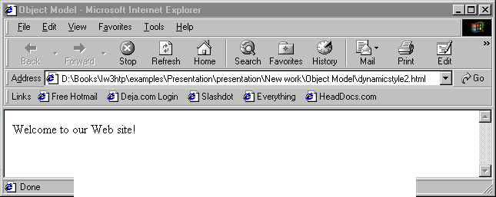
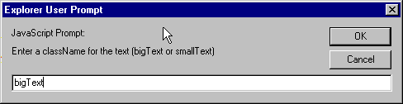
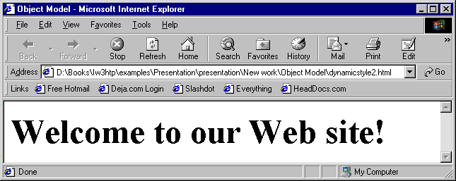
Dynamic styles in action

Slide 18
20.5 Dynamic Positioning
Dynamic positioning
  An element can be positioned with scripting
setInterval function takes two parameters:
  A function name
  How often to run that function
  clearInterval function stops the timer
setTimeout function similar, but only calls the function once
  clearTimeout function stops the timer

Slide 19
1 <!DOCTYPE html PUBLIC "-//W3C//DTD HTML 4.0 Transitional//EN">
2 <HTML>
3
4 <!-- Fig. 20.6: dynamicposition.html -->
1.1 setInterval function
1.2 color, fontFamily and fontSize attributes
5 <!-- Dynamic Positioning -->
6
7 <HEAD>
8 <TITLE>Dynamic Positioning</TITLE>
9
10 <SCRIPT LANGUAGE = "JavaScript">
11 var speed = 5;
12 var count = 10;
13 var direction = 1;
14 var firstLine = "Text growing";
15 var fontStyle = [ "serif", "sans-serif", "monospace" ];
16 var fontStylecount = 0;
17
18 function start()
19 {
20 window.setInterval( "run()", 100 );
21 }
22
23 function run()
24 {
25 count += speed;
26
27 if ( ( count % 200 ) == 0 ) {
28 speed *= -1;
29 direction = !direction;
30

Slide 20
31 pText.style.color =
32 ( speed < 0 ) ? "red" : "blue" ;
33 firstLine =
34 ( speed < 0 ) ? "Text shrinking" : "Text growing";
35 pText.style.fontFamily =
36 fontStyle[ ++fontStylecount % 3 ];
37 }
38
39 pText.style.fontSize = count / 3;
40 pText.style.left = count;
41 pText.innerHTML = firstLine + "<BR> Font size: " +
42 count + "px";
43 }
44</SCRIPT>
45</HEAD>
46
47<BODY ONLOAD = "start()">
48
49<P ID = "pText" STYLE = "position: absolute; left: 0;
50 font-family: serif; color: blue">
51Welcome!</P>
52
53</BODY>
54</HTML>

Slide 21
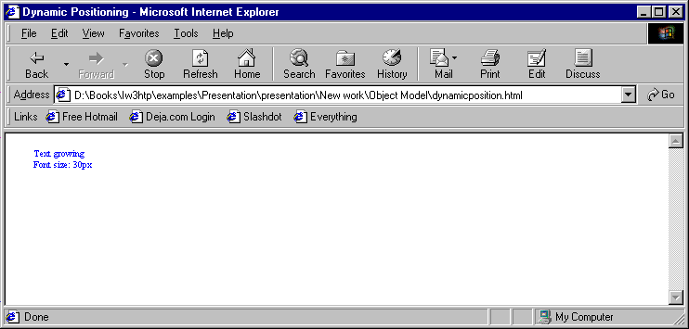
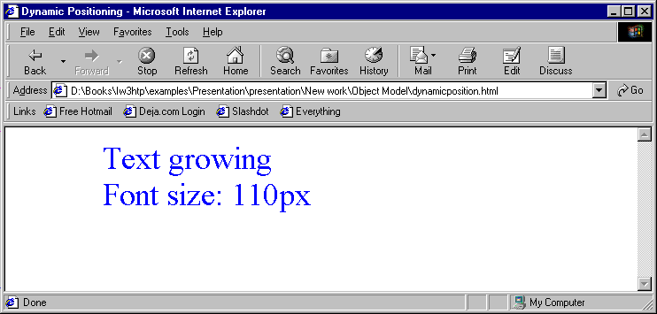
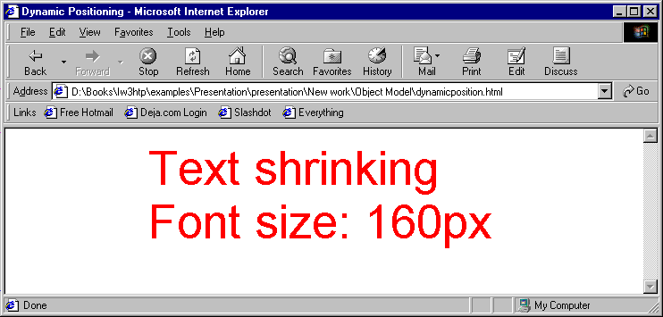
Dynamic positioning

Slide 22
20.6 Using the frames Collection
frames collection
  To reference a frame, use frames(“name”) where name is the ID or NAME of the desired frame
    Ex. frames(“lower”) refers to the element in the frames collection with an ID or NAME of lower

Slide 23
1<!DOCTYPE html PUBLIC "-//W3C//DTD HTML 4.0 Frameset//EN">
2<HTML>
3
4<!-- Fig 20.7: index.html -->
FRAMESET file for cross-frame scripting
5<!-- Using the frames collection -->
6
7<HEAD>
8 <TITLE>Frames collection</TITLE>
9</HEAD>
10
11<FRAMESET ROWS = "100, *">
12 <FRAME SRC = "top.html" NAME = "upper">
13 <FRAME SRC = "" NAME = "lower">
14</FRAMESET>
15
16</HTML>

Slide 24
17<!DOCTYPE html PUBLIC "-//W3C//DTD HTML 4.0 Transitional//EN">
18<HTML>
19
20<!-- Fig 20.8: top.html -->
2. Access other frames using frames collection
21<!-- Cross-frame scripting -->
22
23<HEAD>
24<TITLE>The frames collection</TITLE>
25
26<SCRIPT LANGUAGE = "JavaScript">
27 function start()
28 {
29 var text = prompt( "What is your name?", "" );
30 parent.frames( "lower" ).document.write( "<H1>Hello, " +
31 text + "</H1>" );
32 }
33</SCRIPT>
34</HEAD>
35
36<BODY ONLOAD = "start()">
37
38<H1>Cross-frame scripting!</H1>
39
40
41</BODY>
42</HTML>

Slide 25
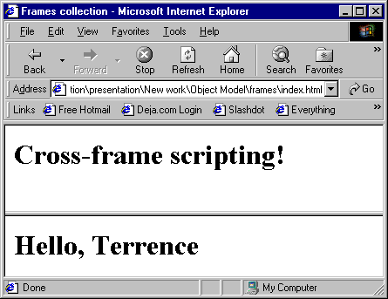
Accessing other frames

Slide 26
20.7 Navigator Object
navigator object
  Supported by Netscape Navigator and Internet Explorer
  navigator object contains info about the Web browser viewing the page
  navigator.appName contains the name of the application
    “Microsoft Internet Explorer”
    “Netscape”
  Value of navigator.appVersion not a simple integer
    Contains other info, such as OS
When using a browser-specific technology
  Make provisions for other browsers

Slide 27
1<!DOCTYPE html PUBLIC "-//W3C//DTD HTML 4.0 Transitional//EN">
2<HTML>
3
4<!-- Fig 20.9: navigator.html -->
Using the navigator object to redirect to appropriate pages
5<!-- Using the navigator object -->
6
7<HEAD>
8<TITLE>The navigator Object</TITLE>
9
10<SCRIPT LANGUAGE = "JavaScript">
11 function start()
12 {
13 if ( navigator.appName == "Microsoft Internet Explorer" ) {
14
15 if ( navigator.appVersion.substring( 1, 0 ) >= "4" )
16 document.location = "newIEversion.html";
17 else
18 document.location = "oldIEversion.html";
19 }
20 else
21 document.location = "NSversion.html";
22 }
23</SCRIPT>
24</HEAD>
25
26<BODY ONLOAD = "start()">
27
28<P>Redirecting your browser to the appropriate page,
29please wait...</P>
30
31</BODY>
32</HTML>

Slide 28
20.8 Summary of the DHTML Object Model
DHTML object model
  Allows script programmer to access every element in an HTML document
  Every element a separate object

Slide 29
20.8 Summary of the DHTML Object Model
window
document
all
frames
document
anchors
history
document
applets
navigator
body
plugins
location
embeds
event
filters
screen
forms
images
Key
links
object
plugins
collection
scripts
styleSheets

Slide 30
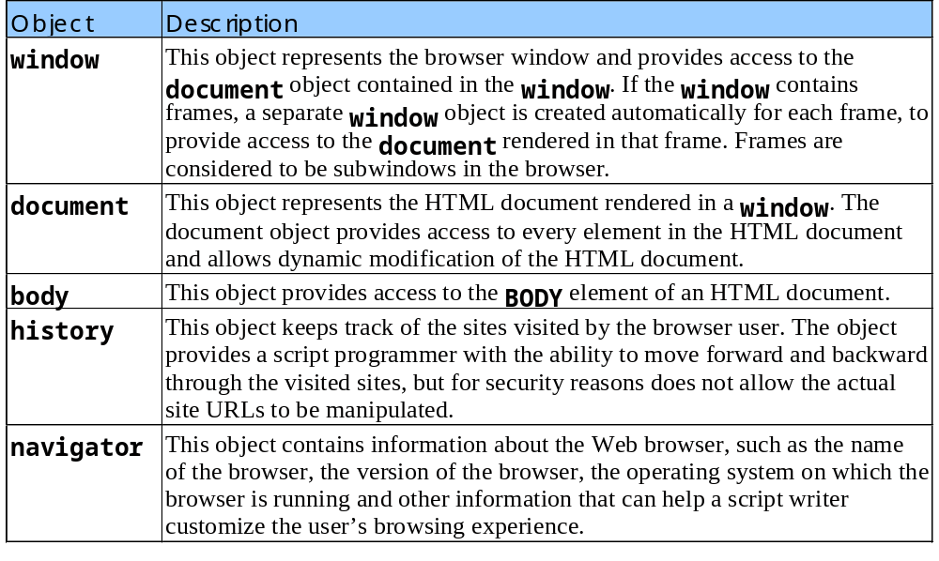
20.8 Summary of the DHTML Object Model
Objects in the Internet Explorer 5 object model

Slide 31
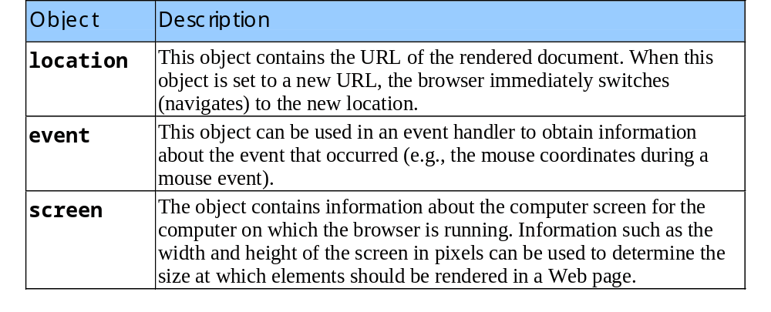
20.8 Summary of the DHTML Object Model
Objects in the Internet Explorer 5 object model
  Continued from previous slide

Slide 32
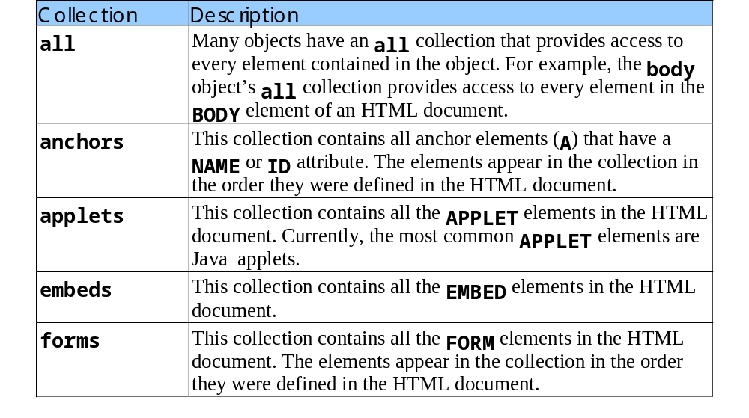
20.8 Summary of the DHTML Object Model
Collections in the Internet Explorer 5 object model

Slide 33
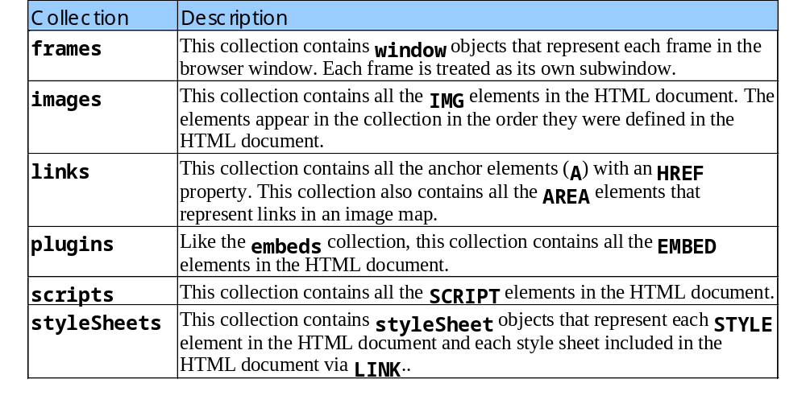
20.8 Summary of the DHTML Object Model
Collections in the Internet Explorer 5 object Model
  Continued from the previous slide

