Slide 1
Chapter 21 – Dynamic HTML:
Event Model
Outline
21.1 Introduction
21.2 Event ONCLICK
21.3 Event ONLOAD
21.4 Error Handling with ONERROR
21.5 Tracking the Mouse with Event ONMOUSEMOVE
21.6 Rollovers with ONMOUSEOVER and ONMOUSEOUT
21.7 Form Processing with ONFOCUS and ONBLUR
21.8 More Form Processing with ONSUBMIT and ONRESET
21.9 Event Bubbling
21.10 More DHTML Events

Slide 2
21.1 Introduction
Event model
  Scripts respond to user actions and change page accordingly
    Moving mouse
    Scrolling screen
    Entering keystrokes
  Content more dynamic
  Interfaces more intuitive

Slide 3
21.2 Event ONCLICK
ONCLICK event
  Fires when user clicks mouse
ID attribute
  Specifies unique identifier for HTML element

Slide 4
1<!DOCTYPE html PUBLIC "-//W3C//DTD HTML 4.0 Transitional//EN">
2<HTML>
3
4<!-- Fig 21.1: onclick.html -->
Use scripting to respond to ONCLICK event
Specify event handlers inline
5<!-- Demonstrating the ONCLICK event -->
6
7<HEAD>
8<TITLE>DHTML Event Model - ONCLICK</TITLE>
9
10<!-- The FOR attribute declares the script for a certain -->
11<!-- element, and the EVENT for a certain event. -->
12<SCRIPT LANGUAGE = "JavaScript" FOR = "para" EVENT = "onclick">
13
14 alert( "Hi there" );
15
16</SCRIPT>
17</HEAD>
18
19<BODY>
20
21<!-- The ID attribute gives a unique identifier -->
22<P ID = "para">Click on this text!</P>
23
24<!-- You can specify event handlers inline -->
25<INPUT TYPE = "button" VALUE = "Click Me!"
26 ONCLICK = "alert( 'Hi again' )">
27
28</BODY>
29</HTML>

Slide 5
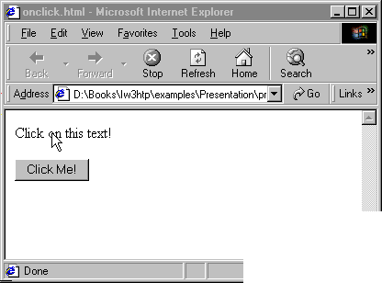

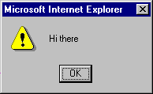
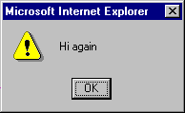
Triggering an ONCLICK event
Executes because of script lines 11-15
Executes because of event handler on line 25

Slide 6
21.3 Event ONLOAD
ONLOAD event
  Fires when element finishes loading successfully
  Often used in BODY tag
    Initiate scripts as soon as page loads

Slide 7
1<HTML>
2
3<!-- Fig. 21.2: onload.html -->
4<!-- Demonstrating the ONLOAD event -->
1.1Define function startTimer
2.1 ONLOAD event in BODY triggers startTimer
5
6<HEAD>
7<TITLE>DHTML Event Model - ONLOAD</TITLE>
8<SCRIPT LANGUAGE = "JavaScript">
9
10var seconds = 0;
11
12function startTimer(){
13 // 1000 milliseconds = 1 second
14 window.setInterval( "updateTime()", 1000 );
15}
16
17function updateTime(){
18 seconds++;
19 soFar.innerText = seconds;
20}
21
22</SCRIPT>
23</HEAD>
24
25<BODY ONLOAD = "startTimer()">
26
27<P>Seconds you have spent viewing this page so far:
28<A ID = "soFar" STYLE = "font-weight: bold">0</A></P>
29
30</BODY>
31</HTML>

Slide 8
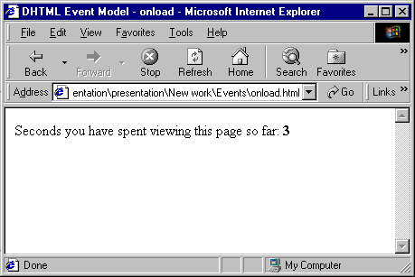
Demonstrating the ONLOAD event

Slide 9
21.4 Error Handling with ONERROR
ONERROR event
  Error dialog box presented by browsers usually confusing to user
  Use ONERROR event to restrain dialog box and handle errors elegantly
  One of few events that pass parameters
    Three parameters:
      Type of error
      URL of file with error
      Line number of error
  Use to prevent incompatible browsers from complaining about scripts they cannot process

Slide 10
1 <!DOCTYPE html PUBLIC "-//W3C//DTD HTML 4.0 Transitional//EN">
2 <HTML>
3
4 <!-- Fig 21.3: onerror.html -->
1.1 Indicate function handleError is to execute when ONERROR event triggered in window object
1.2 Define function handleError
1.3 Return true to event handler to cancel browser’s default response
5 <!-- Demonstrating the ONERROR event -->
6
7 <HEAD>
8 <TITLE>DHTML Event Model - ONERROR</TITLE>
9 <SCRIPT LANGUAGE = "JavaScript">
10
11 // Specify that if an ONERROR event is triggered in the window
12 // function handleError should execute
13 window.onerror = handleError;
14
15 function doThis() {
16 alrrt( "hi" ); // alert misspelled, creates an error
17 }
18
19 // The ONERROR event passes three values to the function: the
20 // name of the error, the url of the file, and the line number.
21 function handleError( errType, errURL, errLineNum )
22 {
23 // Writes to the status bar at the bottom of the window.
24 window.status = "Error: " + errType + " on line " +
25 errLineNum;
26
27 // Returning a value of true cancels the browser’s reaction.
28 return true;
29 }
30
31 </SCRIPT>

Slide 11
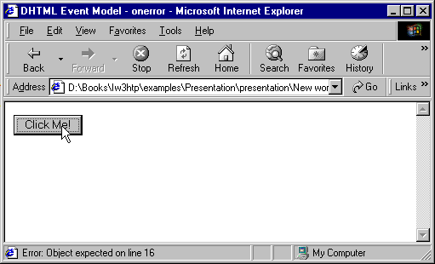
32</HEAD>
33
34<BODY>
35
2. Page rendered by browser
36<INPUT ID = "mybutton" TYPE = "button" VALUE = "Click Me!"
37 ONCLICK = "doThis()">
38
39</BODY>
40</HTML>
Custom error output

Slide 12
21.5 Tracking the Mouse with Event ONMOUSEMOVE
ONMOUSEMOVE event
  Fires constantly whenever mouse in motion
event object
  Contains info about triggered event
  srcElement
    Pointer to element object that triggered event
  offsetX and offsetY
    Give location of mouse cursor relative to top-left corner of object in which event triggered

Slide 13
1<!DOCTYPE html PUBLIC "-//W3C//DTD HTML 4.0 Transitional//EN">
2<HTML>
3
4<!-- Fig 21.4: onmousemove.html -->
Define function updateMouseCoordinates
1.1 Use properties of event object to track mouse cursor
5<!-- Demonstrating the ONMOUSEMOVE event -->
6
7<HEAD>
8<TITLE>DHTML Event Model - ONMOUSEMOVE event</TITLE>
9<SCRIPT LANGUAGE = "JavaScript">
10 function updateMouseCoordinates()
11 {
12 coordinates.innerText = event.srcElement.tagName +
13 " (" + event.offsetX + ", " + event.offsetY + ")";
14 }
15
16</SCRIPT>
17</HEAD>
18
19<BODY ONMOUSEMOVE = "updateMouseCoordinates()">
20
21<SPAN ID = "coordinates">(0, 0)</SPAN><BR>
22<IMG SRC = "deitel.gif" STYLE = "position: absolute; top: 100;
23 left: 100">
24
25</BODY>
26</HTML>

Slide 14
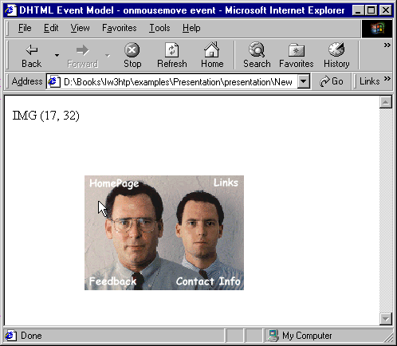
Demonstrating the OMOUSEMOVE event
Updated text (keeps changing as you move the mouse)

Slide 15
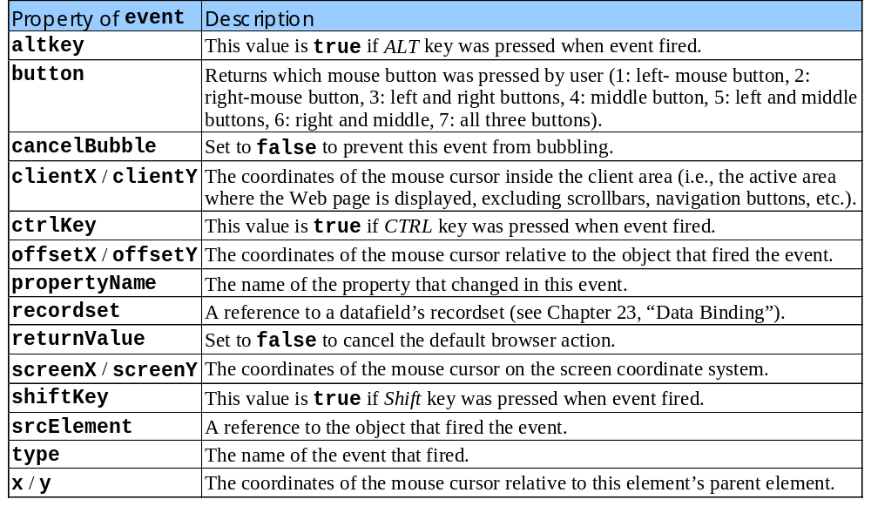
21.5 Tracking the Mouse with Event ONMOUSEMOVE
Properties of the event object

Slide 16
1 <!DOCTYPE html PUBLIC "-//W3C//DTD HTML 4.0 Transitional//EN">
2 <HTML>
3
4 <!-- Fig 21.6: onmouseoverout.html -->
1.1 Pre-load images
1.2 Define functions mOver and mOut
5 <!-- Events ONMOUSEOVER and ONMOUSEOUT -->
6
7 <HEAD>
8 <TITLE>DHTML Event Model - ONMOUSEOVER and ONMOUSEOUT</TITLE>
9 <SCRIPT LANGUAGE = "JavaScript">
10
11 captionImage1 = new Image();
12 captionImage1.src = "caption1.gif";
13 captionImage2 = new Image();
14 captionImage2.src = "caption2.gif";
15
16 function mOver()
17 {
18 if ( event.srcElement.id == "tableCaption" ) {
19 event.srcElement.src = captionImage2.src;
20 return;
21 }
22
23 // If the element which triggered ONMOUSEOVER has an ID,
24 // Change its color to its ID.
25 if ( event.srcElement.id )
26 event.srcElement.style.color = event.srcElement.id;
27 }
28
29 function mOut()
30 {
31 if ( event.srcElement.id == "tableCaption" ) {
32 event.srcElement.src = captionImage1.src;

Slide 17
21.6 Rollovers with ONMOUSEOVER and ONMOUSEOUT
ONMOUSEOVER event
  Fires when mouse cursor moves over an element
ONMOUSEOUT event
  Fires when mouse cursor leaves the element
Combine events for rollover effect
  Pre-load images

Slide 18
33 return;
34 }
35
36 // If it has an ID, change the text inside to the text of
37 // the ID.
38 if ( event.srcElement.id )
39 event.srcElement.innerText = event.srcElement.id;
40 }
41
42 document.onmouseover = mOver;
43 document.onmouseout = mOut;
44
45</SCRIPT>
46</HEAD>
47
48<BODY STYLE = "background-color: wheat">
49
50<H1>Guess the Hex Code's Actual Color</H1>
51
52<P>Can you tell a color from its hexadecimal RGB code value?
53Look at the hex code, guess the color. To see what color it
54corresponds to, move the mouse over the hex code. Moving the
55mouse out will display the color name.</P>
56
57<TABLE STYLE = "width: 50%; border-style: groove;
58 text-align: center; font-family: monospace;
59 font-weight: bold">
60
61 <CAPTION>
62 <IMG SRC = "caption1.gif" ID = "tableCaption">
63 </CAPTION>
64
65 <TR>
66 <TD><A ID = "Black">#000000</A>

Slide 19
67 <TD><A ID = "Blue">#0000FF</A>
68 <TD><A ID = "Magenta">#FF00FF</A>
69 <TD><A ID = "Gray">#808080</A>
70 </TR>
71 <TR>
72 <TD><A ID = "Green">#008000</A>
73 <TD><A ID = "Lime">#00FF00</A>
74 <TD><A ID = "Maroon">#800000</A>
75 <TD><A ID = "Navy">#000080</A>
76 </TR>
77 <TR>
78 <TD><A ID = "Olive">#808000</A>
79 <TD><A ID = "Purple">#800080</A>
80 <TD><A ID = "Red">#FF0000</A>
81 <TD><A ID = "Silver">#C0C0C0</A>
82 </TR>
83 <TR>
84 <TD><A ID = "Cyan">#00FFFF</A>
85 <TD><A ID = "Teal">#008080</A>
86 <TD><A ID = "Yellow">#FFFF00</A>
87 <TD><A ID = "White">#FFFFFF</A>
88 <TR>
89</TABLE>
90
91</BODY>
92</HTML>

Slide 20
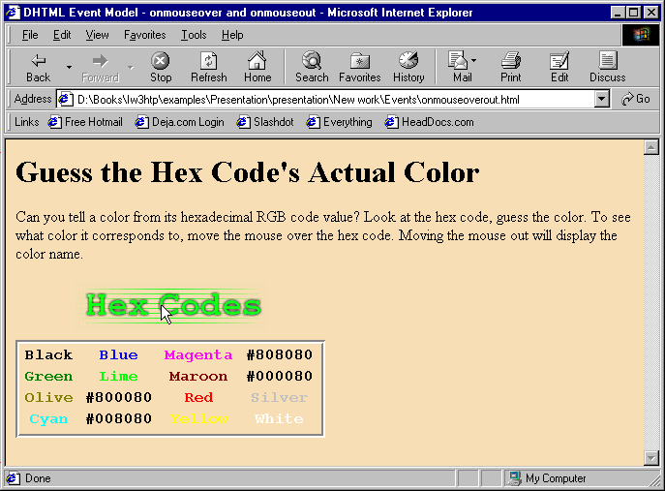
Events ONMOUSEOVER and ONMOUSEOUT

Slide 21
21.7 Form Processing with ONFOCUS and ONBLUR
ONFOCUS event
  Fires when an element gains focus
    User clicks on form field
    User uses Tab key to highlight element
ONBLUR event
  Fires when an element loses focus

Slide 22
1 <!DOCTYPE html PUBLIC "-//W3C//DTD HTML 4.0 Transitional//EN">
2 <HTML>
3
4 <!-- Fig 21.7: onfocusblur.html -->
Use ONFOCUS and ONBLUR events to provide a form with help messages
5 <!-- Demonstrating the ONFOCUS and ONBLUR events -->
6
7 <HEAD>
8 <TITLE>DHTML Event Model - ONFOCUS and ONBLUR</TITLE>
9 <SCRIPT LANGUAGE = "JavaScript">
10
11 var helpArray =
12 [ "Enter your name in this input box.",
13 "Enter your email address in this input box, " +
14 "in the format user@domain.",
15 "Check this box if you liked our site.",
16 "In this box, enter any comments you would " +
17 "like us to read.",
18 "This button submits the form to the " +
19 "server-side script",
20 "This button clears the form",
21 "This TEXTAREA provides context-sensitive " +
22 "help. Click on any input field or use the TAB " +
23 "key to get more information about the input field." ];
24
25 function helpText( messageNum )
26 {
27 myForm.helpBox.value = helpArray[ messageNum ];
28 }
29 </SCRIPT>
30 </HEAD>
31
32 <BODY>

Slide 23
33
34<FORM ID = "myForm">
35Name: <INPUT TYPE = "text" NAME = "name"
36 ONFOCUS = "helpText(0)" ONBLUR = "helpText(6)"><BR>
37Email: <INPUT TYPE = "text" NAME = "email"
38 ONFOCUS = "helpText(1)" ONBLUR = "helpText(6)"><BR>
39Click here if you like this site
40<INPUT TYPE = "checkbox" NAME = "like" ONFOCUS = "helpText(2)"
41 ONBLUR = "helpText(6)"><BR><HR>
42
43Any comments?<BR>
44<TEXTAREA NAME = "comments" ROWS = 5 COLS = 45 ONFOCUS =
45 "helpText(3)" ONBLUR = "helpText(6)"></TEXTAREA><BR>
46<INPUT TYPE = "submit" VALUE = "Submit" ONFOCUS = "helpText(4)"
47 ONBLUR = "helpText(6)">
48<INPUT TYPE = "reset" VALUE = "Reset" ONFOCUS = "helpText(5)"
49 ONBLUR = "helpText(6)">
50
51<TEXTAREA NAME = "helpBox" STYLE = "position: absolute;
52 right: 0; top: 0" ROWS = 4 COLS = 45>
53This TEXTAREA provides context-sensitive help. Click on any
54input field or use the TAB key to get more information about the
55input field.</TEXTAREA>
56</FORM>
57
58</BODY>
59</HTML>

Slide 24
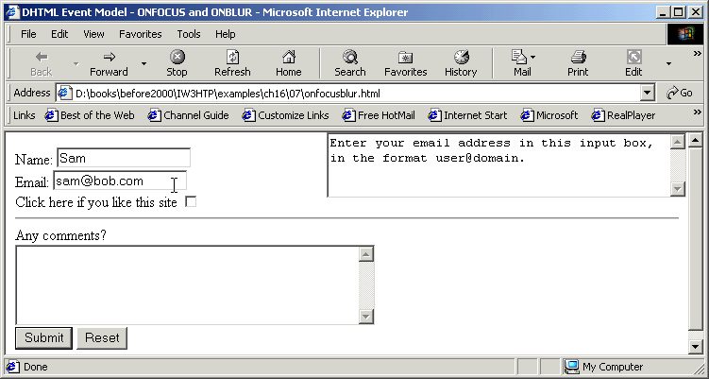
Events ONFOCUS and ONBLUR

Slide 25
21.8 More Form Processing with ONSUBMIT and ONRESET
ONSUBMIT event
  Fires when a form is submitted
ONRESET event
  Fires when a form is reset

Slide 26
1 <!DOCTYPE html PUBLIC "-//W3C//DTD HTML 4.0 Transitional//EN">
2 <HTML>
3
4 <!-- Fig 21.8: onsubmitreset.html -->
Use ONSUBMIT and ONRESET events to confirm the user’s clicking the button
Set returnValue to false to cancel the default action of the event on the element (browser submits form)
5 <!-- Demonstrating the ONSUBMIT and ONRESET events -->
6
7 <HEAD>
8 <TITLE>DHTML Event Model - ONSUBMIT and ONRESET events</TITLE>
9 <SCRIPT LANGUAGE = "JavaScript">
10
11 var helpArray =
12 [ "Enter your name in this input box.",
13 "Enter your email address in this input box, " +
14 "in the format user@domain.",
15 "Check this box if you liked our site.",
16 "In this box, enter any comments you would " +
17 "like us to read.",
18 "This button submits the form to the " +
19 "server-side script",
20 "This button clears the form",
21 "This TEXTAREA provides context-sensitive " +
22 "help. Click on any input field or use the TAB " +
23 "key to get more information about the input field." ];
24
25 function helpText( messageNum )
26 {
27 myForm.helpBox.value = helpArray[ messageNum ];
28 }
29
30 function formSubmit() {
31 window.event.returnValue = false;
32

Slide 27
33 if ( confirm ( "Are you sure you want to submit?" ) )
34 window.event.returnValue = true;
35 }
36
Set returnValue back to true since the user has confirmed that the form should be submitted
37 function formReset() {
38 window.event.returnValue = false;
39
40 if ( confirm ( "Are you sure you want to reset?" ) )
41 window.event.returnValue = true;
42 }
43
44</SCRIPT>
45</HEAD>
46
47<BODY>
48
49<FORM ID = "myForm" ONSUBMIT = "formSubmit()"
50 ONRESET = "formReset()">
51Name: <INPUT TYPE = "text" NAME = "name" ONFOCUS = "helpText(0)"
52 ONBLUR = "helpText(6)"><BR>
53Email: <INPUT TYPE = "text" NAME = "email"
54 ONFOCUS = "helpText(1)" ONBLUR = "helpText(6)"><BR>
55Click here if you like this site
56<INPUT TYPE = "checkbox" NAME = "like" ONFOCUS = "helpText(2)"
57 ONBLUR = "helpText(6)"><HR>
58
59Any comments?<BR>
60<TEXTAREA NAME = "comments" ROWS = 5 COLS = 45
61 ONFOCUS = "helpText(3)" ONBLUR = "helpText(6)"></TEXTAREA><BR>
62<INPUT TYPE = "submit" VALUE = "Submit" ONFOCUS = "helpText(4)"
63 ONBLUR = "helpText(6)">
64<INPUT TYPE = "reset" VALUE = "Reset" ONFOCUS = "helpText(5)"

Slide 28
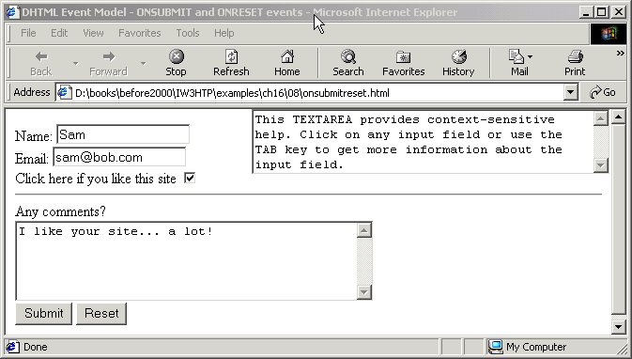
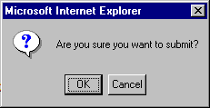
65 ONBLUR = "helpText(6)">
66
67<TEXTAREA NAME = "helpBox" STYLE = "position: absolute; right:0;
68 top: 0" ROWS = 4 COLS = 45>
2. Page rendered by browser
69This TEXTAREA provides context-sensitive help. Click on any
70input field or use the TAB key to get more information about the
71input field.</TEXTAREA>
72</FORM>
73
74</BODY>
75</HTML>

Slide 29
21.9 Event Bubbling
Event bubbling
  Events fired in child elements also “bubble” up to their parent elements for handling
  Cancel bubbling using cancelBubble property of event object
  Forgetting to cancel event bubbling when necessary may cause unexpected results in your scripts

Slide 30
1<!DOCTYPE html PUBLIC "-//W3C//DTD HTML 4.0 Transitional//EN">
2<HTML>
3
4<!-- Fig 21.9: bubbling.html -->
Use cancelBubble property to cancel event bubbling
1.1 Define function documentClick
2.1 P elements pass true or false for event bubbling
5<!-- Disabling event bubbling -->
6
7<HEAD>
8<TITLE>DHTML Event Model - Event Bubbling</TITLE>
9
10<SCRIPT LANGUAGE = "JavaScript">
11 function documentClick()
12 {
13 alert( "You clicked in the document" );
14 }
15
16 function paragraphClick( value )
17 {
18 alert( "You clicked the text" );
19 if ( value )
20 event.cancelBubble = true;
21 }
22
23 document.onclick = documentClick;
24</SCRIPT>
25</HEAD>
26
27<BODY>
28
29<P ONCLICK = "paragraphClick( false )">Click here!</P>
30<P ONCLICK = "paragraphClick( true )">Click here, too!</P>
31</BODY>
32</HTML>

Slide 31
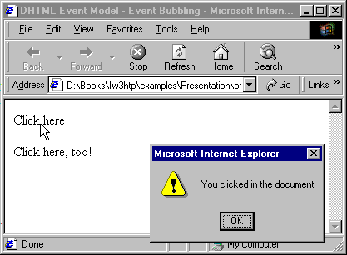

Event bubbling
The event has bubbled up to the document level
The event has been canceled

Slide 32
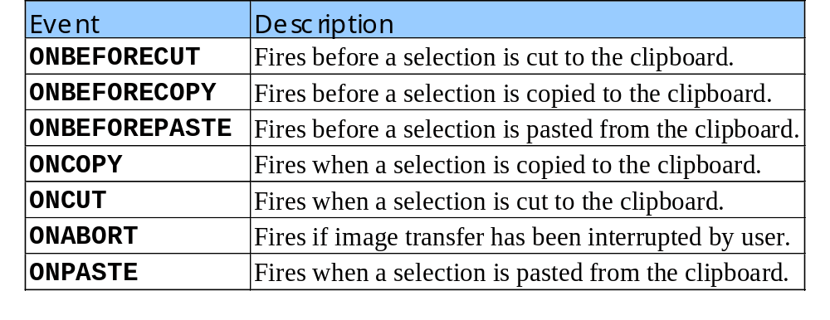
21.10 More DHTML Events
Clipboard events

Slide 33
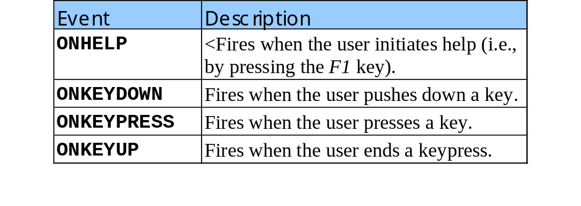
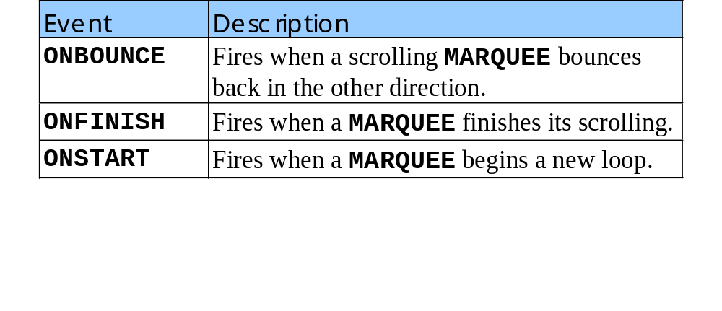
21.10 More DHTML Events
Keyboard events
Marquee Events

Slide 34
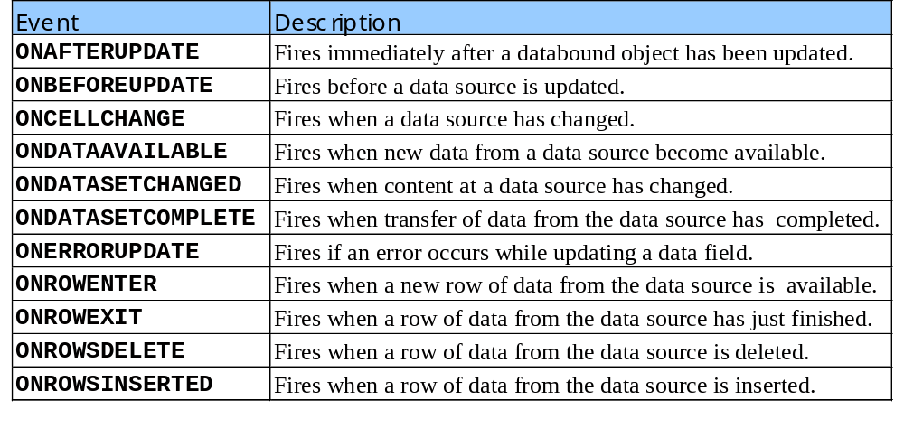
21.10 More DHTML Events
Data binding events

Slide 35
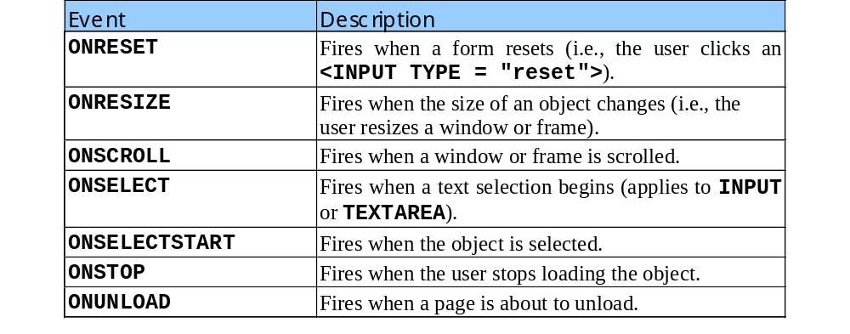
21.10 More DHTML Events
Miscellaneous events
  Continued from previous slide

Slide 36
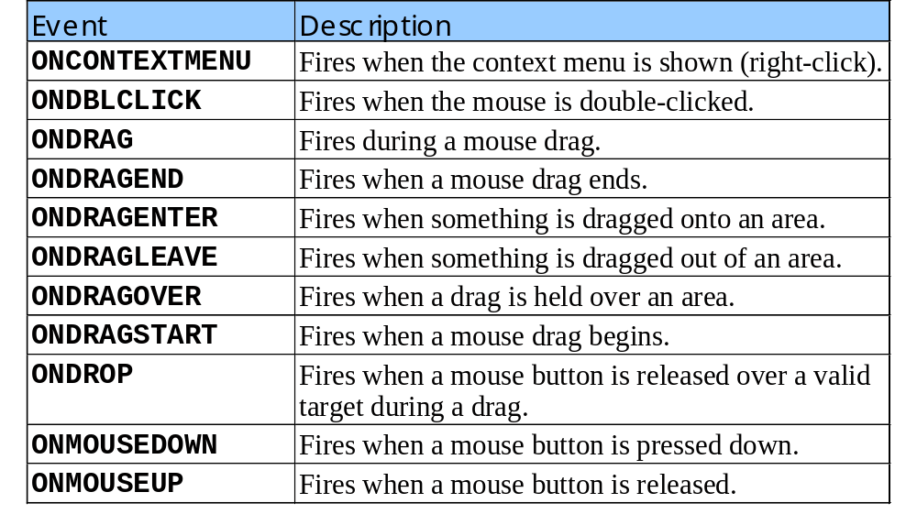
21.10 More DHTML Events
Mouse events

Slide 37
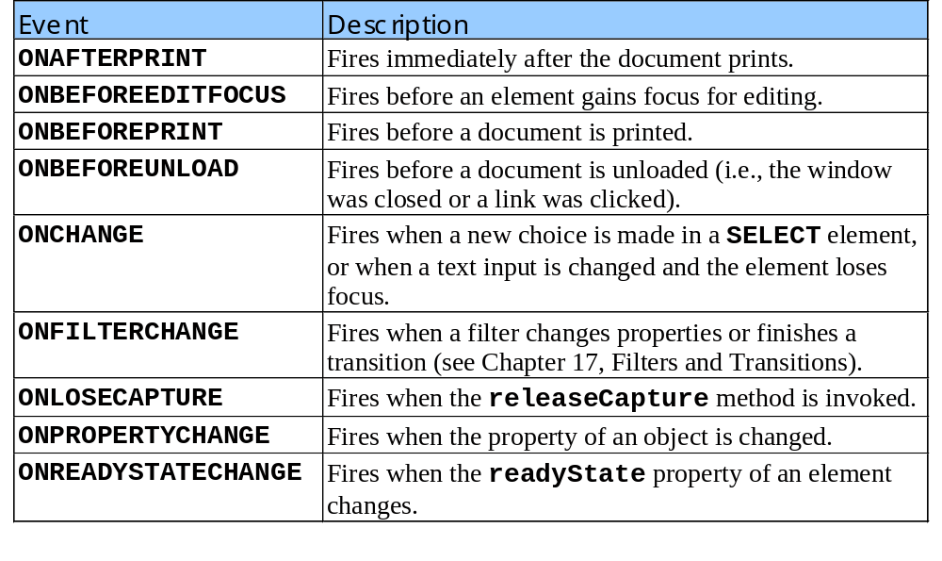
21.10 More DHTML Events
Miscellaneous events

