Slide 1
Chapter 22 – Dynamic HTML:
Filters and Transitions
Outline
22.1 Introduction
22.2 Flip filters: flipv and fliph
22.3 Transparency with the chroma Filter
22.4 Creating Image masks
22.5 Miscellaneous Image filters: invert, gray and xray
22.6 Adding shadows to Text
22.7 Creating Gradients with alpha
22.8 Making Text glow
22.9 Creating Motion with blur
22.10 Using the wave Filter
22.11 Advanced Filters: dropShadow and light
22.12 Transitions I: Filter blendTrans
22.13 Transitions II: Filter revealTrans

Slide 2
22.1 Introduction
Many visual effects implemented in client-side browser
  No server-side processing delays
  DHTML code usually small
Filters
  Cause changes to text and images
  Persistent
Transitions
  Transfer from page to page
  Temporary
Filters and transitions built into Windows IE5
  CSS filter property
  Can only be applied to block-level elements or inline-level elements which have height or width CSS properties set

Slide 3
22.2 Flip filters: flipv and fliph
flipv filter
  Mirrors text or images vertically
fliph filter
  Mirrors text or images horizontally
Filters applied in the STYLE attribute
  <TD STYLE = “filter: flipv fliph”>

Slide 4
1<!DOCTYPE html PUBLIC "-//W3C//DTD HTML 4.0 Transitional//EN">
2<HTML>
3
4<!-- Fig. 22.1: flip.html -->
5<!-- Using the flip filters -->
Apply flipv and fliph filters using the STYLE attribute
6
7<HEAD>
8<TITLE>The flip filter</TITLE>
9
10<STYLE TYPE = "text/css">
11 BODY { background-color: #CCFFCC }
12
13 TABLE { font-size: 3em;
14 font-family: Arial, sans-serif;
15 background-color: #FFCCCC;
16 border-style: ridge ;
17 border-collapse: collapse }
18
19 TD { border-style: groove;
20 padding: 1ex }
21</STYLE>
22</HEAD>
23
24<BODY>
25
26<TABLE>
27
28 <TR>
29 <!-- Filters are applied in style declarations -->
30 <TD STYLE = "filter: fliph">Text</TD>
31 <TD>Text</TD>
32 </TR>
33

Slide 5
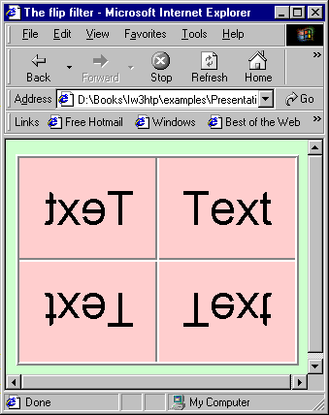
34 <TR>
35 <!-- More than one filter can be applied at once -->
36 <TD STYLE = "filter: flipv fliph">Text</TD>
37 <TD STYLE = "filter: flipv">Text</TD>
2. Page rendered by browser
38 </TR>
39
40 </TABLE>
41
42 </BODY>
43 </HTML>

Slide 6
22.3 Transparency with the chroma Filter
chroma filter
  Apply transparency effects dynamically
Each filter has a property enabled
  If set to true, filter applied
  If set to false, filter not applied
ONCHANGE event
  Fires whenever the VALUE of a form field changes

Slide 7
1<!DOCTYPE html PUBLIC "-//W3C//DTD HTML 4.0 Transitional//EN">
2<HTML>
3
4<!-- Fig 22.2: chroma.html -->
Define function changecolor
1.1 use parseInt function to convert value to hexadecimal integer
5<!-- Applying transparency using the chroma filter -->
6
7<HEAD>
8<TITLE>Chroma Filter</TITLE>
9
10<SCRIPT LANGUAGE = "JavaScript">
11
12 function changecolor()
13 {
14 if ( colorSelect.value ) { // if the user selected a color,
15
16 // parse the value to hex and set the filter color.
17 chromaImg.filters( "chroma" ).color =
18 parseInt( colorSelect.value, 16 );
19 chromaImg.filters( "chroma" ).enabled = true;
20 }
21 else // if the user selected "None",
22
23 // disable the filter.
24 chromaImg.filters( "chroma" ).enabled = false;
25 }
26
27</SCRIPT>
28</HEAD>
29
30<BODY>
31
32<H1>Chroma Filter:</H1>

Slide 8
33
34<IMG ID = "chromaImg" SRC = "trans.gif" STYLE =
35 "position: absolute; filter: chroma">
36
37<!-- The ONCHANGE event fires when a selection is changed -->
38<SELECT ID = "colorSelect" ONCHANGE = "changecolor()">
39 <OPTION VALUE = "">None
40 <OPTION VALUE = "00FFFF">Cyan
41 <OPTION VALUE = "FFFF00">Yellow
42 <OPTION VALUE = "FF00FF">Magenta
43 <OPTION VALUE = "000000" SELECTED>Black
44</SELECT>
45
46</BODY>
47</HTML>

Slide 9
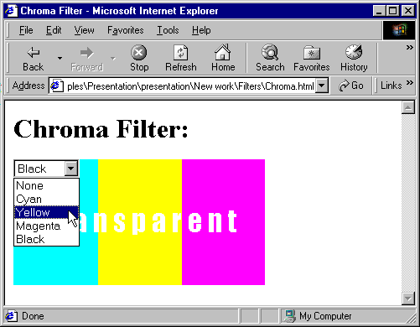
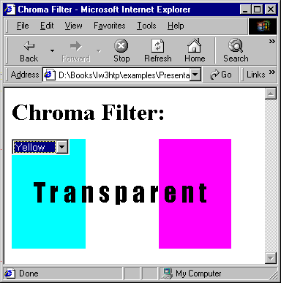
Changing values of the chroma filter

Slide 10
22.4 Creating Image masks
mask filter
  Create an image mask
    Background of element solid color
    Foreground of element transparent to image or color behind
    color parameter specifies mask color

Slide 11
1<!DOCTYPE html PUBLIC "-//W3C//DTD HTML 4.0 Transitional//EN">
2<HTML>
3
4<!-- Fig 22.3: mask.html -->
Applying mask filter
1.1 Specify color parameter
5<!-- Placing a mask over an image -->
6
7<HEAD>
8<TITLE>Mask Filter</TITLE>
9</HEAD>
10
11<BODY>
12
13<H1>Mask Filter</H1>
14
15<!-- Filter parameters are specified in parentheses, in -->
16<!-- the form param1 = value1, param2 = value2, etc. -->
17<DIV STYLE = "position: absolute; top: 125; left: 20;
18 filter: mask( color = #CCFFFF )">
19<H1 STYLE = "font-family: Courier, monospace">
20AaBbCcDdEeFfGgHhIiJj<BR>
21KkLlMmNnOoPpQqRrSsTt
22</H1>
23</DIV>
24
25<IMG SRC = "gradient.gif" WIDTH = "400" HEIGHT = "200">
26</BODY>
27</HTML>

Slide 12
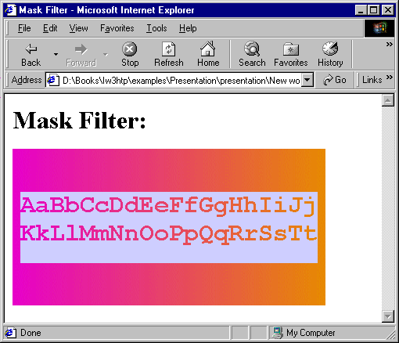
Using the mask filter

Slide 13
22.5 Miscellaneous Image filters: invert, gray and xray
invert filter
  Negative image effect
    Dark areas become light
    Light areas become dark
  Good use of invert filter:
    Signify something has just been clicked or selected
gray filter
  Grayscale image effect
    Color stripped from image
    All that remains is brightness data
xray filter
  Xray effect
    Inversion of grayscale effect

Slide 14
1<!DOCTYPE html PUBLIC "-//W3C//DTD HTML 4.0 Transitional//EN">
2<HTML>
3
4<!-- Fig 22.4: misc.html -->
Apply invert, gray and xray filters to harvey.jpg
5<!-- Image filters to invert, grayscale, or xray an image -->
6
7<HEAD>
8<TITLE>Misc. Image filters</TITLE>
9
10<STYLE TYPE = "text/css">
11 .cap { font-weight: bold;
12 background-color: #DDDDAA;
13 text-align: center }
14</STYLE>
15</HEAD>
16
17<BODY>
18<TABLE>
19 <TR CLASS = "cap">
20 <TD>Normal</TD>
21 <TD>Grayscale</TD>
22 <TD>Xray</TD>
23 <TD>Invert</TD>
24 </TR>
25
26 <TR>
27 <TD><IMG SRC = "harvey.jpg"></TD>
28 <TD><IMG SRC = "harvey.jpg" STYLE = "filter: gray"></TD>
29 <TD><IMG SRC = "harvey.jpg" STYLE = "filter: xray"></TD>
30 <TD><IMG SRC = "harvey.jpg" STYLE = "filter: invert"></TD>
31 </TR>

Slide 15
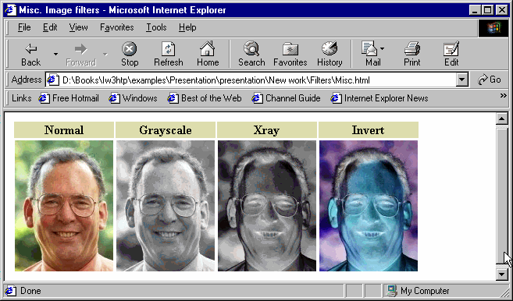
32 </TABLE>
33
34 </BODY>
35 </HTML>
2. Page rendered by browser

Slide 16
22.6 Adding shadows to Text
shadow filter
  Creates shadowing effect
  Property direction
    Direction of shadow
    0 (up), 45 (above-right), 90 (right), 135 (below-right), 180 (below), 225 (below-left), 270 (left) and 315 (above-left)
  Property color
Increase padding if cut off by element borders

Slide 17
1<!DOCTYPE html PUBLIC "-//W3C//DTD HTML 4.0 Transitional//EN">
2<HTML>
3
4<!-- Fig 22.5: shadow.html -->
Define function runDemo to cycle through all values of direction property
5<!-- Applying the shadow filter -->
6
7<HEAD>
8<TITLE>Shadow Filter</TITLE>
9
10<SCRIPT LANGUAGE = "JavaScript">
11 var shadowDirection = 0;
12
13 function start()
14 {
15 window.setInterval( "runDemo()", 500 );
16 }
17
18 function runDemo()
19 {
20 shadowText.innerText =
21 "Shadow Direction: " + shadowDirection % 360;
22 shadowText.filters( "shadow" ).direction =
23 ( shadowDirection % 360 );
24 shadowDirection += 45;
25 }
26</SCRIPT>
27</HEAD>
28
29<BODY ONLOAD = "start()">
30
31<H1 ID = "shadowText" STYLE = "position: absolute; top: 50;

Slide 18
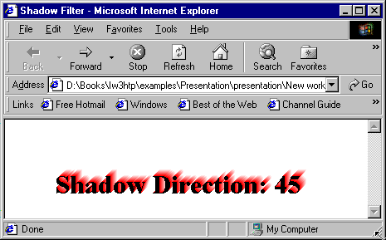
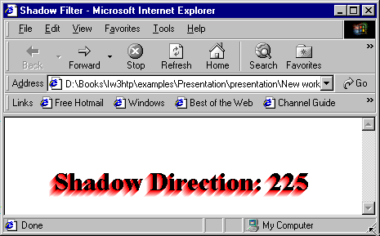
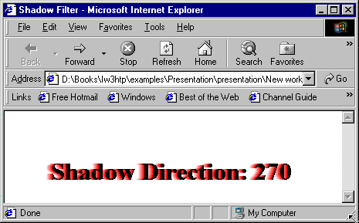
32 left: 50; padding: 10; filter: shadow( direction = 0,
33 color = red )">Shadow Direction: 0</H1>
34</BODY>
35</HTML>
2. Page rendered by browser (at different times)
2.1 Apply padding so shadow effect is not cut off

Slide 19
22.7 Creating Gradients with alpha
Gradient effect
  Gradual progression from starting color to target color
alpha filter
  style property
    What style opacity applied
      0: uniform opacity
      1: linear gradient
      2: circular gradient
      3: rectangular gradient
  opacity and finishopacity properties
    Percentages for opacity of specified gradient
  startX, startY, finishX, finishY
    Specify x-y coordinates for start and finish of gradient

Slide 20
1<!DOCTYPE html PUBLIC "-//W3C//DTD HTML 4.0 Transitional//EN">
2<HTML>
3
4<!-- Fig 22.6: alpha.html -->
Applying the alpha filter to a DIV element containing an image
5<!-- Applying the alpha filter to an image -->
6
7<HEAD>
8<TITLE>Alpha Filter</TITLE>
9<SCRIPT LANGUAGE = "JavaScript">
10 function run()
11 {
12 pic.filters( "alpha" ).opacity = opacityButton.value;
13 pic.filters( "alpha" ).finishopacity = opacityButton2.value;
14 pic.filters( "alpha" ).style = styleSelect.value;
15 }
16</SCRIPT>
17</HEAD>
18
19<BODY>
20
21<DIV ID = "pic"
22 STYLE = "position: absolute; left:0; top: 0;
23 filter: alpha( style = 2, opacity = 100,
24 finishopacity = 0 )">
25 <IMG SRC = "flag.gif">
26</DIV>
27
28<TABLE STYLE = "position: absolute; top: 250; left: 0;
29 background-color: #CCFFCC" BORDER = "1">
30
31 <TR>
32 <TD>Opacity (0-100):</TD>

Slide 21
33 <TD><INPUT TYPE = "text" ID = "opacityButton" SIZE = "3"
34 MAXLENGTH = "3" VALUE = "100"></TD>
35 </TR>
36
37 <TR>
38 <TD>FinishOpacity (0-100):</TD>
39 <TD><INPUT TYPE = "text" ID = "opacityButton2" SIZE = "3"
40 MAXLENGTH = "3" VALUE = "0"></TD>
41 </TR>
42
43 <TR>
44 <TD>Style:</TD>
45 <TD><SELECT ID = "styleSelect">
46 <OPTION VALUE = "1">Linear
47 <OPTION VALUE = "2" SELECTED>Circular
48 <OPTION VALUE = "3">Rectangular
49 </SELECT></TD>
50 </TR>
51
52 <TR>
53 <TD ALIGN = "center" COLSPAN = "2"><INPUT TYPE = "button"
54 VALUE = "Apply" ONCLICK = "run()"></TD>
55 </TR>
56</TABLE>
57
58</BODY>
59</HTML>

Slide 22
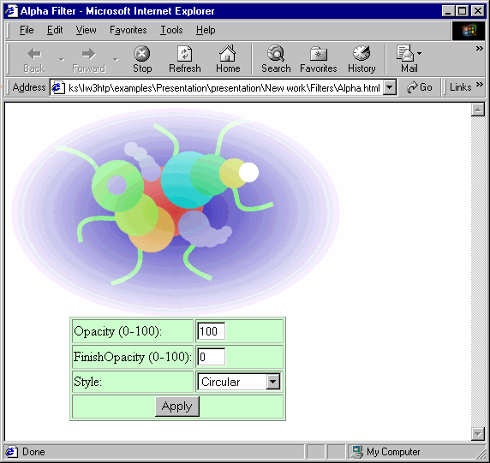
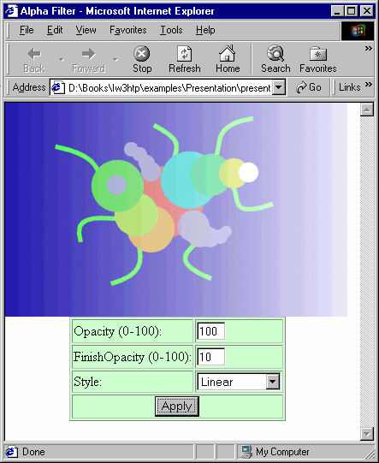
Applying the alpha filter

Slide 23
22.8 Making Text glow
glow filter
  Add aura of color around text
  Specify color and strength
  Add padding if large strength cuts off effect with element borders

Slide 24
1 <!DOCTYPE html PUBLIC "-//W3C//DTD HTML 4.0 Transitional//EN">
2 <HTML>
3
4 <!-- Fig 22.7: glow.html -->
1.1 Define functions apply, startdemo and rundemo
5 <!-- Applying the glow filter -->
6
7 <HEAD>
8 <TITLE>Glow Filter</TITLE>
9 <SCRIPT LANGUAGE = "JavaScript">
10 var strengthIndex = 1;
11 var counter = 1;
12 var upDown = true;
13 var colorArray = [ "FF0000", "FFFF00", "00FF00",
14 "00FFFF", "0000FF", "FF00FF" ];
15 function apply()
16 {
17 glowSpan.filters( "glow" ).color =
18 parseInt( glowColor.value, 16);
19 glowSpan.filters( "glow" ).strength =
20 glowStrength.value;
21 }
22
23 function startdemo()
24 {
25 window.setInterval( "rundemo()", 150 );
26 }
27
28 function rundemo()
29 {
30 if ( upDown )
31 glowSpan.filters( "glow" ).strength = strengthIndex++;

Slide 25
32 else
33 glowSpan.filters( "glow" ).strength = strengthIndex--;
34
35 if ( strengthIndex == 1 ) {
1.2 Apply glow filter to SPAN element containing text
2. Increase padding so effect is not cut off by element borders
36 upDown = !upDown;
37 counter++;
38 glowSpan.filters( "glow" ).color =
39 parseInt( colorArray[ counter % 6 ], 16 );
40 }
41
42 if ( strengthIndex == 10 ) {
43 upDown = !upDown;
44 }
45 }
46</SCRIPT>
47</HEAD>
48
49<BODY STYLE = "background-color: #00AAAA">
50<H1>Glow Filter:</H1>
51
52<SPAN ID = "glowSpan" STYLE = "position: absolute; left: 200;
53 top: 100; padding: 5; filter: glow( color = red,
54 strength = 5 )">
55 <H2>Glowing Text</H2>
56</SPAN>
57
58<TABLE BORDER = 1 STYLE = "background-color: #CCFFCC">
59 <TR>
60 <TD>Color (Hex)</TD>
61 <TD><INPUT ID = "glowColor" TYPE = "text" SIZE = 6
62 MAXLENGTH = 6 VALUE = FF0000></TD>

Slide 26
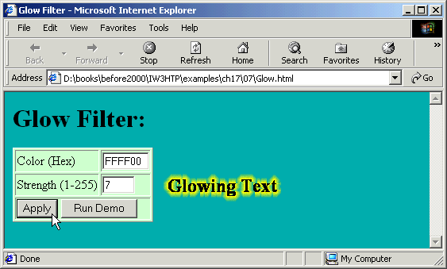
63 </TR>
64 <TR>
65 <TD>Strength (1-255)</TD>
66 <TD><INPUT ID = "glowStrength" TYPE = "text" SIZE = 3
67 MAXLENGTH = 3 VALUE = 5></TD>
2. Page rendered by browser
68 </TR>
69 <TR>
70 <TD COLSPAN = 2>
71 <INPUT TYPE = "BUTTON" VALUE = "Apply"
72 ONCLICK = "apply()">
73 <INPUT TYPE = "BUTTON" VALUE = "Run Demo"
74 ONCLICK = "startdemo()"></TD>
75 </TR>
76</TABLE>
77
78</BODY>
79</HTML>

Slide 27
22.9 Creating Motion with blur
blur filter
  Creates illusion of motion
  Blurs text or images in a certain direction
  Three properties:
    add
      true adds a copy of original image over blurred image
    direction
      Angular form (like shadow filter)
    strength
      Strength of blur effect

Slide 28
1 <!DOCTYPE html PUBLIC "-//W3C//DTD HTML 4.0 Transitional//EN">
2 <HTML>
3
4 <!-- Fig 22.8: blur.html -->
Using the blur filter
1.2 Various blur parameters
5 <!-- The blur filter -->
6
7 <HEAD>
8 <TITLE>Blur Filter</TITLE>
9 <SCRIPT LANGUAGE = "JavaScript">
10 var strengthIndex = 1;
11 var blurDirection = 0;
12 var upDown = 0;
13 var timer;
14
15 function reBlur()
16 {
17 blurImage.filters( "blur" ).direction =
18 document.forms( "myForm" ).Direction.value;
19 blurImage.filters( "blur" ).strength =
20 document.forms( "myForm" ).Strength.value;
21 blurImage.filters( "blur" ).add =
22 document.forms( "myForm" ).Add.checked;
23 }
24
25 function startDemo()
26 {
27 timer = window.setInterval( "runDemo()", 5 );
28 }
29
30 function runDemo( )
31 {
32 document.forms( "myForm" ).Strength.value = strengthIndex;

Slide 29
33 document.forms( "myForm" ).Direction.value =
34 ( blurDirection % 360 );
35
36 if( strengthIndex == 35 || strengthIndex == 0 )
37 upDown = !upDown;
38
39 blurImage.filters( "blur" ).strength =
40 ( upDown ? strengthIndex++ : strengthIndex-- );
41
42 if ( strengthIndex == 0 )
43 blurImage.filters( "blur" ).direction =
44 ( ( blurDirection += 45 ) % 360 );
45 }
46
47</SCRIPT>
48</HEAD>
49
50<BODY>
51<FORM NAME = "myForm">
52
53<TABLE BORDER = "1" STYLE = "background-color: #CCFFCC">
54<CAPTION>Blur filter controls</CAPTION>
55
56 <TR>
57 <TD>Direction:</TD>
58 <TD><SELECT NAME = "Direction">
59 <OPTION VALUE = "0">above
60 <OPTION VALUE = "45">above-right
61 <OPTION VALUE = "90">right
62 <OPTION VALUE = "135">below-right
63 <OPTION VALUE = "180">below
64 <OPTION VALUE = "225">below-left

Slide 30
97<DIV ID = "blurImage" STYLE = "position: absolute; top: 0;
98 left: 300; padding: 0; filter:
99 blur( add = 0, direction = 0, strength = 0 );
100 background-color: white;">
2. Apply blur filter to DIV element containing an image
101 <IMG ALIGN = "center" SRC = "shapes.gif">
102</DIV>
103
104</BODY>
105</HTML>

Slide 31
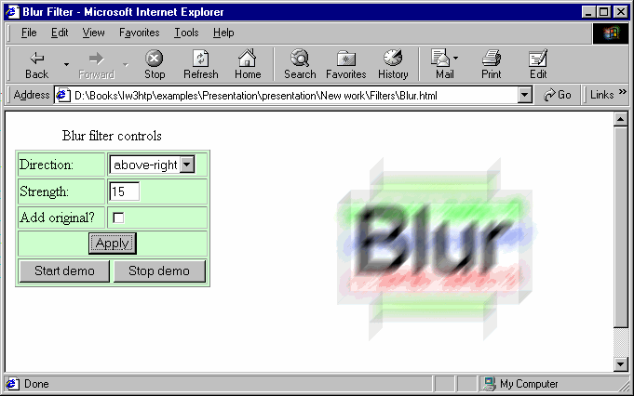
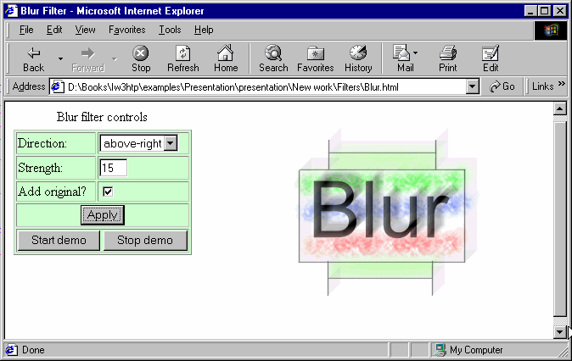
Using the blur filter with the add property false, then true

Slide 32
22.10 Using the wave Filter
wave filter
  Apply sine-wave distortions to text and images
  Properties:
    add
      Adds a copy of text or image underneath filtered effect
    freq
      Frequency of sine wave
        How many complete sine waves applied
    phase
      Phase shift of sine wave
    strength
      Amplitude of sine wave
  Processor intensive

Slide 33
1<!DOCTYPE html PUBLIC "-//W3C//DTD HTML 4.0 Transitional//EN">
2<HTML>
3
4<!-- Fig 22.9: wave.html -->
Define function start to demonstrate wave filter (with various parameter settings)
5<!-- Applying the wave filter -->
6
7<HEAD>
8<TITLE>Wave Filter</TITLE>
9
10<SCRIPT LANGUAGE = "JavaScript">
11 var wavePhase = 0;
12
13 function start()
14 {
15 window.setInterval( "wave()", 5 );
16 }
17
18 function wave()
19 {
20 wavePhase++;
21 flag.filters( "wave" ).phase = wavePhase;
22 }
23</SCRIPT>
24</HEAD>
25
26<BODY ONLOAD = "start();">
27
28<SPAN ID = "flag"
29 STYLE = "align: center; position: absolute;
30 left: 30; padding: 15;
31 filter: wave(add = 0, freq = 1, phase = 0, strength = 10)">

Slide 34
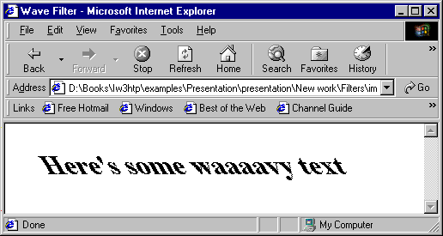


32 <H1>Here's some waaaavy text</H1>
33 </SPAN>
34
35 </BODY>
2. Page rendered by browser (at different times)
36 </HTML>

Slide 35
22.11 Advanced Filters: dropShadow and light
dropShadow filter
  Places blacked-out version of image behind original image
  Offset by specified number of pixels
    offx and offy properties
  color property

Slide 36
22.11 Advanced Filters: dropShadow and light
Light filter
  Simulates effect of light source
  addPoint method
    Adds point light source
  addPoint (xSource, ySource, height, R, G, B, strength%);
  addCone method
    Adds a cone light source
    addCone (xSource, ySource, height, xTarget,
    yTarget, R, G, B, strength%);

Slide 37
1 <!DOCTYPE html PUBLIC "-//W3C//DTD HTML 4.0 Transitional//EN">
2 <HTML>
3
4 <!-- Fig 22.10: dropshadow.html -->
1.1 Define function setLight
1.2 Use method addPoint to add a point light source
1.3 Use method moveLight to update position of light source
5 <!-- Using the light filter with the dropshadow filter -->
6
7 <HEAD>
8 <TITLE>DHTML dropShadow and light Filters</TITLE>
9
10 <SCRIPT LANGUAGE = "JavaScript">
11 function setlight( )
12 {
13 dsImg.filters( "light" ).addPoint( 150, 150,
14 125, 255, 255, 255, 100);
15 }
16
17 function run()
18 {
19 eX = event.offsetX;
20 eY = event.offsetY;
21
22 xCoordinate = Math.round( eX-event.srcElement.width/2, 0 );
23 yCoordinate = Math.round( eY-event.srcElement.height/2, 0 );
24
25 dsImg.filters( "dropShadow" ).offx = xCoordinate / -3;
26 dsImg.filters( "dropShadow" ).offy = yCoordinate / -3;
27
28 dsImg.filters( "light" ).moveLight(0, eX, eY, 125, 1);
29 }
30 </SCRIPT>
31 </HEAD>
32

Slide 38
33<BODY ONLOAD = "setlight()" STYLE = "background-color: green">
34
35<IMG ID = "dsImg" SRC = "circle.gif"
36 STYLE = "top: 100; left: 100; filter: dropShadow( offx = 0,
2. Add dropShadow and light filters to IMG element
37 offy = 0, color = black ) light()" ONMOUSEMOVE = "run()">
38
39</BODY>
40</HTML>

Slide 39
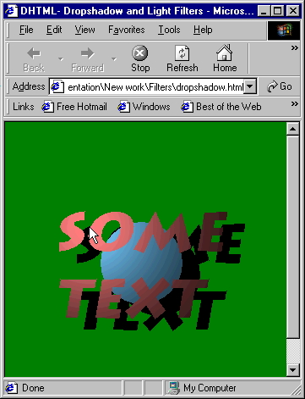
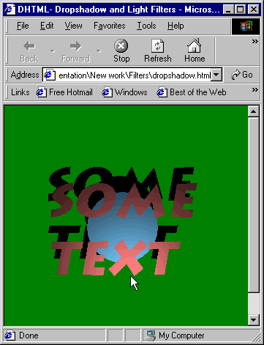
Applying light filter with a dropShadow

Slide 40
1 <!DOCTYPE html PUBLIC "-//W3C//DTD HTML 4.0 Transitional//EN">
2 <HTML>
3
4 <!-- Fig 22.11: conelight.html -->
Use addCone method to add cone light source
5 <!-- Automating the cone light source -->
6
7 <HEAD><TITLE>Cone lighting</TITLE>
8
9 <SCRIPT LANGUAGE = "JavaScript">
10 var upDown = true;
11 var counter = 0;
12 var moveRate = -2;
13
14 function setLight()
15 {
16 marquee.filters( "light" ).addCone( 0, marquee.height, 8,
17 marquee.width/2, 30, 255, 150, 255, 50, 15 );
18 marquee.filters( "light" ).addCone( marquee.width,
19 marquee.height, 8, 200, 30, 150, 255, 255, 50, 15 );
20 marquee.filters( "light" ).addCone( marquee.width/2,
21 marquee.height, 4, 200, 100, 255, 255, 150, 50, 50 );
22
23 window.setInterval( "moveLight()", 100 );
24 }
25
26 function moveLight()
27 {
28 counter++;
29
30 if ( ( counter % 30 ) == 0 )
31 upDown = !upDown;
32

Slide 41
33 if ( ( counter % 10 ) == 0 )
34 moveRate *= -1;
35
36 if ( upDown ) {
2. moveLight method, when used with cone source, moves the target of the light
37 marquee.filters( "light" ).moveLight( 0,-1,-1,3,0 );
38 marquee.filters( "light" ).moveLight( 1,1,-1,3,0 );
39 marquee.filters( "light" ).moveLight(2,moveRate,0,3,0);
40 }
41 else {
42 marquee.filters( "light" ).moveLight( 0,1,1,3,0 );
43 marquee.filters( "light" ).moveLight( 1,-1,1,3,0 );
44 marquee.filters( "light" ).moveLight(2,moveRate,0,3,0);
45 }
46 }
47</SCRIPT>
48
49<BODY STYLE = "background-color: #000000" ONLOAD = "setLight()">
50
51<IMG ID = "marquee" SRC = "marquee.gif"
52 STYLE = "filter: light; position: absolute; left: 100;
53 top: 100">
54
55</BODY>
56</HTML>

Slide 42
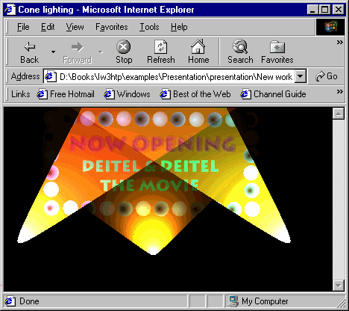
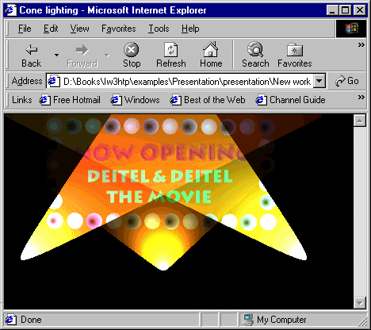
Dynamic cone source lighting

Slide 43
22.12 Transitions I: Filter blendTrans
Transitions
  Set as values of filter CSS property
blendTrans transition
  Creates a smooth fade-in/fade-out effect
  Parameter duration
    Determines how long the transition will take

Slide 44
1<!DOCTYPE html PUBLIC "-//W3C//DTD HTML 4.0 Transitional//EN">
2<HTML>
3
4<!-- Fig 22.12: blendtrans.html -->
1.1 apply method initializes transition
1.2 Set visibility of element to hidden; takes effect when invoke play
5<!-- Blend transition -->
6
7<HEAD>
8<TITLE>Using blendTrans</TITLE>
9
10<SCRIPT LANGUAGE = "JavaScript">
11 function blendOut()
12 {
13 textInput.filters( "blendTrans" ).apply();
14 textInput.style.visibility = "hidden";
15 textInput.filters( "blendTrans" ).play();
16 }
17</SCRIPT>
18</HEAD>
19
20<BODY>
21
22<DIV ID = "textInput" ONCLICK = "blendOut()"
23 STYLE = "width: 300; filter: blendTrans( duration = 3 )">
24 <H1>Some fading text</H1>
25</DIV>
26
27</BODY>
28</HTML>

Slide 45
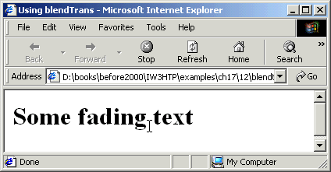
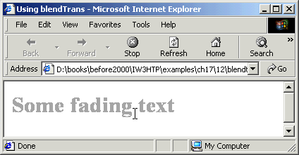
Using the blendTrans transition

Slide 46
1 <!DOCTYPE html PUBLIC "-//W3C//DTD HTML 4.0 Transitional//EN">
2 <HTML>
3
4 <!-- Fig 22.13: blendtrans2.html -->
1.1 Define blend function
1.2 zIndex is JavaScript’s version of z-index
5 <!-- Blend Transition -->
6
7 <HEAD>
8 <TITLE>Blend Transition II</TITLE>
9
10 <SCRIPT LANGUAGE = "JavaScript">
11 var whichImage = true;
12
13 function blend()
14 {
15 if ( whichImage ) {
16 image1.filters( "blendTrans" ).apply();
17 image1.style.visibility = "hidden";
18 image1.filters( "blendTrans" ).play();
19 }
20 else {
21 image2.filters( "blendTrans" ).apply();
22 image2.style.visibility = "hidden";
23 image2.filters( "blendTrans" ).play();
24 }
25 }
26
27 function reBlend ( fromImage )
28 {
29 if ( fromImage ) {
30 image1.style.zIndex -= 2;
31 image1.style.visibility = "visible";
32 }

Slide 47
33 else {
34 image1.style.zIndex += 2;
35 image2.style.visibility = "visible";
36 }
1.3 BODY tag’s ONLOAD event calls function blend
37
38 whichImage = !whichImage;
39 blend();
40 }
41</SCRIPT>
42</HEAD>
43
44<BODY STYLE = "color: darkblue; background-color: lightblue"
45 ONLOAD = "blend()">
46
47<H1>Blend Transition Demo</H1>
48
49<IMG ID = "image2" SRC = "cool12.jpg"
50 ONFILTERCHANGE = "reBlend( false )"
51 STYLE = "position: absolute; left: 50; top: 50; width: 300;
52 filter: blendTrans( duration = 4 ); z-index: 1">
53
54<IMG ID = "image1" SRC = "cool8.jpg"
55 ONFILTERCHANGE = "reBlend( true )"
56 STYLE = "position: absolute; left: 50; top: 50; width: 300;
57 filter: blendTrans( duration = 4 ); z-index: 2">
58
59</BODY>
60</HTML>

Slide 48
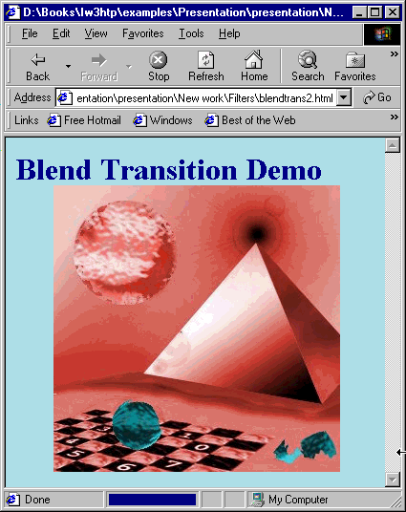
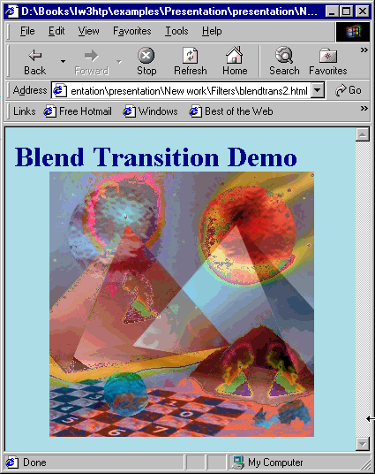
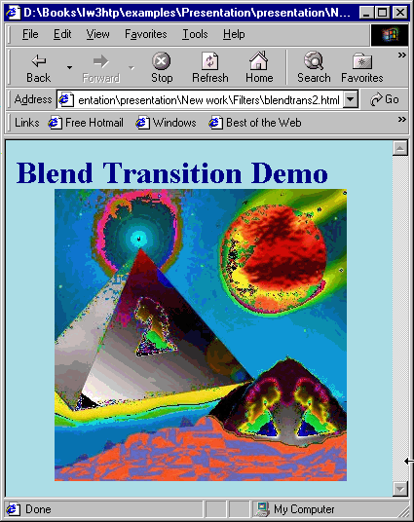
Blending between images with blendTrans

Slide 49
22.13 Transitions II: Filter revealTrans
revealTrans filter
  Transition using professional-style transitions
  From box out to random dissolve
  24 different transitions

Slide 50
1 <!DOCTYPE html PUBLIC "-//W3C//DTD HTML 4.0 Transitional//EN">
2 <HTML>
3
4 <!-- Fig 22.14: revealtrans.html -->
Cycle through 24 transitions using revealTrans
1.1 Create array containing different transition names
5 <!-- Cycling through 24 transitions -->
6 <HEAD>
7 <TITLE>24 DHTML Transitions</TITLE>
8
9 <SCRIPT>
10 var transitionName =
11 ["Box In", "Box Out",
12 "Circle In", "Circle Out",
13 "Wipe Up", "Wipe Down", "Wipe Right", "Wipe Left",
14 "Vertical Blinds", "Horizontal Blinds",
15 "Checkerboard Across", "Checkerboard Down",
16 "Random Dissolve",
17 "Split Vertical In", "Split Vertical Out",
18 "Split Horizontal In", "Split Horizontal Out",
19 "Strips Left Down", "Strips Left Up",
20 "Strips Right Down", "Strips Right Up",
21 "Random Bars Horizontal", "Random Bars Vertical",
22 "Random"];
23
24 var counter = 0;
25 var whichImage = true;
26
27 function blend()
28 {
29 if ( whichImage ) {
30 image1.filters( "revealTrans" ).apply();
31 image1.style.visibility = "hidden";
32 image1.filters( "revealTrans" ).play();

Slide 51
33 }
34 else {
35 image2.filters( "revealTrans" ).apply();
36 image2.style.visibility = "hidden";
37 image2.filters( "revealTrans" ).play();
38 }
39 }
40
41 function reBlend( fromImage )
42 {
43 counter++;
44
45 if ( fromImage ) {
46 image1.style.zIndex -= 2;
47 image1.style.visibility = "visible";
48 image2.filters("revealTrans").transition = counter % 24;
49 }
50 else {
51 image1.style.zIndex += 2;
52 image2.style.visibility = "visible";
53 image1.filters("revealTrans").transition = counter % 24;
54 }
55
56 whichImage = !whichImage;
57 blend();
58 transitionDisplay.innerHTML = "Transition " + counter % 24 +
59 ":<BR> " + transitionName[ counter % 24 ];
60 }
61 </SCRIPT>
62 </HEAD>
63
64 <BODY STYLE = "color: white; background-color: lightcoral"

Slide 52
65 ONLOAD = "blend()">
66
67 <IMG ID = "image2" SRC = "icontext.gif"
68 STYLE = "position: absolute; left: 10; top: 10;
69 width: 300; z-index:1; visibility: visible;
70 filter: revealTrans( duration = 2, transition = 0 )"
71 ONFILTERCHANGE = "reBlend( false )">
72
73 <IMG ID = "image1" SRC = "icons2.gif"
74 STYLE = "position: absolute; left: 10; top: 10;
75 width: 300; z-index:1; visibility: visible;
76 filter: revealTrans( duration = 2, transition = 0 )"
77 ONFILTERCHANGE = "reBlend( true )">
78
79<DIV ID = "transitionDisplay" STYLE = "position: absolute;
80 top: 10; left: 325">Transition 0:<BR> Box In</DIV>
81
82</BODY>
83</HTML>

Slide 53
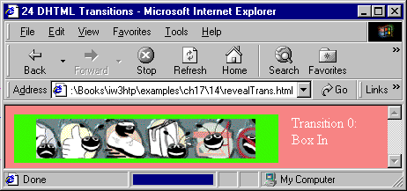
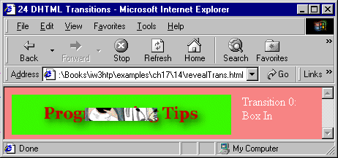
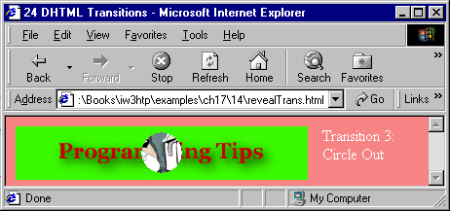
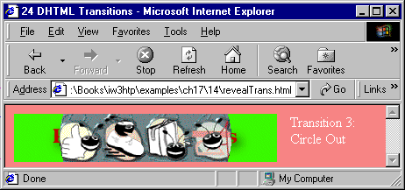
Transitions using revealTrans

Slide 54
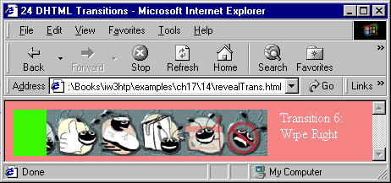
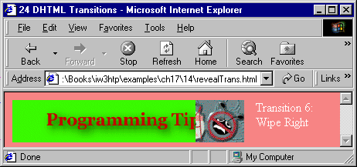
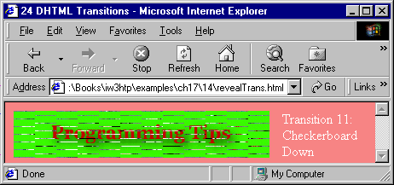
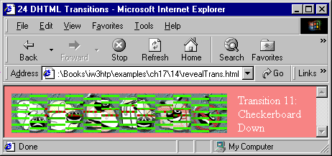
Transitions using revealTrans

Slide 55
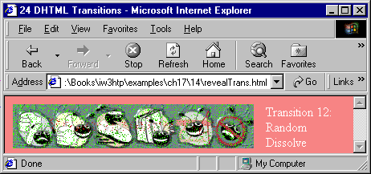
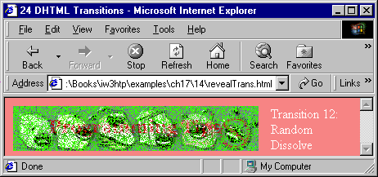

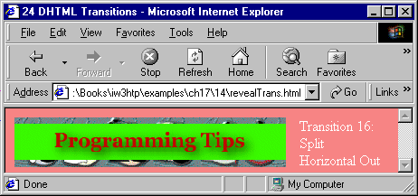
Transitions using revealTrans

Slide 56
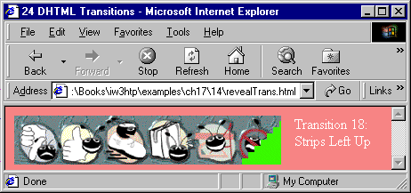
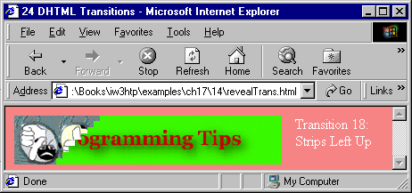
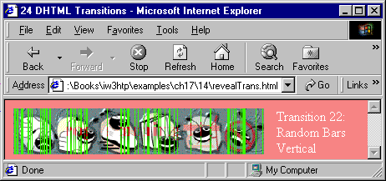
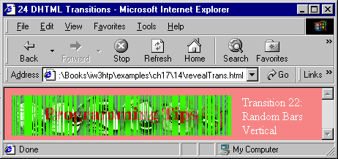
Transitions using revealTrans

