Slide 1
Chapter 23 – Dynamic HTML: Data Binding with Tabular Data Control
Outline
23.1 Introduction
23.2 Simple Data Binding
23.3 Moving a Recordset
23.4 Binding to an IMG
23.5 Binding to a TABLE
23.6 Sorting TABLE Data
23.7 Advanced Sorting and Filtering
23.8 Data Binding Elements

Slide 2
23.1 Introduction
With DHTML
  Send large amount of data to client
  IE enables processing to begin immediately after a portion of data arrives
Data binding
  Data maintained on client
  Changes to data do not propagate back to server
  To bind external data to HTML elements
    Data Source Objects (DSOs)
      IE5: Tabular Data Control (TDC)

Slide 3
23.2 Simple Data Binding
Tabular Data Control (TDC)
  ActiveX control
  Added with OBJECT element
Header row
  Specifies names of columns below
  Set UseHeader parameter to true
Text qualifiers
Field delimiters
Recordset
  A set of data

Slide 4
1 @ColorName@|@ColorHexRGBValue@
2 @aqua@|@#00FFFF@
3 @black@|@#000000@
4 @blue@|@#0000FF@
HTML color table data
(HTMLStandardColors. txt)
1.1 Header row
1.2 Text qualifiers (@)
1.3 Field delimiters (|)
5 @fuchsia@|@#FF00FF@
6 @gray@|@#808080@
7 @green@|@#008000@
8 @lime@|@#00FF00@
9 @maroon@|@#800000@
10 @navy@|@#000080@
11 @olive@|@#808000@
12 @purple@|@#800080@
13 @red@|@#FF0000@
14 @silver@|@#C0C0C0@
15 @teal@|@#008080@
16 @yellow@|@#FFFF00@
17 @white@|@#FFFFFF@

Slide 5
1<!DOCTYPE html PUBLIC "-//W3C//DTD HTML 4.0 Transitional//EN">
2<HTML>
3
4<!-- Fig 23.2: introdatabind.html -->
1.1 Insert TDC using OBJECT element
1.2 Specify first line of data has header row
5<!-- Simple data binding and recordset manipulation -->
6
7<HEAD>
8<TITLE>Intro to Data Binding</TITLE>
9
10<!-- This OBJECT element inserts an ActiveX control for -->
11<!-- handling and parsing our data. The PARAM tags -->
12<!-- give the control starting parameters such as URL. -->
13<OBJECT ID = "Colors"
14 CLASSID = "CLSID:333C7BC4-460F-11D0-BC04-0080C7055A83">
15 <PARAM NAME = "DataURL" VALUE = "HTMLStandardColors.txt">
16 <PARAM NAME = "UseHeader" VALUE = "TRUE">
17 <PARAM NAME = "TextQualifier" VALUE = "@">
18 <PARAM NAME = "FieldDelim" VALUE = "|">
19</OBJECT>
20
21<SCRIPT LANGUAGE = "JavaScript">
22 var recordSet = Colors.recordset;
23
24 function reNumber()
25 {
26 if ( !recordSet.EOF )
27 recordNumber.innerText = recordSet.absolutePosition;
28 else
29 recordNumber.innerText = " ";
30 }

Slide 6
31
32 function forward()
33 {
34 if ( !recordSet.EOF )
1.3 Notice loop in forward
1.4 Bind data to SPAN element
35 recordSet.MoveNext();
36 else
37 recordSet.MoveFirst();
38
39 colorSample.style.backgroundColor = colorRGB.innerText;
40 reNumber();
41 }
42
43</SCRIPT>
44</HEAD>
45
46<BODY ONLOAD = "reNumber()" ONCLICK = "forward()">
47
48<H1>HTML Color Table</H1>
49<H3>Click to move forward in the recordset.</H3>
50
51<P><STRONG>Color Name: </STRONG>
52<SPAN ID = "colorName" STYLE = "font-family: monospace"
53 DATASRC = "#Colors" DATAFLD = "ColorName"></SPAN><BR>
54
55<STRONG>Color RGB Value: </STRONG>
56<SPAN ID = "colorRGB" STYLE = "font-family: monospace"
57 DATASRC = "#Colors" DATAFLD = "ColorHexRGBValue"></SPAN>
58<BR>
59
60Currently viewing record number

Slide 7
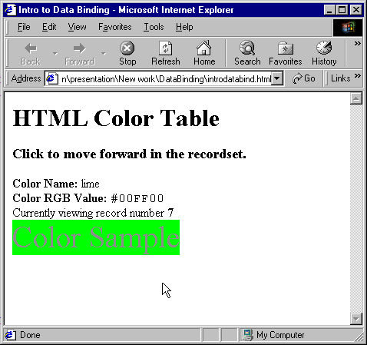
61<SPAN ID = "recordNumber" STYLE = "font-weight: 900"></SPAN>
62<BR>
63
64<SPAN ID = "colorSample" STYLE = "background-color: aqua;
2. Page rendered by browser
65 color: 888888; font-size: 30pt">Color Sample</SPAN>
66</P>
67
68</BODY>
69</HTML>

Slide 8
23.3 Moving a Recordset
recordSet methods
  MoveNext
  MovePrevious
  MoveFirst
  MoveLast
recordSet properties
  BOF
    true if at beginning of file
  EOF
    true if at end of file

Slide 9
1<!DOCTYPE html PUBLIC "-//W3C//DTD HTML 4.0 Transitional//EN">
2<HTML>
3
4<!-- Fig 23.3: moving.html -->
5<!-- Moving through a recordset -->
1.1 Insert TDC using OBJECT element
1.2 Use switch structure to move through recordset in response to user’s actions
6
7<HEAD>
8<TITLE>Dynamic Recordset Viewing</TITLE>
9<OBJECT ID = "Colors"
10 CLASSID = "CLSID:333C7BC4-460F-11D0-BC04-0080C7055A83">
11 <PARAM NAME = "DataURL" VALUE = "HTMLStandardColors.txt">
12 <PARAM NAME = "UseHeader" VALUE = "TRUE">
13 <PARAM NAME = "TextQualifier" VALUE = "@">
14 <PARAM NAME = "FieldDelim" VALUE = "|">
15</OBJECT>
16
17<SCRIPT LANGUAGE = "JavaScript">
18 var recordSet = Colors.recordset;
19
20 function update()
21 {
22 h1Title.style.color = colorRGB.innerText;
23 }
24
25 function move( whereTo )
26 {
27 switch ( whereTo ) {
28
29 case "first":
30 recordSet.MoveFirst();
31 update();
32 break;
33
34 // If recordset is at beginning, move to end.

Slide 10
35 case "previous":
36
37 if ( recordSet.BOF )
38 recordSet.MoveLast();
39 else
1.3 Use BOF and EOF properties to avoid errors when moving through the recordset
40 recordSet.MovePrevious();
41
42 update();
43 break;
44
45 // If recordset is at end, move to beginning.
46 case "next":
47
48 if ( recordSet.EOF )
49 recordSet.MoveFirst();
50 else
51 recordSet.MoveNext();
52
53 update();
54 break;
55
56 case "last":
57 recordSet.MoveLast();
58 update();
59 break;
60 }
61 }
62
63</SCRIPT>
64
65<STYLE TYPE = "text/css">
66 INPUT { background-color: khaki;
67 color: green;
68 font-weight: bold }

Slide 11
69</STYLE>
70</HEAD>
71
72<BODY STYLE = "background-color: darkkhaki">
73
1.4 Bind data to SPAN element
74<H1 STYLE = "color: black" ID = "h1Title">HTML Color Table</H1>
75
76<SPAN STYLE = "position: absolute; left: 200; width: 270;
77 border-style: groove; text-align: center;
78 background-color: cornsilk; padding: 10">
79<STRONG>Color Name: </STRONG>
80<SPAN ID = "colorName" STYLE = "font-family: monospace"
81 DATASRC = "#Colors" DATAFLD = "ColorName">ABC</SPAN><BR>
82
83<STRONG>Color RGB Value: </STRONG>
84<SPAN ID = "colorRGB" STYLE = "font-family: monospace"
85 DATASRC = "#Colors" DATAFLD = "ColorHexRGBValue">ABC
86</SPAN><BR>
87
88<INPUT TYPE = "button" VALUE = "First"
89 ONCLICK = "move( 'first' );">
90
91<INPUT TYPE = "button" VALUE = "Previous"
92 ONCLICK = "move( 'previous' );">
93
94<INPUT TYPE = "button" VALUE = "Next"
95 ONCLICK = "move( 'next' );">
96
97<INPUT TYPE = "button" VALUE = "Last"
98 ONCLICK = "move( 'last' );">
99</SPAN>
100
101</BODY>
102</HTML>

Slide 12
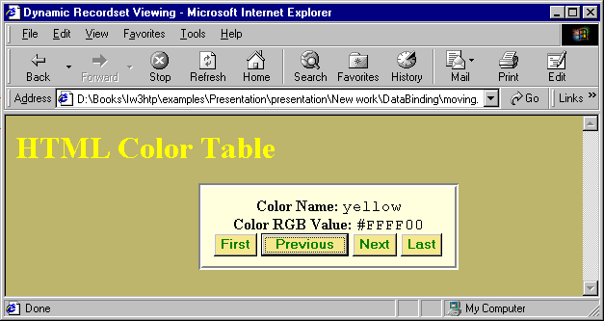
Moving through a recordset using JavaScript

Slide 13
23.4 Binding to an IMG
Many different types of HTML elements can be bound to data sources
  IMG element
  <IMG DATASRC = “#Images” DATAFLD = “image” STYLE = “position: relative; left: 45 px”>

Slide 14
1 image
2 numbers/0.gif
3 numbers/1.gif
4 numbers/2.gif
images.txt data
source file
1.1 Header row
1.2 Use image file locations as data
5 numbers/3.gif
6 numbers/4.gif
7 numbers/5.gif
8 numbers/6.gif
9 numbers/7.gif
10 numbers/8.gif
11 numbers/9.gif

Slide 15
1<!DOCTYPE html PUBLIC "-//W3C//DTD HTML 4.0 Transitional//EN">
2<HTML>
3
4<!-- Fig. 23.5: bindimg.html -->
1.1 Insert TDC using OBJECT element
1.2 Use switch structure to navigate through recordset in response to user’s actions
5<!-- Binding data to an image -->
6
7<HEAD>
8<TITLE>Binding to a IMG</TITLE>
9
10<OBJECT ID = "Images"
11 CLASSID = "CLSID:333C7BC4-460F-11D0-BC04-0080C7055A83">
12 <PARAM NAME = "DataURL" VALUE = "images.txt">
13 <PARAM NAME = "UseHeader" VALUE = "True">
14</OBJECT>
15
16<SCRIPT LANGUAGE = "JavaScript">
17
18 recordSet = Images.recordset;
19
20 function move( whereTo )
21 {
22 switch( whereTo ) {
23
24 case "first":
25 recordSet.MoveFirst();
26 break;
27
28 case "previous":
29
30 if ( recordSet.BOF )

Slide 16
32 else
33 recordSet.MovePrevious();
34
35 break;
1.3 Bind data source to IMG element
36
37 case "next":
38
39 if ( recordSet.EOF )
40 recordSet.MoveFirst();
41 else
42 recordSet.MoveNext();
43
44 break;
45
46 case "last":
47 recordSet.MoveLast();
48 break;
49 }
50 }
51
52</SCRIPT>
53</HEAD>
54
55<BODY>
56
57<IMG DATASRC = "#Images" DATAFLD = "image"
58 STYLE = "position: relative; left: 45px"><BR>
59
60<INPUT TYPE = "button" VALUE = "First"

Slide 17
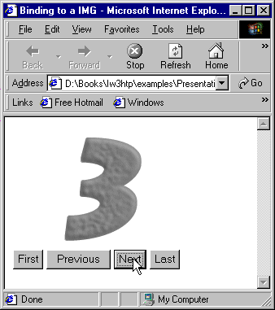
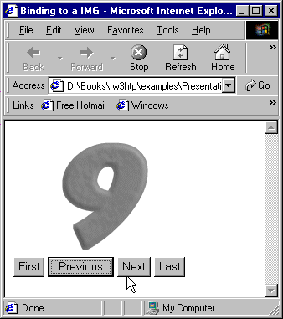
61 ONCLICK = "move( 'first' );">
62
63<INPUT TYPE = "button" VALUE = "Previous"
64 ONCLICK = "move( 'previous' );">
2. Page rendered by browser
65
66<INPUT TYPE = "button" VALUE = "Next"
67 ONCLICK = "move( 'next' );">
68
69<INPUT TYPE = "button" VALUE = "Last"
70 ONCLICK = "move( 'last' );">
71
72</BODY>
73</HTML>

Slide 18
23.5 Binding to a TABLE
Add DATASRC attribute to TABLE tag
  <TABLE DATASRC = “#Colors” STYLE =
  “border-style: ridge; border-color: darkseagreen; background-color: lightcyan”>
Add DATAFLD attribute to SPAN tags that reside in table cells
  <TD><SPAN DATAFLD = “ColorName”></SPAN></TD>
  <TD><SPAN DATAFLD = “ColorHexRGBValue” STYLE = “font-family: monospace”></SPAN></TD>

Slide 19
1<!DOCTYPE html PUBLIC "-//W3C//DTD HTML 4.0 Transitional//EN">
2<HTML>
3
4<!-- Fig 23.6: tablebind.html -->
Bind data source to TABLE element
1.1 DATASRC attribute in TABLE element
5<!-- Using Data Binding with tables -->
6
7<HEAD>
8<TITLE>Data Binding and Tables</TITLE>
9<OBJECT ID = "Colors"
10 CLASSID = "CLSID:333C7BC4-460F-11D0-BC04-0080C7055A83">
11 <PARAM NAME = "DataURL" VALUE = "HTMLStandardColors.txt">
12 <PARAM NAME = "UseHeader" VALUE = "TRUE">
13 <PARAM NAME = "TextQualifier" VALUE = "@">
14 <PARAM NAME = "FieldDelim" VALUE = "|">
15</OBJECT>
16</HEAD>
17
18<BODY STYLE = "background-color: darkseagreen">
19
20<H1>Binding Data to a <CODE>TABLE</CODE></H1>
21
22<TABLE DATASRC = "#Colors" STYLE = "border-style: ridge;
23 border-color: darkseagreen; background-color: lightcyan">
24
25 <THEAD>
26 <TR STYLE = "background-color: mediumslateblue">
27 <TH>Color Name</TH>
28 <TH>Color RGB Value</TH>
29 </TR>
30 </THEAD>

Slide 20
31
32 <TBODY>
33 <TR STYLE = "background-color: lightsteelblue">
34 <TD><SPAN DATAFLD = "ColorName"></SPAN></TD>
1.2 DATAFLD attributes in TD elements
1.3 IE iterates through data file
35 <TD><SPAN DATAFLD = "ColorHexRGBValue"
36 STYLE = "font-family: monospace"></SPAN></TD>
37 </TR>
38 </TBODY>
39
40</TABLE>
41
42</BODY>
43</HTML>

Slide 21
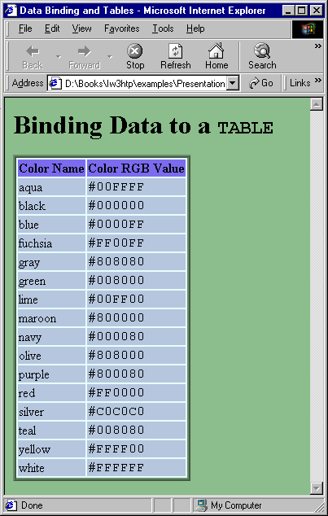
Binding data to a TABLE element

Slide 22
23.6 Sorting TABLE Data
Sort property of TDC
  <SELECT ONCHANGE = “Colors.Sort = this.value; Colors.reset();”>
Reset method displays data in new sort order
By default, column sorted in ascending order
  To sort in descending order, precede column name with minus sign (-)
    <OPTION VALUE = “-ColorName”>

Slide 23
1<!DOCTYPE html PUBLIC "-//W3C//DTD HTML 4.0 Transitional//EN">
2<HTML>
3
4<!-- Fig 23.7: sorting.html -->
1.1 Sort data with Sort property of TDC
1.2 Reset method displays data in new sort order
1.3 Note keyword this (line 27)
5<!-- Sorting TABLE data -->
6
7<HEAD>
8<TITLE>Data Binding and Tables</TITLE>
9<OBJECT ID = "Colors"
10 CLASSID = "CLSID:333C7BC4-460F-11D0-BC04-0080C7055A83">
11 <PARAM NAME = "DataURL" VALUE = "HTMLStandardColors.txt">
12 <PARAM NAME = "UseHeader" VALUE = "TRUE">
13 <PARAM NAME = "TextQualifier" VALUE = "@">
14 <PARAM NAME = "FieldDelim" VALUE = "|">
15</OBJECT>
16</HEAD>
17
18<BODY STYLE = "background-color: darkseagreen">
19
20<H1>Sorting Data</H1>
21
22<TABLE DATASRC = "#Colors" STYLE = "border-style: ridge;
23 border-color: darkseagreen; background-color: lightcyan">
24 <CAPTION>
25 Sort by:
26
27 <SELECT ONCHANGE = "Colors.Sort = this.value;
28 Colors.Reset();">
29 <OPTION VALUE = "ColorName">Color Name (Ascending)
30 <OPTION VALUE = "-ColorName">Color Name (Descending)

Slide 24
31 <OPTION VALUE = "ColorHexRGBValue">Color RGB Value
32 (Ascending)
33 <OPTION VALUE = "-ColorHexRGBValue">Color RGB Value
34 (Descending)
35 </SELECT>
36 </CAPTION>
37
38 <THEAD>
39 <TR STYLE = "background-color: mediumslateblue">
40 <TH>Color Name</TH>
41 <TH>Color RGB Value</TH>
42 </TR>
43 </THEAD>
44
45 <TBODY>
46 <TR STYLE = "background-color: lightsteelblue">
47 <TD><SPAN DATAFLD = "ColorName"></SPAN></TD>
48 <TD><SPAN DATAFLD = "ColorHexRGBValue"
49 STYLE = "font-family: monospace"></SPAN></TD>
50 </TR>
51 </TBODY>
52
53</TABLE>
54
55</BODY>
56</HTML>

Slide 25
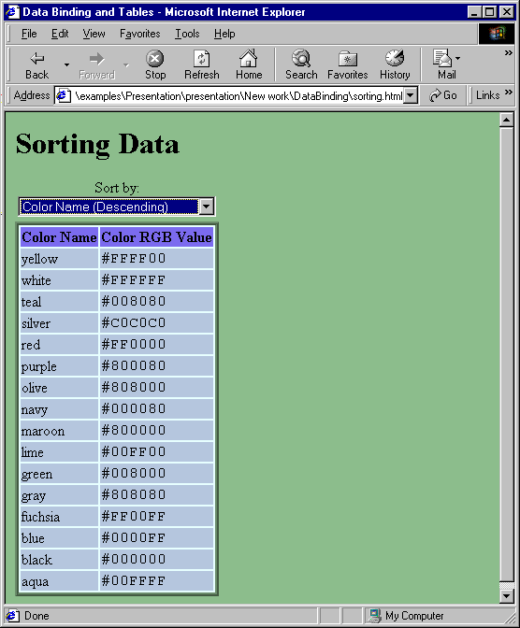
Sorting data in a TABLE

Slide 26
23.7 Advanced Sorting and Filtering
TDC sorts multiple columns
Filtering
  Filter property
    Filter out all records that do not have a cell matching the text specified
    ColumnName = FilterText
cursor CSS attribute
  Specifies mouse cursor display
  SPAN {cursor: hand;}
    Specifies the hand cursor

Slide 27
1 @Title:String@|@Authors:String@|@Copyright:String@|
@Edition:String@|@Type:String@
2 @C How to Program@|@Deitel,Deitel@|@1992@|@1@|@BK@
3 @C How to Program@|@Deitel,Deitel@|@1994@|@2@|@BK@
DBPublications.txt data file
4 @C++ How to Program@|@Deitel,Deitel@|@1994@|@1@|@BK@
5 @C++ How to Program@|@Deitel,Deitel@|@1998@|@2@|@BK@
6 @Java How to Program@|@Deitel,Deitel@|@1997@|@1@|@BK@
7 @Java How to Program@|@Deitel,Deitel@|@1998@|@2@|@BK@
8 @Java How to Program@|@Deitel,Deitel@|@2000@|@3@|@BK@
9 @Visual Basic 6 How to Program@|@Deitel,Deitel,Nieto@|@1999@|
@1@|@BK@
10 @Internet and World Wide Web How to Program@|@Deitel,Deitel@|
@2000@|@1@|@BK@
11 @The Complete C++ Training Course@|@Deitel,Deitel@|@1996@|
@1@|@BKMMCD@
12 @The Complete C++ Training Course@|@Deitel,Deitel@|@1998@|
@2@|@BKMMCD@
13 @The Complete Java Training Course@|@Deitel,Deitel@|@1997@|
@1@|@BKMMCD@
14 @The Complete Java Training Course@|@Deitel,Deitel@|@1998@|
@2@|@BKMMCD@
15 @The Complete Java Training Course@|@Deitel,Deitel@|@2000@|
@3@|@BKMMCD@
16 @The Complete Visual Basic 6 Training Course@|
@Deitel,Deitel,Nieto@|@1999@|@1@|@BKMMCD@
17 @The Complete Internet and World Wide Web Programming Training Course@|@Deitel,Deitel@|@2000@|@1@|@BKMMCD@

Slide 28
1<!DOCTYPE html PUBLIC "-//W3C//DTD HTML 4.0 Transitional//EN">
2<HTML>
3
4<!-- Fig 23.9: advancedsort.html -->
1.1 Insert TDC using OBJECT element
1.2 Set SPAN cursor CSS attribute to hand to show that SPAN is clickable
5<!-- Sorting and filtering data -->
6
7<HEAD>
8<TITLE>Data Binding - Sorting and Filtering</TITLE>
9
10<OBJECT ID = "Publications"
11 CLASSID = "CLSID:333C7BC4-460F-11D0-BC04-0080C7055A83">
12 <PARAM NAME = "DataURL" VALUE = "DBPublications.txt">
13 <PARAM NAME = "UseHeader" VALUE = "TRUE">
14 <PARAM NAME = "TextQualifier" VALUE = "@">
15 <PARAM NAME = "FieldDelim" VALUE = "|">
16 <PARAM NAME = "Sort" VALUE = "+Title">
17</OBJECT>
18
19<STYLE>
20
21 A { font-size: 9pt;
22 text-decoration: underline;
23 cursor: hand;
24 color: blue }
25
26 CAPTION { cursor: hand; }
27
28 SPAN { cursor: hand; }
29
30</STYLE>

Slide 29
31
32 <SCRIPT LANGUAGE = "JavaScript">
33 var sortOrder;
34
1.3 Sort and Filter properties
1.4 Note use of event.ctrlKey (sort multiple columns)
35 function reSort( column, order )
36 {
37 if ( order )
38 sortOrder = "";
39 else
40 sortOrder = "-";
41
42 if ( event.ctrlKey ) {
43 Publications.Sort += "; " + sortOrder + column;
44 Publications.Reset();
45 }
46 else {
47 Publications.Sort = sortOrder + column;
48 Publications.Reset();
49 }
50
51 spanSort.innerText = "Current sort: " + Publications.Sort;
52 }
53
54 function filter( filterText, filterColumn )
55 {
56 Publications.Filter = filterColumn + "=" + filterText;
57 Publications.Reset();
58 spanFilter.innerText =
59 "Current filter: " + Publications.Filter;
60 }

Slide 30
61
62 function clearAll()
63 {
64 Publications.Sort = " ";
65 spanSort.innerText = "Current sort: None";
66 Publications.Filter = " ";
67 spanFilter.innerText = "Current filter: None";
68 Publications.Reset();
69 }
70</SCRIPT>
71</HEAD>
72
73<BODY>
74<H1>Advanced Sorting</H1>
75Click on the link next to a column head to sort by that column.
76To sort by more than one column at a time, hold down CTRL while
77you click another sorting link. Click on any cell to filter by
78the data of that cell. To clear filters and sorts, click on the
79green caption bar.
80
81<TABLE DATASRC = "#Publications" BORDER = 1 CELLSPACING = 0
82 CELLPADDING = 2 STYLE = "background-color: papayawhip;">
83
84 <CAPTION STYLE = "background-color: lightgreen; padding: 5"
85 ONCLICK = "clearAll()">
86 <SPAN ID = "spanFilter" STYLE = "font-weight: bold;
87 background-color: lavender">Current filter: None
88 </SPAN>
89 <SPAN ID = "spanSort" STYLE = "font-weight: bold;
90 background-color: khaki">Current sort: None</SPAN>

Slide 31
91 </CAPTION>
92
93 <THEAD>
94 <TR>
1.5 Each column head has associated ONCLICK event
95 <TH>Title <BR>
96 (<A ONCLICK = "reSort( 'Title', true )">
97 Ascending</A>
98 <A ONCLICK = "reSort( 'Title', false )">
99 Descending</A>)
100 </TH>
101
102 <TH>Authors <BR>
103 (<A ONCLICK = "reSort( 'Authors', true )">
104 Ascending</A>
105 <A ONCLICK = "reSort( 'Authors', false )">
106 Descending</A>)
107 </TH>
108
109 <TH>Copyright <BR>
110 (<A ONCLICK = "reSort( 'Copyright', true )">
111 Ascending</A>
112 <A ONCLICK = "reSort( 'Copyright', false )">
113 Descending</A>)
114 </TH>
115
116 <TH>Edition <BR>
117 (<A ONCLICK = "reSort( 'Edition', true )">
118 Ascending</A>
119 <A ONCLICK = "reSort( 'Edition', false )">
120 Descending</A>)

Slide 32
121 </TH>
122
123 <TH>Type <BR>
124 (<A ONCLICK = "reSort( 'Type', true )">
125 Ascending</A>
126 <A ONCLICK = "reSort( 'Type', false )">
127 Descending</A>)
128 </TH>
129 </TR>
130 </THEAD>
131
132 <TR>
133 <TD><SPAN DATAFLD = "Title" ONCLICK =
134 "filter( this.innerText, 'Title' )"></SPAN></A>
135 </TD>
136
137 <TD><SPAN DATAFLD = "Authors" ONCLICK =
138 "filter( this.innerText, 'Authors')"></SPAN>
139 </TD>
140
141 <TD><SPAN DATAFLD = "Copyright" ONCLICK =
142 "filter( this.innerText, 'Copyright' )"></SPAN>
143 </TD>
144
145 <TD><SPAN DATAFLD = "Edition" ONCLICK =
146 "filter( this.innerText, 'Edition' )"></SPAN>
147 </TD>
148
149 <TD><SPAN DATAFLD = "Type" ONCLICK =
150 "filter( this.innerText, 'Type' )"></SPAN>

Slide 33
151 </TD>
152
153 </TR>
154
155 </TABLE>
156
157 </BODY>
158 </HTML>

Slide 34
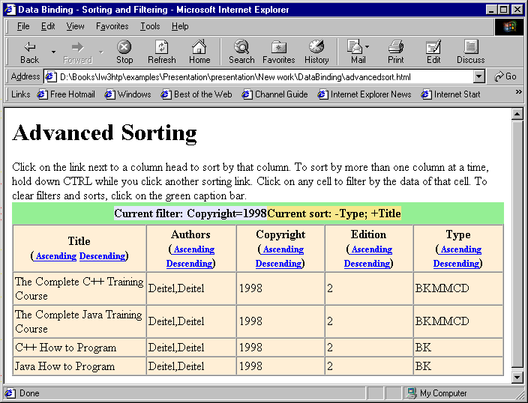
Advanced sorting and filtering

Slide 35
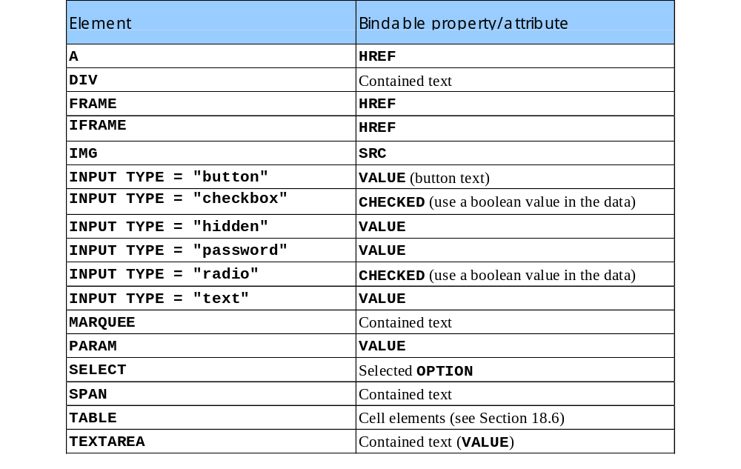
23.8 Data Binding Elements

