Slide 1
Chapter 24 – Dynamic HTML: Client-Side Scripting with VBScript
Outline
24.1 Introduction
24.2 Operators
24.3 Data Types and Control Structures
24.4 VBScript Functions
24.5 VBScript Example Programs
24.6 Arrays
24.7 String Manipulation
24.8 Classes and Objects

Slide 2
24.1 Introduction
Visual Basic Script (VBScript)
  Subset of Microsoft Visual Basic
  IE contains VBScript scripting engine (interpreter)
  Similar to JavaScript
    JavaScript used more for client-side scripting
  VBScript de facto language for ASP (Active Server Pages)

Slide 3
24.2 Operators
VBScript
  Not case-sensitive
  Provides arithmetic operators, logical operators, concatenation operators, comparison operators and relational operators
  Arithmetic operators
    Similar to JavaScript arithmetic operators
    Division operator
      \
      Returns integer result
    Exponentiation operator
      ^
      Raises a value to a power

Slide 4
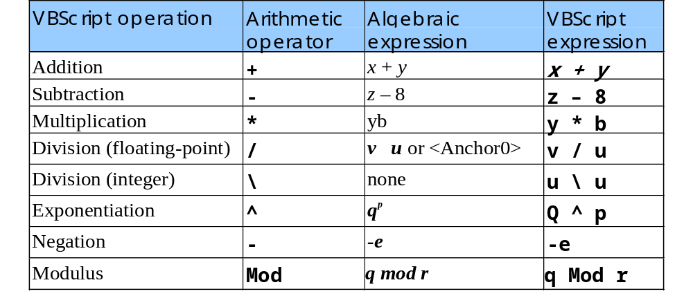
24.2 Operators
Arithmetic operators

Slide 5
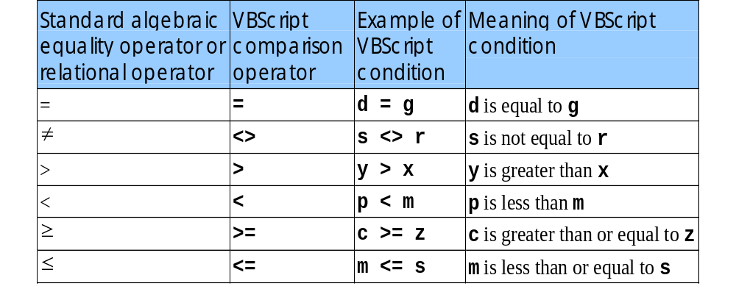
24.2 Operators
Comparison operators

Slide 6
24.2 Operators
  Comparison operators
    Only symbols for equality operator (=) and inequality operator (<>) differ from JavaScript
    Can also be used to compare strings
  Logical operators
    And (logical AND)
    Or (logical OR)
    Not (logical negation)
    Imp (logical implication)
    Xor (exclusive OR)
    Eqv (logical equivalence)
    Not short-circuit; both conditions always evaluated

Slide 7
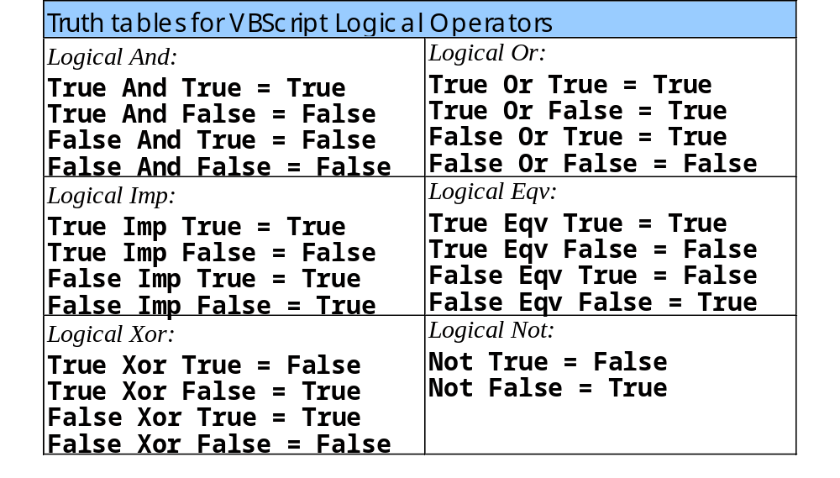
24.2 Operators
Truth tables for VBScript logical operators

Slide 8
24.2 Operators
String concatenation
  Plus sign, +
  Ampersand, &
    Formally called string concatenation operator
  If both operands are strings, + and & can be used interchangeably
    s3 = s1 & s2
    s3 = s1 + s2
  If varying data types, use ampersand (&)
    Error: s1 = “hello” + 22

Slide 9
24.3 Data Types and Control Structures
VBScript has only one data type:
  Variant
    Capable of storing different types of data
      Variant subtypes
Variable names
  Cannot be keywords
  Must begin with a letter
  Max length: 255 characters
  Letters, digits (0-9) and underscores
OptionExplicit statement
  Requires variables to be declared before use

Slide 10
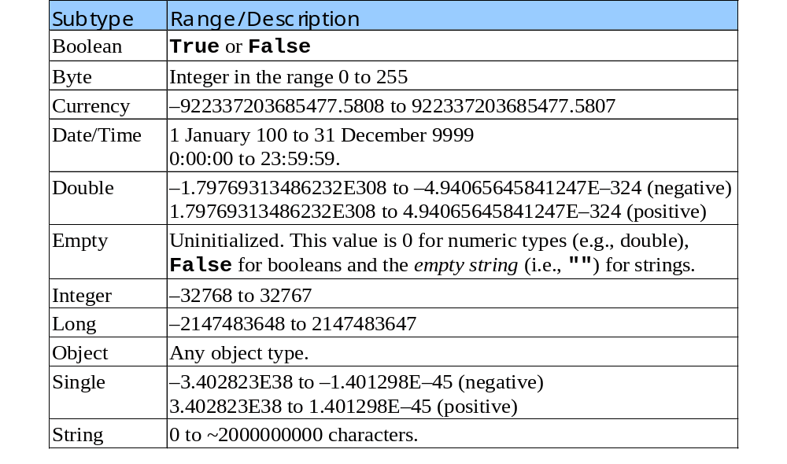
24.3 Data Types and Control Structures
VBScript variant subtypes

Slide 11
24.3 Data Types and Control Structures
VBScript control structures
  Every control structure begins and ends with one or more keywords (not curly braces as in JavaScript)
  VBScript does not use statement terminator
    JavaScript uses semicolons
  Parentheses around conditions optional
  True: variant subtype boolean True or considered non-zero
  False: variant subtype boolean False or considered 0

Slide 12
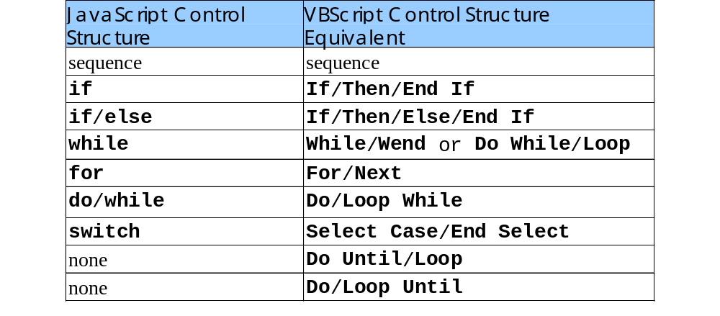
24.3 Data Types and Control Structures
Comparing VBScript control structures to JavaScript control structures

Slide 13
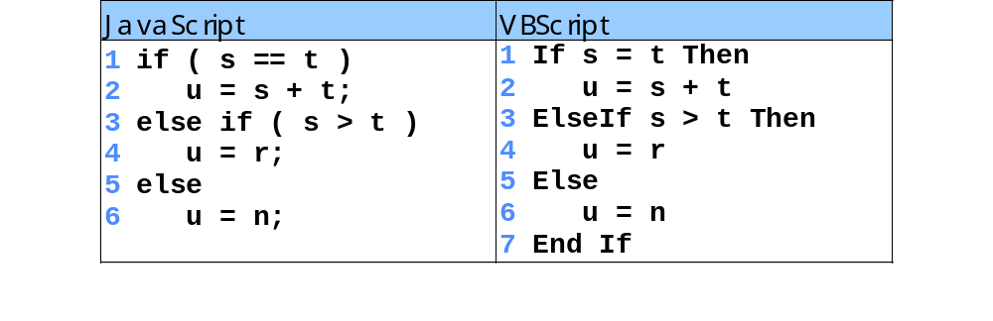
24.3 Data Types and Control Structures
Comparing JavaScript’s if structure to VBScript’s If structure

Slide 14
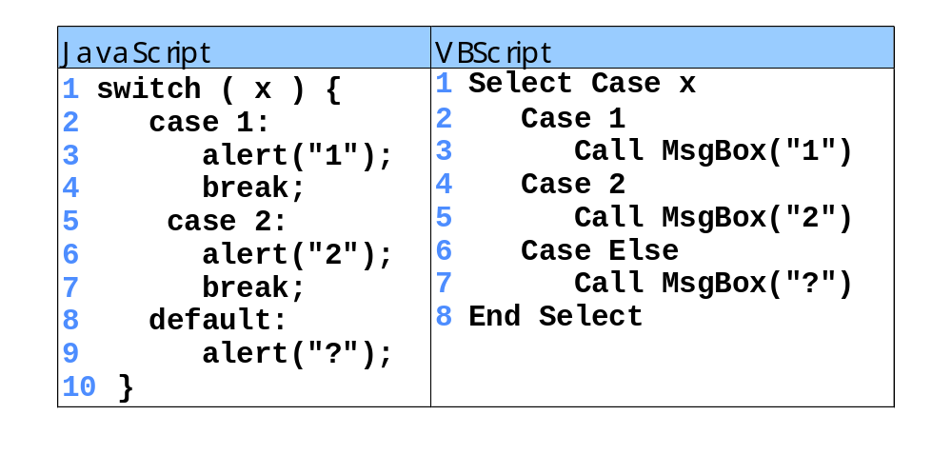
24.3 Data Types and Control Structures
Comparing JavaScript’s switch with VBScript’s Select Case

Slide 15
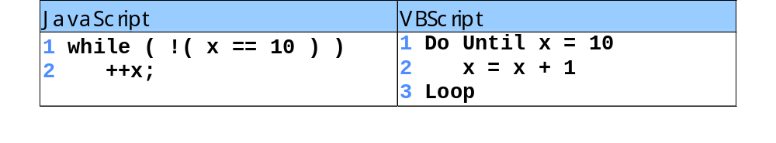
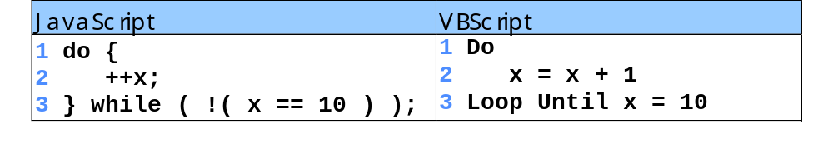
24.3 Data Types and Control Structures
Comparing JavaScript’s while to VBScript’s Do Until
Comparing JavaScript’s Do/While to VBScript’s Do Loop/Until

Slide 16
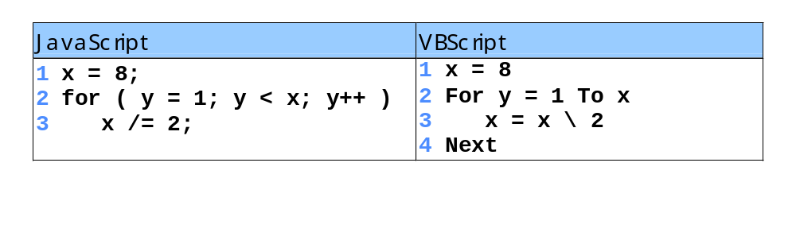
24.3 Data Types and Control Structures
Comparing JavaScript’s for to VBScript’s For

Slide 17
24.3 Data Types and Control Structures
  Select Case/End Select
    Does not require break type statement
  VBScript structures without direct JavaScript equivalents:
    Do Until/Loop
    Do/Loop Until
    Loop until condition becomes True
  Exit Do
    Immediate exit from Do While/Loop, Do/Loop While, Do Until/Loop or Do/Loop Until
  Exit For
    Immediate exit from For/Next
  For loop
    Optional Step keyword to increment or decrement

Slide 18
1 ’ VBScript
2 For y = 2 To 20 Step 2
3 Call MsgBox( "y = " & y )
4 Next
1. For repetition structure with keyword Step

Slide 19
24.4 VBScript Functions
Predefined functions
  Variant functions
    IsEmpty
      Returns True if variant not initialized
  Math functions
    Cos, Sin, etc.
      Take arguments in radians
      radians = degrees × π/180
  InputBox
    Displays dialog in which user can input data
  MsgBox
    Displays message dialog
  VBScript functions often take optional arguments
  Formatting functions
    FormatCurrency, FormatDateTime, etc.

Slide 20
24.4 VBScript Functions
  Functions for getting info about scripting engine
    ScriptEngine
      Returns “Jscript”, “VBScript” or “VBA”
    ScriptEngineBuildVersion
      Returns current build version; ID number for current release
    ScriptEngineMajorVersion
      Returns major version number for script engine
    ScriptEngineMinorVersion
      Returns minor release number
Line continuation character
  Underscore character, _
  Statements cannot extend beyond current line without character

Slide 21
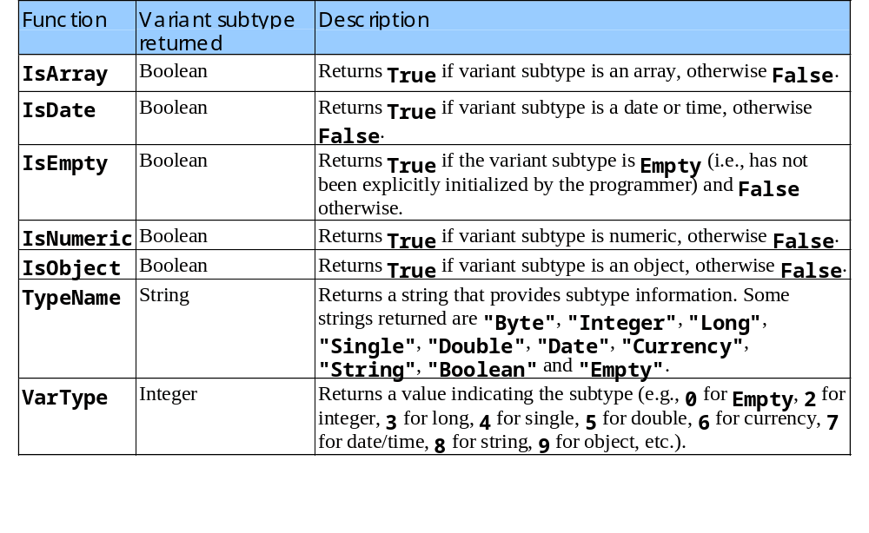
24.4 VBScript Functions
Some variant functions

Slide 22
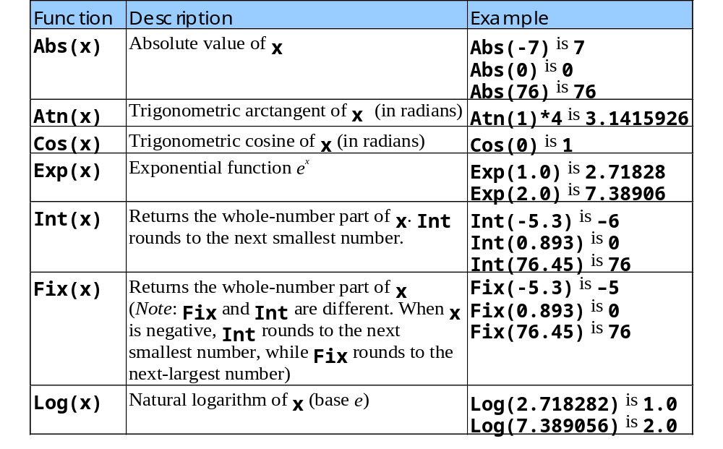
24.4 VBScript Functions
VBScript math functions

Slide 23
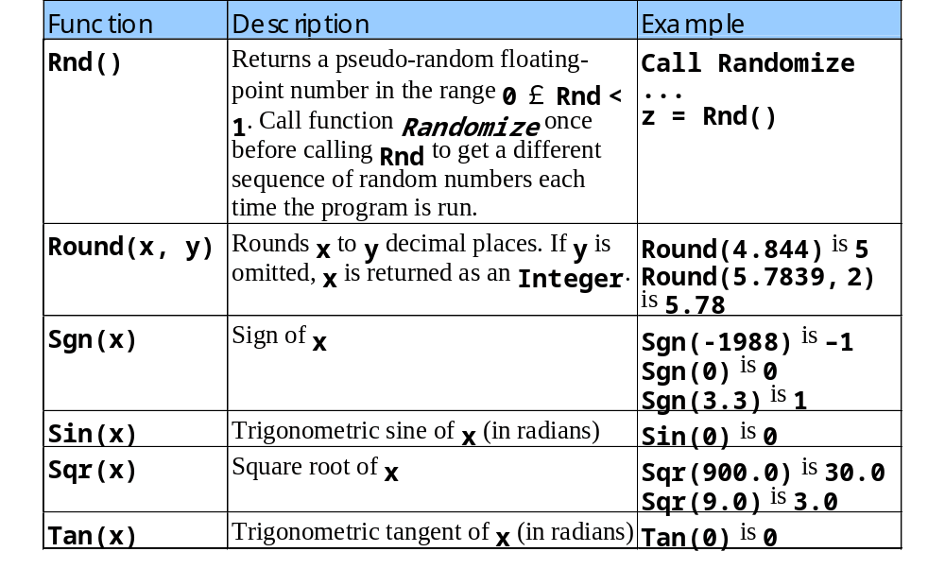
24.4 VBScript Functions
VBScript math functions (continued)

Slide 24
24.5 VBScript Example Programs
<script> tag
  Used to set the language of an HTML document
Option Explicit
  Forces all variables to be declared
Procedures
  VBScript’s equivalent of a function in JavaScript
  Sub
    Procedure that does not return value
    Ended with End Sub
Const
  Used to create constants

Slide 25
1<!DOCTYPE HTML PUBLIC "-//W3C//DTD HTML 4.0 Transitional//EN">
2<HTML>
3<!--Fig. 24.15: addition.html -->
5<HEAD>
1.1 Set language to VBScript
1.2 OptionExplicit statement
1.3 Define procedure OnClick for the cmAdd button
1.4 Use CInt to convert input values from string subtype to integer subtype
6<TITLE>Our first VBScript</TITLE>
7
8<SCRIPT LANGUAGE = "VBScript">
9<!--
10 Option Explicit
11 Dim intTotal
12
13 Sub cmdAdd_OnClick()
14 Dim intValue
15
16 intValue = InputBox("Enter an integer", "Input Box", , _
17 1000, 1000)
18 intTotal = CInt( intTotal ) + CInt( intValue )
19 Call MsgBox("You entered " & intValue & _
20 "; total so far is " & intTotal, , "Results")
21 End Sub
22-->
23</SCRIPT>
24</HEAD>
25
26<BODY>
27Click the button to add an integer to the total.
28<HR>
29<FORM>
30<INPUT NAME = "cmdAdd" TYPE = "BUTTON"
31 VALUE = "Click Here to Add to the Total">
32</FORM>
33</BODY>
34</HTML>

Slide 26
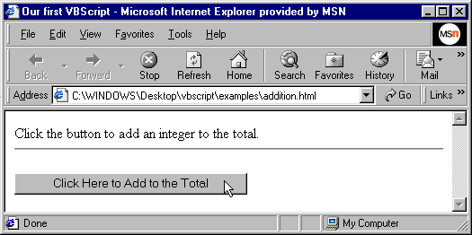
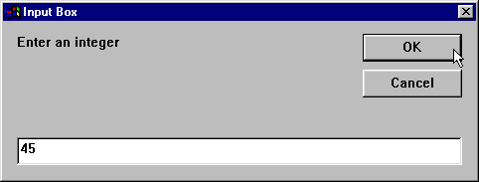
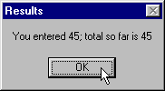

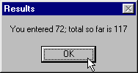
Adding integers on a Web page using VBScript
Input dialog
Message dialog

Slide 27
24.5 VBScript Example Programs
<script> tag’s attributes
  for attribute
    Indicates the HTML component on which the script operates
  event attribute
    Indicates the event to which the script should respond
  language attribute
    Specifies the scripting language

Slide 28
1<!DOCTYPE HTML PUBLIC "-//W3C//DTD HTML 4.0 Transitional//EN">
2<HTML>
3<!-- Fig. 24.16: site.html -->
4
1.1 Create form with pulldown menu
1.2 Script response to user’s selecting an option in the menu
5<HEAD>
6 <TITLE>Select a site to browse</TITLE>
7</HEAD>
8
9<BODY>
10Select a site to browse<P>
11<HR>
12<FORM>
13<SELECT NAME = "SiteSelector" SIZE = "1">
14
15 <OPTION VALUE = "http://www.deitel.com">
16 Deitel & Associates, Inc.
17 </OPTION>
18
19 <OPTION VALUE = "http://www.prenhall.com">
20 Prentice Hall
21 </OPTION>
22
23 <OPTION VALUE = "http://www.phptr.com/phptrinteractive">
24 Prentice Hall Interactive
25 </OPTION>
26
27</SELECT>
28
29<!-- VBScript code -->
30<SCRIPT FOR = "SiteSelector" EVENT = "ONCHANGE"

Slide 29
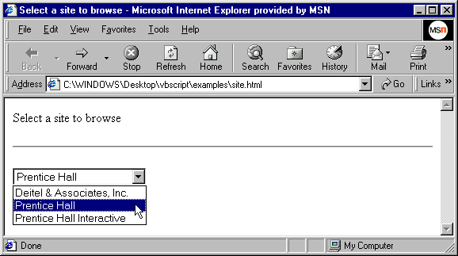
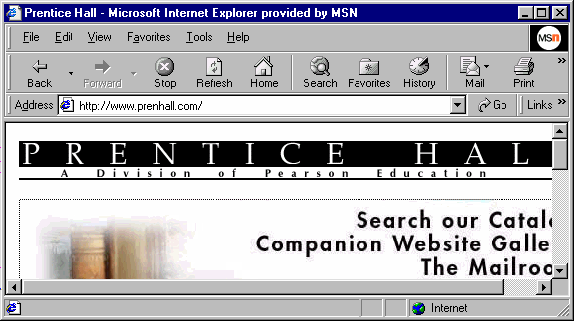
31 LANGUAGE = "VBScript">
32 <!--
33 Document.Location = Document.Forms( 0 ).SiteSelector.Value
34 -->
2. Page rendered by browser
35 </SCRIPT>
36 </FORM>
37 </BODY>
38 </HTML>

Slide 30
24.5 VBScript Example Programs
Procedures in the next program
  Minimum
    Determines the smallest of three numbers
  OddEven
    Determines if the smallest number is odd or even
Comments
  Indicated by either single quote (‘) or keyword Rem

Slide 31
1 <!DOCTYPE HTML PUBLIC "-//W3C//DTD HTML 4.0 Transitional//EN">
2 <HTML>
3 <!--Fig. 24.17: minimum.html -->
4
1.1 Define procedures Minimum and OddEven
1.2 Use modulus operator to determine whether number odd or even
5 <HEAD>
6 <TITLE>Using VBScript Procedures</TITLE>
7
8 <SCRIPT LANGUAGE = "VBScript">
9 <!--
10 Option Explicit
11
12 ’ Find the minimum value. Assume that first value is
13 ’ the smallest.
14 Function Minimum( min, a, b )
15
16 If a < min Then
17 min = a
18 End If
19
20 If b < min Then
21 min = b
22 End If
23
24 Minimum = min ’ Return value
25 End Function
26
27 Sub OddEven( n )
28 If n Mod 2 = 0 Then
29 Call MsgBox( n & " is the smallest and is even" )
30 Else

Slide 32
31 Call MsgBox( n & " is the smallest and is odd" )
32 End If
33 End Sub
34
35 Sub cmdButton_OnClick()
36 Dim number1, number2, number3, smallest
37
38 ’ Convert each input to Long subtype
39 number1 = CLng( Document.Forms( 0 ).txtBox1.Value )
40 number2 = CLng( Document.Forms( 0 ).txtBox2.Value )
41 number3 = CLng( Document.Forms( 0 ).txtBox3.Value )
42
43 smallest = Minimum( number1, number2, number3 )
44 Call OddEven( smallest )
45 End Sub
46-->
47</SCRIPT>
48</HEAD>
49
50<BODY>
51<FORM> Enter a number
52<INPUT TYPE = "text" NAME = "txtBox1" SIZE = "5" VALUE = "0">
53<P>Enter a number
54<INPUT TYPE = "text" NAME = "txtBox2" SIZE = "5" VALUE = "0">
55<P>Enter a number
56<INPUT TYPE = "text" NAME = "txtBox3" SIZE = "5" VALUE = "0">
57<P><INPUT TYPE = "BUTTON" NAME = "cmdButton" VALUE = "Enter">
58
59</FORM>
60</BODY>
61</HTML>

Slide 33
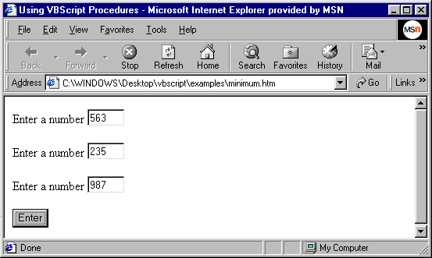
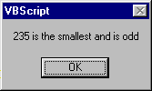
Program that determines the smallest of three numbers

Slide 34
24.6 Arrays
Arrays
  Data structures of related items of same type
  Fixed-size array
    Size does not change during program execution
  Dynamic array
    Size can change during program execution
    Redimmable array (re-dimensionable array)
  Array elements referred to by array name followed by element position (index) in parentheses, ()
  First array element at index 0
  Upper bound
    Highest valid index

Slide 35
24.6 Arrays
Ubound function
  Returns upper bound
Procedures are Public by default
  Accessible to scripts on other Web pages
  Private → accessible only from HTML document in which defined
ReDim function
  Allocations memory for dynamic array
  Keyword Preserve maintains current values in array
  Memory for dynamic array can be deallocated using keyword Erase
Multidimensional arrays
  tripleArray(100, 8, 15)
  Wrong: tripleArray(100)(8)(15)

Slide 36
1<!DOCTYPE HTML PUBLIC "-//W3C//DTD HTML 4.0 Transitional//EN">
2<HTML>
3<!--Fig. 24.18: arrays.html -->
4
1.1 Define procedure DisplayArray
1.2 Initialize arrays
5<HEAD>
6<TITLE>Using VBScript Arrays</TITLE>
7
8<SCRIPT LANGUAGE = "VBScript">
9<!--
10 Option Explicit
11
12 Public Sub DisplayArray( x, s )
13 Dim j
14
15 Document.Write( s & ": " )
16 For j = 0 to UBound( x )
17 Document.Write( x( j ) & " " )
18 Next
19
20 Document.Write( "<BR>" )
21 End Sub
22
23 Dim fixedSize( 3 ), fixedArray, dynamic(), k
24
25 ReDim dynamic( 3 ) ’ Dynamically size array
26 fixedArray = Array( "A", "B", "C" )
27
28 ’ Populate arrays with values
29 For k = 0 to UBound( fixedSize )
30 fixedSize( k ) = 50 - k
31 dynamic( k ) = Chr( 75 + k )

Slide 37
31 dynamic( k ) = Chr( 75 + k )
32 Next
33
34 ’ Display contents of arrays
35 Call DisplayArray( fixedSize, "fixedSize" )
36 Call DisplayArray( fixedArray, "fixedArray" )
37 Call DisplayArray( dynamic, "dynamic" )
38
39 ’ Resize dynamic, preserve current values
40 ReDim Preserve dynamic( 5 )
41 dynamic( 3 ) = 3.343
42 dynamic( 4 ) = 77.37443
43
44 Call DisplayArray( dynamic, _
45 "dynamic after ReDim Preserve" )
46 -->
47 </SCRIPT>
48 </HEAD>
49 </HTML>

Slide 38
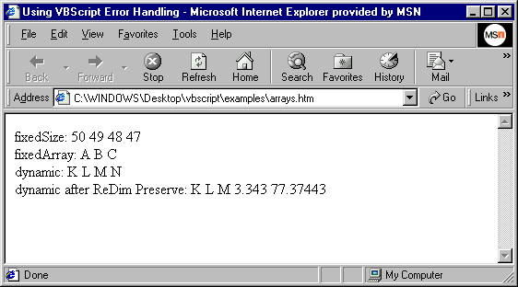
Using VBScript arrays

Slide 39
24.7 String Manipulation
VBScript strings
  Case sensitive
String-manipulation functions
  List of all String-manipulation functions in Fig. 24.19 on pages 750-752 in the textbook
  Instr
    Searches string (first argument) for substring (second argument)
    Searching performed from left to right
    If substring is found, index of found substring in the search string returned
    Instr("sparrow","arrow") returns 3
    Instr("japan","wax") returns 0

Slide 40
24.7 String Manipulation
  Lcase
    Returns a lowercase string
    Lcase(“HELLO@97[“) returns “hello@97[“
  Right
    Returns string containing characters from right side of string argument
    Right(“Web”,2) returns “eb”
  Join
    Returns string containing the concatenation of array elements separated by a delimiter
    Default delimiter is a space
      Change by passing a delimiter string for second argument
    Join(Array("one","two","three")) returns “one two three”
    Join(Array("one","two","three"),"$^") returns “one$^two$^three”

Slide 41
24.7 String Manipulation
  Split
    Returns array containing substrings
    Default delimiter is space character
    Optional second argument changes the delimiter
    Split("red,white,and blue", ",") returns array containing elements "red", "white" and "and blue"

Slide 42
24.7 String Manipulation
Pig Latin translation algorithm:
  Translate one word at a time
  If first letter a consonant,
    Move first letter to end of word
    Add "ay"
    jump becomes umpjay
  If first letter a vowel
    Move first letter to end of word
    Add "y"
    ace becomes ceay
  Blanks remain as blanks
  Assume no punctuation marks, all words have two or more letters

Slide 43
1 <!DOCTYPE HTML PUBLIC "-//W3C//DTD HTML 4.0 Transitional//EN">
2 <HTML>
3 <!--Fig. 24.20: piglatin.html -->
4
Define Function procedure TranslateToPigLatin
1.1 Split phrase into words
1.2 Convert each word to pig Latin
5 <HEAD>
6 <TITLE>Using VBScript String Functions</TITLE>
7
8 <SCRIPT LANGUAGE = "VBScript">
9 <!--
10 Option Explicit
11
12 Public Function TranslateToPigLatin( englishPhrase )
13 Dim words ’ Stores each individual word
14 Dim k, suffix
15
16 ’ Get each word and store in words, the
17 ’ default delimiter for Split is a space
18 words = Split( englishPhrase )
19
20 For k = 0 to UBound( words )
21 ’ Check if first letter is a vowel
22 If InStr( 1, "aeiou", _
23 LCase( Left( words( k ), 1 ) ) ) Then
24 suffix = "y"
25 Else
26 suffix = "ay"
27 End If
28
29 ’ Convert the word to pig Latin
30 words( k ) = Right( words( k ), _

Slide 44
31 Len( words( k ) ) - 1 ) & _
32 Left( words( k ), 1 ) & suffix
33 Next
34
1.3 Return translated phrase using Join function
35 ’ Return translated phrase, each word
36 ’ is separated by spaces
37 TranslateToPigLatin = Join( words )
38 End Function
39
40 Sub cmdButton_OnClick()
41 Dim phrase
42
43 phrase = Document.Forms( 0 ).txtInput.Value
44
45 Document.forms( 0 ).txtPigLatin.Value = _
46 TranslateToPigLatin( phrase )
47 End Sub
48-->
49</SCRIPT>
50</HEAD>
51
52<BODY>
53<FORM> Enter a sentence
54<INPUT TYPE = "text" NAME = "txtInput" SIZE = "50"><P>
55Pig Latin
56<INPUT TYPE = "text" NAME = "txtPigLatin" SIZE = "70"><P>
57<INPUT TYPE = "button" NAME = "cmdButton" VALUE = "Translate">
58
59</FORM>
60</BODY>
61</HTML>

Slide 45
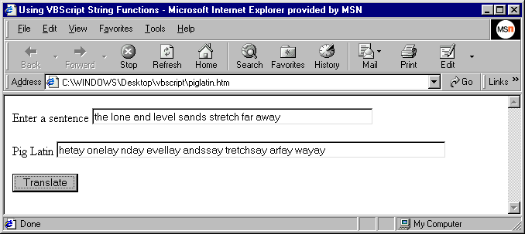
Using VBScript string processing functions

Slide 46
24.8 Classes and Objects
Object-oriented programming
  Objects encapsulate data (attributes) and methods (behaviors)
  Objects have property of information hiding
  Programmers create user-defined or programmer-defined types
    Classes
  Software reusability
  Stacks
    Push onto stack
    Pop off of stack
    LIFO data structure
      Last-in, first-out
  Data abstraction
    Abstract data types (ADTs)

Slide 47
24.8 Classes and Objects
Private data
  Get method
    Accessor method
    Query method
    Allow clients to read value of Private data
  Set method
    Mutator method
    Enable clients to modify Private data
    Can provide data validation capabilities
  Public methods to get or set Private instance variables
    Property Let
      Non-object subtypes (integer, string, byte, etc.)
    Property Set
      Object subtypes
    Property Get

Slide 48
1 Private theHour
2
3 Public Property Let Hour( hr )
4 If hr >= 0 And hr < 24 Then
A simple Property Let procedure
A simple Property Get procedure
5 theHour = hr
6 Else
7 theHour = 0
8 End If
9 End Property
1 Public Property Get Hour()
2 Hour = theHour
3 End Property

Slide 49
24.8 Classes and Objects
Creating objects
  Use keyword New followed by class name
Assigning object to variable
  Use keyword Set
  Variable referring to object called reference
Keywords Class and End Class
Exit Property statement
  Immediately exits Property procedure
Predicate methods
  Test truth or falsity of conditions
Utility or helper methods
  Private methods in a class’s implementation

Slide 50
1 Class CTime1
2 Private mHour
3
4 Public Property Let Hour( hr )
A simple Class definition
5 If hr >= 0 And hr < 24 Then
6 theHour = hr
7 Else
8 theHour = 0
9 End If
10 End Property
11
12 Public Property Get Hour()
13 Hour = theHour
14 End Property
15 End Class

Slide 51
24.8 Classes and Objects
Regular expressions
  RegExp VBScript class
  Complex pattern matching
  regularExpression.Pattern = "^\d{3}-\d{2}-\d{4}$"
    Pattern property
    Caret, ^, indicates beginning of string
    \d indicates any digit is a match
    {3}, {2} and {4} indicate exactly 3 occurrences, 2 occurrences and 4 occurrences
    Dollar sign, $, indicates end of string
    Hyphens treated as literal characters

Slide 52
1 <!DOCTYPE HTML PUBLIC "-//W3C//DTD HTML 4.0 Transitional//EN">
2 <HTML>
3 <!--Fig. 24.24: classes.html -->
4
Define Class Person
1.1 Define Property Let and Property Get procedures
5 <HEAD>
6 <TITLE>Using a VBScript Class</TITLE>
7
8 <SCRIPT LANGUAGE = "VBScript">
9 <!--
10 Option Explicit
11
12 Class Person
13 Private name, yearsOld, ssn
14
15 Public Property Let FirstName( fn )
16 name = fn
17 End Property
18
19 Public Property Get FirstName()
20 FirstName = name
21 End Property
22
23 Public Property Let Age( a )
24 yearsOld = a
25 End Property
26
27 Public Property Get Age()
28 Age = yearsOld
29 End Property
30

Slide 53
31 Public Property Let SocialSecurityNumber( n )
32
33 If Validate( n ) Then
34 ssn = n
1.2 Define Property Let SocialSecurity Number
1.2.1 Call validate
1.3 Validate
1.3.1 Use regular expression to check format
35 Else
36 ssn = "000-00-0000"
37 Call MsgBox( "Invalid Social Security Format" )
38 End If
39
40 End Property
41
42 Public Property Get SocialSecurityNumber()
43 SocialSecurityNumber = ssn
44 End Property
45
46 Private Function Validate( expression )
47 Dim regularExpression
48 Set regularExpression = New RegExp
49
50 regularExpression.Pattern = "^\d{3}-\d{2}-\d{4}$"
51
52 If regularExpression.Test( expression ) Then
53 Validate = True
54 Else
55 Validate = False
56 End If
57
58 End Function
59
60 Public Function ToString()

Slide 54
61 ToString = name & Space( 3 ) & age & Space( 3 ) _
62 & ssn
63 End Function
64
65 End Class ’ Person
1.4 Instantiate Person object
66
67 Sub cmdButton_OnClick()
68 Dim p ’ Declare object reference
69 Set p = New Person ’ Instantiate Person object
70
71 With p
72 .FirstName = Document.Forms(0).txtBox1.Value
73 .Age = CInt( Document.Forms(0).txtBox2.Value )
74 .SocialSecurityNumber = Document.Forms(0).txtBox3.Value
75 Call MsgBox( .ToString() )
76 End With
77
78 End Sub
79-->
80</SCRIPT>
81</HEAD>
82
83<BODY>
84<FORM>Enter first name
85<INPUT TYPE = "text" NAME = "txtBox1" SIZE = "10">
86<P>Enter age
87<INPUT TYPE = "text" NAME = "txtBox2" SIZE = "5">
88<P>Enter social security number
89<INPUT TYPE = "text" NAME = "txtBox3" SIZE = "10"> <P>
90<INPUT TYPE = "button" NAME = "cmdButton" VALUE = "Enter">
91
92</FORM>
93</BODY>
94</HTML>

Slide 55
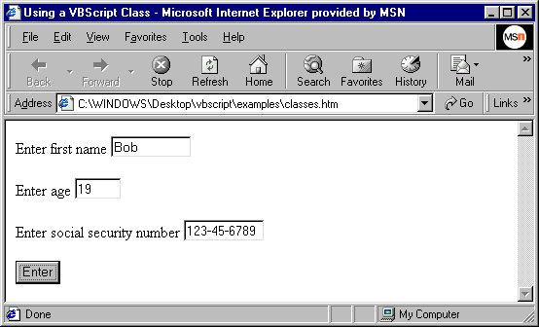
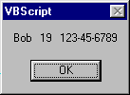
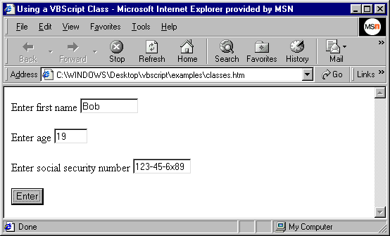
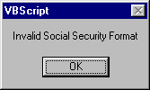

Using VBScript classes and regular expressions

