Slide 1
Chapter 25 – Active Server Pages (ASP)
Outline
25.1 Introduction
25.2 How Active Server Pages Work
25.3 Client-side Scripting versus Server-side Scripting
25.4 Using Personal Web Server or Internet Information Server
25.5 Active Server Page Objects
25.6 A Simple ASP Example
25.7 Server-side ActiveX Components
25.8 File System Objects
25.9 Session Tracking and Cookies
25.10 Microsoft SQL, UDA and ADO
25.11 Accessing a Database from an Active Server Page

Slide 2
25.1 Introduction
Active Server Pages (ASP)
  Processed in response to client request
  ASP file contains HTML and scripting code
  VBScript de facto language for ASP scripting
    Other languages can be used
      JavaScript
  .asp file extension
  Microsoft-developed technology
  Send dynamic Web content
    HTML
    DHTML
    ActiveX controls
    Client-side scripts
    Java applets

Slide 3
25.2 How Active Server Pages Work
Client sends request
  Server receives request and directs it to ASP
  ASP processes, then returns result to client
HTTP request types
  Request methods
    GET
      Gets (retrieves) information from server
      Retrieve HTML document or image
    POST
      Posts (sends) data to server
      Send info from HTML form

Slide 4
25.2 How Active Server Pages Work
Browsers often cache Web pages
  Cache: save on disk
  Typically do not cache POST response
    Next POST request may not return same result
Client requests ASP file
  Parsed (top to bottom) by ActiveX component asp.dll
  Parsed each time requested
  Web server must support ASP by providing component such as asp.dll

Slide 5
25.3 Client-side Scripting versus
Server-side Scripting
Client-side scripting
  Commonly used
  Browser-dependent
    Scripting language must be supported by browser or scripting host
  Viewable on client
    Protecting source code difficult
  Reduces the number of requests the server receives
  Enhance a Web page’s content
    Richer functionality than HTMl

Slide 6
25.3 Client-side Scripting versus
Server-side Scripting
Server-side scripting
  Reside on server
  Greater flexibility – database access
  Usually generate custom response for client
  Access to ActiveX server components
    Extend scripting language functionality
  Run exclusively on server → cross-platform issues not a concern
  Not visible to client
    Only HTML + client-side scripts sent to client

Slide 7
25.4 Using Personal Web Server or Internet Information Server
ASP requires
  Web server
    Personal Web Server (PWS) 4.0
    Internet Information Server (IIS) 4.0
  Database – .mdb files
  Configuration for examples in this book can be found on page 778
    May have to change paths in .asp files to reflect your directory structure

Slide 8
25.5 Active Server Page Objects
ASP has several built-in objects
  Request object
    Access information passed by GET or POST
    Used to access cookies
  Response object
    Sends information such as HTML or text to client
  Server object
    Provides access to server methods and properties
    Provides method CreateObject
      Used to instantiate other objects

Slide 9
25.6 A Simple ASP Example
Scripting delimiters
  <% and %>
  Indicate code is to be executed on server, not client
@LANGUAGE
  Specify scripting language (default VBScript)
  <% @LANGUAGE = “VBScript” %>
Each time page refreshed, server loads and interprets ASP

Slide 10
1<% @LANGUAGE = VBScript %>
2<% Option Explicit %>
3<!DOCTYPE HTML PUBLIC "-//W3C//DTD HTML 4.0 Transitional//EN">
4<% ' Fig. 25.2 : clock.asp %>
1.1 Specify VBScript as scripting language
1.2 Use Option Explicit to indicate variables be explicitly declared by programmer
1.3 Use META tag to set refresh interval
Time gets current time on server (hh:mm:ss)
Short for <% Call Response.Write( Time() ) %>
5
6<HTML>
7<HEAD>
8<TITLE>A Simple ASP Example</TITLE>
9<META HTTP-EQUIV = "REFRESH" CONTENT = "60; URL = CLOCK.ASP">
10</HEAD>
11<BODY>
12
13<FONT FACE = ARIAL SIZE = 4><STRONG>Simple ASP Example</STRONG>
14</FONT><P>
15 <TABLE BORDER = "6">
16 <TR>
17 <TD BGCOLOR = "#000000">
18 <FONT FACE = Arial COLOR = "#00FF00" SIZE = 4>
19 <% =Time() %>
20 </FONT>
21 </TD>
22 </TR>
23 </TABLE>
24</BODY>
25</HTML>

Slide 11
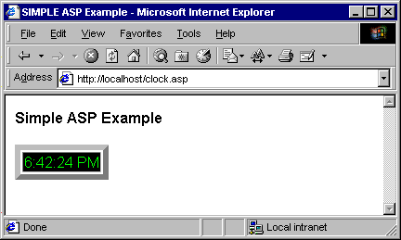

Output from a simple Active Server Page

Slide 12
25.7 Server-side ActiveX Components
Server-side ActiveX components
  Typically do not have GUI
  If scripting language for ASP not support certain feature, create ActiveX Server component
    Visual C++, Visual Basic, Delphi, etc.
  Usually execute faster than scripting language equivalents
  Executed on server
    Client does not need to support ActiveX technologies

Slide 13
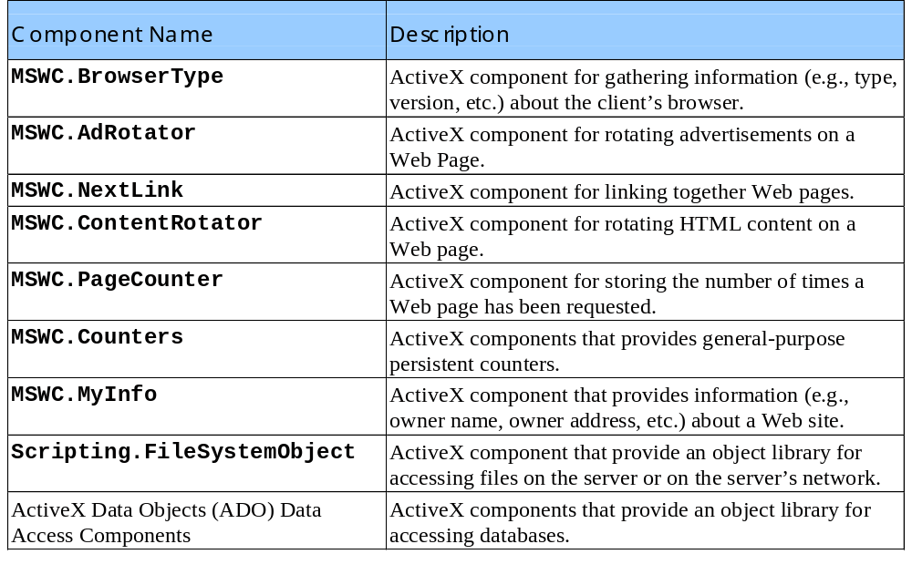
Some server-side ActiveX components included with IIS and PWS

Slide 14
1<% @LANGUAGE = VBScript %>
2<% Option Explicit %>
3<% ' Fig. 25.4 : rotate.asp %>
4
1.1 Create instance of AdRotator component
1.2 Call Response object’s Write method to send advertisement to client
5<!DOCTYPE HTML PUBLIC "-//W3C//DTD HTML 4.0 Transitional//EN">
6<HTML>
7<HEAD>
8<TITLE>AdRotator Example</TITLE>
9</HEAD>
10
11<BODY>
12<FONT FACE = "Arial" SIZE = "4">
13<STRONG>AdRotator Example</STRONG>
14</FONT><P>
15<%
16 ' Declare flagChanger
17 Dim flagChanger
18
19 ' Create an AdRotator object
20 Set flagChanger = Server.CreateObject( "MSWC.AdRotator" )
21
22 ' Use config.txt to send an advertisement to the client
23 Call Response.Write( _
24 flagChanger.GetAdvertisement( "config.txt" ) )
25%>
26</BODY>
27</HTML>

Slide 15
28REDIRECT redirect.asp
29WIDTH 54
30HEIGHT 36
31BORDER 1
config.txt
Header includes image HEIGHT, image WIDTH and image BORDER width
Asterisk separates header from advertisements
Image location
Destination URL
ALT tag
Percentage of time image appears
32*
33/images/us.gif
34http://www.odci.gov/cia/publications/factbook/us.html
35United States Information
3620
37/images/france.gif
38http://www.odci.gov/cia/publications/factbook/fr.html
39France Information
4020
41/images/germany.gif
42http://www.odci.gov/cia/publications/factbook/gm.html
43Germany Information
4420
45/images/italy.gif
46http://www.odci.gov/cia/publications/factbook/it.html
47Italy Information
4820
49/images/spain.gif
50http://www.odci.gov/cia/publications/factbook/sp.html
51Spain Information
5220

Slide 16
HTML sent to client by rotate.asp
Note this has been edited for presentation
53 <A HREF = "redirect.asp?url=http://www.odci.gov/cia/publications/
54 factbook/us.html&image=/images/us.gif">
55 <IMG SRC = "/images/us.gif" ALT = "United States Information"
56 WIDTH = "54" HEIGHT = "36" BORDER = "1"></A>

Slide 17
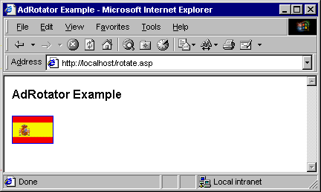
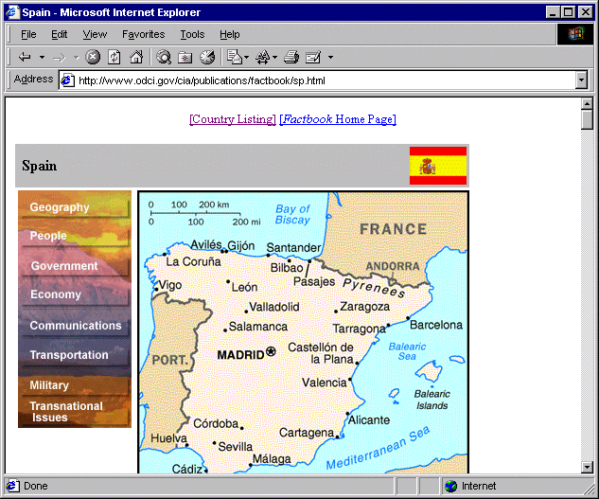
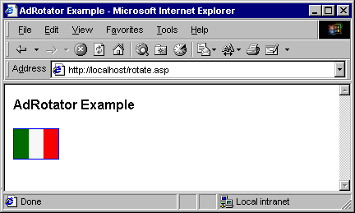
Demonstrating the AdRotator ActiveX component

Slide 18
25.8 File System Objects
File System Objects (FSOs)
  Manipulate files, directories and drives
  Read and write text
  In Microsoft Scripting Runtime Library
  5 FSO types:
    FileSystemObject
      Interact with Files, Folders and Drives
    File
      Manipulate Files of any type
    Folder
      Manipulate Folders (i.e, directories)
    Drive
      Gather info about Drives (local or remote)
    TextStream
      Read and write text files

Slide 19
25.8 File System Objects
OpenTextFile(filename, code, create)
  filename - file to open
  code
    8 - open for appending
    1 - open for reading
    2 - open for writing
  create? - if true, creates a new file if does not exist

Slide 20
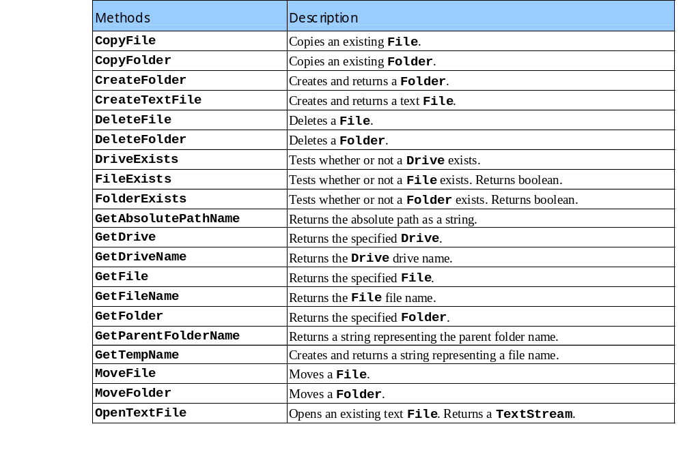
FileSystemObject methods

Slide 21
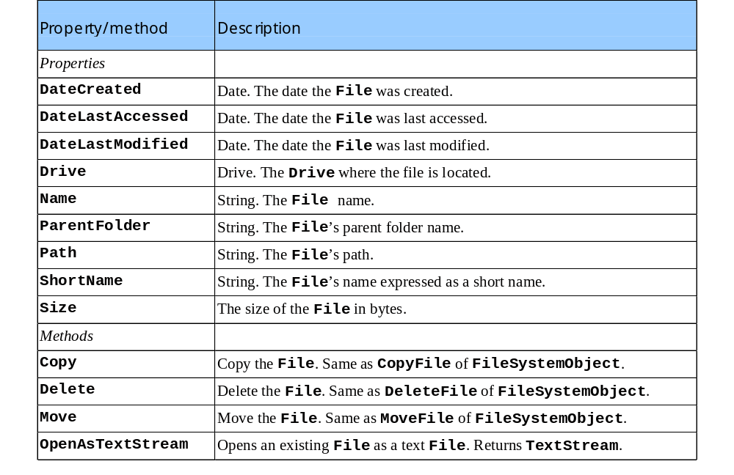
Some common File properties and methods

Slide 22
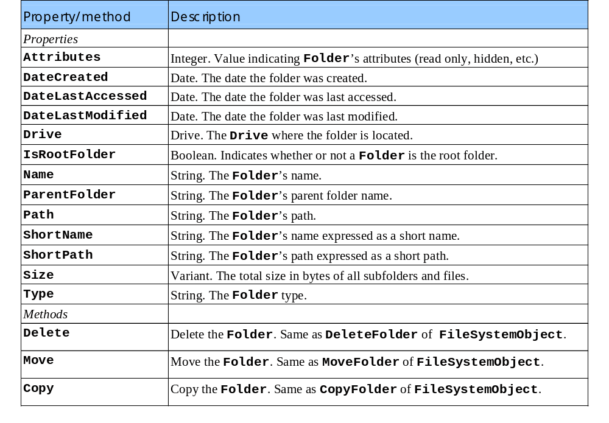
Some Folder properties and methods

Slide 23
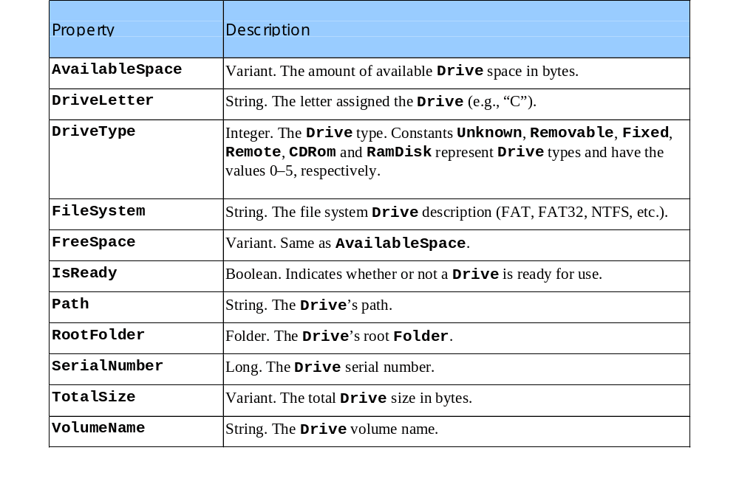
Drive properties

Slide 24
1<% @LANGUAGE = VBScript %>
2<% Option Explicit %>
3
4<% ' Fig. 25.12 : guestbook.asp %>
5
1.1 Test if entry variable “true”; when page first requested has value “”; passed value “true” during POST operation
1.2 Create FSO instance
6<!DOCTYPE HTML PUBLIC "-//W3C//DTD HTML 4.0 Transitional//EN">
7<HTML>
8<HEAD>
9<TITLE>GuestBook Example</TITLE>
10<BODY>
11<FONT SIZE = "4" FACE = "Arial" COLOR = "blue">
12
13<%
14 Dim fileObject, textFile, guestBook, mailtoUrl
15
16 ' If user has made an entry and thus the page is
17 ' reloading, then process this entry
18 If Request( "entry" ) = "true" Then
19
20 ' Print a thank you
21 Call Response.Write( "Thanks for your entry, " )
22 Call Response.Write( Request( "name" ) & "!" )
23%>
24<HR COLOR = "blue" SIZE = "1">
25<% ' Instantiate a FileSystemObject
26 Set fileObject = Server.CreateObject( _
27 "Scripting.FileSystemObject" )
28
29 ' Guestbook path must be modified to reflect the file
30 ' structure of the server.
31 guestBook = "c:\Inetpub\Wwwroot\Deitel\" & "guestbook.txt"
32
33 ' Check if the file exists. If not, create it.

Slide 25
34 If fileObject.FileExists( guestbook ) <> True Then
35 Call fileObject.CreateTextFile( guestBook )
36 End If
37
38 ' Guestbook must be open for writing.
1.3 Specify POST operation
39 ' Open the guestbook, 8 is for appending
40 Set textFile = fileObject.OpenTextFile( guestbook, 8, True )
41
42 ' Build the mailtoUrl
43 mailtoUrl = Date() & " <A HREF = " & Chr( 34 ) _
44 & "mailto:" & Request( "email" ) & Chr( 34 ) _
45 & ">" & Request( "name" ) & "</A>: "
46
47 ' Write data to guestbook.txt
48 Call textFile.WriteLine( "<HR COLOR = " & Chr( 34 ) _
49 & "blue" & Chr( 34 ) & " SIZE = " & Chr( 34 ) _
50 & "1" & Chr( 34 ) & ">" )
51 Call textFile.WriteLine( mailtoUrl )
52 Call textFile.WriteLine( Request( "comment" ) )
53 Call textFile.Close()
54 End If
55%>
56
57Please leave a message in our guestbook.
58
59</FONT>
60<FORM ACTION = "guestbook.asp?entry=true" METHOD = "POST">
61<CENTER>
62<TABLE>
63<TR>
64<TD><FONT FACE = "Arial" SIZE = "2">Your Name: </FONT></TD>
65<TD><INPUT TYPE = "text" FACE = "Arial"
66 SIZE = "60" NAME = "name"></TD>

Slide 26
67</TR>
68<TR>
69<TD><FONT FACE = "Arial" SIZE = "2">Your email address:
70</FONT></TD>
71<TD><INPUT TYPE = "text" FACE = "Arial" SIZE = "60"
1.5 Load FSO
72 NAME = "email" VALUE = "user@isp.com"></TD>
73</TR>
74<TR>
75<TD><FONT FACE = "Arial" SIZE = "2">Tell the world: </FONT>
76</TD>
77<TD><TEXTAREA NAME = "comment" ROWS = "3" COLS = "50">
78Replace this text with the information
79you would like to post.
80</TEXTAREA></TD>
81</TR>
82</TABLE>
83<INPUT TYPE = "submit" VALUE = "SUBMIT">
84<INPUT TYPE = "reset" VALUE = "CLEAR">
85</CENTER>
86</FORM>
87
88<%
89 Dim fileObject2, textFile2
90
91 ' Instantiate a FileSystemObject
92 Set fileObject2 = Server.CreateObject( _
93 "Scripting.FileSystemObject" )
94
95 ' Guestbook path must be modified to reflect
96 ' the file structure of the server.
97 guestBook = "c:\Inetpub\wwwroot\Deitel\" & "guestbook.txt"
98
99 ' Check if the file exists. If not, create it.

Slide 27
100 If fileObject2.FileExists( guestBook ) = True Then
101
102 ' Guestbook must be open for writing.
103 ' Open the guestbook, "1" is for reading.
104 Set textFile2 = fileObject2.OpenTextFile( guestbook, 1 )
1.6 Display contents of guestbook.txt
105
106 ' Read the entries from the file and write them to
107 ' the client.
108 Call Response.Write( "Guestbook Entries:<BR>" )
109 Call Response.Write( textFile2.ReadAll() )
110 Call textFile2.Close()
111 End If
112%>
113
114</BODY>
115</HTML>

Slide 28
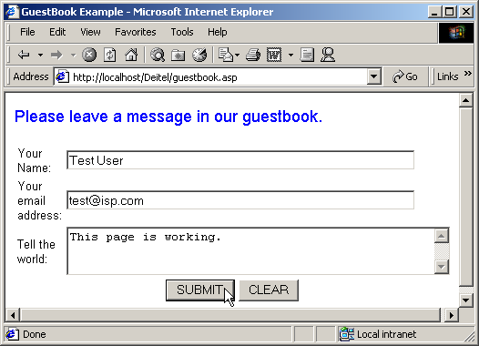
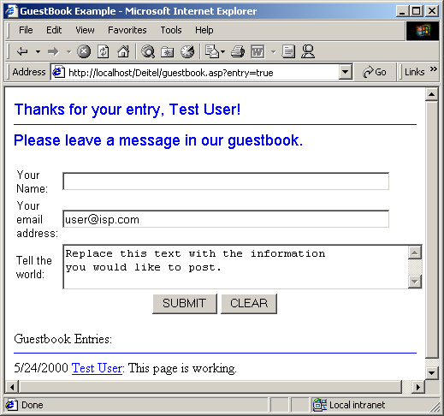
Guest book Active Server Page

Slide 29
25.9 Session Tracking and Cookies
Customized services
  http://my.yahoo.com/
  Shopping cart
  Marketing
Track clients
  Session tracking
    Handled by server
    ASP: Session object
      Timeout property
        Default: 20 minutes
        Terminate with Abandon method

Slide 30
25.9 Session Tracking and Cookies
Cookies
  Small files sent as part of response to client
  Every HTTP interaction between client and server includes header
    Contains info about request or response
      Request: type of request (GET or POST) and cookies stored on client machine
  Maximum age
    Duration of browsing session
    Store cookies on client computer for future use
    Cookies automatically deleted when expire

Slide 31
25.9 Session Tracking and Cookies
ASP application
  Multiple ASP pages linked through POST requests
Server side include (SSI)
  SSI statement replaced with contents of file
  SSI statements always execute before any scripting code
  .inc extension
Virtual paths vs. physical paths

Slide 32
1<% @LANGUAGE = VBScript %>
2<% Option Explicit %>
3
4<% ' Fig. 25.13 : instantpage.asp %>
1.1 Use SSI statement to include mgtheader.inc
1.2 Retrieve value of session variable fileNameString
1.3 Load process.asp in response to POST request
5
6<!DOCTYPE HTML PUBLIC "-//W3C//DTD HTML 4.0 Transitional//EN">
7<HTML>
8<HEAD>
9<TITLE>Instant Page Content Builder</TITLE>
10</HEAD>
11
12<BODY>
13
14<% ' Include the header %>
15<!-- #include virtual = "/includes/mgtheader.shtml" -->
16<FONT FACE = "Arial" SIZE = "2">
17<H2>Instant Page Content Builder</H2>
18
19<% ' If process.asp signaled an error, print the error
20 ' message.
21 If Request( "error" ) = "yes" Then
22 Call Response.Write( Session( "errorMessage" ) )
23 ' Otherwise, print the welcome back message, if any.
24 Else
25 Call Response.Write( Session( "welcomeBack" ) )
26 End If
27
28 ' A form to get the information from the user.
29%>
30<FORM ACTION = "process.asp" METHOD = "POST">
31
32<CENTER>

Slide 33
33
34<TABLE>
35<TR>
36<TD><FONT FACE = "Arial" SIZE = "2">Your Name:
37</FONT><BR></TD>
38<TD><INPUT TYPE = "text" FACE = "Arial" SIZE = "60"
39 NAME = "name"><BR></TD>
40</TR>
41<TR>
42<TD><FONT FACE = "Arial" SIZE = "2">Enter the Filename:
43</FONT><BR></TD>
44<TD><INPUT TYPE = "text" FACE = "Arial" SIZE = "60"
45 NAME = "filename" VALUE = "YourFileName.asp"><BR>
46</TD>
47</TR>
48<TR>
49<TD><FONT FACE = "Arial" SIZE = "2">Enter the Title:
50</FONT><BR></TD>
51<TD><INPUT TYPE = "text" FACE = "Arial" SIZE = "60"
52 NAME = "doctitle" VALUE = "Document Title"><BR>
53</TD>
54</TR>
55<TR>
56<TD><FONT FACE = "Arial" SIZE = "2">Enter the Content:
57</FONT><BR></TD>
58<TD><TEXTAREA NAME = "content" ROWS = "3" COLS = "50">
59Replace this text with the
60information you would like to post.
61</TEXTAREA><BR></TD>
62</TR>
63</TABLE>
64<INPUT TYPE = "submit" VALUE = "SUBMIT">

Slide 34
65<INPUT TYPE = "reset" VALUE = "CLEAR">
66</CENTER>
67</FORM>
68
1.4 Use SSI statement to include mgtfooter.inc
mgtheader.inc
mgtfooter.inc
69<!-- #include virtual = "/includes/mgtfooter.shtml" -->
70</FONT>
71</BODY>
72</HTML>
73<HR SIZE = "1" COLOR = "blue">
74<IMG HEIGHT = "100" SRC = "/images/mgheader.gif">
75<HR SIZE = "1" COLOR = "blue">
76 <HR COLOR = "blue" SIZE = "1">
77 <CENTER>
78 <A HREF = "mailto:orders">Ordering Information</A> -
79 <A HREF = "mailto:editor">Contact the Editor</A><BR>
80 <HR COLOR = "blue" SIZE = "1">
81 </CENTER>

Slide 35
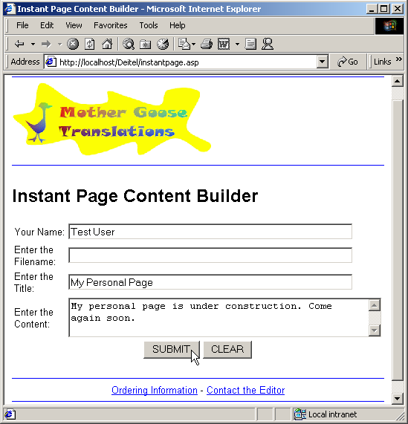
Output from instantpage.asp

Slide 36
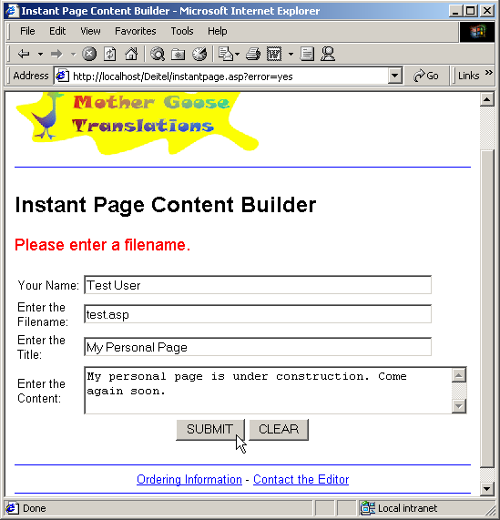
Output from instantpage.asp

Slide 37
82<% @LANGUAGE = VBScript %>
83<% Option Explicit %>
84
85<% ' Fig. 25.17 : process.asp %>
1. process.asp
1.1 Validate the filename
1.2 Create a FileSystemObject
1.3 Set directoryPath
86
87<% Dim q
88 q = Chr( 34 )
89
90 ' Check to make sure that they have entered a filename
91 If Request( "filename" ) = "YourFileName.asp" Or _
92 Request( "filename" ) = "" Then
93 Session( "errorMessage" ) = "<FONT COLOR = " & q _
94 & "red" & q & " SIZE = " & q & "4" & q & ">" _
95 & "Please enter a filename." & "</FONT>" & "<BR>"
96 Call Response.Redirect( "instantpage.asp?error=yes" )
97 End If
98
99 Dim directoryPath, filePath, fileObject
100
101 ' Create a FileSystem Object
102 Set fileObject = Server.CreateObject( _
103 "Scripting.FileSystemObject" )
104
105 ' directoryPath must be modified to reflect the file
106 ' structure of your server
107 directoryPath = "c:\Inetpub\Wwwroot\userpages\"
108
109 ' See if the directory exists. If not, create it.

Slide 38
110 If Not fileObject.FolderExists( directoryPath ) Then
111 Call fileObject.CreateFolder( directoryPath )
112 End If
113
1.4 Check if file exists
1.5 Write welcome back message
114 ' Build path for text file.
115 filePath = directoryPath & Request( "filename" )
116
117 ' Check if the file already exists
118 If fileObject.FileExists( filePath ) Then
119 Session( "errorMessage" ) = "<FONT COLOR = " & q _
120 & "red" & q & " SIZE = " & q & "4" & q & ">" _
121 & "This filename is in use. " _
122 & "Please enter another filename." & "</FONT>" _
123 & "<BR>"
124 Call Response.Redirect( "instantpage.asp?error=yes" )
125 End If
126
127 ' Save HTML for the welcome back message
128 ' in a session variable
129 Session( "welcomeBack" )= "<FONT COLOR = " _
130 & q & "blue" & q & " SIZE = " _
131 & q & "4" & q & ">" _
132 & "Welcome Back, " & Request( "name" ) & "!</FONT>" _
133 & "<BR>"
134
135 Dim header, footer, textFile, openMark, closeMark
136 openMark = "<" & "%"
137 closeMark = "%" & ">"
138

Slide 39
139 ' Build the header.
140 ' vbCrLf inserts a carriage return/linefeed into the text
141 ' string which makes the HTML code more readable
142 header = openMark & " @LANGUAGE = VBScript " & closeMark _
1.6 Create header
1.7 Create footer
143 & vbCrLf & openMark & " ' " & Request( "filename" ) _
144 & " " & closeMark & vbCrLf & vbCrLf _
145 & "<!DOCTYPE HTML PUBLIC " & q _
146 & "-//W3C//DTD HTML 4.0 Transitional//EN" & q & ">" _
147 & vbCrLf & "<HTML>" & vbCrLf & "<HEAD>" & vbCrLf _
148 & "<META NAME = " & q & "author" & q & " CONTENT = " _
149 & q & Request( "name" ) & q & ">" & vbCrLf _
150 & "<META NAME = " & q & "pubdate" & q _
151 & " CONTENT = " & q & Date() & q & ">" & vbCrLf _
152 & "<TITLE>" & Request( "doctitle" ) & "</TITLE>" _
153 & vbCrLf & "</HEAD>" & vbCrLf & "<BODY>" & vbCrLf _
154 & "<FONT FACE = " & q & "arial" & q & " SIZE = " & q _
155 & "3" & q & " >" & vbCrLf _
156 & "<!-- #include virtual = " & q _
157 & "/includes/mgtheader.shtml" & q & " -->" & vbCrLf _
158 & "<CENTER><U><H2>" & Request( "doctitle" ) _
159 & "</H2></U>" & vbCrLf & "<BR>" & vbCrLf
160
161 ' Build the footer using a different style for
162 ' building the string
163 footer = vbCrLf & "</CENTER><BR><BR><BR>" & vbCrLf
164 footer = footer & "You have requested this page on "
165 footer = footer & openMark & " =Date() " & closeMark & ","
166 footer = footer & vbCrLf & "at " & openMark & " =Time() "
167 footer = footer & closeMark & "." & vbCrLf
168 footer = footer & "<!-- #include virtual = " & q
169 footer = footer & "/includes/mgtfooter.shtml" & q

Slide 40
170 footer = footer & " -->" & vbCrLf & "</FONT>"
171 footer = footer & vbCrLf & "</BODY>" & vbCrLf & "</HTML>"
172
173 ' Create the html file
2. HTML portion of page
2.1 Provide link to generated page
174 Set textFile = fileObject.CreateTextFile( filePath, False )
175 Call textFile.WriteLine( header )
176 Call textFile.WriteLine( Request( "content" ) )
177 Call textFile.Write( footer )
178 Call textFile.Close
179%>
180<!DOCTYPE HTML PUBLIC "-//W3C//DTD HTML 4.0 Transitional//EN">
181<HTML>
182<HEAD>
183
184<% ' Use the title given by the user %>
185<TITLE>File Generated: <% =Request( "filename" ) %></TITLE>
186</HEAD>
187
188<BODY>
189
190<!-- #include virtual = "/includes/mgtheader.shtml" -->
191
192<FONT FACE = "Arial" SIZE = "3">
193<CENTER><U><H2>
194 File Generated: <% =Request( "filename" ) %>
195</H2></U></CENTER><BR>
196<% ' Provide a link to the generated page %>
197Your file is ready:
198<A HREF = "/userpages/<% =Request( "filename" ) %>">
199<% =Request( "doctitle" ) %></A>

Slide 41
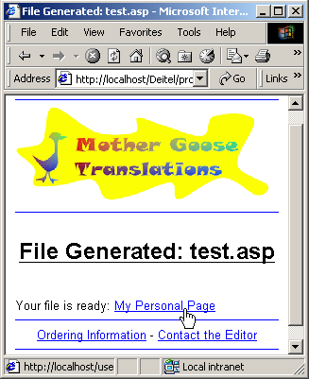
200
201<!-- #include virtual = "/includes/mgtfooter.shtml" -->
202
203</FONT>
204</BODY>
205</HTML>

Slide 42
1<% @LANGUAGE = VBScript %>
2<% ' Fig. 25.18 : test.asp %>
3
4<!DOCTYPE HTML PUBLIC "-//W3C//DTD HTML 4.0 Transitional//EN">
1. test.asp
5<HTML>
6<HEAD>
7<META NAME = "author" CONTENT = "Test User">
8<META NAME = "pubdate" CONTENT = "5/29/2000">
9<TITLE>My Personal Page</TITLE>
10</HEAD>
11<BODY>
12<FONT FACE = "Arial" SIZE = "3">
13<!-- #include virtual = "/includes/mgtheader.shtml" -->
14<CENTER><U><H2>My Personal Page</H2></U>
15<BR>
16
17My personal page is under construction. Come again soon.
18
19</CENTER><BR><BR><BR>
20You have requested this page on <% =Date() %>,
21at <% =Time() %>.
22<!-- #include virtual = "/includes/mgtfooter.shtml" -->
23</FONT>
24</BODY>
25</HTML>

Slide 43
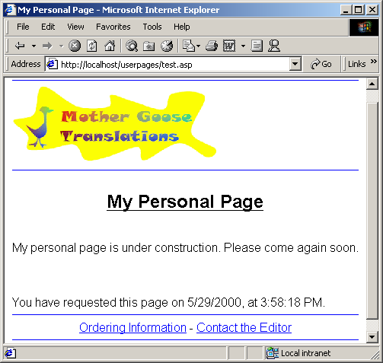
Listing for test.asp

Slide 44
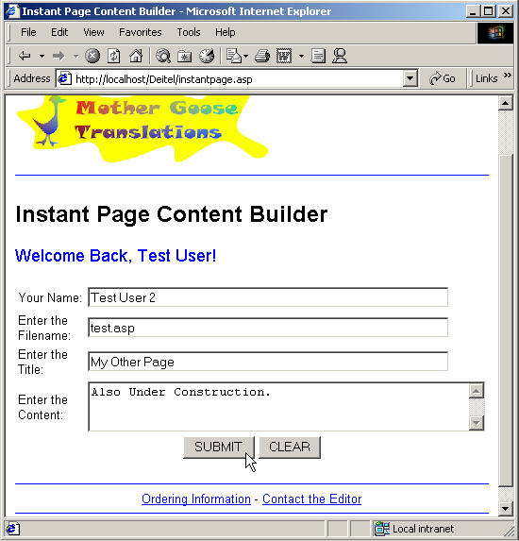
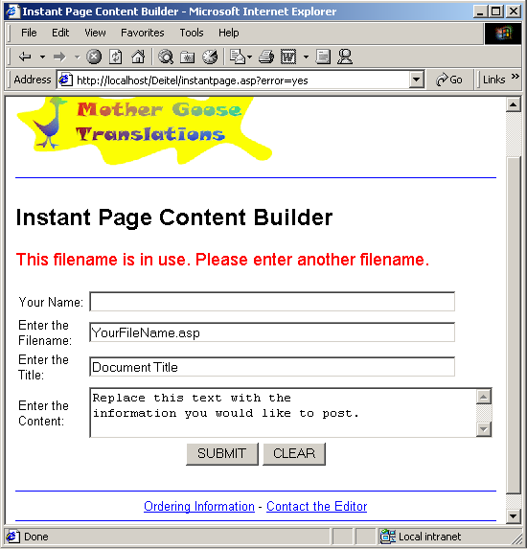
Output from instantpage.asp

Slide 45
25.10 Databases, SQL,
Microsoft UDA and ADO
Database
  Integrated collection of data
  Relational databases
    Composed of tables with columns (or fields) and records (or rows)
    Primary key – unique field used to identify a record
    Structured Query Language (SQL)
  Queries – data requests
Database management system (DBMS)
  Data
  Controlling software – storage and retrieval

Slide 46
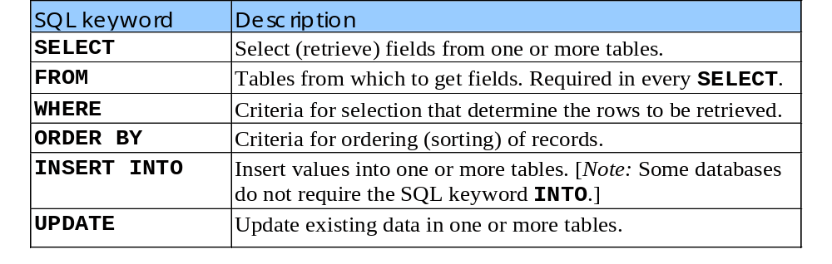
25.10 Databases, SQL,
Microsoft UDA and ADO
Some SQL query keywords
SELECT
  Performs queries
  Simplest form:
        SELECT * FROM TableName
    * indicates that all rows and columns from Tablename should be selected

Slide 47
25.10 Databases, SQL,
Microsoft UDA and ADO
  Selecting specific field from a table
    SELECT FieldName1, FieldName2 FROM TableName
  Specifying selection criteria
    SELECT FieldName1, FieldName2 FROM TableName WHERE criteria
WHERE
  Can contain equality and relational operators
  LIKE used for pattern matching
    Wildcard characters
      Asterick(*)
      Question Mark(?)

Slide 48
25.10 Databases, SQL,
Microsoft UDA and ADO
  Join conditions – conditions that join, merge or extract data from multiple tables
    SELECT * FROM TableName1, TableName2 WHERE criteria
ORDER BY
  Sort query results into ascending or descending order
    SELECT * FROM TableName ORDER BY fieldName ASC
INSERT INTO
  INSERT INTO TableName ( fieldName1, fieldName2, … , fieldNameN )
  VALUES( value1, value2, … , valueN )
UPDATE
  UPDATE TableName
  SET fieldName1 = value1, …, fieldNameN = ValueN
  WHERE criteria

Slide 49
25.10 Databases, SQL,
Microsoft UDA and ADO
Accessing a database
  To execute an SQL query, program must have access to database
  Open Database Connectivity (ODBC)
  Application Program Interface (API)
Microsoft Universal Data Access (UDA)
  High performance database architecture
  Non-relational
  ActiveX Data Objects (ADO)
  www.microsoft.com/data/ado/adords15/

Slide 50
25.11 Accessing a Database from an
Active Server Page
ASP can communicate with databases
  Via ADO (ActiveX Data Objects)
Three-tier distributed applications
  User interface
    Often created using HTML, Dynamic HTML or XML
  Business logic
    Use Web servers
  Database access
  All three tiers may reside on separate computers connected to a network

Slide 51
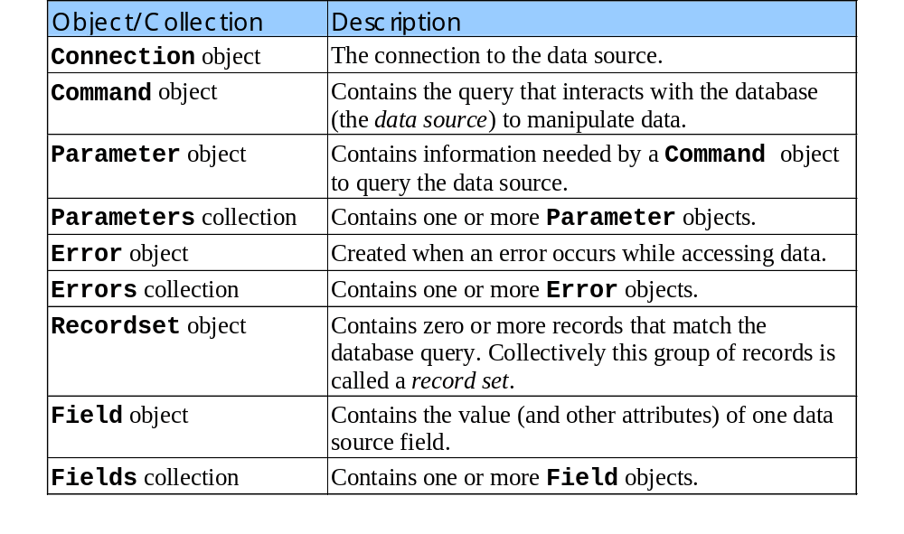
25.11 Accessing a Database from an
Active Server Page
Some ADO object and collection types:

Slide 52
1<% @LANGUAGE = VBScript %>
2<% Option Explicit %>
3
4<% ' Fig. 25.24 : login.asp %>
5
1. login.asp
1.1 Establish database connection
6<% Dim connection, query, loginData
7
8 Set connection = Server.CreateObject( "ADODB.Connection" )
9 Call connection.Open( "login" )
10
11 ' Create the SQL query
12 query = "SELECT loginID FROM Users"
13
14 ' Create the record set
15 Set loginData = Server.CreateObject( "ADODB.Recordset" )
16 Call loginData.Open( query, connection )
17
18 ' If an error occurs, ignore it
19 On Error Resume Next
20%>
21
22<!DOCTYPE HTML PUBLIC "-//W3C//DTD HTML 4.0 Transitional//EN">
23<HTML>
24<HEAD><TITLE>Login Page</TITLE></HEAD>
25
26<BODY>
27
28<!-- #include virtual="/includes/mgtheader.shtml" -->
29
30<%
31 ' If this is a return after a failed attempt,
32 ' print an error
33 If Session( "loginFailure" ) = True Then %>

Slide 53
34<FONT SIZE = "4" COLOR = "red"> Login attempt failed,
35please try again <P></FONT>
36<% End If
37
38 ' Begin the form %>
1.2 User name and password form
1.3 Check loginID with cookies
39<FONT FACE = "Arial" SIZE = "2">
40Please select your name and enter
41your password to login:<BR>
42</FONT>
43<FORM ACTION = "submitlogin.asp" METHOD = "POST">
44
45<% ' Format the form using a table %>
46<TABLE BORDER = "0">
47<TR>
48<TD><FONT FACE = "Arial" SIZE = "2">Name:</FONT></TD>
49<TD><SELECT NAME = "loginID">
50<OPTION VALUE = "noSelection">Select your name
51
52<% ' If the loginID cookie is an empty string then there is
53 ' no need to consider the returning case
54 If Request.Cookies( "loginID" ) <> "" Then
55 Call BuildReturning()
56 Else
57 Call BuildNewUser()
58 End If
59%>
60
61</SELECT>
62</TD>
63</TR>
64
65<TR>
66<TD><FONT FACE = "Arial" SIZE = "2">Password:</FONT></TD>

Slide 54
67<TD><INPUT TYPE = "password" NAME = "password"></TD>
68</TR>
69<TR>
70<TD>&nbsp;</TD>
71<TD ALIGN = "left">
1.4 Create dropdown list
72 <INPUT TYPE = "submit" VALUE = "Log Me In">
73</TD>
74</TR>
75</TABLE>
76</FORM>
77</FONT>
78
79<!-- #include virtual="/includes/mgtfooter.shtml" -->
80
81</BODY>
82</HTML>
83
84<% ' Builds the OPTION items for loginIDs and writes
85 ' selected for the loginID of the returning user
86 Sub BuildReturning()
87 Dim found
88
89 ' Pull user names from the record set to populate the
90 ' dropdown list
91 found = False
92 While Not loginData.EOF
93 ' Create this record's dropdown entry
94%> <OPTION
95<% ' If we did not write SELECTED for any OPTION
96 ' before
97 If ( Not found ) Then
98
99 ' If the current record's loginID is equal to

Slide 55
100 ' the loginID cookie, then it is the loginID of
101 ' the returning user, and thus we need to write
102 ' SELECTED for this option; in this case we also
103 ' need to signal that we have written SELECTED
1.4 Create drop down list
1.5 BuildNewUser function
104 ' for an OPTION by setting found to True.
105 If Request.Cookies( "loginID" ) _
106 = loginData( "loginID" ) _
107 Then
108 Call Response.Write( "SELECTED" )
109 found = True
110 End If
111 End If
112%> VALUE = "<% =loginData( "loginID" ) %>">
113 <% =loginData( "loginID" ) %>
114<% Call loginData.MoveNext()
115 Wend
116 End Sub
117
118 ' Builds the OPTION items for loginIDs without writing
119 ' SELECTED for any loginID
120 Sub BuildNewUser()
121
122 ' Pull user names from the record set to populate the
123 ' dropdown list
124 While Not loginData.EOF
125 ' Create this record's dropdown entry
126%> <OPTION VALUE = "<% =loginData( "loginID" ) %>">
127 <% =loginData( "loginID" ) %>
128<% Call loginData.MoveNext()
129 Wend
130 End Sub
131%>

Slide 56
132<% @LANGUAGE = VBScript %>
133<% Option Explicit %>
134
135<% ' Fig. 25.25 : submitlogin.asp %>
136
1. submitlogin.asp
1.1 Database connection
1.2 Database query
1.3 Password validation
137<% ' First, make sure that a user name and a password were
138 ' entered. If not, redirect back to the login page.
139
140 If Request( "password" ) = "" Or _
141 Request( "loginID" ) = "noSelection" _
142 Then
143 Session( "loginFailure" ) = True
144 Call Response.Redirect( "login.asp" )
145 End If
146
147 Dim connection, query, loginData
148
149 Set connection = Server.CreateObject( "ADODB.Connection" )
150 Call connection.Open( "login" )
151
152 ' Create the SQL query
153 query = "SELECT * FROM Users WHERE loginID = '" _
154 & Request( "loginID" ) & "'"
155
156 ' Create the record set
157 Set loginData = Server.CreateObject( "ADODB.Recordset" )
158 Call loginData.Open( query, connection )
159
160 ' If an error occurs, ignore it
161 On Error Resume Next
162
163 If Request( "password" ) = loginData( "password" ) Then
164

Slide 57
165 ' Password is OK, adjust loginFailure
166 Session( "loginFailure" ) = False
167
1.4 Create cookie
1.5 Redirect to next page
168 ' Write a cookie to recognize them the next time they
169 ' go to login.asp
170 Response.Cookies( "loginID" ) = Request( "loginID" )
171
172 ' Give it three days to expire
173 Response.Cookies( "loginID" ).Expires = Date() + 3
174
175 ' Send them on to the next page
176 Call Response.Redirect( "instantpage.asp" )
177 Else
178 Session( "loginFailure" ) = True
179 Call Response.Redirect( "login.asp" )
180 End If
181%>

Slide 58
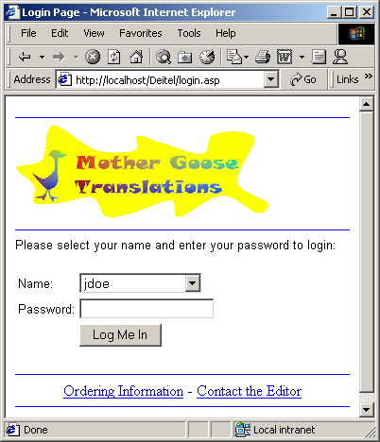
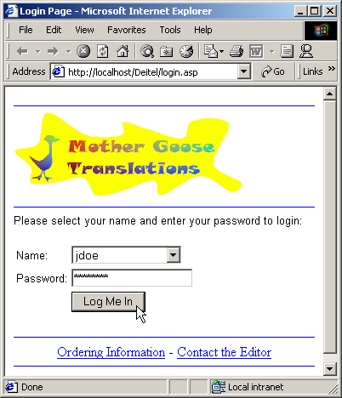
Output for login.asp

