Slide 1
Chapter 26 – ASP Case Studies
Outline
26.1 Introduction
26.2 Setup
26.3 Case Study: a Shopping Cart
26.4 Case Study: an Online Auction Site
26.5 Case Study: a Comparison Pricing Search Engine

Slide 2
26.1 Introduction
3 e-commerce case studies
  Shopping cart
  Online Auction Site
  Comparison Pricing Search Engine
Sites utilize
  HTML, VBScript and ASP
  HTML on the client
  ASP in the middle tier
  Database third tier

Slide 3
26.2 Setup
For setup and installation instructions for each of the case studies see pages 825-827 in e-Business and E-commerce How to Program

Slide 4
26.3 Case Study: a Shopping Cart
Shopping cart model
  Store list of items considering purchasing
  Easy addition and removal of items
  Implemented with cookies
Database used
  4 tables
    Technologies
    Products
    Authors
    Authorlist

Slide 5
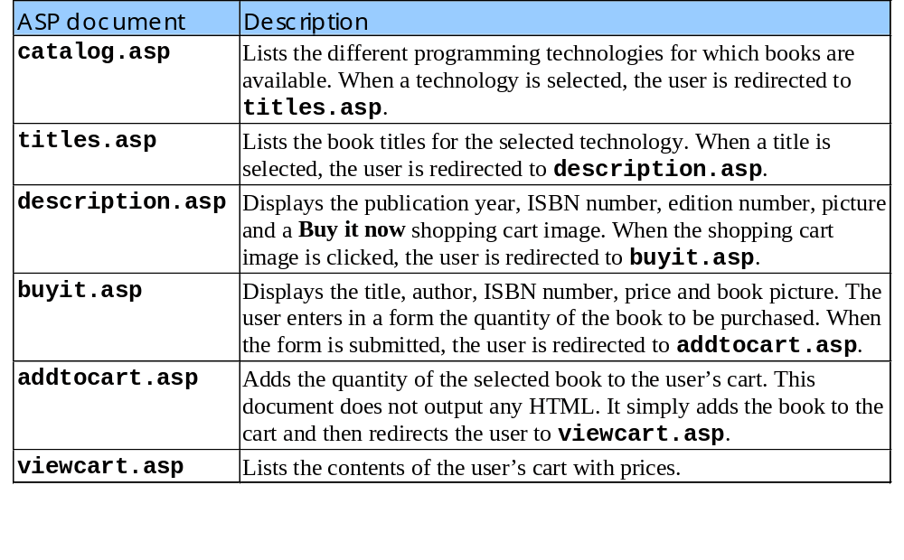
26.3 Case Study: a Shopping Cart
Table of ASPs used in shopping cart model

Slide 6
1<% @LANGUAGE = VBScript %>
2<% Option Explicit %>
3
4<% ' Fig 26.2 : catalog.asp %>
5
1. Title information
2. Table of technologies
2.1 Database connection
6<!DOCTYPE HTML PUBLIC "-//W3C//DTD HTML 4.0 Transitional//EN">
7<HTML>
8<HEAD>
9<TITLE>Textbook Information Center: Technology</TITLE>
10</HEAD>
11<BODY BGCOLOR = "#FFFFFF">
12
13<!-- #include virtual = "/includes/header.shtml" -->
14
15<CENTER>
16<H2><FONT COLOR = "brown">
17Welcome to the Textbook Information Center</FONT></H2>
18</CENTER>
19
20<TABLE BORDER = "0" WIDTH = "100%"
21 CELLPADDING = "0" CELLSPACING = "0">
22<TR>
23<TD WIDTH = "25%">&nbsp;</TD>
24<TD BGCOLOR = "#008080" WIDTH = "10%">&nbsp;</TD>
25<TD BGCOLOR = "#008080" WIDTH = "40%">
26<FONT COLOR = "yellow" SIZE = "2">To view available titles
Establish a connection to the database.
27for a technology<BR>select a link from this list:</FONT>
28
29<%
30 Dim connection, query, data
31
32 Set connection = Server.CreateObject( "ADODB.Connection" )
33 Call connection.Open( "catalog" )

Slide 7
34
35 ' Create the SQL query and the record set
36 query = "SELECT * FROM technologies"
37 Set data = Server.CreateObject( "ADODB.Recordset" )
38 Call data.Open( query, connection )
2.2 Open database
3. Loop through data
3.1 Establish links
39%>
40<UL>
Retrieve all records from the Technologies table.
41<% ' Begin a while loop that iterates through each record
42 ' in the record set
43 While Not data.EOF
44
45 ' Create a link that passes the technologyID
46 ' number to titles.asp and uses the text
47 ' value of technology to label the link.
48%> <LI>
Iterate through the retrieved records and create a link for each record’s technology field.
49 <A HREF = "titles.asp?technologyid=<%
50 =data( "technologyID" ) %>">
51 <FONT COLOR = "yellow" SIZE = "2">
52 <% =data( "technology" ) %>
53 </FONT>
54 </A>
55
56<% ' Move to the next record
57 Call data.MoveNext()
58 Wend
59 Call data.Close()
60 Call connection.Close()
61%>
62
63</UL></TD>
64
65<TD WIDTH = "25%"></TD>
66</TR></TABLE><BR>

Slide 8
67
68<TABLE ALIGN = "center">
69<TR>
70<TD><IMG SRC = "/images/cartonly.gif"
4. Table of images
5. View Cart form
71 ALT = "cartonly.gif"></TD>
72
73<% ' The following form has 2 input items:
Create a submit button labeled View Cart and a hidden input named url, that is given the value catalog.asp.
74 ' - A submit button that, when clicked, redirects
75 ' the user to viewcart.asp
76 ' - A hidden input item that holds the URL of this
77 ' this page. The viewcart.asp page uses this hidden
78 ' item to provide a link back to this page.
79%>
80
81<FORM ACTION = "viewcart.asp" METHOD = "POST">
82<TD><INPUT TYPE = "submit" VALUE = "View Cart"></TD>
83<INPUT TYPE = "hidden" NAME = "url" VALUE = "catalog.asp">
84</FORM>
85
86<TD><IMG SRC = "/images/cartonly.gif"
87 ALT = "cartonly.gif"></TD>
88</TR>
89</TABLE>
90
91<!-- #include virtual = "/includes/footer.shtml" -->
92
93</BODY>
94</HTML>

Slide 9
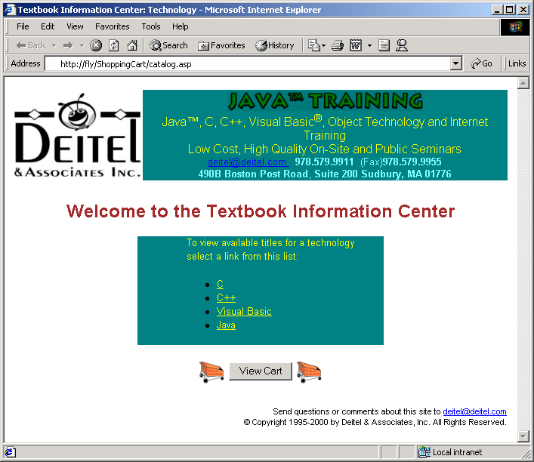
Screenshot of Catalog.asp

Slide 10
95<% @LANGUAGE = VBScript %>
96<% Option Explicit %>
97
98<% ' Fig 26.3 : titles.asp %>
1. Table of titles
2. Database connection
99
100<!DOCTYPE HTML PUBLIC "-//W3C//DTD HTML 4.0 Transitional//EN">
101<HTML>
102<HEAD>
103<TITLE>Textbook Information Center: Titles</TITLE>
104</HEAD>
105<BODY BGCOLOR = "#FFFFFF">
106
107<!-- #include virtual = "/includes/header.shtml" -->
108
109<CENTER>
110<H2><FONT COLOR = "brown">Welcome to the Textbook
111Information Center</FONT></H2></CENTER>
112<TABLE BORDER = "0" WIDTH = "100%"
113 CELLPADDING = "0" CELLSPACING = "0">
114<TR>
115<TD WIDTH = "15%">&nbsp;</TD>
116<TD BGCOLOR = "#008080" WIDTH = "5%">&nbsp;</TD>
117<TD BGCOLOR = "#008080" WIDTH = "60%">
118<FONT COLOR = "yellow" SIZE = "2">Select a title from the
119list below:</FONT>
120<%
121 Dim connection, query, data
122
123 Set connection = Server.CreateObject( "ADODB.Connection" )
124 Call connection.Open( "catalog" )
125
126 ' Create the SQL query and the record set

Slide 11
127 query = "SELECT * FROM products WHERE technologyID = " _
128 & Request( "technologyid" )
129 Set data = Server.CreateObject( "ADODB.Recordset" )
130 Call data.Open( query, connection )
2.1 Open database
3. Loop through data
3.1 Establish links
131%>
132<UL>
133<% ' Begin a while loop that iterates through the records
134 ' in the record set
Establish a link that passes the product number to description.asp
135 While Not data.EOF
136
137 ' Create a link that passes the productID number to
138 ' description.asp and uses the title and the edition
139 ' to label the link.
140%> <LI><A HREF="description.asp?productid=<%
141 =data( "productID" ) %>">
142 <FONT COLOR = "yellow" SIZE = "2">
143 <% =data( "title" ) %></A>&nbsp; Edition
144 <% =data( "edition" ) %>
145 </FONT>
146 </LI>
147<% Call data.MoveNext() ' Move to the next record
148 Wend
149 Call data.Close()
150 Call connection.Close()
151%>
152</UL>
153</TD>
154
155<TD BGCOLOR = "#008080" WIDTH = "5%">&nbsp;</TD>
156
157<TD WIDTH = "15%"></TD>
158</TR>

Slide 12
159</TABLE>
160
161<% ' Provide a link back to the previous page %>
162<P ALIGN = "center"><FONT SIZE = "3">Back to<STRONG>
4. Table of images
5. View Cart form
163<A HREF = "catalog.asp">Technology List</FONT></A></STRONG>
164</P>
165
166<% Dim url
167
168 ' Store the URL of this page
169 url = "titles.asp?technologyid=" & Request( "technologyid" ) %>
170
171<TABLE ALIGN = "center">
172<TR>
173<TD><IMG SRC = "/images/cartonly.gif" ALT = "cartonly.gif">
174</TD>
175
176<% ' A form similar to the form in catalog.asp %>
177<FORM ACTION = "viewcart.asp" METHOD = "POST">
178 <TD><INPUT TYPE = "submit" VALUE = "View Cart"></TD>
179 <INPUT TYPE = "hidden" NAME = "url" VALUE = "<% =url %>">
180</FORM>
181
182<TD><IMG SRC = "/images/cartonly.gif" ALT = "cartonly.gif">
183</TD>
184</TR>
185</TABLE>
186
187<!-- #include virtual = "/includes/footer.shtml" -->
188
189</BODY>
190</HTML>

Slide 13
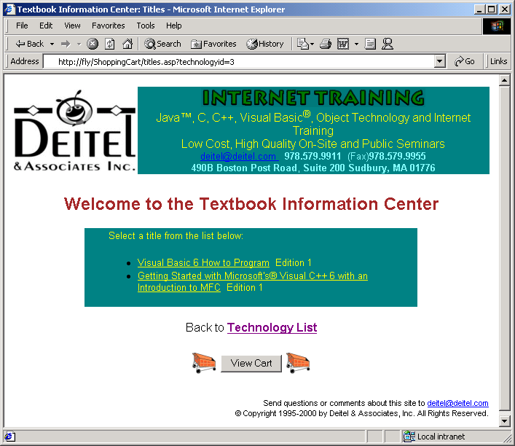
Screenshot of title.asp

Slide 14
191<% @LANGUAGE = VBScript %>
192<% Option Explicit %>
193
194<% ' Fig. 26.4 : description.asp %>
1. Database connection
1.1 Open database
195
196<!DOCTYPE HTML PUBLIC "-//W3C//DTD HTML 4.0 Transitional//EN">
197<HTML>
198<HEAD>
199<TITLE>Textbook Information Center: Description
200</TITLE>
201</HEAD>
202
203<BODY BGCOLOR = "#FFFFFF">
204
205<!-- #include virtual = "/includes/header.shtml" -->
Retrieve the book’s record from the database.
206
207<%
208 Dim connection, query, data
209
210 Set connection = Server.CreateObject( "ADODB.Connection" )
211 Call connection.Open( "catalog" )
212
213 ' Create the SQL query and the record set
214 query = "SELECT * FROM products WHERE productID=" _
215 & Request( "productid" )
216 Set data = Server.CreateObject( "ADODB.Recordset" )
Display the book title.
217 Call data.Open( query, connection )
218%>
219
220<CENTER><H2>
221<FONT COLOR = "brown">
222<% =data( "title" ) %>

Slide 15
223</FONT>
224</H2></CENTER>
225<TABLE BORDER = "0" WIDTH = "100%"
Display book image.
226 CELLPADDING = "0" CELLSPACING = "0">
2. Display a picture of book
3. Display book information
4. Link to purchase book
227<TR>
228<TD WIDTH = "25%">&nbsp;</TD>
229<TD BGCOLOR = "#008080" WIDTH = "10%">
230<% ' Display the book image %>
231<IMG SRC = "/images/<% =data( "coverart" ) %>">
232</TD>
Display the publication year, ISBN number and edition number.
233
234<TD BGCOLOR = "#008080" WIDTH = "40%">
235<FONT COLOR = "yellow" SIZE = "2">
236
237<% ' Display the record fields %>
238<CENTER>Published in: <% =data( "publishDate" ) %><BR>
239ISBN: <% =data( "isbn" ) %><BR>
240EDITION: <% =data( "edition" ) %><BR>
241</CENTER></FONT>
Passes the product number in the URL of buyit.asp.
242
243<P ALIGN = "center">
244<FONT SIZE = "5" COLOR = "red">
245<STRONG>Buy it now</STRONG></FONT><BR>
246
247<A HREF = "buyit.asp?productid=<%
248 =data( "productID" ) %>">
249<IMG SRC = "/images/cart.gif" ALT = "cart.gif"></A>
250</P>
251</TD>
252<TD WIDTH = "25%">&nbsp;</TD>
253

Slide 16
254</TR>
255</TABLE>
256
257<P ALIGN = "center"><FONT SIZE = "3">Back to<STRONG>
5. Close database connection
6. View Cart form
258<A HREF = "titles.asp?technologyid=<% =data( "technologyID" ) %>">
259 Titles</FONT></A></STRONG></P>
260
261<% Call data.Close()
262 Call connection.Close()
263 Dim url
264
265 ' Store the URL of this page
266 url = "description.asp?productid=" _
267 & Request( "productid" ) %>
268
269<TABLE ALIGN = "center">
270<TR>
271<TD><IMG SRC = "/images/cartonly.gif" ALT = "cartonly.gif">
272</TD>
273
274<% ' A form similar to the form in catalog.asp %>
275<FORM ACTION = "viewcart.asp" METHOD = "POST">
276 <TD><INPUT TYPE = "submit" VALUE = "View Cart"></TD>
277 <INPUT TYPE = "hidden" NAME = "url" VALUE = "<% =url %>">
278</FORM>
279
280<TD><IMG SRC = "/images/cartonly.gif" ALT = "cartonly.gif">
281</TD>
282</TR>
283</TABLE>

Slide 17
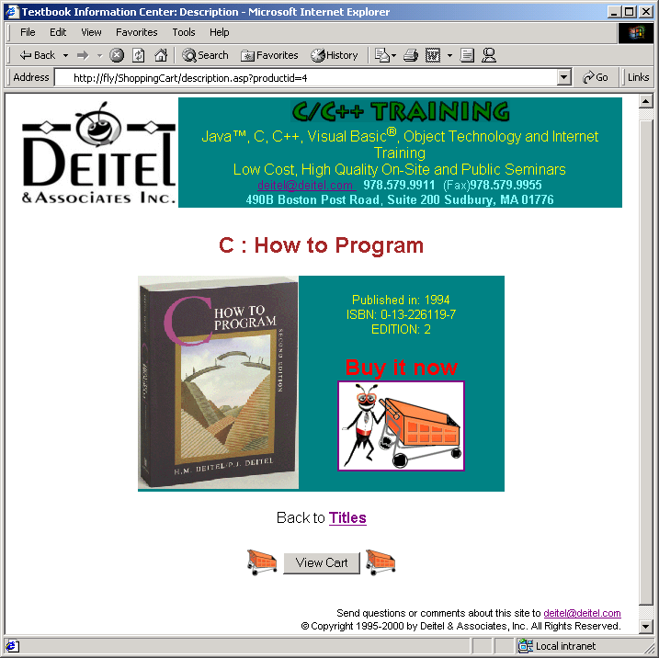
284
285<!-- #include virtual = "/includes/footer.shtml" -->
286
287</BODY>
288</HTML>

Slide 18
289<% @LANGUAGE = VBScript %>
290<% Option Explicit %>
291
292<% ' Fig. 26.5 : buyit.asp %>
1. Establish database connection
1.1 Retrieve databse information
293
294<!DOCTYPE HTML PUBLIC "-//W3C//DTD HTML 4.0 Transitional//EN">
295<HTML>
296<HEAD>
297<TITLE>Textbook Information Center: BUY IT</TITLE>
298</HEAD>
299
300<BODY BGCOLOR = "#FFFFFF">
301
302<!-- #include virtual = "/includes/header.shtml" -->
303
Use join clauses to retrieve book information from the Authorlist, Authors and Products tables.
304<%
305 Dim connection, query, data, bookString
306
307 Set connection = Server.CreateObject( "ADODB.Connection" )
308 Call connection.Open( "catalog" )
309
310 ' Create the SQL query and the record set
311 query = "SELECT * FROM products, authors, " _
312 & "authorlist WHERE products.productID = " _
313 & Request( "productid" ) & " AND products.productID" _
314 & " = authorlist.productID AND authorlist.authorID " _

Slide 19
315 & "= authors.authorID"
316
317 Set data = Server.CreateObject( "ADODB.Recordset" )
318 Call data.Open( query, connection )
1.1 Retrieve database information
2. Table with book information
319%>
320
321<CENTER>
322<H2>
323 <FONT COLOR = "brown">Buy it:</FONT>
324</H2>
325
326<IMG BORDER = "1" SRC = "/images/<% =data( "coverart" ) %>"
327ALIGN = "center" VALIGN = "center">
328
329</CENTER>
330
331<TABLE BORDER = "0" align = "center" WIDTH = "100%"
332 CELLPADDING = "4" CELLSPACING = "1">
333<TR>
334 <TD><STRONG><U>TITLE<STRONG></U></TD>
335 <TD><STRONG><U>AUTHOR(S)</STRONG></U></TD>
336 <TD><STRONG><U>ISBN</STRONG></U></TD>
337 <TD><STRONG><U>PRICE</STRONG></U></TD>
338</TR>
339<TR>
340
341<% ' Fill the table and build the book string %>
342 <TD><STRONG><EM><% =data( "title" ) %></EM></STRONG>
343 </TD>
344
345 <TD><EM><% =data( "Name" ) %>
346

Slide 20
347<% bookString = data( "title" ) & "|" & data( "Name" )
348 Call data.MoveNext()
349 While Not data.EOF
350 Call Response.Write( ", " & data( "Name" ) )
351 bookString = bookString & ", " & data( "Name" )
2.1 Create bookstring
3. Store URL information
352 Call data.MoveNext()
Store the title, author(s), ISBN number and price are stored in a temporary variable bookString. Note that each field is separated by a pipe character (|).
353 Wend
354 Call data.MoveFirst()
355 bookString = bookString & "|" & data( "isbn" ) & "|" _
356 & FormatCurrency( data( "price" ) )
357
358 ' Save the book string in a session variable so
359 ' that add.asp can use it
360 Session( "book" ) = bookString
361%>
362 </EM></TD>
Store the value of bookString in the session variable book.
363
364 <TD><EM><% =data( "isbn" ) %></EM></TD>
365 <TD><EM><% =FormatCurrency( data( "price" ) ) %>
366 </EM></TD>
367 </TR>
368
369</TABLE><BR><BR>
370
371<% Dim url1, url2
372
373 ' Store the URL of titles.asp (the document the
374 ' user was just viewing)
375 url1 = "titles.asp?technologyid=" & _
376 data( "technologyID" )
377
378 ' Store the URL of this page
379 url2 = "buyit.asp?productid=" & Request( "productid" )

Slide 21
380
381 Call data.Close()
382 Call connection.Close()
383
384 ' Next we display two forms in a table. The first form
4. Close database connection
5. Add to Cart form
385 ' retrieves, from the user, the quantity to be added to
386 ' the cart. The first form also has a hidden item that
387 ' holds the URL of titles.asp (the document the user
388 ' was just viewing). This hidden item is passed to
389 ' addtocart.asp which will pass it along to viewcart.asp
390 ' for the back link. The second form is similar to the
391 ' form in catalog.asp.
392%>
393
394<TABLE>
395
396<FORM ACTION = "addtocart.asp" METHOD = "POST">
397<TR>
398
399<TD>
400<STRONG><FONT SIZE = "3">Quantity:&nbsp</FONT></STRONG>
401<INPUT TYPE = "text" SIZE = "3"
402 NAME = "Quantity" VALUE = "1">
A link that when clicked passes the book’s productID number in the URL of description.asp.
403</TD>
404
405<TD WIDTH = "50"></TD>
406
407<TD COLSPAN = "3">
408<P ALIGN = "center">Back to<STRONG>
409<A HREF="description.asp?productid=<%
410 =Request( "productid" ) %>">Description Page</A></STRONG>
411</P>
412</TD>

Slide 22
413</TR>
414
415<TR>
416<TD>
6. View Cart form
417<INPUT TYPE = "submit" value = "Add to Cart">
418<INPUT TYPE = "reset" value = "Clear">
419</TD>
420<INPUT TYPE = "hidden" NAME = "url" VALUE = "<% =url1 %>">
421</FORM>
422
423<TD WIDTH = "50"></TD>
424
425<TD><IMG SRC = "/images/cartonly.gif" ALT = "cartonly.gif">
426</TD>
427
428<FORM ACTION = "viewcart.asp" METHOD = "POST">
429 <TD><INPUT TYPE = "submit" VALUE = "View Cart"></TD>
430 <INPUT TYPE = "hidden" NAME = "url" VALUE = "<% =url2 %>">
431</FORM>
432
433<TD><IMG SRC = "/images/cartonly.gif" ALT = "cartonly.gif">
434</TD>
435
436</TR>
437</TABLE>
438
439<!-- #include virtual = "/includes/footer.shtml" -->
440
441</BODY>
442</HTML>

Slide 23
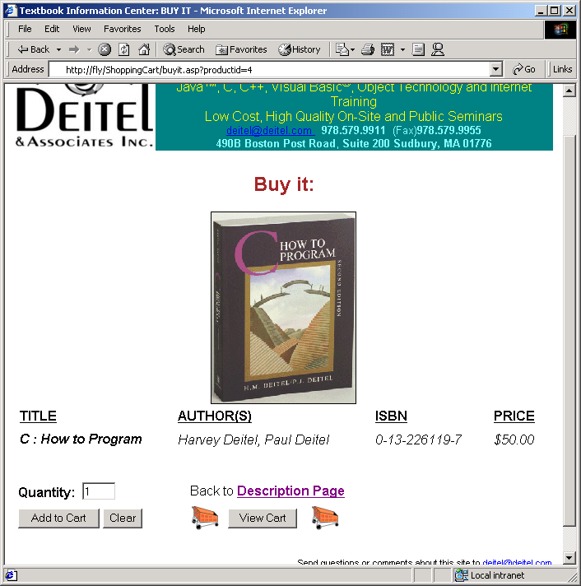
Output of buyit.asp

Slide 24
443<% @LANGUAGE = VBScript %>
444<% Option Explicit %>
445
446<% ' Fig 26.6 : addtocart.asp %>
447
1. Nested If statments
2. Cookies
2.1 Read cookies
2.2 Set cookie values
448<% ' If the submitted quantity is valid
Obtain the Cookie collection’s Count property.
449 If Request( "Quantity" ) <> "" Then
450 If CInt( Request( "Quantity" ) ) <> 0 Then
451
452 Dim count, i, found, s, quantity
453
454 ' How many books are in the cookie
455 count = Request.Cookies( "Books" ).Count / 2
456
457 ' Is the book already in the cookie?
Test to see if the book is already in the cookie.
458 found = False
459 For i = 1 To count
460 If Request.Cookies( "Books" )( _
461 "book" & CStr( i ) ) = Session( "book" ) _
462 Then
463 found = True
464 Exit For
465 End If
466 Next
467
Set the value for each variable in the Books cookie using the Cookies collection.
468 ' If the book is in the cookie, update the quantity
469 If found Then
470 quantity = CInt( Request.Cookies( "Books" ) _
471 ( "quantity" & CStr( i ) ) )
472 Response.Cookies( "Books" )( "quantity" _
473 & CStr( i ) ) = quantity + CInt( _
474 Request( "Quantity" ) )
475

Slide 25
476 ' Set the expiration date
477 Response.Cookies( "Books" ).Expires = Date() + 2
478
479 ' Otherwise, create a new book item
2.2 Set cookie values
3. ONLOAD attribute of <BODY> tag
480 Else
481 s = CStr( count + 1 )
482 Response.Cookies( "Books" )( "book" & _
483 s ) = Session( "book" )
484 Response.Cookies( "Books" )( "quantity" & _
485 s ) = Request( "Quantity" )
486
487 ' Set the expiration date
488 Response.Cookies( "Books" ).Expires = Date() + 2
489 End If
490 End If
491 End If
492%>
Set the expiration date of the cookie.
493
494<!DOCTYPE HTML PUBLIC "-//W3C//DTD HTML 4.0 Transitional//EN">
495<HTML>
496
497<% ' Force the form to submit when the page is loaded %>
498<BODY ONLOAD = document.forms(0).submit()>
499
500<% ' This form's purpose is to redirect the user to
501 ' viewcart.asp and pass the hidden input item that is
502 ' received from buyit.asp. The form is automatically
503 ' submitted when the page is loaded (see the <BODY> tag
504 ' above).
505%>
506
507<FORM ACTION = "viewcart.asp" METHOD = "POST">

Slide 26
508 <INPUT TYPE = "hidden" NAME = "url"
509 VALUE = "<% = Request( "url" ) %>">
510</FORM>
511
512</BODY>
513</HTML>

Slide 27
514<% @LANGUAGE = VBScript %>
515<% Option Explicit %>
516
517<% ' Fig. 26.7 : viewcart.asp %>
1. Variable declarations
2. Test for empty cart
518
519<!DOCTYPE HTML PUBLIC "-//W3C//DTD HTML 4.0 Transitional//EN">
520<HTML>
521
522<HEAD>
523<TITLE>Textbook Information Center: View Cart
524</TITLE>
525</HEAD>
526
527<BODY BGCOLOR = "#FFFFFF">
528
529<!-- #include virtual = "/includes/header.shtml" -->
530
Test to see if the user’s cart is empty. If it is display a message informing them that their cart is empty.
531<% Dim i, j, splitArray, quantity, total, subtotal
532
533 ' If the Books cookie is equal to an empty string,
534 ' no items are in the cart.
535 If Request.Cookies( "Books" ) = "" Then %>
536 <CENTER>
537 <H3>
538 <FONT COLOR = "red">
539 Your cart is empty.

Slide 28
540 </FONT>
541 </H3>
542 </CENTER>
543
3. Table of items in cookie
544<% ' Otherwise, display the items in the cookie
545 Else %>
546 <TABLE BORDER = "1" ALIGN = "center" WIDTH = "100%"
547 CELLPADDING = "0" CELLSPACING = "3">
548 <CAPTION>
549 <H2>
550 <FONT COLOR = "brown">
551 This is your current cart.
552 </FONT>
553 </H2>
554 </CAPTION>
555 <COLGROUP>
556 <COL SPAN = "6" ALIGN = "center">
557 </COLGROUP>
558 <TR>
559 <TH><U>TITLE</U></TH>
560 <TH><U>AUTHOR(S)</U></TH>
561 <TH><U>ISBN</U></TH>
562 <TH><U>PRICE</U></TH>
563 <TH><U>QUANTITY</U></TH>
564 <TH><U>SUBTOTAL</U></TH>
565 </TR>
566
567<% ' Initialize the total price to zero
568 total = 0
569
570 ' Loop through the books in the Books cookie and

Slide 29
571 ' and display each book's contents in the table.
572 ' Each iteration of this loop builds one row in the
573 ' table.
574 For i = 1 To Request.Cookies( "Books" ).Count / 2
3.1 Display book information
4. Calculate cost
575
576 ' Split the book string on | to get the book
577 ' information (e.g., title, author(s), etc.)
578 splitArray = Split( Request.Cookies( "Books" ) _
579 ( "book" & CStr( i ) ), "|" )
580%> <TR>
581
Each book is read as a string from the cookie Books and is split on the pipe character (|).
582<% ' Display the book information
583 For j = 0 To UBound( splitArray ) %>
584 <TD> <% =splitArray( j ) %> </TD>
585<% Next
586
587 ' Display the quantity of the book
588 quantity = Request.Cookies( "Books" )( "quantity" & _
589 CStr( i ) ) %>
590 <TD>
591 <% =quantity %>
592 </TD>
593
594<% ' Update the running total and display the subtotal
595 ' in a table cell
596 subtotal = CCur( splitArray( 3 ) ) * _
597 CInt( quantity )
598 total = total + subtotal
599%> <TD>
600 <% =FormatCurrency( subtotal ) %>
601 </TD>

Slide 30
602
603 </TR>
604<% Next
605
5. Display total
606 ' Finally, display the total
607%> <TR>
608 <TH COLSPAN = "5" ALIGN = "right"><U>Total:</U></TH>
609 <TD> <% =FormatCurrency( total ) %> </TD>
610 </TR>
611
612 </TABLE>
613<% End If %>
614
615<BR>
616
617<P ALIGN = "center">
618<FONT SIZE = "3">Back to<STRONG>
619<A HREF = "<% =Request("url") %>">Shopping</FONT></A>
620</STRONG></P>
621
622<!-- #include virtual = "/includes/footer.shtml" -->
623
624</BODY>
625</HTML>

Slide 31
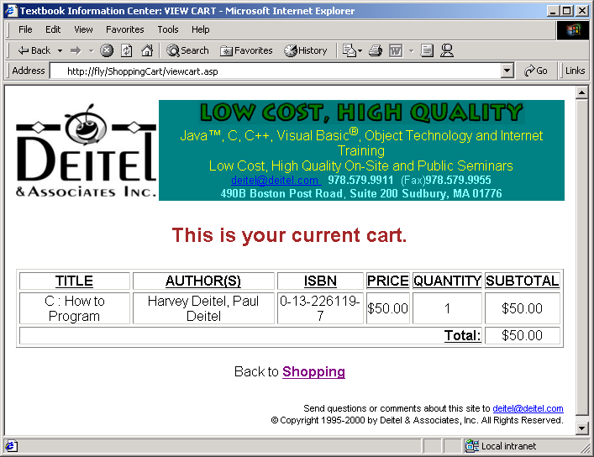
Output of viewcart.asp

Slide 32
626<BODY BGCOLOR = "#FFFFFF">
627<TABLE BORDER = "0" WIDTH = "600">
628<TR>
629<TD><A HREF = "http://www.deitel.com"><IMG
1. header.shtml
1.1 Text in header
630 SRC = "/images/logotiny.gif" BORDER = "0"></A></TD>
631<TD BGCOLOR = "#008080">
632<P ALIGN = "center">
633<SPAN STYLE = "font-family: Arial, Helvetica, sans-serif">
634<IMG SRC = "/images/banneranim.gif"
635 ALT = "banneranim.gif (185545 bytes)" WIDTH = "481"
636 HEIGHT = "28"><BR>
637<FONT COLOR = "#FFFF00">Java&#153;, C, C++, Visual
638Basic<SUP>&#174;</SUP>,
639Object Technology and Internet Training<BR>
640Low Cost, High Quality On-Site and Public Seminars<BR>
641<SMALL><A HREF = "mailto:deitel@deitel.com">deitel@deitel.com
642</A>
643</FONT>&nbsp;
644<FONT COLOR = "#80FFFF"><STRONG>978.579.9911</STRONG>&nbsp;
645(Fax)<STRONG>978.579.9955</STRONG><BR>
646<STRONG>490B Boston Post Road</STRONG>,
647<STRONG>Suite 200 Sudbury, MA 01776</STRONG></FONT>
648</SMALL></SPAN></P>
649</TD>
650</TR>
651<TR><TD COLSPAN = "2">&nbsp;</TD></TR>
652<TR>
653<TD COLSPAN = "2">
654<FONT FACE = "Arial" SIZE = "2">

Slide 33
655 </FONT>
656 <TR><TD COLSPAN = "2">&nbsp;</TD></TR>
657 <TR><TD COLSPAN = "2" ALIGN = "right">
1. footer.shtml
1.1 text in footer
658
659 <SPAN STYLE = "font-family: sans-serif, Helvetica, Arial;
660 font-size: 8pt">
661 Send questions or comments about this site to
662 <A HREF = "mailto:deitel@deitel.com">deitel@deitel.com</A><BR>
663 &copy; Copyright 1995-2000 by Deitel &amp; Associates, Inc.
664 All Rights Reserved.<BR>
665 </SPAN>
666
667 </TD></TR>

Slide 34
26.4 Case Study: an Online Auction Site
Auction site
  Allows users to bid on products
  Four types of items
    Books, cyber classroom software packages, training seats and miscellaneous items
      Only books category is implemented

Slide 35
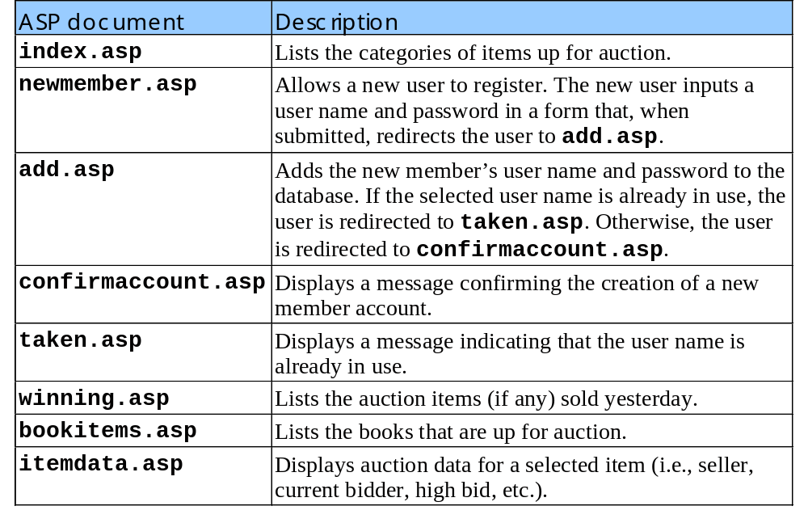
26.4 Case Study: an Online Auction Site
Table of ASP pages used by Auction site

Slide 36
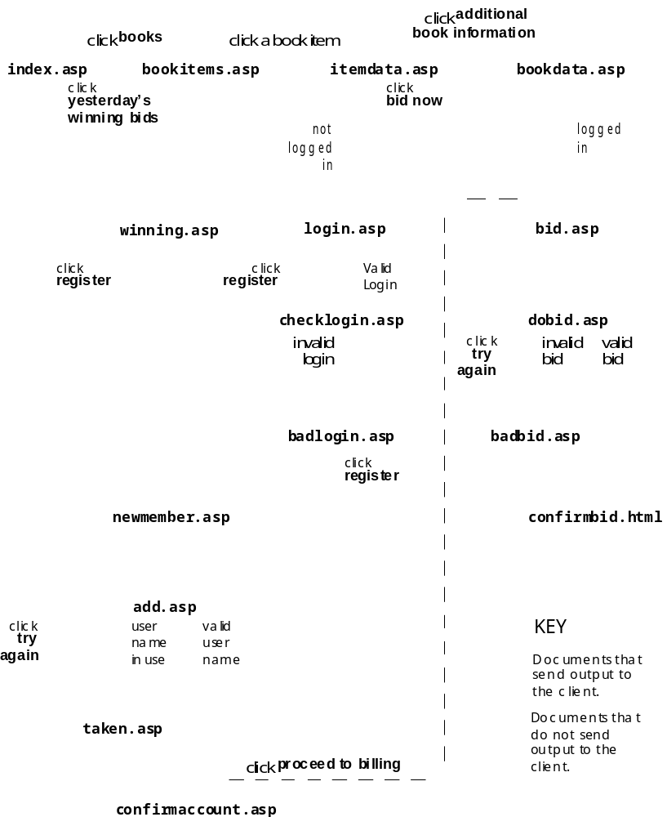
26.4 Case Study: an Online Auction Site

Slide 37
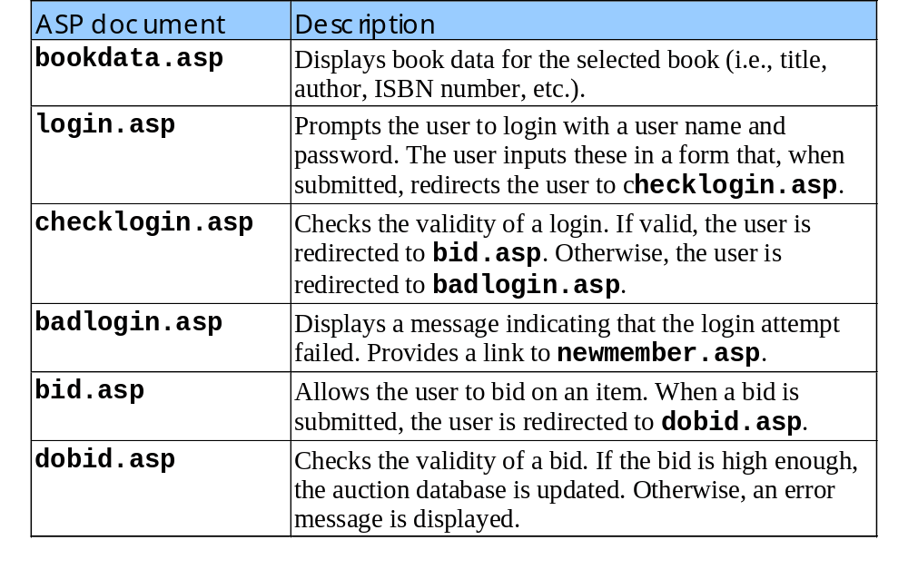
26.4 Case Study: an Online Auction Site
Table of ASP pages used by Auction site (continued)

Slide 38
1<% @LANGUAGE = VBSCRIPT %>
2<% Option Explicit %>
3
4<% ' Fig. 26.12 : index.asp %>
5
1. List of categories
6<!DOCTYPE HTML PUBLIC "-//W3C//DTD HTML 4.0 Transitional //EN">
7<HTML>
8
9<HEAD>
10<TITLE>Deitel Auctions</TITLE>
11</HEAD>
12
13<BODY BGCOLOR = "#FFFF99">
14<FONT COLOR = "magenta">
15<% =Date() %>
16</FONT>
17<H1 ALIGN = "center"><U>Welcome to Deitel Auctions</U>
18</H1><BR><BR><BR>
19<P><STRONG><FONT SIZE = "+1">Categories:</FONT></STRONG>
20</P>
21
22<% ' A list of auction Categories %>
23<UL>
24 <LI><A HREF = "bookitems.asp">Books</A></LI>
25 <LI><A HREF = "notimplemented.html">Cyber Classrooms</A>
26 </LI>
27 <LI><A HREF = "notimplemented.html">Training Seats</A>
28 </LI>
29 <LI><A HREF = "notimplemented.html">Miscellaneous</A>
30 </LI>
31</UL>
32<P><STRONG><FONT COLOR = "red"><CENTER>
33 All our auction items end at midnight on the same day

Slide 39
34 they are posted. Bid Now!
35</CENTER></FONT></STRONG></P>
36
37<% ' Save where the user came from in the "from" session
2. Allow users to register
38 ' variable. Because we have several register links
39 ' in the site, we can use this variable to provide links
40 ' in the registration pages, depending on where the
Variable from is used throughout the site to monitor the user’s movement. Here it records where the user came from.
41 ' user came from.
42 Session( "from" ) = "home" %>
43
44<% ' Provide a link to register a new user %>
45<CENTER>
46 <A HREF = "newmember.asp">Register</A>
47</CENTER>
48<% ' Link to yesterday's winning bids %>
49<A HREF = "winning.asp"><FONT COLOR = "magenta">
50 Yesterday's Winning Bids!</FONT>
51</A><BR>
52<% ' Link to Sell an item %>
53<A HREF = "notimplemented.html">
54 <FONT COLOR = "green">Sell an item</FONT>
55</A><BR><BR>
56</BODY>
57</HTML>

Slide 40
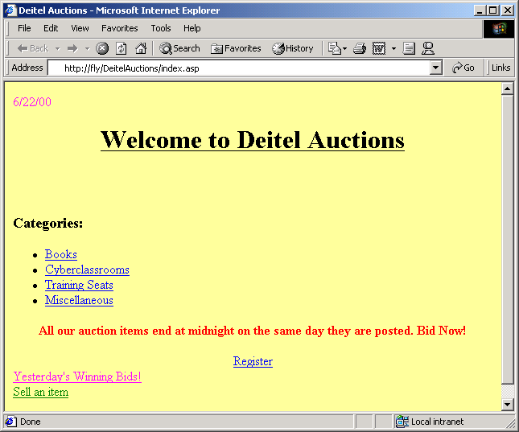
Output from index.asp

Slide 41
58<% @LANGUAGE = VBSCRIPT %>
59<% Option Explicit %>
60
61<% ' Fig. 26.13 : newmember.asp %>
62
1. Registration form
63<!DOCTYPE HTML PUBLIC "-//W3C//DTD HTML 4.0 Transitional //EN">
64<HTML>
65
66<HEAD>
67<TITLE>New Member</TITLE>
68</HEAD>
69
70<BODY BGCOLOR = "#FFFF99">
71<CENTER><H1><U>Welcome New Member!</U></H1></CENTER><BR>
72
73<% ' Form to get user name and password %>
74<FORM METHOD = "post" ACTION = "add.asp">
75 <TABLE>
76 <TR>
77 <TH>Choose your user name:</TH>
78 <TD>
79 <INPUT TYPE = "text" NAME = "UserName" SIZE = "25">
80 </TD>
81 </TR>
82
83 <TR>
84 <TH>Choose your password:</TH>
85 <TD>
86 <INPUT TYPE = "password" NAME = "Password"
87 SIZE = "25">
88 </TD>
89 </TR>
90

Slide 42
91 <TR>
92 <TD></TD>
93 <TD>
94 <INPUT TYPE = "submit" VALUE = "Submit">
1. Registration form
95 <INPUT TYPE = "reset" VALUE = "Clear">
96 </TD>
97 </TR>
98 </TABLE>
99</FORM>
100
Test to see if the user got to this page from login.asp. If they did then link back to login.asp, if they didn’t link them to itemdata.asp.
101<CENTER><A HREF = "index.asp">Home</A>
102
103<% ' If the user came to this page from login.asp,
104 ' provide an additional link to the item description
105 ' page.
106 If Session( "from" ) = "login" Then %>
107 <A HREF =
108 "itemdata.asp?ItemNumber=<% =Session( "ItemNumber" ) %>">
109 Back to Item Description</A>
110<% End If %>
111</CENTER>
112</BODY>
113</HTML>

Slide 43
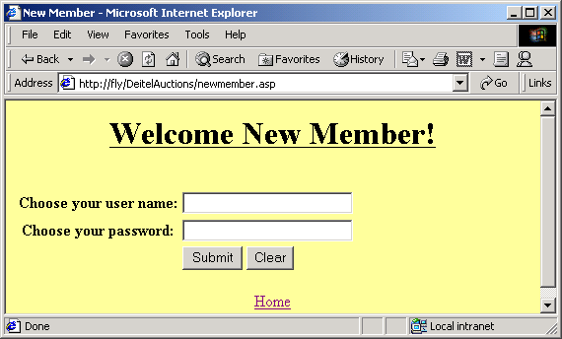
Output from newmember.asp

Slide 44
114<% @LANGUAGE = VBSCRIPT %>
115<% Option Explicit %>
116
117<% ' Fig 26.14 : add.asp %>
118
1. Variable declarations
2. Connect to database
2.1 Query database
2.2 Add new user to database
119<%
120 Dim connection, insert, data, query
121
Attempt to retrieve a record from the Members table with UserName equal to the user name. If a record is retrieved, the name is already in use.
122 ' Open the database connection.
123 Set connection = Server.CreateObject( "ADODB.Connection" )
124 Call connection.Open( "DeitelAuctions" )
125
126 ' Create the SQL query to check if the chosen user name
127 ' exists in the Members table
128 query = "SELECT * FROM Members WHERE UserName = '" & _
129 CStr( Request( "UserName" ) ) & "'"
130 Set data = Server.CreateObject( "ADODB.RecordSet" )
131 Call data.Open( query, connection )
132 On Error Resume Next
133
134 ' Check for records with the same user name
135 If data.EOF Then
136
Insert the username and password into the Members table.
137 ' Give the new member the selected user name.
138 ' Insert a new name/password record into the Members
139 ' table. Build the SQL INSERT statement:
140 insert = "INSERT INTO Members VALUES ( '" & _
141 CStr( Request( "UserName" ) ) & "','" & _
142 CStr( Request( "Password" ) ) & "' )"
143
144 ' Insert the record
145 Call connection.Execute( insert )

Slide 45
146
147 ' Signal a successful login
148 Session( "LoggedIn" ) = True
149
2.3 Close database
150 ' Save the user name in a session variable
151 Session( "UserName" ) = Request( "UserName" )
152
153 ' Confirm account creation
154 Call data.Close()
155 Call connection.Close()
156 Call Response.Redirect( "confirmaccount.asp" )
157 Else
158
159 ' The selected user name is not available.
160 Call data.Close()
161 Call connection.Close()
162 Call Response.Redirect( "taken.asp" )
163 End If
164%>

Slide 46
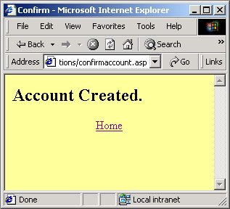
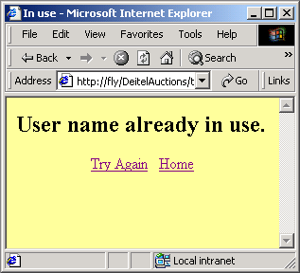
Output from add.asp

Slide 47
165<% @LANGUAGE = VBSCRIPT %>
166<% Option Explicit %>
167
168<% ' Fig. 26.15 : confirmaccount.asp %>
1. Confirmaccount
169
170<!DOCTYPE HTML PUBLIC "-//W3C//DTD HTML 4.0 Transitional //EN">
171<HTML>
172
173<HEAD>
174 <TITLE>Confirm</TITLE>
175</HEAD>
176
177<% ' Print message and provide navigation links. %>
178<BODY BGCOLOR = "#FFFF99">
179<H2>Account Created.</H2>
180
181<CENTER>
182 <A HREF = "index.asp">Home</A>
183<% ' If the user came to this page from the login process,
184 ' provide a link to the bidding page
185 If Session( "from" ) = "login" Then %>
186 &#160;<A HREF = "bid.asp">Proceed to Bidding</A>
187<% End If %>
188</CENTER>
189</BODY>
190</HTML>

Slide 48
191<% @LANGUAGE = VBSCRIPT %>
192<% Option Explicit %>
193
194<% ' Fig. 26.16 : taken.asp %>
195
1. taken.asp
2. Inform user account name is taken
196<!DOCTYPE HTML PUBLIC "-//W3C//DTD HTML 4.0 Transitional //EN">
197<HTML>
198
199<HEAD>
200 <TITLE>In use</TITLE>
201</HEAD>
202
203<BODY BGCOLOR = "FFFF99">
204<% ' Print a message and provide navigation links. %>
205<H2>User name already in use.</H2>
206
207<CENTER>
208 <A HREF = "newmember.asp">Try Again</A> &#160
209 <A HREF = "index.asp">Home</A>
210
211<% ' If the user came to this page from the login process,
212 ' provide a link to the item description page
213 ' (itemdata.asp).
214 If Session( "from" ) = "login" Then %>
215 &#160;<A HREF =
216 "itemdata.asp?ItemNumber=<% =Session( "ItemNumber" ) %>">
217 Back to Item Description</A>
218<% End If %>
219
220</CENTER>
221</BODY>
222</HTML>

Slide 49
223<% @LANGUAGE = VBSCRIPT %>
224<% Option Explicit %>
225
226<% ' Fig. 26.17 : winning.asp %>
1. Connect to database
2. Query database
227
228<% Dim connection, query, data
229
230 ' Open a database connection
231 Set connection = Server.CreateObject( "ADODB.Connection" )
232 Call connection.Open( "DeitelAuctions" )
233
Selects all queries from yesterday that had at least one bid (i.e., that do not have a null CurrentBidder field).
234 ' Create the SQL query to select yesterday's auction items
235 ' that were bid on. Remember, an item might not be bid on.
236 query = "SELECT * FROM AuctionItems " _
237 & "WHERE Ends = #" & Date() - 1 & "# " _
238 & "AND CurrentBidder IS NOT NULL " _
239 & "ORDER BY Display"
240
241 ' Open a record set
242 Set data = Server.CreateObject( "ADODB.RecordSet" )
243 Call data.Open( query, connection )
244
245 On Error Resume Next
246%>

Slide 50
247
248<!DOCTYPE HTML PUBLIC "-//W3C//DTD HTML 4.0 Transitional //EN">
249<HTML>
250<HEAD>
3. Table of winning bids
251<TITLE>Book Items</TITLE>
252</HEAD>
253
254<BODY BGCOLOR = "#FFFF99">
255<FONT COLOR = "magenta">
256<% =Date() %>
257</FONT>
258
259<H1 ALIGN = "center"><U>Yesterday's Winning Bids</U></H1>
260<BR>
261
262<% ' If no items were found, display a message. Otherwise,
263 ' display the items.
264 If data.EOF Then %>
265 <P><H2>There were no winners yesterday</H2></P>
266<% Else %>
267
268<% ' A table to display the results %>
269 <TABLE BORDER = "1" ALIGN = "center">
270
271 <COLGROUP>
272 <COL SPAN = "5" ALIGN = "center">

Slide 51
273 </COLGROUP>
274
275 <CAPTION>Winners</CAPTION>
276 <THEAD>
3. Table of winning bids
4. Close database connection
277 <TR>
278 <TH>Item Number</TH>
279 <TH>Displayed</TH>
280 <TH>Seller</TH>
281 <TH>Winner</TH>
282 <TH>Price</TH>
283 </TR>
284 </THEAD>
285 <TBODY>
286
287<% ' Iterate through the record set and create a new row
288 ' in the table for each record
289 While Not data.EOF %>
290 <TR>
291 <TD><% =data( "ItemNumber" ) %></TD>
292 <TD><% =data( "Display" ) %></TD>
293 <TD><% =data( "Seller" ) %></TD>
294 <TD><% =data( "CurrentBidder" ) %></TD>
295 <TD><% =FormatCurrency( data( "CurrentPrice" ) )
296 %> </TD>
297 </TR>
298<% Call data.MoveNext()
299 Wend
300
301 ' Close the record set and the connection
302 Call data.Close()

Slide 52
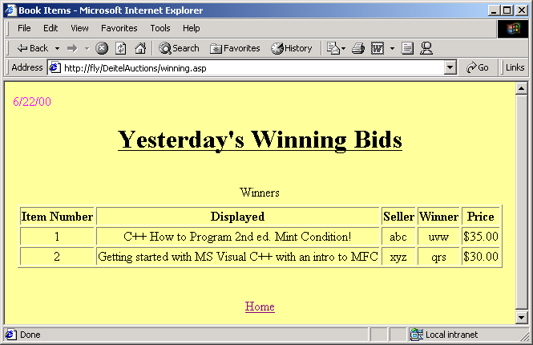
303 Call connection.close()
304%> </TBODY>
305 </TABLE><BR>
306<% End If %><BR>
307
308<% ' Provide a link back to home %>
309<CENTER><A HREF = "index.asp">Home</A></CENTER>
310</BODY>
311</HTML>

Slide 53
312<% @LANGUAGE = VBSCRIPT %>
313<% Option Explicit %>
314
315<% ' Fig. 26.18 : bookitems.asp %>
1. Open database
2. Query all books being currently auctioned
316
317<% Dim connection, query, data
318
Select the records from the AuctionItems table that have ending dates equal to today’s date.
319 ' Open a database connection
320 Set connection = Server.CreateObject( "ADODB.Connection" )
321 Call connection.Open( "DeitelAuctions" )
322
323 ' Create the SQL query
324 query = "SELECT Display, ItemNumber FROM " _
325 & "AuctionItems " _
326 & "WHERE Ends = #" & Date() & "# " _
327 & "ORDER BY Display"
328
329 ' Open a record set
330 Set data = Server.CreateObject( "ADODB.RecordSet" )
331 Call data.Open( query, connection )
332 On Error Resume Next
333%>
334
335<!DOCTYPE HTML PUBLIC "-//W3C//DTD HTML 4.0 Transitional //EN">
336<HTML>

Slide 54
337
338<HEAD>
339<TITLE>Book Items</TITLE>
340</HEAD>
3. List of books being auctioned
3.1 Loop displaying books
341
342<BODY BGCOLOR = "#FFFF99">
343<FONT COLOR = "magenta">
344<% =Date() %>
345</FONT>
346
347<H1 ALIGN = "center"><U>Book Items In Auction</U></H1>
348<BR>
349
350<% ' If no items have been posted today, say so.
351 ' Otherwise, display the items.
352
353 If data.EOF Then
354%> <P><H2>No items have been put up for auction today.
355 </H2></P>
356<% Else %>
357<UL>
358<% ' Iterate through the record set and write the
359 ' Display fields to the client as links to the
360 ' corresponding item description page. Pass the item
361 ' number so that item description page can recognize the
362 ' item and display its description.
363 While Not data.EOF %>
364 <LI>

Slide 55
365 <A HREF =
366 "itemdata.asp?ItemNumber=<% =data( "ItemNumber" ) %>">
367 <% =data( "Display" ) %>
4.1 Loop displaying books
4. Close database connections
368 </A>
369 </LI>
370<% Call data.MoveNext()
371 Wend
372
373 ' Close the record set and the connection.
374 Call data.Close()
375 Call connection.close()
376%> </UL><BR>
377<% End If
378
379 ' Provide a link back to home %>
380<BR>
381<CENTER><A HREF = "index.asp">Home</A></CENTER>
382</BODY>
383</HTML>

Slide 56
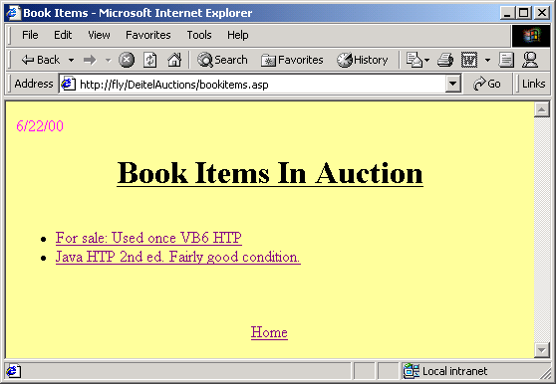
Output of bookitems.asp

Slide 57
384<% @LANGUAGE = VBSCRIPT %>
385<% Option Explicit %>
386
387<% ' Fig. 26.19 : itemdata.asp %>
1. Open database
388
389<% Dim connection, query, data
390
391 ' Open a database connection
392 Set connection = Server.CreateObject( "ADODB.Connection" )
Retrieve the selected item’s record from the AuctionItems table.
393 Call connection.Open( "DeitelAuctions" )
394
395 ' Create the SQL query. Retrieve the selected item.
396 query = "SELECT * FROM AuctionItems WHERE ItemNumber = " _
397 & CStr( Request( "ItemNumber" ) )
398
399 ' Open the record set
400 Set data = Server.CreateObject( "ADODB.RecordSet" )
401 Call data.Open( query, connection )
402 On Error Resume Next
403
404 ' Save the item number in a session variable for the
405 ' bidding page.
406 Session( "ItemNumber" ) = data( "ItemNumber" )
407%>
408
409<!DOCTYPE HTML PUBLIC "-//W3C//DTD HTML 4.0 Transitional //EN">
410<HTML>
411<HEAD>
412<TITLE>Item Description</TITLE>
413</HEAD>
414<BODY BGCOLOR = "#FFFF99">

Slide 58
415<H1 ALIGN = "center"><U>Item Description</U></H1><BR>
416<P>
417<% ' Display the item's information %>
418<FONT COLOR = "red"><% =data( "Display" ) %></FONT><BR>
2. Output of the selected book’s information
3. Close database connection
419<STRONG>Item#:&#160</STRONG>
420<% =data( "ItemNumber" ) %><BR>
421<STRONG>Seller:&#160</STRONG>
422<% =data( "Seller" ) %><BR>
423<STRONG>Ends:&#160</STRONG>
424<% =data( "Ends" ) %><BR>
425
426<STRONG>Current Bidder:&#160</STRONG>
427<% ' If there are no bids yet, say so.
428 If IsNull( data( "CurrentBidder" ) ) Then %>
429 No bids on this item yet.<BR>
430<% Else %>
431 <% =data( "CurrentBidder" ) %><BR>
432<% End If %>
433
434<STRONG>Current Price:&#160</STRONG>
435<% =FormatCurrency( data( "CurrentPrice" ) ) %><BR>
436<STRONG>State:&#160</STRONG>
437<% =data( "State" ) %><BR>
438<STRONG>Payment Type:&#160</STRONG>
439<% =data( "PaymentType" ) %><BR>
440</P>
441
442<% ' Create a link to bookdata.asp. Pass the product
443 ' number as a parameter.
444 Dim s
445 s = "bookdata.asp?ProductNumber=" & data( "ProductNumber" )
446 Call data.Close()

Slide 59
447 Call connection.Close()
448%>
449
450<A HREF = "<% =s %>">
451 Additional Book Information
4. Bid Now form
452</A>
453
454<% If Session( "LoggedIn" ) Then
455 s = "bid.asp"
456 Else
457 s = "login.asp"
458 End If
459%>
460
461<CENTER>
462 <FORM METHOD = "POST" ACTION = "<% =s %>">
463 <INPUT TYPE = "submit" VALUE = "Bid Now">
464 </FORM>
465</CENTER>
466
467<% ' Provide links back to home and book items. %>
468<BR><BR>
469<CENTER>
470 <A HREF = "index.asp">Home</A>&#160
471 <A HREF = "bookitems.asp">Back to Book Items</A>
472</CENTER>
473</BODY>
474</HTML>

Slide 60
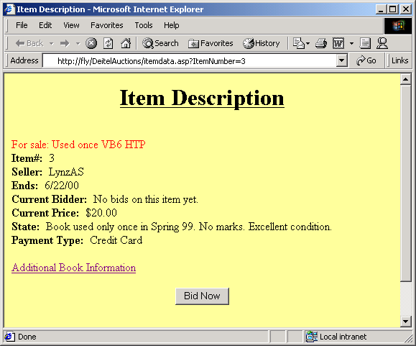
Output from itemdata.asp

Slide 61
475<% @LANGUAGE = VBSCRIPT %>
476<% Option Explicit %>
477
478<% ' Fig. 26.20 : bookdata.asp %>
1. Open database
479
480 <%
481 Dim connection, query, data
482
483 ' Open a database connection
484 Set connection = Server.CreateObject( "ADODB.Connection" )
485 Call connection.Open( "DeitelAuctions" )
486
487 ' Create the SQL query. Retrieve the product with the same
488 ' product number as the number passed to this page.
489 query = "SELECT * FROM Products WHERE ProductNumber = " _
490 & CStr( Request( "ProductNumber" ) )
491
492 ' Open the record set
493 Set data = Server.CreateObject( "ADODB.RecordSet" )
494 Call data.Open( query, connection )
495 On Error Resume Next
496 %>
497
498
499 <!DOCTYPE HTML PUBLIC "-//W3C//DTD HTML 4.0 Transitional //EN">
500 <HTML>
501
502 <HEAD>
503 <TITLE>Book Information</TITLE>
504 </HEAD>
505
506 <BODY BGCOLOR = "#FFFF99">
507 <H1 ALIGN = "center"><U>Book Information</U></H1>
508
509 <BR>
510

Slide 62
511<P>
512<% ' Display the book information %>
513<STRONG>Title:&#160</STRONG>
514<% =data( "Title" ) %><BR>
2. Output of the selected book’s information
2.1 Check for picture
515<STRONG>Language:&#160</STRONG>
516<% =data( "Language" ) %><BR>
517<STRONG>Publication Year:&#160</STRONG>
518<% =data( "PublishYear" ) %><BR>
519<STRONG>Edition:&#160</STRONG>
520<% =data( "Edition" ) %><BR>
521<STRONG>ISBN:&#160</STRONG>
522<% =data( "ISBN" ) %><BR>
523<STRONG>Description:&#160</STRONG>
Test the Picture parameter’s value and displays a picture of the book if Picture’s value is “yes”.
524<% =data( "Description" ) %><BR>
525
526<% ' If the Picture link was clicked, display the
527 ' picture.
528 If Request( "Picture" ) = "yes" Then %>
529 <STRONG>Picture:</STRONG><BR>
530 <CENTER>
531 <IMG SRC = "/images/<% =data( "PictureFile" ) %>"
532 BORDER = "1" ALT = "Book Picture">
533 </CENTER>
534
535<% ' Otherwise, display the Picture link or Not
536 ' Available if there is no picture.
537 Else
538
539 ' If the book does not have a picture, say so
540 If IsNull( data( "PictureFile" ) ) Then
541%> <STRONG>Picture:&#160</STRONG>Not Available<BR>
542<% Else

Slide 63
543
544 ' Provide a link that reloads the page
545 ' to display the picture.
546 Dim s
3. Close databse
547 s = "bookdata.asp?Picture=yes&ProductNumber=" _
548 & Request( "ProductNumber" ) %>
549 <A HREF = "<% =s %>">Picture</A>
550<% End If
551 End If
552%> </P>
553<% Call data.Close()
554 Call connection.Close()
555%> <BR><BR>
556
557<CENTER>
558<A HREF = "index.asp">Home</A> &#160
559<A HREF =
560 "itemdata.asp?ItemNumber=<% =Session( "ItemNumber" ) %>">
561 Back to Item Description
562</A>
563</CENTER>
564</BODY>
565</HTML>

Slide 64
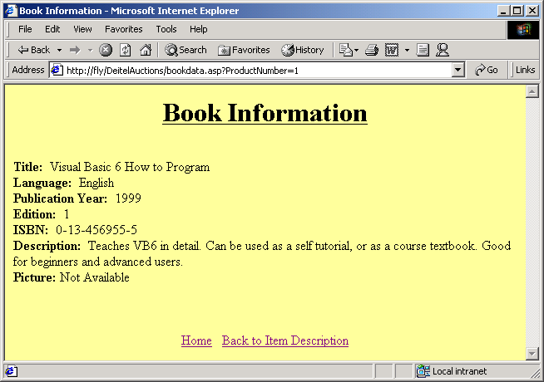
Output from bookdata.asp

Slide 65
566<% @LANGUAGE = VBSCRIPT %>
567<% Option Explicit %>
568
569<% ' Fig. 26.21 : login.asp %>
1. login.asp
2. Login form
570
571<!DOCTYPE HTML PUBLIC "-//W3C//DTD HTML 4.0 Transitional //EN">
572<HTML>
573
574<HEAD>
575<TITLE>Login</TITLE>
576</HEAD>
577
578<BODY BGCOLOR = "#FFFF99">
579
580<CENTER><H2><U>Please Log In</U></H2></CENTER><BR><BR>
581<% ' Form to post the login data %>
582<FORM METHOD = "POST" ACTION = "checklogin.asp">
583 <TABLE>
584 <TR>
585 <TH>User Name:</TH>
586 <TD>
587 <INPUT TYPE = "text" NAME = "UserName" SIZE = "25">
588 </TD>
589 </TR>
590
591 <TR>
592 <TH>Password:</TH>
593 <TD>
594 <INPUT TYPE = "password" NAME = "Password"
595 SIZE = "25">

Slide 66
596 </TD>
597 </TR>
598 <TR>
599 <TD></TD>
2. Login form
600 <TD>
601 <INPUT TYPE = "submit" VALUE = "Submit">
602 <INPUT TYPE = "reset" VALUE = "Clear">
603 </TD>
604 </TR>
605 </TABLE>
606</FORM><BR>
607
608<% ' Save where the user came from in the "from" session
609 ' variable. Because we have several register links
610 ' in the site, we can use this variable to provide
611 ' links in the registration pages, depending on where
612 ' the user came from. %>
613
614<% Session( "from" ) = "login" %>
615
616<% ' Provide a link to register a new user %>
617<P><STRONG>Do you not have an account?</STRONG>
618 <A HREF = "newmember.asp">Register</A></P>
619</BODY>
620</HTML>

Slide 67
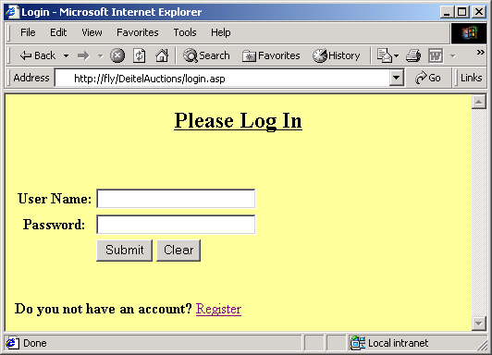
Output from login.asp

Slide 68
621<% @LANGUAGE = VBSCRIPT %>
622<% Option Explicit %>
623
624<% ' Fig 26.22 : checklogin.asp %>
625
1. checklogin.asp
1. Open database
2. Query for UserName
3. Close database
626<%
627 Dim connection, check, data
628
629 ' Open a database connection
630 Set connection = Server.CreateObject( "ADODB.Connection" )
Attempt to retrieve a record from the Members table that matches the user name and password.
631 Call connection.Open( "DeitelAuctions" )
632
633 ' Build the SQL query
634 check = "SELECT * FROM Members WHERE UserName = '" _
635 & CStr( Request( "UserName" ) ) & "'" _
636 & " AND Password = '" _
637 & CStr( Request( "Password" ) ) & "'"
638
639 ' Open the record set
If no record is retrieved, the user is redirected to badlogin.asp. If the record is retrieved, the login is valid and we set the session variables LoggedIn and UserName to the value true, before redirecting to bid.asp.
640 Set data = Server.CreateObject( "ADODB.RecordSet" )
641 Call data.Open( check, connection )
642 On Error Resume Next
643
644 If data.EOF Then
645
646 ' The user's login is incorrect
647 Call data.Close()
648 Call connection.Close()
649 Call Response.Redirect( "badlogin.asp" )
650 Else
651
652 ' The user's login is correct
653 Session( "UserName" ) = Request( "UserName" )
654 Session( "LoggedIn" ) = True

Slide 69
655 Call data.Close()
656 Call connection.Close()
657 Call Response.Redirect( "bid.asp" )
658 End If
659%>

Slide 70
660<% @LANGUAGE = VBSCRIPT %>
661<% Option Explicit %>
662
663<% ' Fig 26.23 : badlogin.asp %>
1. badlogin.asp
2. Links if user has a bad password
664
665<!DOCTYPE HTML PUBLIC "-//W3C//DTD HTML 4.0 Transitional //EN">
666<HTML>
667
668<HEAD>
669 <TITLE>Login Failure</TITLE>
670</HEAD>
671
672<BODY BGCOLOR = "#FFFF99">
673 <H2>Invalid username or password.</H2>
674
675<CENTER>
676 <A HREF = "login.asp">Try Again</A>&#160
677 <A HREF = "index.asp">Home</A>&#160
678 <A HREF =
679 "itemdata.asp?ItemNumber=<% =Session( "ItemNumber" ) %>">
680 Back to Item Description
681 </A>
682</CENTER>
683
684<% ' Provide a link to register a new user %>
685<BR><BR>
686<P><STRONG>Do you not have an account?</STRONG>
687 <A HREF = "newmember.asp">Register</A>
688</P>
689</BODY>
690</HTML>

Slide 71
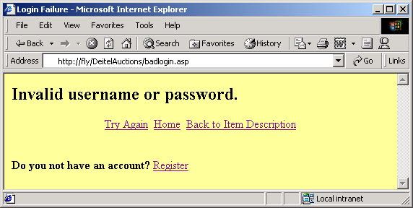
Output from badlogin.asp

Slide 72
691<% @LANGUAGE = VBSCRIPT %>
692<% Option Explicit %>
693
694<% ' Fig 26.24 : bid.asp %>
1. Open database
2. Query database
695
696<%
697 Dim connection, query, data
698
699 ' Open a database connection
700 Set connection = Server.CreateObject( "ADODB.Connection" )
701 Call connection.Open( "DeitelAuctions" )
Retrieve the record of the item the user wants to bid on.
702
703 ' Create the SQL query. Retrieve the record of the
704 ' item the user wants to bid on.
705 query = "SELECT CurrentPrice, ItemNumber, Display " & _
706 "FROM AuctionItems " & _
707 "WHERE ItemNumber = " & CStr( Session( "ItemNumber" ) )
708
709 ' Open the record set.
710 Set data = Server.CreateObject( "ADODB.RecordSet" )
711 Call data.Open( query, connection )
712 On Error Resume Next
713%>
714
715<!DOCTYPE HTML PUBLIC "-//W3C//DTD HTML 4.0 Transitional //EN">
716<HTML>
717
718<HEAD>
719<TITLE>Bid</TITLE>
720</HEAD>

Slide 73
721
722<BODY BGCOLOR = "#FFFF99">
723<FONT COLOR = "magenta">
724<% =Date() %>
3. Display book description and current price
4. dobid form
725</FONT>
726<H1 ALIGN = "center"><U>New Bid</U></H1>
727<BR>
728<P>
729<% ' Display the item number and the current price.
730 ' Also, provide the display caption for the item.
731%> <FONT COLOR = "red"><% =data( "Display" ) %></FONT><BR>
732<STRONG>Item#:&#160</STRONG><% =data( "ItemNumber" ) %><BR>
733<STRONG>Current Price:&#160</STRONG>
734<% =FormatCurrency( data( "CurrentPrice" ) ) %><BR>
735</P>
736
737<% ' A form to post bidding data %>
738<FORM METHOD = "POST" ACTION = "dobid.asp">
739 <P>
740 <STRONG>Your Bid:</STRONG>$
741 <INPUT TYPE = "text" NAME = "Bid" SIZE = "25">
742 </P>
743 <CENTER>
744 <INPUT TYPE = "submit" VALUE = "Submit">
745 <INPUT TYPE = "reset" VALUE = "Clear">
746 </CENTER><BR><BR>
747</FORM><BR><BR>
748<CENTER>
749 <A HREF = "index.asp">Home</A>&#160
750 <A HREF =
751 "itemdata.asp?ItemNumber=<% =data( "ItemNumber" )%>">

Slide 74
752 Back to Item Description
753 </A>
754</CENTER>
755
5. Close database
756<% ' Close the database connection and the record set
757 Call data.Close()
758 Call connection.Close()
759%>
760</BODY>
761</HTML>

Slide 75
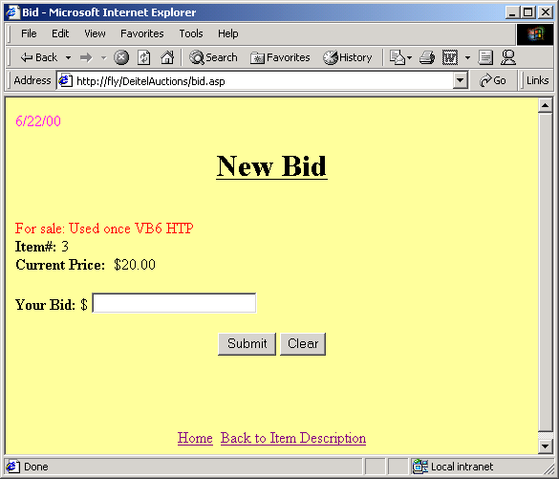
Output from bid.asp

Slide 76
762<% @LANGUAGE = VBSCRIPT %>
763<% Option Explicit %>
764
765<% ' Fig. 26.25 : dobid.asp %>
766
1. dobid.asp
2. Open database
3. Check bid validity
767<%
768 Dim connection, data, query, update
769
770 ' Open a database connection.
771 Set connection = Server.CreateObject( "ADODB.Connection" )
772 Call connection.Open( "DeitelAuctions" )
773
774 ' Create the SQL query. Retrieve the record for this
775 ' item.
776 query = "SELECT ItemNumber, CurrentPrice " & _
777 "FROM AuctionItems WHERE ItemNumber = " & _
778 CStr( Session( "ItemNumber" ) )
779
780 ' Open the record set
781 Set data = Server.CreateObject( "ADODB.RecordSet" )
782 Call data.Open( query, connection )
A bid is invalid if it is for less than a previous bid.
783 On Error Resume Next
784
785 ' Check the validity of the bid
786 If CCur( Request( "Bid" ) ) _
787 <= CCur( data( "CurrentPrice" ) ) _
788 Then
789 Call data.Close()
790 Call connection.Close()
791 Call Response.Redirect( "badbid.asp" )
792 Else
793
794 ' Create an update SQL statement that updates the item's

Slide 77
795 ' record with the new high bidder and new bid.
796 update = "UPDATE AuctionItems " & _
797 "SET CurrentBidder = '" & _
798 CStr( Session( "UserName" ) ) & "'" & _
4. Update highest price
5. Close database
799 ", CurrentPrice = " & _
800 CStr( Request( "Bid" ) ) & _
801 " WHERE ItemNumber = " & _
Update the item’s CurrentBidder and CurrentPrice fields.
802 CStr( data( "ItemNumber" ) )
803
804 ' Execute the update statement.
805 Call connection.Execute( update )
806
807 ' Confirm the bid.
808 Call data.Close()
809 Call connection.Close()
810 Call Response.Redirect( "confirmbid.html" )
811 End If
812%>

Slide 78
813<!DOCTYPE HTML PUBLIC "-//W3C//DTD HTML 4.0 Transitional //EN">
814<!-- Fig. 26.26 : confirmbid.html -->
815<HTML>
816<HEAD>
1. confirmbid.html
817 <TITLE>Confirm Bid</TITLE>
818</HEAD>
819<!-- Display the message and provide navigational links -->
820<BODY BGCOLOR = "#FFFF99">
821<H2>Thanks. You are the high bidder now!</H2>
822
823<CENTER>
824 <A HREF = "index.asp">Home</A>&#160
825 <A HREF = "bookitems.asp">Back to Book Items</A>
826</CENTER>
827</BODY>
828</HTML>

Slide 79
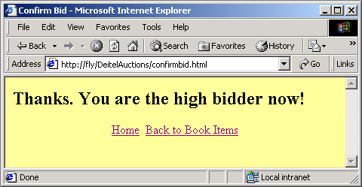
Output from confirmbid.html

Slide 80
829<% @LANGUAGE = VBSCRIPT %>
830<% Option Explicit %>
831
832<% ' Fig. 24.27 : badbid.asp %>
1. badbid.asp
833
834<!DOCTYPE HTML PUBLIC "-//W3C//DTD HTML 4.0 Transitional //EN">
835<HTML>
836
837<HEAD>
838 <TITLE>Invalid Bid</TITLE>
839</HEAD>
840
841<BODY BGCOLOR = "#FFFF99">
842
843<% ' Print error message and provide navigational links %>
844<H2>Invalid Bid.</H2>
845<H2>You must bid higher than the current price.</H2>
846
847<CENTER>
848<A HREF = "bid.asp">Try Again</A>&#160
849<A HREF = "index.asp">Home</A>&#160
850<A HREF =
851 "itemdata.asp?ItemNumber=<% =Session( "ItemNumber" ) %>">
852 Back to Item Description
853</A>
854</CENTER>
855</BODY>
856</HTML>

Slide 81
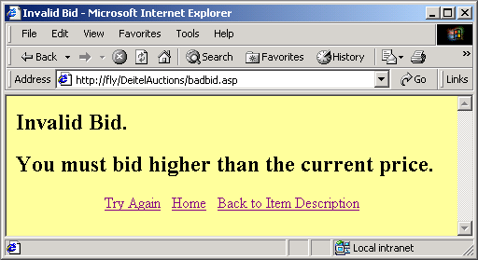
Output from badbid.asp

Slide 82
26.5 Case Study: a Comparison Pricing Search Engine
Comparison Pricing Search Engine
  Searches Web sites for pricing information
  Uses a single ASP page – lowest.asp
Database used
  Information on books being searched
  List of Web sites to search and methods to use when searching (Get or Post)

Slide 83
1<% @LANGUAGE = VBScript %>
2<% Option Explicit %>
3
4<% ' Fig. 26.28: lowest.asp %>
5
1. Declare variables
6<% Dim connection, query, data
7
8 ' Open a database connection
9 Set connection = Server.CreateObject( "ADODB.Connection" )
10
Retrieve all records in the Products table.
11 ' System DSN named Lowest
12 Call connection.Open( "Lowest" )
13
14 query = "SELECT * FROM Products"
15
16 ' Open a record set
17 Set data = Server.CreateObject( "ADODB.RecordSet" )
18 Call data.Open( query, connection )
19
20 On Error Resume Next
21%>
22
23<!DOCTYPE HTML PUBLIC "-//W3C//DTD HTML 4.0 Transitional //EN">
24<HTML>
25
26<HEAD>
27<TITLE>Lowest Price</TITLE>
28</HEAD>
29
30<BODY BGCOLOR = "FFFF99">
31
32<CENTER><H1>Welcome to Deitel Lowest Price</H1></CENTER><BR>
33

Slide 84
34<CENTER>
35<STRONG>Please Select a book.</STRONG>
36<FORM ACTION = "lowest.asp?entry=true" METHOD = "POST">
37
38<SELECT NAME = "isbn">
2. Search Prices form
2.1 Drop-down list of titles
39
40<% ' Iterate through the records to form a book list
41 While Not data.EOF
42
43 ' Set the value of the OPTION to the book's
While loop which builds the book list to be displayed in the drop down box.
44 ' ISBN number %>
45 <OPTION VALUE = "<% =data( "ISBN" ) %>"
46
47 <% ' If the user has made a selection, keep their
48 ' selection by writing SELECTED for this OPTION
49 ' if it has the same ISBN number as the
50 ' selected ISBN number.
51 If Request( "entry" ) = "true" And _
52 Request( "isbn" ) = data( "ISBN" ) _
53 Then
54 Call Response.Write( "SELECTED" )
55 End If
56 %> >
57
58 <% ' Display the titles as OPTIONs for the user
59 Call Response.Write( data( "Title" ) )
60 Call data.MoveNext()
61
62 Wend
63 Call data.Close() %>
64
65</SELECT>
66

Slide 85
67<INPUT TYPE = "submit" VALUE = "Search Prices">
68
69</FORM>
70</CENTER>
71
3. If the book is found
3.1 Declare variables
3.2 Search for ISBN number
72<% ' If the user has made a selection, process the request
73 If Request( "entry" ) = "true" Then
74
75 Dim url, method, postData, label, _
76 isbn, s, ok, p, count, a()
77
78 p = 0
79
80 ' Count how many sites are in the database. This is
81 ' the number of entries needed in the price array.
82 ' Thus, dynamically allocate the array.
83 query = "SELECT Count(*) As C FROM Sites"
84 Call data.Open( query, connection )
Retrieve the number of records in the Sites table and create an array with of necessary length.
85 count = data( "C" )
86 Call data.Close()
87 ReDim a( count - 1 )
88
89 ' This is the ISBN number to search for.
90 ' Store it in the variable isbn.
91 isbn = Request( "isbn" )
92
93 Call Response.Write( "<STRONG> Searching " )
94
95 ' Search all the Web sites in the database.
96 ' The query retrieves information about the Web sites
97 ' from the Sites table.
98 query = "SELECT * FROM Sites"
99 Call data.Open( query, connection )

Slide 86
100
101 ' Iterate through the sites and search them
102 While Not data.EOF
103 Set a( p ) = New CRecord
3.3 Iterate through all sites
104
105 ' Set the variables to the corresponding fields of
106 ' the current record.
107 Call SetVariables()
108
109 ' Get the price
110 s = GetPrice( url, method, postData, label )
111
112 ' Insert the price into the array a
113 Call Insert( s )
114
115 ' Print search progress dots.
116 ' One dot is printed per site.
117 Call Response.Write(". ")
118
119 ' Move to the next record
120 Call data.MoveNext()
121
122 ' Increment the array index
123 p = p + 1
124 Wend
125 Call data.Close()
126 Call Response.Write( "</STRONG><BR>" )
127
128 ' Sort the array by price
129 Dim i, j, o
130
131 j = UBound( a )

Slide 87
132 While j >= 1
133
Perform a bubblesort on the array. Sort by the Price element.
134 For i = 0 To j - 1
135
136 If a( i ).Price > a( i + 1 ).Price Then
3.4 Sort the array
3.5 Display table
137 Set o = a( i )
138 Set a( i ) = a( i + 1 )
139 Set a( i + 1 ) = o
140 Set o = Nothing
141 End If
142
143 Next
144 j = j - 1
145
146 Wend
147
148 ' Display the array elements in a table %>
149 <TABLE BORDER = "1" ALIGN = "CENTER">
150 <CAPTION><STRONG>Search Results</STRONG></CAPTION>
151
152<% For i = 0 To UBound( a ) %>
153 <TR>
154 <TD><STRONG><% =a( i ).Name %></STRONG></TD>
155 <TD><% =a( i ).Display %></TD>
156 </TR>
157<% Next %>
158
159 </TABLE>
160<% End If
161
162 Call connection.Close()
163
164 ' A class to store the search results of a site

Slide 88
165 Class CRecord
166
167 ' Site name, book price and the display which is
168 ' either the book price as a link, "Failed" or "N/A".
4. Crecord Class definition
4.1 Private variable declarations
4.3 Procedure declarations
4.4 Function declarations
169 Private n, p, d
170
171 Public Property Get Name()
172 Name = n
173 End Property
174
175 Public Property Let Name( parameter )
176 n = parameter
177 End Property
178
179 Public Property Get Price()
180 Price = p
181 End Property
182
183 Public Property Let Price( parameter )
184 p = parameter
185 End Property
186
187 Public Property Get Display()
188 Display = d
189 End Property
190
191 Public Property Let Display( parameter )
192 d = parameter
193 End Property
194 End Class
195
196 ' Sets the variables corresponding to the fields of the

Slide 89
197 ' current record.
198 Sub SetVariables()
199 a( p ).Name = data( "Name" )
200 url = data( "SearchURL" )
5. Procedure SetVariables
6. Function GetPrice
201 method = data( "Method" )
202
203 ' Append the current ISBN number to postData
204 postData = data( "PostData" ) & isbn
205 label = data( "Label" )
206 End Sub
207
208 ' This function returns the price of the book from the
209 ' current Web site. The parameters are: url is the URL of
210 ' the search script on a Web site; method is the request
Use the ASP component ASPTear from SoftWing to grab Web pages.
211 ' type, 1 or 2; postData is the data to pass to the
212 ' site; label is the string used by the site to indicate
213 ' the price (e.g., "Our Price", "Online Price").
214 Function GetPrice( url, method, postData, label )
215 Dim s, aspTear, i, e, expression, b
216
217 Set aspTear = Server.CreateObject( "SOFTWING.AspTear" )
218
219 i = 1
220 e = 1
221
222 ' Make, at most, 3 attempts to grab a page
223 On Error Resume Next
224 While i <= 3 And e <> 0
225 s = aspTear.Retrieve( url, method, _
226 postData, "", "" )

Slide 90
227 e = Err.Number
228 i = i + 1
229 Wend
230
231 If Err.Number <> 0 Then
232 GetPrice = "Failed"
233 ok = False
234 Exit Function
235 End If
236
237 ' Split the string on the "$" character
238 b = Split( s, "$" )
239
240 ' If the "$" character was not found
241 If UBound( b ) = 0 Then
242 GetPrice = "N/A"
243 ok = False
244 Exit Function
245 End If
246
247 ' Look for the label
248 For i = UBound( b ) - 1 To 0 Step -1
249 If InStr( LCase( b( i ) ), LCase( label ) ) <> 0 Then
250 Exit For
251 End If
252 Next
253
254 ' If the label was not found
255 If i = -1 Then
256 GetPrice = "Failed"
257 ok = False
258 Exit Function

Slide 91
259 End If
260
261 ' Set s
262 s = b( i + 1 )
263
264 ' Find the "<" character and remove it and the
265 ' remaining characters to the right
266 s = Left( s, InStr( s, "<" ) - 1 )
267
268 ' Find the "~" character and remove it and the
269 ' remaining characters to the right
270 s = Left( s, InStr( s, "~" ) - 1 )
271
272 ' Find the characters, Chr(9) to Chr(13), and
273 ' remove them and the remaining characters to
274 ' the right
275 For i = 9 To 13
276 s = Left( s, InStr( s, Chr( i ) ) - 1 )
277 Next
278
279 ' Remove any remaining spaces from the string
280 s = Replace( s, " ", "" )
281
282 ' Check the pattern
283 Set expression = New RegExp
284 expression.Pattern = "^\d*\.{0,1}\d*$"
285
286 If expression.Test( s ) Then
287 GetPrice = "$" & s
288 ok = True
289 Else
290 GetPrice = "Failed"

Slide 92
291 ok = False
292 End If
293 Set expression = Nothing
294 End Function
7. Procedure Insert
295
296 ' Inserts the results of a Web site search in the
297 ' array a.
298 Sub Insert( s )
299 Dim display, href
300
301 ' If a price was found, set the price field at the
302 ' current array position, get the book's URL and
303 ' build the book's hyperlink.
304 If ok Then
305 a( p ).Price = CCur( s )
306 href = GetURL()
307 display = "<A HREF = """ & href & """>"
308 Else
309
310 ' If a price was not found, set the price field
311 ' at the current array position to a large number.
312 ' When the array is sorted, the "Failed" and "N/A"
313 ' items are moved to the end.
314 a( p ).Price = CCur( 60000 )
315
316 End If
317
318 ' Append what GetPrice returned to the display field.
319 display = display & s
320

Slide 93
321 ' If a price was found, the link needs to be closed.
322 If ok Then
323 display = display & "</A>"
324 End If
8. Function GetURL
325
326 a( p ).Display = display
327 End Sub
328
329 ' Returns a link to the book we are searching for. The
330 ' link returned is on the Web site of the current
331 ' record.
332 Function GetURL()
333 Dim query2, data2
334
335 ' If a direct link to a page on the site is not
336 ' available, a link to the script that returns
337 ' the page containing the book is used.
338 If data( "DirectBookLink" ) = False Then
339 GetURL = url & "?" & postData
340 Else
341
342 ' If a hyperlink to a processing script on the site
343 ' does not work, a direct link to a page on the
344 ' site is needed. This link is stored in the
345 ' DirectLinks table.
346 query2 = "SELECT * FROM DirectLinks " &_
347 "WHERE SiteID = " & data( "SiteID" )
348
349 ' Open a record set
350 Set data2 = _
351 Server.CreateObject( "ADODB.RecordSet" )
352 Call data2.Open( query2, Connection )

Slide 94
353 On Error Resume Next
354
355 ' Build the link by concatenating the left part
356 ' of the URL, the ISBN number and the right part
357 ' of the URL.
358 GetURL = data2( "LeftSubURL" ) & isbn _
359 & data2( "RightSubURL" )
360 Call data2.Close()
361 End If
362 End Function
363%>
364
365</BODY>
366</HTML>

Slide 95
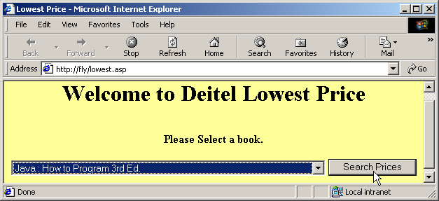
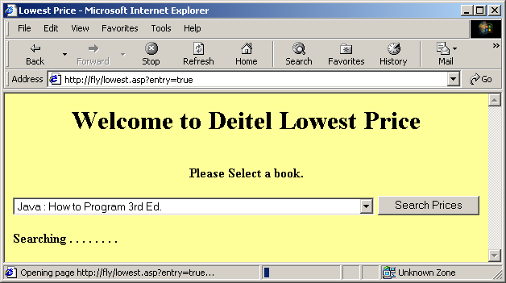
Comparison-Pricing Search Engine

Slide 96
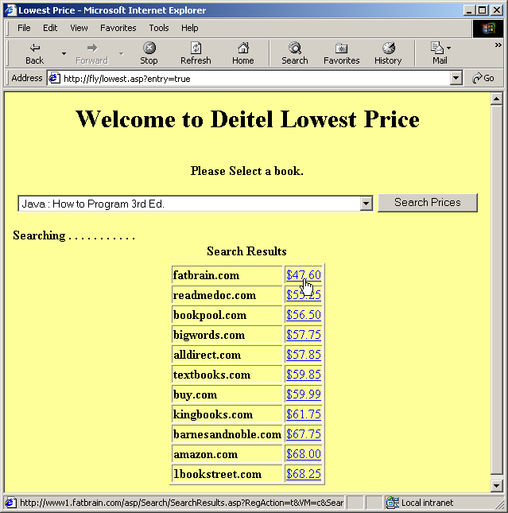
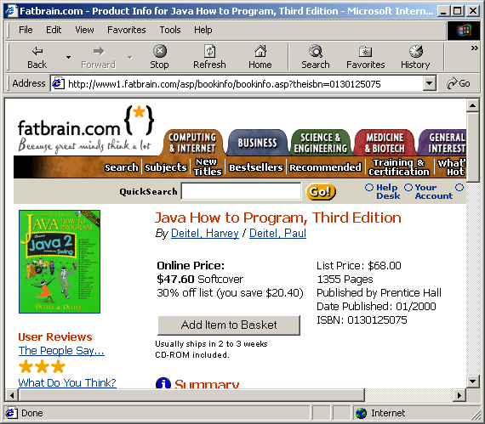
Comparison-Pricing Search Engine

