Slide 1
Chapter 27 – XML
(Extensible Markup Language)
Outline
27.1 Introduction
27.2 Structuring Data
27.3 Document Type Definitions (DTD)
27.4 Customized Markup Languages
27.4.1 MathML
27.4.2 WML
27.4.3 XBRL
27.4.4 ebXML
27.4.5 FpML
27.4.6 Other Markup Languages
27.5 Using XML with HTML
27.6 Document Object Model (DOM)
27.7 Extensible Style Language (XSL)
27.8 Microsoft Schema
27.9 Extensible Hypertext Markup Language (XHTML™)
27.10 Microsoft BizTalk™
27.11 Simple Object Access Protocol (SOAP)

Slide 2
27.1 Introduction
XML
  Markup language for describing structured data – content is seperated from presentation
  XML documents contain only data
    Applications decide how to display the data
  Language for creating markup languages
    Can create new tags
  Possible to search, sort, manipulate and render XML using Extensible Markup Language (XSL)
  Highly portable
  Files end in the .xml extension

Slide 3
27.1 Introduction
XML parsers
  Check an XML document’s syntax
  Support either the
    Document Object Model (DOM)
      Build a tree structure containing the XML document’s data
    Simple API for XML (SAX)
      Process the document and generate events
    www.xml.com/xml/pub/Guide/XML_Parsers
  Document Type Definition (DTD) files
    Defines grammatical rules for the document
    Used to check the XML document structure against

Slide 4
27.2 Structuring Data
Element types
  Can be declared to describe data structure
XML elements
  Root element
    Must be exactly one per XML document
    Contains all other elements in document
    Lines preceding the root element are called the prolog
  Container element
    Contains sub-elements (children)
  Empty element
    No matching end tag
    In HTML, IMG
    Terminate with forward slash (/)

Slide 5
1 <?xml version = "1.0"?>
2
3 <!-- Fig. 27.3: article.xml -->
4 <!-- Article formatted with XML -->
1.1 XML declaration tells parser which version of XML
1.2 Tags contain data appropriate for tag names
<article> - root
<author> - container
<fname>, <lname> - sub-elements
5
6 <article>
7
8 <title>Simple XML</title>
9
10 <date>September 6, 1999</date>
11
12 <author>
13 <fname>Tem</fname>
14 <lname>Nieto</lname>
15 </author>
16
17 <summary>XML is pretty easy.</summary>
18
19 <content>Once you have mastered HTML, XML is easily
20 learned. You must remember that XML is not for
21 displaying information but for managing information.
22 </content>
23
24 </article>

Slide 6
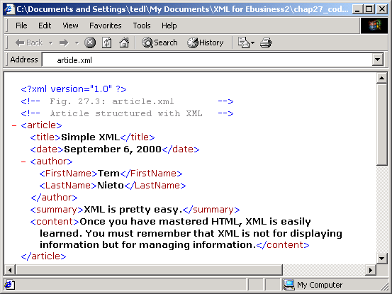
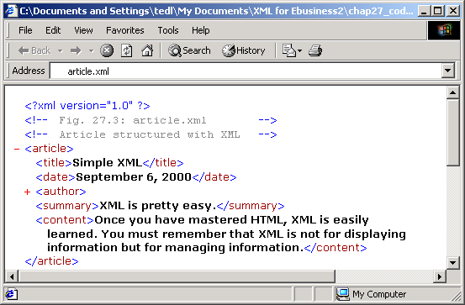
IE5 displaying article.xml

Slide 7
1<?xml version = "1.0"?>
2
3<!-- Fig. 27.5: letter.xml -->
4<!-- Business letter formatted with XML -->
5
1.1 Specify DTD file’s name and location
Attribute's value in quotes
Empty element uses /
6<!DOCTYPE letter SYSTEM "letter.dtd">
7
8<letter>
9
10 <contact type = "from">
11 <name> John Doe</name>
12 <address1>123 Main St.</address1>
13 <address2></address2>
14 <city>Anytown</city>
15 <state>Anystate</state>
16 <zip>12345</zip>
17 <phone>555-1234</phone>
18 <flag gender = "M"/>
19 </contact>
20
21 <contact type = "to">
22 <name>Joe Schmoe</name>
23 <address1>Box 12345</address1>
24 <address2>15 Any Ave.</address2>
25 <city>Othertown</city>
26 <state>Otherstate</state>
27 <zip>67890</zip>
28 <phone>555-4321</phone>
29 <flag gender = "M"/>
30 </contact>
31
32 <salutation>Dear Sir:</salutation>
33

Slide 8
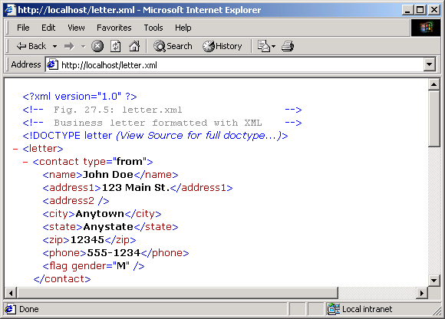
34 <paragraph>It is our privilege to inform you about our new
35 database managed with XML. This new system allows
36 you to reduce the load of your inventory list server by
37 having the client machine perform the work of sorting
38 and filtering the data.</paragraph>
39 <closing>Sincerely</closing>
40 <signature>Mr. Doe</signature>
41
42</letter>

Slide 9
27.3 Document Type Definitions (DTD)
Document Type Definition
  Specify list of element types, attributes and their relationships to each other
  Optional, but recommended for program conformity
  !Element
    Element type declaration – defines the rules for an element
    Plus sign (+) – one or more occurrences
    Asterisk (*) – any number of occurrences
    Question mark (?) – either zero or exactly one occurrence
    Omitted operator – exactly one occurrence
    #PCDATA
      The element can store parsed character data

Slide 10
27.3 Document Type Definitions (DTD)
  !ATTLIST
    Defines attributes for an element
    #IMPLIED
      Can assign its own type attribute or ignore
    #REQUIRED
      The specified attribute must be declared in the document
    #FIXED
      The Specified attribute must be declared with given value

Slide 11
1<!-- Fig 27.6: letter.dtd -->
2<!-- DTD document for letter.xml -->
3
4<!ELEMENT letter (contact+, salutation, paragraph+,
Business letter DTD
Declare elements and elements’ attributes
#IMPLIED indicates attribute is unspecified—system gives it a value
CDATA states that attribute contains a string
#PCDATA specifies parsed character data
EMPTY specifies element does not contain content (commonly used for attributes)
5 closing, signature )>
6
7<!ELEMENT contact (name, address1, address2, city, state,
8 zip, phone, flag)>
9<!ATTLIST contact type CDATA #IMPLIED>
10
11<!ELEMENT name (#PCDATA)>
12<!ELEMENT address1 (#PCDATA)>
13<!ELEMENT address2 (#PCDATA)>
14<!ELEMENT city (#PCDATA)>
15<!ELEMENT state (#PCDATA)>
16<!ELEMENT zip (#PCDATA)>
17<!ELEMENT phone (#PCDATA)>
18<!ELEMENT flag EMPTY>
19<!ATTLIST flag gender (M | F) "M">
20
21<!ELEMENT salutation (#PCDATA)>
22<!ELEMENT closing (#PCDATA)>
23<!ELEMENT paragraph (#PCDATA)>
24<!ELEMENT signature (#PCDATA)>

Slide 12
27.4 Customized Markup Languages
Customized Markup Languages
  Can create own tags to describe data, creating a new markup language

Slide 13
27.4.1 MathML
MathML
  Developed by W3C for describing mathematical notations and expressions
  Amaya™ browser
    www.w3.org/Amaya/User/BinDist.html

Slide 14
1<!DOCTYPE HTML PUBLIC "-//W3C//DTD HTML 4.0 Transitional//EN">
2<HTML>
3
4<!-- Fig. 27.7 mathml.html -->
5<!-- Calculus example using MathML -->
1. mathml.html
6
7<BODY>
8
9<MATH>
10 <mrow>
11 <msubsup>
12 <mo>&Integral;</mo>
13 <mn>0</mn>
14 <mrow>
15 <mn>1</mn>
16 <mo>-</mo>
17 <mi>y</mi>
18 </mrow>
19 </msubsup>
20
21 <msqrt>
22 <mrow>
23 <mn>4</mn>
24 <mo>&InvisibleTimes;</mo>
25 <msup>
26 <mi>x</mi>
27 <mn>2</mn>
28 </msup>
29 <mo>+</mo>
30 <mi>y</mi>
31 </mrow>
32 </msqrt>
33

Slide 15
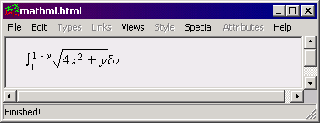
34 <mo>&delta;</mo>
35 <mi>x</mi>
36 </mrow>
37</MATH>
38</BODY>
39</HTML>
Integral symbol
Delta symbol

Slide 16
27.4.2 WML
Wireless Markup Language
  Allows portions of Web pages to be displayed on wireless devices
  Works with Wireless Application Protocol (WAP)
  www.wapforum.org
  www.xml.com/pub/Guide/WML

Slide 17
27.4.3 XBRL
Extensible Business Reporting Language (XBRL)
  Facilitates the creation, exchange and validation of financial information
  Namespaces
    Minimize conflicts between XML elements with the same name
    Example:
  <school:subject>English</school:subject>
  <medical:subject>Thrombosis</medical:subject>

Slide 18
1<?xml version = "1.0" encoding = "utf-8"?>
2<!DOCTYPE group SYSTEM "xbrl-core-00-04-04.dtd">
3
4<!-- Fig. 27.8:financialHighlights.xml -->
1.financialHighlights.xml
1.1 group elements
5<!-- XBRL example -->
6
7<group
8 xmlns = "http://www.xbrl.org/us/aicpa-us-gaap-ci-00-04-04"
9 xmlns:ExComp = "http://www.example-ExComp.org/fHighlights.xml"
10 id = "XXXXXX-X-X-X"
11 entity = "NASDAQ:EXCOMP"
12 period = "2000-12-31"
13 scaleFactor = "3"
14 precision = "3"
15 type = "ExComp:statement.financialHighlights"
16 unit = "ISO4217:USD"
17 decimalPattern = "#,###.###">
18
19 <group id = "1" type = "ExComp:financialHighlights.introduction">
20 <item type = "ExComp:statement.declaration"
21 period = "2000-12-31">
22 ExComp has adopted all standard procedures for accounting.
23 This statement gives a financial highlight summary for the
24 last 4 years.
25 It also gives an account of percentage change in profit for
26 each year, which is useful in measuring the company’s
27 performance.
28 </item>
29 </group>
30
31 <group id = "2" type = "ExComp:financialHighlights.statistics">

Slide 19
32 <group id = "21" type = "ExComp:sales.revenue">
33 <item period = "P1Y/2000-12-30">2961.5</item>
34 <item period = "P1Y/1999-12-30">3294.97</item>
35 <item period = "P1Y/1998-12-30">3593.78</item>
1.1 group elements
36 <item period = "P1Y/1997-12-30">4301.55</item>
37 </group>
38
39 <group id = "22" type = "ExComp:cost.production">
40 <item period = "P1Y/2000-12-30">1834.126</item>
41 <item period = "P1Y/1999-12-30">1923.226</item>
42 <item period = "P1Y/1998-12-30">2872.10</item>
43 <item period = "P1Y/1997-12-30">3101.11</item>
44 </group>
45
46 <group id = "23"
47 type = "ExComp:cost.transportAndMaintenance">
48 <item period = "P1Y/2000-12-30">134.07</item>
49 <item period = "P1Y/1999-12-30">334.47</item>
50 <item period = "P1Y/1998-12-30">821.59</item>
51 <item period = "P1Y/1997-12-30">1007.12</item>
52 </group>
53
54 <group id = "24" type = "ExComp:net.profit">
55 <item period = "P1Y/2000-12-30">1335.5</item>
56 <item period = "P1Y/1999-12-30">1135.52</item>
57 <item period = "P1Y/1998-12-30">1142.03</item>
58 <item period = "P1Y/1997-12-30">1312.62</item>
59 </group>
60
61 <group id = "25" type = "ExComp:percentageChange.profit">
62 <item period = "P1Y/2000-12-30">18.35</item>
63 <item period = "P1Y/1999-12-30">11.11</item>

Slide 20
64 <item period = "P1Y/1998-12-30">10.25</item>
65 <item period = "P1Y/1997-12-30">24.98</item>
66 </group>
67
1.2 Labels
68 <!-- Labels -->
69 <label href = "#21">Revenue</label>
70 <label href = "#22">Production cost</label>
71 <label href = "#23">Transport and Maintenance</label>
72 <label href = "#24">Profit</label>
73 <label href = "#25">Percentage Change in profit</label>
74
75 </group>
76
77</group>

Slide 21
27.4.4 ebXML
Electronic Business XML (ebXML)
  Used for exchanging business data
  www.ebxml.org

Slide 22
27.4.5 FpML
Financial Products Markup Language (FpML)
  Emerging standard for exchanging financial ifnormation over the Internet
  www.fpml.org

Slide 23
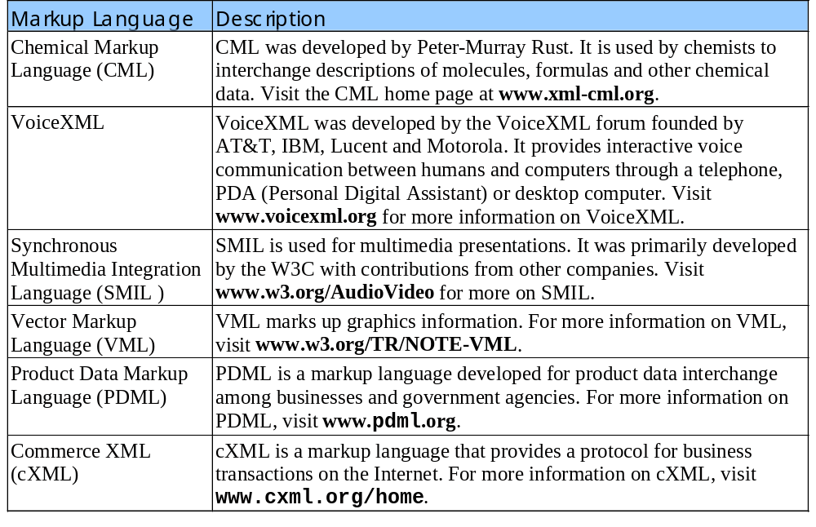
27.4.6 Other Markup Languages

Slide 24
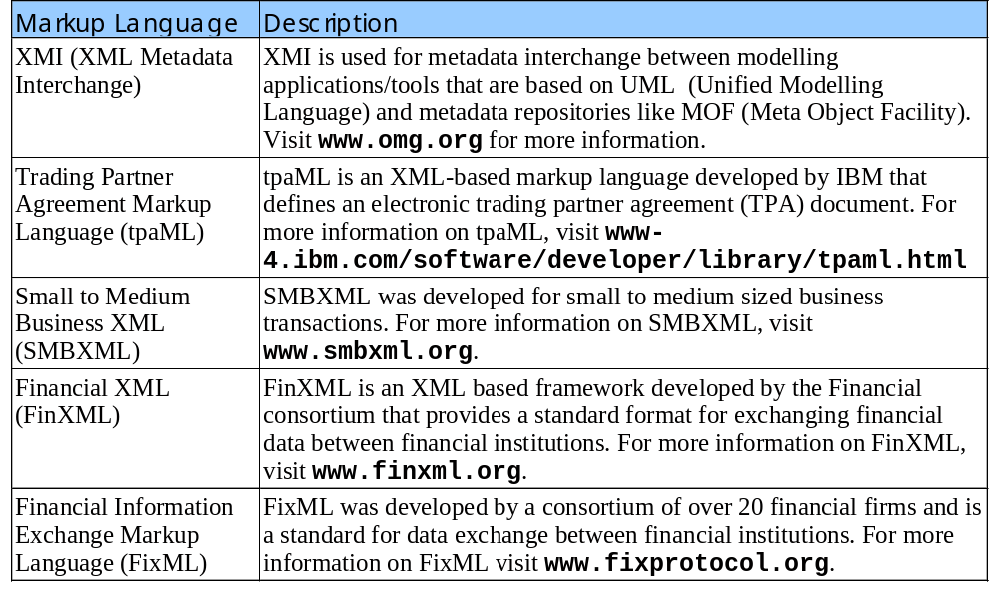
27.4.6 Other Markup Languages

Slide 25
1<!DOCTYPE HTML PUBLIC "-//W3C//DTD HTML 4.0 Transitional//EN">
2<HTML>
3
4<!-- Fig. 27.10: simple_contact.html -->
1.1 Open XML markup area
1.2 Markup data with XML tags
1.3 Close XML area
2.1 Open TABLE element with DATASRC attribute
5<!-- A Simple Contact List Database -->
6
7<BODY>
8
9<XML ID = "xmlDoc">
10 <contacts>
11
12 <contact>
13 <LastName>Deitel</LastName>
14 <FirstName>Harvey</FirstName>
15 </contact>
16
17 <contact>
18 <LastName>Deitel</LastName>
19 <FirstName>Paul</FirstName>
20 </contact>
21
22 <contact>
23 <LastName>Nieto</LastName>
24 <FirstName>Tem</FirstName>
25 </contact>
26
27 </contacts>
28</XML>
29
30<TABLE BORDER = "1" DATASRC = "#xmlDoc">
31 <THEAD>
32 <TR>

Slide 26
27.5 Using XML with HTML
XML documents are data sources
  XML documents embedded in HTML documents
    Using the XML tag
    Embedded XML document called a data island
<XML ID = “xmldoc”>…</XML>
  Marks boundaries of data island
  Attribute ID
    Name used to reference the data island
DATASRC=name attribute
  In opening TABLE element’s start-tag, binds specified data island to table
To use bound bound data
  Use SPAN element with a DATAFLD attribute

Slide 27
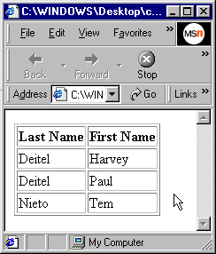
33 <TH>Last Name</TH>
34 <TH>First Name</TH>
35 </TR>
36 </THEAD>
37
2.2 Enter table header
2.3 Enter SPAN elements with defined DATAFLD attribute
2.4 Close TABLE element
38 <TR>
39 <TD><SPAN DATAFLD = "LastName"></SPAN></TD>
40 <TD><SPAN DATAFLD = "FirstName"></SPAN></TD>
41 </TR>
42 </TABLE>
43
44 </BODY>
45 </HTML>

Slide 28
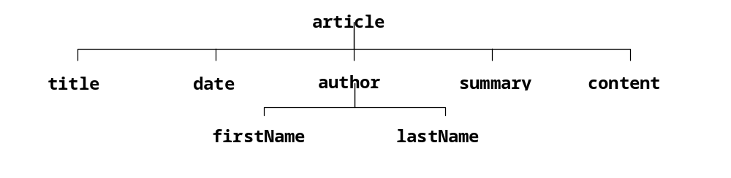
27.6 Document Object Model (DOM)
Document Object Model (DOM)
  Retrieving data from a text file impractical
  DOM created when XML file is parsed
    Hierarchical tree structure
      Node – Each name in the tree structure
    Single root node – contains all other nodes
    Tree structure for article.xml:

Slide 29
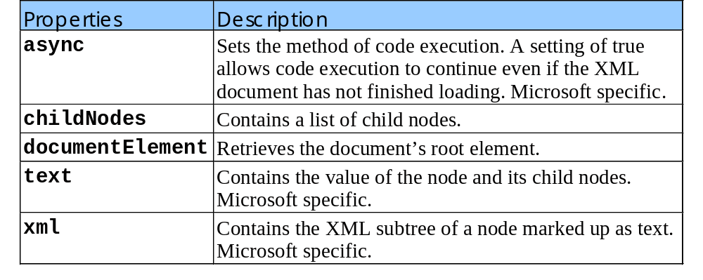
27.6 Document Object Model (DOM)
DOM representation
  Entire DOM represented by a DOMDocument object
    Contains root node and all its child nodes
  Any node in a DOM can be represented with the object XMLDOMNODE
  Some DOMDocument properties

Slide 30
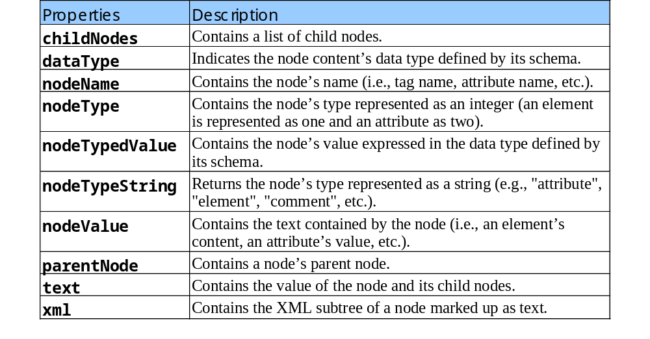
27.6 Document Object Model (DOM)
Some XMLDOMNode properties
  Almost all Microsoft specific

Slide 31
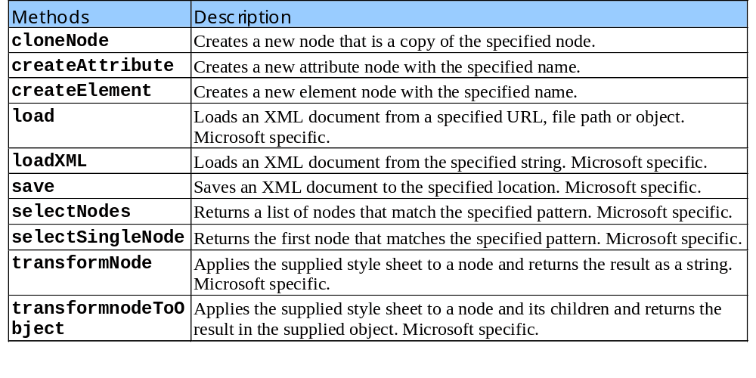
27.6 Document Object Model (DOM)
Some DOMDocument methods:

Slide 32
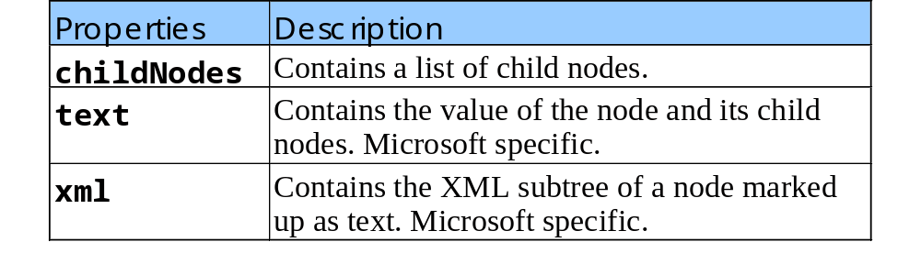
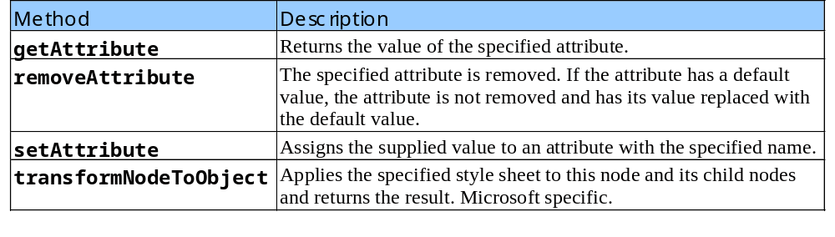
27.6 Document Object Model (DOM)
Some XMLDOMElement properties
Some XMLDOMElement methods

Slide 33
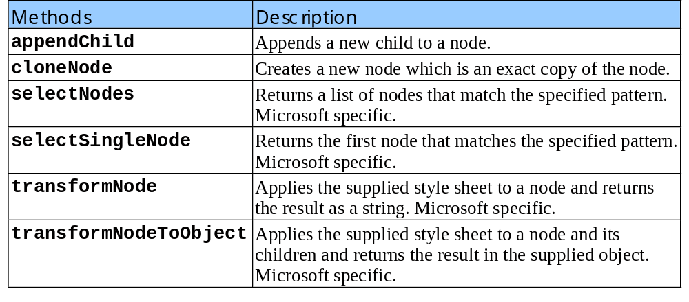
27.6 Document Object Model (DOM)
XMLDOMNode methods

Slide 34
33 document.writeln( "<BR>The first child of the root node is:" );
34 document.writeln( "<STRONG>" + currentNode.nodeName);
35 document.writeln( "</STRONG><BR>The next sibling is:" );
36
37 var nextSib = currentNode.nextSibling;
38
39 document.writeln( "<STRONG>" + nextSib.nodeName
40 + "</STRONG>." );
41 document.writeln( "<BR/>Value of <STRONG>" + nextSib.nodeName
42 + "</STRONG> element is:" );
43
44 var value = nextSib.firstChild;
45
46 document.writeln( "<EM>" + value.nodeValue + "</EM>" );
47 document.writeln( "<BR>The parent node of " );
48 document.writeln( "<STRONG>" + nextSib.nodeName
49 + "</STRONG> is:" );
50 document.writeln( "<STRONG>" + nextSib.parentNode.nodeName
51 + "</STRONG>." );
52
53</SCRIPT>
54
55</BODY>
56</HTML>

Slide 35
1<!DOCTYPE HTML PUBLIC "-//W3C//DTD HTML 4.0 Transitional//EN">
2<HTML>
3
4<!-- Fig. 27.18: DOMExample.html -->
1. DOMExample.html
5<!-- Using the DOM -->
6<HEAD>
7 <TITLE>A DOM Example</TITLE>
8</HEAD>
9
10<BODY>
11
12<SCRIPT LANGUAGE = "JavaScript">
13
14 var xmlDocument = new ActiveXObject( "Microsoft.XMLDOM" );
15
16 xmlDocument.load( "article.xml" );
17
18 var element = xmlDocument.documentElement;
19
20 document.writeln( "The root node of the document is:" );
21 document.writeln( "<STRONG>" + element.nodeName
22 + "</STRONG>" );
23 document.writeln( "<BR>Its child elements are:" );
24
25 for ( i = 0; i < element.childNodes.length; i++ ) {
26 var curNode = element.childNodes.item( i );
27 document.writeln( "<LI><STRONG>" + curNode.nodeName
28 + "</STRONG></LI>" );
29 }
30
31 var currentNode = element.firstChild;
32

Slide 36
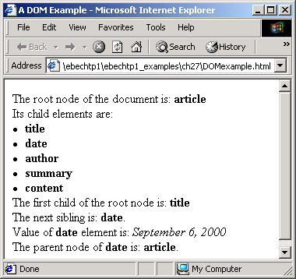
Output from DOMExample.html

Slide 37
27.7 Extensible Style Language (XSL)
Extensible style language (XSL)
  Defines layout of XML document
    Much like CSS defines layout of HTML document
    XSL much more powerful that CSS
  XSL Style sheet
    Provides rules for displaying or organizing an XML document’s data
  Provides elements that define rules for
    XSL Transformations (XSLT)
      How one XML document can be transformed into another XML document
      Example: XML document can be transformed into a well-formed HTML document

Slide 38
27.7 Extensible Style Language (XSL)
XML documents can be placed in their own file
  Referenced in HTML document
    <XML ID = “name” SRC = fileName.html”></XML>
xsl:for-each element
  Iterates over items in specified document

Slide 39
27.7 Extensible Style Language (XSL)
xmlns
  Defines an XML namespace
    Identifies collections of element type declarations so that they do not conflict with declarations of same name created by other programmers
  Predefined namespaces
    xml, xsl
Programmers can create own namespaces
    <subject>English</subject>
    <subject>Thrombosis</subject>
    Can be differentiated by using namespaces:
    <school:subject>English</subject>
    <medical:subject>Thrombosis</subject>

Slide 40
27.7 Extensible Style Language (XSL)
XSL sorting
  Attribute order-by
    Specifies what is sorted
      Plus (+) sign: indicates ascending order
      Minus (-) sign: indicates descending order
  When more than one item to be sorted
    Items separated by semi-colon (;)
  Attribute select
    Defines which elements are selected
  Attribute xmlns:xsl
    Indicates location of element specification

Slide 41
27.7 Extensible Style Language (XSL)
xsl:value-of element
  Retrieves data specified in select attribute
  Data returned replaces xsl:value-of element
  Empty element – ends in a forward slash /
Brackets ([])
  Specify XSL conditional statement
XML Document Object Model
  Generate dynamic content from an XML document by using scripting
transformNodeToObject
  XML DOM method
  Applies specified XSL style sheet to data contained in the parent object

Slide 42
1<?xml version = "1.0"?>
2<?xml:stylesheet type = "text/xsl" href = "contact_list.xsl"?>
3<!-- Fig. 27.19: contact.xml -->
4
5<contacts>
1.1 Embed XML coding
1.2 Enter contacts start-tag
1.3 Insert contact tags and sub-tags
1.4 Enter contact end-tag
6
7 <contact>
8 <lastName>Black</lastName>
9 <firstName>John</firstName>
10 </contact>
11
12 <contact>
13 <lastName>Green</lastName>
14 <firstName>Sue</firstName>
15 </contact>
16
17 <contact>
18 <lastName>Red</lastName>
19 <firstName>Bob</firstName>
20 </contact>
21
22 <contact>
23 <lastName>Blue</lastName>
24 <firstName>Mary</firstName>
25 </contact>
26
27 <contact>
28 <LastName>White</LastName>
29 <FirstName>Mike</FirstName>
30 </contact>
31
32 <contact>
33 <lastName>Brown</lastName>

Slide 43
34 <firstName>Jane</firstName>
35 </contact>
36
37 <contact>
38 <lastName>Gray</lastName>
39 <firstName>Bill</firstName>
40 </contact>
41
42</contacts>

Slide 44
43<?xml version = "1.0"?>
44<xsl:stylesheet xmlns:xsl = "http://www.w3.org/TR/WD-xsl">
45
46<!-- Fig. 27.19: contact_list.xsl -->
2.1 Start HTML section
2.2 match = “/” XSL
2.3 comment XSL
2.4 Function update
47
48<xsl:template match = "/">
49
50<HTML>
51<BODY>
52
53<DIV ID = "data">
54 <xsl:apply-templates/>
55</DIV>
56
57<SCRIPT TYPE = "text/javascript" LANGUAGE = "JavaScript">
58 <xsl:comment><![CDATA[
59 var styleSheet = document.XSLDocument;
60 var xmlDocument = document.XMLDocument;
61
62 function update( scope, sortKey )
63 {
64 var sortBy = styleSheet.selectSingleNode( "//@order-by" );
65 sortBy.value = sortKey;
66 var scopeBy =

Slide 45
67 styleSheet.selectSingleNode( "//xsl:for-each/@select" );
68 scopeBy.value = scope;
69 data.innerHTML =
70 xmlDocument.documentElement.transformNode( styleSheet );
2.5 Name table
71 }
72
73 ]]>
74 </xsl:comment>
75</SCRIPT>
76
77<TABLE BORDER = "1" DATASRC = "#xmlData" DATAPAGESIZE = "3"
78 ID = "tbl">
79 <THEAD>
80 <TR>
81 <TH>Last Name</TH>
82 <TH>First Name</TH>
83 </TR>
84 </THEAD>
85 <TR>
86 <TD><SPAN DATAFLD = "lastName"></SPAN></TD>
87 <TD><SPAN DATAFLD = "firstName"></SPAN></TD>
88 </TR>
89</TABLE>
90
91<INPUT TYPE = "button" VALUE = "Revert"
92 ONCLICK = "update('contact','+firstName;+lastName');"/>
93<BR/>
94<INPUT TYPE = "button" VALUE = "Sort By Last Name"
95 ONCLICK = "update('contact','+lastName;+firstName');"/>
96<INPUT TYPE = "button" VALUE = "Sort By First Name"
97 ONCLICK = "update('contact','-firstName;+lastName');"/>
98<BR/>

Slide 46
99<INPUT TYPE = "button"
100 VALUE = "Filter for last name starting with 'B' "
101 ONCLICK = "update(
102 'contact[lastName &gt; \'B\' and lastName &lt; \'C\']',
2.6 XSL template
103 '+firstName;+lastName');"/>
104<BR/>
105<INPUT TYPE = "button" VALUE = "|&lt;"
106 ONCLICK = "tbl.firstPage();"/>
107<INPUT TYPE = "button" VALUE = "&lt;"
108 ONCLICK = "tbl.previousPage();"/>
109<INPUT TYPE = "button" VALUE = "&gt;"
110 ONCLICK = "tbl.nextPage();"/>
111<INPUT TYPE = "button" VALUE = "&gt;|"
112 ONCLICK = "tbl.lastPage();"/>
113
114</BODY>
115</HTML>
116</xsl:template>
117
118<xsl:template match = "contacts">
119 <XML ID = "xmlData">
120 <contacts>
121 <xsl:for-each select = "contact"
122 order-by = "+firstName;+lastName">
123 <contact>
124 <lastName><xsl:value-of select = "lastName"/>
125 </lastName>
126 <firstName><xsl:value-of select = "firstName"/>
127 </firstName>
128 </contact>
129 </xsl:for-each>
130 </contacts>

Slide 47
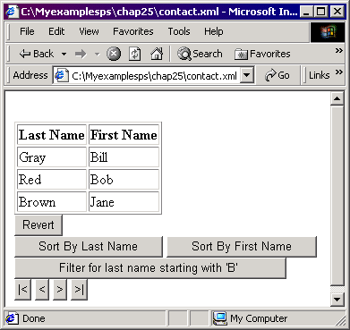
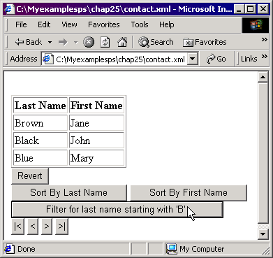
131 </XML>
132</xsl:template>
133
134</xsl:stylesheet>

Slide 48
27.8 Microsoft Schema
Schema
  Microsoft’s expansion of the DTD
    Called XML-Data
    Developed to a schema create document definitions using XML syntax
  Schemas or DTD’s
    May be used to specify document’s grammar
    DTD’s may be preferred because Microsoft’s schema language is proprietary technology

Slide 49
27.8 Microsoft Schema
<?xml:stylesheet type = “text/xsl” href = “books.xsl?>
  xml:stylesheet processing instruction
  Indicates that XML document uses style sheet books.xsl
    XSL files end with the .xsl extension
<database xmlns = “x-schema:books-schema.xml”>
  Defines database element as using the books-schema.xml file as a schema

Slide 50
27.8 Microsoft Schema
Schema element types
  Declared using element ElementType
  Attribute name
    Value defines name of element
<![CDATA[content]]>
  Preserves text in the in the content section
  Not processed by any style sheet
  Rendered exactly as appears within tags

Slide 51
27.8 Microsoft Schema
XSL elements
  Element element
    References an element type that can appear as part of the enclosing ElementType element’s content model
  xsl:stylesheet
    Style sheet definition
  xsl:template
    Template rule
    Attribute match
      Selects nodes (elements) to which the xsl:template is applied

Slide 52
27.8 Microsoft Schema
XSL Elements (continued)
  group
    Defines number of times an element is allowed to occur
    Attributes minOccurs and maxOccurs
      Set minimum and maximum number of occurrences
  xsl:apply-templates
    Applies specified template at tag’s position
  xsl:choose
    Performs conditional tests
    Composed of one or more xsl:when elements
  xsl:element
    Generates markup for an element of specified name

Slide 53
27.8 Microsoft Schema
Upcoming files – Deitel book database
  books.xml
    Defines database
  books-schema.xml
    Defines element grammar
  books.xsl
    Defines element rendering style

Slide 54
1<?xml version = "1.0"?>
2<?xml:stylesheet type = "text/xsl" href = "books.xsl"?>
3<!-- Fig. 27.20: books.xml -->
4
5<database xmlns = "x-schema:books-schema.xml">
1. books.html
1.1 book declarations
6 <author>Deitel &amp; Associates, Inc.</author>
7
8 <book>
9 <title>C++ How to Program: Third Edition</title>
10 <isbn>0-13-089571-7</isbn>
11 <pages>1130</pages>
12 <description>C++ programming textbook.
13 </description>
14 <image>cplus.jpg</image>
15 </book>
16
17 <book>
18 <title>Getting Started with Microsoft's Visual C++ 6
19 with an Introduction to MFC</title>
20 <isbn>0-13-016147-0</isbn>
21 <pages>163</pages>
22 <description>Introductory MFC programming textbook.
23 </description>
24 <image>mfcvcplus.jpg</image>
25 </book>
26
27 <book>
28 <title>Java How to Program: Third Edition</title>
29 <isbn>0-13-012507-5</isbn>
30 <pages>1200</pages>
31 <description>Java Programming textbook.
32 </description>
33 <image>javahtp.jpg</image>

Slide 55
34 </book>
35
36</database>
37<?xml version = "1.0"?>
38
1.2 <Schema>
39<!-- Fig. 27.20: books-schema.xml -->
40
41<Schema xmlns = "urn:schemas-microsoft-com:xml-data">
42
43 <ElementType name = "author"/>
44 <ElementType name = "image"/>
45 <ElementType name = "title"/>
46 <ElementType name = "isbn"/>
47 <ElementType name = "pages"/>
48 <ElementType name = "description"/>
49
50 <ElementType name = "database" content = "eltOnly">
51 <group minOccurs = "0" maxOccurs = "1">
52 <element type = "author"/>
53 </group>
54 <group minOccurs = "1" maxOccurs = "*">
55 <element type = "book"/>
56 </group>
57 </ElementType>
58
59 <ElementType name = "book" content = "eltOnly">
60 <element type = "title"/>
61 <element type = "isbn"/>
62 <element type = "pages"/>
63 <element type = "description"/>
64 <element type = "image"/>
65 </ElementType>
66
67</Schema>

Slide 56
68<?xml version = "1.0"?>
69
70<!-- Fig. 27.20: books.xsl -->
71
72<xsl:stylesheet xmlns:xsl = "http://www.w3.org/TR/WD-xsl">
1.3 XSL stylesheet
1.4 Function sort
73 <xsl:template match = "/">
74 <HTML>
75 <HEAD>
76 <TITLE>
77 <xsl:value-of select = "database/author"/>
78 </TITLE>
79 <STYLE>
80 .head1 {font: bold}
81 .head2 {font: bold; cursor: hand}
82 </STYLE>
83 </HEAD>
84
85 <SCRIPT FOR = "window" EVENT = "ONLOAD">
86 <xsl:comment><![CDATA[
87 stylesheet = document.XSLDocument;
88 source = document.XMLDocument;
89 sortBy = document.XSLDocument.selectSingleNode(
90 "//@order-by" );
91 ]]></xsl:comment>
92 </SCRIPT>
93
94 <SCRIPT><xsl:comment><![CDATA[
95 var sortBy; // To carry the sorting field
96 var source; // Contains a reference to XML DOM
97 var stylesheet; // Contains a reference to XSL DOM
98
99 function sort( data )
100 {

Slide 57
101 sortBy.value = data;
102 list.innerHTML =
103 source.documentElement.transformNode(
104 stylesheet );
1.5 XSL template
105 }
106 ]]></xsl:comment></SCRIPT>
107
108 <BODY>
109 <H1>
110 <CENTER>
111 <xsl:value-of select = "database/author"/>
112 </CENTER>
113 </H1>
114
115 <DIV ID = "list">
116 <xsl:apply-templates select = "database"/>
117 </DIV>
118 </BODY>
119 </HTML>
120 </xsl:template>
121
122 <xsl:template match = "database">
123 <TABLE WIDTH = "100%" CELLSPACING = "0" BORDER = "1">
124 <THEAD>
125 <TD WIDTH = "200" ALIGN = "CENTER">
126 <DIV CLASS = "head1">Image</DIV>
127 </TD>
128 <TD WIDTH = "30%" ALIGN = "CENTER">
129 <DIV ONCLICK = "sort('title;isbn')"
130 CLASS = "head2">Title</DIV>
131 </TD>

Slide 58
132 <TD WIDTH = "25%" ALIGN = "CENTER">
133 <DIV ONCLICK = "sort('isbn;title')"
134 CLASS = "head2">ISBN</DIV>
135 </TD>
1.5 XSL template
136 <TD WIDTH = "5%" ALIGN = "CENTER">
137 <DIV ONCLICK = "sort('pages;title')"
138 CLASS = "head2">Pages</DIV>
139 </TD>
140 <TD WIDTH = "30%" ALIGN = "CENTER">
141 <DIV CLASS = "head1">Description</DIV>
142 </TD>
143 </THEAD>
144
145 <xsl:for-each select = "book" order-by = "title">
146 <TR>
147 <TD WIDTH = "200" ALIGN = "CENTER" VALIGN = "TOP">
148 <xsl:choose>
149 <xsl:when test = "image[.!='']">
150 <xsl:element name = "IMG">
151 <xsl:attribute name = "SRC">
152 <xsl:value-of select = "image"/>
153 </xsl:attribute>
154 </xsl:element>
155 </xsl:when>
156 <xsl:otherwise>
157 n/a
158 </xsl:otherwise>
159 </xsl:choose>
160 </TD>
161
162 <TD WIDTH = "25%" ALIGN = "LEFT" VALIGN = "TOP">
163 <xsl:choose>

Slide 59
164 <xsl:when test = "title[.!='']">
165 <xsl:value-of select = "title"/>
166 </xsl:when>
167 <xsl:otherwise>
1.5 XSL template
168 n/a
169 </xsl:otherwise>
170 </xsl:choose>
171 </TD>
172
173 <TD WIDTH = "10%" ALIGN = "CENTER" VALIGN = "TOP">
174 <xsl:choose>
175 <xsl:when test = "isbn[.!='']">
176 <xsl:value-of select = "isbn"/>
177 </xsl:when>
178 <xsl:otherwise>
179 n/a
180 </xsl:otherwise>
181 </xsl:choose>
182 </TD>
183
184 <TD WIDTH = "5%" ALIGN = "CENTER" VALIGN = "TOP">
185 <xsl:choose>
186 <xsl:when test = "pages[.!=''] ">
187 <xsl:value-of select = "pages"/>
188 </xsl:when>
189 <xsl:otherwise>
190 n/a
191 </xsl:otherwise>
192 </xsl:choose>
193 </TD>
194
195 <TD WIDTH = "60%" ALIGN = "LEFT" VALIGN = "TOP">

Slide 60
196 <xsl:choose>
197 <xsl:when test = "description[.!='']">
198 <xsl:value-of select = "description"/>
199 </xsl:when>
1.5 XSL template
200 <xsl:otherwise>
201 n/a
202 </xsl:otherwise>
203 </xsl:choose>
204 </TD>
205
206 </TR>
207 </xsl:for-each>
208 </TABLE>
209 </xsl:template>
210</xsl:stylesheet>

Slide 61
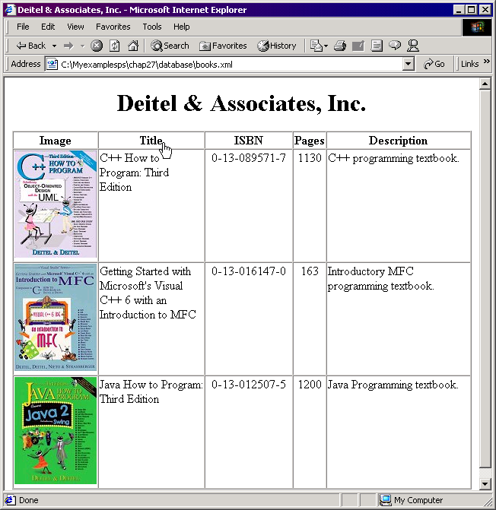
Output from books.xml

Slide 62
27.9 Extensible Hypertext
Markup Language (XHTML™)
XHTML
  Allows
    Complex documents to be created by combining HTML elements with XML’s extensibility
      Ability to create new elements
    Example: XHTML document might combine HTML elements with MathML and CML elements
  Well formed documents
    Each XHTML document validated using DTD’s
  Features provide structure HTML lacks
  Uses XML syntax
    All tags lowercase and closed

Slide 63
1<!DOCTYPE html PUBLIC "-//W3C//DTD XHTML 1.0 Frameset//EN"
2 "http://www.w3.org/TR/xhtml1/DTD/frameset.dtd">
3<html>
4
5<!-- Fig. 27.21: xhtmlExample.html -->
1. xhtmlExample
6<!--An XHTML example-->
7<head>
8
9<meta name = "keywords" content = "Webpage, design, HTML,
10 tutorial, personal, help, index, form, contact, feedback,
11 list, links, frame, deitel"/>
12
13<meta name = "description" content = "This Web site will help
14 you learn the basics of HTML and Webpage design through the
15 use of interactive examples and instruction."/>
16
17</head>
18
19<frameset cols = "110,*">
20 <frame name = "nav" scrolling = "no" src = "nav.html"/>
21
22 <!-- Nested Framesets are used to change the formatting -->
23 <!-- and spacing of the frameset as a whole -->
24 <frameset rows = "175,*">
25 <frame name = "picture" src = "picture.html"
26 noresize = "noresize"/>
27 <frame name = "main" src = "main.html"/>
28 </frameset>
29
30 <noframes>
31 <p>This page uses frames, but your browser does not
32 support them.</p>
33 <p>Get Internet Explorer 5 at the

Slide 64
34 <a href = "http://www.microsoft.com/">Microsoft
35 Web-Site</a></p>
36 </noframes>
37</frameset>
1.1 <simple> xhtml tag
38
39 <simple xmlns:ct = "http://www.deitel.com">
40 <ct:contact>
41 <ct:LastName>Black</ct:LastName>
42 <ct:FirstName>John</ct:FirstName>
43 </ct:contact>
44
45 <ct:contact>
46 <ct:LastName>Green</ct:LastName>
47 <ct:FirstName>Sue</ct:FirstName>
48 </ct:contact>
49 </simple>
50
51</html>

Slide 65
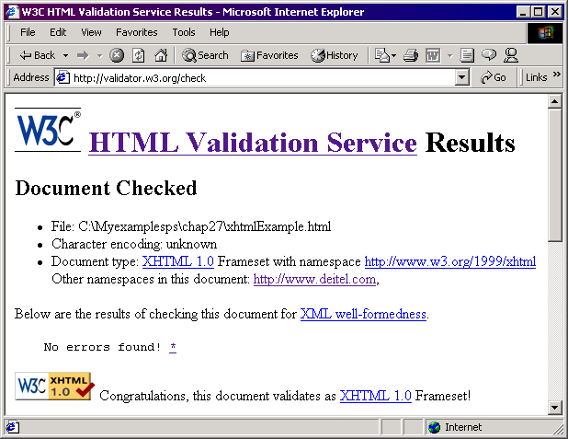
Validation of xhtmlExample.html

Slide 66
27.10 Microsoft BizTalk™
Internet data exchange
  Sending data between organizations is difficult
    Different platforms, applications and data specifications
  XML simplifies data transfers
  Microsoft BizTalk
    Manages and facilitates business transactions
    Ensures uniformity
    Three parts
      BizTalk Server
      BizTalk Framework
      BizTalk Schema Library

Slide 67
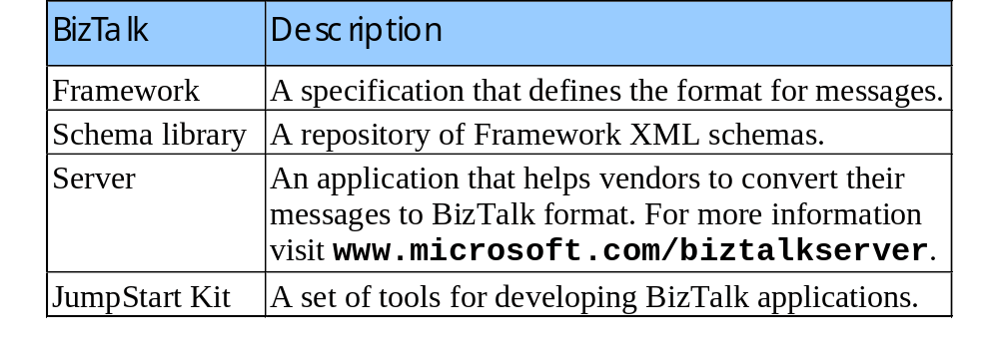
27.10 Microsoft BizTalk™
BizTalk terminologies
BizTalk documents
  All have the root element BizTalk
  Element Route – mandatory, contains routing information
  Element To – specifies the document’s desitination
  Element From – specifies the document’s source

Slide 68
1<?xml version = "1.0"?>
2<BizTalk
3 xmlns = "urn:schemas-biztalk-org:BizTalk/biztalk-0.81.xml">
4
5<!-- Fig. 27.23: BizTalkexample.xml -->
BizTalkexample.xml
1.1 <BizTalk> root tag
1.2 <Route> tag
1.3 <Body> tag and Offers element
6<!-- BizTalk example -->
7<Route>
8 <From locationID = "8888888" locationType = "DUNS"
9 handle = "23" />
10
11 <To locationID = "454545445" locationType = "DUNS"
12 handle = "45" />
13</Route>
14
15<Body>
16 <Offers xmlns =
17 "x-schema:http://schemas.biztalk.org/eshop_msn_com/t7ntoqnq.xml">
18 <Offer>
19 <Model>12-a-3411d</Model>
20 <Manufacturer>ExComp, Inc.</Manufacturer>
21 <ManufacturerModel>DCS-48403</ManufacturerModel>
22 <MerchantCategory>Clothes | Sports wear</MerchantCategory>
23 <MSNClassId></MSNClassId>
24 <StartDate>2000-06-05 T13:12:00</StartDate>
25 <EndDate>2000-12-05T13:12:00</EndDate>
26 <RegularPrice>89.99</RegularPrice>
27 <CurrentPrice>25.99</CurrentPrice>
28 <DisplayPrice value = "3" />
29 <InStock value = "15" />
30 <ReferenceImageURL>
31 http://www.Example.com/clothes/index.jpg
32 </ReferenceImageURL>
33 <OfferName>Clearance sale</OfferName>

Slide 69
34 <OfferDescription>This is a clearence sale.</OfferDescription>
35 <PromotionalText>Free Shipping</PromotionalText>
36 <Comments>Clothes that you would love to wear.</Comments>
37 <IconType value = "BuyNow" />
38 <ActionURL>http://www.example.com/action.htm</ActionURL>
39 <AgeGroup1 value = "Infant" />
40 <AgeGroup2 value = "Adult" />
41 <Occasion1 value = "Birthday" />
42 <Occasion2 value = "Anniversary" />
43 <Occasion3 value = "Christmas" />
44 </Offer>
45 </Offers>
46</Body>
47</BizTalk>

Slide 70
27.11 Simple Object Access Protocol (SOAP)
Data transfers
  Clients little processing power, invoke method calls on other machines
    Behind firewalls
  SOAP messages
    Envelope – structure for describing a method call
    Request – remote procedure call
    Response – HTTP response containing results of method call

