Slide 1
Chapter 28 – Case Study: An Online Bookstore
Outline
28.1 Introduction
28.2 Setup
28.3 Client-Side Documents
28.4 XML Data(Book Listing)
28.5 Other Server-Side Documents
28.6 Business-to-Business (B2B) Models
28.7 B2B Example

Slide 2
28.1 Introduction
Case study of Online bookstore
  Divided into two parts
    Business-to-client (B2C)
    Business-to-business(B2B)
  Three fundamental pieces
    Client-side scripting – JavaScript
    Server-side scripting – ASP which generates XML
    Database

Slide 3
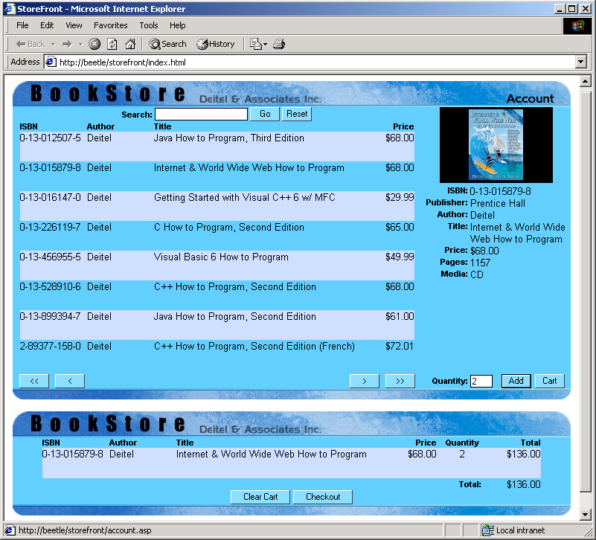
Preview of the bookstore
Link to account information
Book list
Book search field
Detailed book information
Shopping cart
Button to show/hide shopping cart

Slide 4
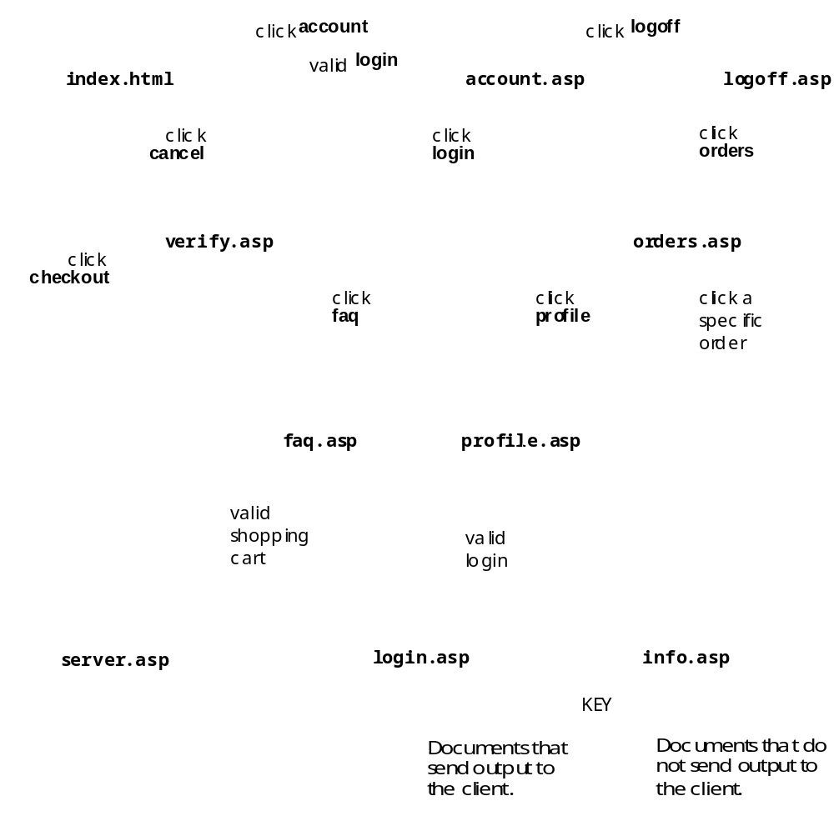
Key interactions between bookstore documents

Slide 5
28.2 Setup
Setup instructions for the Online bookstore can be found in the book on page 948

Slide 6
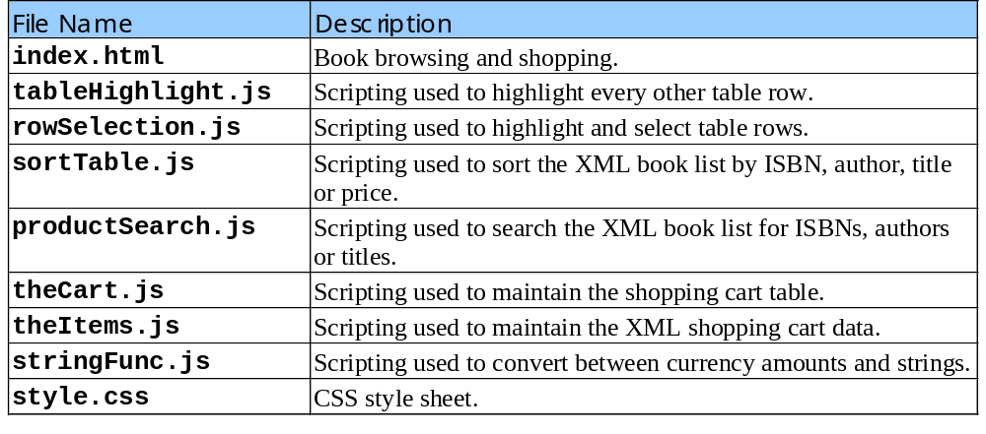
28.3 Client-Side Documents
Table of client-side documents

Slide 7
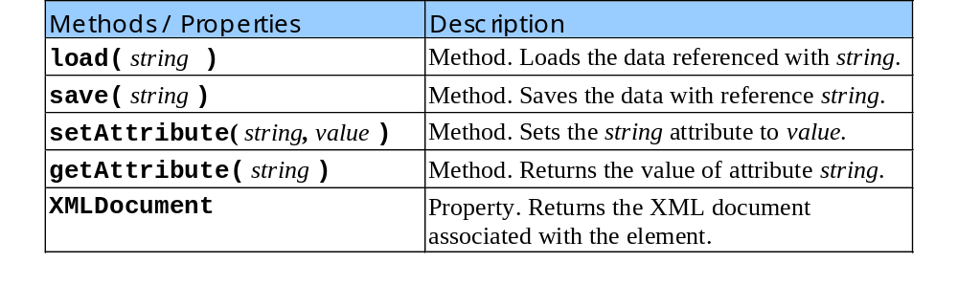
28.3 Client-Side Documents
Methods and properties of the Microsoft userData behavior

Slide 8
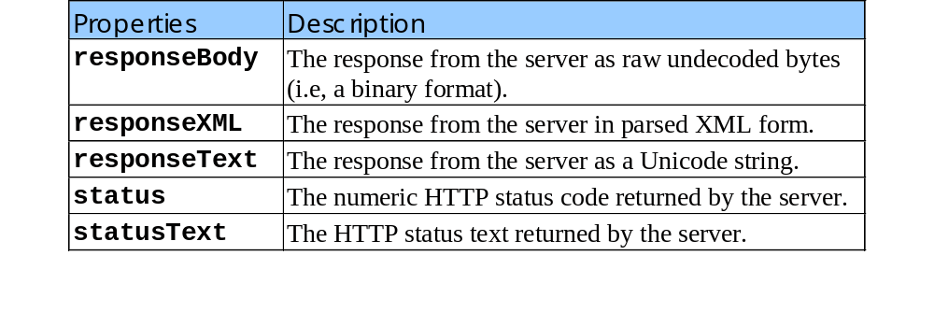
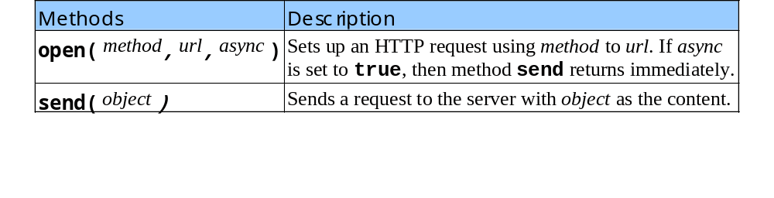
28.3 Client-Side Documents
Properties of the XMLHttpRequest object
Methods of the XMLHttpRequest object

Slide 9
1 <!DOCTYPE HTML PUBLIC "-//W3C//DTD HTML 4.0 Transitional//EN">
2 <HTML>
Lines 9 through 22 contain references to external files that contain JavaScript. To reference an external file, use element SCRIPT’s SRC attribute.
3
4 <!-- Figure 28.5: index.html -->
1. index.html
1.1 Link JavaScript files
1.2 Set serverLocation
5
6 <HEAD>
7 <TITLE>StoreFront</TITLE>
8 <LINK REL = "stylesheet" TYPE = "text/css" HREF = "style.css">
9 <SCRIPT LANGUAGE = "JavaScript" SRC = "tableHighlight.js">
10 </SCRIPT>
11 <SCRIPT LANGUAGE = "JavaScript" SRC = "rowSelection.js">
12 </SCRIPT>
13 <SCRIPT LANGUAGE = "JavaScript" SRC = "sortTable.js">
14 </SCRIPT>
15 <SCRIPT LANGUAGE = "JavaScript" SRC = "productSearch.js">
16 </SCRIPT>
17 <SCRIPT LANGUAGE = "JavaScript" SRC = "theCart.js">
18 </SCRIPT>
19 <SCRIPT LANGUAGE = "JavaScript" SRC = "theItems.js">
20 </SCRIPT>
21 <SCRIPT LANGUAGE = "JavaScript" SRC = "stringFunc.js">
22 </SCRIPT>
23 <SCRIPT LANGUAGE = "JavaScript">
24 var saveXMLProducts = null;
25
26 // Location of the pages. Required for XMLHTTP posting.
27 var serverLocation = "http://beetle/storefront/";
28

Slide 10
29 // Handle the loading state of the XML documents.
30 // Large documents can take a while to load.
Function handleLoading controls when user interface components are available for use.
31 function handleLoading()
32 {
1.4 Function handleLoading
33 if ( xmlProducts.readyState == 'loading' ) {
34 window.status = "Loading Data. Please Wait.";
35 return;
36 }
37 else if ( xmlProducts.readyState == 'complete' ) {
38 // XML list finished loading.
39
40 if ( saveXMLProducts == null )
41 saveXMLProducts = xmlProducts.cloneNode( true );
42
43 window.status = "Done";
44
45 // Enable the interface.
46 navFirst.disabled = false;
47 navPrev.disabled = false;
48 navNext.disabled = false;
49 navLast.disabled = false;
50 boxSearch.disabled = false;
51 btnSearchGo.disabled = false;
52 btnSearchReset.disabled = false;
53 buyCart.disabled = false;
54 boxQty.value = 0;
55
56 // Hide the notification window.
57 notice.style.display = "none";
58 notice.style.position = "absolute";
59

Slide 11
60 // Display the Product Listing.
61 productListing.style.display = "block";
62 productListing.style.position = "relative";
63 }
1.4 Function handleLoading
1.5 End Script
1.6 Begin HTML
1.7 Bookstore table header
64 }
65 </SCRIPT>
66 </HEAD>
67
68 <BODY ONLOAD = "loadShoppingCart();" SCROLLING = "yes">
69 <CENTER>
70 <TABLE WIDTH = "750" ALIGN = "center" CELLPADDING = "0"
71 CELLSPACING = "0" BORDER = "0" BGCOLOR = "#67CDFF"
72 ID = "productList" STYLE = "position: relative;
73 display: block; top: 0; left: 0;">
74 <TR>
75 <TD COLSPAN = "2" WIDTH = "750" HEIGHT = "35"><IMG
The search box (lines 82 through 92) in the book store table.
76 SRC = "images/header.jpg" WIDTH = "650"
77 HEIGHT = "35"><A HREF = "account.asp"><IMG
78 SRC = "images/head_account.jpg"
79 WIDTH = "100" HEIGHT = "35" BORDER = "0"></A></TD>
80 </TR>
81 <TR>
82 <TD WIDTH = "550" ALIGN = "center" CLASS = "label">
83 Search:
84 <INPUT TYPE = "text" CLASS = "brand" ID = "boxSearch"
85 ONKEYPRESS = "actSearchType( event )" DISABLED>
86 <INPUT TYPE = "button" VALUE = "Go" CLASS = "button"
87 ID = "btnSearchGo" ONCLICK = "actSearchGo()"
88 DISABLED>
89 <INPUT TYPE = "button" VALUE = "Reset"

Slide 12
90 CLASS = "button" ID = "btnSearchReset"
91 ONCLICK = "actSearchReset()" DISABLED>
92 </TD>
93 <TD WIDTH = "200" ROWSPAN = "2" VALIGN = "top"
1.7 Bookstore table header
94 ALIGN = "center">
95 <TABLE WIDTH = "190" CELLSPACING = "0" CELLPADDING = "0">
96 <TR>
The book details (lines 93 through 174) in the book store table.
97 <TD WIDTH = "190" ALIGN = "center"
98 COLSPAN = "2">
99 <IMG SRC = "images/none.jpg" WIDTH = "150"
100 HEIGHT = "100" BORDER = "1"
101 ID = "descImage">
102 </TD>
103 </TR>
104 <TR>
105 <TD WIDTH = "60" ALIGN = "right"
106 VALIGN = "top" CLASS = "label">
107 ISBN:&nbsp;</TD>
108 <TD WIDTH = "130" VALIGN = "top"
109 ID = "descISBN">
110 N/A
111 </TD>
112 </TR>
113 <TR>
114 <TD WIDTH = "60" ALIGN = "right"
115 VALIGN = "top" CLASS = "label">
116 Publisher:&nbsp;
117 </TD>
118 <TD WIDTH = "130" VALIGN = "top"
119 ID = "descPub">

Slide 13
120 N/A
121 </TD>
122 </TR>
123 <TR>
1.7 Bookstore table header
124 <TD WIDTH = "60" ALIGN = "right"
125 VALIGN = "top" CLASS = "label">
126 Author:&nbsp;
127 </TD>
128 <TD WIDTH = "130" VALIGN = "top"
129 ID = "descAuthor">
130 N/A
131 </TD>
132 </TR>
133 <TR>
134 <TD WIDTH = "60" ALIGN = "right"
135 VALIGN = "top" CLASS = "label">
136 Title:&nbsp;
137 </TD>
138 <TD WIDTH = "130" VALIGN = "top"
139 ID = "descTitle">
140 N/A
141 </TD>
142 </TR>
143 <TR>
144 <TD WIDTH = "60" ALIGN = "right"
145 VALIGN = "top" CLASS = "label">
146 Price:&nbsp;
147 </TD>
148 <TD WIDTH = "130" VALIGN = "top"
149 ID = "descPrice">
150 N/A

Slide 14
151 </TD>
152 </TR>
153 <TR>
154 <TD WIDTH = "60" ALIGN = "right"
1.7 Bookstore table header
1.8 Bookstore table body
155 VALIGN = "top" CLASS = "label">
156 Pages:&nbsp;
157 </TD>
158 <TD WIDTH = "130" VALIGN = "top"
159 ID = "descPages">
160 N/A
161 </TD>
162 </TR>
163 <TR>
164 <TD WIDTH = "60" ALIGN = "right"
165 VALIGN = "top" CLASS = "label">
166 Media:&nbsp;
167 </TD>
168 <TD WIDTH = "130" VALIGN = "top"
169 ID = "descMedia">
170 N/A
171 </TD>
172 </TR>
173 </TABLE>
174 </TD>
175 </TR>
176 <TR>
177 <TD WIDTH = "550" HEIGHT = "340" VALIGN = "top"
178 ALIGN = "center">
179 <DIV ALIGN = "center" ID = "notice"
180 STYLE = "position: relative; display: block;">
181 Please wait. Book inventory is being loaded.
182 </DIV>

Slide 15
183 <TABLE WIDTH = "530" CELLPADDING = "0"
184 CELLSPACING = "0" BORDER = "0" DATAPAGESIZE = "8"
185 ID = "productListing" DATASRC = "#xmlProducts"
186 ONREADYSTATECHANGE = "refreshTable();"
The book list (lines 183 through 225) of the book store table.
1.8 Bookstore table body
187 STYLE = "display: none; position: absolute">
188 <THEAD>
189 <TD WIDTH = "90" CLASS = "labelhand"
190 ONCLICK = "sortProducts( 0 );">
191 ISBN
192 </TD>
193 <TD WIDTH = "90" CLASS = "labelhand"
194 ONCLICK = "sortProducts( 1 );">
195 Author
196 </TD>
197 <TD WIDTH = "280" CLASS = "labelhand"
198 ONCLICK = "sortProducts( 2 );">
199 Title
200 </TD>
201 <TD WIDTH = "70" ALIGN = "right"
202 CLASS = "labelhand"
203 ONCLICK = "sortProducts( 3 );">
204 Price
205 </TD>
206 </THEAD>
207 <TR ONMOUSEOVER = "rowSelect();"
208 ONMOUSEOUT = "rowUnSelect();"
209 ONCLICK = "displayDetail();"
210 CLASS = "handable" HEIGHT = "40">
211 <TD WIDTH = "90" VALIGN = "top">
212 <SPAN DATAFLD = "isbn"></SPAN>
213 </TD>

Slide 16
214 <TD WIDTH = "90" VALIGN = "top">
215 <SPAN DATAFLD = "author"></SPAN>
216 </TD>
217 <TD WIDTH = "280" VALIGN = "top">
1.8 Bookstore table body
1.9 Bookstore table footer
218 <SPAN DATAFLD = "title"></SPAN>
219 </TD>
220 <TD WIDTH = "70" ALIGN = "right"
221 VALIGN = "top">
222 $<SPAN DATAFLD = "price"></SPAN>
223 </TD>
The navigation bar (lines 230 through 259) of the book store table.
224 </TR>
225 </TABLE>
226 </TD>
227 </TR>
228 <TR>
229 <TD WIDTH = "550" ALIGN = "center">
230 <TABLE WIDTH = "540" CELLPADDING = "0"
231 CELLSPACING = "0">
232 <TR>
233 <TD WIDTH = "50" ALIGN = "center">
234 <INPUT TYPE = "button" VALUE = z
235 CLASS = "button" ID = "navFirst"
236 ONCLICK = "hideTable();
237 productListing.firstPage();" DISABLED>
238 </TD>
239 <TD WIDTH = "50" ALIGN = "center">
240 <INPUT TYPE = "button" VALUE = "<"
241 CLASS = "button" ID = "navPrev" DISABLED
242 ONCLICK = "hideTable();
243 productListing.previousPage();">
244 </TD>

Slide 17
245 <TD WIDTH = "440"></TD>
246 <TD WIDTH = "50" ALIGN = "center">
247 <INPUT TYPE = "button" VALUE = ">"
248 CLASS = "button" ID = "navNext" DISABLED
1.9 Bookstore table footer
249 ONCLICK = "hideTable();
250 productListing.nextPage();">
251 </TD>
252 <TD WIDTH = "50" ALIGN = "center">
253 <INPUT TYPE = "button" VALUE = ">>"
254 CLASS = "button" ID = "navLast" DISABLED
255 ONCLICK = "hideTable();
256 productListing.lastPage();">
The shopping cart functionality (lines 262 through 287) of the book store table.
257 </TD>
258 </TR>
259 </TABLE>
260 </TD>
261 <TD WIDTH = "200" ALIGN = "center">
262 <TABLE WIDTH = "190" CELLPADDING = "0"
263 CELLSPACING = "0">
264 <TR>
265 <TD WIDTH = "60" ALIGN = "right"
266 CLASS = "label">
267 Quantity:&nbsp;
268 </TD>
269 <TD WIDTH = "40">
270 <INPUT TYPE = "text" SIZE = "3"
271 VALIGN = "absmiddle" CLASS = "quantity"
272 ID = "boxQty" DISABLED VALUE = "0"
273 ONKEYUP = "changeAddButton();"
274 MAXLENGTH = "2">
275 </TD>

Slide 18
276 <TD WIDTH = "45" ALIGN = "center">
277 <INPUT TYPE = "button" VALUE = "Add"
278 CLASS = "button" ID = "buyAdd" DISABLED
279 ONCLICK = "goBuy();">
1.9 Bookstore table footer
1.10 Shopping cart table
280 </TD>
281 <TD WIDTH = "45" ALIGN = "center">
282 <INPUT TYPE = "button" VALUE = "Cart"
283 CLASS = "button" ID = "buyCart" DISABLED
284 ONCLICK = "goCart();">
285 </TD>
286 </TR>
287 </TABLE>
288 </TD>
289 </TR>
290 <TR>
291 <TD COLSPAN = "2" WIDTH = "750" HEIGHT = "15"><IMG
292 SRC = "images/footer.jpg" WIDTH = "750"
The shopping cart table (lines 297 through 365) is initially hidden and contains no items. When the Cart button is clicked, the contents of the shopping cart are displayed.
293 HEIGHT = "15"></TD>
294 </TR>
295 </TABLE>
296 <BR>
297 <TABLE WIDTH = "750" CELLPADDING = "0" ALIGN = "center"
298 CELLSPACING = "0" BORDER = "0" BGCOLOR = "#67CDFF"
299 ID = "cartWindow" STYLE = "position: absolute;
300 display: none; top: 0; left: 0;">
301 <TR>
302 <TD COLSPAN = "2" WIDTH = "750" HEIGHT = "35"><IMG
303 SRC = "images/header2.jpg" WIDTH = "750"
304 HEIGHT = "35"></TD>
305 </TR>

Slide 19
306 <TR>
307 <TD WIDTH = "750" VALIGN = "top" ALIGN = "center">
308 <TABLE WIDTH = "670" CELLPADDING = "0"
309 CELLSPACING = "0" BORDER = "0" ID = "shoppingCart">
1.10 Shopping cart table
310 <THEAD>
311 <TD WIDTH = "90" CLASS = "label">
312 ISBN
313 </TD>
314 <TD WIDTH = "90" CLASS = "label">
315 Author
316 </TD>
317 <TD WIDTH = "280" CLASS = "label">
318 Title
319 </TD>
320 <TD WIDTH = "70" ALIGN = "right"
321 CLASS = "label">
322 Price
323 </TD>
324 <TD WIDTH = "10"></TD>
325 <TD WIDTH = "50" ALIGN = "center"
326 CLASS = "label">
327 Quantity
328 </TD>
329 <TD WIDTH = "80" ALIGN = "right"
330 CLASS = "label">
331 Total
332 </TD>
333 </THEAD>
334 <TFOOT>
335 <TD WIDTH = "90"></TD>
336 <TD WIDTH = "90"></TD>

Slide 20
337 <TD WIDTH = "280"></TD>
338 <TD WIDTH = "70"></TD>
339 <TD WIDTH = "10"></TD>
340 <TD WIDTH = "50" ALIGN = "right"
1.10 Shopping cart table
341 CLASS = "label">
342 Total:
343 </TD>
344 <TD WIDTH = "80" ALIGN = "right">
345 $<SPAN ID = "subTotal">0.00</SPAN>
346 </TD>
347 </TFOOT>
348 </TABLE>
349 </TD>
350 </TR>
351 <TR>
352 <TD COLSPAN = "2" WIDTH = "750" ALIGN = "center">
353 <INPUT TYPE = "button" VALUE = "Clear Cart"
354 CLASS = "button2" ID = "goClearShoppingCart"
355 ONCLICK = "clearShoppingCart();" DISABLED>
356 <INPUT TYPE = "button" VALUE = "Checkout"
357 CLASS = "button2" ID = "goCheckOut" DISABLED
358 ONCLICK = "buyCheckOut();">
359 </TD>
360 </TR>
361 <TR>
362 <TD COLSPAN = "2" WIDTH = "750" HEIGHT = "15"><IMG
363 SRC = "images/footer.jpg" WIDTH = "750" HEIGHT = "15">
364 </TD></TR>
365 </TABLE>

Slide 21
366 <BR>
367 <TABLE WIDTH = "750" ALIGN = "center" CELLPADDING = "0"
368 CELLSPACING = "0" BORDER = "0" BGCOLOR = "#67CDFF"
369 ID = "noticeShopping" STYLE = "position: absolute;
370 display: none; top: 0; left: 0;">
1.11 XML tags for XMLShoppingCart
1.12 XML tag for XMLSortProducts
1.13 XML tag for XMLSortProducts
1.14 XML tag for XMLProducts
371 <TR>
372 <TD COLSPAN = "2" WIDTH = "750" HEIGHT = "35"><IMG
373 SRC = "images/header2.jpg" WIDTH = "750" HEIGHT = "35">
374 </TD></TR>
375 <TR>
The notice message table (lines 367 through 385) is initially hidden, and is used to notify users that the shopping cart is being submitted. This block is displayed when the user enters the checkout process.
376 <TD WIDTH = "750" VALIGN = "top" ALIGN = "center">
377 Please wait. Shopping cart is being submitted.<BR>
378 The browser will be redirected when complete.
379 </TD>
380 </TR>
On line 390, the XML element xmlSortProducts references the XSL document sorting.xsl.
Lines 393 and 394 reference the XML book list (xmlProducts) generated by products.asp.
381 <TR>
382 <TD COLSPAN = "2" WIDTH = "750" HEIGHT = "15"><IMG
383 SRC = "images/footer.jpg" WIDTH = "750" HEIGHT = "15">
384 </TD></TR>
385 </TABLE>
386 </CENTER>
387 <DIV ID = "xmlShoppingCart" CLASS = "userData"
388 STYLE = "position: absolute; display: none; left: 0; top: 0;">
389 </DIV>
390 <XML ID = "xmlSortProducts" SRC = "sorting.xsl"
The DIV element xmlShoppingCart is used to store the shopping car contents over browser sessions by using Microsoft’s CSS persistence.
391 STYLE = "position: absolute; display: none; left: 0; top: 0;">
392 </XML>
393 <XML ID = "xmlProducts" SRC = "products.asp"
394 ONREADYSTATECHANGE = "handleLoading();"
395 STYLE = "position: absolute; display: none; left: 0; top: 0;">
396 </XML>
397 </BODY>
398
399 </HTML>

Slide 22
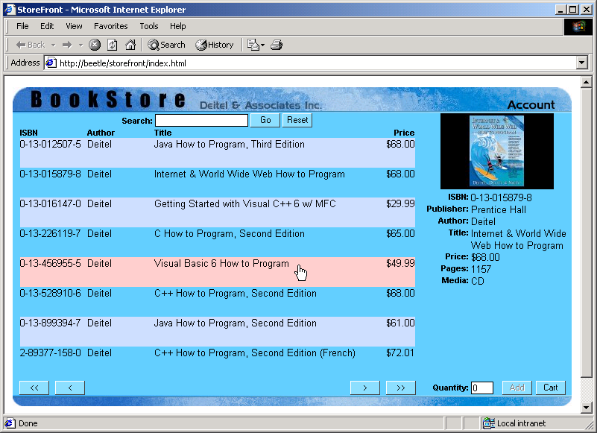
Output from index.html

Slide 23
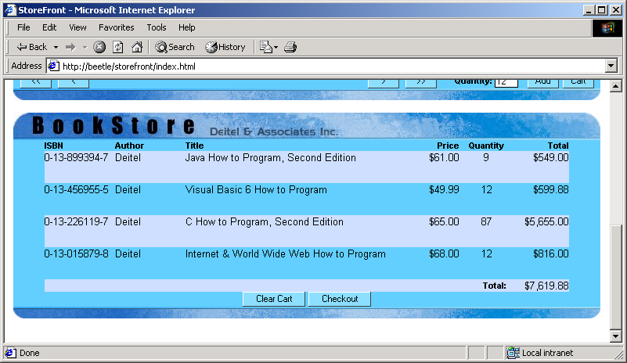
Output from index.html

Slide 24
400 // Figure 28.6: tableHighlight.js
401
402 // Highlights every other row in a table with ID
403 // "productListing".
2.tableHighlight.js
2.1 Function hideTable
2.2 Function highlightTable
404
405 var newColor = "#CCDDFF";
Assign the color #CCDDFF to variable newColor. This color is used to highlight every other row in the table, when the function highlightTable is called.
406
407 // Hide the product table.
408 function hideTable()
409 {
410 productListing.style.display = 'none';
411 }
412
413 // Set every other item to a different color.
414 function highlightTable()
415 {
416 if ( window.productListing ) {
417 var objRow = window.productListing.rows;
418 var objRowLength = objRow.length;
419
420 for ( i = 1; i < objRowLength; i++ )
421 if ( i % 2 == 1 )
422 objRow[ i ].style.background = newColor;
423 else
424 objRow[ i ].style.background = "none";
425 }
426 }
427

Slide 25
428 // If the table has changed, redo the highlighting
429 function refreshTable()
430 {
431 if ( productListing.readyState == 'complete' ) {
2.3 Function refreshTable
2.4 Function refreshShoppingTable
432 highlightTable();
433 productListing.style.display = "block";
434 }
435 }
436
437 // If the shopping cart has changed, redo the highlighting
438 function refreshShoppingTable()
439 {
440 if ( window.shoppingCart ) {
441 var objRow = window.shoppingCart.rows;
442 var objRowLength = objRow.length;
443
444 for ( i = 1; i < objRowLength; i++ )
445 if ( i % 2 == 1 )
446 objRow[ i ].style.background = newColor;
447 else
448 objRow[ i ].style.background = "none";
449 }
450 }

Slide 26
451 // Figure 28.7: rowSelection.js
452
453 // The original highlight color.
454 var originalBGColor;
3. rowSelection.js
3.1 Function rowSelect
3.2 Function rowUnSelect
455
456 // Highlight the row.
457 function rowSelect()
458 {
459 var object = window.event.srcElement;
460
461 while ( object.tagName != "TR" )
462 object = object.parentElement;
463
464 originalBGColor = object.style.background;
465 object.style.background = "#FFCCCC";
466 }
467
468 // Un-highlight the row.
469 function rowUnSelect()
470 {
471 var object = window.event.srcElement;
472
473 while ( object.tagName != "TR" )
474 object = object.parentElement;
475
476 object.style.background = originalBGColor;
477 }
478

Slide 27
479 // Take the product list and put it into the detail pane.
480 function displayDetail()
481 {
482 var object = window.event.srcElement;
Function displayDetail retrieves information from the XML book list and places the selected book’s information into the detailed book information area. If information for a field does not exist, N/A is used.
483
3.3 Function displayDetail
484 while ( object.tagName != "TR" )
485 object = object.parentElement;
486
487 if ( object.cells[ 0 ].innerText == '' )
488 return;
489
490 var theXMLnode =
491 xmlProducts.documentElement.selectSingleNode(
492 "book[ isbn = '" + object.cells[ 0 ].innerText + "' ]" );
493
Call the method selectSingleNode to retrieve the book element from the book list. From this node, use the selectSingleNode method to retrieve the node’s children to populate the detail area.
494 var objNode = theXMLnode.selectSingleNode( 'image' );
495
496 if ( objNode != null && objNode.text != '' )
497 descImage.src = objNode.text;
498 else
499 descImage.src = "images/none.jpg";
500
501 objNode = theXMLnode.selectSingleNode( 'isbn' );
502
503 if ( objNode != null && objNode.text != '' )
504 descISBN.innerText = objNode.text;
505 else
506 descISBN.innerText = "N/A";
507
508 objNode = theXMLnode.selectSingleNode( 'publisher' );
509

Slide 28
510 if ( objNode != null && objNode.text != '' )
511 descPub.innerText = objNode.text;
512 else
513 descPub.innerText = "N/A";
3.3 Function displayDetail
514
515 objNode = theXMLnode.selectSingleNode( 'author' );
516
517 if ( objNode != null && objNode.text != '' )
518 descAuthor.innerText = objNode.text;
519 else
520 descAuthor.innerText = "N/A";
521
522 objNode = theXMLnode.selectSingleNode( 'title' );
523
524 if ( objNode != null && objNode.text != '' )
525 descTitle.innerText = objNode.text;
526 else
527 descTitle.innerText = "N/A";
528
529 objNode = theXMLnode.selectSingleNode( 'price' );
530
531 if ( objNode != null && objNode.text != '' )
532 descPrice.innerText = "$" + objNode.text;
533 else
534 descPrice.innerText = "N/A";
535
536 objNode = theXMLnode.selectSingleNode( 'pages' );
537
538 if ( objNode != null && objNode.text != '' )
539 descPages.innerHTML = objNode.text;

Slide 29
540 else
541 descPages.innerText = "N/A";
542
543 objNode = theXMLnode.selectSingleNode( 'media' );
3.3 Function displayDetail
544
545 if ( objNode != null && objNode.text != '' )
546 descMedia.innerHTML = objNode.text;
547 else
548 descMedia.innerText = "N/A";
549
550 boxQty.disabled = false;
551 boxQty.value = findItem( descISBN.innerText );
552
553 if ( boxQty.value > 0 )
554 buyAdd.disabled = false;
555 else
556 buyAdd.disabled = true;
557 }

Slide 30
558 // Figure 28.8: sortTable.js
559
560 // These Global variables used to determine last sort order
561 var sortISBN, sortAuthor, sortTable, sortPrice, lastNum;
4. sortTable.js
4.1 Function sortProducts
562 sortISBN = sortAuthor = sortTitle = sortPrice = "+";
563 lastNumber = -1;
564
565 // Sort The product list via XSL.
566 function sortProducts( number )
567 {
Function sortProducts sets the sorting variables using the argument provided (e.g., the function call on line 190). Using these variables, we create a string, which is then used by XSLT to transform the book list.
568 if ( number == lastNumber ) {
569 switch ( number ) {
570 case 0:
571 sortISBN = ( sortISBN == "+" ) ? "-" : "+";
572 break;
573 case 1:
574 sortAuthor = ( sortAuthor == "+" ) ? "-" : "+";
575 break;
576 case 2:
577 sortTitle = ( sortTitle == "+" ) ? "-" : "+";
578 break;
579 case 3:
580 sortPrice = ( sortPrice == "+" ) ? "-" : "+";
581 break;
582 }
583 }
584
585 lastNumber = number;
586
587 var sortBy = xmlSortProducts.selectSingleNode(
588 "//@order-by" );
589

Slide 31
590 switch ( number ) {
591 case 0:
592 sortBy.value = sortISBN + 'isbn';
4.1 Function sortProducts
593 break;
594 case 1:
595 sortBy.value = sortAuthor + 'author;' +
596 sortTitle + 'title';
597 break;
598 case 2:
599 sortBy.value = sortTitle + 'title;' + sortAuthor +
600 'author';
601 break;
602 case 3:
603 sortBy.value = sortPrice + 'number(price);' +
Method transformNodeToObject transforms the book list stored in xmlProducts element according to the XSLT document in element xmlSortProducts.
604 sortAuthor + 'author;' + sortTitle + 'title';
605 break;
606 }
607
608 xmlProducts.documentElement.transformNodeToObject(
609 xmlSortProducts.documentElement,
610 xmlProducts.XMLDocument );
611 }

Slide 32
612 // Figure 28.9: productSearch.js
613
614 // If Enter (keyCode 13) was pressed, then submit.
615 function actSearchType( evt )
5. productSearch.js
5.1 Function actSearchGo
616 {
Function actSearchType handles the event fired when keyboard buttons are pressed. If the Enter key is pressed we perform a search by calling function actSearchGo.
617 if ( evt.keyCode == 13 )
618 actSearchGo();
619 }
620
621 // Do a ISBN / Author / Title Search.
622 function actSearchGo()
623 {
624 var sortBy;
Function actSearchGo performs an XSL transformation on the book list using the text entered into the text box when the Go button is pressed.
625
626 sortBy = xmlSortProducts.selectSingleNode( "//@expr" );
627
628 if ( boxSearch.value == "" )
629 sortBy.value = "true";
630 else
631 sortBy.value =
632 "(this.selectSingleNode('isbn').text.indexOf('" +
633 boxSearch.value + "', 0) != -1) ||" +
634 "(this.selectSingleNode('author').text.indexOf('" +
635 boxSearch.value + "', 0) != -1) ||" +
636 "(this.selectSingleNode('title').text.indexOf('" +
637 boxSearch.value + "', 0) != -1)";
638
639 saveXMLProducts.documentElement.transformNodeToObject(
640 xmlSortProducts.documentElement,
641 xmlProducts.XMLDocument );
642 }

Slide 33
643
644 // Reset the Search.
645 function actSearchReset()
646 {
5.2 Function actSearchReset
647 boxSearch.value = "";
648
649 actSearchGo();
650 }

Slide 34
651 // Figure 28.10: theCart.js
652
653 // Cart button pressed.
654 function goCart()
6. theCart.js
6.1 Function goCart
6.2 Function fillTable
655 {
656 if ( cartWindow.style.display == "none" ) {
657 cartWindow.style.position = "relative";
658 cartWindow.style.display = "block";
659
660 cartWindow.scrollIntoView();
661 }
662 else {
663 cartWindow.style.position = "absolute";
664 cartWindow.style.display = "none";
665
666 window.scrollTo( 0, 0 );
667 }
668 }
Function fillTable adds items to the shopping cart table. If null is returned by the search for the ISBN, the item is considered invalid and is rejected. If an item already exists in the table, the existing entry is modified. If an item is new it is appeneded to the table.
669
670 // The array for shopping cart data storage
671 var cartArray = new Array();
672
673 // Fill in the shopping cart table
674 function fillTable( isbn, quantity )
675 {
676 var theCell = null;
677 var xmlProduct = null;
678 var tempObj = null;
679 var theQuantity, thePrice;
680 var i;
681

Slide 35
682 xmlProduct =
683 xmlProducts.documentElement.selectSingleNode(
684 "book[ isbn = '" + isbn + "' ]" );
685
6.2 Function fillTable
686 if ( xmlProduct == null )
687 return;
688
689 if ( cartArray[ isbn ] == null ) {
690 cartArray[ isbn ] = shoppingCart.insertRow(
691 shoppingCart.rows.length - 1 );
692
693 cartArray[ isbn ].height = "41";
694
695 // ISBN
696 theCell = cartArray[ isbn ].insertCell();
697 theCell.innerText = isbn;
698 theCell.vAlign = "top";
699
700 // Author
701 theCell = cartArray[ isbn ].insertCell();
702 tempObj = xmlProduct.selectSingleNode( "author" );
703 theCell.innerText = tempObj.text;
704 theCell.vAlign = "top";
705
706 // Title
707 theCell = cartArray[ isbn ].insertCell();
708 tempObj = xmlProduct.selectSingleNode( "title" );
709 theCell.innerText = tempObj.text;
710 theCell.vAlign = "top";
711

Slide 36
712 // Price
713 theCell = cartArray[ isbn ].insertCell();
714 tempObj = xmlProduct.selectSingleNode( "price" );
715 thePrice = parseFloat( tempObj.text );
6.2 Function fillTable
716 theCell.innerText = "$" +
717 createPriceNum( parseFloat( tempObj.text ) );
718 theCell.align = "right";
719 theCell.vAlign = "top";
720
721 // Blank cell
722 theCell = cartArray[ isbn ].insertCell();
723
724 // Quantity
725 theCell = cartArray[ isbn ].insertCell();
726 theCell.innerText = quantity;
727 theCell.align = "center";
728 theCell.vAlign = "top";
729
730 // Total
731 theCell = cartArray[ isbn ].insertCell();
732 theCell.innerText = "$" +
733 createPriceNum( thePrice * quantity );
734 theCell.align = "right";
735 theCell.vAlign = "top";
736
737 // Assign events to the objects
738 cartArray[ isbn ].className = "handable";
739 cartArray[ isbn ].onclick = displayDetail;
740 cartArray[ isbn ].onmouseover = rowSelect;
741 cartArray[ isbn ].onmouseout = rowUnSelect;
742

Slide 37
743 subTotal.innerText =
744 createPriceNum( parsePriceNum( subTotal.innerText )
745 + thePrice * quantity );
746 }
6.2 Function fillTable
747 else {
748 // Price
749 thePrice = parsePriceNum(
750 cartArray[ isbn ].cells( 3 ).innerText.substr( 1 ) );
751 theQty = parseFloat(
752 cartArray[ isbn ].cells( 5 ).innerText );
753
754 subTotal.innerText = createPriceNum(
755 parsePriceNum( subTotal.innerText ) -
756 thePrice * theQuantity );
757
758 // Quantity
759 cartArray[ isbn ].cells( 5 ).innerText = quantity;
760
761 // Total
762 cartArray[ isbn ].cells( 6 ).innerText = "$" +
763 createPriceNum( thePrice * quantity );
764
765 subTotal.innerText = createPriceNum(
766 parsePriceNum( subTotal.innerText ) +
767 thePrice * quantity );
768 }
769 }
770

Slide 38
771 // Remove item from the table.
772 function unfillTable( isbn )
773 {
774 var thePrice;
6.3 Function unfillTable
6.4 Function loadShoppingCart
775
776 var index = cartArray[ isbn ].rowIndex;
777
778 // Retrieve the Total Price
779 thePrice = parsePriceNum(
780 cartArray[ isbn ].cells( 6 ).innerText.substr( 1 ) );
781
782 subTotal.innerText = createPriceNum(
783 parsePriceNum( subTotal.innerText ) - thePrice );
784
785 cartArray[ isbn ] = null;
786
Function loadShoppingCart loads the XML shopping cart data into the shopping cart table.
787 shoppingCart.deleteRow( index );
788 }
789
790 // Load the shopping cart
791 function loadShoppingCart()
792 {
793 // clear out old shopping cart...
794 cartArray = new Array();
795
796 var tableRows = shoppingCart.rows;
797 var tableLength = tableRows.length;
798
799 for ( i = 1; i < tableLength - 1; i++ )
800 shoppingCart.deleteRow( 1 );
801

Slide 39
802 subTotal.innerText = "0.00";
803
804 // Load the cart
805 xmlShoppingCart.load( "storeFrontShoppingCart" );
6.4 Function loadShoppingCart
806
807 var xmlRoot = xmlShoppingCart.XMLDocument.documentElement;
808
809 if ( xmlRoot.nodeName != "cart" ) {
810 xmlShoppingCart.XMLDocument.loadXML( "<cart></cart>" );
811 xmlShoppingCart.save( "storeFrontShoppingCart" );
812
813 xmlRoot = xmlShoppingCart.XMLDocument.documentElement;
814 }
815
816 if ( xmlRoot.childNodes.length > 0 ) {
817 goCheckOut.disabled = false;
818 goClearShoppingCart.disabled = false;
819
820 // For each element in the cart, add to shopping cart list
821 var xmlData = xmlRoot.childNodes;
822
823 for ( i = 0; i < xmlData.length; i++ ) {
824 fillTable( xmlData.item( i ).getAttribute( "isbn" ),
825 xmlData.item( i ).getAttribute( "qty" ) );
826 }
827
828 refreshShoppingTable();
829 }
830 }
831

Slide 40
832 // Remove all items from the shopping cart
833 function clearShoppingCart()
834 {
835 if ( confirm( "Are you sure you want to clear the " +
6.5 Function clearShoppingCart
836 "Shopping Cart?" ) == 0 )
837 return;
838
839 cartArray = new Array();
840
841 var tableRows = shoppingCart.rows;
842 var tableLength = tableRows.length;
843
844 for ( i = 1; i < tableLength - 1; i++ )
845 shoppingCart.deleteRow( 1 );
846
847 subTotal.innerText = "0.00";
848
849 // Clear out the cart
850 xmlShoppingCart.XMLDocument.loadXML( "<cart></cart>" );
851 xmlShoppingCart.save( "storeFrontShoppingCart" );
852
853 boxQty.value = "0";
854
855 goCheckOut.disabled = true;
856 goClearShoppingCart.disabled = true;
857 }
858

Slide 41
859 // Return the quantity of an item in the cart.
Function findItem provides JavaScript code that retrieves a shopping cart item’s quantity.
860 function findItem( val )
861 {
862 var xmlProduct =
6.6 Function findItem
863 xmlShoppingCart.XMLDocument.selectSingleNode(
864 "cart/item[ @isbn = '" + val + "' ]" );
865
866 if ( xmlProduct == null )
867 return 0;
868 else if ( xmlProduct.getAttribute( "qty" ) == "0" )
869 return 0;
870 else
871 return parseInt( xmlProduct.getAttribute( "qty" ) );
872 }

Slide 42
873 // Figure 28.12: theItems.js
874
875 // Disable/Enable the Add button.
876 function changeAddButton()
7. theItems.js
7.1 Function changeAddButton
7.2 Function goBuy
877 {
878 if ( isNaN( boxQty.value ) )
879 buyAdd.disabled = true;
880 else {
881 if ( parseInt( boxQty.value ) >= 0 )
882 buyAdd.disabled = false;
883 else
884 buyAdd.disabled = true;
Function goBuy adds a book to the shopping cart when the add button is clicked (line 279).
885 }
886 }
887
888 // Buy button pressed
889 function goBuy()
890 {
891 var xmlProduct =
892 xmlShoppingCart.XMLDocument.selectSingleNode(
893 "cart/item[ @isbn = '" + descISBN.innerText + "' ]" );
894
895 var xmlRoot = xmlShoppingCart.XMLDocument.documentElement;
896
897 if ( xmlProduct == null ) {
898 if ( parseInt( boxQty.value, 10 ) <= 0 )
899 return;
900
901 // Product does not exist. Create it.
902 xmlProduct = xmlRoot.appendChild(
903 xmlShoppingCart.XMLDocument.createElement( "item" ) );

Slide 43
904 xmlProduct.setAttribute( "isbn", descISBN.innerText );
905 xmlProduct.setAttribute( "qty",
906 parseInt( boxQty.value, 10 ) );
907
7.2 Function goBuy
908 fillTable( descISBN.innerText,
909 parseInt( boxQty.value, 10 ) );
910 refreshShoppingTable();
911 }
912 else if ( parseInt( boxQty.value, 10 ) > 0 ) {
913 // Product exits already. Just update.
914 xmlProduct.setAttribute( "isbn", descISBN.innerText );
915 xmlProduct.setAttribute( "qty",
916 parseInt( boxQty.value, 10 ) );
917
918 fillTable( descISBN.innerText,
919 parseInt( boxQty.value, 10 ) );
920 refreshShoppingTable();
921 }
922 else {
923 // Quantity of zero. Remove item from XML.
924
925 xmlRoot.removeChild( xmlProduct );
926 unfillTable( descISBN.innerText );
927 refreshShoppingTable();
928 }
929
930 xmlShoppingCart.save( "storeFrontShoppingCart" );
931
932 if ( xmlRoot.childNodes.length == 0 ) {
933 goCheckOut.disabled = true;
934 goClearShoppingCart.disabled = true;
935 }

Slide 44
936 else {
937 goCheckOut.disabled = false;
938 goClearShoppingCart.disabled = false;
939 }
7.2 Function goBuy
7.3 Function buyCheckOut
Function buyCheckOut submits the shopping cart to the server for verification when the Checkout button is clicked (line 358).
940 }
941
942 // Checkout button pressed
943 function buyCheckOut()
944 {
945 if ( confirm( "Continue Checkout?" ) == 0 )
946 return;
947
948 // Display the notice.
949 cartWindow.style.display = "none";
950 cartWindow.style.position = "absolute";
951
952 productList.style.display = "none";
953 productList.style.position = "absolute";
954
955 productListing.style.display = "none";
956 productListing.style.position = "absolute";
957
958 noticeShopping.style.display = "block";
959 noticeShopping.style.position = "relative";
960
961 // Submit the data.
962 var xmlHttp = new ActiveXObject( "Microsoft.XMLHTTP" );
963 xmlHttp.open( "POST", serverLocation + "server.asp", false );
964 xmlHttp.send( xmlShoppingCart.XMLDocument );
965

Slide 45
966 if ( xmlHttp.responseText != "OK" ) {
967 // An error occurred. Display it.
968 alert( xmlHttp.responseText );
969
7.3 Function buyCheckOut
970 cartWindow.style.display = "block";
971 cartWindow.style.position = "relative";
972
973 productList.style.display = "block";
974 productList.style.position = "relative";
975
976 productListing.style.display = "block";
977 productListing.style.position = "relative";
978
979 noticeShopping.style.display = "none";
980 noticeShopping.style.position = "absolute";
981
982 return;
983 }
984
985 if ( xmlHttp.statusText != "OK" ) {
986 // An error occurred. Display it.
987 alert( "CheckOut could not be completed.\n" +
988 " Please try again later.\n\n" +
989 xmlHttp.statusText );
990
991 cartWindow.style.display = "block";
992 cartWindow.style.position = "relative";
993
994 productList.style.display = "block";
995 productList.style.position = "relative";
996

Slide 46
997 productListing.style.display = "block";
998 productListing.style.position = "relative";
999
1000 noticeShopping.style.display = "none";
7.3 Function buyCheckOut
1001 noticeShopping.style.position = "absolute";
1002
1003 return;
1004 }
1005
1006 // Clear the shopping cart
1007 xmlShoppingCart.XMLDocument.loadXML( "<cart></cart>" );
1008 xmlShoppingCart.save( "storeFrontShoppingCart" );
1009
1010 // Redirect for user verification
1011 window.location = "verify.asp";
1012 }

Slide 47
1013 // Figure 28.15: stringFunc.js
1014
1015 // Format number to "###,###.##"
1016 function createPriceNum( obj )
8. stringFunc.js
8.1 Function createPriceNum
1017 {
1018 var strNum, result, i, thePrice;
1019
1020 // Round the number (in case it is more than 3 decimal places)
1021 thePrice = Math.round( obj * 100 ) / 100
1022
1023 strNum = thePrice.toString();
The file stringFunc.js contains JavaScript code that formats currency values into strings and converts strings into currency values.
1024
1025 // format to ####.##
1026 if ( strNum.indexOf( "." ) == -1 )
1027 strNum = obj + ".00";
1028
1029 // insert ',' into the string
1030 result = strNum.substr( strNum.indexOf( "." ) );
1031 strNum = strNum.substring( 0, strNum.indexOf( "." ) );
1032
1033 for ( i = 0; i < strNum.length; i++ ) {
1034 if ( ( i % 3 == 0 ) && ( i != 0 ) )
1035 result = "," + result;
1036
1037 result = strNum.charAt( strNum.length - i - 1 ) + result;
1038 }
1039
1040 return result;
1041 }

Slide 48
1042
1043 // Format string "###,###.##" to "#####.##"
1044 function parsePriceNum( obj )
1045 {
8.2 Function parsePriceNum
1046 var i, result = "";
1047
1048 for ( i = 0; i < obj.length; i++ )
1049 if ( obj.charAt( i ) != "," )
1050 result += obj.charAt( i );
1051
1052 return parseFloat( result );
1053 }

Slide 49
1054 <!-- Figure 28.16: style.css -->
1055
1056 BODY
1057 {
9. style.css
1058 background: #FFFFFF;
1059 font-family: Arial;
1060 font-size: 10pt;
1061 }
1062
1063 TD
1064 {
1065 font-family: Arial;
1066 font-size: 10pt;
1067 }
1068
1069 .label
1070 {
1071 font-size: 8pt;
1072 font-weight: bold;
1073 }
1074
1075 .typing
1076 {
1077 font-family: Courier;
1078 font-size: 10pt;
1079 }
1080
1081 .marking
1082 {
1083 font-size: 8pt;
1084 }

Slide 50
1085
1086 .handable
1087 {
1088 cursor: hand;
9. style.css
1089 }
1090
1091 .labelhand
1092 {
1093 font-size: 8pt;
1094 font-weight: bold;
1095 cursor: hand;
1096 }
1097
1098 INPUT.brand
1099 {
1100 font-size: 8pt;
1101 border-style: solid;
1102 border-width: 1px;
1103 width: 125px;
1104 }
1105
1106 INPUT.quantity
1107 {
1108 font-size: 8pt;
1109 border-style: solid;
1110 border-width: 1px;
1111 width: 30px;
1112 }
1113

Slide 51
1114 INPUT.button
1115 {
1116 font-size: 8pt;
1117 background: #88DDFF;
9. style.css
1118 border-style: outset;
1119 border-width: 1px;
1120 vertical-align: top;
1121 width: 40px;
1122 cursor: hand;
1123 }
1124
1125 INPUT.button2
1126 {
1127 font-size: 8pt;
1128 background: #88DDFF;
1129 border-style: outset;
1130 border-width: 1px;
1131 vertical-align: top;
1132 width: 80px;
1133 cursor: hand;
1134 }
1135
1136 .userData
1137 {
1138 behavior: url(#default#userdata);
1139 }
1140
1141 TD.margin
1142 {
1143 padding-left: 5px;
1144 }

Slide 52
1145
1146 .note
1147 {
1148 font-size: 7pt;
9. style.css
1149 font-style: italic;
1150 }
1151
1152 .error
1153 {
1154 color: #FF0000;
1155 }

Slide 53
28.4 XML Data (Book Listing)
The book listing is in file products.asp

Slide 54
1 <% @Language = "VBScript" %>
2 <% Option Explicit %>
3 <% Response.Expires = 0 %>
4 <% ' Figure 28.17: products.asp %>
1. products.asp
1.1 Database connection
1.2 <book> tag
5
6 <?xml version = "1.0"?>
7
8 <productlist xmlns = "x-schema:productSchema.xml">
9 <%
10 Dim objConnection, objRecord, strQuery
11
12 Set objConnection = Server.CreateObject( "ADODB.Connection" )
13 Set objRecord = Server.CreateObject( "ADODB.RecordSet" )
14 Call objConnection.Open( "DSN=dbStorefront" )
15 strQuery = "SELECT * FROM Products"
16
17 Call objRecord.Open( strQuery, objConnection, 1, 2 )
18
19 While Not objRecord.EOF
20 %>
21 <book>
22 <isbn><% =objRecord( "isbn" ) %></isbn>
23 <publisher><% =objRecord( "publisher" ) %></publisher>
24 <author><% =objRecord( "author" ) %></author>
25 <title><% =objRecord( "title" ) %></title>
26 <price><% =FormatNumber( objRecord( "price" ), 2 )%></price>
27 <pages><% =objRecord( "pages" ) %></pages>
28 <image><% =objRecord( "image" ) %></image>
29 <media><% =objRecord( "media" ) %></media>
30 </book>

Slide 55
31 <%
32 Call objRecord.MoveNext()
33 Wend
34 %>
35 </productlist>

Slide 56
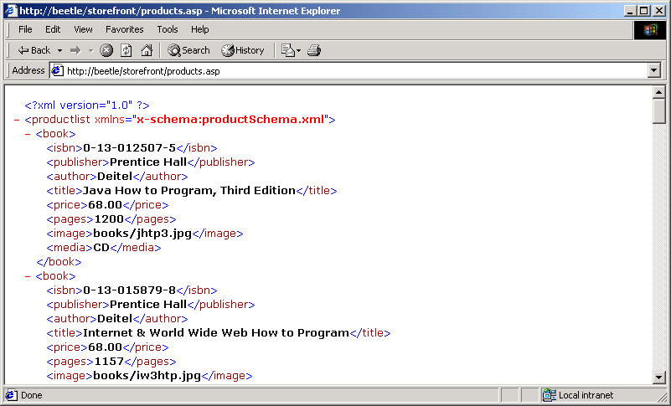
Output from products.asp

Slide 57
36 <?xml version = "1.0"?>
37
38 <!-- Figure 28.18: productSchema.xml -->
39
2.productSchema.xml
2.1 <Schema> tag
40 <Schema xmlns = "urn:schemas-microsoft-com:xml-data">
41 <ElementType name = "isbn" content = "textOnly"/>
42 <ElementType name = "publisher" content = "textOnly"/>
43 <ElementType name = "author" content = "textOnly"/>
44 <ElementType name = "title" content = "textOnly"/>
45 <ElementType name = "price" content = "textOnly"/>
46 <ElementType name = "pages" content = "textOnly"/>
47 <ElementType name = "image" content = "textOnly"/>
48 <ElementType name = "media" content = "textOnly"/>
49
50 <ElementType name = "book" content = "eltOnly"
51 model = "closed">
52 <element type = "isbn"/>
53 <element type = "publisher"/>
54 <element type = "author"/>
55 <element type = "title"/>
56 <element type = "price"/>
57 <element type = "pages"/>
58 <element type = "image"/>
59 <element type = "media"/>
60 </ElementType>
61 <ElementType name = "productlist" content = "eltOnly"
62 model = "closed">
63 <element type = "book" maxOccurs = "*"/>
64 </ElementType>
65 </Schema>

Slide 58
66 <?xml version = "1.0"?>
67
The xsl:if element filters the data using the expression string that we created in productSearch.js. By setting the attribute expr to true, all records are initially displayed.
68 <!-- Figure 28.19: sorting.xsl -->
69
3. sorting.xsl
3.1 <productlist> tag
70 <productlist>
71 <xsl:for-each select = "book" order-by = "id"
72 xmlns:xsl = "http://www.w3.org/TR/WD-xsl">
73 <xsl:if expr = "true">
74 <book>
75 <isbn><xsl:value-of select = "isbn"/></isbn>
76 <publisher><xsl:value-of select = "publisher"/>
77 </publisher>
78 <author><xsl:value-of select = "author"/></author>
79 <title><xsl:value-of select = "title"/></title>
80 <price><xsl:value-of select = "price"/></price>
81 <pages><xsl:value-of select = "pages"/></pages>
82 <image><xsl:value-of select = "image"/></image>
83 <media><xsl:value-of select = "media"/></media>
84 </book>
85 </xsl:if>
86 </xsl:for-each>
87 </productlist>

Slide 59
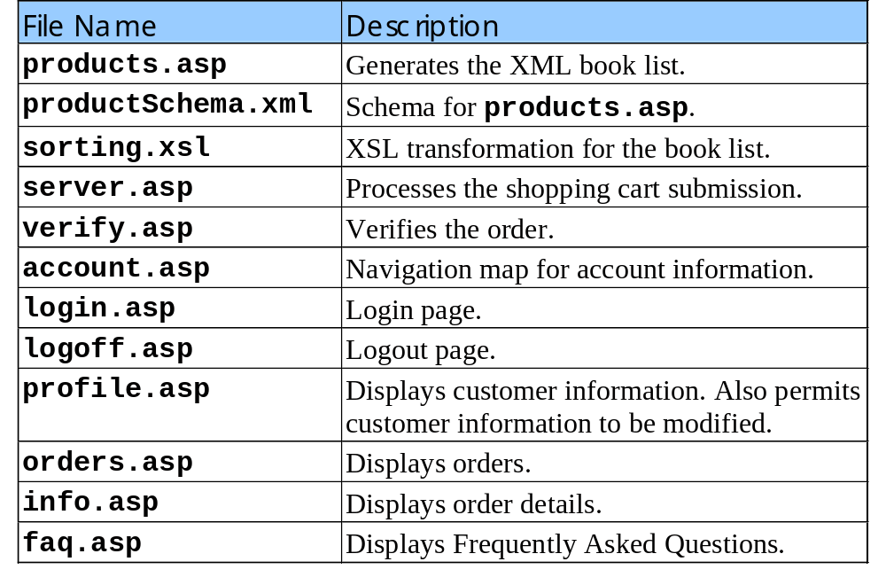
28.5 Other Server-Side Documents
Table of server-side documents

Slide 60
88 <% @Language = "VBScript" %>
89 <% Option Explicit %>
90 <% Response.Expires = 0 %>
91 <%
4. server.asp
4.1 Create a DOMDocument
4.2 Verify the data
4.3 Insert the data into the database
92 ' Figure 28.20: server.asp
93
Create a DOMDocument (Microsoft.XMLDOM) object to store the incoming XML data.
94 Dim xmlData, xmlItems, objConnection, objRecord
95
96 Session( "StoreFrontOrderID" ) = Empty
97
98 Set xmlData = Server.CreateObject( "Microsoft.XMLDOM" )
99 xmlData.Async = False
Lines 102 through 113 verify that the data we loaded is valid.
100 Call xmlData.Load( Request )
101
102 If xmlData.Xml = "" Then
103 Response.ContentType = "text/html"
104 Call Response.Write( "Invalid submission." )
105 Call Response.End()
106 End If
107
108 If xmlData.DocumentElement.ChildNodes.Length <= 0 Then
109 Response.ContentType = "text/html"
Lines 115 through 136 insert the data into the database.
110 Call Response.Write( "Invalid number of items in " & _
111 "Shopping Cart" )
112 Call Response.End()
113 End If
114
115 Set xmlItems = xmlData.DocumentElement.ChildNodes
116

Slide 61
117 Set objConnection = Server.CreateObject( "ADODB.Connection" )
118 Set objRecord = Server.CreateObject( "ADODB.RecordSet" )
119 Call objConnection.Open( "DSN=dbStorefront" )
120
121 objRecord.ActiveConnection = objConnection
122 objRecord.Source = "Orders"
123 objRecord.CursorType = 1 ' adOpenKeyset
124 objRecord.LockType = 2 ' adLockPessimistic
125 Call objRecord.Open()
Line 127 does not execute an SQL statement directly, but uses the RecordSet method Addnew.
126
127 Call objRecord.AddNew()
128 objRecord( "orderdate" ) = Now
129 objRecord( "product_xml" ) = xmlData.xml
130 Call objRecord.Update()
131
132 Session( "StoreFrontOrderDate" ) = objRecord( "orderdate" )
133 Session( "StoreFrontOrderID" ) = _
134 Right( "000000" & objRecord( "orderid" ), 6 )
135
136 Call objRecord.Close()
137
138 ' Everything is OK
139 Response.ContentType = "text/html"
140 Call Response.Write( "OK" )
141 %>

Slide 62
142 <% @Language = "VBScript" %>
143 <% Option Explicit %>
144 <% Response.Expires = 0 %>
145 <%
5. verify.asp
146 ' Figure 28.21: verify.asp
147
148 Dim objConnect, objRecord, strQuery, errorMessage, count
149 Dim storeFrontOrderID, storeFrontOrderDate, customerID
150
151 If Session( "storeFrontOrderID" ) = Empty Or _
152 Session( "storeFrontOrderDate" ) = Empty Then
153
154 Session( "storeFrontOrderID" ) = Empty
155 Session( "storeFrontOrderDate" ) = Empty
156
157 Session( "error" ) = "Submission / Verification Error."
158 Call Response.Redirect( "account.asp" )
159 End If
160
161 If Request( "cmdButton" ) = "Cancel" And _
162 Request( "orderID" ) <> Empty Then
163
164 ' Query DB for record.
165 Set objConnect = Server.CreateObject( "ADODB.Connection" )
166 Set objRecord = Server.CreateObject( "ADODB.RecordSet" )
167 Call objConnect.Open( "DSN=dbStorefront" )
168 strQuery = "SELECT * FROM Orders WHERE orderid = " & _
169 Request( "orderID" )
170
171 Call objRecord.Open( strQuery, objConnect, 1, 2 )
172

Slide 63
173 If objRecord.RecordCount > 0 Then
174 Call objRecord.Delete()
175 Call objRecord.Close()
176 End If
5.1 Verify the user name and password are correct
5.2 Connect to database
5.3 Set the user and total price of the order into the record
177
178 Call Response.Redirect( "index.html" )
179 End If
180
181 If Request( "cmdButton" ) = "Submit" Then
182 If Request( "txtUser" ) <> Empty And _
183 Request( "txtPass" ) <> Empty And _
184 Request( "orderID" ) <> Empty Then
185
186 Set objConnect = Server.CreateObject("ADODB.Connection")
187 Set objRecord = Server.CreateObject( "ADODB.RecordSet" )
188 Call objConnect.Open( "DSN=dbStorefront" )
189 strQuery = "SELECT * FROM Customer WHERE userid = '" & _
190 Request( "txtUser" ) & "' AND password = '" & _
191 Request( "txtPass" ) & "'"
192
193 Call objRecord.Open( strQuery, objConnect, 1, 2 )
194
195 If objRecord.RecordCount > 0 Then
196 customerID = objRecord( "customerid" )
197 Session( "storeFrontLoggedIn" ) = customerID
198 Call objRecord.Close()
199
200 ' Get Order.
201 strQuery = "SELECT * FROM Orders WHERE orderid = " & _
202 Request( "orderID" ) & " AND verified = False"
203

Slide 64
204 Call objRecord.Open( strQuery, objConnect, 1, 2 )
205
206 If objRecord.RecordCount > 0 Then
207 ' Update Records
5.3 Set the user and total price of the order into the record
5.4 Redirect user to the account status page
208 objRecord( "orderdate" ) = Now
209 objRecord( "verified" ) = True
210 objRecord( "customerid" ) = customerID
211 objRecord( "total_cost" ) = Request( "total" )
212 Call objRecord.Update()
213 Else
214 Session( "storeFrontOrderID" ) = Empty
215 Session( "storeFrontOrderDate" ) = Empty
216 Session( "error" ) = "Order Not Found"
217 Call Response.Redirect( "account.asp" )
218 End If
219
220 Session( "storeFrontOrderID" ) = Empty
221 Session( "storeFrontOrderDate" ) = Empty
222
223 ' Finished
224 Session( "error" ) = "Order Verified. " & _
225 "Thank You for your purchase."
226 Call Response.Redirect( "account.asp" )
227 Else
228 Call objRecord.Close()
229 Call objConnect.Close()
230 Session( "storeFrontLoggedIn" ) = Empty
231 errorMessage = "Invalid Username / Password pair."
232 End If

Slide 65
233 Else
234 Session( "storeFrontLoggedIn" ) = Empty
235 errorMessage = "Invalid Username / Password pair."
236 End If
5.5 Begin HTML portion
5.6 Shopping table header
237 End If
238
239 storeFrontOrderID = Session( "storeFrontOrderID" )
240 storeFrontOrderDate = Session( "storeFrontOrderDate" )
241 %>
242
243 <!DOCTYPE HTML PUBLIC "-//W3C//DTD HTML 4.0 Transitional//EN">
244 <HTML>
245
246 <HEAD>
247 <TITLE>StoreFront</TITLE>
248 <LINK REL = "stylesheet" TYPE = "text/css" HREF = "style.css">
249 <SCRIPT LANGUAGE = "JavaScript" SRC = "tableHighlight.js">
250 </SCRIPT>
251 </HEAD>
252
253 <BODY ONLOAD = "refreshShoppingTable();">
254 <TABLE WIDTH = "750" ALIGN = "center" CELLPADDING = "0"
255 CELLSPACING = "0" BORDER = "0" BGCOLOR = "#67CDFF">
256 <TR>
257 <TD COLSPAN = "2" WIDTH = "750" HEIGHT = "35"><IMG
258 SRC = "images/header2.jpg" WIDTH = "750"
259 HEIGHT = "35"></TD>
260 </TR>

Slide 66
261 <TR>
262 <TD WIDTH = "750" VALIGN = "top" ALIGN = "center">
263 <P>Please confirm your order<BR>
264 <DIV CLASS = "error"><% =errorMessage %></DIV><BR></P>
5.6 Shopping table header
265 <TABLE WIDTH = "670" CELLPADDING = "2"
266 CELLSPACING = "0" BORDER = "0">
267 <TR>
268 <TD WIDTH = "25%" ALIGN = "right"
269 CLASS = "label">Order ID:</TD>
270 <TD WIDTH = "75%" CLASS = "typing">
271 <% =storeFrontOrderID %></TD>
272 </TR>
273 <TR>
274 <TD WIDTH = "25%" ALIGN = "right"
275 CLASS = "label">Order Date:</TD>
276 <TD WIDTH = "75%" CLASS = "typing">
277 <% =storeFrontOrderDate %></TD>
278 </TR>
279 </TABLE>
280 <BR>
281 <TABLE WIDTH = "670" CELLPADDING = "0"
282 CELLSPACING = "0" BORDER = "0"
283 ID = "shoppingCart">
284 <THEAD>
285 <TD WIDTH = "90" CLASS = "label">
286 ISBN
287 </TD>
288 <TD WIDTH = "90" CLASS = "label">
289 Author
290 </TD>

Slide 67
291 <TD WIDTH = "280" CLASS = "label">
292 Title
293 </TD>
294 <TD WIDTH = "70" ALIGN = "right"
5.7 Connect to database
5.8 Generate book list
295 CLASS = "label">
296 Price
297 </TD>
298 <TD WIDTH = "10"></TD>
299 <TD WIDTH = "50" ALIGN = "center"
300 CLASS = "label">
301 Quantity
302 </TD>
303 <TD WIDTH = "80" ALIGN = "right"
304 CLASS = "label">
On lines 309 through 380, the book list is generated by matching the items in the XML shopping cart to the items in the database. We also calculate the total price of the order.
305 Total
306 </TD>
307 </THEAD>
308 <%
309 Dim newInfo, newInfoRoot, numTotal, product
310 Dim prodISBN, prodAuthor, prodTitle, prodQuantity
311 Dim prodTotal, prodPrice
312
313 Set objConnect = Server.CreateObject( "ADODB.Connection" )
314 Set objRecord = Server.CreateObject( "ADODB.RecordSet" )
315 Call objConnect.Open( "DSN=dbStorefront" )
316 strQuery = "SELECT * FROM Orders WHERE orderid = " & _
317 storeFrontOrderID
318
319 Call objRecord.Open( strQuery, objConnect, 1, 2 )
320

Slide 68
321 If objRecord.RecordCount > 0 Then
322 If objRecord("orderdate") <> storeFrontOrderDate Then
323 Call Response.Clear()
324 Call Response.Redirect( "index.html" )
5.8 Generate book list
325 End If
326
327 Set newInfo = Server.CreateObject( "Microsoft.XMLDOM" )
328
329 newInfo.Async = False
330 Call newInfo.LoadXML( objRecord( "product_xml" ) )
331
332 Call objRecord.Close()
333
334 Set newInfoRoot = newInfo.DocumentElement
335
336 numTotal = 0
337
338 For count = 0 To ( newInfoRoot.ChildNodes.Length - 1 )
339 Set product = newInfoRoot.ChildNodes.Item( count )
340 prodISBN = product.GetAttribute( "isbn" )
341
342 ' Search the DB for the prodID.
343 strQuery = "SELECT * FROM Products WHERE isbn = '" & _
344 prodISBN & "'"
345 Call objRecord.Open( strQuery, objConnect, 1, 2 )
346
347 ' Fill in the rest of the items.
348 prodAuthor = objRecord( "author" )
349 prodTitle = objRecord( "title" )
350 prodPrice = objRecord( "price" )
351 prodPrice = FormatNumber( prodPrice, 2 )

Slide 69
352 prodQuantity = product.getAttribute( "qty" )
353 prodTotal = prodPrice * prodQuantity
354 prodTotal = FormatNumber( prodTotal, 2 )
355 numTotal = numTotal + prodTotal
5.8 Generate book list
5.9 Shopping table body
356 Call objRecord.Close()
357 %>
358 <TR>
359 <TD WIDTH = "90" VALIGN = "top">
360 <% =prodISBN %></TD>
361 <TD WIDTH = "90" VALIGN = "top">
362 <% =prodAuthor %></TD>
363 <TD WIDTH = "280" VALIGN = "top">
364 <% =prodTitle %></TD>
365 <TD WIDTH = "70" ALIGN = "right"
366 VALIGN = "top">
367 $<% =prodPrice %></TD>
368 <TD WIDTH = "10"></TD>
369 <TD WIDTH = "50" ALIGN = "center"
370 VALIGN = "top">
371 <% =prodQuantity %></TD>
372 <TD WIDTH = "80" ALIGN = "right"
373 VALIGN = "top">
374 $<% =prodTotal %></TD>
375 </TR>
376 <%
377 Next
378
379 numTotal = FormatNumber( numTotal, 2 )
380 End If
381 %>

Slide 70
382 <TFOOT>
383 <TD WIDTH = "90"></TD>
384 <TD WIDTH = "90"></TD>
385 <TD WIDTH = "280"></TD>
5.10 Shopping table footer
386 <TD WIDTH = "70"></TD>
387 <TD WIDTH = "10"></TD>
388 <TD WIDTH = "50" ALIGN = "right"
389 CLASS = "label">
390 Total:
391 </TD>
392 <TD WIDTH = "80" ALIGN = "right">
393 $<% =numTotal %>
394 </TD>
395 </TFOOT>
396 </TABLE>
397 <BR>
398 <FORM METHOD = "POST" ACTION = "verify.asp">
399 <DIV ALIGN = "center">
400 <TABLE CELLSPACING = "1" CELLPADDING = "0">
401 <TR>
402 <TD CLASS = "label">Username</TD>
403 <TD CLASS = "label">Password</TD>
404 </TR>
405 <TR>
406 <TD>
407 <INPUT TYPE = "text"
408 NAME = "txtUser" ID = "txtUser"
409 VALUE = "<% =Request( "txtUser" ) %>"
410 CLASS = "typing">
411 </TD>

Slide 71
412 <TD>
413 <INPUT TYPE = "password"
414 NAME = "txtPass" ID = "txtPass"
415 CLASS = "typing">
5.10 Shopping table footer
416 </TD>
417 </TR>
418 </TABLE>
419 <BR>
420 <INPUT TYPE = "submit" NAME = "cmdButton"
421 VALUE = "Submit" CLASS = "button2">
422 <INPUT TYPE = "submit" NAME = "cmdButton"
423 VALUE = "Cancel" CLASS = "button2">
424 <INPUT TYPE = "hidden" NAME = "orderID"
425 VALUE = "<% =storeFrontOrderID %>">
426 <INPUT TYPE = "hidden" NAME = "total"
427 VALUE = "<% =numTotal %>">
428 </DIV>
429 </FORM>
430 </TD>
431 </TR>
432 <TR>
433 <TD COLSPAN = "2" WIDTH = "750" HEIGHT = "15"><IMG
434 SRC = "images/footer.jpg" WIDTH = "750"
435 HEIGHT = "15"></TD>
436 </TR>
437 </TABLE>
438 </BODY>
439
440 </HTML>

Slide 72
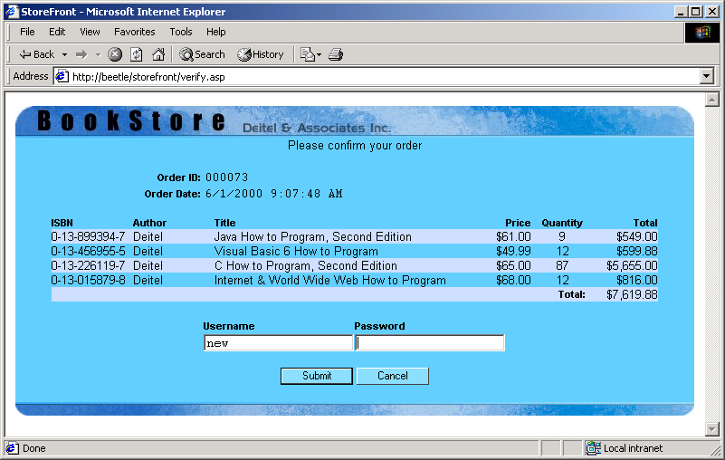
Output from verify.asp

Slide 73
441 <% @Language = "VBScript" %>
442 <% Option Explicit %>
443 <% Response.Expires = 0 %>
444
6. account.asp
6.1 Account information table header
445 <% ' Figure 28.22: account.asp %>
446
447 <!DOCTYPE HTML PUBLIC "-//W3C//DTD HTML 4.0 Transitional//EN">
448 <HTML>
449
450 <HEAD>
451 <TITLE>StoreFront</TITLE>
452 <LINK REL = "stylesheet" TYPE = "text/css" HREF = "style.css">
453 </HEAD>
454
455 <BODY>
456 <CENTER>
457 <TABLE WIDTH = "750" ALIGN = "center" CELLPADDING = "0"
458 CELLSPACING = "0" BORDER = "0" BGCOLOR = "#67CDFF"
459 ID = "productList" STYLE = "position: relative;
460 display: block; top: 0; left: 0;">
461 <TR>
462 <TD COLSPAN = "2" WIDTH = "750" HEIGHT = "35"><IMG
463 SRC = "images/header.jpg" WIDTH = "650"
464 HEIGHT = "35"><A HREF = "index.html"><IMG
465 SRC = "images/head_products.jpg"
466 WIDTH = "100" HEIGHT = "35" BORDER = "0"></A></TD>
467 </TR>
468 <TR>
469 <TD WIDTH = "150" VALIGN = "top" CLASS = "margin"
470 BGCOLOR = "#CCDDFF">
471 <STRONG>Account Information</STRONG><BR>

Slide 74
472 <%
473 If Session( "StoreFrontLoggedIn" ) = Empty Then
474 %>
475 <A HREF = "login.asp">Login</A><BR>
6.2 Account information table body
476 <%
477 Else
478 %>
479 <A HREF = "profile.asp">Customer Profile</A><BR>
480 <A HREF = "orders.asp">Orders</A><BR>
481 <A HREF = "logoff.asp">Logoff</A><BR>
482 <%
483 End If
484 %>
485 <BR>
486 <STRONG>Help!</STRONG><BR>
487 <A HREF = "faq.asp">FAQ</A><BR>
488 Customer Support
489 <DIV CLASS = "note">&nbsp;&nbsp;&nbsp;not available</DIV>
490 </TD>
491 <TD WIDTH = "600" VALIGN = "top" CLASS = "margin">
492 <P>Welcome to the StoreFront Account Information
493 page.</P>
494 <P CLASS = "error"><% =Session( "Error" ) %></P>
495 <P>Please select an item from the menu.</P>
496 </TD>
497 </TR>

Slide 75
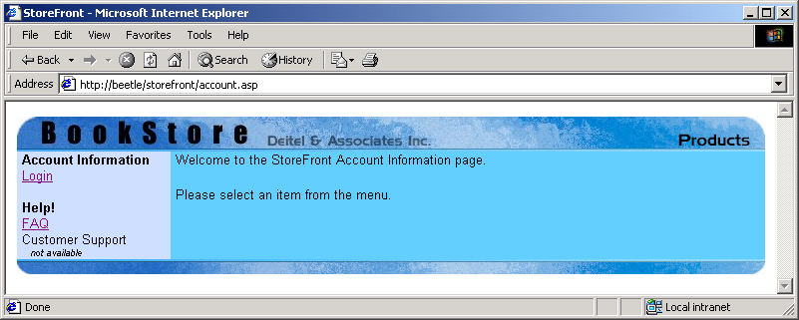
498 <TR>
499 <TD COLSPAN = "2" WIDTH = "750" HEIGHT = "15"><IMG
500 SRC = "images/footer.jpg" WIDTH = "750"
501 HEIGHT = "15"></TD>
6.3 Account information table footer
502 </TR>
503 </TABLE>
504 </CENTER>
505 </BODY>
506 <%
507 Session( "Error" ) = Empty
508 %>
509 </HTML>

Slide 76
510 <% @Language = "VBScript" %>
511 <% Option Explicit %>
Query the database for the username and password pair and if successful, we store the userid as a session variable named StoreFrontLoggedIn.
512 <% Response.Expires = 0 %>
513 <%
7. login.asp
7.1 Connect to database
7.2 Check login
514 ' Figure 28.23: login.asp
515
516 Dim objConnect, objRecord, strQuery, errorMessage
517
518 If Request( "cmdButton" ) <> Empty Then
519 If Request( "txtUser" ) <> Empty And _
520 Request( "txtPass" ) <> Empty Then
521
522 Set objConnect = Server.CreateObject( "ADODB.Connection" )
523 Set objRecord = Server.CreateObject( "ADODB.RecordSet" )
524 Call objConnect.Open( "DSN=dbStorefront" )
525 strQuery = "SELECT * FROM Customer WHERE " & _
526 "userid = '" & Request( "txtUser" ) & _
527 "' AND password = '" & Request( "txtPass" ) & "'"
528
529 Call objRecord.Open( strQuery, objConnect, 1, 2 )
530
531 If objRecord.RecordCount > 0 Then
532 Session( "StoreFrontLoggedIn" ) = _
533 objRecord( "customerid" )
534
535 Call Response.Redirect( "profile.asp" )
536 Else
537 Session( "StoreFrontLoggedIn" ) = Empty
538 errorMessage = "Invalid Username / Password pair."
539 End If

Slide 77
540 Else
541 errorMessage = "Invalid Username / Password pair."
542 End If
543 End If
7.3 Function validate
544 %>
545
546 <!DOCTYPE HTML PUBLIC "-//W3C//DTD HTML 4.0 Transitional//EN">
547 <HTML>
548
549 <HEAD>
550 <TITLE>StoreFront</TITLE>
551 <LINK REL = "stylesheet" TYPE = "text/css" HREF = "style.css">
We perform client-side verification for the username and password fields.
552 <SCRIPT LANGUAGE = "JavaScript">
553
554 // Validate the username and password fields
555 function validate()
556 {
557 if ( login.txtUser.value == "" ||
558 login.txtPass.value == "" ) {
559 alert( "Some fields empty" );
560
561 return false;
562 }
563
564 return true;
565 }
566 </SCRIPT>
567 </HEAD>
568

Slide 78
569 <BODY>
570 <CENTER>
571 <TABLE WIDTH = "750" ALIGN = "center" CELLPADDING = "0"
572 CELLSPACING = "0" BORDER = "0" BGCOLOR = "#67CDFF"
573 ID = "productList" STYLE = "position: relative;
7.4 Login table header
7.5 Login table body
574 display: block; top: 0; left: 0;">
575 <TR>
576 <TD COLSPAN = "2" WIDTH = "750" HEIGHT = "35"><IMG
577 SRC = "images/header.jpg" WIDTH = "650"
578 HEIGHT = "35"><A HREF = "index.html"><IMG
579 SRC = "images/head_products.jpg"
580 WIDTH = "100" HEIGHT = "35" BORDER = "0"></A></TD>
581 </TR>
582 <TR>
583 <TD WIDTH = "150" VALIGN = "top" CLASS = "margin"
584 BGCOLOR = "#CCDDFF">
585 <STRONG>Account Information</STRONG><BR>
586 Login<BR><BR>
587 <STRONG>Help!</STRONG><BR>
588 <A HREF = "faq.asp">FAQ</A><BR>
589 Customer Support
590 <DIV CLASS = "note">&nbsp;&nbsp;&nbsp;not available</DIV>
591 </TD>
592 <TD WIDTH = "600" VALIGN = "top" CLASS = "margin">
593 <P>Please enter your username and password</P>
594 <P CLASS = "error"><% =errorMessage %></P>
595 <FORM METHOD = "POST" ACTION = "login.asp"
596 ID = "login" ONSUBMIT = "return validate();">
597 <DIV ALIGN = "center">
598 <TABLE CELLSPACING = "1" CELLPADDING = "0">
599 <TR>
600 <TD CLASS = "label">Username</TD>
601 <TD CLASS = "label">Password</TD>
602 </TR>

Slide 79
603 <TR>
604 <TD>
605 <INPUT TYPE = "text"
606 NAME = "txtUser" ID = "txtUser"
7.5 Login table body
7.6 Login table footer
607 CLASS = "typing">
608 </TD>
609 <TD>
610 <INPUT TYPE = "password"
611 NAME = "txtPass" ID = "txtPass"
612 CLASS = "typing">
613 </TD>
614 </TR>
615 </TABLE>
616 <BR>
617 <INPUT TYPE = "submit" NAME = "cmdButton"
618 VALUE = "Login" CLASS = "button2">
619 </DIV>
620 </FORM>
621 </TD>
622 </TR>
623 <TR>
624 <TD COLSPAN = "2" WIDTH = "750" HEIGHT = "15"><IMG
625 SRC = "images/footer.jpg" WIDTH = "750"
626 HEIGHT = "15"></TD>
627 </TR>
628 </TABLE>
629 </CENTER>
630 </BODY>
631 </HTML>

Slide 80
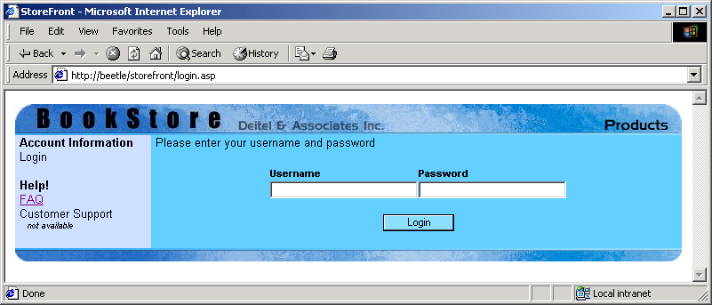
Output from login.asp

Slide 81
634 <% Response.Expires = 0 %>
635 <%
636 ' Figure 28.24: logoff.asp
637
8. logoff.asp
8.1 Logoff table header
638 ' Reset the User ID.
639 Session( "StoreFrontLoggedIn" ) = Empty
640 %>
641
642 <!DOCTYPE HTML PUBLIC "-//W3C//DTD HTML 4.0 Transitional//EN">
643 <HTML>
644
645 <HEAD>
646 <TITLE>StoreFront</TITLE>
647 <LINK REL = "stylesheet" TYPE = "text/css" HREF = "style.css">
648 </HEAD>
649
650 <BODY>
651 <CENTER>
652 <TABLE WIDTH = "750" ALIGN = "center" CELLPADDING = "0"
653 CELLSPACING = "0" BORDER = "0" BGCOLOR = "#67CDFF"
654 ID = "productList" STYLE = "position: relative;
655 display: block; top: 0; left: 0;">
656 <TR>
657 <TD COLSPAN = "2" WIDTH = "750" HEIGHT = "35"><IMG
658 SRC = "images/header.jpg" WIDTH = "650"
659 HEIGHT = "35"><A HREF = "index.html"><IMG
660 SRC = "images/head_products.jpg"
661 WIDTH = "100" HEIGHT = "35" BORDER = "0"></A></TD>
662 </TR>

Slide 82
663 <TR>
664 <TD WIDTH = "150" VALIGN = "top" CLASS = "margin"
665 BGCOLOR = "#CCDDFF">
666 <STRONG>Account Information</STRONG><BR>
8.2 Logoff table body
8.3 Logoff table footer
667 <A HREF = "login.asp">Login</A><BR><BR>
668 <STRONG>Help!</STRONG><BR>
669 <A HREF = "faq.asp">FAQ</A><BR>
670 Customer Support
671 <DIV CLASS = "note">&nbsp;&nbsp;&nbsp;not available</DIV>
672 </TD>
673 <TD WIDTH = "600" VALIGN = "top" CLASS = "margin">
674 <P>You have logged off.</P>
675 </TD>
676 </TR>
677 <TR>
678 <TD COLSPAN = "2" WIDTH = "750" HEIGHT = "15"><IMG
679 SRC = "images/footer.jpg" WIDTH = "750"
680 HEIGHT = "15"></TD>
681 </TR>
682 </TABLE>
683 </CENTER>
684 </BODY>
685 </HTML>

Slide 83
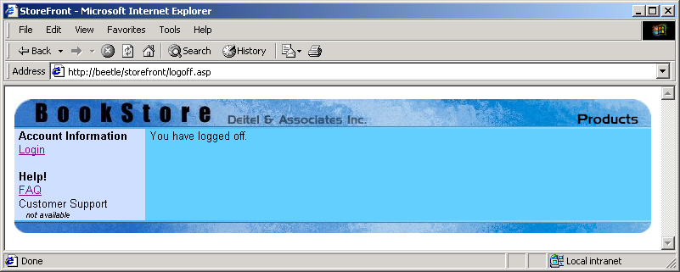
Output from logoff.asp

Slide 84
686 <% @Language = "VBScript" %>
687 <% Option Explicit %>
688 <% Response.Expires = 0 %>
689 <%
9. profile.asp
9.1 Connect to database
690 ' Figure 28.25: profile.asp
691
692 Dim objConnection, objRecord, strQuery, numID, errorMessage
693
694 ' Check for Login.
695 If Session( "storeFrontLoggedIn" ) = Empty Then
696 Session( "error" ) = "You are not logged in."
697 Call Response.Redirect( "account.asp" )
698 End If
699
700 ' Get the Customer profile
701 Set objConnection = server.CreateObject( "ADODB.Connection" )
702 Set objRecord = server.CreateObject( "ADODB.RecordSet" )
703 Call objConnection.Open( "DSN=dbStorefront" )
704 strQuery = "SELECT * FROM Customer WHERE customerid = " & _
705 Session("StoreFrontLoggedIn")
706
707 Call objRecord.Open( strQuery, objConnection, 1, 2 )
708
709 If objRecord.RecordCount > 0 Then
710 ' Check update status
711 If Request( "cmdSubmit" ) <> Empty Then
712
713 ' If password field nonempty, update it.
714 If Request( "password1" ) <> Empty Then
715 objRecord( "password" ) = Request( "password1" )
716 End If

Slide 85
717
718 ' Billing information
719 objRecord( "bill_fname" ) = Request( "bill_fname" )
720 objRecord( "bill_lname" ) = Request( "bill_lname" )
721 objRecord( "bill_address1" ) = Request( "bill_address1" )
9.2 Make database requests
722 objRecord( "bill_address2" ) = Request( "bill_address2" )
723 objRecord( "bill_city" ) = Request( "bill_city" )
724 objRecord( "bill_state" ) = Request( "bill_state" )
725 objRecord( "bill_zip" ) = Request( "bill_zip" )
726 objRecord( "bill_country" ) = Request( "bill_country" )
727 objRecord( "bill_phone" ) = Request( "bill_phone" )
728
729 ' Shipping information
730 objRecord( "ship_fname" ) = Request( "ship_fname" )
731 objRecord( "ship_lname" ) = Request( "ship_lname" )
732 objRecord( "ship_address1" ) = Request( "ship_address1" )
733 objRecord( "ship_address2" ) = Request( "ship_address2" )
734 objRecord( "ship_city" ) = Request( "ship_city" )
735 objRecord( "ship_state" ) = Request( "ship_state" )
736 objRecord( "ship_zip" ) = Request( "ship_zip" )
737 objRecord( "ship_country" ) = Request( "ship_country" )
738 objRecord( "ship_phone" ) = Request( "ship_phone" )
739
740 ' Credit information
741 objRecord( "credit_name" ) = Request( "credit_name" )
742 If Request( "credit_number" ) <> Empty Then
743 objRecord( "credit_number" ) = _
744 Request( "credit_number" )
745 End If
746
747 objRecord( "credit_expire" ) = Request( "credit_expire" )
748 Call objRecord.Update()

Slide 86
749
750 errorMessage = "Profile updated."
751 End If
752 Else
9.3 Function validate
753 errorMessage = "No Records Found."
754 End If
755 %>
756
757 <!DOCTYPE HTML PUBLIC "-//W3C//DTD HTML 4.0 Transitional//EN">
758 <HTML>
759
760 <HEAD>
761 <TITLE>StoreFront</TITLE>
Function validate performs client-side verification of the dates and phone numbers, by using regular expressions.
762 <LINK REL = "stylesheet" TYPE = "text/css" HREF = "style.css">
763 <SCRIPT LANGUAGE = "JavaScript">
764
765 // Validate the form
766 function validate()
767 {
768 // Validate Password
769 if ( form.password1.value != form.password2.value ) {
770 errorMessage.innerText = "Password fields do not match.";
771 form.password1.scrollIntoView();
772 alert( "Password fields do not match." );
773
774 return false;
775 }
776
777 // Validate Phone Numbers
778 var phoneReg = new RegExp( "\\d{3}-\\d{3}-\\d{4}" );
779

Slide 87
780 if ( phoneReg.test( form.bill_phone.value ) == false ) {
781 errorMessage.innerText =
782 "Billing Phone number is formatted incorrectly.";
783 form.bill_phone.scrollIntoView();
9.3 Function validate
784 alert( "Billing Phone number is " +
785 "formatted incorrectly." );
786
787 return false;
788 }
789
790 if ( phoneReg.test( form.ship_phone.value ) == false ) {
791 errorMessage.innerText =
792 "Shipping Phone number is formatted incorrectly.";
793 form.ship_phone.scrollIntoView();
794 alert( "Shipping Phone number is " +
795 "formatted incorrectly." );
796
797 return false;
798 }
799
800 // Validate Credit Expiration Date
801 var dateReg = new RegExp( "\\d{2}/\\d{4}" );
802
803 if ( dateReg.test( form.credit_expire.value ) == false) {
804 errorMessage.innerText =
805 "Credit Expiration date is formatted incorrectly.";
806 form.credit_expire.scrollIntoView();
807 alert( "Credit Expiration date is " +
808 "formatted incorrectly." );
809
810 return false;
811 }

Slide 88
812
813 // Everything is OK
814 return true;
815 }
9.4 Customer profile table header
816 </SCRIPT>
817 </HEAD>
818
819 <BODY>
820 <CENTER>
821 <TABLE WIDTH = "750" ALIGN = "center" CELLPADDING = "0"
822 CELLSPACING = "0" BORDER = "0" BGCOLOR = "#67CDFF"
823 ID = "productList" STYLE = "position: relative;
824 display: block; top: 0; left: 0;">
825 <TR>
826 <TD COLSPAN = "2" WIDTH = "750" HEIGHT = "35"><IMG
827 SRC = "images/header.jpg" WIDTH = "650"
828 HEIGHT = "35"><A HREF = "index.html"><IMG
829 SRC = "images/head_products.jpg"
830 WIDTH = "100" HEIGHT = "35" BORDER = "0"></A></TD>
831 </TR>
832 <TR>
833 <TD WIDTH = "150" VALIGN = "top" CLASS = "margin"
834 BGCOLOR = "#CCDDFF">
835 <STRONG>Account Information</STRONG><BR>
836 <%
837 If Session( "StoreFrontLoggedIn" ) = Empty Then
838 %>
839 <A HREF = "login.asp">Login</A><BR>
840 <%
841 Else
842 %>

Slide 89
843 Customer Profile<BR>
844 <A HREF = "orders.asp">Orders</A><BR>
845 <A HREF = "logoff.asp">Logoff</A><BR>
846 <%
9.5 Customer profile table body
847 End If
848
849 numID = Right( "000000" & objRecord( "customerid" ), 6 )
850 %>
851 <BR>
852 <STRONG>Help!</STRONG><BR>
853 <A HREF = "faq.asp">FAQ</A><BR>
854 Customer Support
855 <DIV CLASS = "note">&nbsp;&nbsp;&nbsp;not available</DIV>
856 </TD>
857 <TD WIDTH = "600" VALIGN = "top" CLASS = "margin">
858 <P>This is your Customer Profile.</P>
859 <P ID = "errorMessage" CLASS = "error">
860 <% =errorMessage %></P>
861 <FORM METHOD = "POST" ACTION = "profile.asp"
862 ONSUBMIT = "return validate();" ID = "form">
863 <TABLE WIDTH = "100%" CELLPADDING = "2"
864 CELLSPACING = "0">
865 <TR>
866 <TD WIDTH = "25%" CLASS = "label"
867 ALIGN = "right"></TD>
868 <TD WIDTH = "75%" CLASS = "label">
869 User Information</TD>
870 </TR>
871 <TR>
872 <TD WIDTH = "25%" CLASS = "marking"
873 ALIGN = "right">Customer ID</TD>

Slide 90
874 <TD WIDTH = "75%" CLASS = "typing">
875 <% =numID %></TD>
876 </TR>
877 <TR>
9.5 Customer profile table body
878 <TD WIDTH = "25%" CLASS = "marking"
879 ALIGN = "right">Username</TD>
880 <TD WIDTH = "75%" CLASS = "typing">
881 <% =objRecord( "userid" ) %></TD>
882 </TR>
883 <TR>
884 <TD WIDTH = "25%" CLASS = "marking"
885 ALIGN = "right">Password</TD>
886 <TD WIDTH = "75%" CLASS = "typing">
887 <INPUT TYPE = "password"
888 CLASS = "typing" ID = "password1"
889 NAME = "password1" SIZE = "20"></TD>
890 </TR>
891 <TR>
892 <TD WIDTH = "25%" CLASS = "marking"
893 ALIGN = "right">Confirm Password</TD>
894 <TD WIDTH = "75%" CLASS = "typing">
895 <INPUT TYPE = "password"
896 CLASS = "typing" ID = "password2"
897 NAME = "password2" SIZE = "20"></TD>
898 </TR>
899 <TR>
900 <TD WIDTH = "100%" COLSPAN = "2">
901 &nbsp;</TD>
902 </TR>
903 <TR>
904 <TD WIDTH = "25%" CLASS = "label"
905 ALIGN = "right"></TD>

Slide 91
906 <TD WIDTH = "75%" CLASS = "label">
907 Customer Information</TD>
908 </TR>
909 <TR>
9.5 Customer profile table body
910 <TD WIDTH = "25%" CLASS = "marking"
911 ALIGN = "right">First Name</TD>
912 <TD WIDTH = "75%" CLASS = "typing">
913 <% =objRecord( "fname" ) %></TD>
914 </TR>
915 <TR>
916 <TD WIDTH = "25%" CLASS = "marking"
917 ALIGN = "right">Last Name</TD>
918 <TD WIDTH = "75%" CLASS = "typing">
919 <% =objRecord( "lname" ) %></TD>
920 </TR>
921 <TR>
922 <TD WIDTH = "100%" COLSPAN = "2">
923 &nbsp;</TD>
924 </TR>
925 <TR>
926 <TD WIDTH = "25%" CLASS = "label"
927 ALIGN = "right"></TD>
928 <TD WIDTH = "75%" CLASS = "label">
929 Billing Information</TD>
930 </TR>
931 <TR>
932 <TD WIDTH = "25%" CLASS = "marking"
933 ALIGN = "right">First Name</TD>

Slide 92
934 <TD WIDTH = "75%" CLASS = "typing">
935 <INPUT TYPE = "text" SIZE = "20"
936 CLASS = "typing" ID = "bill_fname"
937 NAME = "bill_fname"
9.5 Customer profile table body
938 VALUE =
939 "<% =objRecord( "bill_fname" ) %>">
940 </TD>
941 </TR>
942 <TR>
943 <TD WIDTH = "25%" CLASS = "marking"
944 ALIGN = "right">Last Name</TD>
945 <TD WIDTH = "75%" CLASS = "typing">
946 <INPUT TYPE = "text" SIZE= "20"
947 CLASS = "typing" ID = "bill_lname"
948 NAME = "bill_lname"
949 VALUE =
950 "<% =objRecord( "bill_lname" ) %>">
951 </TD>
952 </TR>
953 <TR>
954 <TD WIDTH = "25%" CLASS = "marking"
955 ALIGN = "right">Address</TD>
956 <TD WIDTH = "75%" CLASS = "typing">
957 <INPUT TYPE = "text" SIZE = "30"
958 CLASS = "typing"
959 ID = "bill_address1"
960 NAME = "bill_address1"
961 VALUE =
962 "<% =objRecord( "bill_address1" ) %>">
963 </TD>
964 </TR>

Slide 93
965 <TR>
966 <TD WIDTH = "25%" CLASS = "marking"
967 ALIGN = "right"></TD>
968 <TD WIDTH = "75%" CLASS = "typing">
969 <INPUT TYPE = "text" SIZE = "30"
9.5 Customer profile table body
970 CLASS = "typing"
971 ID = "bill_address2"
972 NAME = "bill_address2"
973 VALUE =
974 "<% =objRecord( "bill_address2" ) %>">
975 </TD>
976 </TR>
977 <TR>
978 <TD WIDTH = "25%" CLASS = "marking"
979 ALIGN = "right">City</TD>
980 <TD WIDTH = "75%" CLASS = "typing">
981 <INPUT TYPE = "text" SIZE = "20"
982 CLASS = "typing" ID = "bill_city"
983 NAME = "bill_city"
984 VALUE = "<% =objRecord( "bill_city" ) %>">
985 </TD>
986 </TR>
987 <TR>
988 <TD WIDTH = "25%" CLASS = "marking"
989 ALIGN = "right">State</TD>
990 <TD WIDTH = "75%" CLASS = "typing">
991 <INPUT TYPE = "text" SIZE = "20"
992 CLASS = "typing" ID = "bill_state"
993 NAME = "bill_state"
994 VALUE =
995 "<% =objRecord( "bill_state" ) %>">
996 </TD>
997 </TR>

Slide 94
998 <TR>
999 <TD WIDTH = "25%" CLASS = "marking"
1000 ALIGN = "right">Postal Code</TD>
1001 <TD WIDTH = "75%" CLASS = "typing">
1002 <INPUT TYPE = "text" SIZE = "20"
9.5 Customer profile table body
1003 CLASS = "typing" ID = "bill_zip"
1004 NAME = "bill_zip"
1005 VALUE = "<% =objRecord( "bill_zip" ) %>">
1006 </TD>
1007 </TR>
1008 <TR>
1009 <TD WIDTH = "25%" CLASS = "marking"
1010 ALIGN = "right">Country</TD>
1011 <TD WIDTH = "75%" CLASS = "typing">
1012 <INPUT TYPE = "text" SIZE = "20"
1013 CLASS = "typing" ID = "bill_country"
1014 NAME = "bill_country"
1015 VALUE =
1016 "<% =objRecord( "bill_country" ) %>">
1017 </TD>
1018 </TR>
1019 <TR>
1020 <TD WIDTH = "25%" CLASS = "marking"
1021 ALIGN = "right">Phone Number</TD>
1022 <TD WIDTH = "75%" CLASS = "typing">
1023 <INPUT TYPE = "text" SIZE = "12"
1024 CLASS = "typing" ID = "bill_phone"
1025 NAME = "bill_phone" MAXLENGTH = "12"
1026 VALUE =
1027 "<% =objRecord( "bill_phone" ) %>">
1028 ###-###-####
1029 </TD>
1030 </TR>

Slide 95
1031 <TR>
1032 <TD WIDTH = "100%" COLSPAN = "2">
1033 &nbsp;
1034 </TD>
1035 </TR>
9.5 Customer profile table body
1036 <TR>
1037 <TD WIDTH = "25%" CLASS = "label"
1038 ALIGN = "right"></TD>
1039 <TD WIDTH = "75%" CLASS = "label">
1040 Shipping Information</TD>
1041 </TR>
1042 <TR>
1043 <TD WIDTH = "25%" CLASS = "marking"
1044 ALIGN = "right">First Name</TD>
1045 <TD WIDTH = "75%" CLASS = "typing">
1046 <INPUT TYPE = "text" SIZE = "20"
1047 CLASS = "typing" ID = "ship_fname"
1048 NAME = "ship_fname"
1049 VALUE =
1050 "<% =objRecord( "ship_fname" ) %>">
1051 </TD>
1052 </TR>
1053 <TR>
1054 <TD WIDTH = "25%" CLASS = "marking"
1055 ALIGN = "right">Last Name</TD>
1056 <TD WIDTH = "75%" CLASS = "typing">
1057 <INPUT TYPE = "text" SIZE = "20"
1058 CLASS = "typing" ID = "ship_lname"
1059 NAME = "ship_lname"
1060 VALUE =
1061 "<% =objRecord( "ship_lname" ) %>">
1062 </TD>
1063 </TR>

Slide 96
1064 <TR>
1065 <TD WIDTH = "25%" CLASS = "marking"
1066 ALIGN = "right">Address</TD>
1067 <TD WIDTH = "75%" CLASS = "typing">
1068 <INPUT TYPE = "text" SIZE = "30"
9.5 Customer profile table body
1069 CLASS = "typing"
1070 ID = "ship_address1"
1071 NAME = "ship_address1"
1072 VALUE =
1073 "<% =objRecord( "ship_address1" ) %>">
1074 </TD>
1075 </TR>
1076 <TR>
1077 <TD WIDTH = "25%" CLASS = "marking"
1078 ALIGN = "right"></TD>
1079 <TD WIDTH = "75%" CLASS = "typing">
1080 <INPUT TYPE = "text" SIZE = "30"
1081 CLASS = "typing"
1082 ID = "ship_address2"
1083 NAME = "ship_address2"
1084 VALUE =
1085 "<% =objRecord( "ship_address2" ) %>">
1086 </TD>
1087 </TR>
1088 <TR>
1089 <TD WIDTH = "25%" CLASS = "marking"
1090 ALIGN = "right">City</TD>
1091 <TD WIDTH = "75%" CLASS = "typing">
1092 <INPUT TYPE = "text" SIZE = "20"
1093 CLASS = "typing" ID = "ship_city"
1094 NAME = "ship_city" VALUE =
1095 "<% =objRecord( "ship_city" ) %>">
1096 </TD>
1097 </TR>

Slide 97
1098 <TR>
1099 <TD WIDTH = "25%" CLASS = "marking"
1100 ALIGN = "right">State</TD>
1101 <TD WIDTH = "75%" CLASS = "typing">
9.5 Customer profile table body
1102 <INPUT TYPE = "text" SIZE = "20"
1103 CLASS = "typing" ID = "ship_state"
1104 NAME = "ship_state"
1105 VALUE =
1106 "<% =objRecord( "ship_state" ) %>">
1107 </TD>
1108 </TR>
1109 <TR>
1110 <TD WIDTH = "25%" CLASS = "marking"
1111 ALIGN = "right">Postal Code</TD>
1112 <TD WIDTH = "75%" CLASS = "typing">
1113 <INPUT TYPE = "text" SIZE = "20"
1114 CLASS = "typing" ID = "ship_zip"
1115 NAME = "ship_zip"
1116 VALUE = "<% =objRecord( "ship_zip" ) %>">
1117 </TD>
1118 </TR>
1119 <TR>
1120 <TD WIDTH = "25%" CLASS = "marking"
1121 ALIGN = "right">Country</TD>
1122 <TD WIDTH = "75%" CLASS = "typing">
1123 <INPUT TYPE = "text" SIZE = "20"
1124 CLASS = "typing" ID = "ship_country"
1125 NAME = "ship_country"
1126 VALUE =
1127 "<% =objRecord( "ship_country" ) %>">
1128 </TD>
1129 </TR>

Slide 98
1130 <TR>
1131 <TD WIDTH = "25%" CLASS = "marking"
1132 ALIGN = "right">Phone Number</TD>
1133 <TD WIDTH = "75%" CLASS = "typing">
1134 <INPUT TYPE = "text" SIZE = "12"
9.5 Customer profile table body
1135 CLASS = "typing" ID = "ship_phone"
1136 NAME = "ship_phone" MAXLENGTH = "12"
1137 VALUE =
1138 "<% =objRecord( "ship_phone" ) %>">
1139 ###-###-####
1140 </TD>
1141 </TR>
1142 <TR>
1143 <TD WIDTH = "100%" COLSPAN = "2">
1144 &nbsp;
1145 </TD>
1146 </TR>
1147 <TR>
1148 <TD WIDTH = "25%" CLASS = "label"
1149 ALIGN = "right"></TD>
1150 <TD WIDTH = "75%" CLASS = "label">
1151 Credit Information</TD>
1152 </TR>
1153 <TR>
1154 <TD WIDTH = "25%" CLASS = "marking"
1155 ALIGN = "right">Name on Card</TD>
1156 <TD WIDTH = "75%" CLASS = "typing">
1157 <INPUT TYPE = "text" SIZE = "20"
1158 CLASS = "typing" ID = "credit_name"
1159 NAME = "credit_name"
1160 VALUE =
1161 "<% =objRecord( "credit_name" ) %>">
1162 </TD>
1163 </TR>

Slide 99
1164 <TR>
1165 <TD WIDTH = "25%" CLASS = "marking"
1166 ALIGN = "right">Card Number</TD>
1167 <TD WIDTH = "75%" CLASS = "typing">
9.5 Customer profile table body
1168 <INPUT TYPE = "text" SIZE = "20"
1169 CLASS = "typing"
1170 ID = "credit_number"
1171 NAME = "credit_number" VALUE = "">
1172 ....
1173 <% =Right( objRecord("credit_number"), 4 ) %>
1174 </TD>
1175 </TR>
1176 <TR>
1177 <TD WIDTH = "25%" CLASS = "marking"
1178 ALIGN = "right">Expiration Date</TD>
1179 <TD WIDTH = "75%" CLASS = "typing">
1180 <INPUT TYPE = "text" SIZE = "7"
1181 CLASS = "typing" MAXLENGTH = "7"
1182 ID = "credit_expire"
1183 NAME = "credit_expire"
1184 VALUE =
1185 "<% =objRecord( "credit_expire" ) %>">
1186 ##/####
1187 </TD>
1188 </TR>
1189 <TR>
1190 <TD WIDTH = "100%" COLSPAN = "2">
1191 &nbsp;
1192 </TD>
1193 </TR>

Slide 100
1194 <TR>
1195 <TD WIDTH = "25%" CLASS = "marking"
1196 ALIGN = "right"></TD>
1197 <TD WIDTH = "75%" CLASS = "typing">
9.5 Customer profile table body
9.6 Customer profile table footer
1198 <INPUT TYPE = "submit"
1199 CLASS = "button2" ID = "btnSubmit"
1200 NAME = "cmdSubmit" VALUE = "Update">
1201 <INPUT TYPE = "reset" CLASS = "button2"
1202 ID = "btnReset" NAME = "btnReset"
1203 VALUE = "Reset">
1204 </TD>
1205 </TR>
1206 </TABLE>
1207 </FORM>
1208 </TD>
1209 </TR>
1210 <TR>
1211 <TD COLSPAN = "2" WIDTH = "750" HEIGHT = "15"><IMG
1212 SRC = "images/footer.jpg" WIDTH = "750"
1213 HEIGHT = "15"></TD>
1214 </TR>
1215 </TABLE>
1216 </CENTER>
1217 </BODY>
1218 </HTML>

Slide 101
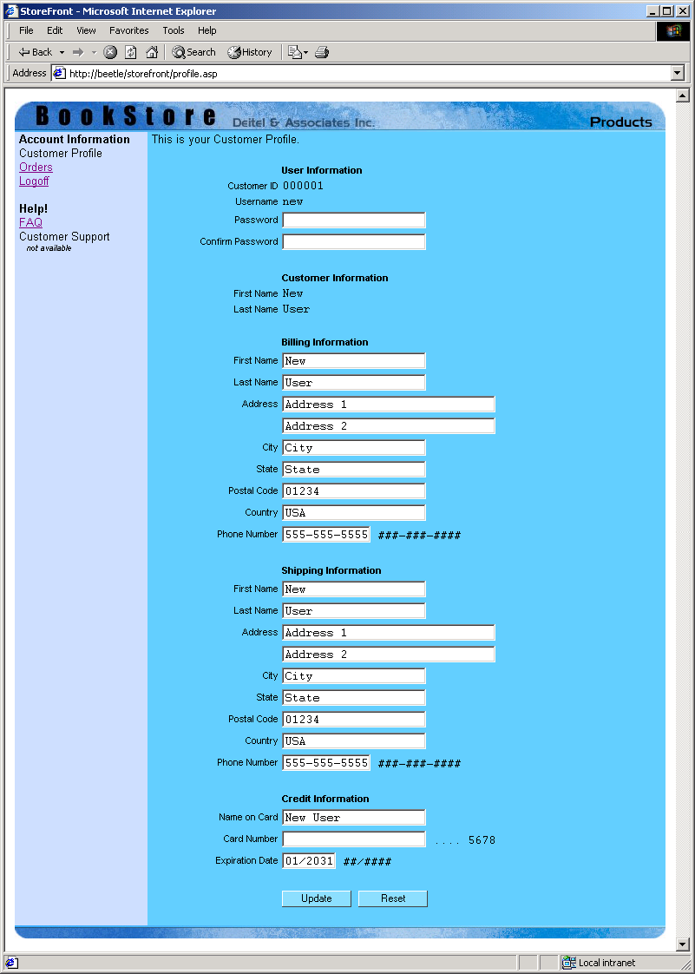
Output from profile.asp

Slide 102
1219 <% @Language = "VBScript" %>
1220 <% Option Explicit %>
1221 <% Response.Expires = 0 %>
1222 <%
10. order.asp
10.1 Links to JavaScript files
10.2 Order history table header
1223 ' Figure 28.26: orders.asp
1224
1225 Dim errorMessage
1226
1227 If Session( "storeFrontLoggedIn" ) = Empty Then
1228 Session( "error" ) = "You are not logged in."
1229 Call Response.Redirect( "account.asp" )
1230 End If
1231 %>
1232
1233 <!DOCTYPE HTML PUBLIC "-//W3C//DTD HTML 4.0 Transitional//EN">
1234 <HTML>
1235
1236 <HEAD>
1237 <TITLE>StoreFront</TITLE>
1238 <LINK REL = "stylesheet" TYPE = "text/css" HREF = "style.css">
1239 <SCRIPT LANGUAGE = "JavaScript" SRC = "tableHighlight.js">
1240 </SCRIPT>
1241 <SCRIPT LANGUAGE = "JavaScript" SRC = "rowSelection.js">
1242 </SCRIPT>
1243 </HEAD>
1244
1245 <BODY ONLOAD = "refreshShoppingTable();">
1246 <CENTER>
1247 <TABLE WIDTH = "750" ALIGN = "center" CELLPADDING = "0"
1248 CELLSPACING = "0" BORDER = "0" BGCOLOR = "#67CDFF"
1249 ID = "productList" STYLE = "position: relative;
1250 display: block; top: 0; left: 0;">

Slide 103
1251 <TR>
1252 <TD COLSPAN = "2" WIDTH = "750" HEIGHT = "35"><IMG
1253 SRC = "images/header.jpg" WIDTH = "650"
1254 HEIGHT = "35"><A HREF = "index.html"><IMG
10.2 Order history table header
10.3 Check to see if customer is logged in
1255 SRC = "images/head_products.jpg"
1256 WIDTH = "100" HEIGHT = "35" BORDER = "0"></A></TD>
1257 </TR>
1258 <TR>
1259 <TD WIDTH = "150" VALIGN = "top" CLASS = "margin"
1260 BGCOLOR = "#CCDDFF">
1261 <STRONG>Account Information</STRONG><BR>
1262 <%
1263 If Session( "StoreFrontLoggedIn" ) = Empty Then
1264 %>
1265 <A HREF = "login.asp">Login</A><BR>
1266 <%
1267 Else
1268 %>
1269 <A HREF = "profile.asp">Customer Profile</A><BR>
1270 Orders<BR>
1271 <A HREF = "logoff.asp">Logoff</A><BR>
1272 <%
1273 End If
1274 %>
1275 <BR>
1276 <STRONG>Help!</STRONG><BR>
1277 <A HREF = "faq.asp">FAQ</A><BR>
1278 Customer Support
1279 <DIV CLASS = "note">&nbsp;&nbsp;&nbsp;not available</DIV>
1280 </TD>

Slide 104
1281 <TD WIDTH = "600" VALIGN = "top" CLASS = "margin">
1282 <P>This is your Order History.</P>
1283 <P ID = "errorMessage" CLASS = "error">
1284 <% =errorMessage %>
10.4 Database connection
1285 </P>
1286 <TABLE CELLPADDING = "0" CELLSPACING = "0"
1287 ID = "shoppingCart" WIDTH = "90%">
1288 <TR>
1289 <TD CLASS = "label" ALIGN = "right">
1290 Order ID</TD>
1291 <TD WIDTH = "10"></TD>
1292 <TD CLASS = "label">Date</TD>
1293 <TD CLASS = "label" ALIGN = "right">
1294 Price</TD>
1295 </TR>
1296 <%
1297 Dim objConnection, objRecord, strQuery
1298
1299 ' Select all orders for this customer
1300 Set objConnection = server.CreateObject( "ADODB.Connection" )
1301 Set objRecord = server.CreateObject( "ADODB.RecordSet" )
1302 Call objConnection.Open( "DSN=dbStorefront" )
1303 strQuery = "SELECT * FROM Orders WHERE customerid = " & _
1304 Session( "StoreFrontLoggedIn" )
1305
1306 Call objRecord.Open( strQuery, objConnection, 1, 2 )
1307
1308 Dim foID, foCost, foLoc
1309

Slide 105
1310 While Not objRecord.EOF
1311 ' Loop over the records
1312 foID = Right( "000000" & objRecord( "orderid" ), 6 )
1313 foCost = FormatNumber( objRecord( "total_cost" ), 2 )
1314 foLoc = "info.asp?id=" & _
10.5 Loop through records and generate table body
10.6 Order history table footer
1315 Right( "000000" & objRecord( "orderid" ), 6 )
1316 %>
1317 <TR CLASS = "handable" ONMOUSEOVER = "rowSelect();"
1318 ONMOUSEOUT = "rowUnSelect();"
1319 ONCLICK = "window.location = '<% =foLoc %>';">
1320 <TD ALIGN = "right"><% =foID %></TD>
1321 <TD WIDTH = "10"></TD>
1322 <TD><% =objRecord( "orderdate" ) %></TD>
1323 <TD ALIGN = "right">$<% =foCost %></TD>
1324 </TR>
1325 <%
1326 Call objRecord.MoveNext()
1327 Wend
1328
1329 Call objRecord.Close()
1330 %>
1331 </TABLE>
1332 </TD>
1333 </TR>
1334 <TR>
1335 <TD COLSPAN = "2" WIDTH = "750" HEIGHT = "15"><IMG
1336 SRC = "images/footer.jpg" WIDTH = "750"
1337 HEIGHT = "15"></TD>
1338 </TR>
1339 </TABLE>
1340 </CENTER>
1341 </BODY>
1342 </HTML>

Slide 106
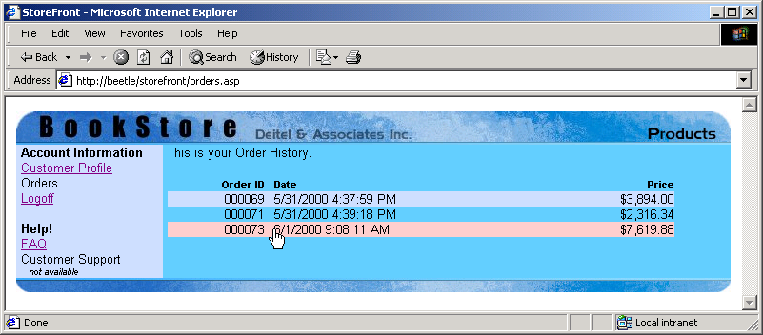
Output from orders.asp

Slide 107
1343 <% @Language = "VBScript" %>
1344 <% Option Explicit %>
1345 <% Response.Expires = 0 %>
1346 <%
11. info.asp
11.1 Check to see if logged in
11.2 Match customer’s order
1347 ' Figure 28.27: info.asp
1348
1349 Dim objConnection, objRecord, strQuery
1350 Dim storeFrontOrderID, storeFrontOrderDate
1351
1352 ' Check if logged in.
1353 If Session( "StoreFrontLoggedIn" ) = Empty Then
1354 Session( "Error" ) = "You are not logged in."
1355 Call Response.Redirect( "account.asp" )
1356 End If
1357
1358 ' Check for ID request.
1359 If Request( "id" ) <> Empty Then
1360 StoreFrontOrderID = Request( "id" )
1361
1362 ' Get the Order ID. Match with Customer ID also.
1363 Set objConnection = Server.CreateObject("ADODB.Connection")
1364 Set objRecord = Server.CreateObject( "ADODB.RecordSet" )
1365 Call objConnection.Open( "DSN=dbStorefront" )
1366 strQuery = "SELECT * FROM Orders WHERE orderid = " & _
1367 StoreFrontOrderID & " AND customerid = " & _
1368 Session( "StoreFrontLoggedIn" )
1369 Call objRecord.Open( strQuery, objConnection, 1, 2 )
1370
1371 If objRecord.RecordCount > 0 Then
1372 ' Record Found. Get all the data.
1373

Slide 108
1374 StoreFrontOrderDate = objRecord( "orderdate" )
1375 numTotal = objRecord( "total_cost" )
1376
1377 Set xmlData = _
11.2 Match customer’s order
1378 Server.CreateObject( "Microsoft.XMLDOM" )
1379
1380 xmlData.Async = False
1381 Call xmlData.LoadXML( objRecord( "product_xml" ) )
1382 Else
1383 ' No Records found. Invalid ID and/or Customer.
1384
1385 Session( "Error" ) = "Invalid Request"
1386 Call Response.Redirect( "account.asp" )
1387 End If
1388 Else
1389 Session( "Error" ) = "Invalid Request"
1390 Call Response.Redirect( "account.asp" )
1391 End If
1392 %>
1393
1394 <!DOCTYPE HTML PUBLIC "-//W3C//DTD HTML 4.0 Transitional//EN">
1395 <HTML>
1396
1397 <HEAD>
1398 <TITLE>StoreFront</TITLE>
1399 <LINK REL = "stylesheet" TYPE = "text/css" HREF = "style.css">
1400 <SCRIPT LANGUAGE = "JavaScript" SRC = "tableHighlight.js">
1401 </SCRIPT>
1402 </HEAD>
1403

Slide 109
1404 <BODY ONLOAD = "refreshShoppingTable();">
1405 <TABLE WIDTH = "750" ALIGN = "center" CELLPADDING = "0"
1406 CELLSPACING = "0" BORDER = "0" BGCOLOR = "#67CDFF">
1407 <TR>
11.3 Order table header
1408 <TD COLSPAN = "2" WIDTH = "750" HEIGHT = "35"><IMG
1409 SRC = "images/header.jpg" WIDTH = "650"
1410 HEIGHT = "35"><A HREF = "orders.asp"><IMG
1411 SRC = "images/head_account.jpg"
1412 WIDTH = "100" HEIGHT = "35" BORDER = "0"></A></TD>
1413 </TR>
1414 <TR>
1415 <TD WIDTH = "750" VALIGN = "top" ALIGN = "center">
1416 <TABLE WIDTH = "670" CELLPADDING = "2"
1417 CELLSPACING = "0" BORDER = "0">
1418 <TR>
1419 <TD WIDTH = "25%" ALIGN = "right"
1420 CLASS = "label">Order ID:</TD>
1421 <TD WIDTH = "75%" CLASS = "typing">
1422 <% =StoreFrontOrderID %></TD>
1423 </TR>
1424 <TR>
1425 <TD WIDTH = "25%" ALIGN = "right"
1426 CLASS = "label">Order Date:</TD>
1427 <TD WIDTH = "75%" CLASS = "typing">
1428 <% =StoreFrontOrderDate %></TD>
1429 </TR>
1430 </TABLE>
1431 <BR>
1432 <TABLE WIDTH = "670" CELLPADDING = "0"
1433 CELLSPACING = "0" BORDER = "0"
1434 ID = "shoppingCart">

Slide 110
1435 <THEAD>
1436 <TD WIDTH = "90" CLASS = "label">
1437 ISBN
1438 </TD>
11.4 Connect to database
1439 <TD WIDTH = "90" CLASS = "label">
1440 Author
1441 </TD>
1442 <TD WIDTH = "280" CLASS = "label">
1443 Title
1444 </TD>
1445 <TD WIDTH = "70" ALIGN = "right" CLASS = "label">
1446 Price
1447 </TD>
1448 <TD WIDTH = "10"></TD>
1449 <TD WIDTH = "50" ALIGN = "center" CLASS = "label">
1450 Quantity
1451 </TD>
1452 <TD WIDTH = "80" ALIGN = "right" CLASS = "label">
1453 Total
1454 </TD>
1455 </THEAD>
1456 <%
1457 Dim numTotal, xmlData, xmlDataRoot, count, product
1458 Dim prodTotal, prodPrice
1459 Dim prodISBN, prodAuthor, prodTitle, prodQuantity
1460
1461 Set objConnection = Server.CreateObject( "ADODB.Connection" )
1462 Set objRecord = Server.CreateObject( "ADODB.RecordSet" )
1463 Call objConnection.Open( "DSN=dbStorefront" )
1464

Slide 111
1465 ' The root element. <cart>
1466 Set xmlDataRoot = xmlData.DocumentElement
1467
1468 ' Format the total amount due
11.5 Retrieve order information
1469 numTotal = FormatNumber( numTotal, 2 )
1470
1471 ' For each item in the cart. <item>
1472 For count = 0 To ( xmlDataRoot.ChildNodes.Length - 1 )
1473
1474 ' Retreive the DOMNode
1475 Set product = xmlDataRoot.ChildNodes.Item( count )
1476
1477 ' The ISBN
1478 prodISBN = product.GetAttribute( "isbn" )
1479
1480 ' Search the database for the ISBN.
1481 strQuery = "SELECT * FROM Products WHERE isbn = '" & _
1482 prodISBN & "'"
1483 Call objRecord.Open( strQuery, objConnection, 1, 2 )
1484
1485 ' Fill in the author name
1486 prodAuthor = objRecord( "author" )
1487
1488 ' Fill in the title
1489 prodTitle = objRecord( "title" )
1490
1491 ' Fill in the product price
1492 prodPrice = objRecord( "price" )
1493 prodPrice = FormatNumber( prodPrice, 2 )
1494

Slide 112
1495 ' Fill in the quantity
1496 prodQuantity = product.GetAttribute( "qty" )
1497
1498 ' Calculate the subtotal
11.6 Generate body of order table
1499 prodTotal = prodPrice * prodQuantity
1500 prodTotal = FormatNumber( prodTotal, 2 )
1501 %>
1502 <TR>
1503 <TD WIDTH = "90" VALIGN = "top">
1504 <% =prodISBN %></TD>
1505 <TD WIDTH = "90" VALIGN = "top">
1506 <% =prodAuthor %></TD>
1507 <TD WIDTH = "280" VALIGN = "top">
1508 <% =prodTitle %></TD>
1509 <TD WIDTH = "70" ALIGN = "right"
1510 VALIGN = "top">
1511 $<% =prodPrice %></TD>
1512 <TD WIDTH = "10"></TD>
1513 <TD WIDTH = "50" ALIGN = "center"
1514 VALIGN = "top">
1515 <% =prodQuantity %></TD>
1516 <TD WIDTH = "80" ALIGN = "right"
1517 VALIGN = "top">
1518 $<% =prodTotal %></TD>
1519 </TR>
1520 <%
1521 Call objRecord.Close()
1522 Next
1523
1524 ' Table Footer.
1525 %>

Slide 113
1526 <TFOOT>
1527 <TD WIDTH = "90"></TD>
1528 <TD WIDTH = "90"></TD>
1529 <TD WIDTH = "280"></TD>
11.7 Order table footer
1530 <TD WIDTH = "70"></TD>
1531 <TD WIDTH = "10"></TD>
1532 <TD WIDTH = "50" ALIGN = "right"
1533 CLASS = "label">
1534 Total:
1535 </TD>
1536 <TD WIDTH = "80" ALIGN = "right">
1537 $<% =numTotal %>
1538 </TD>
1539 </TFOOT>
1540 </TABLE>
1541 </TD>
1542 </TR>
1543 <TR>
1544 <TD COLSPAN = "2" WIDTH = "750" HEIGHT = "15"><IMG
1545 SRC = "images/footer.jpg" WIDTH = "750"
1546 HEIGHT = "15"></TD>
1547 </TR>
1548 </TABLE>
1549 </BODY>
1550
1551 </HTML>

Slide 114
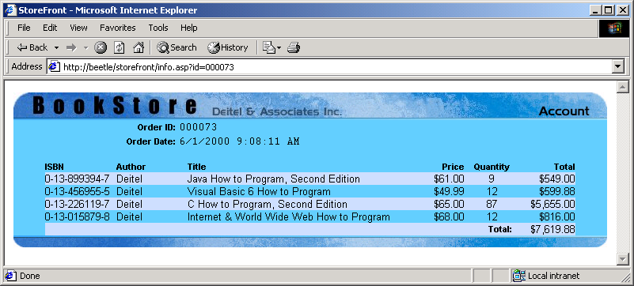
Output from info.asp

Slide 115
1552 <% @Language = "VBScript" %>
1553 <% Option Explicit %>
1554 <% Response.Expires = 0 %>
1555 <% ' Figure 28.28: faq.asp %>
12. faq.asp
12.1 FAQ table header
1556
1557 <!DOCTYPE HTML PUBLIC "-//W3C//DTD HTML 4.0 Transitional//EN">
1558 <HTML>
1559
1560 <HEAD>
1561 <TITLE>StoreFront</TITLE>
1562 <LINK REL = "stylesheet" TYPE = "text/css" HREF = "style.css">
1563 </HEAD>
1564
1565 <BODY>
1566 <CENTER>
1567 <TABLE WIDTH = "750" ALIGN = "center" CELLPADDING = "0"
1568 CELLSPACING = "0" BORDER = "0" BGCOLOR = "#67CDFF"
1569 ID = "productList" STYLE = "position: relative;
1570 display: block; top: 0; left: 0;">
1571 <TR>
1572 <TD COLSPAN = "2" WIDTH = "750" HEIGHT = "35"><IMG
1573 SRC = "images/header.jpg" WIDTH = "650"
1574 HEIGHT = "35"><A HREF = "index.html"><IMG
1575 SRC = "images/head_products.jpg"
1576 WIDTH = "100" HEIGHT = "35" BORDER = "0"></A></TD>
1577 </TR>
1578 <TR>
1579 <TD WIDTH = "150" VALIGN = "top" CLASS = "margin"
1580 BGCOLOR = "#CCDDFF">
1581 <STRONG>Account Information</STRONG><BR>

Slide 116
1582 <%
1583 If Session( "StoreFrontLoggedIn" ) = Empty Then
1584 %>
1585 <A HREF = "login.asp">Login</A><BR>
12.2 FAQ table body
1586 <%
1587 Else
1588 %>
1589 <A HREF = "profile.asp">Customer Profile</A><BR>
1590 <A HREF = "orders.asp">Orders</A><BR>
1591 <A HREF = "logoff.asp">Logoff</A><BR>
1592 <%
1593 End If
1594 %>
1595 <BR>
1596 <STRONG>Help!</STRONG><BR>
1597 FAQ<BR>
1598 Customer Support
1599 <DIV CLASS = "note">&nbsp;&nbsp;&nbsp;not available</DIV>
1600 </TD>
1601 <TD WIDTH = "600" VALIGN = "top" CLASS = "margin">
1602 <P>Here are the more Frequently Asked Questions</P>
1603 <UL>
1604 <LI><STRONG>Where are you located?</STRONG><BR>
1605 <SPAN CLASS = "typing">490B Boston Post Road,
1606 Suite 200<BR>Sudbury, MA 01776</SPAN></LI>
1607 </UL>
1608 </TD>
1609 </TR>

Slide 117
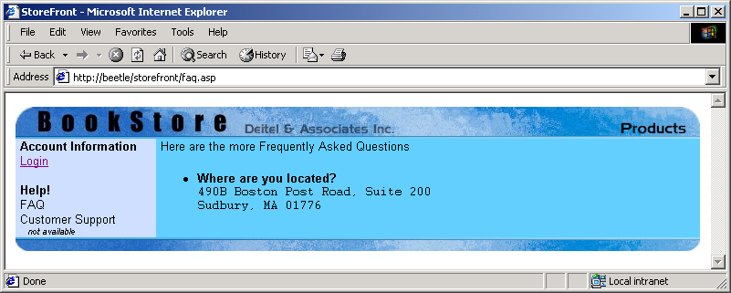
1610 <TR>
1611 <TD COLSPAN = "2" WIDTH = "750" HEIGHT = "15"><IMG
1612 SRC = "images/footer.jpg" WIDTH = "750"
1613 HEIGHT = "15"></TD>
12.3 FAQ table footer
1614 </TR>
1615 </TABLE>
1616 </CENTER>
1617 </BODY>
1618
1619 </HTML>

Slide 118
28.6 Business-to-Business (B2B) Models
B2B transactions
  Involve transfer of data
    Examples – purchase orders, invoices, payments, document specifications and other documents
    Internet provides means for instantaneous delivery
  Supplier-oriented B2B model
    Suppliers provide means for buyers to purchase directly
  Buyer-oriented B2B model
    Buyers making available their product needs
  Intermediary-oriented B2B model
    A business which manages product information from multiple suppliers and provides buyers with this data

Slide 119
28.7 B2B Example
Documents in the B2B exmaple
  request.asp
    Creates a purchase request form for our book store
  warehouse.asp
    Acquires data sent by request.asp

Slide 120
1 <% @Language = "VBScript" %>
2 <% Option Explicit %>
3 <% Response.Expires = 0 %>
4
1. request.asp
1.1 Function submitRequest
5 <% ' Figure 28.29: request.asp %>
6
7 <!DOCTYPE HTML PUBLIC "-//W3C//DTD HTML 4.0 Transitional//EN">
8 <HTML>
9
10 <HEAD>
11 <TITLE>StoreFront : Purchase Request</TITLE>
12 <LINK REL = "stylesheet" TYPE = "text/css" HREF = "style.css">
Function submitRequest creates the XML purchase request document and submits the data using the XMLHttpRequest object. It is called when the Submit button is clicked (line 112).
13 <SCRIPT LANGUAGE = "JavaScript" SRC = "tableHighlight.js">
14 </SCRIPT>
15 <SCRIPT LANGUAGE = "JavaScript">
16
17 function submitRequest()
18 {
19 var strID, numQuantity;
20 var xmlDocument, xmlNode, xmlRoot, xmlHttp;
21
Method createElement creates the root element, req.
22 xmlDocument = new ActiveXObject( "Microsoft.XMLDOM" );
23 xmlDocument.async = false;
24
25 xmlNode = xmlDocument.createElement( "req" );
26 xmlDocument.appendChild( xmlNode );
27 xmlRoot = xmlDocument.documentElement;
28

Slide 121
29 for ( i = 0; i < request.length; i++ ) {
30 strID = request.item( i ).id;
31 numQuantity = parseInt( request.item( i ).value );
32
33 if ( strID.substr(0, 4) == "isbn" && numQuantity > 0 ) {
1.1 Function submitRequest
34 xmlNode = xmlDocument.createElement( "book" );
35 xmlNode.setAttribute( "isbn", strID.substr( 4 ) );
36 xmlNode.setAttribute( "qty", numQuantity );
37
38 xmlRoot.appendChild( xmlNode );
Line 38 appends the book element to the req root element using method appendChild.
39 }
40 }
41
42 if ( xmlRoot.childNodes.length > 0 ) {
43 if ( confirm( "Send Purchase Request?" ) )
If the XML document contained books, we submit the document to warehouse.asp using the XMLHttpRequest object.
44 {
45 xmlHttp = new ActiveXObject( "Microsoft.XMLHTTP" );
46 xmlHttp.open( "POST",
47 "http://beetle/storefront/warehouse.asp",
48 false );
49 xmlHttp.send( xmlDocument );
50
51 document.body.innerHTML = xmlHttp.responseText;
52 }
53 }
54 else {
55 alert( "No purchase request made." );
56 }
57 }
58
59 </SCRIPT>
60 </HEAD>
61

Slide 122
62 <BODY ONLOAD = "highlightTable()">
63 <CENTER>
64 <TABLE WIDTH = "750" ALIGN = "center" CELLPADDING = "0"
65 CELLSPACING = "0" BORDER = "0" BGCOLOR = "#67CDFF">
1.2 Bookstore table header
1.3 Database connection
66 <TR>
67 <TD WIDTH = "750" HEIGHT = "35"><IMG
68 SRC = "images/header2.jpg" WIDTH = "750"
69 HEIGHT = "35"></TD>
70 </TR>
71 <TR>
72 <TD VALIGN = "top">
73 <FORM ID = "request">
74 <TABLE ALIGN = "center" ID = "productListing"
75 CELLSPACING = "0" CELLPADDING = "2" BORDER = "0">
76 <TR>
77 <TD ALIGN = "right" CLASS = "label">
78 ISBN</TD>
79 <TD CLASS = "label">Author</TD>
80 <TD CLASS = "label">Title</TD>
81 <TD ALIGN = "right" CLASS = "label">
82 Available</TD>
83 <TD CLASS = "label">To Order</TD>
84 </TR>
85 <%
86 Dim objConnection, objRecord, strQuery
87
88 Set objConnection = Server.CreateObject( "ADODB.Connection" )
89 Set objRecord = Server.CreateObject( "ADODB.RecordSet" )
90 Call objConnection.Open( "DSN=dbStorefront" )
91 strQuery = "SELECT * FROM Products"
92

Slide 123
93 Call objRecord.Open( strQuery, objConnection )
94
95 While Not objRecord.EOF
96 %>
1.4 Generate bookstore table body
97 <TR STYLE = "background: none">
98 <TD ALIGN = "right"><% =objRecord( "isbn" ) %></TD>
99 <TD><% =objRecord( "author" ) %></TD>
100 <TD><% =objRecord( "title" ) %></TD>
101 <TD ALIGN = "right"><% =objRecord( "qty" ) %></TD>
102 <TD><INPUT TYPE = "input"
103 SIZE = "3" ID = "isbn<% =objRecord( "isbn" ) %>"
104 VALUE = "0"></TD>
105 </TR>
106 <%
107 Call objRecord.MoveNext()
108 Wend
109 %>
110 </TABLE>
111 <CENTER>
112 <INPUT TYPE = "button" CLASS = "button2" VALUE = "Submit"
113 ONCLICK = "submitRequest()">
114 <INPUT TYPE = "reset" CLASS = "button2" VALUE = "Reset">
115 </CENTER>
116 </FORM>
117 </TD>
118 </TR>

Slide 124
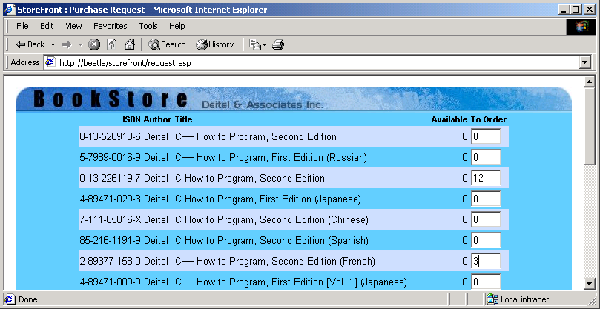
119 <TR>
120 <TD WIDTH = "750" HEIGHT = "15"><IMG
121 SRC = "images/footer.jpg" WIDTH = "750"
122 HEIGHT = "15"></TD>
1.5 Bookstore table footer
123 </TR>
124 </TABLE>
125 </CENTER>
126 </BODY>
127 </HTML>

Slide 125
1 <% @Language = "VBScript" %>
2 <% Option Explicit %>
3 <% Response.Expires = 0 %>
4 <%
1. warehouse.asp
5 ' Figure 28.30: warehouse.asp
6
7 Dim xmlDocument, strXML
8
9 Set xmlDocument = Server.CreateObject( "Microsoft.XMLDOM" )
10 xmlDocument.Async = False
11 Call xmlDocument.Load( Request )
12
13 strXML = xmlDocument.Xml
14 strXML = Replace( strXML, "<b", " <b" )
15 strXML = Replace( strXML, "<", "&lt;" )
16 strXML = Replace( strXML, ">", "&gt;" & vbCRLF )
17 strXML = Replace( strXML, "=", " = " )
18 %>
19 <!DOCTYPE HTML PUBLIC "-//W3C//DTD HTML 4.0 Transitional//EN">
20 <HTML>
21 <BODY>
22
23 <H1>Warehouse: Purchase Request Received</H1>
24 Your request:
25 <PRE>
26 <% =strXML %>
27 </PRE>
28 </BODY>
29 </HTML>

Slide 126
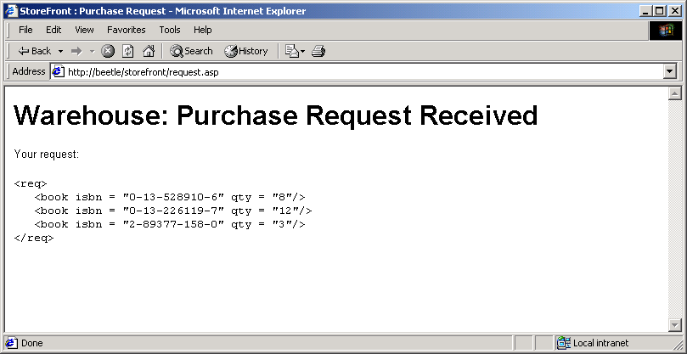
Output from warehouse.asp

