Slide 1
Chapter 29 – Perl 5 and CGI
(Common Gateway Interface)
Outline
29.1 Introduction
29.2 Perl
29.3 String Processing and Regular Expressions
29.4 Viewing Client/Server Environment Variables
29.5 Form Processing and Business Logic
29.6 Server-Side Includes
29.7 Verifying a Username and Password
29.8 Using ODBC to Connect to a Database
29.9 Cookies and Perl
29.10 Example: An Internet Shopping Cart

Slide 2
29.1 Introduction
Practical Extraction and Report Language (Perl)
  Widely used programming language
  Most commonly used for CGI scripting
Common Gateway Interface (CGI)
  Standard protocol enabling application interaction with Web servers
    Clients interface with applications on server
  Not programmed in directly
    Script or executable must be executed to interact with it
CGI scripts
  Often utilize and process data gathered from a form
  .cgi or .pl file extensions
  Located in special directory /cgi-bin

Slide 3
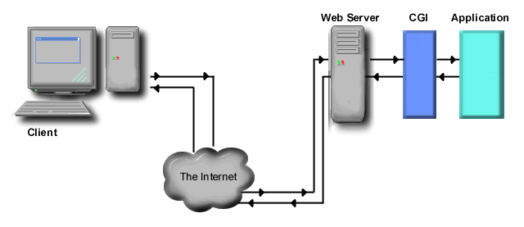
29.1 Introduction
Client / Server interaction
  Application output sent to server through CGI
  Results sent back to client as HTML
  Interact through standard input and standard output
    For CGI scripts standard output is redirected (piped) through the CGI to the server and then sent to a Web browser for rendering

Slide 4
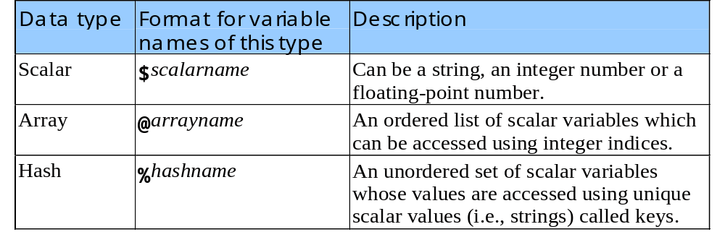
29.2 Perl
Perl syntax
  Comment character (#)
  “Shebang” construct (#!) – indicates path to Perl interpreter on Unix systems
  Function print
  Perl is case sensative
Perl data types

Slide 5
1#!perl
2# Fig. 29.2: first.pl
3# A first program in Perl.
4
1. first.pl
1.1 Comments
1.2 print statement
Program Output
5print "Welcome to Perl!\n";
Welcome to Perl!

Slide 6
29.2 Perl
Perl variables
  Created the first time they are encountered
  When variable encountered inside a double quoted string it is replaced by its value
  Assignment operators
    =, +=, -=, *=, /=
  Unitialized variables have the value undef
  Strings when used in numeric context evaluate to undef
    Unless they begin with a number

Slide 7
1#!perl
2# Fig. 29.4: variable.pl
3# Program to illustrate the use of scalar variables.
4
1. variable.pl
1.1 scalars
1.2 strings
5$a = 5;
6print "The value of variable a is: $a\n";
7
8$a = $a + 5;
9print "Variable a after adding 5 is: $a\n";
10
11$a *= 2;
12print "Variable a after multiplying by 2 is: $a\n";
13
14# using an uninitialized variable in the context of a string
15print "Using a variable before initializing: $var\n";
16
17# using an uninitialized variable in a numeric context
18$test = $num + 5;
19print "Adding uninitialized variable \$num to 5 yields: $test.\n";
20
21# using strings in numeric contexts
22$str = "A string value";
23$a = $a + $str;
24print "Adding a string to an integer yields: $a\n";
25
26$strnum = "15charactersand1";
27$c = $a + $strnum;
28print "Adding $a to string \"$strnum\" yields: $c\n";

Slide 8
The value of variable a is: 5
Variable a after adding 5 is: 10
Variable a after multiplying by 2 is: 20
Using a variable before initializing:
Adding uninitialized variable $num to 5 yields: 5.
Adding a string to an integer yields: 20
Adding 20 to string "15charactersand1" yields: 35
Program Output

Slide 9
29.2 Perl
Arrays
  Braces([])
    Used to access individual array elements
  @ character
    Used to reference the array as a whole
  Range operator (..)
    Specifies that all values between its parameters should be placed in an array
        @MyArray = ( A..Z );
  Memory management handled automatically

Slide 10
1#!perl
2# Fig. 29.5: arrays.pl
3# Program to demonstrate arrays in Perl
4
1. array.pl
1.1 Array assignment
1.2 Element reference
1.3 Range operator
5@array = ( "Bill", "Bobby", "Sue", "Michelle" );
6
7print "The array contains: @array\n";
8print "Printing array outside of quotes: ", @array, "\n\n";
9
10print "Third element: $array[ 2 ]\n";
11
12$number = 3;
13print "Fourth element: $array[ $number ]\n\n";
14
15@array2 = ( A..Z );
16print "The range operator is used to create a list of\n";
17print "all letters from capital A to Z:\n";
18print "@array2 \n\n";
19
20$array3[ 3 ] = "4th";
21print "@array3 \n\n";
22
23print 'Printing literal using single quotes: @array and \n', "\n";
24print "Printing literal using backslashes: \@array and \\n\n";

Slide 11
The array contains: Bill Bobby Sue Michelle
Printing array outside of quotes: BillBobbySueMichelle
Third element: Sue
Fourth element: Michelle
The range operator is used to create a list of
all letters from capital A to Z:
A B C D E F G H I J K L M N O P Q R S T U V W X Y Z
4th
Printing literal using single quotes: @array and \n
Printing literal using backslashes: @array and \n
Program Output

Slide 12
29.3 String Processing and Regular Expressions
Processing textual data easily and efficiently
  One of Perl’s most powerful capabilities
  Usually done through use of regular expressions
    Patterns of characters used to search through text files and databases
    Allows large amounts of text to be searched using relatively simple expressions
Comparison operators
  For strings – equal (eq), not equal (ne), less than (lt), greater than (ge)
  For numbers – equal (==), not equal (!=), less than (<), greater than (>), <=, >=

Slide 13
29.3 String Processing and Regular Expressions
foreach statement
  Control structure
  Iterates sequentially through an array
if statement
  Parenthesis surround condition being tested
  Required curly braces surround block of code to be executed
  Anything except the number 0 and the empty string is true

Slide 14
1#!perl
2# Fig. 29.6: equals.pl
3# Program to demonstrate the eq, ne, lt, gt operators
4
1. equals.pl
1.1 foreach statement
1.2 if statement
1.3 String equalities
5@fruits = qw( apple orange banana );
6
7foreach $item ( @fruits )
8{
9 if ( $item eq "banana" )
10 {
11 print "String '$item' matches string 'banana'\n";
12 }
13
14 if ( $item ne "banana" )
15 {
16 print "String '$item' does not match string 'banana'\n";
17 }
18
19 if ( $item lt "banana" )
20 {
21 print "String '$item' is less than string 'banana'\n";
22 }
23
24 if ( $item gt "banana" )
25 {
26 print "String '$item' is greater than string 'banana'\n";
27 }
28}

Slide 15
String ’apple’ does not match string ’banana’
String ’apple’ is less than string ’banana’
String ’orange’ does not match string ’banana’
String ’orange’ is greater than string ’banana’
String ’banana’ matches string ’banana’
Program Output

Slide 16
29.3 String Processing and Regular Expressions
Match operator (m//)
  Uses regular expressions to search a string for a specified pattern
  Takes two operands
    Regular expression pattern to search for
      Placed between the two / operators
    String to search in
      Assigned to the match operator use =~
  Example
        $search =~ /Now/
    Match the pattern Now inside variable $search

Slide 17
29.3 String Processing and Regular Expressions
  \ represent escape characters
    If using escape characters place the string you are trying to match in parenthesis
    Example:
        $search =~ /\b ( \w+ ow ) \b/x
Modifying characters
  Placed to the right of the forward slash that delimits the regular expression
  Instruct the interpreter to modify its search

Slide 18
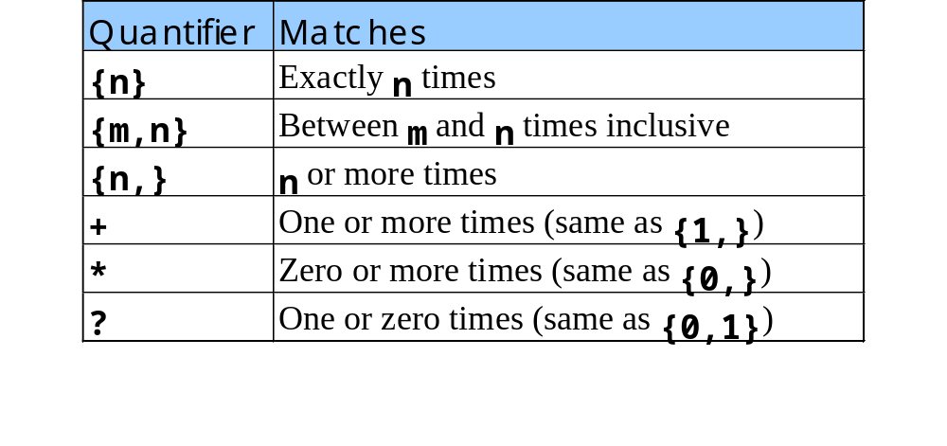
29.3 String Processing and Regular Expressions
Some of Perl’s quantifiers

Slide 19
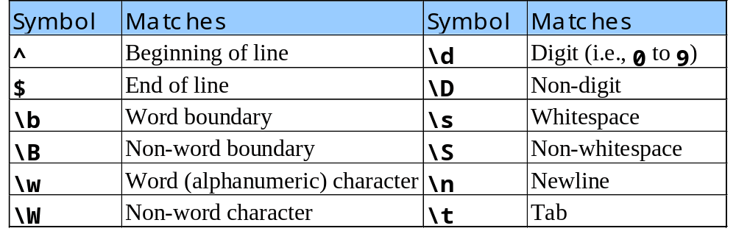
29.3 String Processing and Regular Expressions
Some of Perl’s metacharacters

Slide 20
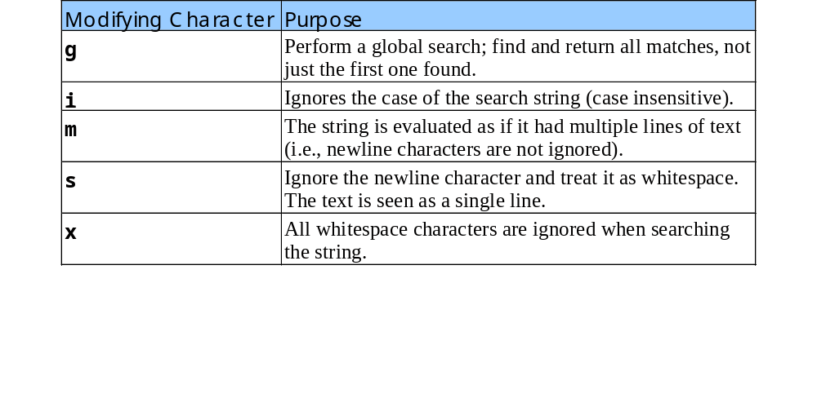
29.3 String Processing and Regular Expressions
Some of Perl’s modifying characters

Slide 21
1#!perl
2# Fig 29.7: expression.pl
3# searches using the matching operator and regular expressions
4
1. expressions.pl
1.1 Regular expression searches
5$search = "Now is is the time";
6print "Test string is: '$search'\n\n";
7
8if ( $search =~ /Now/ )
9{
10 print "String 'Now' was found.\n";
11}
12
13if ( $search =~ /^Now/ )
14{
15 print "String 'Now' was found at the beginning of the line.\n";
16}
17
18if ( $search =~ /Now$/ )
19{
20 print "String 'Now' was found at the end of the line.\n";
21}
22
23if ( $search =~ /\b ( \w+ ow ) \b/x )
24{
25 print "Word found ending in 'ow': $1 \n";
26}
27
28if ( $search =~ /\b ( \w+ ) \s ( \1 ) \b/x )
29{
30 print "Repeated words found: $1 $2\n";
31}
32

Slide 22
33@matches = ( $search =~ / \b ( t \w+ ) \b /gx );
34print "Words beginning with 't' found: @matches\n";
String ’Now’ was found.
String ’Now’ was found at the beginning of the line.
Word found ending in ’ow’: Now
Repeated words found: is is
Words beginning with ’t’ found: the time
Program Output

Slide 23
29.4 Viewing Client/Server Environment Variables
Knowing info about client very useful to system administrators
CGI environment variables
  Contains info about client
    Web browser being used
    Version of CGI server running
    HTTP host, HTTP connection
    Much more
Use statement
  Allows inclusion of predefined library packages called modules

Slide 24
29.4 Viewing Client/Server Environment Variables
CGI module
  Included to provide functionality that makes it easier to write HTML sent to Web browser
  Contains keywords that represent HTML tags
foreach loop
  Iterates through keys in given hashtable, performs indicated actions
  foreach $key (sort keys %ENV)
  Iterates through %ENV hashtable
    Built-in table in Perl that contains names and values of all CGI environment variables
  sort function
    returns list in alphabetical order
  Assigns current key to $key and performs indicated actions

Slide 25
1#!perl
2# Fig. 29.11: environment.pl
3# Program to display CGI environment variables
4
5use CGI qw( :standard );
1. environment.pl
1.1 Print the HTML header
1.2 Print an HTML table
6
7print header;
8print <<End_Begin;
9<HTML>
10 <HEAD>
11 <TITLE>Environment Variables...</TITLE>
12 </HEAD>
13 <BODY TEXT = "BLACK" BGCOLOR = "WHITE">
14 <TABLE BORDER = "0" CELLPADDING = "2" CELLSPACING = "0"
15 WIDTH = 100%>
16End_Begin
17
18foreach $variable ( sort( keys( %ENV ) ) )
19{
20 print <<End_Row;
21 <TR>
22 <TD BGCOLOR = "#11BBFF"><STRONG>$variable</STRONG></TD>
23 <TD><FONT COLOR = "BLACK" SIZE = "2">$ENV{$variable}
24 </FONT></TD>
25 </TR>
26End_Row
27}
28
29print <<End_Finish;
30 </TABLE>
31 </BODY>
32</HTML>
33End_Finish
34# Must include newline after End_Finish!

Slide 26
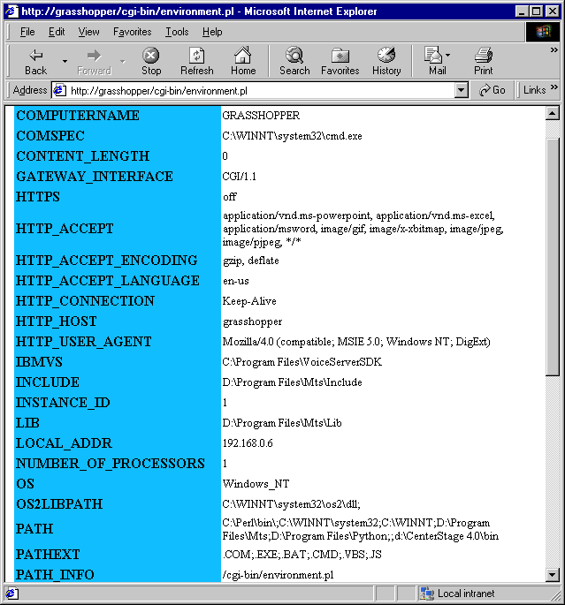
Ouput from environment.pl

Slide 27
29.5 Form Processing and Business Logic
HTML FORMs
  1. Allow users to enter data
  2. Data sent to Web server for processing
  3. Program processes data
  Allows users to interact with server
  Vital to electronic commerce
FORM element
  Indicates what action should occur when user submits form
  Attribute: ACTION = “cgi-bin/form.pl”
    Directs server to execute form.pl Perl script

Slide 28
1<!DOCTYPE html PUBLIC "-//W3C//DTD HTML 4.0 Transitional//EN">
2<!-- Fig. 29.12: form.html -->
3
4<HTML>
5<HEAD>
1.1 Open FORM
1.2 Define FORM attributes
1.3 Insert and define form INPUT elements
1.4 Specify correct input format
6<TITLE>Sample FORM to take user input in HTML</TITLE>
7</HEAD>
8
9<FONT FACE = "ARIAL,SANS-SERIF" SIZE = "2">
10
11 <FONT SIZE = "+2">
12 <STRONG>This is a sample registration form.</STRONG>
13 </FONT><BR>
14 Please fill in all fields and click Register.
15
16 <FORM METHOD = "POST" ACTION = "/cgi-bin/form.pl">
17 <IMG SRC = "images/user.gif"><BR>
18 <FONT COLOR = "BLUE">
19 Please fill out the fields below.<BR>
20 </FONT>
21
22 <IMG SRC = "images/fname.gif">
23 <INPUT TYPE = "TEXT" NAME = "FNAME"><BR>
24 <IMG SRC = "images/lname.gif">
25 <INPUT TYPE = "TEXT" NAME = "LNAME"><BR>
26 <IMG SRC = "images/email.gif">
27 <INPUT TYPE = "TEXT" NAME = "EMAIL"><BR>
28 <IMG SRC = "images/phone.gif">
29 <INPUT TYPE = "TEXT" NAME = "PHONE"><BR>
30
31 <FONT SIZE = "-2">
32 Must be in the form (555)555-5555<BR><BR>
33 </FONT>

Slide 29
34
35 <IMG SRC = "images/downloads.gif"><BR>
36 <FONT COLOR = "BLUE">
37 Which book would you like information about?<BR>
38 </FONT>
1.5 Continue inserting and defining form INPUT element
1.6 Close FORM element
39
40 <SELECT NAME = "BOOK">
41 <OPTION>Internet and WWW How to Program 1e
42 <OPTION>C++ How to Program 2e
43 <OPTION>Java How to Program 3e
44 <OPTION>Visual Basic How to Program 1e
45 </SELECT>
46 <BR><BR>
47
48 <IMG SRC = "images/os.gif"><BR>
49 <FONT COLOR = "BLUE">
50 Which operating system are you
51 currently using?<BR>
52 </FONT>
53
54 <INPUT TYPE = "RADIO" NAME = "OS" VALUE = "Windows NT"
55 CHECKED>
56 Windows NT
57 <INPUT TYPE = "RADIO" NAME = "OS" VALUE = "Windows 2000">
58 Windows 2000
59 <INPUT TYPE = "RADIO" NAME = "OS" VALUE = "Windows 98">
60 Windows 98<BR>
61 <INPUT TYPE = "RADIO" NAME = "OS" VALUE = "Linux">
62 Linux
63 <INPUT TYPE = "RADIO" NAME = "OS" VALUE = "Other">
64 Other<BR>
65 <INPUT TYPE = "SUBMIT" VALUE = "Register">
66 </FORM>
67</BODY>
68</HTML>

Slide 30
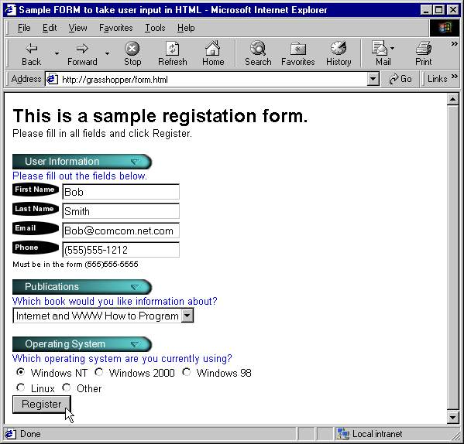
Output from form.html

Slide 31
29.5 Form Processing and Business Logic
Retrieving data from form output
  Assign to variables
  Example: Assign data from form INPUT OS to variable $OS
  $os = param(OS);
Testing for correct form input
  Example: Make sure phone number in format (555)555-5555
  if ( $phone =~ / \( \d{3} \) \d{3} - \d{3} /x) { actions }
  d{n} tests for n characters
  \ is escape character
    Close-bracket (“)”) character is used in Perl statements, needs escape character “\” to appear as part of search test string

Slide 32
1#!perl
2# Fig. 29.13: form.pl
3# Program to read information sent to the server
4# from the FORM in the form.html document.
5
1. form.pl
1.1 Declare variables
1.2 test validity of phone number
1.3 Generate HTML for valid phone number
6use CGI qw( :standard );
7
8$os = param( "OS" );
9$firstName = param( "FNAME" );
10$lastName = param( "LNAME" );
11$email = param( "EMAIL" );
12$phone = param( "PHONE" );
13$book = param( "BOOK" );
14
15print header;
16print "<BODY BACKGROUND = \"images/back.gif\">";
17print "<BASEFONT FACE = \"ARIAL,SANS-SERIF\" SIZE = \"3\">";
18
19if ( $phone =~ / ^ \( \d{3} \) \d{3} - \d{4} $ /x )
20{
21 print <<End_Success;
22 Hi <FONT COLOR = "BLUE"><B>$firstName</B></FONT>.
23 Thank you for completing the survey.<BR>
24 You have been added to the
25 <FONT COLOR = "BLUE"><STRONG>$book</STRONG></FONT>
26 mailing list.<BR><BR>
27 <STRONG>The following information has been saved
28 in our database:</STRONG><BR>
29 <TABLE BORDER = "0" CELLPADDING = "0"
30 CELLSPACING = "10">
31 <TR><TD BGCOLOR = #FFFFAA>Name </TD>
32 <TD BGCOLOR = #FFFFBB>Email</TD>
33 <TD BGCOLOR = #FFFFCC>Phone</TD>

Slide 33
34 <TD BGCOLOR = #FFFFDD>OS</TD></TR>
35 <TR><TD>$firstName $lastName</TD><TD>$email</TD>
36 <TD>$phone</TD><TD>$os</TD></TR>
37 </TABLE>
1.3 Generate HTML for valid phone number
1.4 Generate HTML for invalid phone number
38 <BR><BR><BR>
39 <CENTER><FONT SIZE = "-3">
40 This is only a sample form.
41 You have not been added to a mailing list.
42 </FONT></CENTER>
43End_Success
44}
45else
46{
47 print <<End_Failure;
48 <FONT COLOR = "RED" SIZE = "+2">
49 INVALID PHONE NUMBER</FONT><BR>
50 A valid phone number must be in the form
51 <STRONG>(555)555-5555</STRONG>
52 <FONT COLOR = "BLUE"> Click the Back button,
53 enter a valid phone number and resubmit.<BR><BR>
54 Thank You.
55End_Failure
56}

Slide 34
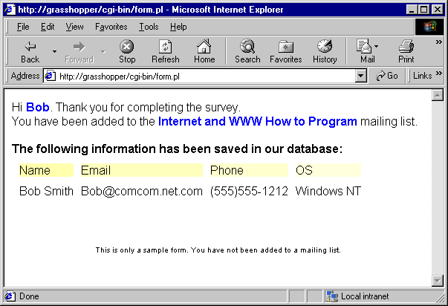
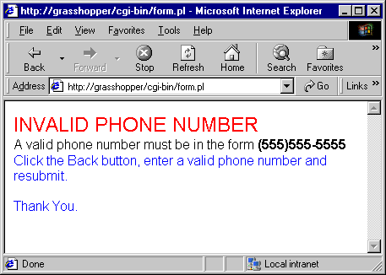
Output from form.pl

Slide 35
29.6 Server-Side Includes
Server-side includes (SSIs)
  Commands embedded in HTML documents
    Written as comments because not all servers support SSI
  Provide for dynamic content creation
  ECHO
    Displays variable information
    Followed by keyword VAR and the variable’s name
        ECHO VAR=“DATE_GMT”
  EXEC
    Used to run CGI scripts and embed their output directly into a Web page
  SSI variables
    DATE_GMT - contains current Greenwich Mean Time
    DOCUMENT_NAME – contains name of current document

Slide 36
29.6 Server-Side Includes
Perl scripts can access and modify other files
  open() function
    Form: open(fileHandle, “>fileName”);
      > - discards any data in file, creates new file if does not exist
      >> - append mode
  While file open, referenced using fileHandle
  Close file using the close() statement
    Format: close(fileHandle);
  While accessing file, print statement can redirect output to a file
    print COUNTWRITE $data;
    Assigns $data to file pointed to by COUNTWRITE

Slide 37
29.6 Server-Side Includes
length() function
  Returns length of string
substr( x, y, z ) function
  Similar to JavaScript’s substr function
  First argument (x)
    Specifies string from which to take a substring
  Second argument (y)
    Specifies offset in characters from beginning of the string
  Third argument (z)
    Specifies length of substring to return

Slide 38
1<!DOCTYPE html PUBLIC "-//W3C//DTD HTML 4.0 Transitional//EN">
2<!-- Fig. 29.14: counter.shtml -->
3
4<HTML>
5 <HEAD>
1. counter.shtml
1.1 Execute counter.pl
1.2 #ECHO commands
6 <TITLE>Using Server Side Includes</TITLE>
7 </HEAD>
8
9<BODY>
10 <CENTER>
11 <H3>Using Server Side Includes</H3>
12 </CENTER>
13
14 <!--#EXEC CGI="/cgi-bin/counter.pl" --><BR>
15
16 The Greenwich Mean Time is
17 <FONT COLOR = "BLUE">
18 <!--#ECHO VAR="DATE_GMT" -->.
19 </FONT><BR>
20
21 The name of this document is
22 <FONT COLOR = "BLUE">
23 <!--#ECHO VAR="DOCUMENT_NAME" -->
24 </FONT><BR>
25
26 The local date is
27 <FONT COLOR = "BLUE">
28 <!--#ECHO VAR="DATE_LOCAL" -->
29 </FONT><BR>
30
31 This document was last modified on
32 <FONT COLOR = "BLUE">
33 <!--#ECHO VAR="LAST_MODIFIED" -->

Slide 39
34 </FONT><BR>
35
36 Your current IP Address is
37 <FONT COLOR = "BLUE">
38 <!--#ECHO VAR="REMOTE_ADDR" -->
39 </FONT><BR>
40
41 My server name is
42 <FONT COLOR = "BLUE">
43 <!--#ECHO VAR="SERVER_NAME" -->
44 </FONT><BR>
45
46 And I am using the
47 <FONT COLOR = "BLUE">
48 <!--#ECHO VAR="SERVER_SOFTWARE" -->
49 Web Server.</FONT><BR>
50
51 You are using
52 <FONT COLOR = "BLUE">
53 <!--#ECHO VAR="HTTP_USER_AGENT" -->.
54 </FONT><BR>
55
56 This server is using
57 <FONT COLOR = "BLUE">
58 <!--#ECHO VAR="GATEWAY_INTERFACE" -->.
59 </FONT><BR>
60
61 <BR><BR>
62 <CENTER>
63 <HR>
64 <FONT SIZE = -5>This document was last modified on
65 <!--#ECHO VAR="LAST_MODIFIED" --></FONT>
66 </CENTER>
67</BODY>
68</HTML>

Slide 40
1#!perl
2# Fig. 29.15: counter.pl
3# Program to track the number of times a web page has been accessed.
4
2. counter.pl
5use CGI qw( :standard );
6
7open( COUNTREAD, "counter.dat" );
8 $data = <COUNTREAD>;
9 $data++;
10close( COUNTREAD );
11
12open( COUNTWRITE, ">counter.dat" );
13 print COUNTWRITE $data;
14close( COUNTWRITE );
15
16print header;
17print "<CENTER>";
18print "<STRONG>You are visitor number</STRONG><BR>";
19
20for ( $count = 0; $count < length( $data ); $count++ )
21{
22 $number = substr( $data, $count, 1 );
23 print "<IMG SRC = \"images/counter/$number.jpg\">";
24}
25
26print "</CENTER>";

Slide 41
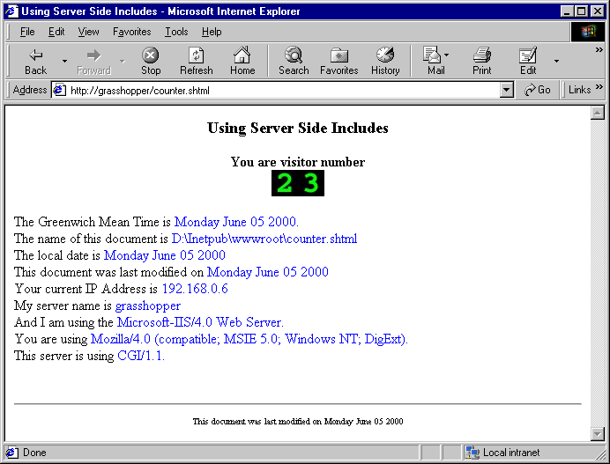
Output from counter.shtml

Slide 42
29.7 Verifying a Username and Password
Often desirable to have private Web site
  Developers often employ username and password authentication to implement privacy
Upcoming files
  verify.html – HTML document client browser displays
  password.pl – Perl script that verifies username and password inputted by client and performs appropriate actions
  data.txt – Text file containing username and password combinations (unencrypted for simplicity)

Slide 43
29.7 Verifying a Username and Password
If file cannot be opened
  Use function die to exit program and print message
while<fileHandle>
  Executes structure while still information in fileHandle
split function
  Read contents of a file into an array
  @arrayName = split(/\n/)
  Creates array arrayName, creates new array entry after every \n character
Access array elements and split into two parts
  foreach $entry (@data) {…}
  Performs indicated action on every entry in array @data
  Subsequently assigns entry information to $entry

Slide 44
29.7 Verifying a Username and Password
Split array into two parts
  ($name, $pass) = split(/,/, $entry)
  Assigns username string of current entry to $name
  Assigns password string of current entry to $pass
Perl accepts logical and (&&) and or (||) operators
  Same format as other languages
  Example:
  if ($userverified && $passwordverified) {…}
  Evaluates to TRUE if both variable values are TRUE
    TRUE: any string or non-zero number
sub functionName {…}
  Sets actions of user-defined function functionName
  User-defined functions accessed: &functionName

Slide 45
1<!DOCTYPE html PUBLIC "-//W3C//DTD HTML 4.0 Transitional//EN">
2<!-- Fig. 29.16: password.html -->
3
4<HTML>
1.1 Print instructions
2.1 Open FORM and define ACTION attribute
3.1 Open HTML TABLE
5<HEAD>
6<TITLE>Verifying a username and a password.</TITLE>
7</HEAD>
8
9<BODY BACKGROUND = "images/back.gif">
10 <P>
11 <FONT FACE = Arial>
12 Type in your username and password below.
13 </FONT><BR>
14 <FONT COLOR = #0000FF FACE = Arial SIZE = 1>
15 <STRONG>
16 Note that password will be sent as plain text
17 </STRONG>
18 </FONT>
19 </P>
20
21 <FORM ACTION = "/cgi-bin/password.pl" METHOD = "post">
22 <BR>
23
24 <TABLE BORDER = "0" CELLSPACING = "0" STYLE = "HEIGHT: 90px;
25 WIDTH: 123px" CELLPADING = "0">
26 <TR>
27 <TD BGCOLOR = #DDDDDD COLSPAN = 3>
28 <FONT FACE = Arial SIZE = 2>
29 <STRONG>Username:</STRONG>
30 </FONT>
31 </TD>
32 </TR>

Slide 46
33 <TR>
34 <TD BGCOLOR = #DDDDDD COLSPAN = 3>
35 <INPUT SIZE = "40" NAME = "USERNAME"
36 STYLE = "HEIGHT: 22px; WIDTH: 115px">
3.2 Insert and define INPUT elements for username and password
3.3 Insert INPUT submit button
3.4 Close TABLE and FORM elements
37 </TD>
38 </TR>
39 <TR>
40 <TD BGCOLOR = #DDDDDD COLSPAN = 3>
41 <FONT FACE = Arial SIZE = 2>
42 <STRONG>Password:</STRONG>
43 </FONT></TD>
44 </TR>
45 <TR>
46 <TD BGCOLOR = #DDDDDD COLSPAN = 3>
47 <INPUT SIZE = "40" NAME = "PASSWORD"
48 STYLE = "HEIGHT: 22px; WIDTH: 115px"
49 TYPE = PASSWORD>
50 <BR></TD>
51 </TR>
52 <TR>
53 <TD COLSPAN = 3>
54 <INPUT TYPE = "submit" VALUE = "Enter"
55 STYLE = "HEIGHT: 23px; WIDTH: 47px">
56 </TD>
57 </TR>
58 </TABLE>
59 </FORM>
60</BODY>
61</HTML>

Slide 47
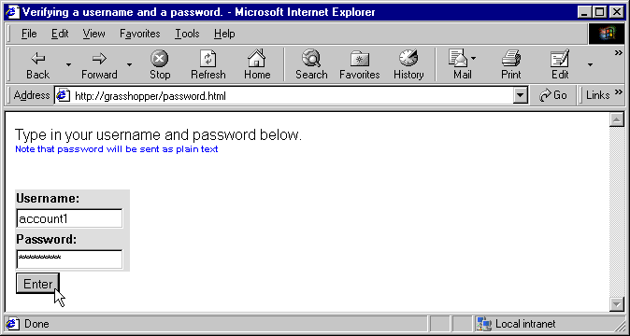
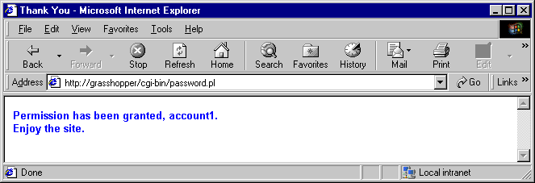
Output from password.html

Slide 48
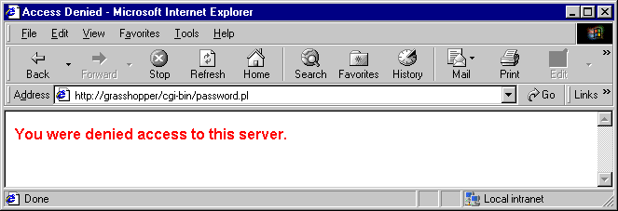
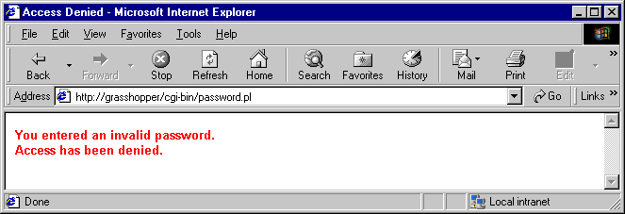
Output from password.html

Slide 49
1#!perl
2# Fig. 29.17: password.pl
3# Program to search a database for usernames and passwords.
4
5use CGI qw(:standard);
1. password.pl
6
7$testUsername = param( "USERNAME" );
8$testPassword = param( "PASSWORD" );
9
10open ( FILE, "password.txt" ) ||
11 die "The database could not be opened";
12
13while ( $line = <FILE> )
14{
15 chomp $line;
16 ( $username, $password ) = split( ",", $line );
17
18 if ( $testUsername eq $username )
19 {
20 $userVerified = 1;
21 if ( $testPassword eq $password )
22 {
23 $passwordVerified = 1;
24 last;
25 }
26 }
27}
28
29close( FILE );
30print header;
31
32if ( $userVerified && $passwordVerified )
33{

Slide 50
34 accessGranted();
35}
36elsif ( $userVerified && !$passwordVerified )
37{
38 wrongPassword();
39}
40else
41{
42 accessDenied();
43}
44
45sub accessGranted
46{
47 print "<TITLE>Thank You</TITLE>";
48 print "<FONT FACE = \"ARIAL\" SIZE = 2 COLOR = \"BLUE\">";
49 print "<STRONG>Permission has been granted, $username.";
50 print "<BR>Enjoy the site.</STRONG></FONT>";
51}
52
53sub wrongPassword
54{
55 print "<TITLE>Access Denied</TITLE>";
56 print "<FONT FACE = \"ARIAL\" SIZE =2 COLOR=\"RED\"><STRONG>";
57 print "You entered an invalid password.<BR>";
58 print "Access has been denied.</STRONG></FONT>";
59}
60
61sub accessDenied
62{
63 print "<TITLE>Access Denied</TITLE>";
64 print "<FONT FACE = \"ARIAL\" SIZE = 3 COLOR =\"RED\"><STRONG>";
65 print "You were denied access to this server.";
66 print "</STRONG></FONT>";
67}

Slide 51
1 account1,password1
2 account2,password2
3 account3,password3
4 account4,password4
Data.txt
1.1 Input username and password combinations using format:
username,password/n
5 account5,password5
6 account6,password6
7 account7,password7
8 account8,password8
9 account9,password9
10 account10,password10

Slide 52
29.8 Using ODBC to Connect to a Database
Databases allow companies to
  Enter world of e-commerce
  Maintain crucial data
Perl module Win32::ODBC
  Enables Perl programs to connect to ODBC data sources
  Data source must first be defined using Data Source Administrator in MS Windows (see Section 25.5)
From Web browser
  1. Client enters SQL query string
  2. String sent to Web server
  3. Perl script executed
    Database queried
  4. Record set in HTML form sent back to client

Slide 53
29.8 Using ODBC to Connect to a Database
Script connects to ODBC Data source
  By passing the Data Source Name, $DSN, to the constructor for the Win32::ODBC object.
  $Data = new Win32::ODBC($DSN)
    new specifies that a new instance of the object is to be created
  Win32::ODBC::Error
    Returns error that occurred
Query string sent to database
  $Data->Sql($querystring)
  If fails, error message is returned

Slide 54
29.8 Using ODBC to Connect to a Database
Method DataHash
  Retrieves the fields in a row from the record set
Coding HTML in Perl
  Open HTML area with print header;
  Close HTML area with print end_html;
Use tables to output fields in a database
  Organizes information neatly

Slide 55
1<!DOCTYPE html PUBLIC "-//W3C//DTD HTML 4.0 Transitional//EN">
2<!-- Fig. 29.19: data.html -->
3
4<HTML>
1.1 Open and define FORM
1.2 Insert and define text INPUT for entering SQL query
1.3 Insert INPUT button
5<HEAD>
6<TITLE>Sample Database Query</TITLE>
7</HEAD>
8
9<BODY BACKGROUND = "images/back.gif">
10<BASEFONT FACE = "ARIAL,SANS-SERIF" SIZE = 2>
11
12 <FONT SIZE = +2>
13 <STRONG>Querying an ODBC database.</STRONG>
14 </FONT><BR>
15
16 <FORM METHOD = "POST" ACTION = "cgi-bin/data.pl">
17 <INPUT TYPE = "TEXT" NAME = "QUERY" SIZE = 40
18 VALUE = "SELECT * FROM AUTHORS"><BR><BR>
19 <INPUT TYPE = "SUBMIT" VALUE = "Send Query">
20 </FORM>
21</BODY>
22</HTML>

Slide 56
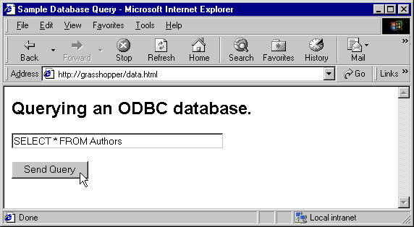
Output from data.html

Slide 57
1#!perl
2# Fig. 29.20: data.pl
3# Program to query a database and send results to the client.
4
5use Win32::ODBC;
1. data.pl
6use CGI qw( :standard );
7
8$queryString = param( "QUERY" );
9$dataSourceName = "Products";
10
11print header, start_html( "Search Results" );
12
13if ( !( $data = new Win32::ODBC( $dataSourceName ) ) )
14{
15 print "Error connecting to $dataSourceName: ";
16 print Win32::ODBC::Error();
17 exit;
18}
19
20if ( $data->Sql( $queryString ) )
21{
22 print "SQL failed. Error: ", $data->Error();
23 $data->Close();
24 exit;
25}
26
27print "<FONT FACE = \"ARIAL,SANS-SERIF\" SIZE = 3>";
28print "<FONT COLOR = \"BLUE\" SIZE = 4>Search Results</FONT>";
29print "<TABLE BORDER = 0 CELLPADDING = 5 CELLSPACING = 0>";
30
31for ( $counter = 0; $data->FetchRow(); $counter++ )
32{
33 %rowHash = $data->DataHash();

Slide 58
34
35 print <<End_Row;
36 <TR BGCOLOR = "#9999CC">
37 <TD>$rowHash{'ID'}</TD>
38 <TD>$rowHash{'FirstName'}</TD>
39 <TD>$rowHash{'LastName'}</TD>
40 <TD>$rowHash{'Phone'}</TD>
41 </TR>
42End_Row
43}
44
45print <<End_Results;
46</TABLE>
47<BR>Your search yielded <B>$counter</B> results.<BR><BR>
48<FONT SIZE = "2">
49Please email comments to
50<A href = "mailto:deitel\@deitel.com">
51Deitel and Associates, Inc.</A>.
52End_Results
53
54print end_html;
55$data->Close();

Slide 59
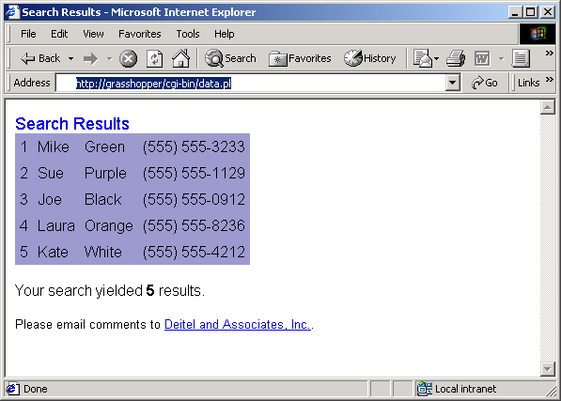
Output from data.pl

Slide 60
29.9 Cookies and Perl
Cookies
  Used to maintain state information for a particular client
  May contain
    Username
    Password
    Specific information that will be helpful when user return to same site
  Are small text files saved on client’s machine
  Sent back to Web server whenever user requests a Web page
  Can be written to client machines using Perl scripts

Slide 61
29.9 Cookies and Perl
To set a cookie using Perl
  Set variable values to user input strings
  Set cookie setup info
    $expires – expiration date of cookie
    $path – location on clients computer to store cookie
    $server_domain – IP address of your server
  print “set-cookie: “; …
  set information to be stored in cookie using print statement
  Repeat as needed to store all information in cookie
After cookie written
  Text file added to Temporary Internet Files directory
    Filename: Cookie:administrator@ip.number

Slide 62
1<!DOCTYPE html PUBLIC "-//W3C//DTD HTML 4.0 Transitional//EN">
2<!-- Fig. 29.21: cookies.html -->
3
4<HTML>
5 <HEAD>
1.1 Enter text instructions
2.1 Open FORM and define ACTION attribute
2.2 Insert and define INPUT fields
2.3 Insert INPUT submit button
2.4 Close FORM area
6 <TITLE>Writing a cookie to the client computer</TITLE>
7 </HEAD>
8
9<BODY BACKGROUND = "images/back.gif">
10<BASEFONT FACE = "ARIAL,SANS-SERIF" SIZE = 2>
11
12 <FONT SIZE = +2>
13 <B>Click Write Cookie to save your cookie data.</B>
14 </FONT><BR>
15
16 <FORM METHOD = "POST" ACTION = "cgi-bin/cookies.pl">
17 <STRONG>Name:</STRONG><BR>
18 <INPUT TYPE = "TEXT" NAME = "NAME"><BR>
19 <STRONG>Height:</STRONG><BR>
20 <INPUT TYPE = "TEXT" NAME = "HEIGHT"><BR>
21 <STRONG>Favorite Color</STRONG><BR>
22 <INPUT TYPE = "TEXT" NAME = "COLOR"><BR>
23 <INPUT TYPE = "SUBMIT" VALUE = "Write Cookie">
24 </FORM>
25</BODY>
26</HTML>

Slide 63
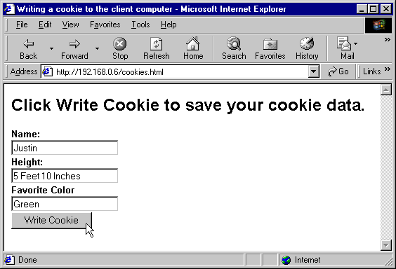
Output from cookies.html

Slide 64
1#!perl
2# Fig. 29.22: cookies.pl
3# Program to write a cookie to a client’s machine
4
1. cookies.pl
5use CGI qw( :standard );
6
7$name = param( NAME );
8$height = param( HEIGHT );
9$color = param( COLOR );
10
11$expires = "Tuesday, 05-JUL-05 16:00:00 GMT";
12
13print "Set-Cookie: Name=$name; expires=$expires; path=\n";
14print "Set-Cookie: Height=$height; expires=$expires; path=\n";
15print "Set-Cookie: Color=$color; expires=$expires; path=\n";
16
17print header, start_html( "Cookie Saved" );
18
19print <<End_Data;
20<FONT FACE = "ARIAL,SANS-SERIF" SIZE = "3">
21The cookie has been set with the folowing data:<BR><BR>
22<FONT COLOR = "BLUE">Name:</FONT> $name<BR>
23<FONT COLOR = "BLUE">Height:</FONT> $height<BR>
24<FONT COLOR = "BLUE">Favorite Color:</FONT>
25<FONT COLOR = $color> $color<BR></FONT>
26<BR>Click <A HREF = "readCookies.pl">here</A> to read saved cookie.
27End_Data
28
29print end_html;

Slide 65
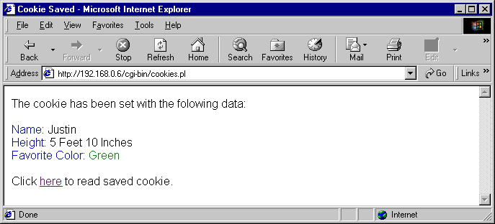
Output from cookies.pl

Slide 66
29.9 Cookies and Perl
Cookies are read from client machine using Perl
  Function &readCookies returns the information stored in cookies sent to client from server ip address
    Information read with statement
    $ENV{‘HTTP_COOKIE’}
  Cookie information can be read by
    Storing information in hash array
    Splitting fields
    Displaying information
Display cookie output in table for organization

Slide 67
1#!perl
2# Fig. 29.25: readCookies.pl
3# Program to read cookies from the client's computer
4
1. readCookies.pl
5use CGI qw( :standard );
6
7print header, start_html( "Read cookies" );
8print "<FONT FACE = \"ARIAL,SANS-SERIF\" SIZE = 3>";
9print "<STRONG>The folowing data is saved in a cookie on your ";
10print "computer.<STRONG><BR><BR>";
11
12%cookies = readCookies();
13
14print "<TABLE BORDER = \"5\" CELLSPACING = \"0\" ";
15print "CELLPADDING = \"10\">";
16
17foreach $cookieName ( "Name", "Height", "Color" )
18{
19 print "<TR>";
20 print " <TD BGCOLOR=#AAAAFF>$cookieName</TD>";
21 print " <TD BGCOLOR=#AAAAAA>$cookies{ $cookieName }</TD>";
22 print "</TR>";
23}
24print "</TABLE>";
25print end_html;
26
27sub readCookies
28{
29 @cookieArray = split( "; ", $ENV{ 'HTTP_COOKIE' } );
30 foreach ( @cookieArray )
31 {
32 ( $cookieName, $cookieValue ) = split ( "=", $_ );

Slide 68
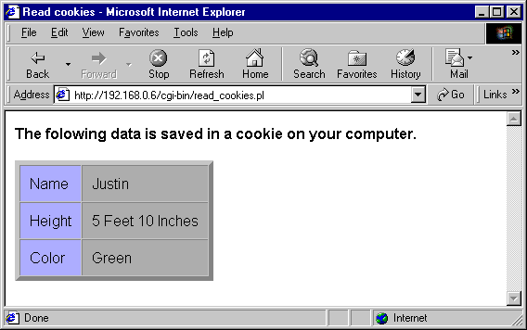
33 $cookieHash{ $cookieName } = $cookieValue;
34 }
35
36 return %cookieHash;
37}

Slide 69
29.10 Example: An Internet Shopping Cart
Building an Internet shopping cart
  books.pl
    Displays the opening Web page, which displays a list of books available for purchase
  catalog.txt
    Text file containing the actual book data
  cart.pl
    Updates and displays the contents of the shopping cart in an HTML table
    Uses cookies to keep track of data

Slide 70
1#!perl
2# Fig. 29.26: books.pl
3# Reads books from a database and prints them in a table
4
5use CGI qw( :standard );
1. books.pl
1.1 Open catalog.txt
1.2 Print table entry for each book
6print header, start_html( "Shopping cart" );
7
8open( FILE, "catalog.txt" ) ||
9 die "The database could not be opened.";
10
11print <<End_Begin;
12<CENTER><P>Books available for sale</P>
13<TABLE BORDER = "1" CELLPADDING = "7">
14<TR><TH>Name</TH><TH>Year</TH><TH>ISBN</TH><TH>Price</TH></TR>
15End_Begin
16
In order to instruct cart.pl which book to add we post that information in each form using hidden fields.
17while ( <FILE> )
18{
19 @data = split( "\t" ); # Variable $_ assumed
20 print "<FORM METHOD = \"POST\" ACTION = \"cart.pl\">";
21 param( "REMOVE" , 0 );
22 param( "NEWBOOK", @data );
23 print hidden( "REMOVE" );
24 print hidden( "NEWBOOK"), "\n<TR>";
25
26 foreach ( @data )
27 {
28 print "<TD>$_</TD>"; # print data item within a cell
29 }
30 print "<TD>", submit( "Buy" ), "</TD></TR></FORM>\n";
31}
32
33print "</TABLE>", end_html;
34close( FILE );

Slide 71
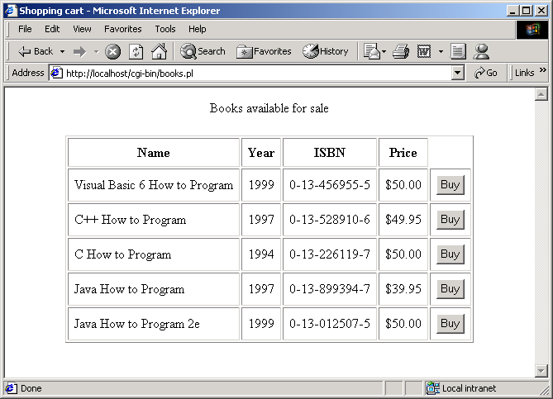
Output of books.pl

Slide 72
1#!perl
2# Fig. 29.27: cart.pl
3# Add or remove a book from cart and print cart contents
4
5use CGI qw( :standard );
1. cart.pl
1.1 Remove book
6
7@cart = readCookie();
8$remove = param( "REMOVE" );
9
10if ( $remove )
11{
12 $number = param( "NUMBER" );
13 @book = splice( @cart, 4 * ($number - 1), 4 );
14
15 writeCookie( @cart );
16 print header;
17 print start_html( "Book removed" );
18
19 print <<End_Remove;
20 <CENTER><P>The book <I>$book[ 0 ]</I> has been removed.</P>
21 <A HREF = "cart.pl">Return to cart</A>
22End_Remove
23
24}
25else
26{
27 @book = param( "NEWBOOK" );
28 push ( @cart, @book );
29
30 if ( ! @cart )
31 {
32 print redirect( "books.pl" );
33 exit;

Slide 73
34 }
35
36 writeCookie( @cart );
37 print header;
38 print start_html( "Shopping Cart" );
1.2 Add book
1.3 Generate HTML
39
40 print <<End_Add;
41 <CENTER><P>Here is your current order.</P>
42 <TABLE BORDER = "1" CELLPADDING = "7"><TR><TH>Item</TH>
43 <TH>Name</TH><TH>Year</TH><TH>ISBN</TH>
44 <TH>Price</TH><TH></TH></TR>
45End_Add
46
47 $counter = 1;
48 $total = 0;
49 @cartCopy = @cart;
50 while ( @book = splice( @cartCopy, 0, 4 ) )
51 {
52 print "<TR><FORM METHOD=\"POST\" ACTION=\"cart.pl\">";
53 print "<TD>$counter</TD><TD>$book[ 0 ]</TD><TD>$book[ 1 ]";
54 print "</TD><TD>$book[ 2 ]</TD><TD>$book[ 3 ]</TD>";
55 print "<TD>", submit( "Remove" ), "</TD>";
56
57 param( "REMOVE", 1 ); # set REMOVE variable to true
58 param( "NUMBER", $counter ); # book number to remove
59 print hidden( "REMOVE" );
60 print hidden( "NUMBER" );
61 print "</FORM></TR>";
62
63 $book[ 3 ] =~ s/\$//; # remove $ sign
64 $total += $book[ 3 ]; # calculate total price
65 $counter++;
66 }

Slide 74
67 print "<TR><TH COLSPAN= \"4\">Total Order</TH><TH>";
68 printf "\$%0.2f", $total; # print the total
69 print "</TABLE><BR>";
70 print "<A HREF= \"books.pl\">Buy more books</A>";
1.4 Function writeCookie
1.5 Function readCookie
71}
72print end_html;
73
74sub writeCookie
75{
76 $expires = "Tuesday, 05-JUL-05 16:00:00 GMT";
77 print "Set-Cookie: ";
78 print "CART=", join( "\t", @_ ), "; expires=$expires\n";
79}
80
81sub readCookie
82{
83 @cookieValues = split( "; ", $ENV{ 'HTTP_COOKIE' } );
84 foreach ( @cookieValues )
85 {
86 ( $name, $value ) = split ( "=" );
87 if ($name eq "CART")
88 {
89 @data = split ( "\t", $value );
90 last;
91 }
92 }
93 return @data;
94}

Slide 75
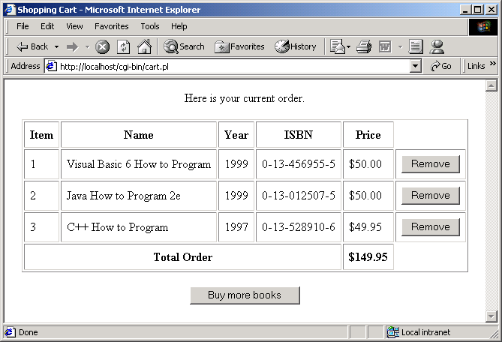
Output of cart.pl

