Slide 1
Chapter 30 – Dynamic HTML: Structured Graphics ActiveX Control
Outline
30.1 Introduction
30.2 Shape Primitives
30.3 Moving Shapes with Translate
30.4 Rotation
30.5 Mouse Events and External Source Files
30.6 Scaling

Slide 2
30.1 Introduction
Structured Graphics ActiveX Control
  Included with IE5
  Add with OBJECT tag
  Web interface for DirectAnimation subset of Microsoft’s DirectX software
  http://www.microsoft.com/directx/dxm/help/da/default.htm

Slide 3
30.2 Shape Primitives
Structured Graphics Control
  Create shapes using PARAM tags in OBJECT elements
  Insert ActiveX Control
PARAM tags
  <PARAM NAME = “Line0001”
  VALUE = “SetLineColor ( 0, 0, 0 )”>
  NAME attribute determines the order in which the function is called
  SetLineStyle method
    Line style parameter
      1: solid line (default)
      0: no line
      2: dashed line
    Line width parameter

Slide 4
30.2 Shape Primitives
  SetFillColor
    Sets foreground color to fill shapes
  SetFillStyle
    14 possible fill styles
  Oval
    First two parameters set x-y coordinates (upper-left corner of “surrounding box”)
      Inside control, origin at center
    Next two parameters specify height and width
    Last parameter specifies clockwise rotation relative to x-axis, in degrees

Slide 5
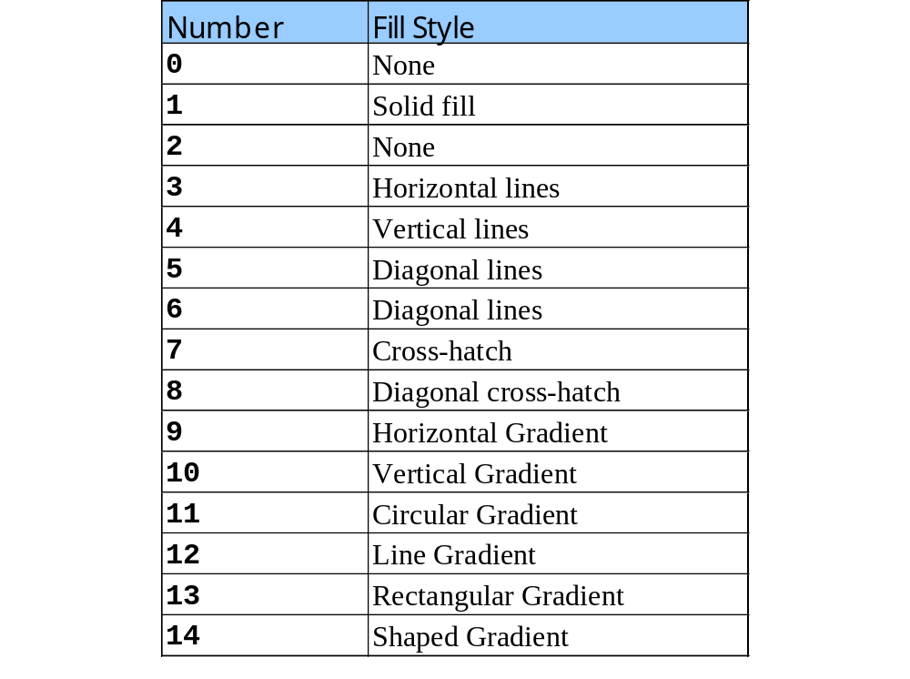
30.2 Shape Primitives
Fill styles for the SetFillStyle method

Slide 6
30.2 Shape Primitives
  Arc
    7 parameters:
      x-y coordinates
      Height and width
      Starting angle, in degrees
      Size of arc relative to starting angle, in degrees
      Rotation of arc
  Pie
    Same as Arc, but filled

Slide 7
30.2 Shape Primitives
  Polygon
    Parameters:
      Number of vertices
      Each successive pair specifies x-y coordinates of vertex
  Rect
    Parameters:
      x-y coordinates
      Height and width
      Rotation in degrees

Slide 8
30.2 Shape Primitives
  RoundRect
    Same as Rect, but with 2 new parameters:
      Width and height of rounded arc at corners of rectangle
  SetFont
    Font style
    SetFont( ‘Arial’, 65, 400, 0, 0, 0 );
      Arial, 65 points high, boldness of 400, neither italic nor underline nor strikethrough
  Text
    Parameters:
      Text
      Position
      Rotation
  PolyLine
    Same as Polygon, only no fill

Slide 9
1<!DOCTYPE html PUBLIC "-//W3C//DTD HTML 4.0 Transitional//EN">
2<HTML>
3
4<!-- Fig 30.1: shapes.html -->
1.1 Insert control using OBJECT element
1.2 Use PARAM tags to call methods
1.3 NAME attribute determines order in which functions called
5<!-- Creating simple shapes -->
6
7<HEAD>
8 <TITLE>Structured Graphics - Shapes</TITLE>
9</HEAD>
10
11<BODY>
12
13 <OBJECT ID = "shapes" STYLE = "background-color: #CCCCFF;
14 width: 500; height: 400"
15 CLASSID = "CLSID:369303C2-D7AC-11d0-89D5-00A0C90833E6">
16
17 <PARAM NAME = "Line0001"
18 VALUE = "SetLineColor( 0, 0, 0 )">
19 <PARAM NAME = "Line0002"
20 VALUE = "SetLineStyle( 1, 1 )">
21 <PARAM NAME = "Line0003"
22 VALUE = "SetFillColor( 0, 255, 255 )">
23 <PARAM NAME = "Line0004"
24 VALUE = "SetFillStyle( 1 )">
25
26 <PARAM NAME = "Line0005"
27 VALUE = "Oval( 0, -175, 25, 50, 45 )">
28 <PARAM NAME = "Line0006"
29 VALUE = "Arc( -200, -125, 100, 100, 45, 135, 0 )">
30 <PARAM NAME = "Line0007"

Slide 10
31 VALUE = "Pie( 100, -100, 150, 150, 90, 120, 0 )">
32 <PARAM NAME = "Line0008"
33 VALUE = "Polygon(5, 0, 0, 10, 20, 0, -30,
34 -10, -10, -10, 25)">
35 <PARAM NAME = "Line0009"
36 VALUE = "Rect( -185, 0, 60, 30, 25 )">
37 <PARAM NAME = "Line0010"
38 VALUE = "RoundRect( 200, 100, 35, 60, 10, 10, 25 )">
39
40 <PARAM NAME = "Line0011"
41 VALUE = "SetFont( 'Arial', 65, 400, 0, 0, 0 )">
42 <PARAM NAME = "Line0012"
43 VALUE = "Text( 'Shapes', -200, 200 , -35 )">
44
45 <PARAM NAME = "Line0013"
46 VALUE = "SetLineStyle( 2,1 )">
47 <PARAM NAME = "Line0014"
48 VALUE = "PolyLine( 5, 100, 0, 120, 175, -150, -50,
49 -75, -75, 75, -75)">
50 </OBJECT>
51
52</BODY>
53</HTML>

Slide 11
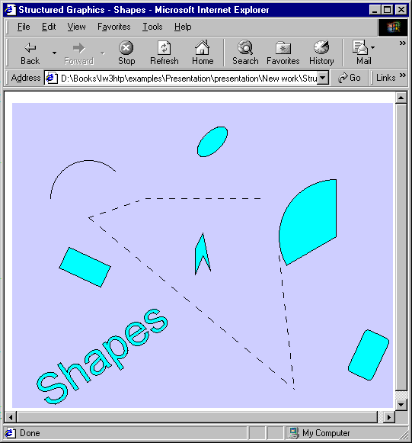
Creating shapes with the Structured Graphics ActiveX Control

Slide 12
30.3 Moving Shapes with Translate
Translate function
  Translate: move object in coordinate space without deforming it
  3 parameters:
    Distance to move along x, y and z axes
Texture
  A picture placed on the surface of a polygon

Slide 13
1 <!DOCTYPE html PUBLIC "-//W3C//DTD HTML 4.0 Transitional//EN">
2 <HTML>
3
4 <!-- Fig 30.3: bounce.html -->
1.1 Define function run to move ball
5 <!-- Textures and the Translate method -->
6
7 <HEAD>
8 <TITLE>Structured Graphics - Translate</TITLE>
9
10 <SCRIPT LANGUAGE = "JavaScript">
11 var x = 15;
12 var y = 15;
13 var upDown = -1;
14 var leftRight = 1;
15
16 function start()
17 {
18 window.setInterval( "run()", 50 );
19 }
20
21 function run()
22 {
23 // if the ball hits the top or bottom side...
24 if ( y == -100 || y == 50 )
25 upDown *= -1;
26
27 // if the ball hits the left or right side...
28 if ( x == -150 || x == 100 )
29 leftRight *= -1;
30

Slide 14
31 // Move the ball and increment our counters
32 ball.Translate( leftRight * 5, upDown * 5, 0 );
33 y += upDown * 5;
34 x += leftRight * 5;
1.2 Use translate method to move ball in coordinate space
1.3 Use SetTextureFill to fill oval
35 }
36
37</SCRIPT>
38</HEAD>
39
40<BODY ONLOAD = "start()">
41
42 <OBJECT ID = "ball" STYLE = "background-color: ffffff;
43 width: 300; height: 200; border-style: groove;
44 position: absolute; top: 50; left: 50;"
45 CLASSID = "CLSID:369303C2-D7AC-11d0-89D5-00A0C90833E6">
46
47 <PARAM NAME = "Line0001" VALUE = "SetLineStyle( 0 )">
48 <PARAM NAME = "Line0002"
49 VALUE = "SetTextureFill( 0, 0, 'ball.gif', 0 )">
50 <PARAM NAME = "Line0003"
51 VALUE = "Oval( 15, 15, 50, 50 )">
52 </OBJECT>
53
54</BODY>
55</HTML>

Slide 15
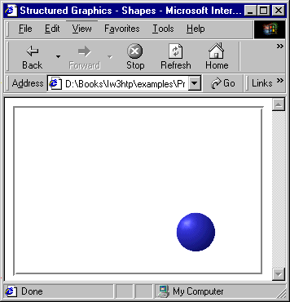
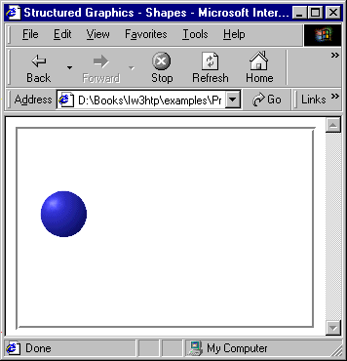
Methods SetTextureFill and Translate

Slide 16
30.4 Rotation
Rotate method
  Rotate shapes in 3D space
  3 parameters specify rotation around the x, y and z axis
SetFillStyle
  9: linear gradient fill from foreground color to background color
  11: circular gradient
  13: rectangular gradient

Slide 17
1 <!DOCTYPE html PUBLIC "-//W3C//DTD HTML 4.0 Transitional//EN">
2 <HTML>
3
4 <!-- Fig 30.4: gradient.html -->
1.1 Use Rotate method to rotate circle around z-axis
5 <!-- Gradients and rotation -->
6
7 <HEAD>
8 <TITLE>Structured Graphics - Gradients</TITLE>
9
10 <SCRIPT LANGUAGE = "JavaScript">
11 var speed = 5;
12 var counter = 180;
13
14 function start()
15 {
16 window.setInterval( "run()", 100 );
17 }
18
19 function run()
20 {
21 counter += speed;
22
23 // accelerate half the time...
24 if ( ( counter % 360 ) > 180 )
25 speed *= ( 5 / 4 );
26
27 // decelerate the other half.
28 if ( ( counter % 360 ) < 180 )
29 speed /= ( 5 / 4 );
30

Slide 18
31 pies.Rotate( 0, 0, speed );
32 }
33</SCRIPT>
34
1.2 Use 3 pie shapes to form a circle
1.3 Use different parameters for SetFillStyle to fill with various gradients
35</HEAD>
36
37<BODY ONLOAD = "start()">
38
39 <OBJECT ID = "pies" STYLE = "background-color:blue;
40 width: 300; height: 200;"
41 CLASSID = "CLSID:369303C2-D7AC-11d0-89D5-00A0C90833E6">
42
43 <PARAM NAME = "Line0001"
44 VALUE = "SetFillColor( 255, 0, 0, 0, 0, 0 )">
45 <PARAM NAME = "Line0002"
46 VALUE = "SetFillStyle( 13 )">
47 <PARAM NAME = "Line0003"
48 VALUE = "Pie( -75, -75, 150, 150, 90, 120, 300 )">
49
50 <PARAM NAME = "Line0004"
51 VALUE = "SetFillStyle( 9 )">
52 <PARAM NAME = "Line0005"
53 VALUE = "Pie( -75, -75, 150, 150, 90, 120, 180 )">
54
55 <PARAM NAME = "Line0006"
56 VALUE = "SetFillStyle( 11 )">
57 <PARAM NAME = "Line0007"
58 VALUE = "Pie( -75, -75, 150, 150, 90, 120, 60 )">
59 </OBJECT>
60
61</BODY>
62</HTML>

Slide 19
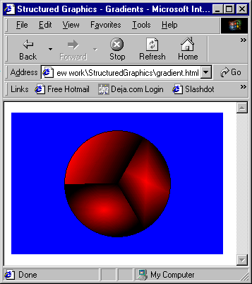
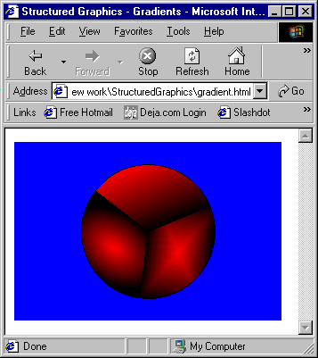
Using gradients and Rotate

Slide 20
30.5 Mouse Events and External Source Files
Structured Graphics control can capture:
  ONMOUSEUP
  ONMOUSEDOWN
  ONMOUSEMOVE
  ONMOUSEOVER
  ONMOUSEOUT
  ONCLICK
  ONDBLCLICK
Does not capture mouse events by default
  MouseEventsEnabled property turns on capturing
    Value of 1 turns on
SourceURL method
  Keep set of method calls in separate file and invoke them

Slide 21
1 SetLineStyle( 1, 3 )
2 SetFillStyle( 1 )
3 Oval( 20, 20, 50, 50, 0 )
4
External source file newoval.txt
5 SetLineStyle( 1, 1 )
6 PolyLine( 2, 45, 20, 45, 70, 0 )
7 PolyLine( 2, 45, 20, 45, 70, 90 )
8 PolyLine( 2, 45, 20, 45, 70, 45 )
9 PolyLine( 2, 45, 20, 45, 70, 135 )
10
11 SetFillColor( 0, 255, 0 )
12 Oval( 30, 30, 30, 30, 0 )
13 SetFillColor( 255,0,0 )
14 Oval( 35, 35, 20, 20, 0 )

Slide 22
1<!DOCTYPE html PUBLIC "-//W3C//DTD HTML 4.0 Transitional//EN">
2<HTML>
3
4<!-- Fig 30.6: bounce2.html -->
1.1 Script ONCLICK event
1.2 Use method SourceURL to load instructions in newoval.txt
5<!-- SourceURL and MouseEventsEnabled -->
6
7<HEAD>
8<TITLE>Structured Graphics - Shapes</TITLE>
9
10<SCRIPT FOR = "ball" EVENT = "onclick" LANGUAGE = "JavaScript">
11 ball.SourceURL = "newoval.txt";
12</SCRIPT>
13
14<SCRIPT LANGUAGE = "JavaScript">
15 var x = 20;
16 var y = 20;
17 var upDown = -1;
18 var leftRight = 1;
19
20 function start()
21 {
22 window.setInterval( "run()", 50 );
23 }
24
25 function run()
26 {
27 if ( y == -100 || y == 50 )
28 upDown *= -1;
29
30 if ( x == -150 || x == 100 )

Slide 23
31 leftRight *= -1;
32
33 ball.Translate( leftRight * 5, upDown * 5, 0 );
34 y += upDown * 5;
1.3 Toggle the mouse-event capturing with
MouseEvents
Enabled property
35 x += leftRight *5;
36 }
37
38</SCRIPT>
39</HEAD>
40
41<BODY ONLOAD = "start()">
42
43 <OBJECT ID = "ball"
44 STYLE = "width: 300; height: 200; border-style: groove;
45 position: absolute; top: 10; left: 10;"
46 CLASSID = "clsid:369303C2-D7AC-11d0-89D5-00A0C90833E6">
47
48 <PARAM NAME = "Line0001" VALUE = "SetLineStyle(0)">
49 <PARAM NAME = "Line0002"
50 VALUE = "SetTextureFill( 0, 0, 'ball.gif', 0 )">
51 <PARAM NAME = "Line0003"
52 VALUE = "Oval( 20, 20, 50, 50 )">
53 <PARAM NAME = "MouseEventsEnabled" VALUE = "1">
54 </OBJECT>
55
56</BODY>
57</HTML>

Slide 24
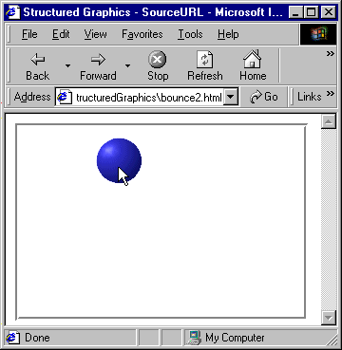
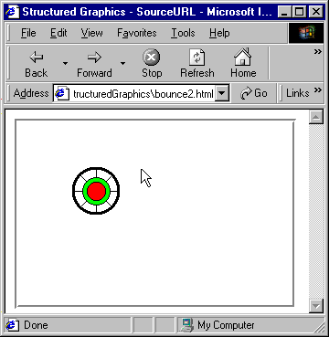
Using SourceURL and MouseEventsEnabled

Slide 25
30.6 Scaling
Scaling
  Modifies the size of an object while retaining its position and shape
  Scale method
    3 parameters for the 3 dimensions

Slide 26
1 <!DOCTYPE html PUBLIC "-//W3C//DTD HTML 4.0 Transitional//EN">
2 <HTML>
3
4 <!-- Fig 30.7: scaling.html -->
5 <!-- Scaling a shape -->
1.1 Use Scale method when defining function run
6
7 <HEAD>
8 <TITLE>Structured Graphics - Scaling</TITLE>
9
10 <SCRIPT LANGUAGE = "JavaScript">
11 var speedX = 0;
12 var speedY = 0;
13 var speedZ = 0;
14 var scale = 1;
15
16 function start()
17 {
18 window.setInterval( "run()", 100 );
19 }
20
21 function run()
22 {
23 drawing.Rotate( speedX, speedY, speedZ );
24 drawing.Scale( scale, scale, scale );
25 }
26
27 function rotate( axis )
28 {
29 axis = ( axis ? 0 : 5 );
30 }
31 </SCRIPT>
32
33 </HEAD>

Slide 27
35<BODY ONLOAD = "start()">
36
37<DIV STYLE = "position: absolute; top: 25; left: 220">
38<INPUT TYPE = "BUTTON" VALUE = "Rotate-X"
39 ONCLICK = "speedX = ( speedX ? 0 : 5 )"><BR>
1.2 Use one control for rotating foreground (lines 51-86)
40<INPUT TYPE = "BUTTON" VALUE = "Rotate-Y"
41 ONCLICK = "speedY = ( speedY ? 0 : 5 )"><BR>
42<INPUT TYPE = "BUTTON" VALUE = "Rotate-Z"
43 ONCLICK = "speedZ = ( speedZ ? 0 : 5 )"><BR>
44<BR>
45<INPUT TYPE = "BUTTON" VALUE = "Scale Up"
46 ONCLICK = "scale = ( scale * 10 / 9 )"><BR>
47<INPUT TYPE = "BUTTON" VALUE = "Scale Down"
48 ONCLICK = "scale = ( scale * 9 / 10 )">
49</DIV>
50
51<OBJECT ID = "drawing" STYLE = " position: absolute;
52 z-index: 2; width: 200; height: 300;"
53 CLASSID = "CLSID:369303C2-D7AC-11d0-89D5-00A0C90833E6">
54
55 <PARAM NAME = "Line0001" VALUE = "SetFillColor( 0,0,0 )">
56 <PARAM NAME = "Line0002" VALUE = "SetFillStyle( 0 )">
57 <PARAM NAME = "Line0003" VALUE = "SetLineStyle( 1, 3 )">
58
59 <PARAM NAME = "Line0004"
60 VALUE = "Oval( -25, -100, 50, 50, 0 )">
61
62 <PARAM NAME = "Line0005"
63 VALUE = "PolyLine(2, 0, -50, 0, 50 )">
64
65 <PARAM NAME = "Line0006"
66 VALUE = "PolyLine( 3, -30, -25, 0, -15, 30, -25 )">
67
68 <PARAM NAME = "Line0007"

Slide 28
70
71 <PARAM NAME = "Line0008"
72 VALUE = "SetFillColor ( 255, 0, 0 )">
73 <PARAM NAME = "Line0009"
1.3 Use second control for oval in background (lines 88-96)
74 VALUE = "Oval( -15, -85, 7, 7, 0 )">
75 <PARAM NAME = "Line0010"
76 VALUE = "Oval( 5, -85, 7, 7, 0 )">
77
78 <PARAM NAME = "Line0011"
79 VALUE = "SetLineStyle( 1, 2 )">
80 <PARAM NAME = "Line0012"
81 VALUE = "SetLineColor( 255, 0, 0 )">
82 <PARAM NAME = "Line0013"
83 VALUE = "SetFont( 'Courier', 25, 200, 0, 0, 0 )">
84 <PARAM NAME = "Line0014"
85 VALUE = "Text( 'Hello', -35, -115 , 0 )">
86</OBJECT>
87
88<OBJECT ID = "background" STYLE = " position:absolute;
89 z-index: 1; width: 200; height: 300; background-color: none"
90 CLASSID = "CLSID:369303C2-D7AC-11d0-89D5-00A0C90833E6">
91
92 <PARAM NAME = "Line0001"
93 VALUE = "SetFillColor( 38, 250, 38 )">
94 <PARAM NAME = "Line0002"
95 VALUE = "Oval( -75, -125, 150, 250, 0 )">
96</OBJECT>
97</BODY>
98</HTML>

Slide 29
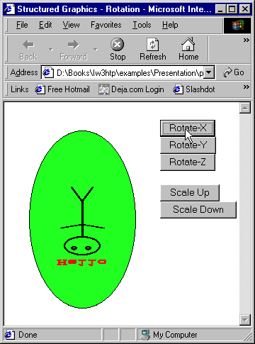
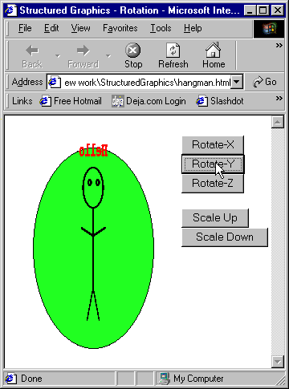
Rotating a shape in three dimensions and scaling up and down

Slide 30
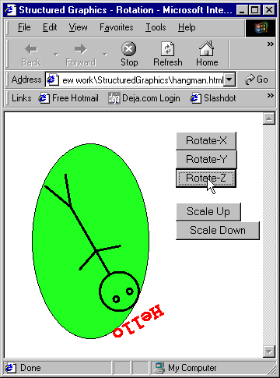
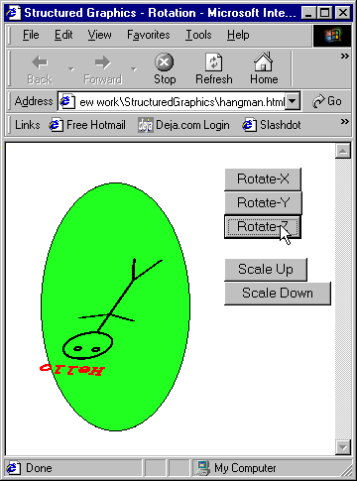
Rotating a shape in three dimensions and scaling up and down

Slide 31
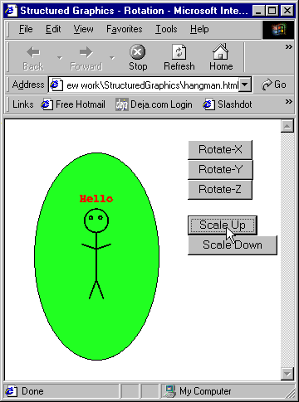
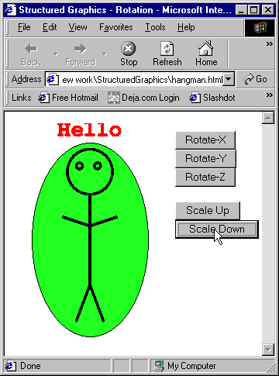
Rotating a shape in three dimensions and scaling up and down

