Slide 1
Chapter 31 – Dynamic HTML: Path, Sequencer and Sprite ActiveX Controls
Outline
31.1 Introduction
31.2 DirectAnimation Path Control
31.3 Multiple Path Controls
31.4 Time Markers for Path Control
31.5 DirectAnimation Sequencer Control
31.6 DirectAnimation Sprite Control
31.7 Animated GIFs

Slide 2
31.1 Introduction
DirectAnimation ActiveX controls
  For use with IE5
    Path Control
    Sequencer Control
    Sprite Control
Multimedia is performance intensive
  Internet bandwidth and processor speed
  Carefully design multimedia-based Web applications

Slide 3
31.2 DirectAnimation Path Control
DirectAnimation Path Control
  Control position of elements on your page
  Create professional presentations
  Use OBJECT element to place control
  Attributes (specify with PARAM tags)
    AutoStart
      Nonzero value starts element as soon as page loads
      0 prevents it from starting automatically
    Repeat
      -1 specifies path should loop continuously

Slide 4
31.2 DirectAnimation Path Control
  Attributes (continued)
    Duration
      Specifies amount of time to traverse path, in seconds
    Bounce
      1 reverses element’s direction when it reaches end
      0 returns element to beginning of path
    Shape
      Determines path
    Target
      Specifies ID of element

Slide 5
1<!DOCTYPE html PUBLIC "-//W3C//DTD HTML 4.0 Transitional//EN">
2<HTML>
3
4<!-- Fig. 31.1: path1.html -->
1.1 Insert DirectAnimation Path Control using OBJECT element
1.2 Use PARAM tags to specify properties of path control
1.3 Setting position to absolute lets Path Control move element on screen
5<!-- Introducing the path control -->
6
7<HEAD>
8 <TITLE>Path control</TITLE>
9</HEAD>
10
11<BODY STYLE = "background-color: #9C00FF">
12
13<H1 ID = "headerText" STYLE = "position: absolute">
14Path animation:</H1>
15
16<OBJECT ID = "oval"
17 CLASSID = "CLSID:D7A7D7C3-D47F-11D0-89D3-00A0C90833E6">
18 <PARAM NAME = "AutoStart" VALUE = "1">
19 <PARAM NAME = "Repeat" VALUE = "-1">
20 <PARAM NAME = "Duration" VALUE = "2">
21 <PARAM NAME = "Bounce" VALUE = "1">
22 <PARAM NAME = "Shape"
23 VALUE = "PolyLine( 2, 0, 0, 200, 50 )">
24 <PARAM NAME = "Target" VALUE = "headerText">
25</OBJECT>
26
27</BODY>
28</HTML>

Slide 6
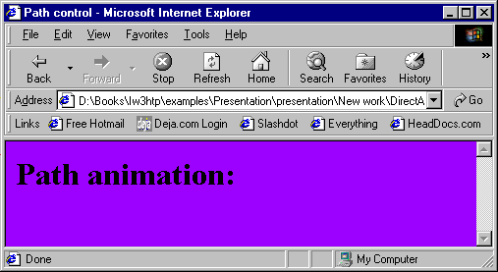
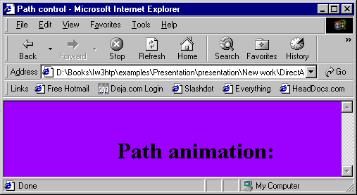
Demonstrating the DirectAnimation Path Control

Slide 7
31.3 Multiple Path Controls
Multiple paths
  Separate OBJECT tag for each element you wish to control
z-index
  If you do not specify z-index of elements that overlap, z-index determined by order of declaration
  Elements declared later are displayed above elements declared earlier

Slide 8
1<!DOCTYPE html PUBLIC "-//W3C//DTD HTML 4.0 Transitional//EN">
2<HTML>
3
4<!-- Fig 31.2: path2.html -->
5<!-- Controlling multiple paths -->
6<HEAD>
7 <TITLE>Path Control - Multiple paths</TITLE>
8
9<STYLE TYPE = "text/css">
10
11 SPAN { position: absolute;
12 font-family: sans-serif;
13 font-size: 2em;
14 font-weight: bold;
15 filter: shadow( direction = 225 );
16 padding: 9px;
17 }
18
19</STYLE>
20</HEAD>
21
22<BODY STYLE = "background-color: lavender">
23
24<IMG SRC = "icons2.gif"
25 STYLE = "position: absolute; left: 30; top: 110">
26
27<SPAN ID = "titleTxt"
28 STYLE = "left: 500; top: 500; color: white">
29Multimedia Cyber Classroom<BR>
30Programming Tip Icons</SPAN>

Slide 9
31
32<SPAN ID = "CPEspan"
33 STYLE = "left: 75; top: 500; color: red">
34Common Programming Errors</SPAN>
1.1 Create SPAN elements to be controlled
1.2 Insert Path Controls using OBJECT elements
35
36<SPAN ID = "GPPspan"
37 STYLE = "left: 275; top: 500; color: orange">
38Good Programming Practices</SPAN>
39
40<SPAN ID = "PERFspan"
41 STYLE = "left: 475; top: 500; color: yellow">
42Performance Tips</SPAN>
43
44<SPAN ID = "PORTspan"
45 STYLE = "left: 100; top: -50; color: green">
46Portability Tips</SPAN>
47
48<SPAN ID = "SEOspan"
49 STYLE = "left: 300; top: -50; color: blue">
50Software Engineering Observations</SPAN>
51
52<SPAN ID = "TDTspan"
53 STYLE = "left: 500; top: -50; color: violet">
54Testing and Debugging Tips</SPAN>
55
56<OBJECT ID = "CyberPath"
57 CLASSID = "CLSID:D7A7D7C3-D47F-11D0-89D3-00A0C90833E6">
58 <PARAM NAME = "Target" VALUE = "titleTxt">
59 <PARAM NAME = "Duration" VALUE = "10">
60 <PARAM NAME = "Shape"

Slide 10
61 VALUE = "PolyLine( 2, 500, 500, 100, 10 )">
62 <PARAM NAME = "AutoStart" VALUE = 1>
63</OBJECT>
64
1.3 Separate OBJECT elements for each SPAN element to be controlled
65<OBJECT ID = "CPEPath"
66 CLASSID = "CLSID:D7A7D7C3-D47F-11D0-89D3-00A0C90833E6">
67 <PARAM NAME = "Target" VALUE = "CPEspan">
68 <PARAM NAME = "Duration" VALUE = "4">
69 <PARAM NAME = "Shape"
70 VALUE = "PolyLine( 3, 75, 500, 300, 170, 35, 175 )">
71 <PARAM NAME = "AutoStart" VALUE = 1>
72</OBJECT>
73
74<OBJECT ID = "GPPPath"
75 CLASSID = "CLSID:D7A7D7C3-D47F-11D0-89D3-00A0C90833E6">
76 <PARAM NAME = "Target" VALUE = "GPPspan">
77 <PARAM NAME = "Duration" VALUE = "5">
78 <PARAM NAME = "Shape"
79 VALUE = "PolyLine( 3, 275, 500, 300, 340, 85, 205 )">
80 <PARAM NAME = "AutoStart" VALUE = 1>
81</OBJECT>
82
83<OBJECT ID = "PERFPath"
84 CLASSID = "CLSID:D7A7D7C3-D47F-11D0-89D3-00A0C90833E6">
85 <PARAM NAME = "Target" VALUE = "PERFspan">
86 <PARAM NAME = "Duration" VALUE = "6">
87 <PARAM NAME = "Shape"
88 VALUE = "PolyLine( 3, 475, 500, 300, 340, 140, 235 )">
89 <PARAM NAME = "AutoStart" VALUE = 1>
90</OBJECT>

Slide 11
91
92<OBJECT ID = "PORTPath"
93 CLASSID = "CLSID:D7A7D7C3-D47F-11D0-89D3-00A0C90833E6">
94 <PARAM NAME = "Target" VALUE = "PORTspan">
95 <PARAM NAME = "Duration" VALUE = "7">
96 <PARAM NAME = "Shape"
97 VALUE = "PolyLine( 3, 600, -50, 300, 340, 200, 265 )">
98 <PARAM NAME = "AutoStart" VALUE = 1>
99</OBJECT>
100
101<OBJECT ID = "SEOPath"
102 CLASSID = "CLSID:D7A7D7C3-D47F-11D0-89D3-00A0C90833E6">
103 <PARAM NAME = "Target" VALUE = "SEOspan">
104 <PARAM NAME = "Duration" VALUE = "8">
105 <PARAM NAME = "Shape"
106 VALUE = "PolyLine( 3, 300, -50, 300, 340, 260, 295 )">
107 <PARAM NAME = "AutoStart" VALUE = 1>
108</OBJECT>
109
110<OBJECT ID = "TDTPath"
111 CLASSID = "CLSID:D7A7D7C3-D47F-11D0-89D3-00A0C90833E6">
112 <PARAM NAME = "Target" VALUE = "TDTspan">
113 <PARAM NAME = "Duration" VALUE = "9">
114 <PARAM NAME = "Shape"
115 VALUE = "PolyLine( 3, 500, -50, 300, 340, 310, 325 )">
116 <PARAM NAME = "AutoStart" VALUE = 1>
117</OBJECT>
118</BODY>
119</HTML>

Slide 12
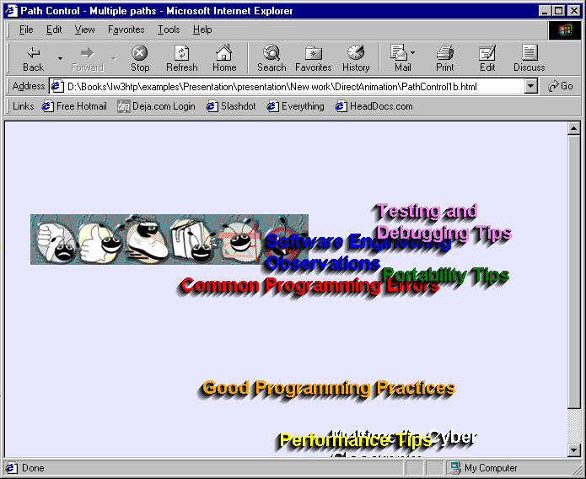
Controlling multiple elements with the Path Control

Slide 13
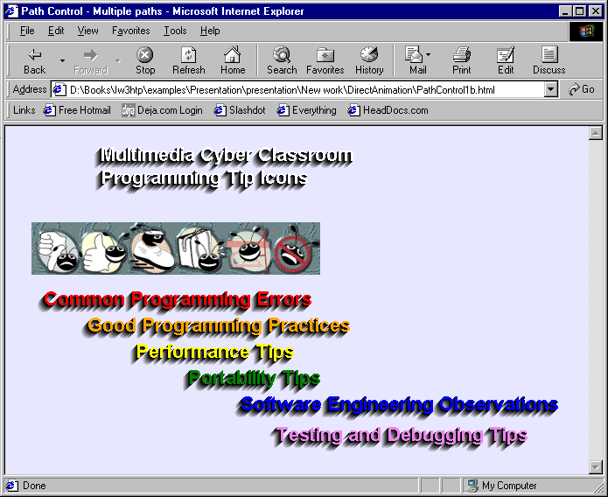
Controlling multiple elements with the Path Control

Slide 14
31.4 Time Markers for Path Control
Execute certain actions at any point along path
  AddTimeMarker method
    First parameter determines at which point time marker placed, in seconds
    Second parameter gives identifying name to event
    Last parameter specifies whether to fire event every time (0) or just the first time (1)

Slide 15
1<!DOCTYPE html PUBLIC "-//W3C//DTD HTML 4.0 Transitional//EN">
2<HTML>
3
4<!-- Fig 31.3: path3.html -->
1.1 Create an event handler for ONMARKER event
1.2 if control structure changes zIndex of pole to alternate bee behind and in front of pole
5<!-- Oval paths and time markers -->
6
7<HEAD>
8<TITLE>Path control - Advanced Paths</TITLE>
9
10<SCRIPT LANGUAGE = "JavaScript" FOR = "oval"
11 EVENT = "ONMARKER ( marker )">
12
13 if ( marker == "mark1" )
14 pole.style.zIndex += 2;
15
16 if ( marker == "mark2" )
17 pole.style.zIndex -= 2;
18</SCRIPT>
19</HEAD>
20
21<BODY STYLE = "background-color: #9C00FF">
22
23<IMG ID = "pole" SRC = "pole.gif" STYLE = "position: absolute;
24 left: 350; top: 80; z-index: 3; height: 300">
25
26<IMG ID = "largebug" SRC = "animatedbug_large.gif"
27 STYLE = "position: absolute; z-index: 4">
28
29<OBJECT ID = "oval"
30 CLASSID = "CLSID:D7A7D7C3-D47F-11D0-89D3-00A0C90833E6">

Slide 16
31 <PARAM NAME = "AutoStart" VALUE = "-1">
32 <PARAM NAME = "Repeat" VALUE = "-1">
33 <PARAM NAME = "Relative" VALUE = "1">
34 <PARAM NAME = "Duration" VALUE = "8">
1.3 Place image on oval path
1.4 Introduce AddTimeMarker method
1.4.1 Note use of sequential identifier in AddTimeMarker1
35 <PARAM NAME = "Shape" VALUE = "Oval( 100, 80, 300, 60 )">
36 <PARAM NAME = "Target" VALUE = "largebug">
37 <PARAM NAME = "AddTimeMarker1" VALUE = "2, mark1, 0">
38 <PARAM NAME = "AddTimeMarker2" VALUE = "6, mark2, 0">
39</OBJECT>
40
41<OBJECT ID = "swarmPath"
42 CLASSID = "CLSID:D7A7D7C3-D47F-11D0-89D3-00A0C90833E6">
43 <PARAM NAME = "AutoStart" VALUE = "-1">
44 <PARAM NAME = "Repeat" VALUE = "-1">
45 <PARAM NAME = "Relative" VALUE = "1">
46 <PARAM NAME = "Duration" VALUE = "15">
47 <PARAM NAME = "Shape"
48 VALUE = "Polygon(6, 0, 0, 400, 300, 450, 50, 320, 300,
49 150, 180, 50, 250 )">
50 <PARAM NAME = "Target" VALUE = "swarm">
51</OBJECT>
52
53<SPAN ID = "swarm"
54 STYLE = "position:absolute; top: 0; left: 0; z-index: 1">
55
56<IMG SRC = "animatedbug_small.gif"
57 STYLE = "position:absolute; top: 25; left: -30">
58<IMG SRC = "animatedbug_small.gif"
59 STYLE = "position:absolute; top: 0; left: 0">
60<IMG SRC = "animatedbug_small.gif"

Slide 17
61 STYLE = "position:absolute; top: 15; left: 70">
62<IMG SRC = "animatedbug_small.gif"
63 STYLE = "position:absolute; top: 30; left: 5">
64<IMG SRC = "animatedbug_small.gif"
65 STYLE = "position: absolute; top: 10; left: 30">
66<IMG SRC = "animatedbug_small.gif"
67 STYLE = "position: absolute; top: 40; left: 40">
68<IMG SRC = "animatedbug_small.gif"
69 STYLE = "position: absolute; top: 65; left: 15">
70
71</SPAN>
72</BODY>
73</HTML>

Slide 18
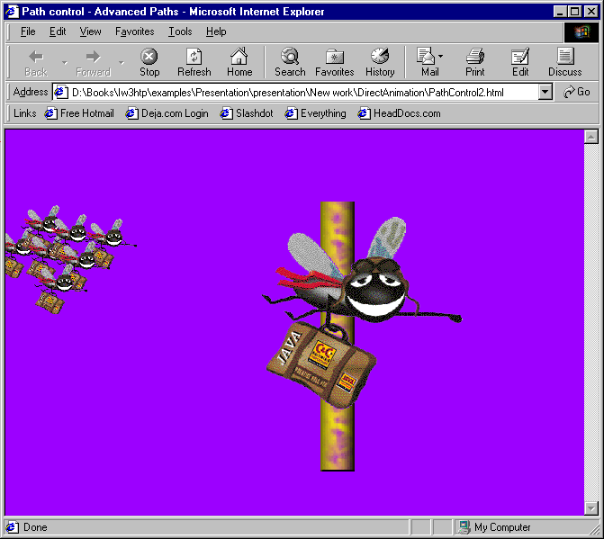
Adding time markers for script interaction

Slide 19
31.5 DirectAnimation Sequencer Control
Sequencer Control
  Control timed events
  Like window.setInterval JavaScript function
  Insert using OBJECT element
Item object
  Creates grouping of events using a common name
at method
  Takes two parameters:
    How many seconds to wait
    What action to perform

Slide 20
1<!DOCTYPE html PUBLIC "-//W3C//DTD HTML 4.0 Transitional//EN">
2<HTML>
3
4<!-- Fig 31.4: sequencer.html -->
1.1 Use script to set parameters for Sequence Control
5<!-- Sequencer Control -->
6
7<HEAD>
8
9<STYLE TYPE = "text/css">
10
11 DIV { font-size: 2em;
12 color: white;
13 font-weight: bold }
14
15</STYLE>
16
17<SCRIPT FOR = "sequencer" EVENT = "oninit">
18 sequencer.Item( "showThem" ).at( 2.0, "show( line1 )" );
19 sequencer.Item( "showThem" ).at( 4.0, "show( line2 )" );
20 sequencer.Item( "showThem" ).at( 6.0, "show( line3 )" );
21 sequencer.Item( "showThem" ).at( 7.0, "show( line4 )" );
22 sequencer.Item( "showThem" ).at( 8.0, "runPath()" );
23</SCRIPT>
24
25<SCRIPT>
26 function show( object )
27 {
28 object.style.visibility = "visible";
29 }
30

Slide 21
31 function start()
32 {
33 sequencer.Item( "showThem" ).Play();
34 }
1.2 Insert control using OBJECT element
35
36 function runPath()
37 {
38 pathControl.Play();
39 }
40</SCRIPT>
41</HEAD>
42
43<BODY STYLE = "background-color: limegreen" ONLOAD = "start()">
44
45<DIV ID = "line1" STYLE = "position: absolute; left: 50;
46 top: 10; visibility: hidden">Sequencer DirectAnimation</DIV>
47
48<DIV ID = "line2" STYLE = "position: absolute; left: 70;
49 top: 60; visibility: hidden">ActiveX Control</DIV>
50
51<DIV ID = "line3" STYLE = "position: absolute; left: 90;
52 top: 110; visibility: hidden">Controls time intervals</DIV>
53
54<DIV ID = "line4" STYLE = "position: absolute; left: 110;
55 top:160; visibility: hidden">For dynamic effects</DIV>
56
57<OBJECT ID = "sequencer"
58 CLASSID = "CLSID:B0A6BAE2-AAF0-11d0-A152-00A0C908DB96">
59</OBJECT>
60

Slide 22
61<OBJECT ID = "pathControl"
62 CLASSID = "CLSID:D7A7D7C3-D47F-11D0-89D3-00A0C90833E6">
63 <PARAM NAME = "AutoStart" VALUE = "0">
64 <PARAM NAME = "Repeat" VALUE = "1">
65 <PARAM NAME = "Relative" VALUE = "1">
66 <PARAM NAME = "Duration" VALUE = "2">
67 <PARAM NAME = "Shape" VALUE = "PolyLine( 2, 0, 0, 250, 0 )">
68 <PARAM NAME = "Target" VALUE = "line4">
69</OBJECT>
70
71</BODY>
72</HTML>

Slide 23
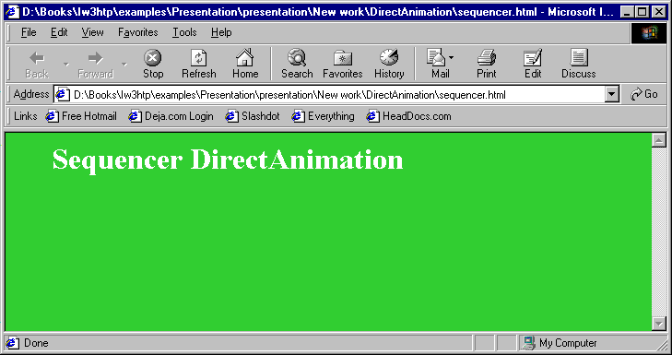
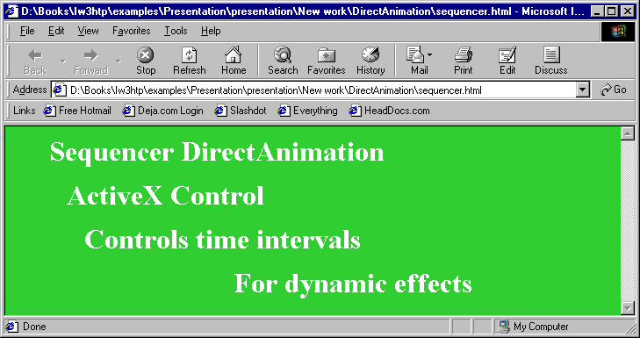
Using the DirectAnimation Sequencer Control

Slide 24
31.6 DirectAnimation Sprite Control
Most standard animation format:
  Animated GIF
Sprite Control
  Provides dynamic control over animation
  Control rate of playback for images or frames
    Animation composed of many individual frames which create illusion of motion
  Insert using OBJECT tag
    height and width CSS properties needed to display image correctly

Slide 25
31.6 DirectAnimation Sprite Control
  Sprite Control attributes:
    REPEAT
      Nonzero VALUE loops indefinitely
    NumFramesAcross and NumFramesDown
      Specify number of rows and columns of frames in animation file
    SourceURL
      Path to file containing animation frames
    AutoStart
      Nonzero VALUE starts animation when page loads

Slide 26
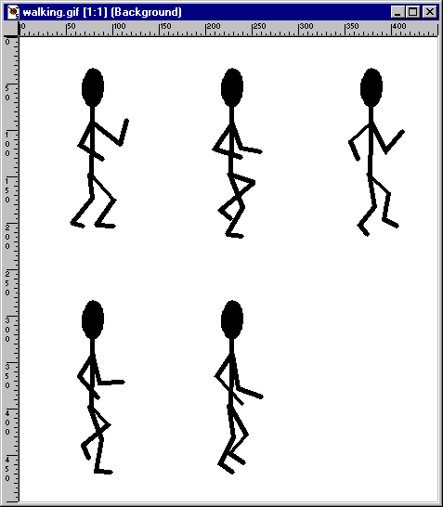
Source image for Sprite Control (walking.gif)

Slide 27
1<!DOCTYPE html PUBLIC "-//W3C//DTD HTML 4.0 Transitional//EN">
2<HTML>
3
4<!-- Fig 31.6: sprite.html -->
Insert Sprite Control using OBJECT element
1.1 Specify attributes of Sprite Control
5<!-- Sprite Control -->
6
7<HEAD>
8 <TITLE>Sprite Control</TITLE>
9</HEAD>
10
11<BODY>
12
13<OBJECT ID = "walking" STYLE = "width: 150; height: 250"
14 CLASSID = "CLSID:FD179533-D86E-11d0-89D6-00A0C90833E6">
15 <PARAM NAME = "Repeat" value = -1>
16 <PARAM NAME = "NumFrames" VALUE = 5>
17 <PARAM NAME = "NumFramesAcross" VALUE = 3>
18 <PARAM NAME = "NumFramesDown" VALUE = 2>
19 <PARAM NAME = "SourceURL" VALUE = "walking.gif">
20 <PARAM NAME = "AutoStart" VALUE = -1>
21</OBJECT>
22
23</BODY>
24 </HTML>

Slide 28
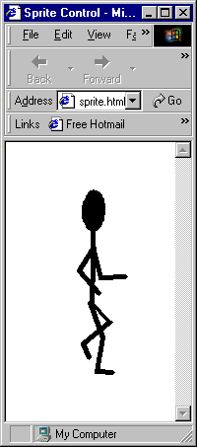
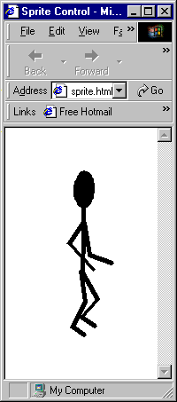
Simple animation with the Sprite Control

Slide 29
31.6 DirectAnimation Sprite Control
Sprite Control
  Can respond to user actions through DHTML
Sprite Control methods
    PlayRate
      Controls rate at which frames displayed
      1 default
      Can only be written at runtime or when animation stopped
    MouseEventsEnabled
      Allows object to capture certain mouse events
    Stop
      Stops animation in place
    Play
      Restarts animation

Slide 30
1<!DOCTYPE html PUBLIC "-//W3C//DTD HTML 4.0 Transitional//EN">
2<HTML>
3
4<!-- Fig 31.7: sprite2.html -->
1.1 Script ONMOUSEOVER event
1.2 Script ONMOUSEOUT event
5<!-- Events with Sprite Control -->
6
7<HEAD>
8<TITLE>Sprite Control</TITLE>
9
10<SCRIPT LANGUAGE = "JavaScript" FOR = "bounce"
11 EVENT = "ONMOUSEOVER">
12
13 bounce.Stop();
14 bounce.PlayRate = -3;
15 bounce.Play();
16</SCRIPT>
17
18<SCRIPT LANGUAGE = "JavaScript" FOR = "bounce"
19 EVENT = "ONMOUSEOUT">
20
21 bounce.Stop();
22 bounce.PlayRate = 1;
23 bounce.Play();
24</SCRIPT>
25</HEAD>
26
27<BODY>
28
29<H1>Sprite Control</H1>
30

Slide 31
31<OBJECT ID = "bounce" STYLE = "width:75; height:75"
32 CLASSID = "CLSID:FD179533-D86E-11d0-89D6-00A0C90833E6">
33 <PARAM NAME = "Repeat" value = -1>
34 <PARAM NAME = "PlayRate" VALUE = 1>
1.3 Insert Sprite Control using OBJECT element
1.4 Enable Sprite Control to capture mouse events
35 <PARAM NAME = "NumFrames" VALUE = 22>
36 <PARAM NAME = "NumFramesAcross" VALUE = 4>
37 <PARAM NAME = "NumFramesDown" VALUE = 6>
38 <PARAM NAME = "SourceURL" VALUE = "bounce.jpg">
39 <PARAM NAME = "MouseEventsEnabled" VALUE = "True">
40 <PARAM NAME = "AutoStart" VALUE = -1>
41</OBJECT>
42
43</BODY>
44</HTML>

Slide 32
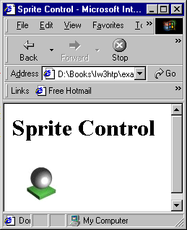

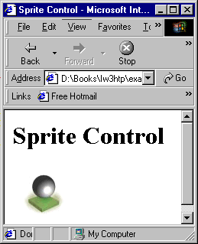
Responding to mouse events with the Sprite Control

Slide 33
31.7 Animated GIFs
Animated GIF
  Most popular method of creating animated graphics
  Composed of frames in GIF format
  Must be assembled in special graphics application
    Animation Shop bundled with Paint Shop Pro
  Format includes features, such as amount of time each frame displayed
  Large number of frames → large file
    Use small images
    Minimize number of frames

Slide 34
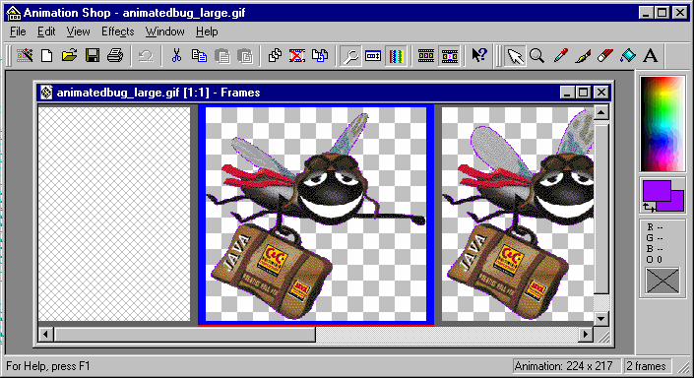
Viewing an Animated Gif in Animation Shop

