Slide 1
Chapter 32 – Multimedia: Audio, Video, Speech Synthesis and Recognition
Outline
32.1 Introduction
32.2 Adding Background Sounds with the BGSOUND Element
32.3 Adding Video with the IMG Element’s DYNSRC Property
32.4 Adding Audio or Video with the EMBED Element
32.5 Using the Windows Media Player ActiveX Control
32.6 Microsoft Agent Control
32.7 RealPlayer Activex Control
32.8 Embedding VRML in a Web page
32.9 Using Streaming Media

Slide 2
32.1 Introduction
Multimedia
  Performance intensive
    Internet bandwidth and processor speed
    Carefully design multimedia-based Web applications
  Multimedia files large
    Some technologies require complete download
    Streaming media
      Audio and video files can begin playing while files are downloading

Slide 3
32.2 Adding Background Sounds with the BGSOUND Element
BGSOUND element
  Specific to IE
  Place in HEAD section
  Ending tag optional
  Four properties
    SRC
      URL of audio clip
    LOOP
      -1 (default) loops until user browses different Web page or clicks Stop button
      Positive integer specifies number of times to loop
      Negative values (other than –1) and zero play clip once

Slide 4
32.2 Adding Background Sounds with the BGSOUND Element
  Four properties (continued)
    BALANCE
      Range from –10000 to 10000
      -10000: sound only from left speaker
      10000: sound only from right speaker
      0: default, sound balanced between left and right speakers
      Cannot be set via scripting
    VOLUME
      Between –10000 (minimum volume) and 0 (maximum volume)
      Default: 0

Slide 5
1<!DOCTYPE HTML PUBLIC "-//W3C//DTD HTML 4.0 Transitional//EN">
2<HTML>
3<!-- Fig. 32.1: BackroundAudio.html -->
4
1.1 Embed audio file with BGSOUND element
1.2 Define function changeProperties to update to user’s input
1.3 Use parseInt to convert input
5<HEAD><TITLE>The BGSOUND Element</TITLE>
6<BGSOUND ID = "audio" SRC = "jazzgos.mid" LOOP = "1"></BGSOUND>
7
8<SCRIPT LANGUAGE = "JavaScript">
9 function changeProperties()
10 {
11 var loop = parseInt( audioForm.loopit.value );
12 audio.loop = ( isNaN( loop ) ? 1 : loop );
13
14 var vol = parseInt( audioForm.vol.value );
15 audio.volume = ( isNaN( vol ) ? 0 : vol );
16 }
17</SCRIPT>
18</HEAD>
19
20<BODY>
21 <H1>Background Music via the BGSOUND Element</H1>
22 <H2>Jazz Gospel</H2>
23
24 This sound is from the free sound downloads at the
25 <A HREF = "http://msdn.microsoft.com/downloads/default.asp">
26 Microsoft Developer Network</a> downloads site.
27 <HR>
28 Use the fields below to change the number of iterations
29 and the volume for the audio clip<BR>
30 Press <B>Stop</B> to stop playing the sound.<BR>

Slide 6
31 Press <B>Refresh</B> to begin playing the sound again.
32
33 <FORM NAME = "audioForm"><P>
34 Loop [-1 = loop forever]
35 <INPUT NAME = "loopit" TYPE = "text" VALUE = "1"><BR>
36 Volume [-10000 (low) to 0 (high)]
37 <INPUT NAME = "vol" TYPE = "text" VALUE = "0"><BR>
38 <INPUT TYPE = "button" VALUE = "Set Properties"
39 ONCLICK = "changeProperties()">
40 </P></FORM>
41</BODY>
42
43</HTML>

Slide 7
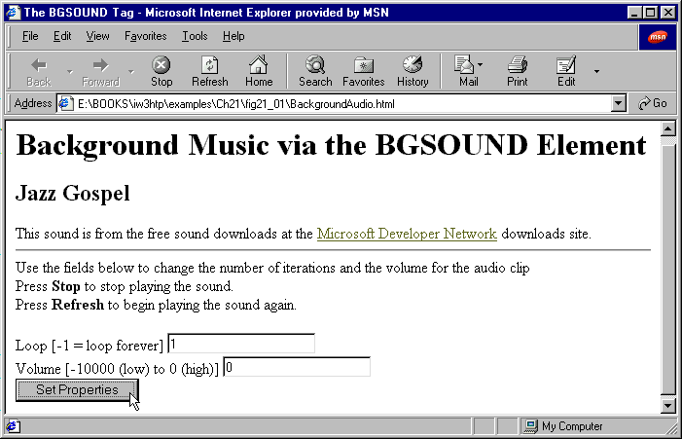
Demonstrating background audio with BGSOUND

Slide 8
32.3 Adding Video with the IMG Element’s DYNSRC Property
Include video with IMG element
  Use DYNSRC (dynamic source) attribute instead of SRC
  DYNSRC attribute specific to IE
  START property
    fileopen: video starts playing as soon as it loads
    mouseover: video plays when user positions mouse over video

Slide 9
1<!DOCTYPE HTML PUBLIC "-//W3C//DTD HTML 4.0 Transitional//EN">
2<HTML>
3<!-- Fig. 32.2: DynamicIMG.html -->
4
1.1 Embed video using DYNSRC property of IMG element
1.2 Set START to mouseover to have video play when user first positions cursor over video
5<HEAD>
6<TITLE>An Embedded Image Using the DYNSRC Property</TITLE>
7<BGSOUND SRC = "newage.mid" LOOP = "-1">
8</HEAD>
9
10<BODY>
11 <H1>An Embedded Video Using the IMG Element's
12 DYNSRC Property</H1>
13 <H2>Spinning Globe and New Age Music</H2>
14 This video is from the
15 <A HREF = "http://www.nasa.gov/gallery/">
16 NASA Multimedia Gallery</A><BR>
17 This sound is from the free sound downloads at the
18 <A HREF = "http://msdn.microsoft.com/downloads/default.asp">
19 Microsoft Developer Network</A> downloads site.
20 <HR>
21 <TABLE><TR>
22 <TD><IMG DYNSRC = "pathfinder.mpeg" START = "mouseover"
23 WIDTH = "180" HEIGHT = "135" LOOP = "-1"
24 ALT = "A spinning image of the Earth"></TD>
25 <TD>This page will play the audio clip and video in a
26 loop.<BR>The video will not begin playing until you move
27 the mouse over the video.<BR>Press <B>Stop</B> to stop
28 playing the sound and the video.</TD></TR></TABLE>
29</BODY>
30</HTML>

Slide 10
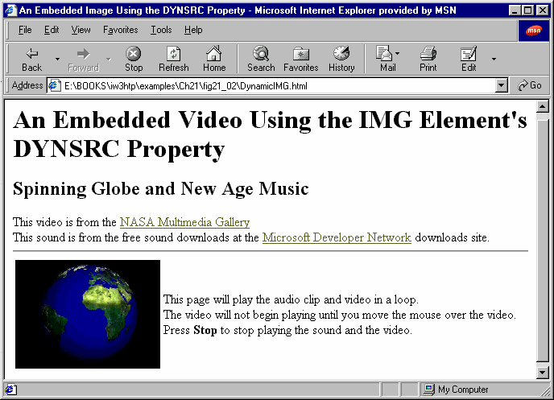
Playing a video with the IMG element’s DYNSRC property

Slide 11
32.4 Adding Audio or Video with the EMBED Element
EMBED element
  Embeds media clip in Web page
  Allows graphical user interface to give user control over clip
    Browser often includes GUI of player registered to handle media type
      Windows Media Player
  HIDDEN property
    Prevent GUI from being displayed
    GUI displayed by default
  LOOP property
    Loop clip forever

Slide 12
1<!DOCTYPE HTML PUBLIC "-//W3C//DTD HTML 4.0 Transitional//EN">
2<HTML>
3<!-- Fig. 32.3: EmbeddedAudio.html -->
4
5<HEAD>
6<TITLE>Background Audio via the EMBED Element</TITLE>
7<STYLE TYPE = "text/css">
8 SPAN { width: 600 }
9 .big { color: blue;
10 font-family: sans-serif;
11 font-size: 50pt;
12 font-weight: bold }
13</STYLE>
14
15<SCRIPT LANGUAGE = "JavaScript">
16 var TimerID;
17 var updown = true;
18 var str = 1;
19
20 function start()
21 {
22 TimerID = window.setInterval( "wave()", 100 );
23 }
24
25 function wave()
26 {
27 if ( str > 20 || str < 1 )
28 updown = !updown;
29
30 if ( updown )

Slide 13
31 str++;
32 else
33 str--;
34
Embed audio clip using EMBED element
35 wft.filters( "wave" ).phase = str * 30;
36 wft.filters( "wave" ).strength = str;
37 }
38</SCRIPT>
39</HEAD>
40
41<BODY ONLOAD = "start()">
42<H1>Background Audio via the EMBED Element</H1>
43<P>Click the text to stop the script.</P>
44
45<SPAN ONCLICK = "window.clearInterval( TimerID )" ID = "wft"
46 STYLE =
47 "filter:wave(add=0, freq=3, light=0, phase=0, strength=5)">
48<P CLASS = "big" ALIGN = "center">WAVE FILTER EFFECT</P></SPAN>
49
50<P>These controls can be used to control the audio.</P>
51<EMBED SRC = "humming.wav" LOOP = "true"></EMBED>
52</BODY>
53</HTML>

Slide 14
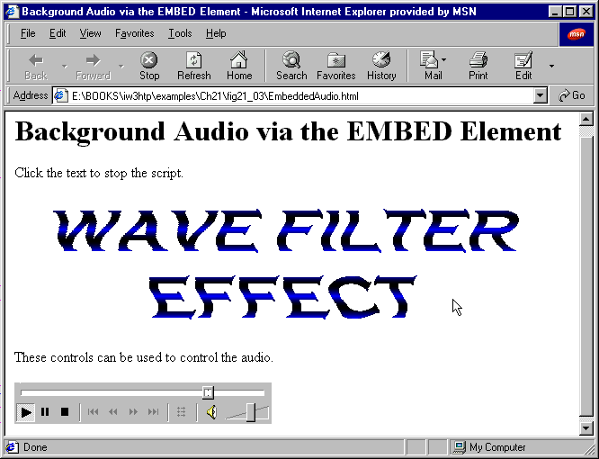
Embedding audio with the EMBED element

Slide 15
1<!DOCTYPE HTML PUBLIC "-//W3C//DTD HTML 4.0 Transitional//EN">
2<HTML>
3<!-- Fig. 32.4: EmbeddedVideo.html -->
4
Embed video clip using EMBED element
5<HEAD>
6<TITLE>Video via the EMBED Element</TITLE>
7</HEAD>
8
9<BODY>
10 <H1>Displaying a Video via the EMBED Element</H1>
11 <H2>Earth Fly-By</H2>
12
13 <TABLE><TR>
14 <TD><EMBED SRC = "approach_1_337.mpeg" LOOP = "false"></EMBED>
15 </TD>
16
17 <TD><P>This video is part of the NASA Multimedia Archives.
18 You can find this video and six additional videos that
19 continue the animation at the <A HREF = "http://
seawifs.gsfc.nasa.gov/OCEAN_PLANET/HTML/oceanography_flyby.html">
20 Sea-viewing Wide Field-of-view Sensor(SeaWiFS) Project
21 </A> site.</P></TD></TABLE>
22 <HR>
23 This page will play the video once.<BR>
24 Use the controls on the embedded video player to play the
25 video again.
26</BODY>
27</HTML>

Slide 16
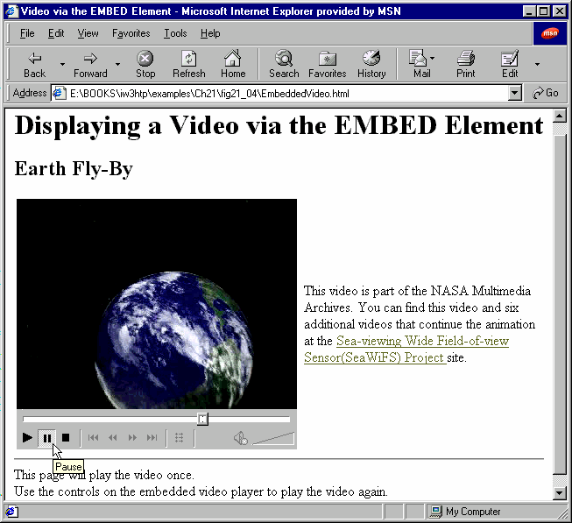
Embedding video with the EMBED element

Slide 17
32.5 Using the Windows Media Player ActiveX Control
Windows Media Player ActiveX control
  Access to range of media formats
  Embed using OBJECT element
  Parameters:
    FileName
      Specifies file containing media clip
    AutoStart
      Boolean for whether clip should start playing when it loads
    ShowControls
      Boolean for whether controls should be displayed
    Loop
      Boolean for whether clip should loop infinitely
  Methods:
    Play
    Pause

Slide 18
1<!DOCTYPE HTML PUBLIC "-//W3C//DTD HTML 4.0 Transitional//EN">
2<HTML>
3<!-- Fig. 32.5: MediaPlayer.html -->
4
1.1Define function toggleVideo to play/pause video
1.2 Embed Windows Media Player ActiveX control for video clip using OBJECT element
1.3 Specify parameters for control
5<HEAD><TITLE>Embedded Media Player Objects</TITLE>
6<SCRIPT LANGUAGE = "JavaScript">
7 var videoPlaying = true;
8
9 function toggleVideo( b )
10 {
11 videoPlaying = !videoPlaying;
12 b.value = videoPlaying ? "Pause Video" : "Play Video";
13 videoPlaying ? VideoPlayer.Play() : VideoPlayer.Pause();
14 }
15</SCRIPT>
16</HEAD>
17
18<BODY>
19<H1>Audio and video through embedded Media Player objects</H1>
20<HR>
21<TABLE>
22 <TR><TD VALIGN = "top" ALIGN = "center">
23 <OBJECT ID = "VideoPlayer" WIDTH = 200 HEIGHT = 225
24 CLASSID = "CLSID:22d6f312-b0f6-11d0-94ab-0080c74c7e95">
25 <PARAM NAME = "FileName" VALUE = "pathfinder.mpeg">
26 <PARAM NAME = "AutoStart" VALUE = "true">
27 <PARAM NAME = "ShowControls" VALUE = "false">
28 <PARAM NAME = "Loop" VALUE = "true">
29 </OBJECT></TD>
30 <TD VALIGN = "bottom" ALIGN = "center">

Slide 19
31 <P>Use the controls below to control the audio clip.</P>
32 <OBJECT ID = "AudioPlayer"
33 CLASSID = "CLSID:22d6f312-b0f6-11d0-94ab-0080c74c7e95">
34 <PARAM NAME = "FileName" VALUE = "newage.mid">
1.4 Embed audio clip using Windows Media Player ActiveX control with OBJECT element
1.5 Create button to allow user to play/pause video
35 <PARAM NAME = "AutoStart" VALUE = "true">
36 <PARAM NAME = "Loop" VALUE = "true">
37 </OBJECT></TD></TR>
38
39 <TR><TD VALIGN = "top" ALIGN = "center">
40 <INPUT NAME = "video" TYPE = "button" VALUE = "Pause Video"
41 ONCLICK = "toggleVideo( this )"></TD>
42</TABLE>
43</BODY>
44</HTML>

Slide 20
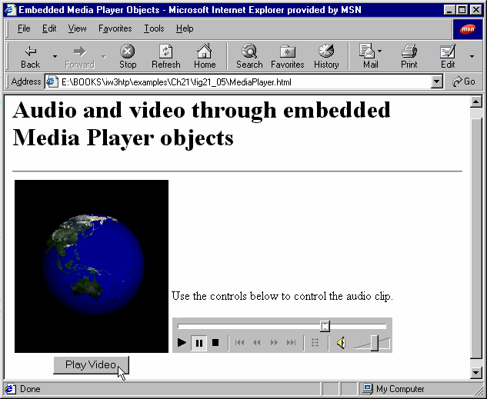
Using the OBJECT element to embed the Windows Media Player ActiveX control in a Web page

Slide 21
32.6 Microsoft Agent Control
Microsoft Agent Control
  Interactive animated characters
    Four predefined:
      Peedy the Parrot
      Genie
      Merlin
      Robby the Robot
    Mouse and keyboard interactions
    Speech (if text-to-speech engine installed)
      Lernout and Hauspie TruVoice text-to-speech engine
    Speech recognition (if speech recognition engine installed)
    Create characters with Microsoft Character Editor and Microsoft Linguistic Sound Editing Tool
    http://msdn.microsoft.com/workshop/imedia/agent

Slide 22
1<!DOCTYPE HTML PUBLIC "-//W3C//DTD HTML 4.0 Transitional//EN">
2<HTML>
3<!-- Fig. 32.6: tutorial.html -->
4
1.1 Embed Microsoft Agent using OBJECT element
1.2 Embed Lernout and Hauspie TruVoice TTS engine using OBJECT element
1.2.1 CODEBASE specifies URL to download control and version of control
1.3 Script Peedy to interact with user
5<HEAD>
6<TITLE>Microsoft Agent and the text to speech engine</TITLE>
7
8<!-- Microsoft Agent ActiveX Control -->
9<OBJECT ID = "agent" WIDTH = "0" HEIGHT = "0"
10 CLASSID = "CLSID:D45FD31B-5C6E-11D1-9EC1-00C04FD7081F"
11 CODEBASE = "#VERSION = 2,0,0,0">
12</OBJECT>
13
14<!-- Lernout & Hauspie TruVoice text to speech engine -->
15<OBJECT WIDTH = "0" HEIGHT = "0"
16 CLASSID = "CLSID:B8F2846E-CE36-11D0-AC83-00C04FD97575"
17 CODEBASE = "#VERSION = 6,0,0,0">
18</OBJECT>
19
20<SCRIPT LANGUAGE = "JavaScript">
21 var parrot;
22 var currentImage = null;
23 var explanations = [
24 // Good Programming Practice Text
25 "Good Programming Practices highlight techniques for " +
26 "writing programs that are clearer, more " +
27 "understandable, more debuggable, and more " +
28 "maintainable.",
29
30 // Software Engineering Observation Text

Slide 23
31 "Software Engineering Observations highlight " +
32 "architectural and design issues that affect the " +
33 "construction of complex software systems.",
34
35 // Performance Tip Text
36 "Performance Tips highlight opportunities for " +
37 "improving program performance.",
38
39 // Portability Tip Text
40 "Portability Tips help students write portable code " +
41 "that can execute in different Web browsers.",
42
43 // Look-and-Feel Observation Text
44 "Look-and-Feel Observations highlight graphical user " +
45 "interface conventions. These observations help " +
46 "students design their own graphical user interfaces " +
47 "in conformance with industry standards.",
48
49 // Testing and Debugging Tip Text
50 "Testing and Debugging Tips tell people how to test " +
51 "and debug their programs. Many of the tips also " +
52 "describe aspects of creating Web pages and scripts " +
53 "that reduce the likelihood of 'bugs' and thus " +
54 "simplify the testing and debugging process.",
55
56 // Common Programming Error Text
57 "Common Programming Errors focus the students’ " +
58 "attention on errors commonly made by beginning " +
59 "programmers. This helps students avoid making the " +
60 "same errors. It also helps reduce the long lines " +

Slide 24
61 "outside instructors’ offices during office hours!" ];
62
63 function loadAgent()
64 {
1.4 Define function loadAgent to load Microsoft Agent character
1.5 Load various animations for Peedy
1.5.1 Use Get method to download states for character
65 agent.Connected = true;
66 agent.Characters.Load( "peedy",
67 "http://agent.microsoft.com/agent2/" +
68 "chars/peedy/peedy.acf" );
69 parrot = agent.Characters.Character( "peedy" );
70 parrot.LanguageID = 0x0409;
71
72 // get states from server
73 parrot.Get( "state", "Showing" );
74 parrot.Get( "state", "Speaking" );
75 parrot.Get( "state", "Hiding" );
76
77 // get Greet animation and do Peedy introduction
78 parrot.Get( "animation", "Greet" );
79 parrot.MoveTo( screenLeft, screenTop - 100 );
80 parrot.Show();
81 parrot.Play( "Greet" );
82 parrot.Speak( "Hello. My name is Peedy the Parrot. " +
83 "Click a programming tip icon, and I will tell " +
84 "you about it." );
85 parrot.Play( "GreetReturn" );
86
87 // get other animations
88 parrot.Get( "animation", "Idling" );
89 parrot.Get( "animation", "MoveDown" );
90 parrot.Get( "animation", "MoveUp" );

Slide 25
91 parrot.Get( "animation", "MoveLeft" );
92 parrot.Get( "animation", "MoveRight" );
93 parrot.Get( "animation", "GetAttention" );
94 }
95
96 function imageSelectTip( tip )
97 {
98 parrot.Stop();
99 for ( var i = 0; i < document.images.length; ++i )
100 if ( document.images( i ) == tip )
101 tellMeAboutIt( i );
102 }
103
104 function tellMeAboutIt( element )
105 {
106 currentImage = document.images( element );
107 currentImage.style.background = "red";
108 parrot.MoveTo( currentImage.offsetParent.offsetLeft,
109 currentImage.offsetParent.offsetTop + 30 );
110 parrot.Speak( explanations[ element ] );
111 }
112</SCRIPT>
113
114<SCRIPT LANGUAGE="JavaScript" FOR = "agent" EVENT = "BalloonHide">
115 if ( currentImage != null ) {
116 currentImage.style.background = "lemonchiffon";
117 currentImage = null;
118 }
119</SCRIPT>
120

Slide 26
121<SCRIPT LANGUAGE = "JavaScript" FOR = "agent" EVENT = "Click">
122 parrot.Stop();
123 parrot.Play( "GetAttention" );
124 parrot.Speak( "Stop poking me with that pointer!" );
1.6 Create TABLE of items for Peedy to describe
125</SCRIPT>
126</HEAD>
127
128<BODY BGCOLOR = "lemonchiffon" ONLOAD = "loadAgent()">
129<TABLE BORDER = "0">
130 <TH COLSPAN = "4"><H1 STYLE = "color: blue">
131 Deitel & Deitel Programming Tips</H1></TH>
132 <TR>
133 <TD ALIGN = "CENTER" VALIGN = "top" WIDTH = "120">
134 <IMG NAME = "gpp" SRC = "GPP_100h.gif"
135 ALT = "Good Programming Practice" BORDER = "0"
136 ONCLICK = "imageSelectTip( this )">
137 <BR>Good Programming Practices</TD>
138 <TD ALIGN = "CENTER" VALIGN = "top" WIDTH = "120">
139 <IMG NAME = "seo" SRC = "SEO_100h.gif"
140 ALT = "Software Engineering Observation" BORDER = "0"
141 ONCLICK = "imageSelectTip( this )">
142 <BR>Software Engineering Observations</TD>
143 <TD ALIGN = "CENTER" VALIGN = "top" WIDTH = "120">
144 <IMG NAME = "perf" SRC = "PERF_100h.gif"
145 ALT = "Performance Tip" BORDER = "0"
146 ONCLICK = "imageSelectTip( this )">
147 <BR>Performance Tips</TD>
148 <TD ALIGN = "CENTER" VALIGN = "top" WIDTH = "120">
149 <IMG NAME = "port" SRC = "PORT_100h.gif"
150 ALT = "Portability Tip" BORDER = "0"

Slide 27
151 ONCLICK = "imageSelectTip( this )">
152 <BR>Portability Tips</TD>
153 </TR>
154 <TR>
155 <TD ALIGN = "CENTER" VALIGN = "top" WIDTH = "120">
156 <IMG NAME = "gui" SRC = "GUI_100h.gif"
157 ALT = "Look-and-Feel Observation" BORDER = "0"
158 ONCLICK = "imageSelectTip( this )">
159 <BR>Look-and-Feel Observations</TD>
160 <TD ALIGN = "CENTER" VALIGN = "top" WIDTH = "120">
161 <IMG NAME = "dbt" SRC = "DBT_100h.gif"
162 ALT = "Testing and Debugging Tip" BORDER = "0"
163 ONCLICK = "imageSelectTip( this )">
164 <BR>Testing and Debugging Tips</TD>
165 <TD ALIGN = "CENTER" VALIGN = "top" WIDTH = "120">
166 <IMG NAME = "cpe" SRC = "CPE_100h.gif"
167 ALT = "Common Programming Error" BORDER = "0"
168 ONCLICK = "imageSelectTip( this )">
169 <BR>Common Programming Errors</TD>
170 </TR>
171</TABLE>
172</BODY>
173</HTML>

Slide 28
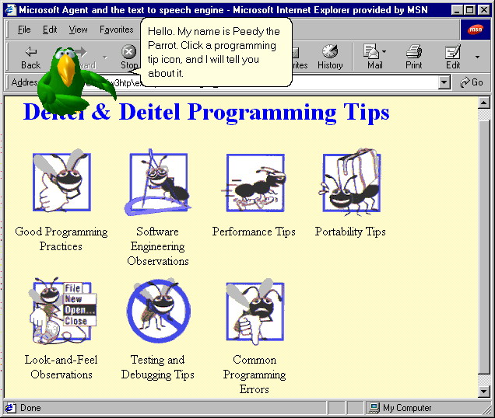
Demonstrating Microsoft Agent and the Lernout and Hauspie TruVoice TTS engine

Slide 29
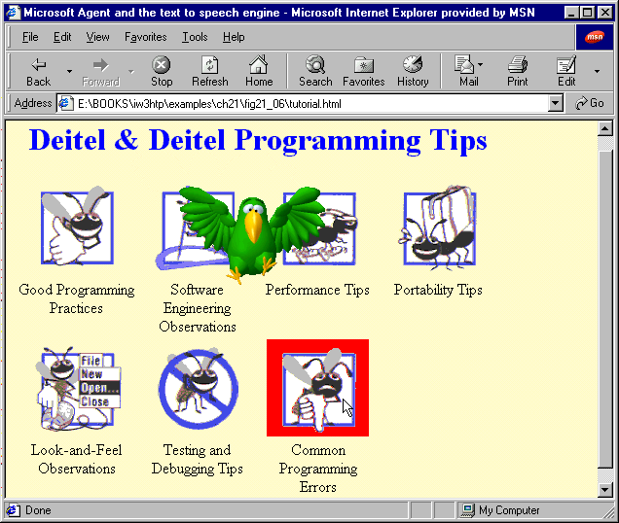
Demonstrating Microsoft Agent and the Lernout and Hauspie TruVoice TTS engine

Slide 30
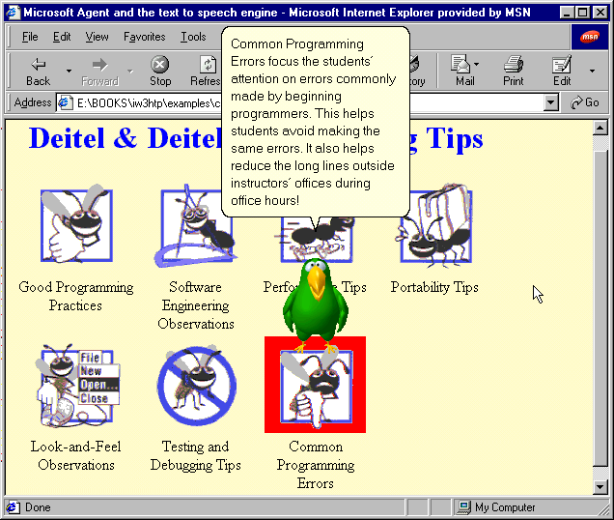
Demonstrating Microsoft Agent and the Lernout and Hauspie TruVoice TTS engine

Slide 31
32.6 Microsoft Agent Control
Microsoft Agent ActiveX controls
  Embedded into Web pages
  CODEBASE property
    Specifies URL to download necessary software
Characters collection
  Load method
  Character method
Character object
  Get method

Slide 32
1<!DOCTYPE HTML PUBLIC "-//W3C//DTD HTML 4.0 Transitional//EN">
2<HTML>
3<!-- Fig. 32.7: tutorial.html -->
4
Enhance previous
example to include
voice recognition
1.1 Include Microsoft Speech Recognition Engine with OBJECT tag
5<HEAD>
6<TITLE>Speech Recognition</TITLE>
7
8<!-- Microsoft Agent ActiveX Control -->
9<OBJECT ID = "agent" WIDTH = "0" HEIGHT = "0"
10 CLASSID = "CLSID:D45FD31B-5C6E-11D1-9EC1-00C04FD7081F"
11 CODEBASE = "#VERSION = 2,0,0,0">
12</OBJECT>
13
14<!-- Lernout & Hauspie TruVoice text to speach engine -->
15<OBJECT WIDTH = "0" HEIGHT = "0"
16 CLASSID = "CLSID:B8F2846E-CE36-11D0-AC83-00C04FD97575"
17 CODEBASE = "#VERSION = 6,0,0,0">
18</OBJECT>
19
20<!-- Microsoft Speech Recognition Engine -->
21<OBJECT WIDTH = "0" HEIGHT = "0"
22 CLASSID = "CLSID:161FA781-A52C-11d0-8D7C-00A0C9034A7E"
23 CODEBASE = "#VERSION = 4,0,0,0">
24</OBJECT>
25
26<SCRIPT LANGUAGE = "JavaScript">
27 var parrot;
28 var currentImage = null;
29 var tips =
30 [ "gpp", "seo", "perf", "port", "gui", "dbt", "cpe" ];

Slide 33
31 var tipNames = [ "Good Programming Practice",
32 "Software Engineering Observation",
33 "Performance Tip", "Portability Tip",
34 "Look-and-Feel Observation",
Optional words or phrases enclosed in brackets
35 "Testing and Debugging Tip",
36 "Common Programming Error" ];
37 var voiceTips = [ "Good [Programming Practice]",
38 "Software [Engineering Observation]",
39 "Performance [Tip]", "Portability [Tip]",
40 "Look-and-Feel [Observation]",
41 "Testing [and Debugging Tip]",
42 "Common [Programming Error]" ];
43 var explanations = [
44 // Good Programming Practice Text
45 "Good Programming Practices highlight techniques for " +
46 "writing programs that are clearer, more " +
47 "understandable, more debuggable, and more " +
48 "maintainable.",
49
50 // Software Engineering Observation Text
51 "Software Engineering Observations highlight " +
52 "architectural and design issues that affect the " +
53 "construction of complex software systems.",
54
55 // Performance Tip Text
56 "Performance Tips highlight opportunities for " +
57 "improving program performance.",
58
59 // Portability Tip Text
60 "Portability Tips help students write portable code " +

Slide 34
61 "that can execute in different Web browsers.",
62
63 // Look-and-Feel Observation Text
64 "Look-and-Feel Observations highlight graphical user " +
65 "interface conventions. These observations help " +
66 "students design their own graphical user interfaces " +
67 "in conformance with industry standards.",
68
69 // Testing and Debugging Tip Text
70 "Testing and Debugging Tips tell people how to test " +
71 "and debug their programs. Many of the tips also " +
72 "describe aspects of creating Web pages and scripts " +
73 "that reduce the likelihood of 'bugs' and thus " +
74 "simplify the testing and debugging process.",
75
76 // Common Programming Error Text
77 "Common Programming Errors focus the students’ " +
78 "attention on errors commonly made by beginning " +
79 "programmers. This helps students avoid making the " +
80 "same errors. It also helps reduce the long lines " +
81 "outside instructors’ offices during office hours!" ];
82
83 function loadAgent()
84 {
85 agent.Connected = true;
86 agent.Characters.Load( "peedy",
87 "http://agent.microsoft.com/agent2/" +
88 "chars/peedy/peedy.acf" );
89 parrot = agent.Characters.Character( "peedy" );
90 parrot.LanguageID = 0x0409; // needed in some conditions

Slide 35
91
92 // get states from server
93 parrot.Get( "state", "Showing" );
94 parrot.Get( "state", "Speaking" );
1.2 Add voice commands with Commands collection’s Add method
95 parrot.Get( "state", "Hiding" );
96
97 // get Greet animation and do Peedy introduction
98 parrot.Get( "animation", "Greet" );
99 parrot.MoveTo( screenLeft, screenTop - 100 );
100 parrot.Show();
101 parrot.Play( "Greet" );
102 parrot.Speak( "Hello. My name is Peedy the Parrot. " +
103 "If you would like me to tell you about a " +
104 "programming tip, click its icon, or, press the " +
105 "'Scroll Lock' key, and speak the name of the " +
106 "tip, into your microphone." );
107 parrot.Play( "GreetReturn" );
108
109 // get other animations
110 parrot.Get( "animation", "Idling" );
111 parrot.Get( "animation", "MoveDown" );
112 parrot.Get( "animation", "MoveUp" );
113 parrot.Get( "animation", "MoveLeft" );
114 parrot.Get( "animation", "MoveRight" );
115 parrot.Get( "animation", "GetAttention" );
116
117 // set up voice commands
118 for ( var i = 0; i < tips.length; ++i )
119 parrot.Commands.Add( tips[ i ], tipNames[ i ],
120 voiceTips[ i ], true, true );

Slide 36
121
122 parrot.Commands.Caption = "Programming Tips";
123 parrot.Commands.Voice = "Programming Tips";
124 parrot.Commands.Visible = true;
1.3 Commands object’s properties Caption, Voice and Visible
125 }
126
127 function imageSelectTip( tip )
128 {
129 for ( var i = 0; i < document.images.length; ++i )
130 if ( document.images( i ) == tip )
131 tellMeAboutIt( i );
132 }
133
134 function voiceSelectTip( cmd )
135 {
136 var found = false;
137
138 for ( var i = 0; i < tips.length; ++i )
139 if ( cmd.Name == tips[ i ] ) {
140 found = true;
141 break;
142 }
143
144 if ( found )
145 tellMeAboutIt( i );
146 }
147
148 function tellMeAboutIt( element )
149 {
150 currentImage = document.images( element );

Slide 37
151 currentImage.style.background = "red";
152 parrot.MoveTo( currentImage.offsetParent.offsetLeft,
153 currentImage.offsetParent.offsetTop + 30 );
154 parrot.Speak( explanations[ element ] );
155 }
156</SCRIPT>
157
158<SCRIPT LANGUAGE = "JavaScript" FOR = "agent"
159 EVENT = "Command( cmd )">
160 voiceSelectTip( cmd );
161</SCRIPT>
162
163<SCRIPT LANGUAGE="JavaScript" FOR = "agent" EVENT = "BalloonHide">
164 if ( currentImage != null ) {
165 currentImage.style.background = "lemonchiffon";
166 currentImage = null;
167 }
168</SCRIPT>
169
170<SCRIPT LANGUAGE = "JavaScript" FOR = "agent" EVENT = "Click">
171 parrot.Play( "GetAttention" );
172 parrot.Speak( "Stop poking me with that pointer!" );
173</SCRIPT>
174
175</HEAD>
176
177<BODY BGCOLOR = "lemonchiffon" ONLOAD = "loadAgent()">
178<TABLE BORDER = "0">
179 <TH COLSPAN = "4">
180 <H1 STYLE="color: blue">Deitel & Deitel Programming Tips</H1>

Slide 38
181 </TH>
182 <TR>
183 <TD ALIGN = "CENTER" VALIGN = "top" WIDTH = "120">
184 <IMG NAME = "gpp" SRC = "GPP_100h.gif"
185 ALT = "Good Programming Practice" BORDER = "0"
186 ONCLICK = "imageSelectTip( this )">
187 <BR>Good Programming Practices</TD>
188 <TD ALIGN = "CENTER" VALIGN = "top" WIDTH = "120">
189 <IMG NAME = "seo" SRC = "SEO_100h.gif"
190 ALT = "Software Engineering Observation" BORDER = "0"
191 ONCLICK = "imageSelectTip( this )">
192 <BR>Software Engineering Observations</TD>
193 <TD ALIGN = "CENTER" VALIGN = "top" WIDTH = "120">
194 <IMG NAME = "perf" SRC = "PERF_100h.gif"
195 ALT = "Performance Tip" BORDER = "0"
196 ONCLICK = "imageSelectTip( this )">
197 <BR>Performance Tips</TD>
198 <TD ALIGN = "CENTER" VALIGN = "top" WIDTH = "120">
199 <IMG NAME = "port" SRC = "PORT_100h.gif"
200 ALT = "Portability Tip" BORDER = "0"
201 ONCLICK = "imageSelectTip( this )">
202 <BR>Portability Tips</TD>
203 </TR>
204 <TR>
205 <TD ALIGN = "CENTER" VALIGN = "top" WIDTH = "120">
206 <IMG NAME = "gui" SRC = "GUI_100h.gif"
207 ALT = "Look-and-Feel Observation" BORDER = "0"
208 ONCLICK = "imageSelectTip( this )">
209 <BR>Look-and-Feel Observations</TD>
210 <TD ALIGN = "CENTER" VALIGN = "top" WIDTH = "120">

Slide 39
211 <IMG NAME = "dbt" SRC = "DBT_100h.gif"
212 ALT = "Testing and Debugging Tip" BORDER = "0"
213 ONCLICK = "imageSelectTip( this )">
214 <BR>Testing and Debugging Tips</TD>
215 <TD ALIGN = "CENTER" VALIGN = "top" WIDTH = "120">
216 <IMG NAME = "cpe" SRC = "CPE_100h.gif"
217 ALT = "Common Programming Error" BORDER = "0"
218 ONCLICK = "imageSelectTip(this)">
219 <BR>Common Programming Errors</TD>
220 </TR>
221</TABLE>
222</BODY>
223</HTML>

Slide 40
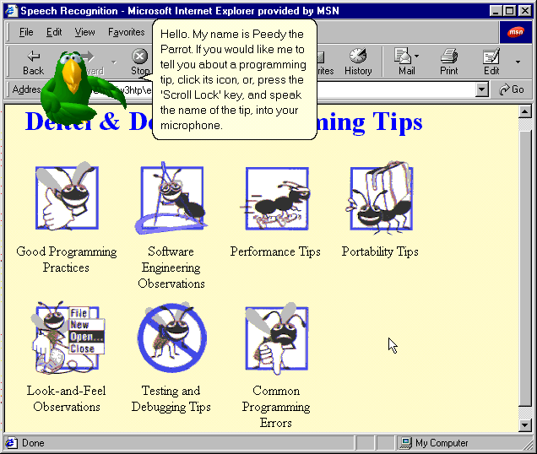
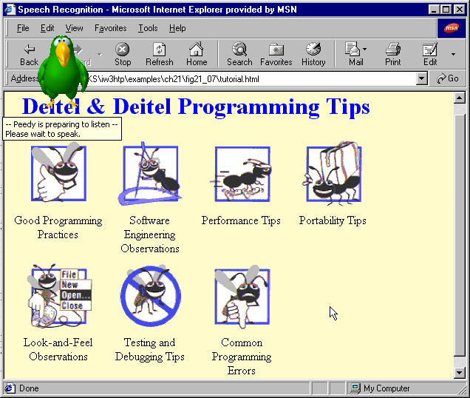
Microsoft Voice Recognition Engine and Microsoft Agent

Slide 41
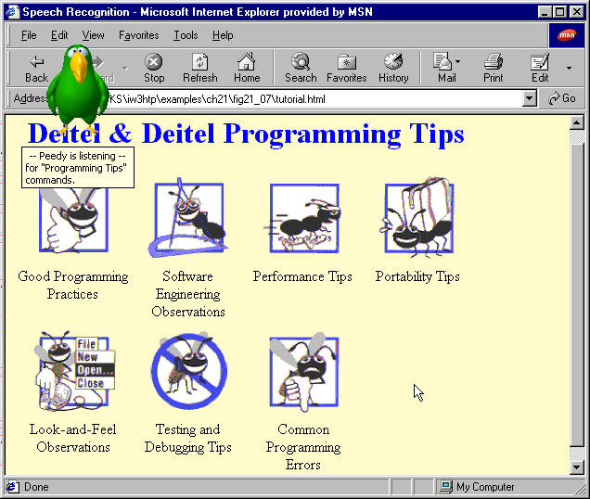
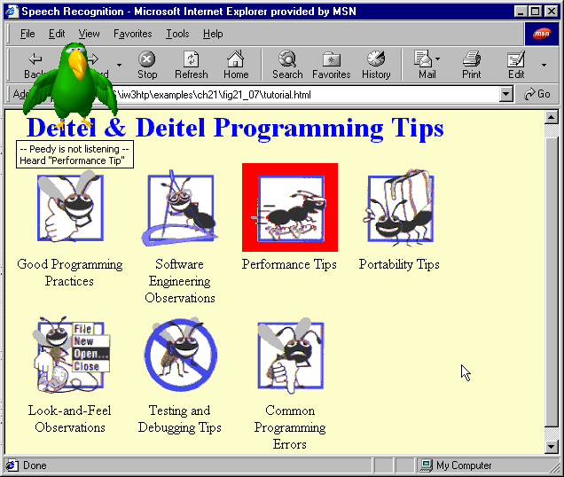
Microsoft Voice Recognition Engine and Microsoft Agent

Slide 42
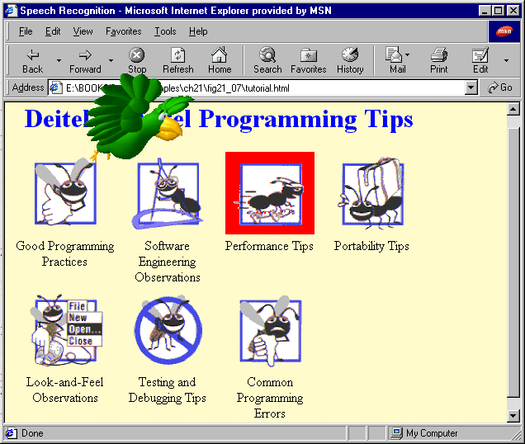
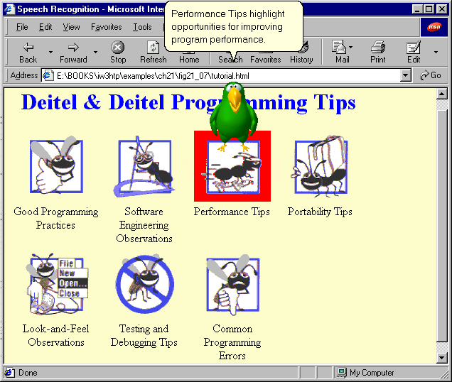
Microsoft Voice Recognition Engine and Microsoft Agent

Slide 43
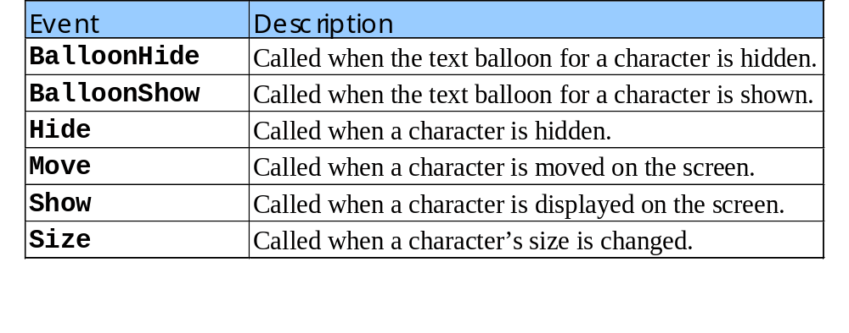
32.6 Using Microsoft Agent Control
Other events for Microsoft Agent control

Slide 44
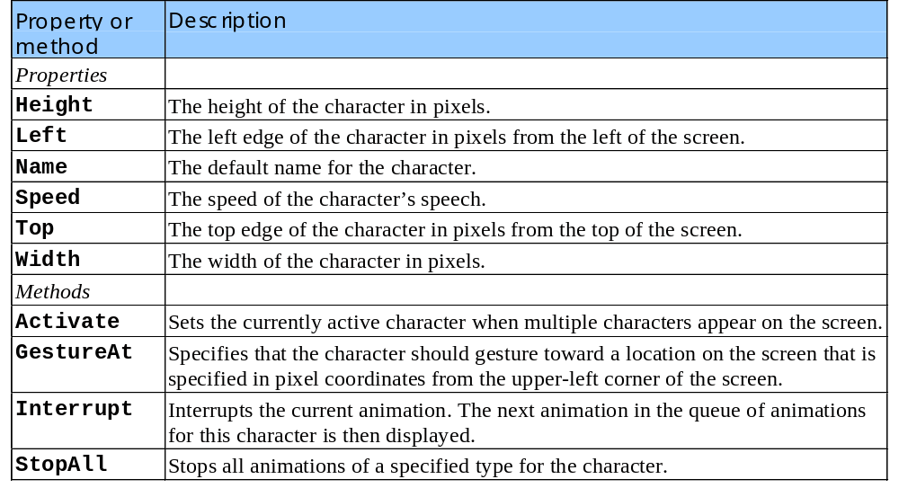
32.6 Using Microsoft Agent Control
Other properties of Characters object

Slide 45
32.7 RealPlayer™ ActiveX Control
EMBED RealPlayer
  Add streaming audio in Web page
  Attributes:
    TYPE
      MIME type of embedded file
    WIDTH and HEIGHT
      Specify dimensions of control
    AUTOSTART
      Boolean for whether audio should start playing when page loads
    CONTROLS
      Specifies which controls available to user
      Play button, Pause button, volume control, etc.
    SRC
      Location of streaming audio

Slide 46
1<!DOCTYPE HTML PUBLIC "-//W3C//DTD HTML 4.0 Transitional//EN">
2<HTML>
3
4<!-- Fig 32.11: real.html -->
1.1 Use JavaScript to dynamically change station
5<!-- Embedding Realplayer into an HTML page -->
6
7<HEAD>
8<TITLE>Live Audio!</TITLE>
9
10<SCRIPT LANGUAGE = "JavaScript">
11 var locations =
12 [ "http://kalx.berkeley.edu/kalx.ram",
13 "http://wmbr.mit.edu/live.ram",
14 "pnm://206.190.42.52/wfmu.ra" ]
15
16 function change( loc )
17 {
18 raControl.SetSource( locations[ loc ] );
19 raControl.DoPlayPause();
20 }
21
22</SCRIPT>
23</HEAD>
24
25<BODY>
26
27<P>
28Pick from my favorite audio streams:
29
30<SELECT ID = "streamSelect" ONCHANGE = "change( this.value )">

Slide 47
31 <OPTION VALUE = "">Select a station</OPTION>
32 <OPTION VALUE = "0">KALX</OPTION>
33 <OPTION VALUE = "1">WMBR</OPTION>
34 <OPTION VALUE = "2">WFMU</OPTION>
1.2 Insert RealPlayer using EMBED element
35</SELECT>
36
37<BR>
38<EMBED ID = "raControl" SRC = ""
39 TYPE = "audio/x-pn-realaudio-plugin" WIDTH = "275"
40 HEIGHT = "125" CONTROLS = "Default" AUTOSTART = "false">
41
42</BODY>
43</HTML>

Slide 48
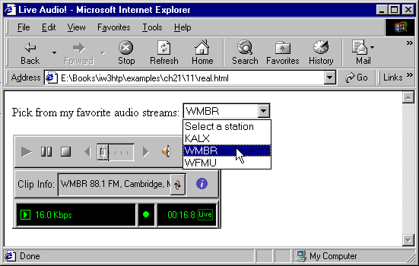
Embedding RealPlayer in a Web page

Slide 49
32.8 Embedding VRML in a Web page
VRML
  Virtual Reality Modeling Language
  Markup language for specifying 3D objects and scenes
  Purely text
  VRML files known as worlds
    End in .wrl file extension
  Use EMBED element to place .wrl file
  IE and Netscape have downloadable plug-ins for VRML
  Controls allow you to rotate world, walk around or change direction

Slide 50
1<HTML>
2
3<!-- Fig 32.11: vrml.html -->
4<!-- Embedding VRML into a Web page -->
1. Use EMBED element to include VRML file in a Web page
5
6<HEAD>
7<TITLE>Live VRML</TITLE>
8</HEAD>
9
10<BODY>
11
12<EMBED SRC = "new.wrl" WIDTH = "400" HEIGHT = "400">
13
14</BODY>
15</HTML>

Slide 51
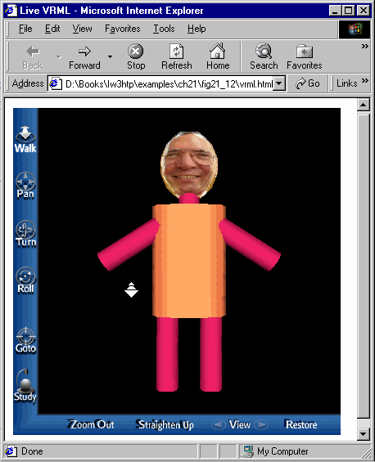
Embedding VRML in a Web page

Slide 52
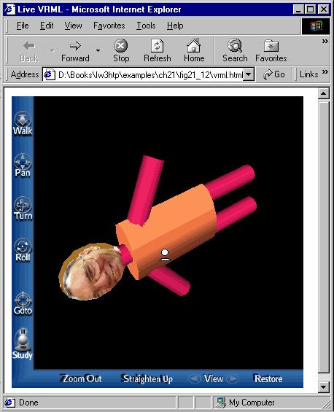
Embedding VRML in a Web page

Slide 53
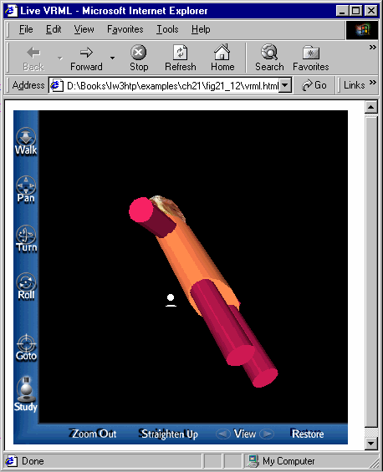
Embedding VRML in a Web page

Slide 54
32.9 Using Streaming Media
Tellsoft Technologies
  Phone-to-Internet content and communications services
  Services include
    iTalkWeb
    iTalkLive
    iTalkSlides
    iTalkMail
Evoke Communications
  Services include
    Talking Email
    Evoke Web conferencing

Slide 55
32.9 Using Streaming Media
iBEAM
  Eliminates latency and jitter from streaming media
  Latency – delay in receiving packets over the Internet
  Jitter – when packets arrive out of order
  Services include
    On-Target
    Activecast
Digital Island
  Offers hosting and network and application services
  Services include
    Footprint
    Footprint Live
    Footprint On-Demand
    Footprint Media Services

