Slide 1
Chapter 34 – Accessibility
Outline
34.1 Introduction
34.2 Providing Alternatives for Multimedia Content
34.3 Maximizing Readability by Focusing on Structure
34.4 Accessibility in HTML Tables
34.5 Accessibility in HTML Frames
34.6 Using Voice Synthesis and Recognition with VoiceXML™
34.7 Accessibility in Microsoft® Windows® 2000
34.7.1 Tools for Visually Impaired People
34.7.2 Tools for Hearing Impaired People
34.7.3 Tools for Users Who Have Difficulty Using the Keyboard
34.7.4 Microsoft Narrator
34.7.5 Microsoft On-Screen Keyboard
34.7.6 Accessibility Features in Microsoft Internet Explorer 5.0
34.8 JAWS® for Windows
34.9 Other Accessibility Tools

Slide 2
34.1 Introduction
Accessibility
  Level of usability of an application or Website for people with disabilities
Web Accessibility Initiative (WAI™)
  World Wide Web Consortium’s attempt to improve accessibility of Websites
  Most Websites considered inaccessible
        www.w3.org/WAI
High level of accessibility hard to obtain
  Different disabilities
  Language barriers
  Hardware and software inconsistencies

Slide 3
34.2 Providing Alternatives for Multimedia Content
ALT attribute
  Used for <IMG> and <INPUT> tags
  Provides a description of multimedia
  Enable user agents to interpret page
User agents
  Program that interprets and translates a Web page
  Examples:
    Screen readers
      Read web pages aloud
    Braille displays
      Convert Web pages to braille

Slide 4
1 <!DOCTYPE HTML PUBLIC "-//W3C//DTD HTML 4.0 Transitional//EN">
2 <HTML LANG = "en">
3
4 <!-- Fig. 34.1 alttag.html -->
1. <STYLE> tag
2. Text explanation
3. <IMG> tag with ALT attribute
5 <!-- Using The ALT tag to Make an Image Accessible -->
6
7 <HEAD>
8 <META HTTP-EQUIV = "Content-Type"
9 CONTENT = "text/html; charset=iso-8859-1">
10
11 <TITLE>
12 How to use the "ALT" attribute
13 </TITLE>
14
15 <STYLE TYPE = "text/css">
16 BODY { background: #6666FF; color: black }
17 P { margin-top: 1em }
18 .center { text-align: center }
19 </STYLE>
20 </HEAD>
21
22 <BODY>
23 <H1>How to use the "ALT" attribute</H1>
24 <P>Below we compare two images, one with the
25 "ALT" attribute present, and one without. The
26 "ALT" appears as a tool tip in the first
27 image, but more importantly, will help users
28 who cannot view information conveyed graphically.
29 </P>
30
31 <P CLASS = "center">
32 This image has the "ALT" attribute<BR>
33 <IMG ALT = "This is a picture of the Internet and World Wide

Slide 5
34 Web How To Program Text Book" SRC = "Images/iw3htpcov.jpg"
35 WIDTH = "182" HEIGHT = "238">
36 </P>
37
3. <IMG> tag with ALT attribute
4. <IMG> tag without ALT attribute
38 <P CLASS = "center">
39 This image does not have the "ALT" attribute<BR>
40 <!-- This markup should be changed -->
41 <!-- becuase there is no ALT attribute -->
42 <IMG SRC = "Images/iw3htpcov.jpg" WIDTH = "182" height="238">
43 </P>
44 </BODY>
45 </HTML>

Slide 6
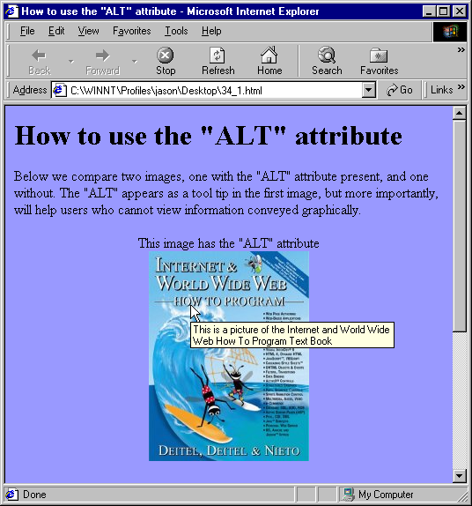
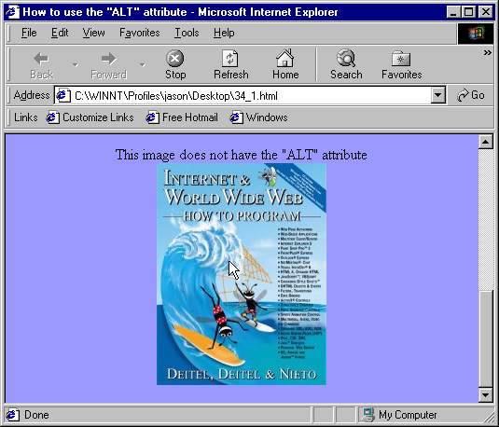
Demonstration of the ALT attribute

Slide 7
34.2 Providing Alternatives for Multimedia Content
Server-side image maps
  Are images stored on a Web server with areas designated as hyperlinks
  Very inaccessible
  Use client-side image maps instead
    Images with hyperlinks, specified in Web page’s source code

Slide 8
34.3 Maximizing Readability by Focusing on Structure
Only use tags as they are intended
  Don’t misuse for aesthetic purposes
  See www.w3.org/TR/WCAG for specifications
Readability
  Reading level page is written at
  Gunning Fog Index
    Formula for grading readability

Slide 9
34.4 Accessibility in HTML Tables
Tables
  Hard for screen readers to interpret
    Read in a linearized manner
      Start at top-left and read left to right, top to bottom
      The table
      would be read:
    Price of Fruit Fruit Price Apple $0.25 Orange $0.50 Banana $1.00 Pineapple $2.00
Price of Fruit
Fruit | Price
Apple | $0.25
Orange | $0.50
Banana | $1.00
Pineapple | $2.00

Slide 10
1 <HTML>
2 <!-- Fig. 34.3 headers.html -->
3
4 <HEAD>
5 <TITLE>HEADERS EXAMPLE</TITLE>
1. <TABLE> tag with SUMMARY attribute
2. <TH> tag with ID attribute
3. <TD> tag with HEADERS attribute
6
7 </HEAD>
8
9 <BODY BGCOLOR = "#7E0810" TEXT = "#ffffff">
10
11 <!-- This table uses the ID and HEADERS attributes -->
12 <!-- Using them ensures readability by text-based browsers -->
13 <!—It also uses a SUMMARY attribute -->
14 <!-- SUMMARY explains the table to a screen reader -->
15
16 <TABLE SUMMARY = "This table uses TH elements and ID and HEADER
17 attributes to make the table readable by screen readers"
18 WIDTH = "47%" BORDER = "1" ALIGN = "CENTER">
19 <CAPTION><B>Price of Fruit
20 </B></CAPTION>
21 <TR>
22 <TH ID = "fruit">Fruit</TH>
23 <TH ID = "price">Price</TH>
24 </TR>
25 <TR>
26 <TD HEADERS = "fruit">Apple</TD>
27 <TD HEADERS = "price">$0.25</TD>
28 </TR>
29 <TR>
30 <TD HEADERS = "fruit">Orange</TD>
31 <TD HEADERS = "price">$0.50</TD>
32 </TR>
33 <TR>

Slide 11
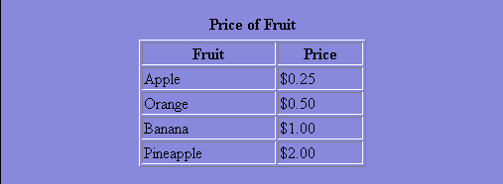
34 <TD HEADERS = "fruit">Banana</TD>
35 <TD HEADERS = "price">$1.00</TD>
36 </TR>
37 <TR>
38 <TD HEADERS = "fruit">Pineapple</TD>
39 <TD HEADERS = "price">$2.00</TD>
40 </TR>
41 </TABLE>
42 </BODY>
43 </HTML>

Slide 12
Screen Readers interpretation of Table
Caption: Price of Fruit
Summary: This table uses TH and the ID and HEADERS attributes to make the table readable by screen readers.
Fruit: Apple, Price: $0.25
Fruit: Orange, Price: $0.50
Fruit: Banana, Price: $1.00
Fruit: Pineapple, Price: $2.00

Slide 13
34.5 Accessibility in HTML Frames
Frames
  Used to display multiple pages simultaneously
  <TITLE> tag
    Used to name and describe each frame
  <NOFRAMES> tag
    Used for browsers that don’t support frames
  Use CSS instead of frames when possible

Slide 14
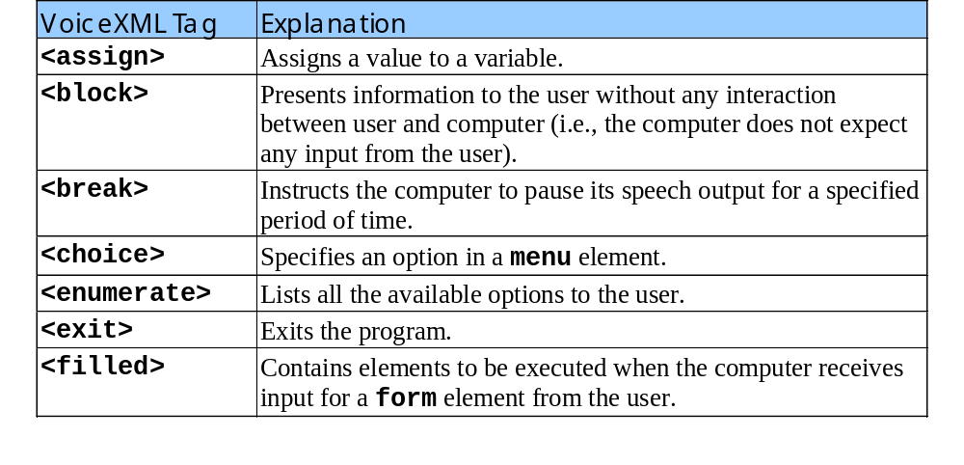
34.6 Using Voice Synthesis and Recognition with VoiceXML
VoiceXML
  Enables the computer to speak to the user
  Document’s text is spoken to the user
  Has tags which enable interactivity

Slide 15
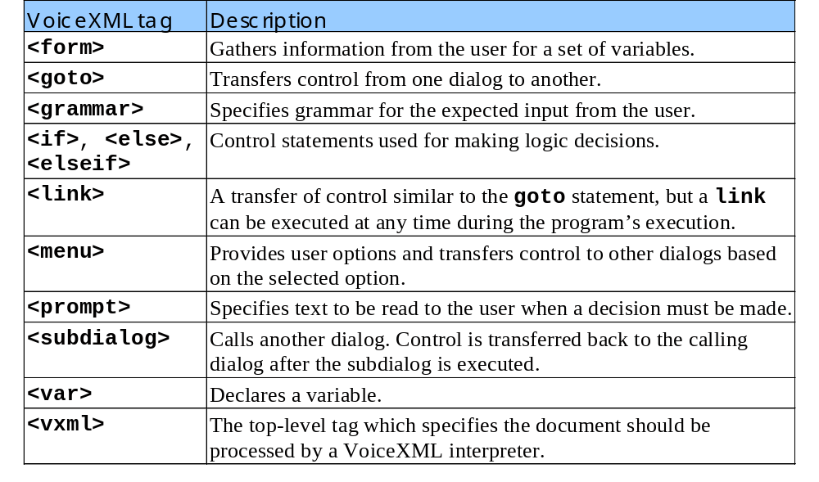
34.6 Using Voice Synthesis and Recognition with VoiceXML
VoiceXML tags (continued)

Slide 16
34.7 Accessibility in Microsoft
Windows 2000
Accessibility Wizard
  Accessibility options Windows 2000
  Accessed through Start menu
Microsoft Magnifier
  Enlarges sections of screen

Slide 17
34.7.1 Tools for Visually Impaired People
Visual tools
  Increase icon and scroll bar sizes
  Change color settings
  Change mouse cursor

Slide 18
34.7.2 Tools for Hearing-Impaired People
Audio tools
  SoundSentry
    Visual signals to replace audio signals
  ShowSounds
    Adds captions

Slide 19
34.7.3 Tools for Users Who Have Difficulty Using the Keyboard
Keyboard tools
  StickyKeys
    Allows user more time for multiple key combinations
  BounceKeys
    Ignores repeated keystrokes
  Extra Keyboard Help
Mouse tools
  MouseKeys
    Keyboard simulation of mouse
  Mouse Button Settings
    Create a virtual left-handed mouse
  MouseSpeed

Slide 20
34.7.3 Tools for Users Who Have Difficulty Using the Keyboard
Accessibility options
  Set Automatic Timeouts
    Toggle accessibility options after a timeout
  Save Settings to File
    Save customized accessibility options

Slide 21
34.7.4 Microsoft Narrator
Microsoft Narrator
  Text-to-speech program
    Reads text
    Describes desktop
    Alerts the user of Windows events
  Screen reader
    Works with many Microsoft products

Slide 22
34.7.5 Microsoft On-Screen Keyboard
Microsoft On-Screen Keybaord
  Displays keyboard on screen
  Can type on on-screen keyboard with mouse
  Other on-screen keyboards available

Slide 23
34.7.6 Accessibility Features in Microsoft Internet Explorer 5.0
Internet Explorer 5.0
  Change Web colors and font sizes
  Specify style sheet
  Expand <ALT> text
  Improve screen reader readability

Slide 24
34.8 JAWS for Windows
JAWS
  Leading screen reader
  www.hj.com

Slide 25
34.9 Other Accessibility Tools
Other accessibility tools
  Braille keyboards
  Speech synthesizers
  SMIL
  EagleEyes

