Slide 1
Data Communication and Networks (Fall 2004)
Lecture 1
The Physical Layer
Data Transmission & Transmission Media
Dr. Sahar M. Ghanem

Slide 2
Course Outline (1)
Time and Location
  Prof. Dr. Nazih: Sunday 10:15 @ auditorium room
  Dr. Sahar: Tuesday 12 @ auditorium room
Teaching Assistant
  Eng. Wael: Wednesday 8:15
References
  W. Stallings, “Data and Computer Communications”, 7th edition, 2003, Prentice Hall
  A. S. Tanenbaum, “Computer Networks”, 4th edition, 2003, Prentice Hall

Slide 3
Course Outline (2)
Prof. Dr. Nazih
  Introduction and Network Design
  The Data Link Layer (2)
  The Medium Access Control Sublayer (3)
Dr. Sahar
  The Physical layer (1)
  The Network Layer (4)
  The Transport Layer (5)
  Network Security

Slide 4
Introduction
Uses of Computer Networks
  Business Applications
  Home Applications
  Social Issues
Network Hardware
  LAN, MAN, WAN, and Internetworks
  Wireless Networks
Network Software
  Use of stack of layers to reduce design complexity
  Each layer provides services (through interface) to the upper layer

Slide 5
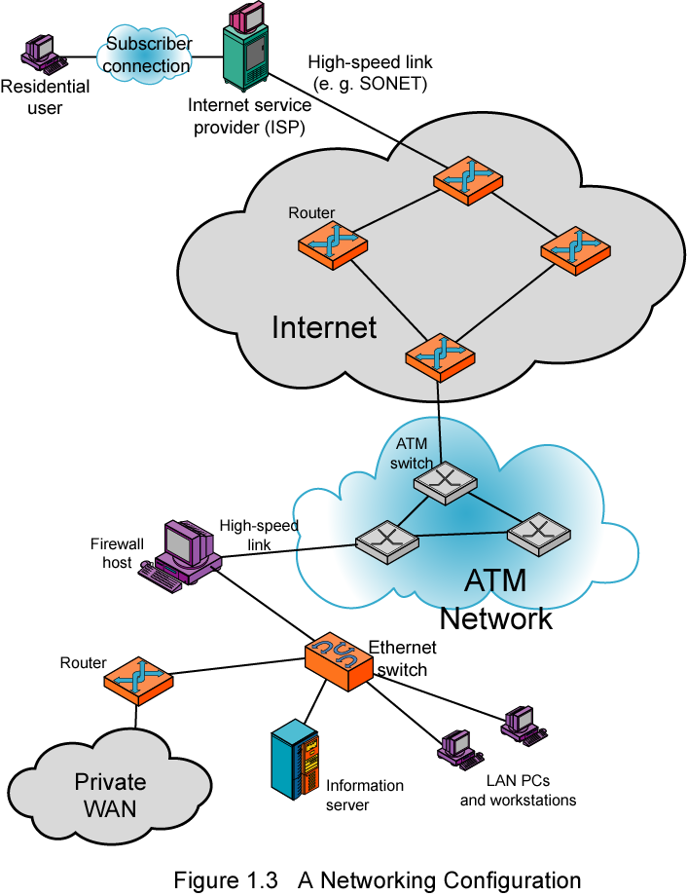
Networking
Configuration

Slide 6
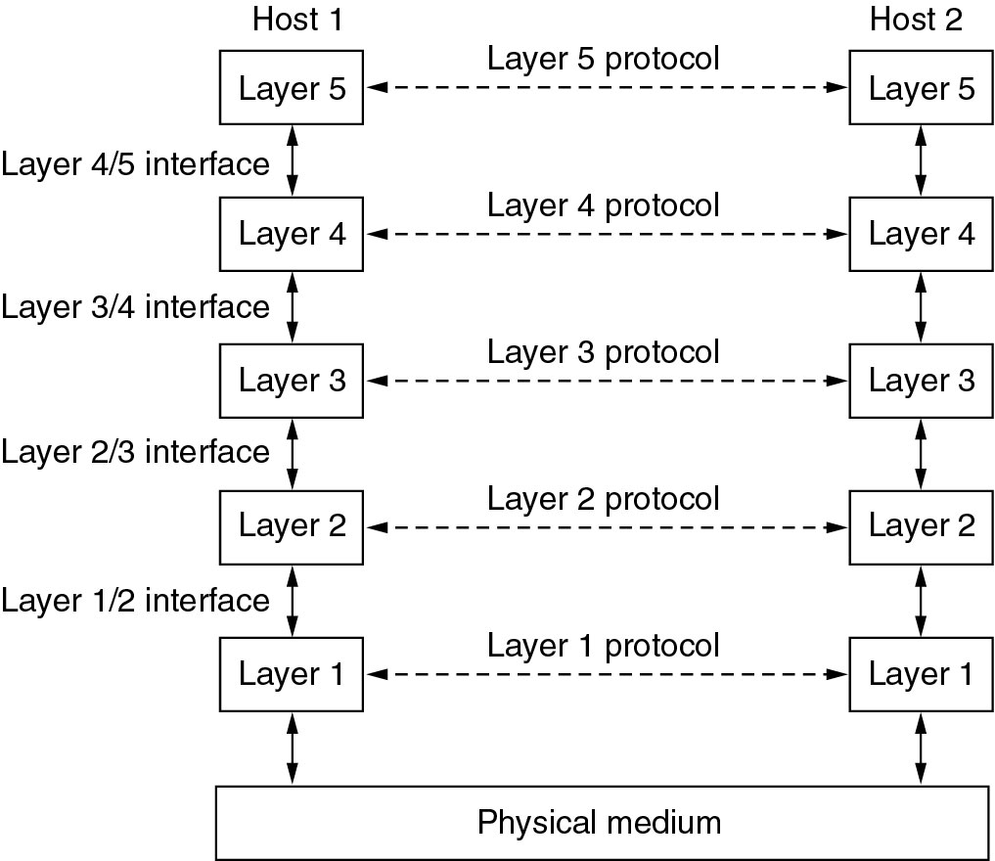
Network Software
Protocol Hierarchies
Layers, protocols, and interfaces.

Slide 7
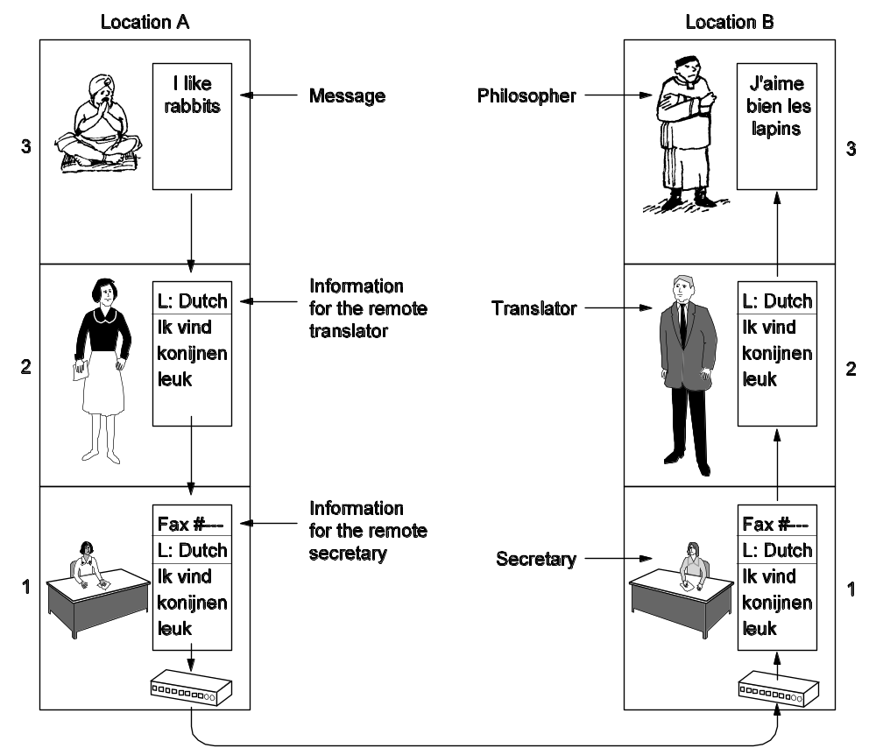
Protocol Hierarchies (2)
The philosopher-translator-secretary architecture.

Slide 8
The Physical Layer

Slide 9
Terminology
The physical layer is concerned with transmitting raw bits over a communication channel (direct link)
Transmitter (sender/source)
Receiver (destination)
Medium
  Guided medium: e.g. twisted pair, optical fiber
  Unguided medium: e.g. air, water, vacuum
Point-to-point vs. Multi-point link
Simplex, half duplex, and duplex transmissions

Slide 10
Concepts
Data :Entities that convey meaning
  Analog Data (continuous): e.g. sound, video
  Digital Data (discrete): e.g. text, integers
Signals: Electric or electromagnetic representations of data
  Signals are means by which data are propagated
Transmission: Communication of data by propagation and processing of signals

Slide 11
Lecture Overview
Signal and Data
Transmission
Channel Capacity
Transmission Media

Slide 12
Signal and Data

Slide 13
Time domain concepts
Analog signal vs. Digital signal
  Analog: various in a smooth way over time
  Digital: Maintains a constant level then changes to another constant level
Periodic signal and Aperiodic signal
Sine wave is a fundamental periodic signal that has three parameters:
  Peak Amplitude (A): maximum strength of signal in volts
  Frequency (f): Rate of change of signal; Hertz (Hz) or cycles per second; Period = time for one repetition (T); T = 1/f
  Phase (φ): Relative position to time zero (degree/radian)

Slide 14
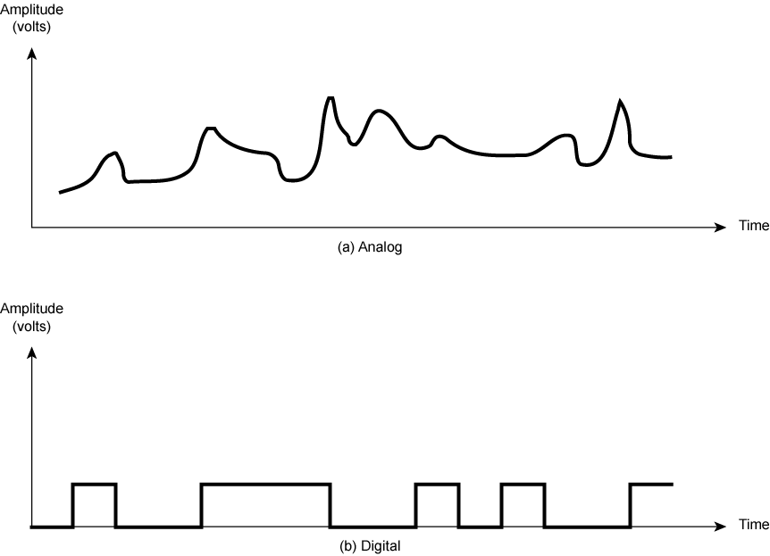
Analogue & Digital Signals

Slide 15
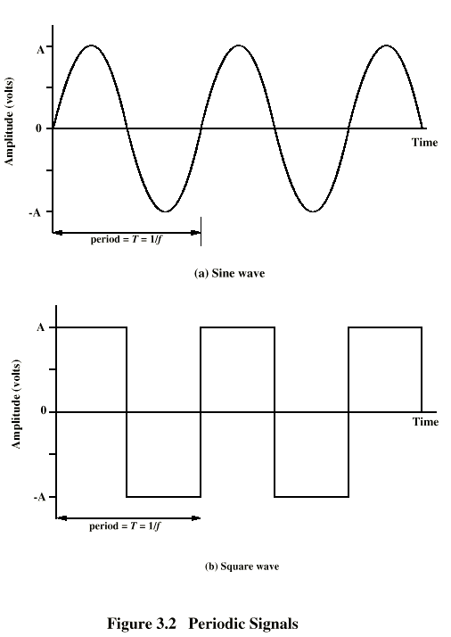
Periodic
Signals

Slide 16
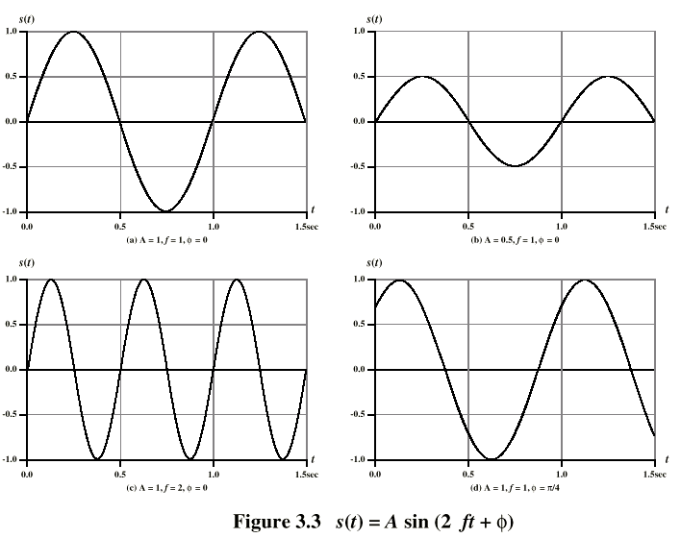
Varying Sine Waves s(t) = A sin(2πft +Φ)

Slide 17
Wavelength
Distance occupied by one cycle
Distance between two points of corresponding phase in two consecutive cycles
λ
Assuming signal velocity v
  λ = vT
  λf = v
  c = 3*10⁸ ms⁻¹ (speed of light in free space)

Slide 18
Frequency Domain Concepts
Can be shown (Fourier analysis) that any signal is made up of component sine waves
  Each with appropriate amplitude, frequency, and phase
Can plot frequency domain function of a signal
  Peak amplitude of the constituent frequencies
  Digital signal has an infinite number of frequency components
Any transmission medium is able to pass only a limited band of frequencies
  This limits the data rate (bps) that can be carried

Slide 19
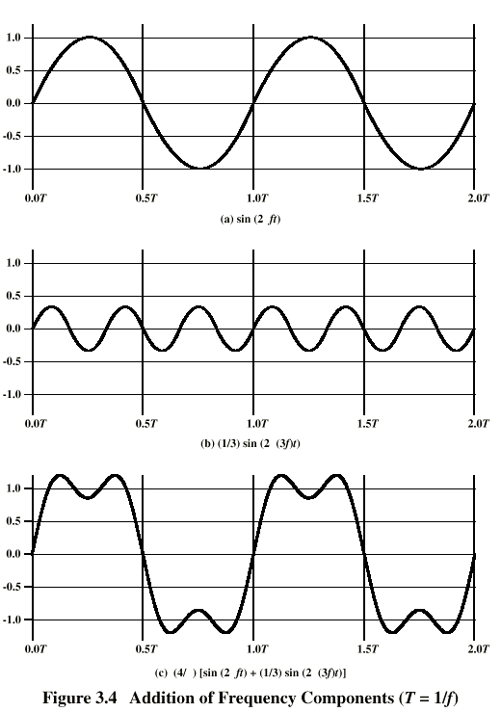
Addition of
Frequency
Components
(T=1/f)

Slide 20
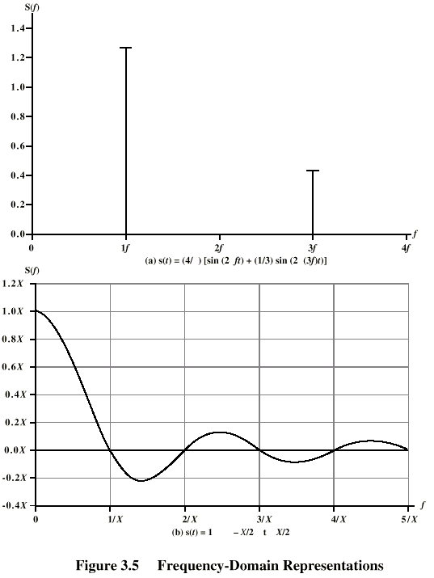
Frequency
Domain
Representations

Slide 21
Spectrum & Bandwidth
Spectrum
  range of frequencies contained in signal
Effective bandwidth
  Often just bandwidth
  Narrow band of frequencies containing most of the energy
DC Component
  Component of zero frequency

Slide 22
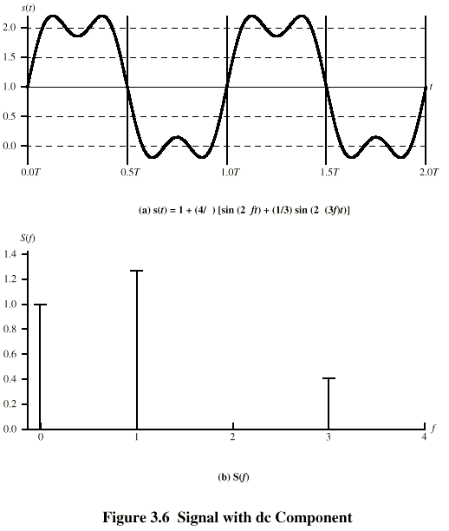
Signal with DC Component

Slide 23
Data to Signal
Speech (sound wave)
  Frequency range (of hearing) 20Hz-20kHz
  Speech spectrum 100Hz-7kHz
  Standard spectrum for voice channel 300-3400Hz
TV video signal
  USA - 525 vertical lines scanned per frame at 30 frames per second (15750 lines per second)
    63.5μs per line -11μs for retrace = 52.5 μs per line
  Worst case scan about 450 lines giving 225 cycles (assume 1010..) of wave in 52.5 μs
  Max frequency of 4.2MHz (approximately 4MHz)
Binary digital data
  Two dc voltage levels
  Bandwidth depends on data rate

Slide 24
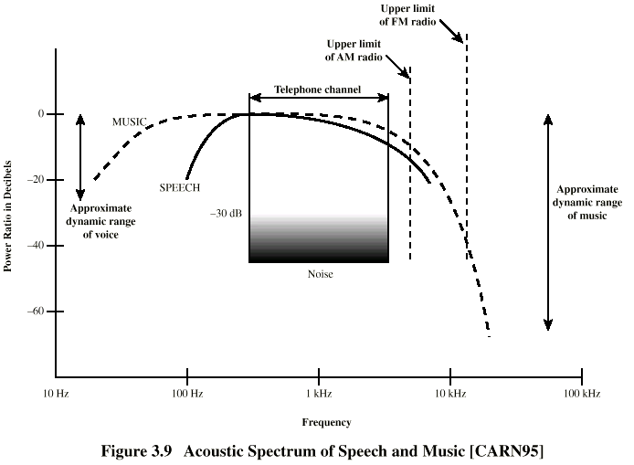
Acoustic Spectrum (Analog)

Slide 25
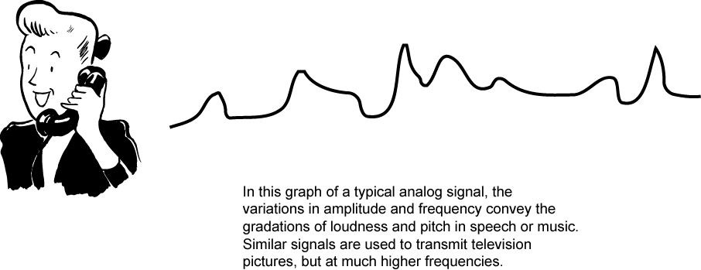
Conversion of Voice Input into Analog Signal

Slide 26
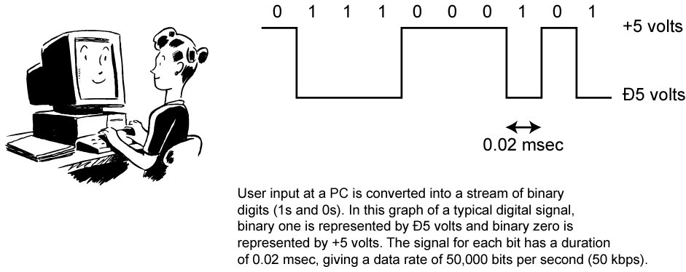
Conversion of PC Input to Digital Signal

Slide 27
Data and Signals
Usually use digital signals for digital data and analog signals for analog data
Can use analog signal to carry digital data
  Modem
Can use digital signal to carry analog data
  Compact Disc audio

Slide 28
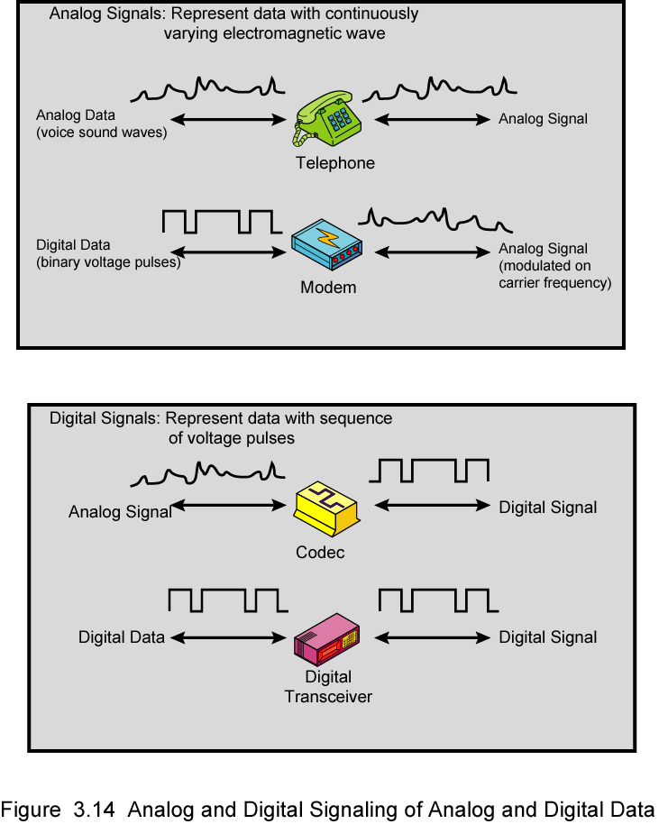
Analog Signals Carrying Analog and Digital Data

Slide 29
Digital Signals Carrying Analog and Digital Data

Slide 30
Transmission

Slide 31
Analog Transmission
Analog signal transmitted without regard to content (analog or digital data)
Attenuated over distance
Use amplifiers to boost signal that also amplifies noise
Digital Transmission
Concerned with content
Integrity endangered by noise, attenuation etc.
Repeaters used: receives signal; extracts bit pattern; retransmits
Noise is not amplified

Slide 32
Advantages of Digital Transmission
Digital technology
  Low cost LSI/VLSI technology
Data integrity
  Repeaters allow longer distances over lower quality lines
Capacity utilization
  High bandwidth links economical
  High degree of multiplexing easier with digital techniques
Security & Privacy
  Encryption
Integration
  Can treat analog and digital data similarly

Slide 33
Transmission Impairments
Signal received may differ from signal transmitted
Analog - degradation of signal quality
Digital - bit errors
Caused by
  Attenuation and attenuation distortion
  Delay distortion
  Noise

Slide 34
Attenuation
Signal strength falls off with distance
Depends on medium
Received signal strength:
  must be enough to be detected
  must be sufficiently higher than noise to be received without error
Attenuation is an increasing function of frequency

Slide 35
Delay Distortion
Only in guided media
Propagation velocity varies with frequency

Slide 36
Noise (1)
Additional signals inserted between transmitter and receiver
Thermal
  Due to thermal agitation of electrons
  Uniformly distributed
  White noise
Intermodulation
  Signals that are the sum and difference of original frequencies sharing a medium

Slide 37
Noise (2)
Crosstalk
  A signal from one line is picked up by another
Impulse
  Irregular pulses or spikes
  e.g. External electromagnetic interference
  Short duration
  High amplitude

Slide 38
Channel Capacity

Slide 39
Channel Capacity
Data rate
  In bits per second
  Rate at which data can be communicated
Bandwidth
  In cycles per second of Hertz
  Constrained by transmitter and medium

Slide 40
Nyquist Bandwidth
If rate of signal transmission is 2B then signal with frequencies no greater than B is sufficient to carry signal rate
Given bandwidth B, highest signal rate is 2B
Given binary signal, data rate supported by B Hz is 2B bps
Can be increased by using M signal levels
C= 2B log₂M

Slide 41
Shannon Capacity Formula
Consider data rate, noise and error rate
Faster data rate shortens each bit so burst of noise affects more bits
  At given noise level, high data rate means higher error rate
Signal to noise ration (in decibels)
SNR_{db}⁼10 log₁₀ (signal/noise)
Capacity C=B log₂(1+SNR)
This is error free capacity

Slide 42
Transmission Media

Slide 43
Transmission Media
Overview
Guided media provide a physical path for signal propagation (i.e. wire)
Unguided media employ an antenna for transmitting through air, vacuum, or water (i.e. wireless)
Data transmission characteristics and quality are determined by medium and signal
  For guided, the medium is more important
  For unguided, the bandwidth produced by the antenna is more important
Data transmission design concerns are data rate and distance (greater is better)

Slide 44
Design Factors
Bandwidth
  Higher bandwidth gives higher data rate
Transmission impairments
  Attenuation limit the distance
Interference from competing signals (e.g. nearby cables)
Number of receivers
  In guided media, more receivers (multi-point) introduce more attenuation

Slide 45
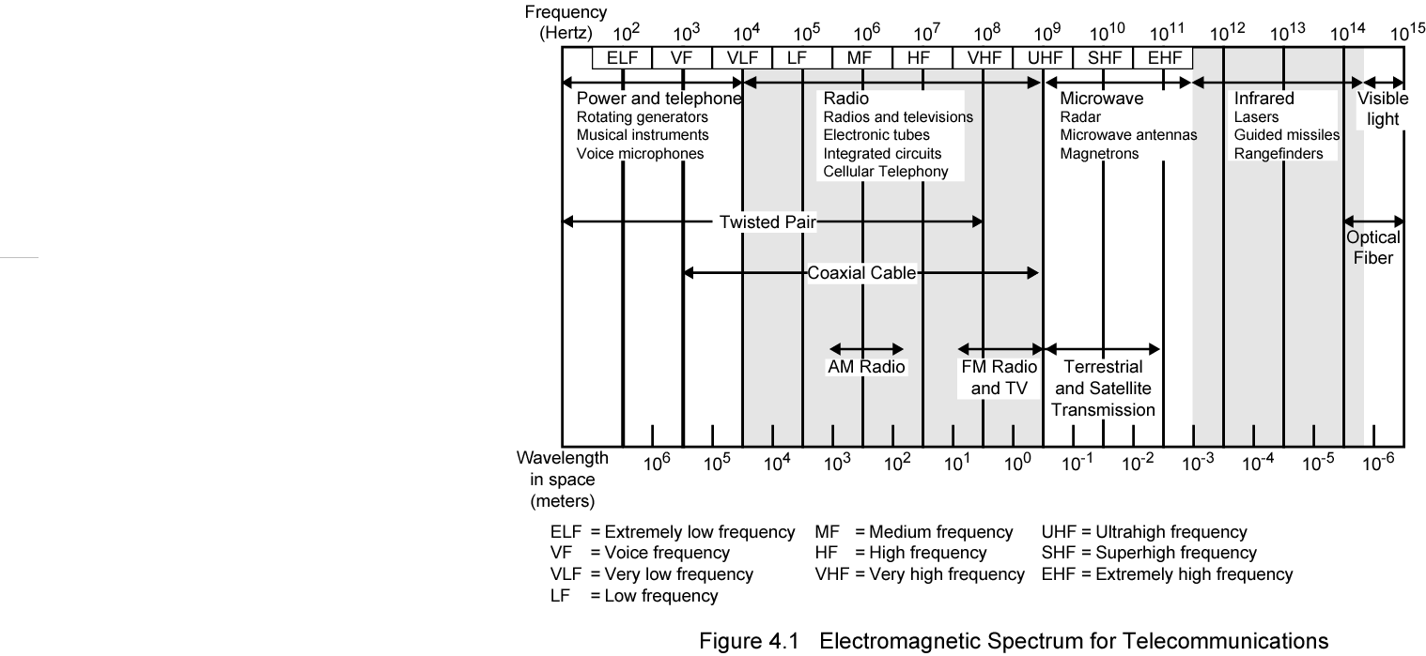
Electromagnetic Spectrum

Slide 46
Guided Transmission Media
Twisted Pair
Coaxial cable
Optical fiber

Slide 47
Transmission Characteristics of Guided Media
Frequency Range
Typical Attenuation
Typical Delay
Repeater Spacing
Twisted pair (with loading)
0 to 3.5 kHz
0.2 dB/km @ 1 kHz
50 µs/km
2 km
Twisted pairs (multi-pair cables)
0 to 1 MHz
0.7 dB/km @ 1 kHz
5 µs/km
2 km
Coaxial cable
0 to 500 MHz
7 dB/km @ 10 MHz
4 µs/km
1 to 9 km
Optical fiber
186 to 370 THz
0.2 to 0.5 dB/km
5 µs/km
40 km

Slide 48
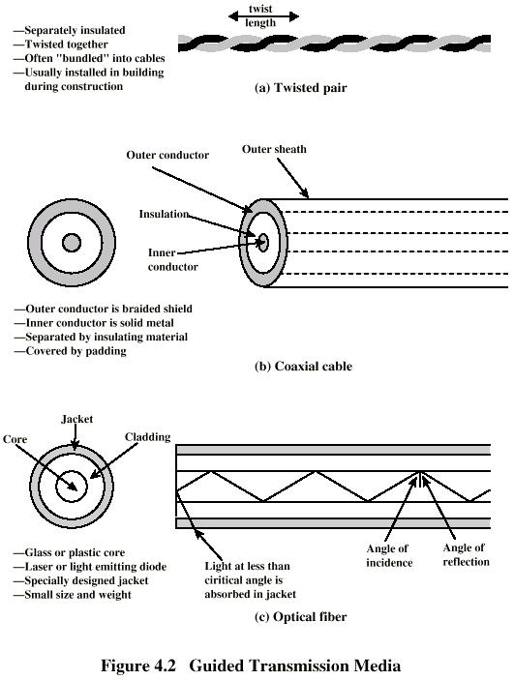
Twisted Pair (1)

Slide 49
Twisted Pair (2)
Two insulated copper wires twisted to reduce crosstalk
Most common medium: cheap; easy to work with
Used in telephone network
  Between house and end office
  Carry voice traffic using analog signal
  By means of modem can carry digital data traffic at 64 kbps
Used for local area networks (LAN)
  Data rate 10Mbps or 100Mbps

Slide 50
Twisted Pair - Transmission Characteristics
Analog
  Amplifiers every 5km to 6km
Digital
  Use either analog or digital signals
  repeater every 2km or 3km
Limited distance
Limited bandwidth (1MHz)
Limited data rate (100Mbps)
Susceptible to interference and noise

Slide 51
Coaxial Cable (1)

Slide 52
Coaxial Cable (2)
Consists of two conductors
Most versatile medium
Applications
Television distribution
Long distance telephone transmission (traditionally)
Short distance computer systems links (e.g. I/O)
Local area networks (LANs)

Slide 53
Coaxial Cable - Transmission Characteristics
Analog
  Amplifiers every few km
  Closer if higher frequency
  Up to 500MHz
Digital
  Repeater every 1km
  Closer for higher data rates
Much less susceptible to interferences and crosstalk

Slide 54
Optical Fiber (1)

Slide 55
Optical Fiber (2)
Thin flexible medium capable of guiding an optical ray
Greater capacity
  data rates of hundreds of Gbps
Smaller size & weight
Lower attenuation
Electromagnetic isolation
Greater repeater spacing
  10s of km at least

Slide 56
Optical Fiber - Applications
Long-haul and metropolitan trunks
  20-100 K voice channels
Subscriber loops
  Replace twisted pair with fiber optic for business subscribers
  Handle voice, data, image, and video
LANs
  100Mbps-10Gbps
  1000s of stations

Slide 57
Wireless Transmission Frequencies
Radio range
  30MHz to 1GHz
  Omnidirectional: broadcast radio
Microwave frequencies
  2GHz to 40GHz
  Highly directional: suitable for Point to point
  Used for satellite communication
Infrared frequencies
  3 x 10¹¹ to 2 x 10¹⁴
  Local within confined area (room)
Transmission and reception are achieved by means of antenna

Slide 58
Antennas
System of electrical conductor used to radiate (or collect) electromagnetic energy
Same antenna often used for both transmission and reception
Antenna radiate power in all directions (not same performance)
Isotropic antenna is (theoretical) point in space
  Radiates in all directions equally
  Gives spherical radiation pattern
Parabolic reflection antenna (dish)
  Used in terrestrial microwave and satellite

Slide 59
Broadcast Radio
Omnidirectional
Radio range: 3k Hz-300GHz
Broadcast radio: 30MHz-1GHz
  Covers FM radio and UHF and VHF television
Transmission is limited to line of sight
Suffers from multipath interference
  Reflections

Slide 60
Terrestrial Microwave
Parabolic dish (antenna) located at substantial heights above ground
  Requires line of sight transmission
  Relay towers is used
  Fewer amplifiers and repeaters (10-100km)
Used for
  voice and TV transmission (12-GHz)
  LANs
  long haul telecommunications bypassing telephone company (4-GHz-6GHz)
  Cellular system
Higher frequencies are less useful for longer distances because of attenuation

Slide 61
Satellite Microwave
Satellite is a microwave relay station that link two (or more) ground-based microwave transmitter/receivers
Satellite receives on one frequency, amplifies or repeats signal and transmits on another frequency
Required to remain stationary with respect to its position over earth (geo-stationary orbit)
  Height of 35,784km
Applications
  Television
  Long distance telephone
  Private business networks
Long delay and broadcast facility

Slide 62
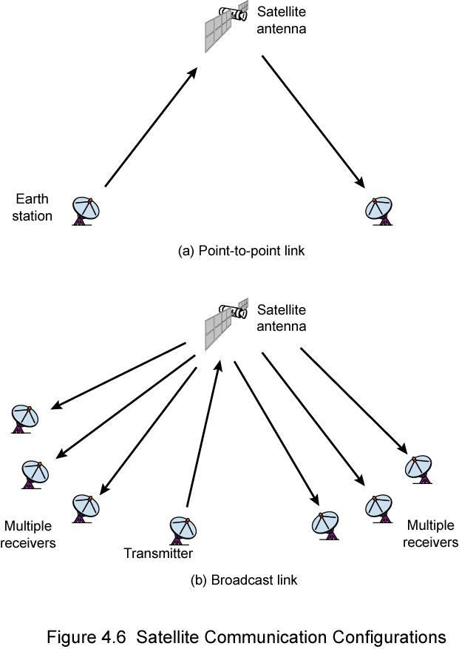
Satellite Point to Point Link

Slide 63
Satellite Broadcast Link

Slide 64
Infrared
Modulate noncoherent infrared light
Transceivers must be within the line of sight of each other
Blocked by walls
e.g. TV remote control

Slide 65
Line of Sight Transmission Impairments
Free space loss
  Signal disperses with distance (greater for lower frequencies)
Refraction
  Change of the speed of the signal
Atmospheric Absorption
  Water vapour and oxygen absorb radio signals
  Rain and fog scatter radio waves
Multipath
  Better to get line of sight if possible
  Signal can be reflected causing multiple copies to be received
  May be no direct signal at all, or May reinforce or cancel direct signal (e.g. mobile telephone)

Slide 66
Required Reading
Stallings Chapter 3 and Chapter 4

