Slide 1
Data Communication and Networks (Fall 2004)
Lecture 2
The Physical Layer (cont.)
Signal Encoding Techniques
Dr. Sahar M. Ghanem

Slide 2
Encoding Techniques
Data source is analog or digital
Encoding: data source is encoded into a digital signal
  Digital signal advantages
Modulation: data source is encoded onto an analog signal with carrier frequency f_{c}
  Fiber optic and unguided media will propagate only analog signals
An encoding technique is chosen to optimize use of medium (i.e. improve performance)
  Conserve bandwidth or minimize errors

Slide 3
Comparison of Encoding Schemes
Signal Spectrum
  Lack of high frequency components (i.e. less bandwidth)
  Concentrate power in the middle of the bandwidth
  Lack of direct-current (dc)
    DC is the average amplitude of the signal
Clocking: synchronizing transmitter and receiver (not easy!)
Error detection (usually built in data link layer)
Signal interference and noise immunity
Cost and complexity
  Higher signal rate leads to higher costs

Slide 4
Digital Data, Digital Signal
Discrete voltage pulses (signal elements)
Terms
  Unipolar: all signal elements have same sign
  Polar: one element is represented by positive voltage the other by negative voltage
  Data rate R : Rate of data transmission in bps
  Duration (length) of a bit = 1/R (sec)
  Modulation (Signal) rate: rate of signal level change (baud)

Slide 5
Digital Encoding Schemes
Nonreturn to Zero
  Nonreturn to Zero-Level (NRZ-L)
  Nonreturn to Zero Inverted (NRZI)
Biphase
  Manchester
  Differential Manchester
Multilevel Binary
  Bipolar -AMI
  Pseudoternary
Scrambling techniques
  B8ZS
  HDB3

Slide 6
Nonreturn to Zero-Level (NRZ-L)
Two different voltages for 0 and 1 bits
  voltage constant during bit interval
  no return to zero voltage
  e.g. absence of voltage for 0, constant +ve voltage for 1
NRZ-L: -ve voltage for one binary value and +ve for the other (polar)
Other codes are generated from NRZ-L

Slide 7
Nonreturn to Zero Inverted (NRZI)
Nonreturn to zero inverted on ones
Constant voltage pulse for duration of bit
Data encoded as presence or absence of signal transition at beginning of bit time
Transition (low to high or high to low) denotes a binary 1
No transition denotes binary 0
An example of differential encoding

Slide 8
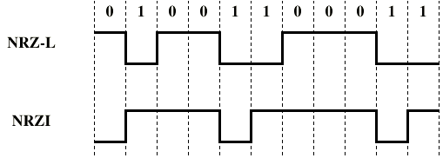
NRZ

Slide 9
Differential Encoding
Data represented by changes rather than levels
Synchronization is provided by the signal change
More reliable detection of transition rather than level
In complex transmission layouts it is easy to lose sense of the signal polarity
  e.g. twisted pair accidentally inverted, all 1s and 0s are inverted

Slide 10
NRZ Pros and Cons
Pros
  Easy to engineer
  Make good use of bandwidth
Cons
  Lack of synchronization capability (NRZ-L long string of 1s or 0s; NRZI long string of 0s)
  DC component
Used for magnetic recording
Unattractive for signal transmission

Slide 11
Biphase
Manchester
  Transition in middle of each bit period
  Transition serves as clock and data
  Low to high represents 1
  High to low represents 0
  Used by IEEE 802.3 (Ethernet)
Differential Manchester
  Mid-bit transition is clocking only
  Transition at start of a bit period represents 0
  No transition at start of a bit period represents 1
  Note: this is a differential encoding scheme
  Used by IEEE 802.5 (token ring)

Slide 12
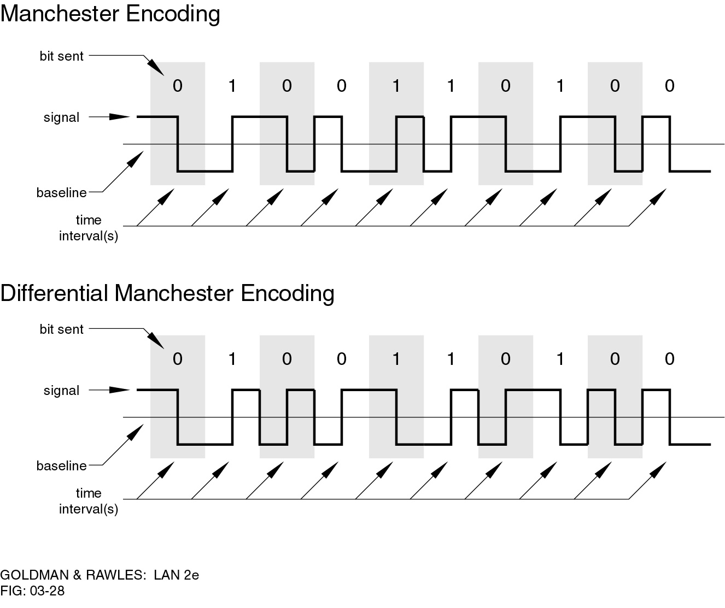
Manchester Encoding

Slide 13
Differential Manchester Encoding

Slide 14
Biphase Pros and Cons
Pros
  Synchronization on mid bit transition (self clocking)
  No dc component
  Error detection
    Absence of expected transition
Cons
  At least one transition per bit time and possibly two
  Maximum modulation rate is twice NRZ
  Requires more bandwidth

Slide 15
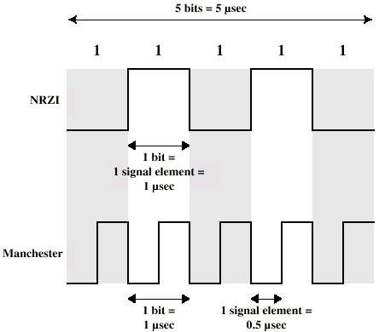
Modulation Rate

Slide 16
Multilevel Binary
Use more than two signal levels
Bipolar-AMI (Alternate Mark Inversion)
  0 is represented by no line signal
  1 is represented by positive or negative pulse that alternate in polarity
Pseudoternary
  1 is represented by absence of line signal
  0 is represented by alternating positive and negative
  No advantage or disadvantage over bipolar-AMI

Slide 17
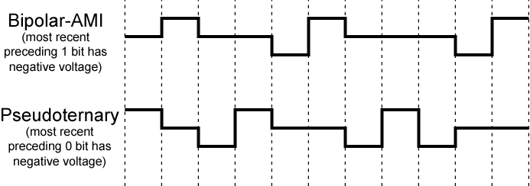
Bipolar-AMI and Pseudoternary

Slide 18
Multilevel Binary Pros and Cons
Pros (Bipolar-AMI)
  No loss of sync if a long string of 1s
  No net dc component
  Easy error detection
  Less bandwidth
Cons
  Long string of 0s still problem
    Add bits for synch that increases the data rate
    Scrambling (discussed next)
  Not as efficient as NRZ
    A bit of information is represented by 1.58 bits (log₂3)
    Receiver must distinguish between three levels (+A, -A, 0)
    Requires more signal power

Slide 19
Scrambling
Use scrambling to replace sequences that would produce constant voltage
Filling sequence
  Must produce enough transitions to sync
  Must be recognized by receiver and replace with original
  Same length as original
No dc component
No long sequences of zero level line signal
Signaling rate is the same as data rate
Error detection capability
Used for long distance transmission

Slide 20
B8ZS (Bipolar With 8 Zeros Substitution)
Based on bipolar-AMI
If octet of all 0s and last voltage pulse preceding was +ve encode as 000+-0-+
If octet of all 0s and last voltage pulse preceding was -ve encode as 000-+0+-
Causes two violations of AMI code
Unlikely to occur as a result of noise
Receiver detects and interprets as octet of all 0s
Used in North America

Slide 21
HDB3 (High Density Bipolar 3 Zeros)
Based on bipolar-AMI
String of four 0s replaced with one or two pulses determined by
  Polarity of preceding pulse
  Number of 1s since last substitution
Rules
  (-, odd): 000- (-, even): +00+
  (+,odd): 000+ (+,even): -00-
Used in Europe and Japan

Slide 22
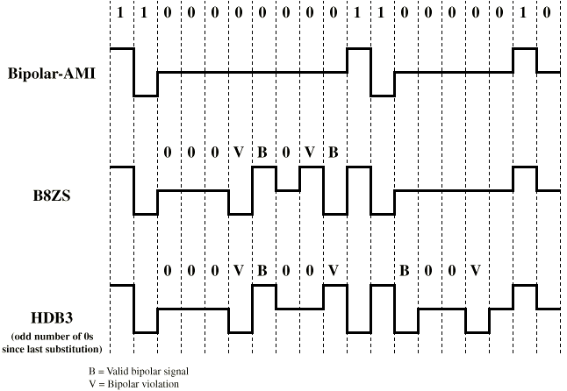
B8ZS and HDB3

Slide 23
Digital Data, Analog Signal
Public telephone system
  300Hz to 3400Hz
  Use modem (modulator-demodulator)
Modulation involve operation on one or more of the three characteristic of the carrier frequency
  Amplitude shift keying (ASK)
  Frequency shift keying (FSK)
  Phase shift keying (PSK)

Slide 24
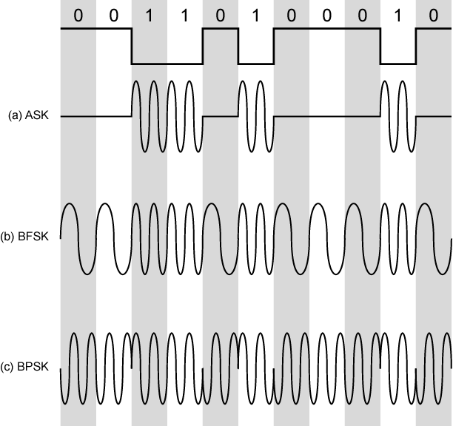
Modulation Techniques

Slide 25
Amplitude Shift Keying (ASK)
Values represented by different amplitudes of carrier
  Usually, presence and absence of carrier is used
Susceptible to sudden gain changes
Inefficient
Used over optical fiber

Slide 26
Frequency Shift Keying (FSK)
Most common form is binary FSK (BFSK)
Two binary values represented by two different frequencies
  typically offset from the carrier frequency
Less susceptible to error than ASK
Used by some modems
Used for high frequency (3-30 MHz) radio transmission

Slide 27
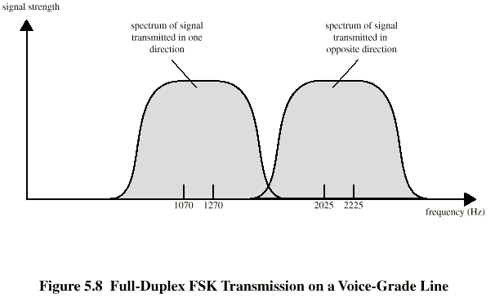
FSK on Voice Grade Line

Slide 28
Multiple FSK
More than two frequencies used (M)
Each signalling element encodes more than one bit (L bits)
  Number of signal elements M = 2^L
  A signal element is held for a period Ts = LT; T is bit duration (1/R)
More bandwidth efficient
More prone to error

Slide 29
Phase Shift Keying (PSK)
Phase of carrier signal is shifted to represent data
Binary PSK
  Two phases represent two binary digits
Differential PSK
  Phase shifted relative to previous transmission rather than some reference signal

Slide 30
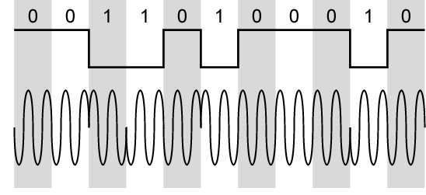
Differential PSK

Slide 31
Quadrature PSK
More efficient use of bandwidth
  each signal element representing more than one bit
Example: shifts of π/2 (90º)
  Each element represents two bits
QPSK signal have a symbol rate that is half the input bit rate (next figure)
  A phase change as much as π is possible
Offset QPSK (orthogonal QPSK)
  Delay in Q stream
  Same performance but phase change never exceeds π/2
Multilevel PSK
  Standard 9600bps modem uses 12 angles , four of which have two amplitudes (16 signal element; 2400 baud)

Slide 32
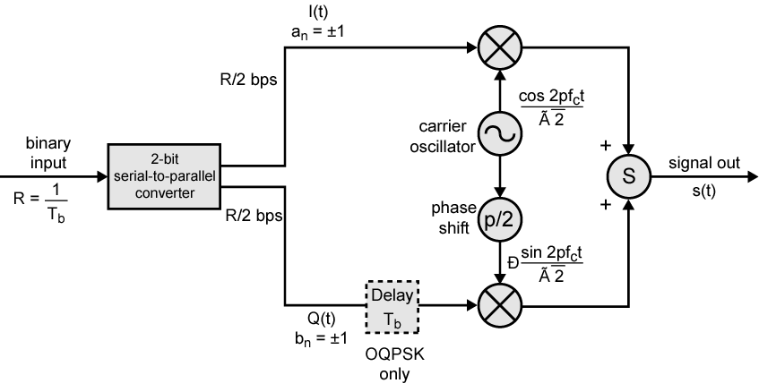
QPSK and OQPSK Modulators

Slide 33
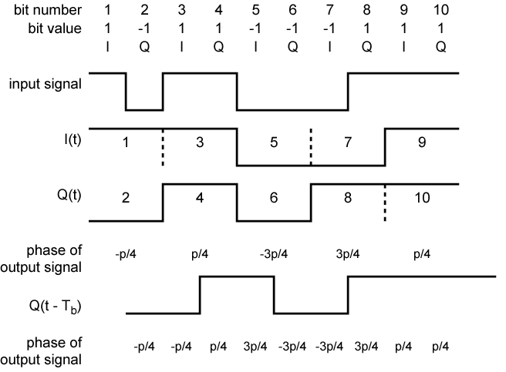
Examples of QPSF and OQPSK Waveforms

Slide 34
Performance of Digital to Analog Modulation Schemes
Bandwidth
  ASK and PSK bandwidth directly related to bit rate
  FSK bandwidth related to bit rate for lower frequencies, but to offset of modulated frequency from carrier at high frequencies
Multilevel signaling uses the bandwidth more efficiently (transmit more data)
In the presence of noise PSK and QPSK are superior to ASK and FSK

Slide 35
Quadrature Amplitude Modulation
QAM used on asymmetric digital subscriber line (ADSL) and some wireless
Combination of ASK and PSK
Send two different signals simultaneously on same carrier frequency
  Use two copies of carrier, one shifted 90° (PSK)
  Each carrier is ASK modulated
  Two independent signals over same medium

Slide 36
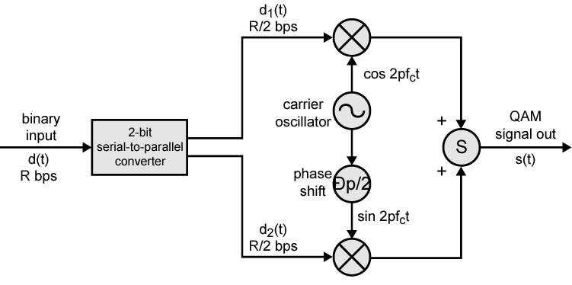
QAM Modulator

Slide 37
Analog Data, Digital Signal
Digitization
  Conversion of analog data into digital data using a codec
  Digital data can then be transmitted using digital encoding schemes
  Digital data can then be modulated to analog signal (!?)
Codec Techniques
  Pulse code modulation
  Delta modulation

Slide 38
Pulse Code Modulation (PCM)
Sampling Theorem: If a signal is sampled at a rate higher than twice the highest signal frequency, the samples contain all the information of the original signal
e.g. bandwidth B Hz; sample every Ts = 1/2B (sec)
Each analog sample (pulse amplitude modulation/PAM) is assigned digital value represented by n bits (PCM pulse)
Quantization error due to approximation
Nonlinear encoding (levels are not equally spaced) is used to reduce the signal distortion
  Compressing-expanding the analog signal can achieve the same effect

Slide 39
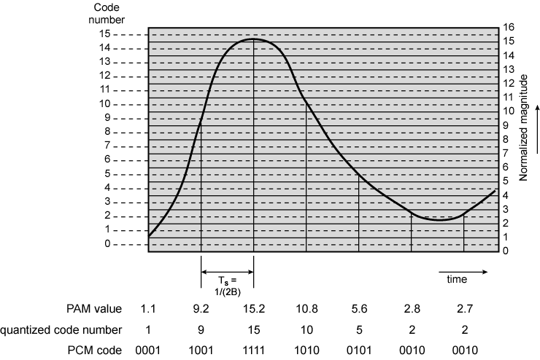
PCM Example

Slide 40
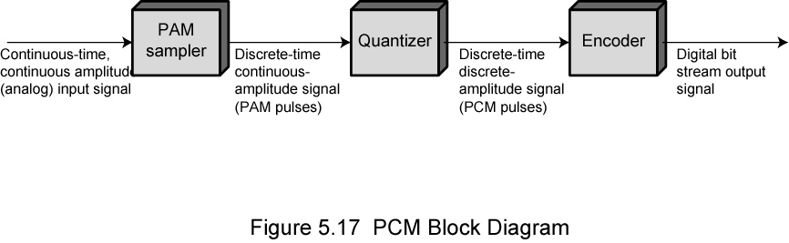
PCM Block Diagram

Slide 41
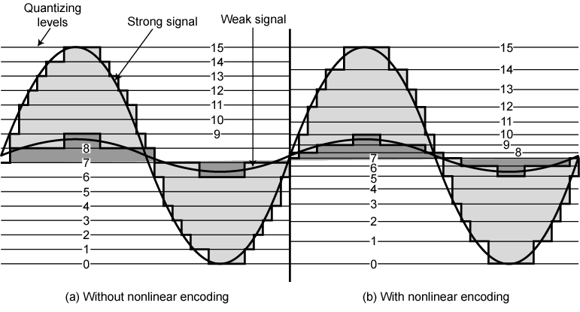
Effect of Non-Linear Coding

Slide 42
Delta Modulation (DM)
Analog input is approximated by a staircase function
Move up or down one level (δ) at each sample interval (binary sequence)
Parameters are the sampling rate and the size of the step (δ)
  Analog wave is changing rapidly, slope overhead noise increases as δ decrease
  Analog wave is changing slowly, quantization noise increases as δ increase
  Increasing the sample rate improves the performance but increases the data rate
DM is simpler to implement; PCM exhibits better error characteristics

Slide 43
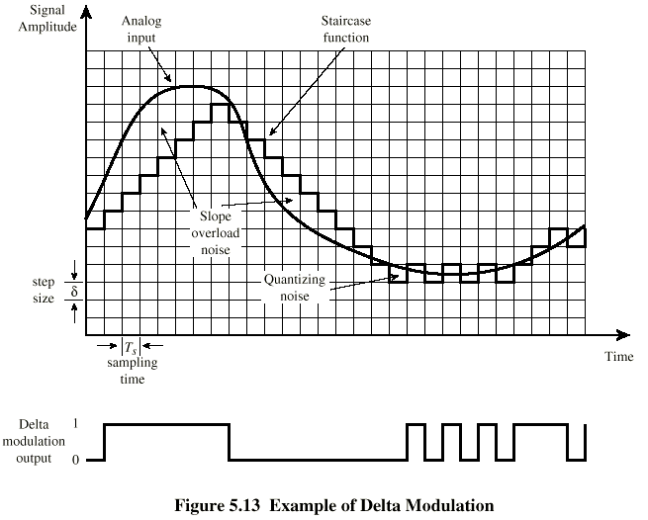
Delta Modulation - example

Slide 44
Analog Data, Analog Signals
Voice signals are transmitted over telephone lines at their original spectrum
Why modulate analog signals?
  Higher frequency can give more efficient transmission (e.g. unguided transmission)
  Permits frequency division multiplexing (next lecture)
Types of modulation
  Amplitude (AM)
  Angle
    Frequency (FM)
    Phase (PM)

Slide 45
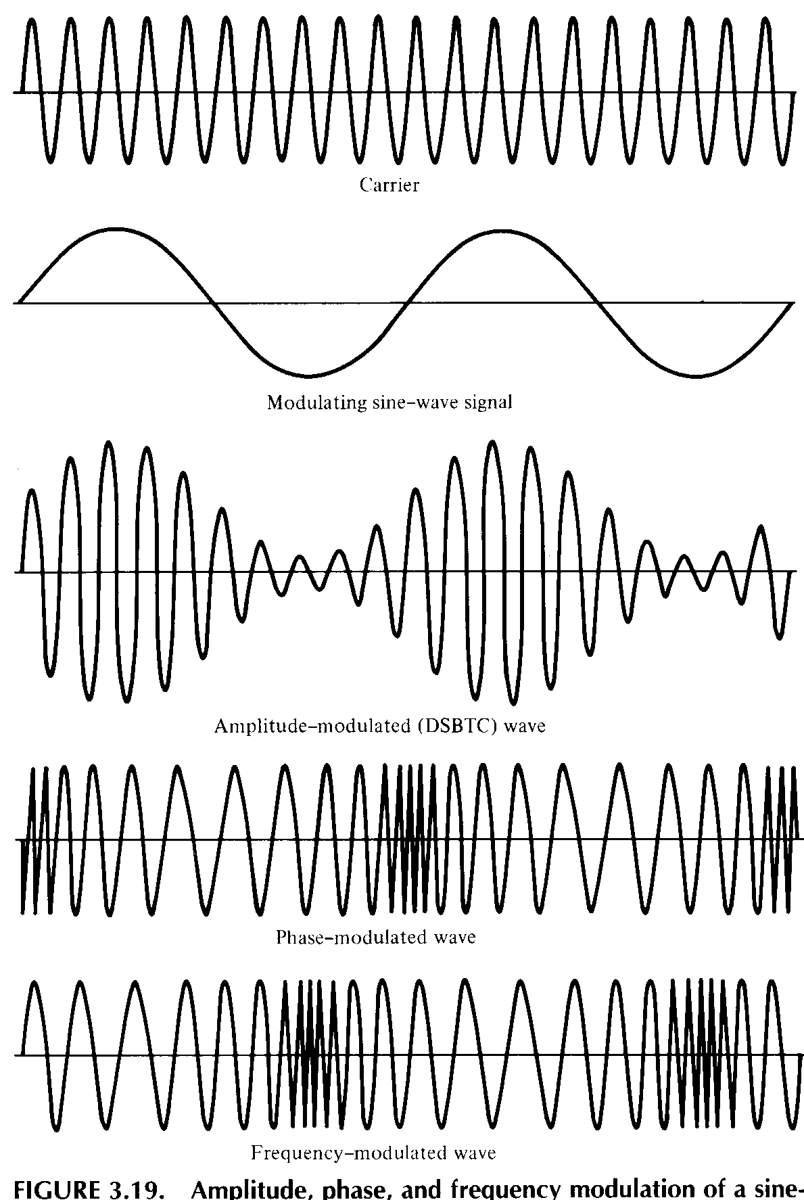
Analog
Modulation

Slide 46
Required Reading
Stallings chapter 5

