Slide 1
Data Communication and Networks (Fall 2004)
Lecture 3
The Physical Layer (cont.)
Multiplexing
Dr. Sahar M. Ghanem

Slide 2
Multiplexing
Multiplexing allows several transmission sources to share a large transmission capacity
  Fiber, coaxial, or microwave links
Techniques
  Frequency Division Multiplexing (FDM)
    Analog (modulated) signals
  Synchronous Time Division Multiplexing (TDM)
    Digital data (analog or digital signal)
    A source is assigned time slots in repetitive frames
  Statistical (Asynchronous) Time Division Multiplexing
    Data are transmitted using available time slots

Slide 3
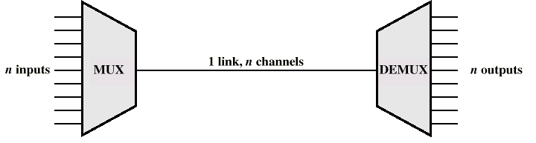
Multiplexing

Slide 4
Frequency Division Multiplexing (FDM)
Each analog signal (subscriber) is modulated to a different carrier frequency then summed to produce the composite signal
Carrier frequencies separated so signals do not overlap (guard bands)
Composite signal may be modulated again
  Grouping reduces multiplexing cost
e.g. voiceband signals (4 kHz) over high-capacity transmission links (throughout the world)
  Group = 12 channels = 46 k Hz;
  Super-group = 5 groups (60 channels) = 240 kHz ;
  Master-group =10 super-groups (600 channels) = 2.52 MHz

Slide 5
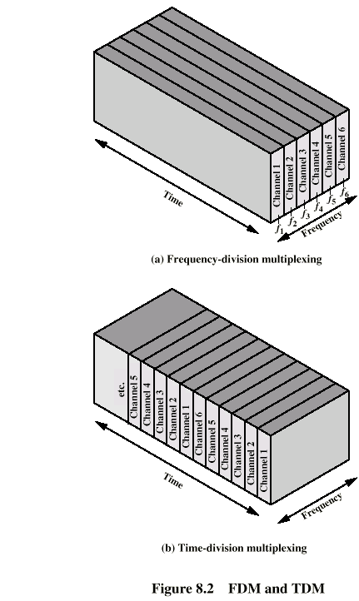
Frequency Division Multiplexing
Diagram

Slide 6
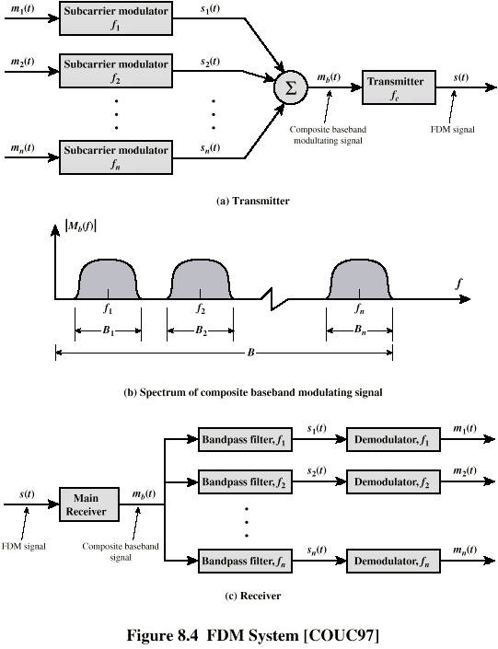
FDM System

Slide 7
Wavelength Division Multiplexing (WDM)
A form of FDM carried by optical fiber
Multiple beams of light at different frequencies
  Laser beams have different wavelengths (colors)
Each color of light (wavelength) carries separate data channel

Slide 8
Synchronous Time Division Multiplexing (TDM)
Multiple digital-data signals interleaved in time
  May be at bit level or in blocks of bytes
  Time slots pre-assigned to sources and fixed (synchronous)
Time slots (channel) allocated even if no data
Time slots do not have to be evenly distributed amongst sources

Slide 9
Time Division Multiplexing

Slide 10
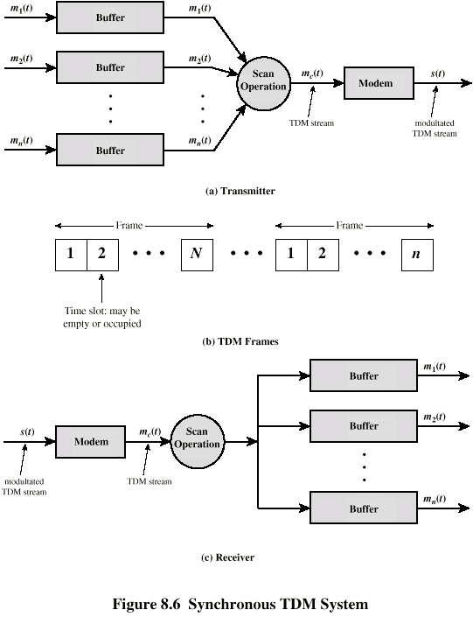
TDM System

Slide 11
Framing
Must provide synchronizing mechanism
  No flag or SYNC characters bracketing TDM frames
Added digit framing
  One control bit (channel) added to each TDM frame
    Looks like another channel - “control channel”
  Identifiable bit pattern used on control channel
    e.g. alternating 01010101…unlikely on a data channel
  Receiver compare incoming bit patterns on each channel with sync pattern

Slide 12
Pulse Stuffing
Problem - Synchronizing data sources
  Clocks in different sources drifting
  Data rates from different sources not related
Solution - Pulse Stuffing
  Stuff extra dummy bits into each incoming signal until it matches local clock
  Outgoing data rate higher than the sum of incoming rates

Slide 13
TDM Examples (1)
Digital carrier Systems (DS-1/T1)
  Log distance voice signals over high capacity transmission links (through the world)
  Voice channel is 4 kHz; 8000 baud sample per sec
    A frame every 125 micro-sec
  Frame = 24 channel x 8 bits + 1 bit for framing = 193 bits → 1.544 Mbps
  T2 combines 4 T1s into 6.312 Mbps (bit interleaved)
  T3 combines 4/7 T2s
  T4 combines 4/6 T3s

Slide 14
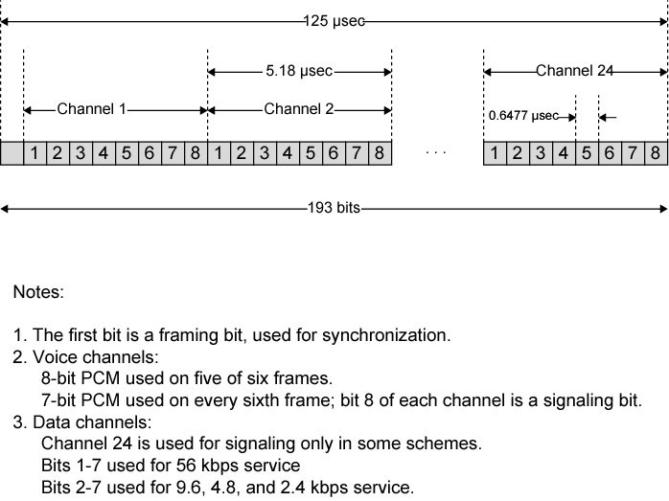
DS-1 Transmission Format

Slide 15
TDM Examples (2)
SONET/SDH
  Synchronous Optical Network (ANSI)
  Synchronous Digital Hierarchy (ITU-T)
  Optical transmission interface
  Hierarchy of standardized digital data rates
  Every 125 micro-sec a frame of 810 (9x90) bytes is transmitted

Slide 16
Statistical TDM
Allocates time slots dynamically based on demand
Multiplexer scans input lines (buffers) and collects data until a frame is full
Multiplexed data rate is less than aggregate rates of input lines
  can support more devices
Address information is required
  more overhead per slot
Inefficient under heavy load and can exceed capacity
Tradeoff between the size of the buffer used and the data rate of the line (single-server queue)
  Required to minimize both but reduction in one increases the other
Used by cable modem

Slide 17
Required Reading
Stallings chapter 8
Tanenbaum section 2.5

