Slide 1
Lecture 4
The Network Layer
Routing
Dr. Sahar M. Ghanem
Data Communication and Networks (Fall 2004)

Slide 2
Outline
Circuit switching vs. packet switching
Packet switching network layer
  Connectionless vs. connection-oriented
Routing Algorithms
  Shortest Path Routing
  Flooding
  Distance Vector Routing
  Link State Routing
  Hierarchical Routing

Slide 3
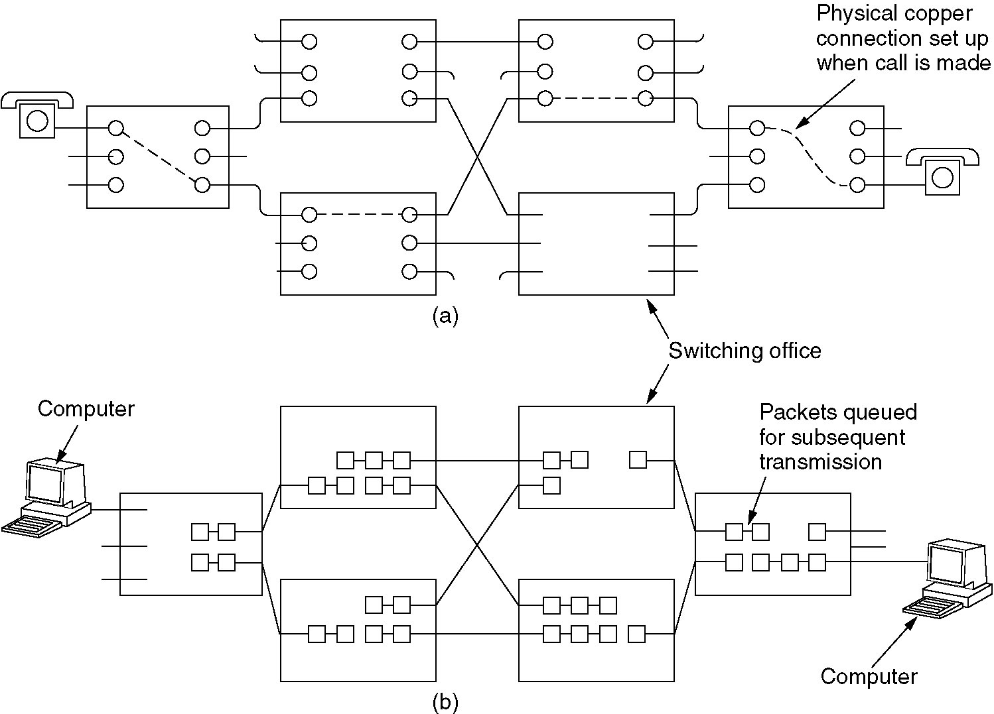
Switching
(a) Circuit switching.
(b) Packet switching.

Slide 4
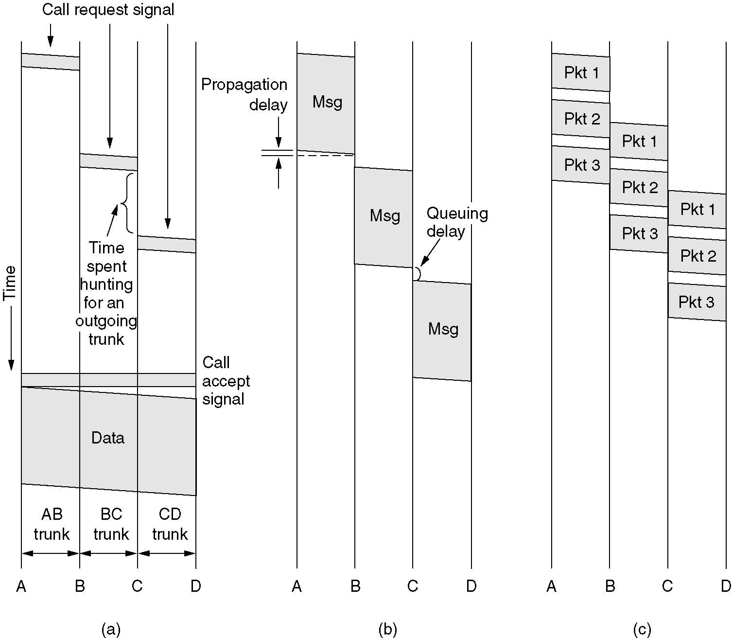
Timing of Events
(a) Circuit switching (b) Message switching (telegrams) (c) Packet switching (Internet)

Slide 5
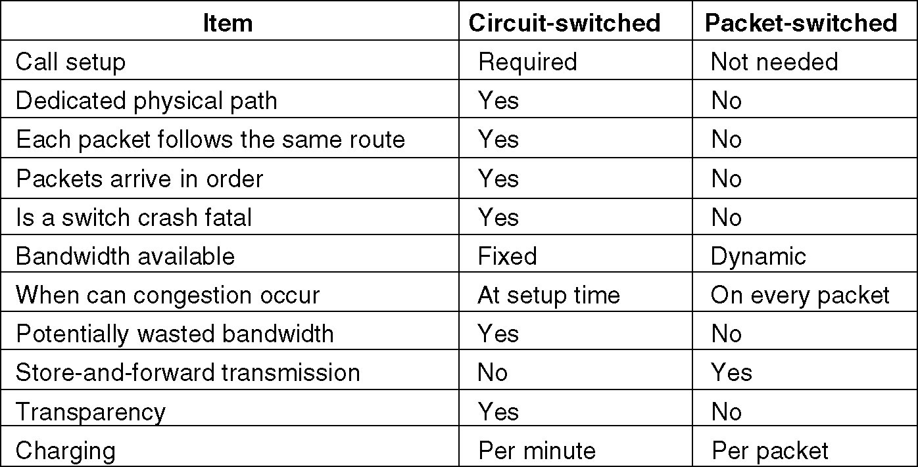
Comparison
A comparison of circuit switched and packet-switched networks.

Slide 6

Packet Switching Networks
fig 5-1
The environment of the network layer protocols.

Slide 7
Network Layer Services
Provided to the Transport layer
Goals
  Services independent of the router technology
  Shield the number, type, and topology of the routers
  Network address is uniform across LANs and WANs
Services
  Connectionless (Internet)
    Datagram packets (in analogy with telegram)
  Connection-oriented (ATM)
    Virtual circuit (VC) (in analogy with physical circuit by telephone system)

Slide 8

Implementation of Connectionless Service
Routing within a datagram subnet.

Slide 9

Implementation of Connection-Oriented Service
Routing within a virtual-circuit subnet.

Slide 10

Comparison of Virtual-Circuit and Datagram Subnets
5-4

Slide 11
Routing Algorithms
A router has two processes
  Routing algorithm: filling and updating the routing table
  Forwarding: when a packet arrives, look up the outgoing line in the routing table
Desirable properties
  Correctness, simplicity, robustness, stability, fairness, and optimality
Conflict! minimize packet delay or maximize network throughput
  Usually minimizing the number of hops is a compromise
Static routing vs. adaptive routing

Slide 12
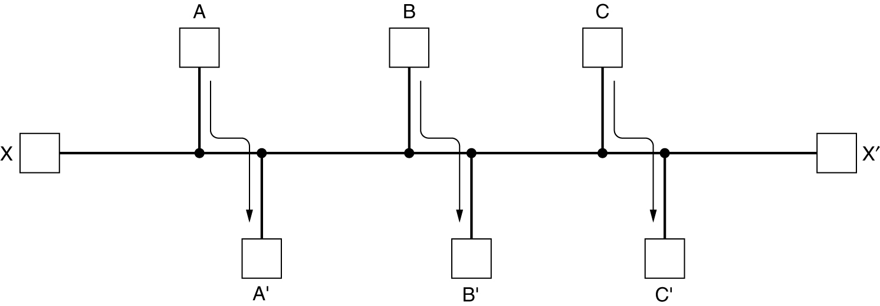
Routing Algorithms (2)
Conflict between fairness and optimality.

Slide 13
The Optimality Principle
If router J is on the optimal path from router I to router K, then the optimal path from J to K also falls along the same path

Slide 14
Shortest Path Routing
Graph of the subnet: node is a router; weighted arc is a link (communication line)
Weights on the arcs could be
    Distance Bandwidth
    Average traffic Communication cost
    Mean queue length Measured delay combination
Shortest path is measured according to weight
Dijkstra’s algorithm for shortest path between two nodes
  Node label (distance from source, best known path)
  Label is either tentative or permanent
  Initially all labels are infinity and tentative

Slide 15
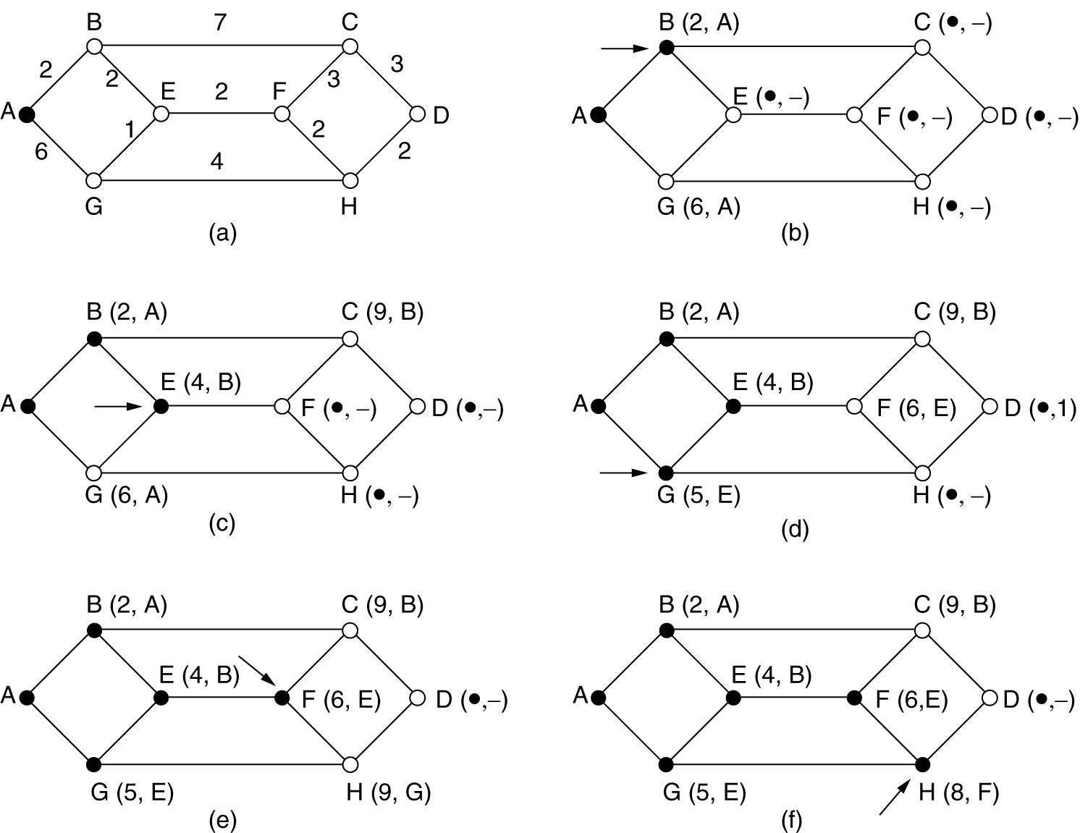
Shortest Path Routing (2)
Dijkstra’s shortest path from A to D.

Slide 16
Flooding
Every incoming packet is sent out on every outgoing packet except the one it arrived on
Infinite process damp techniques
  Hop counter in each packet: decremented at each hop and packet is discarded when counter reaches zero
  Sequence number in each packet: a router keeps a list per source router of seen sequence numbers; incoming packet is not flooded if on list
Selective flooding: send packets on lines that are going (approximately) in the right direction

Slide 17
Flooding Applications
Military applications
Concurrent update of distributed database
Wireless networks
Metric to compare other algorithms

Slide 18
Distance Vector Routing
Other names: Bellman-Ford; Ford-Fulkerson
  Original ARPANET routing algorithm
Each router maintains a routing table
  Index: a destination router
  Entry: preferred outgoing line; estimate of the delay or distance
Each router knows (measure) the “delay” to its neighbors
Periodically (every T msec) each router sends to its neighbors a vector of the estimated delays to each destination
Each router updates his routing table upon the reception of its neighbors’ vectors

Slide 19
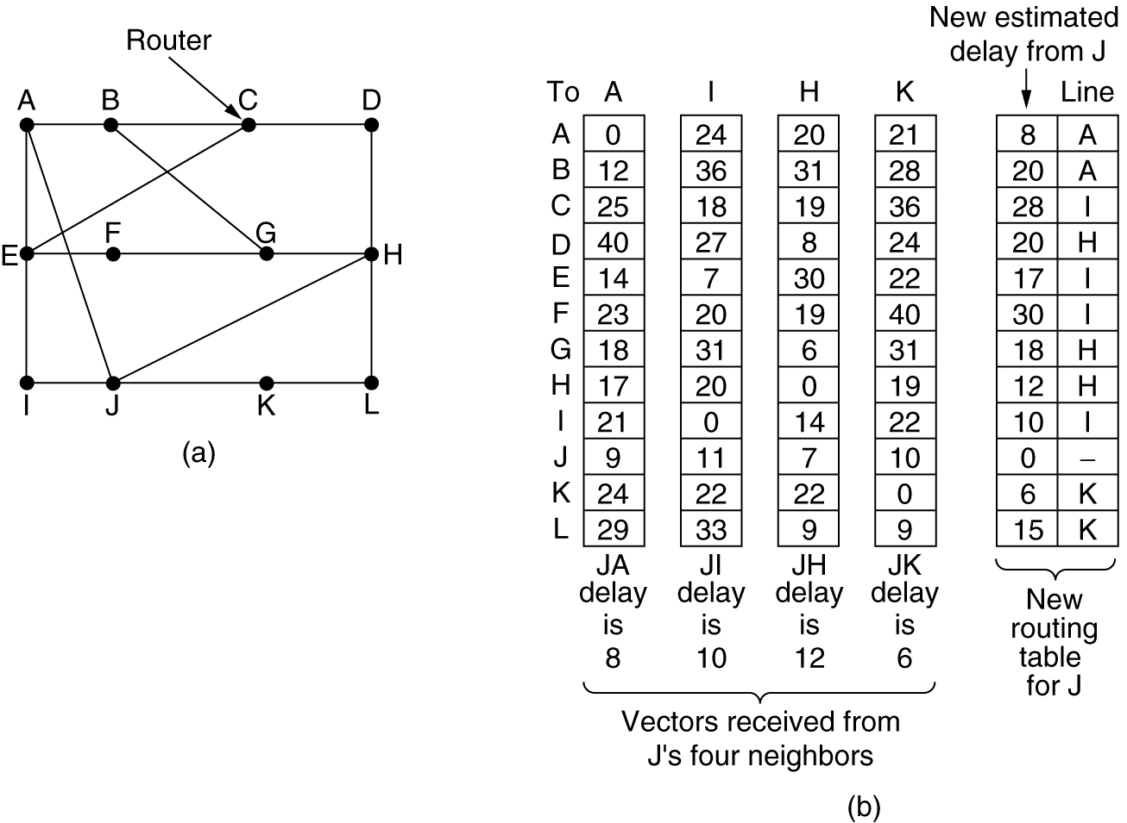
Distance Vector Routing (2)
(a) A subnet. (b) Input from A, I, H, K, and the new routing table for J.

Slide 20
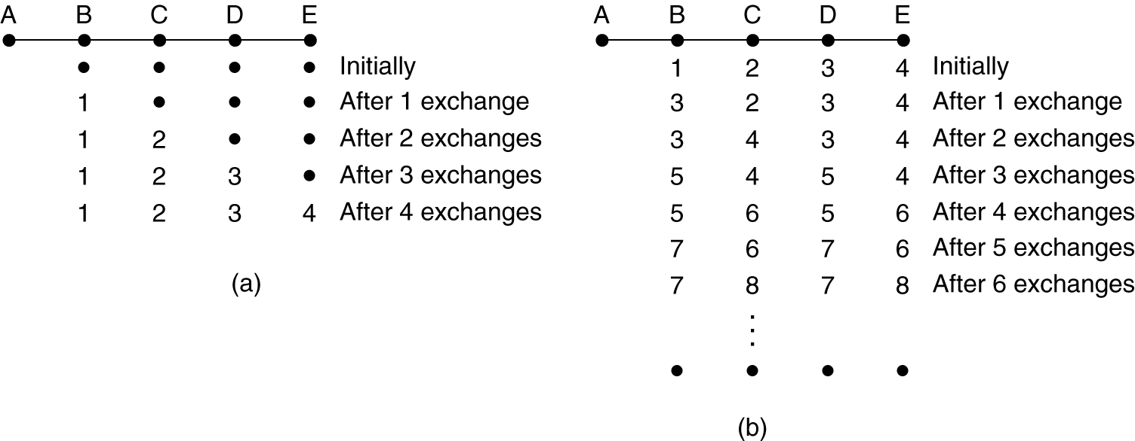
Distance Vector Routing (3)
The count-to-infinity problem
  When X tells Y that is has a path somewhere, Y has no way of knowing whether it itself is on the path
(a) Router A is up (good news). (b) Router A is down (bad news).

Slide 21
Link State Routing
Replaced Distance Vector Routing in the ARPANET
The network topology and delays are experimentally measured and distributed by each router
Each router must do the following:
Discover its neighbors, learn their network address.
Measure the delay or cost to each of its neighbors.
Construct a packet telling all it has just learned.
Send this packet to all other routers.
Compute the shortest path to every other router.

Slide 22
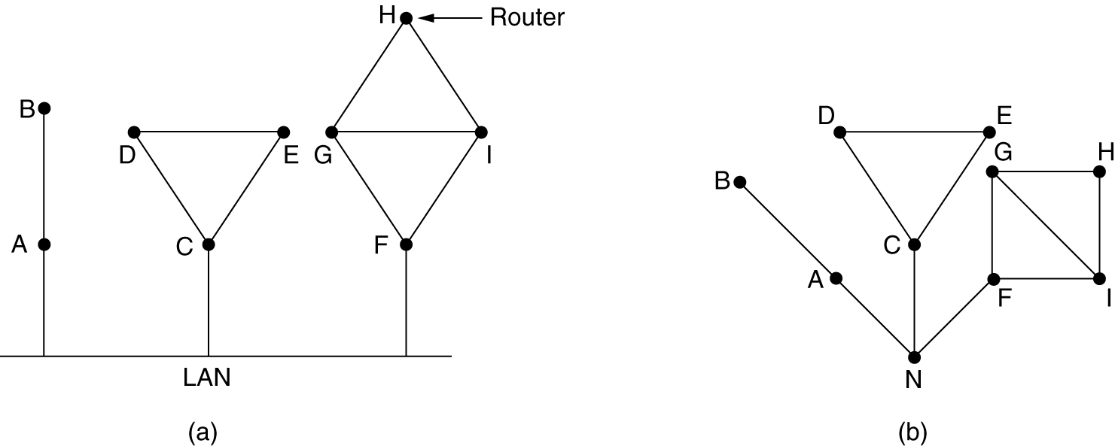
(1) Learning about the Neighbors
When a router is booted, it sends a special HELLO packet on each point-to-point line
A neighbor replies telling who it is (global unique name)
A LAN is modeled as a node
(a) Nine routers and a LAN. (b) A graph model of (a).

Slide 23
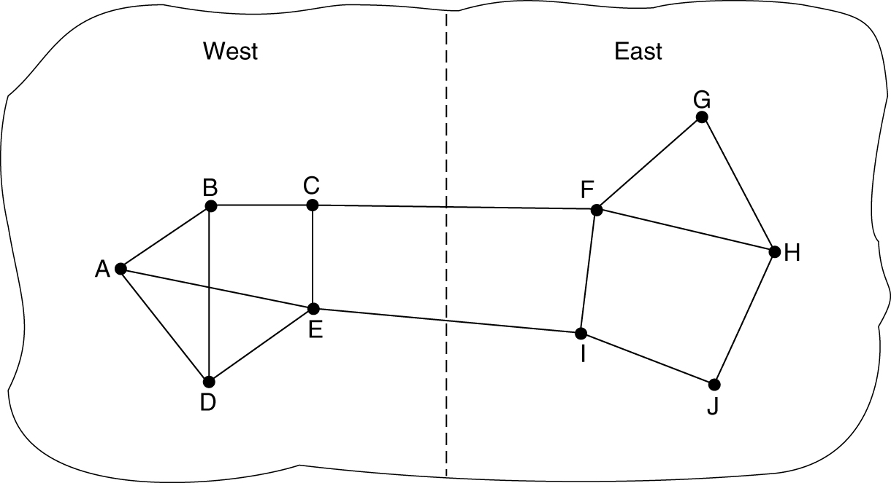
(2) Measuring Line Cost
The router sends a special ECHO packet on each line
A neighbor is required to send back immediately
Round-trip time (RTT) is better estimated after several rounds
Issue: start timer when the packet is queued (i.e. load into account) or when it is sent ?
A subnet in which the East and West parts are connected by two lines.

Slide 24
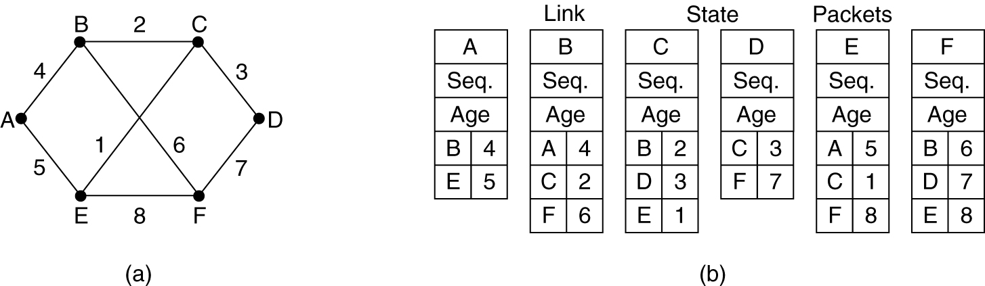
(3) Building Link State Packets
Link state packet {sender, sequence number, age, and list of neighbors}
When to build the packets ?
  Periodically
  Line/neighbor going down, coming up, or changing its properties
(a) A subnet. (b) The link state packets for this subnet.

Slide 25
(4) Distributing the Link State Packets
Use flooding and sequence number
Seq. number wrap around problem
  use 32-bit sequence number (137 years to wrap around)
Router crash and corrupted sequence number problems: use age
  age is decrement once per second and during flooding
  the packet is discarded when age is 0
  e.g. age is 60 sec and a packet every 10 sec
Holding area: discard duplicates, throw older
Acknowledge packets to guard against errors on lines
Holding area is scanned in round-robin to send or acknowledge a packet

Slide 26
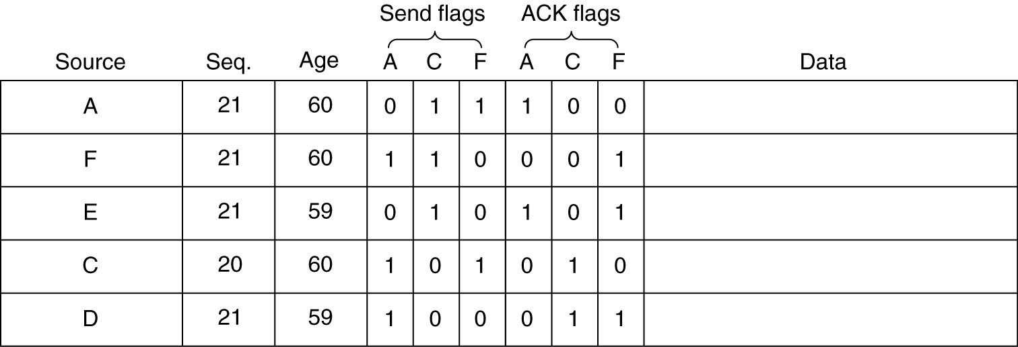
(4) Distributing the Link State Packets
The packet buffer for router B in the previous slide.
If a copy of C’s state arrives from F before forwarding, F bits (Send, ACK) will change to 01

Slide 27
(5) Computing the New Routes
Construct the entire subnet graph
Every link is represented twice one for each direction
Use Dijkstra’s algorithm to construct the shortest path to all possible destinations

Slide 28
Hierarchical Routing
Tow-level hierarchy: routers are divided into regions
  A router knows only the details within its own region
Huge networks
  Clusters, zones, groups, …
e.g.: a net that contains 720 routers
  two-levels: 24 regions x 30 router; routing table size = 30 + 23 = 53 entries
  Three-levels: 8 clusters x 9 regions x 10 routers; routing table size = 10 + 8 + 7 = 25 entries

Slide 29
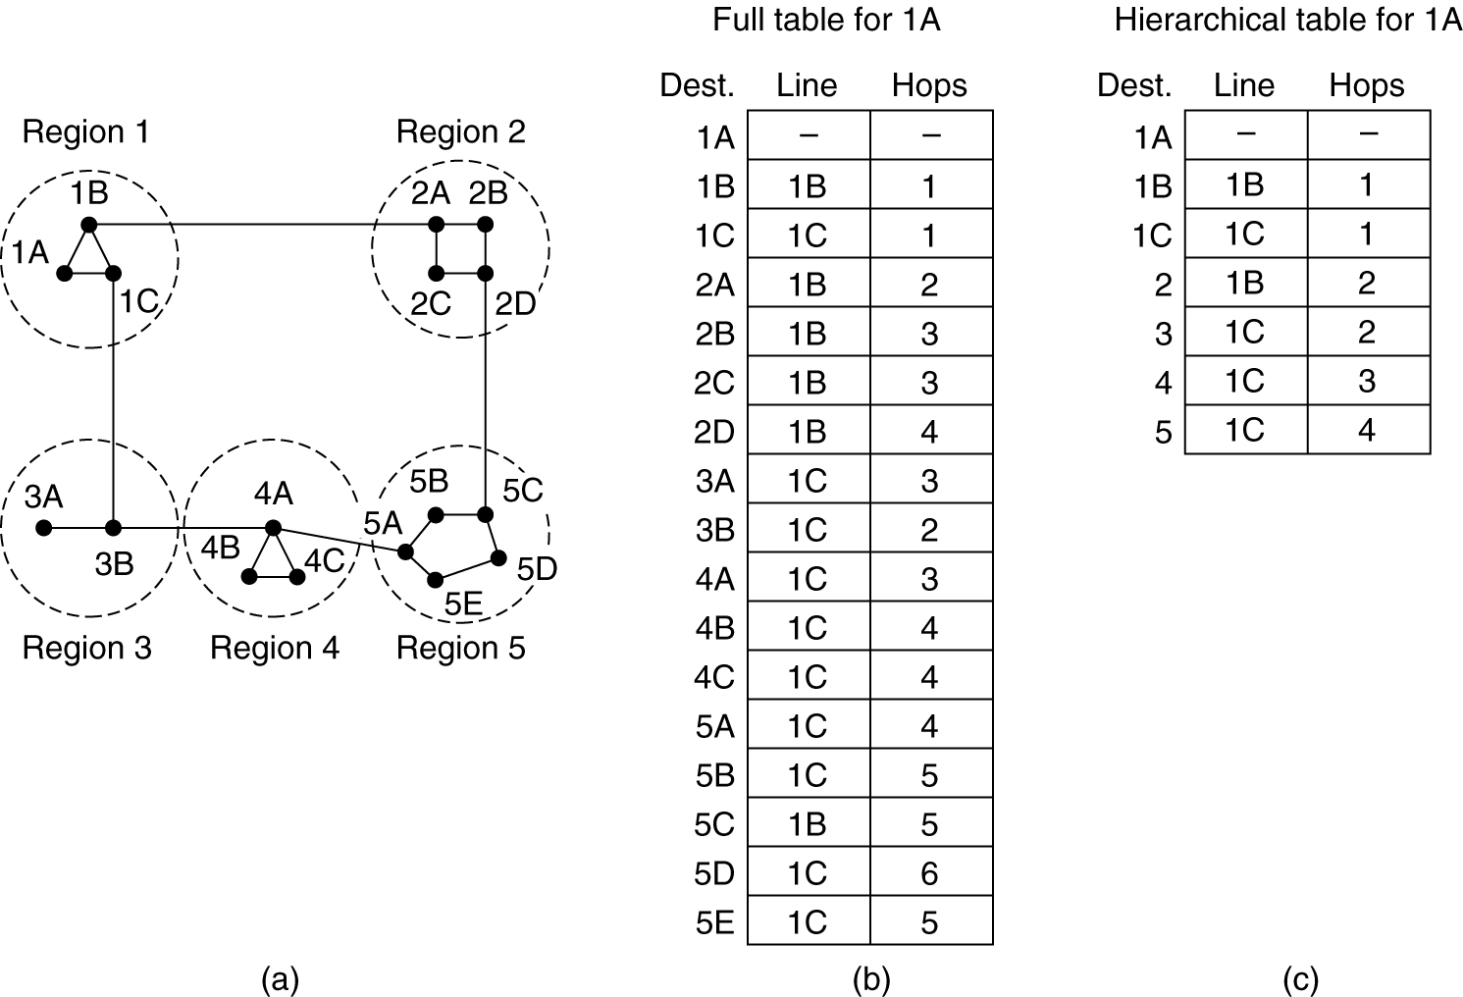
Hierarchical Routing (2)
Hierarchical routing.

Slide 30
Reading
Tanenbaum 2.5.5, 5.1, 5.2.1-6

