Slide 1
Lecture 5
The Network Layer
Routing (cont.)
Dr. Sahar M. Ghanem
Data Communication and Networks (Fall 2004)

Slide 2
Outline
Routing Algorithms
  Shortest Path Routing
  Flooding
  Distance Vector Routing
  Link State Routing
  Hierarchical Routing
  OSPF (IP interior routing protocol)
  BGP (IP exterior routing protocol)

Slide 3
Shortest Path Routing
Graph of the subnet: node is a router; weighted arc is a link (communication line)
Weights on the arcs could be
    Distance Bandwidth
    Average traffic Communication cost
    Mean queue length Measured delay combination
Shortest path is measured according to weight
Dijkstra’s algorithm for shortest path between two nodes
  Node label (distance from source, best known path)
  Label is either tentative or permanent
  Initially all labels are infinity and tentative

Slide 4
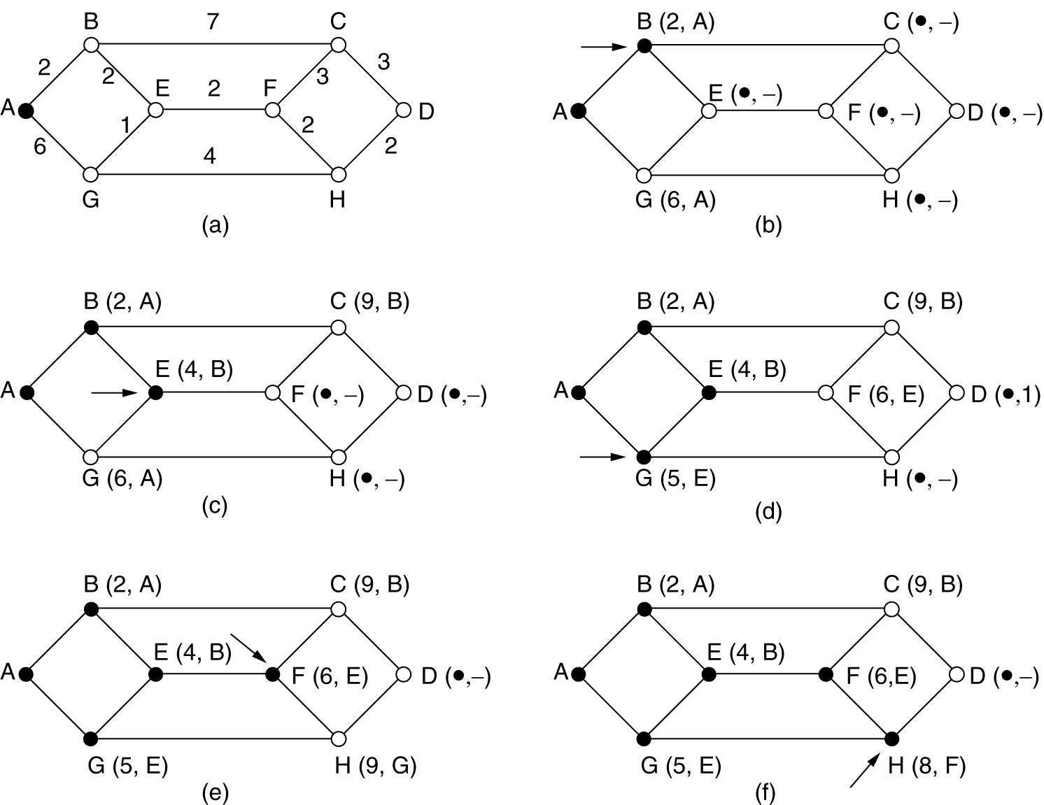
Shortest Path Routing (2)
Dijkstra’s shortest path from A to D.

Slide 5
Flooding
Every incoming packet is sent out on every outgoing packet except the one it arrived on
Infinite process damp techniques
  Hop counter in each packet: decremented at each hop and packet is discarded when counter reaches zero
  Sequence number in each packet: a router keeps a list per source router of seen sequence numbers; incoming packet is not flooded if on list
Selective flooding: send packets on lines that are going (approximately) in the right direction
  reverse path forwarding

Slide 6
Flooding Applications
Military applications
Concurrent update of distributed database
Wireless networks
Metric to compare other algorithms

Slide 7
Distance Vector Routing
Other names: Bellman-Ford; Ford-Fulkerson
  Original ARPANET routing algorithm
Each router maintains a routing table
  Index: a destination router
  Entry: preferred outgoing line; estimate of the delay or distance
Each router knows (measure) the “delay” to its neighbors
Periodically (every T msec) each router sends to its neighbors a vector of the estimated delays to each destination
Each router updates his routing table upon the reception of its neighbors’ vectors

Slide 8
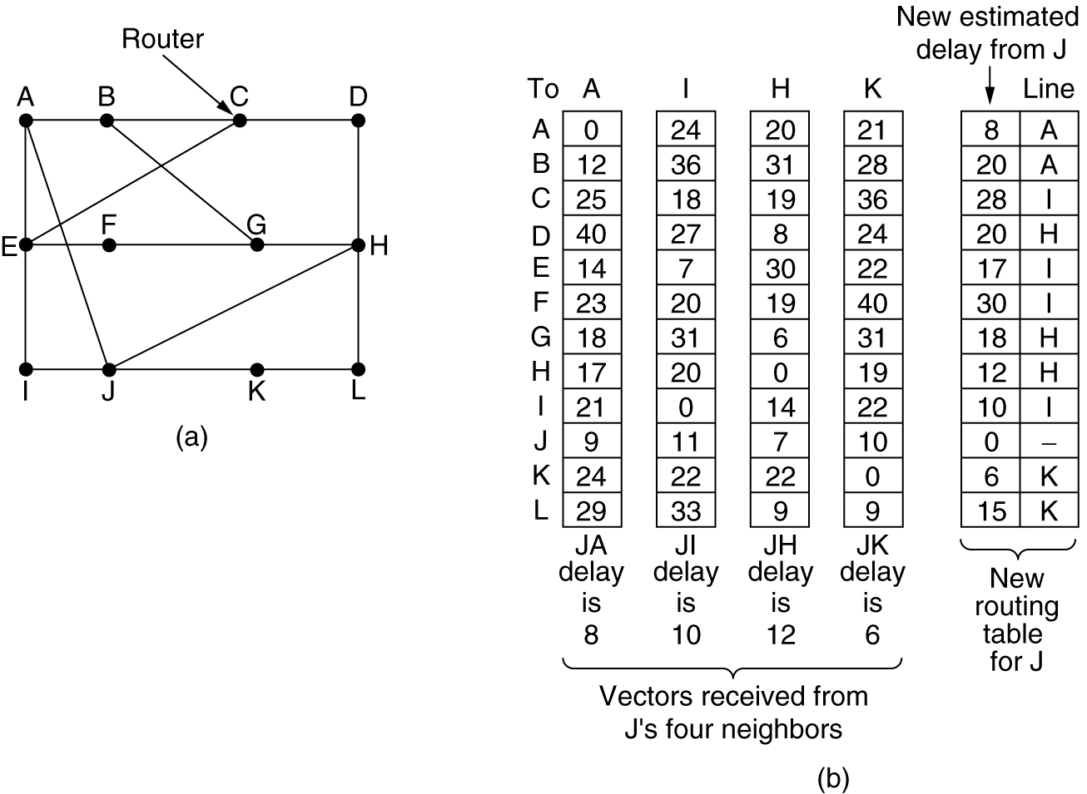
Distance Vector Routing (2)
(a) A subnet. (b) Input from A, I, H, K, and the new routing table for J.

Slide 9
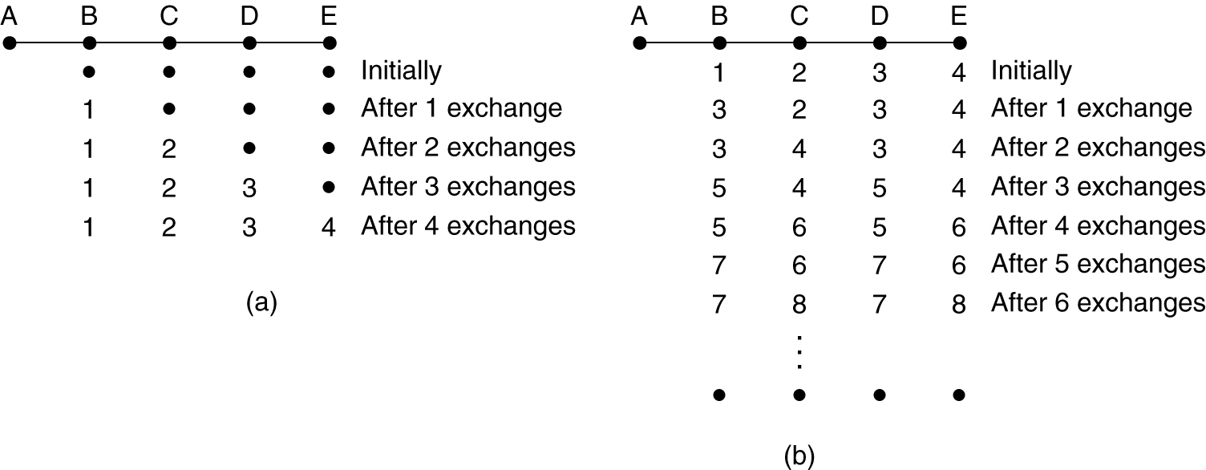
Distance Vector Routing (3)
The count-to-infinity problem
  When X tells Y that it has a path somewhere, Y has no way of knowing whether it itself is on the path
(a) Router A is up (good news). (b) Router A is down (bad news).

Slide 10
Link State Routing
Replaced Distance Vector Routing in the ARPANET
The network topology and delays are experimentally measured and distributed by each router
Each router must do the following:
Discover its neighbors, learn their network address.
Measure the delay or cost to each of its neighbors.
Construct a packet telling all it has just learned.
Send this packet to all other routers.
Compute the shortest path to every other router.

Slide 11
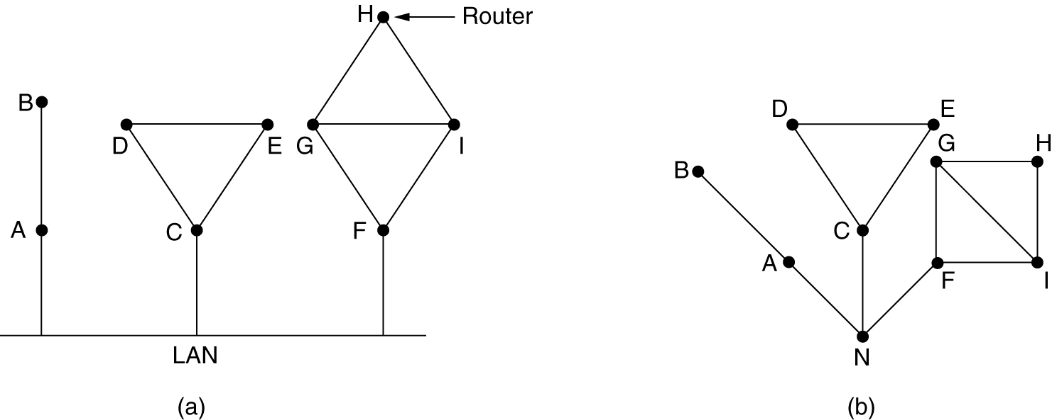
(1) Learning about the Neighbors
When a router is booted, it sends a special HELLO packet on each point-to-point line
A neighbor replies telling who it is (global unique name)
A LAN is modeled as a node
(a) Nine routers and a LAN. (b) A graph model of (a).

Slide 12
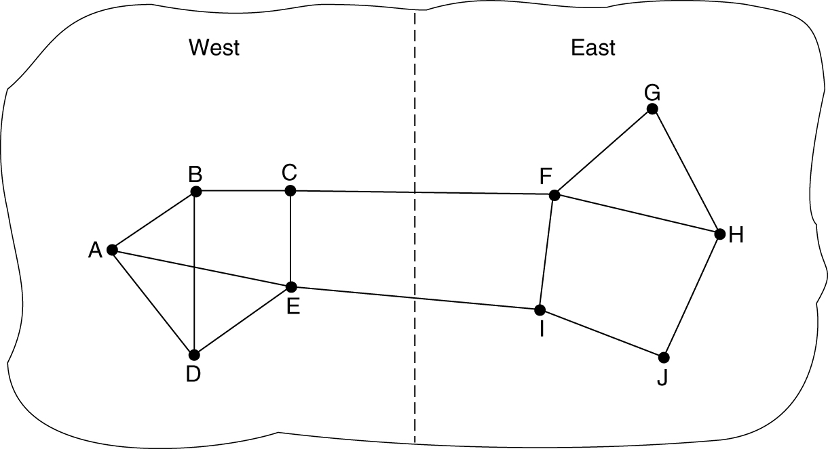
(2) Measuring Line Cost
The router sends a special ECHO packet on each line
A neighbor is required to send back immediately
Round-trip time (RTT) is better estimated after several rounds
Issue: start timer when the packet is queued (i.e. load into account) or when it is sent ?
A subnet in which the East and West parts are connected by two lines.

Slide 13
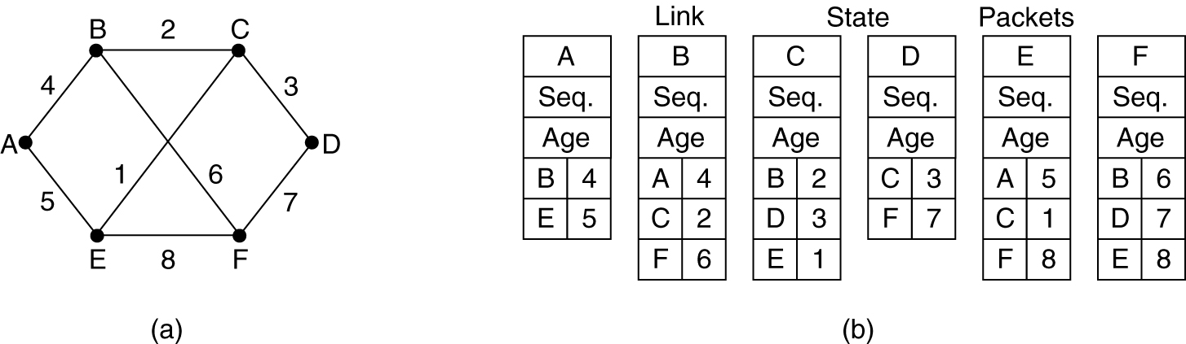
(3) Building Link State Packets
Link state packet {sender, sequence number, age, and list of neighbors}
When to build the packets ?
  Periodically
  Line/neighbor going down, coming up, or changing its properties
(a) A subnet. (b) The link state packets for this subnet.

Slide 14
(4) Distributing the Link State Packets
Use flooding and sequence number
Seq. number wrap around problem
  use 32-bit sequence number (1 per sec:137 years to wrap around)
Router crash and corrupted sequence number problems: use age
  age is decrement once per second and during flooding
  the packet is discarded when age is 0
  e.g. age is 60 sec and a packet every 10 sec
Holding area: discard duplicates, throw older
Acknowledge packets to guard against errors on lines
Holding area is scanned in round-robin to send or acknowledge a packet

Slide 15
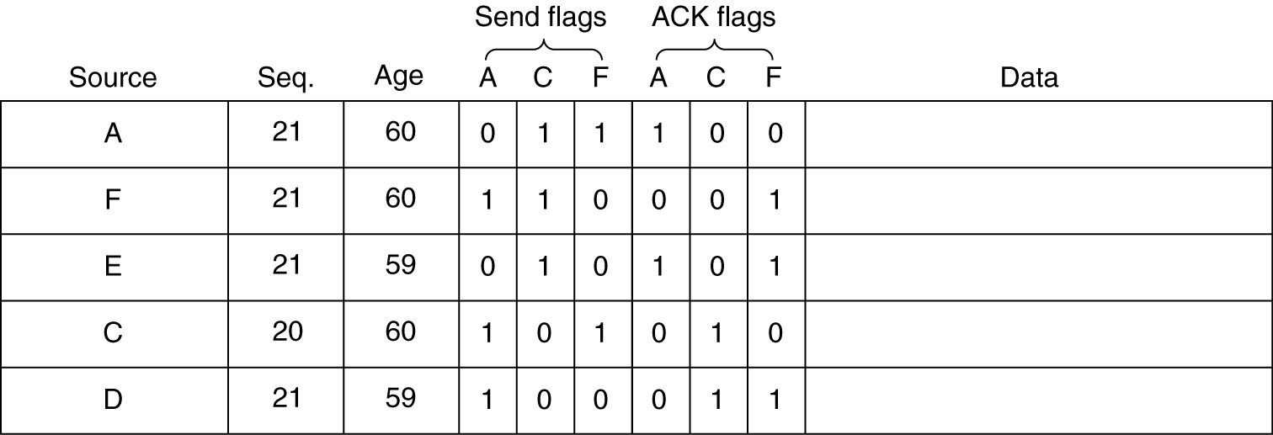
(4) Distributing the Link State Packets
The packet buffer for router B in the previous slide.
If a copy of C’s state arrives from F before forwarding, F bits (Send, ACK) will change to 01

Slide 16
(5) Computing the New Routes
Construct the entire subnet graph
Every link is represented twice one for each direction
Use Dijkstra’s algorithm to construct the shortest path to all possible destinations
Issues for large networks?
  Memory
  Computation time
  Router corruption

Slide 17
Hierarchical Routing
Tow-level hierarchy: routers are divided into regions
  A router knows only the details within its own region
Huge networks
  Clusters, zones, groups, …
e.g.: a net that contains 720 routers
  two-levels: 24 regions x 30 router; routing table size = 30 + 23 = 53 entries
  Three-levels: 8 clusters x 9 regions x 10 routers; routing table size = 10 + 8 + 7 = 25 entries

Slide 18
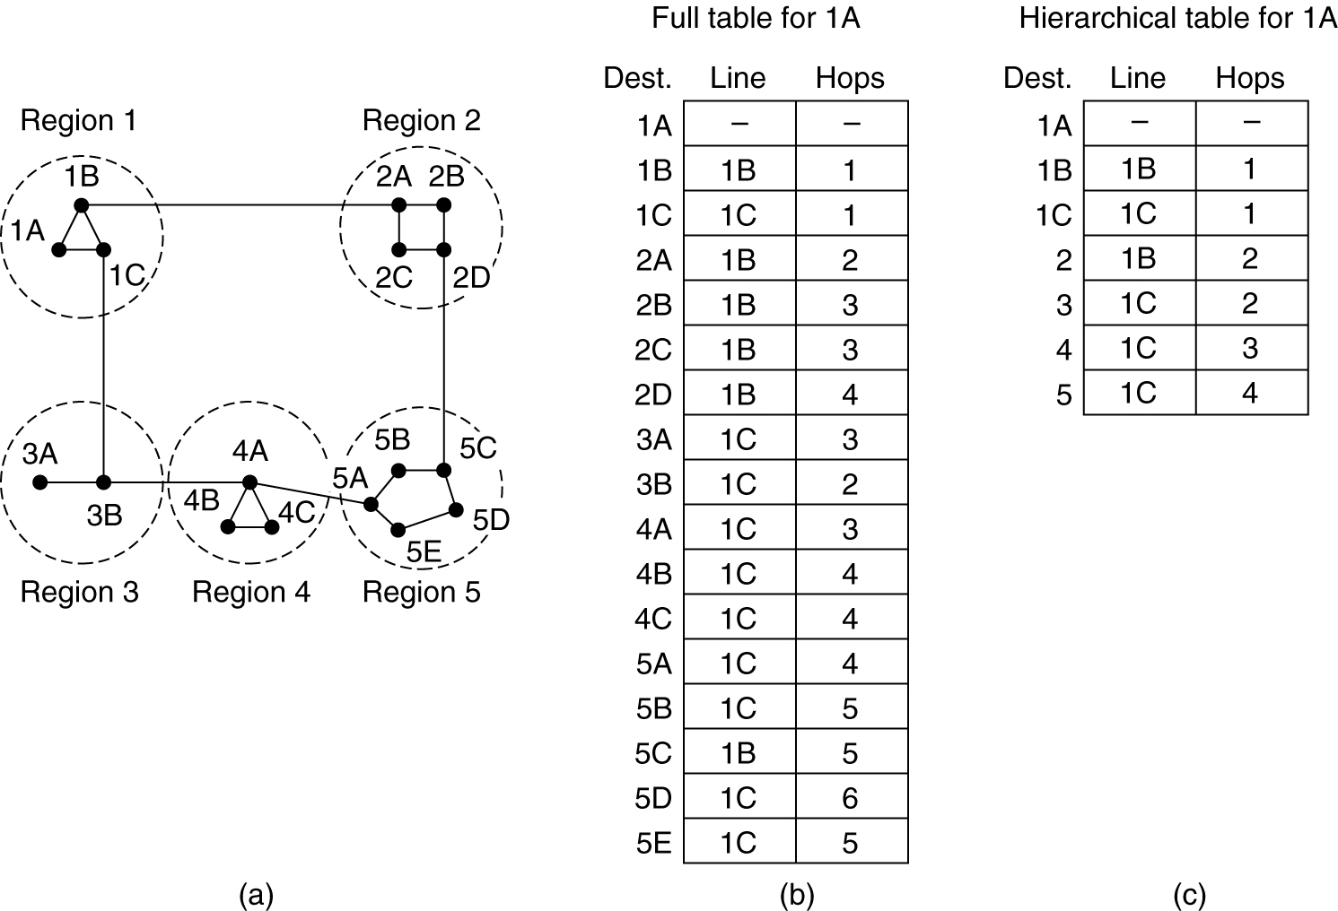
Hierarchical Routing (2)
Hierarchical routing.

Slide 19
Open Shortest Path First (OSPF)
Internet is made up of a large number of autonomous systems (ASes)
OSPF is the main IP interior routing protocol
  Link state routing protocol
  Message are sent as raw IP packets
Support 3 kinds of connections
  Point-to-point between two routers
  Multi-access net (many routers) with broadcasting (LAN)
  Multi-access net without broadcasting (packet-switched WAN)
Network is represented as a weighted directed graph

Slide 20
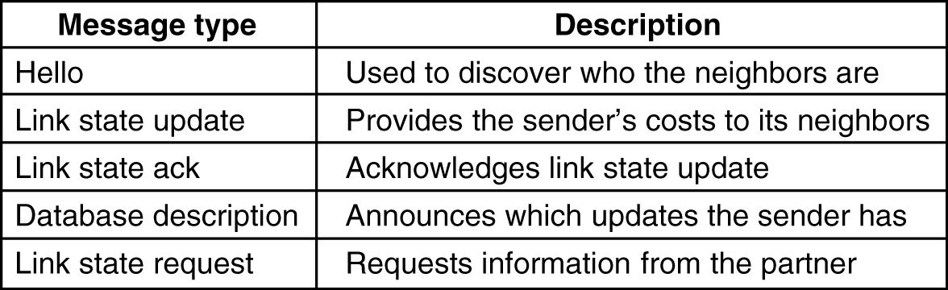
OSPF (2)
5-66
The five types of OSPF messeges.

Slide 21
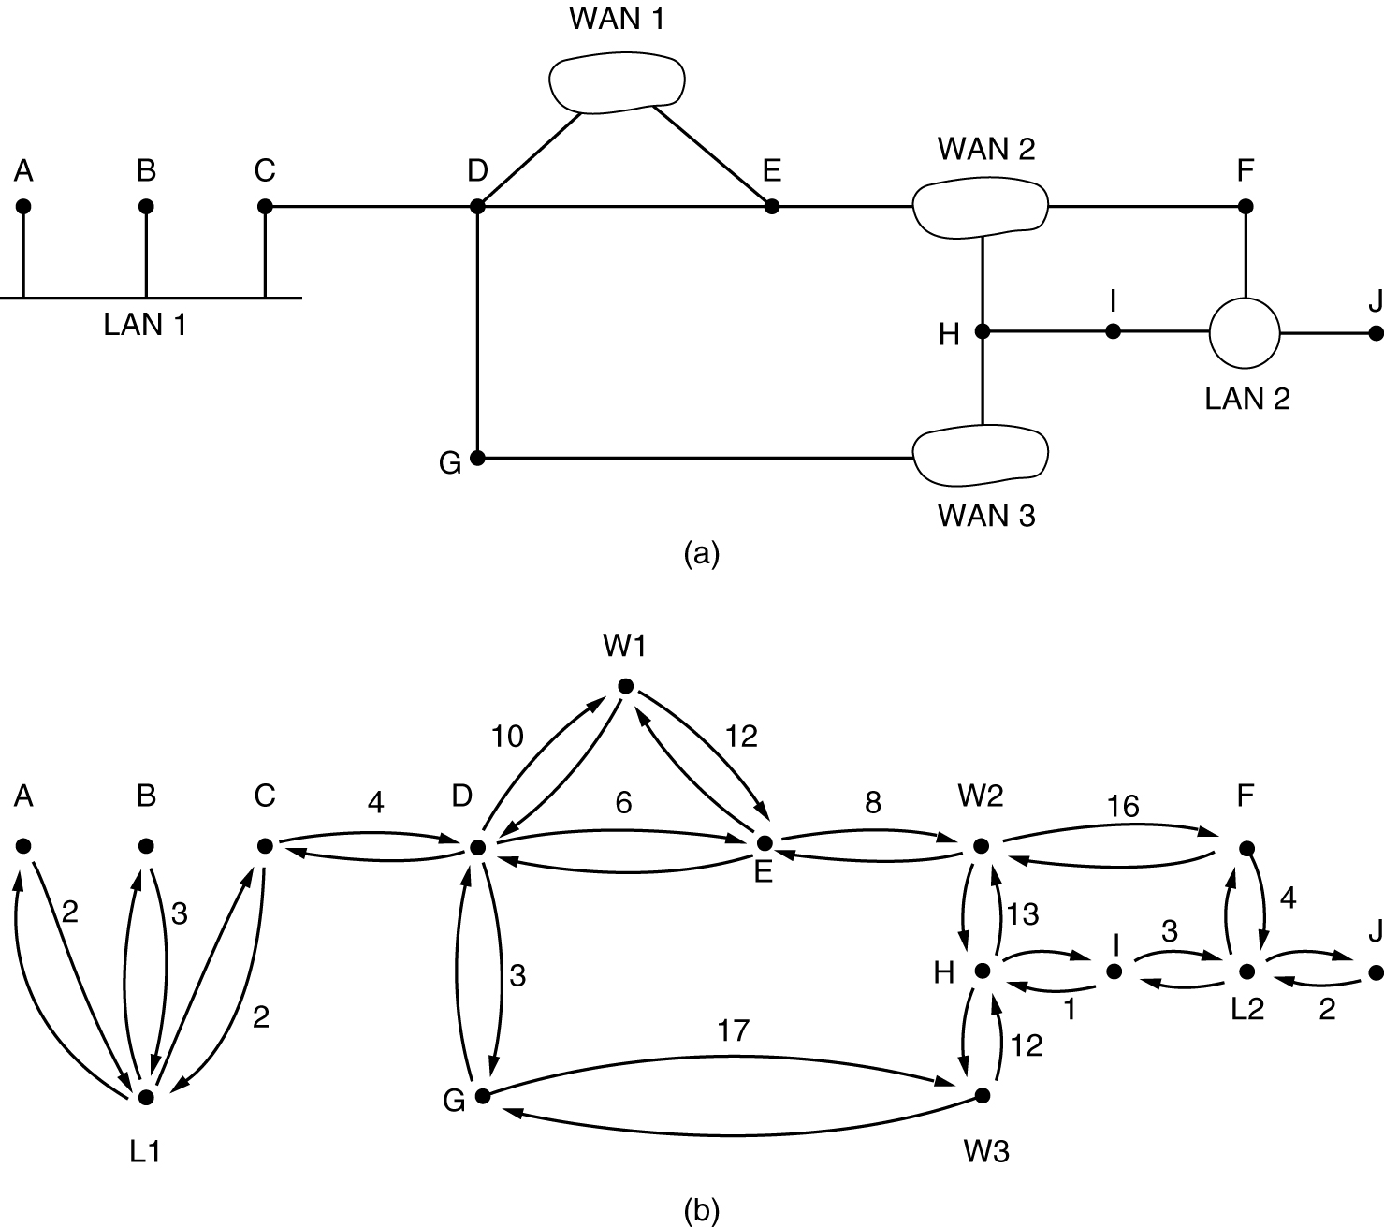
OSPF (3)
(a) An autonomous system. (b) A graph representation of (a).

Slide 22
OSPF (4)
An AS is divided into numbered areas
Area 0 is backbone area
  All areas are connected to the backbone
Classes of routers
  Internal routers are within one area
  Area border routers connect two or more areas
  Backbone routers are on the backbone
  AS boundary routers talk to routers in other ASes
Route kinds: intra-area, inter-area, and inter-AS

Slide 23
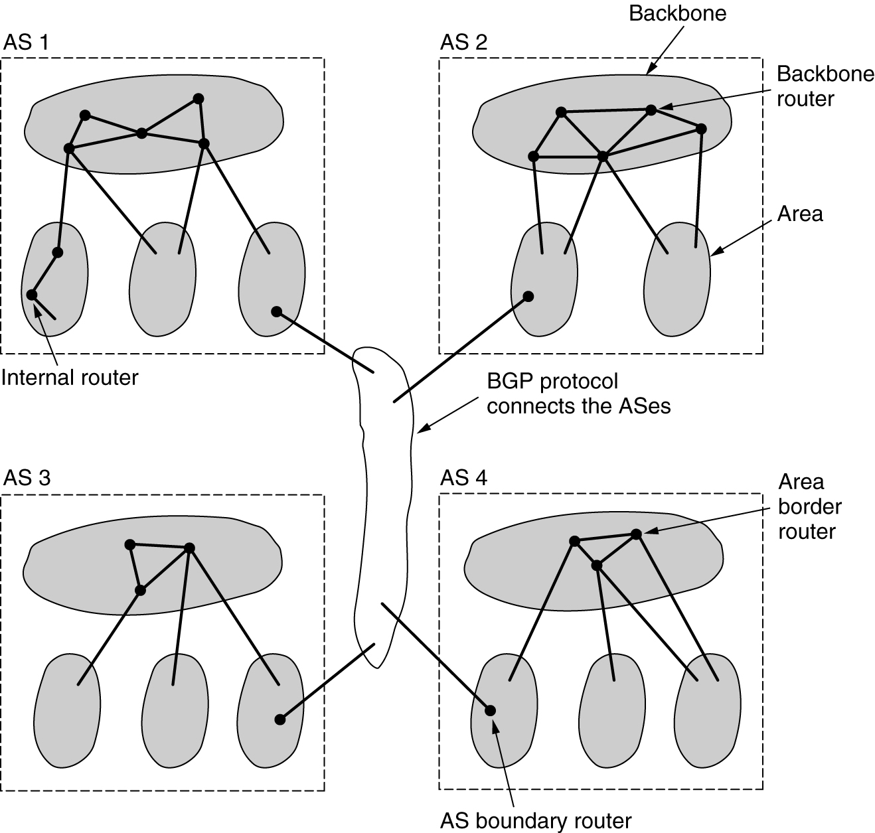
OSPF (5)
The relation between ASes, backbones, and areas in OSPF.

Slide 24
Border Gateway Routing Protocol (BGP)
BGP is the main IP exterior routing protocol
Have to worry about politics
  Manually configured into each BGP router
Pairs of BGP routers communicate by TCP connections
Distance vector routing +
  Keep track of path and tell its neighbors the exact path
Routers scoring function
  check policy for violating constraints

Slide 25
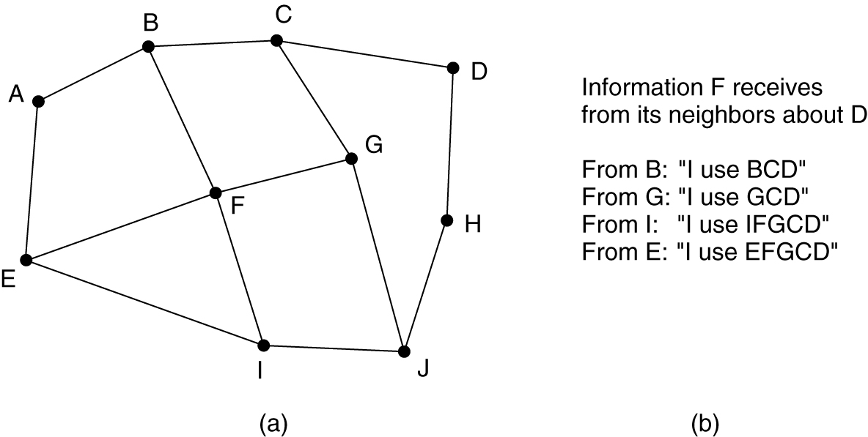
BGP
(a) A set of BGP routers. (b) Information sent to F.

Slide 26
Reading
Tanenbaum 5.2.2-6, 5.6.4-5

