Slide 1
Data Communication and Networks (Fall 2004)
Lecture 6
The Network Layer (cont.)
Congestion & QoS
Dr. Sahar M. Ghanem

Slide 2
Congestion Control Algorithms
General Principles of Congestion Control
Congestion Prevention Policies
Congestion Control in Virtual-Circuit Subnets
Congestion Control in Datagram Subnets
Load Shedding
Jitter Control

Slide 3
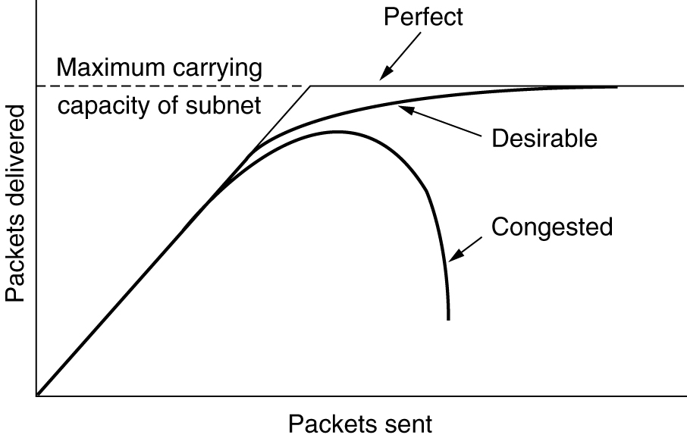
Congestion
When too much traffic is offered, congestion sets in and performance degrades sharply.

Slide 4
General Principles of Congestion Control
Monitor the system .
  detect when and where congestion occurs.
Pass information to where action can be taken.
Adjust system operation to correct the problem.

Slide 5
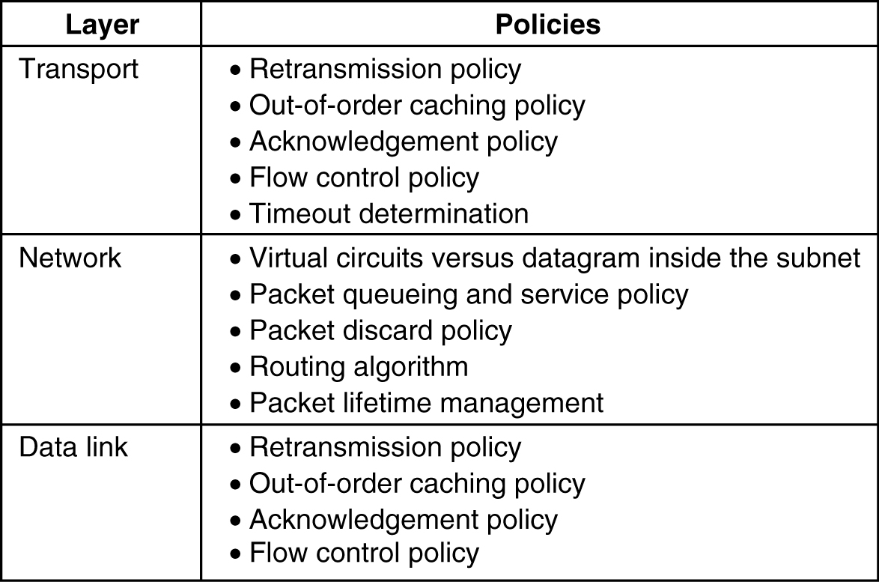
Congestion Prevention Policies
5-26
Policies that affect congestion.

Slide 6
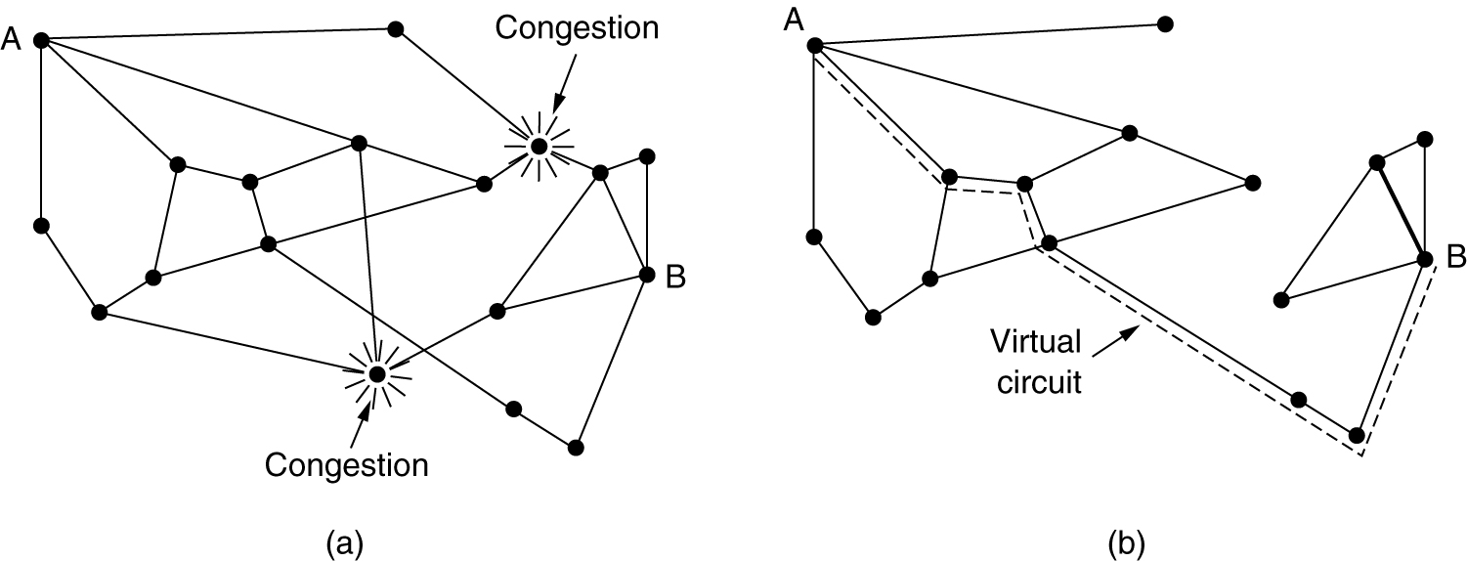
Congestion Control in Virtual-Circuit Subnets
(a) A congested subnet. (b) A redrawn subnet, eliminates congestion and a virtual circuit from A to B.

Slide 7
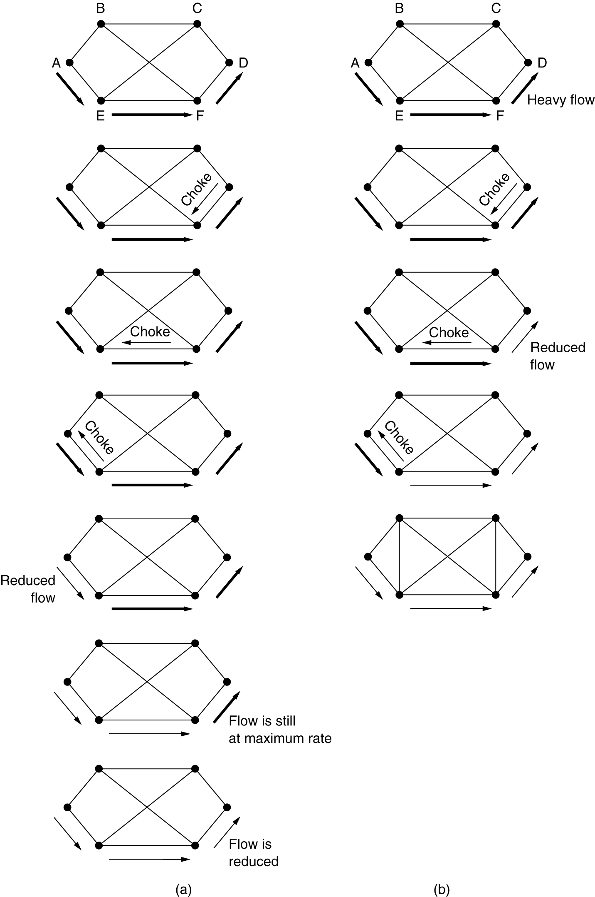
Hop-by-Hop Choke Packets
(a) A choke packet that affects only the source.
(b) A choke packet that affects each hop it passes through.

Slide 8
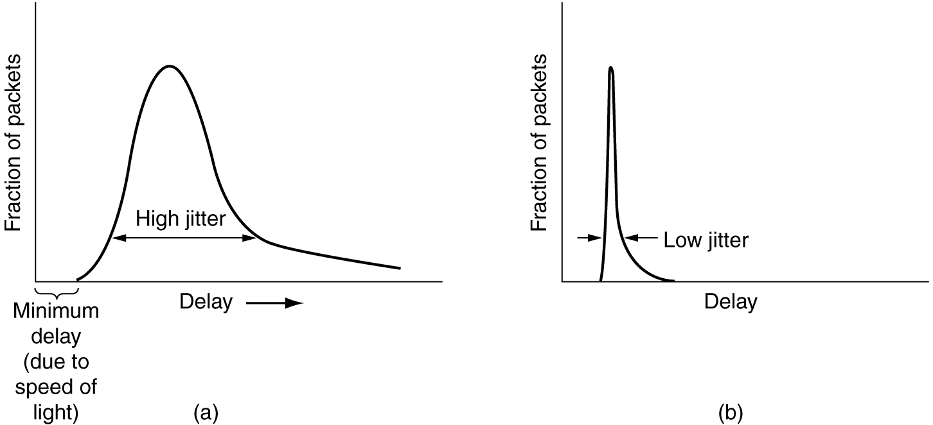
Jitter Control
(a) High jitter. (b) Low jitter.

Slide 9
Quality of Service
Requirements
Techniques for Achieving Good Quality of Service
Integrated Services
Differentiated Services
Label Switching and MPLS

Slide 10
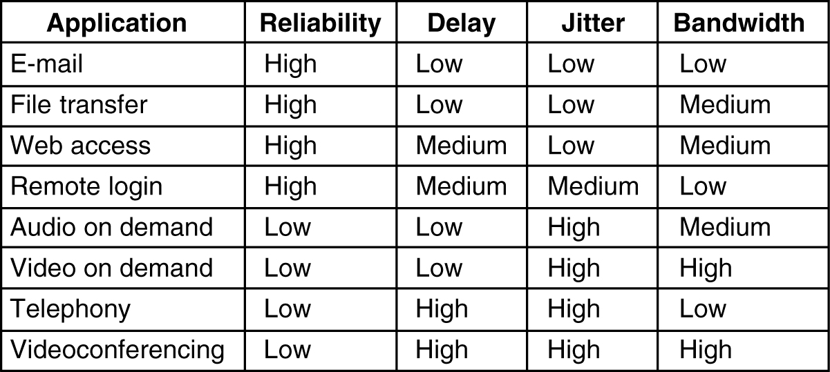
Requirements
5-30
How stringent the quality-of-service requirements are.

Slide 11
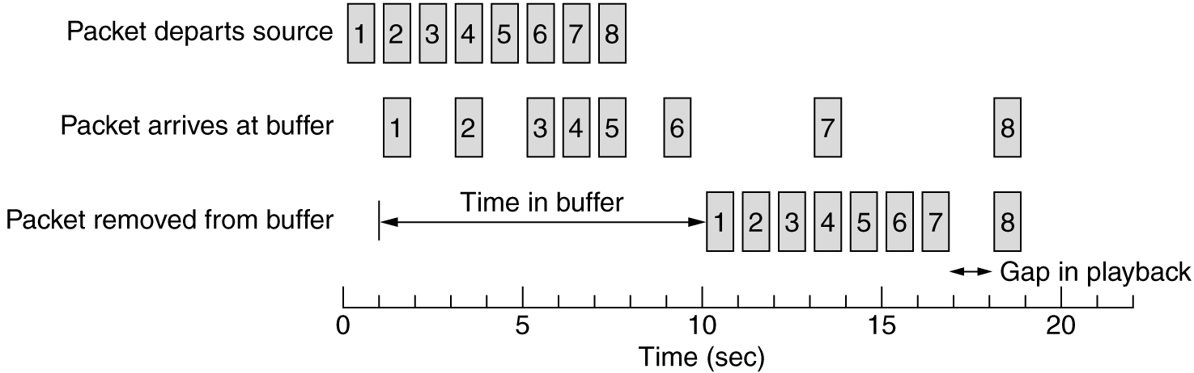
Buffering
Smoothing the output stream by buffering packets.

Slide 12
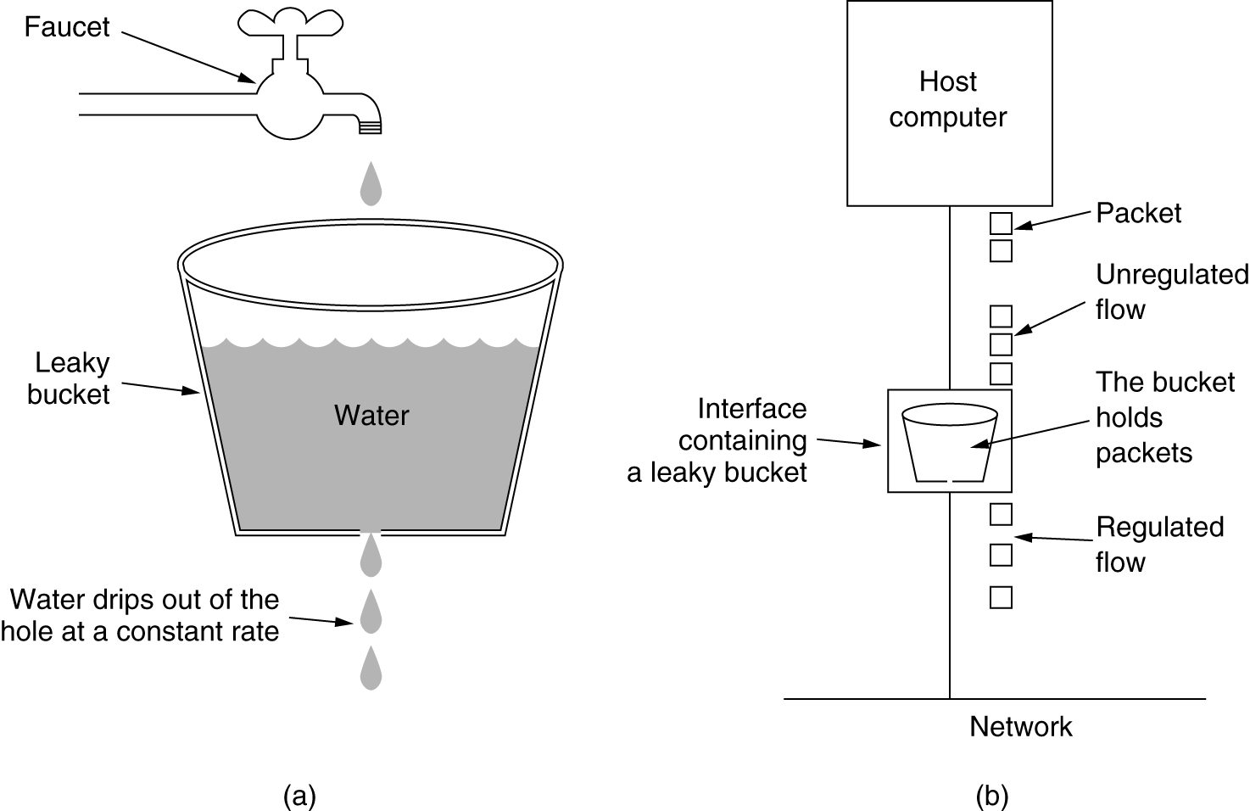
The Leaky Bucket Algorithm
(a) A leaky bucket with water. (b) a leaky bucket with packets.

Slide 13
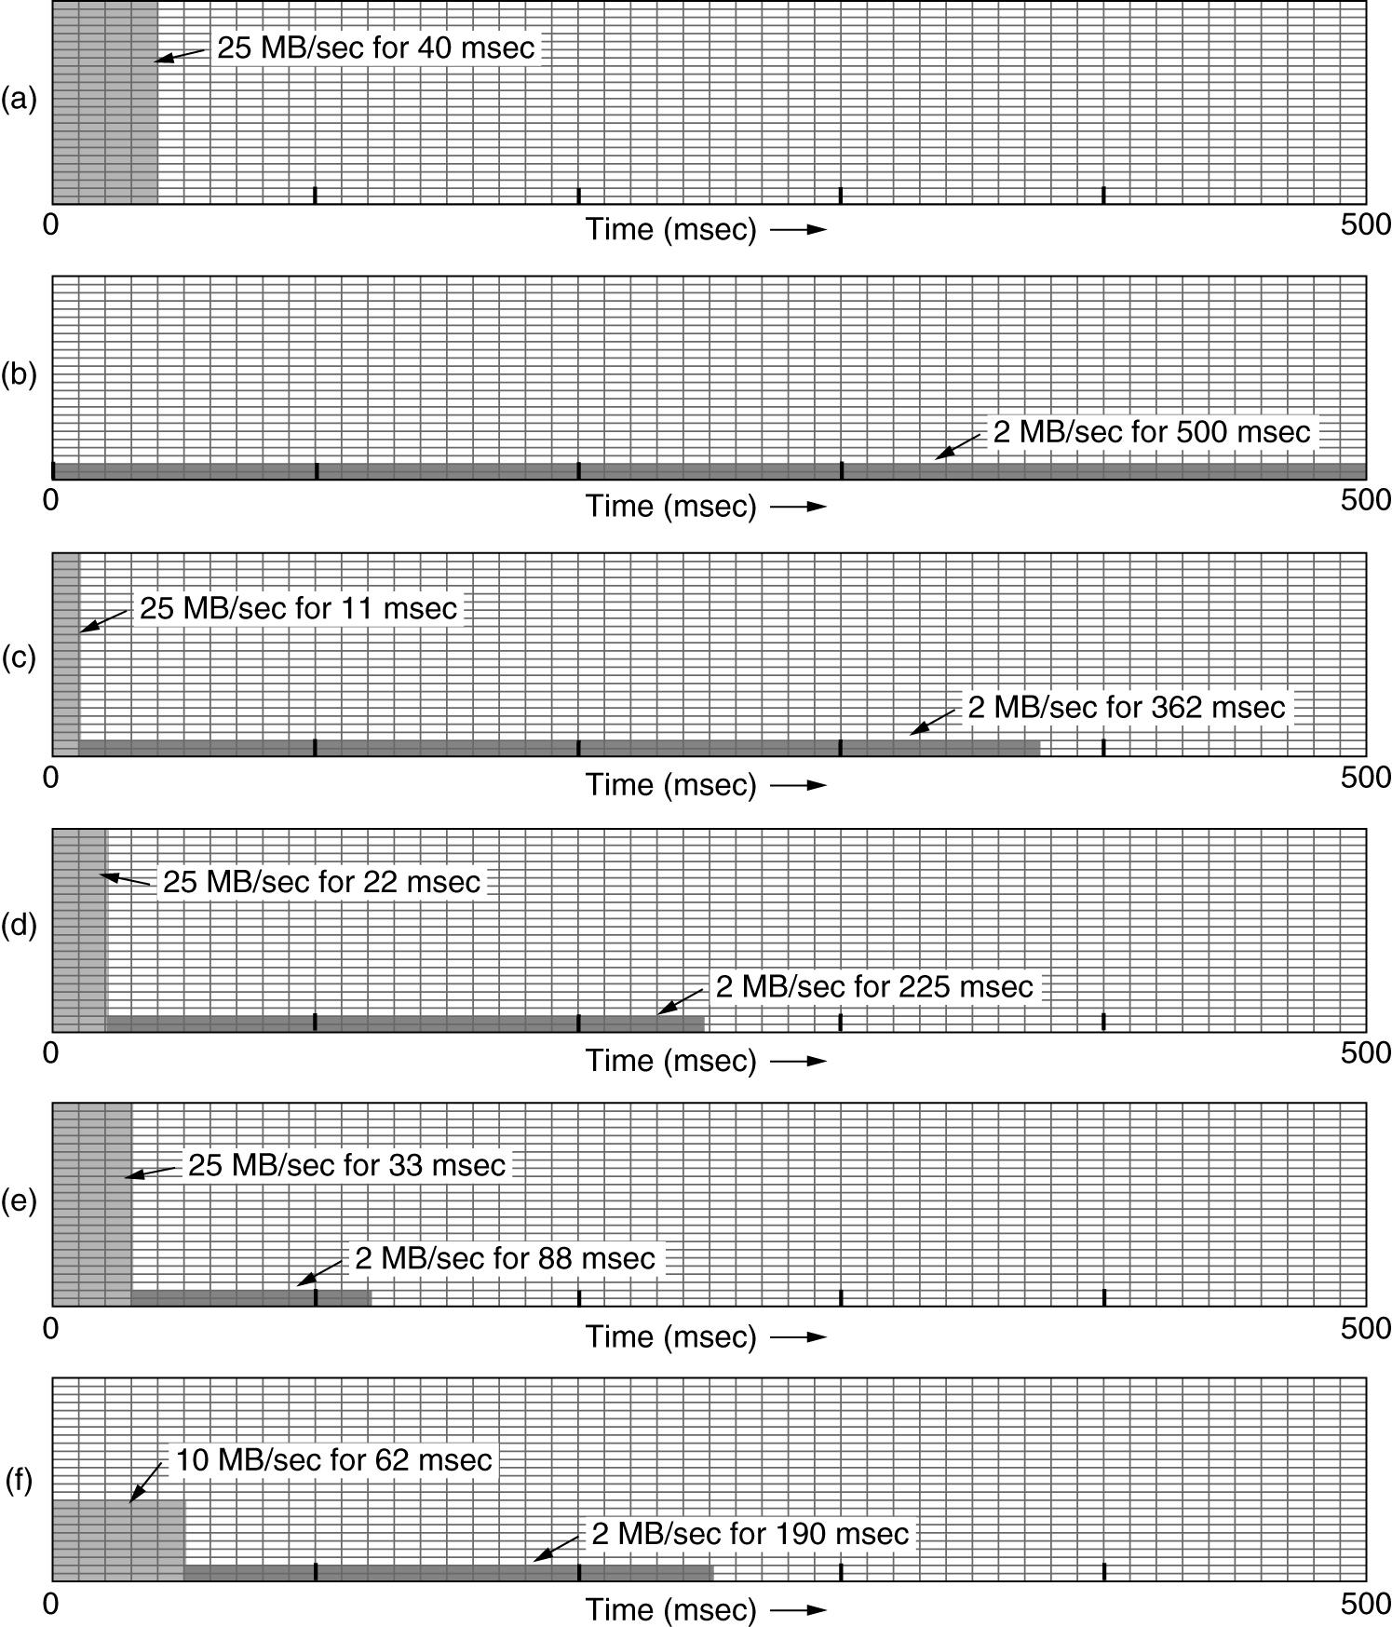
The Leaky Bucket Algorithm
(a) Input to a leaky bucket. (b) Output from a leaky bucket. Output from a token bucket with capacities of (c) 250 KB, (d) 500 KB, (e) 750 KB, (f) Output from a 500KB token bucket feeding a 10-MB/sec leaky bucket.

Slide 14
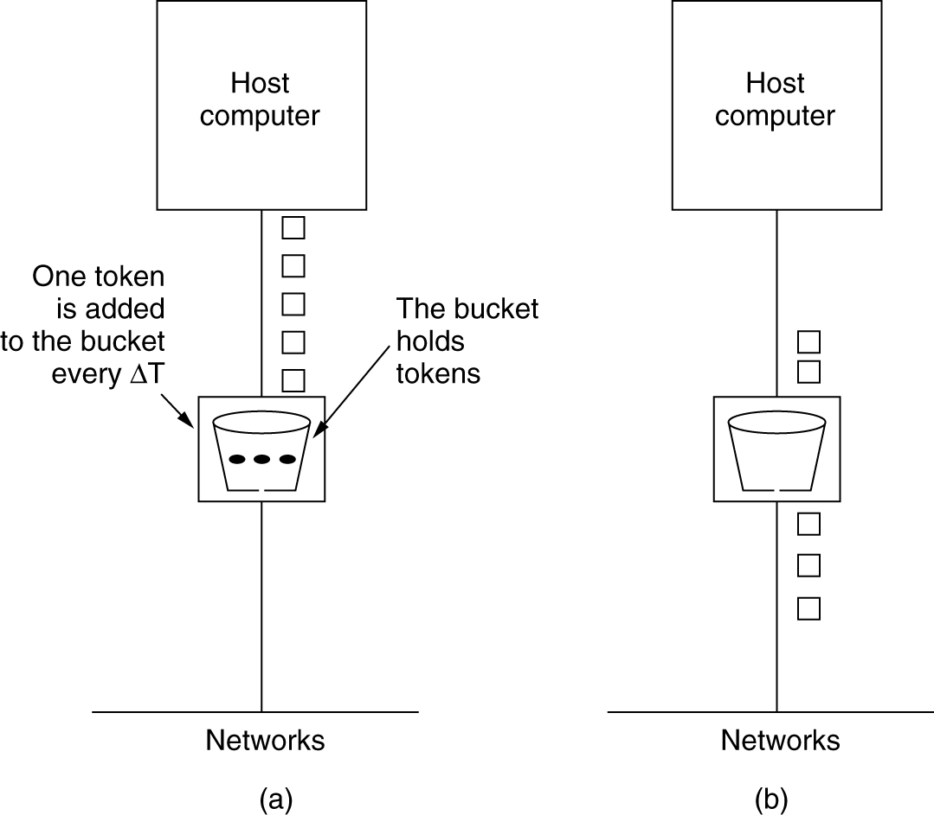
The Token Bucket Algorithm
5-34
(a) Before. (b) After.

Slide 15
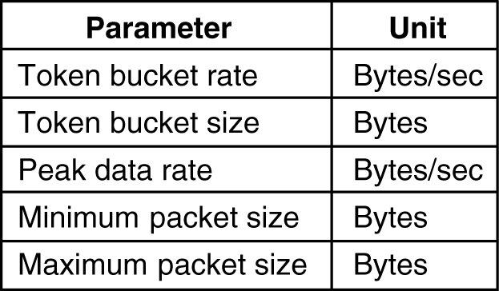
Admission Control
5-34
An example of flow specification.

Slide 16
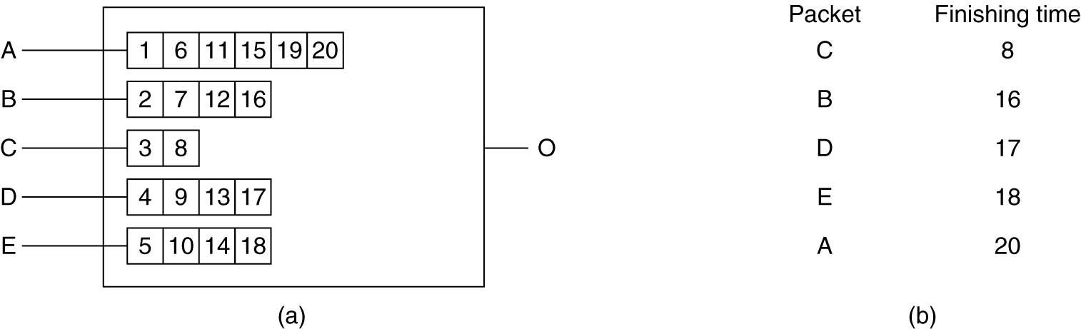
Packet Scheduling
(a) A router with five packets queued for line O.
(b) Finishing times for the five packets.

Slide 17
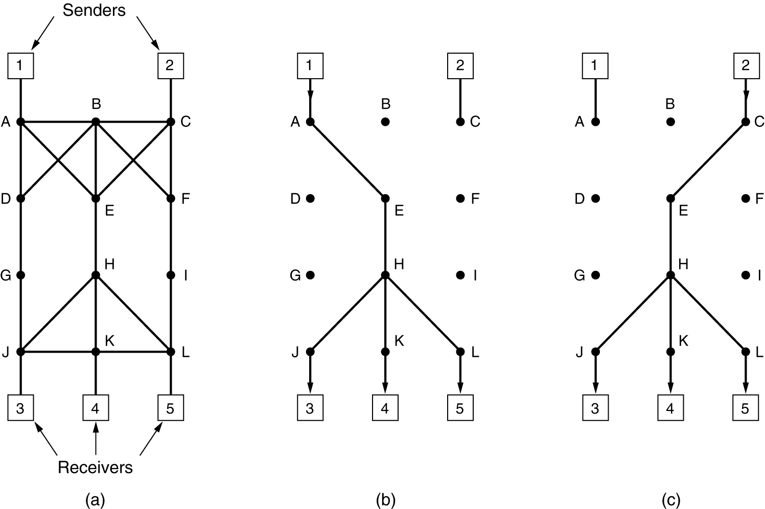
RSVP-The ReSerVation Protocol
(a) A network, (b) The multicast spanning tree for host 1.
(c) The multicast spanning tree for host 2.

Slide 18
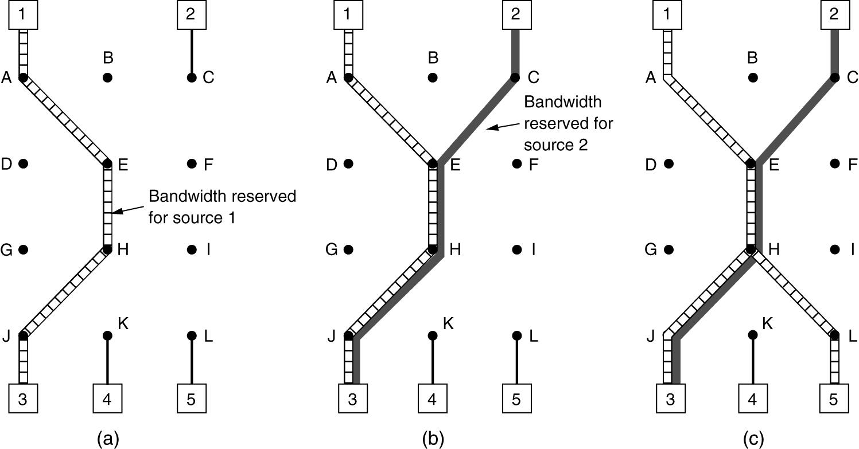
RSVP-The ReSerVation Protocol (2)
(a) Host 3 requests a channel to host 1. (b) Host 3 then requests a second channel, to host 2. (c) Host 5 requests a channel to host 1.

Slide 19
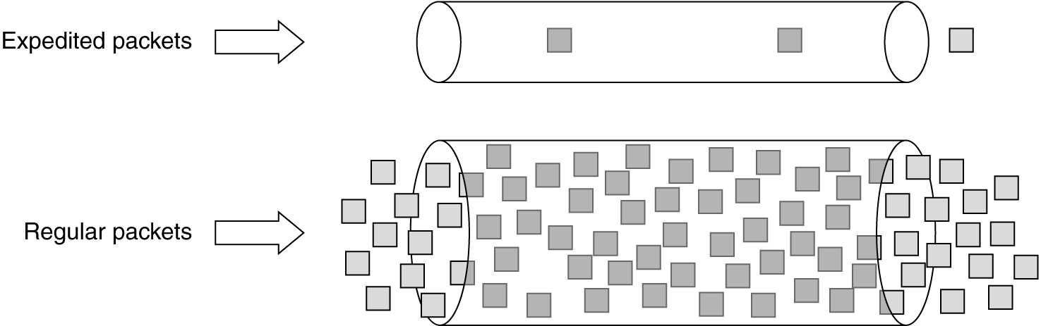
Expedited Forwarding
Expedited packets experience a traffic-free network.

Slide 20
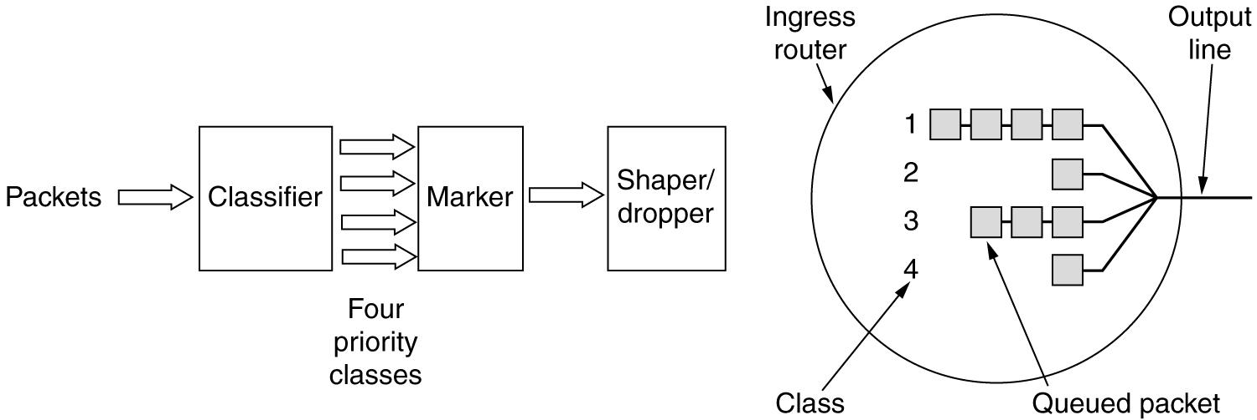
Assured Forwarding
A possible implementation of the data flow for assured forwarding.

Slide 21
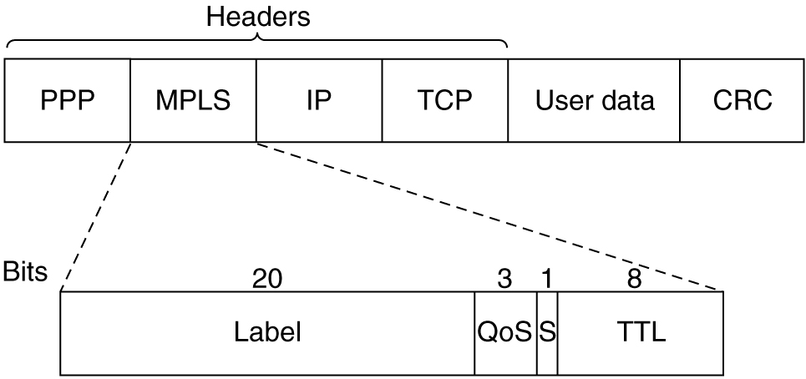
Label Switching and MPLS
Transmitting a TCP segment using IP, MPLS, and PPP.

