Slide 1
Data Communication and Networks (Fall 2004)
Lecture 7
The Network Layer in the Internet (cont.)
Dr. Sahar M. Ghanem

Slide 2
Outline
ICMP
ARP
RARP, BOOTP, and DHCP
IPv4 Header
IPv6
Internetworking
  Tunneling
  Fragmentation

Slide 3
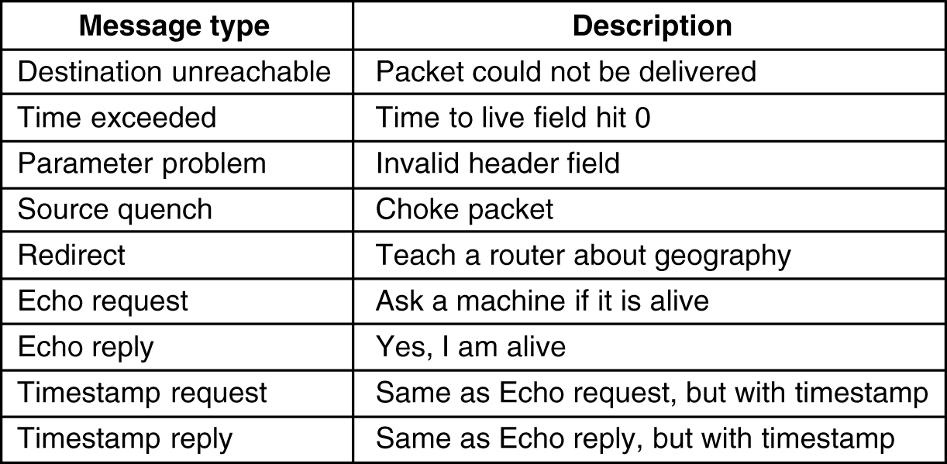
Internet Control Message Protocol (ICMP)
ICMP is used by routers to test and monitor the Internet
Messages are sent as IP packets (protocol 1)
The principal ICMP message types.

Slide 4
The Address Resolution Protocol (ARP)
ARP maps IP addresses onto data link layer (MAC) addresses
Host-1 usually knows the name of Host-2
  DNS translates name to IP
ARP is running on every machine
  Host-1 broadcast to the LAN the question “who owns the IP?”
  Host-2 only will respond
An ARP packet is encapsulated into a data link frame

Slide 5
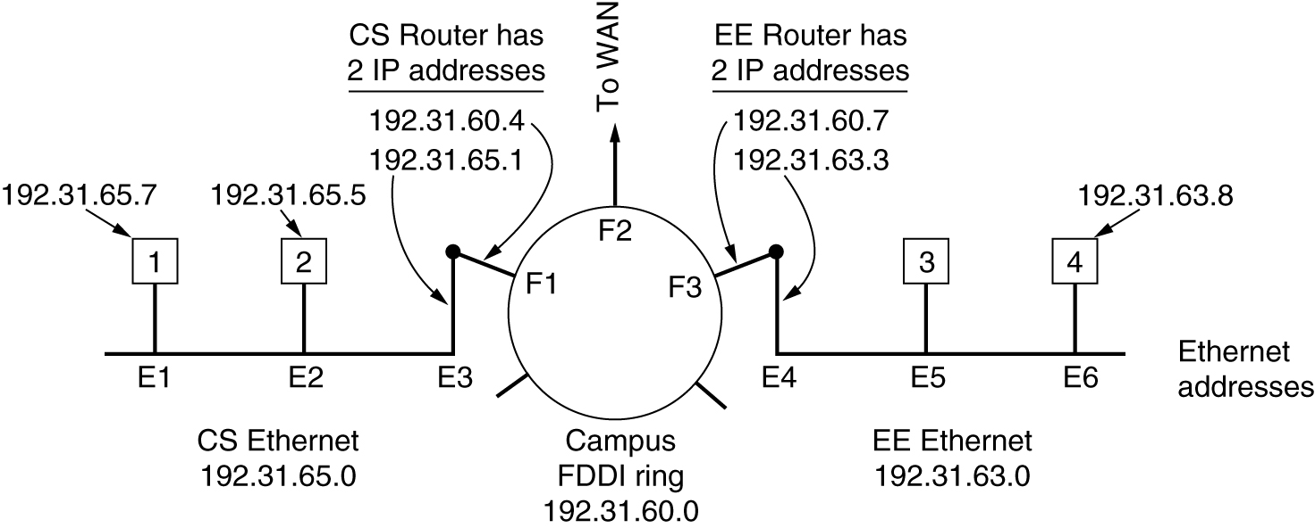
ARP (2)
Three interconnected /24 networks: two Ethernets and an FDDI ring.

Slide 6
ARP (3)
Optimizations
  Cache the result (time out)
  Host-1 include his link layer address in the broadcast (cached by all machines)
  A machine broadcast its mapping when boots
Routers do not forward LAN broadcast
Routers could broadcast an ARP packet to learn another router or host data-link-layer address
Host-1 to Host-4 solutions
  Proxy ARP: routers are configured to respond to ARP requests for other LANs
  send all remote traffic to a default link layer address

Slide 7
RARP, BOOTP, and HCP
Diskless workstation is booted: what is my IP?
RARP (Reverse ARP)
  Broadcast the question, RARP server send back the IP
  RARP server is needed on each LAN
BOOTP (BOOTstrap Protocol)
  Uses UDP messages that is forwarded by routers
  Require manual configuration of the server
DHCP (Dynamic Host Configuration Protocol)
  Allows manual and automatic IP address assignment
  DHCP relay agent is needed on each LAN
  Leasing to avoid permanently losing IPs

Slide 8
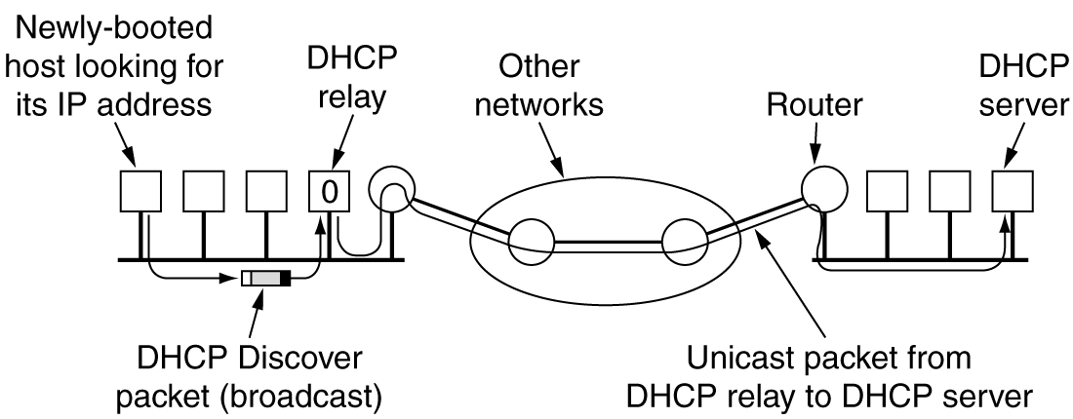
D HCP
Operation of DHCP.

Slide 9
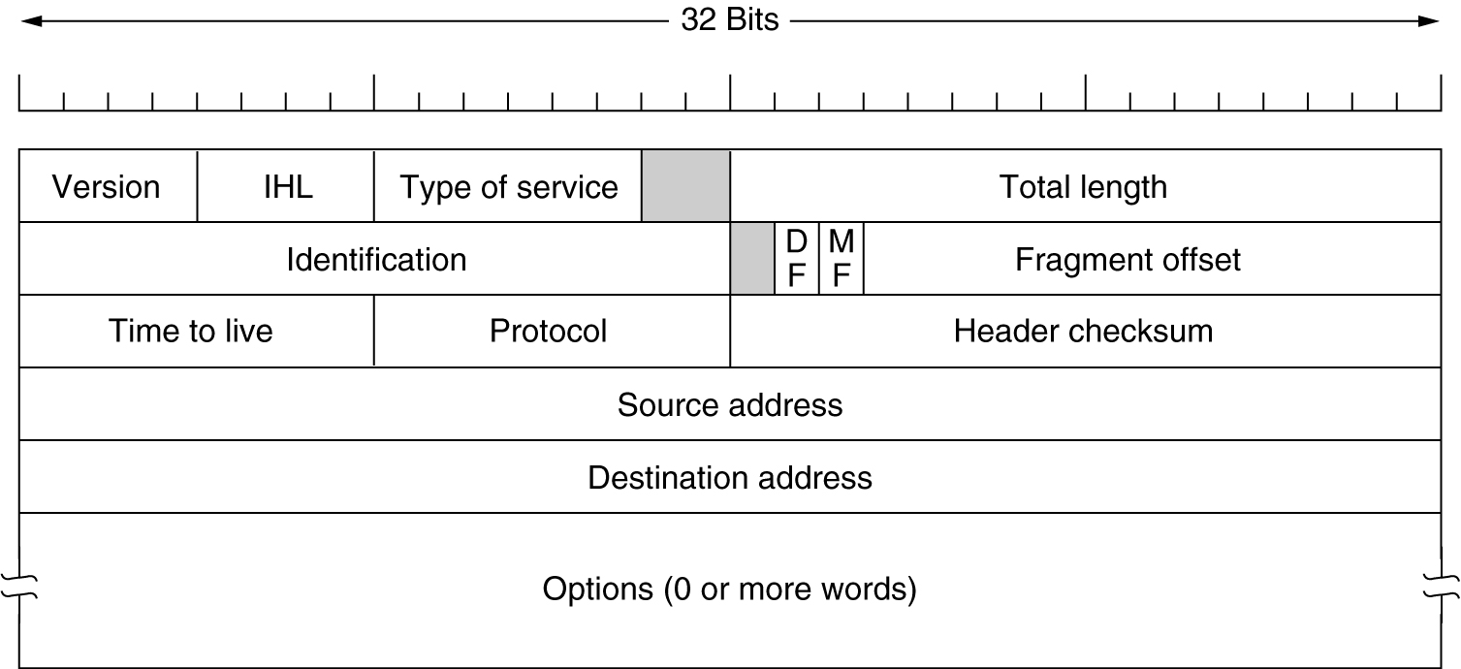
The IPv4 Header

Slide 10
The IPv4 Header (2)
Header: 20-byte fixed + optional (max 40 bytes)
Version, 4 bits
IHL, 4 bits: header length in 32-bits words
TOS, 6 bits: often ignored
Total length, 16 bits
ID, 16 bits: all fragments contains same ID
DF, MF
Fragment offset, 13 bits: multiple of 8 bytes
TTL, 8 bits: max 225 sec
Protocol, 8 bits: assigned protocol numbers RFC 1700
Header checksum, 16 bits: recomputed every hop
Source address, destination address, 32 bits
Options: 1 byte ID, padded to a multiple of 4 bytes
All machines are required to accept fragments of 576 bytes or less

Slide 11
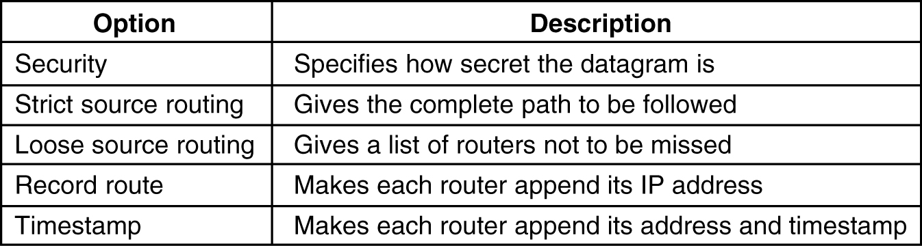
Some of IPv4 options
5-54

Slide 12
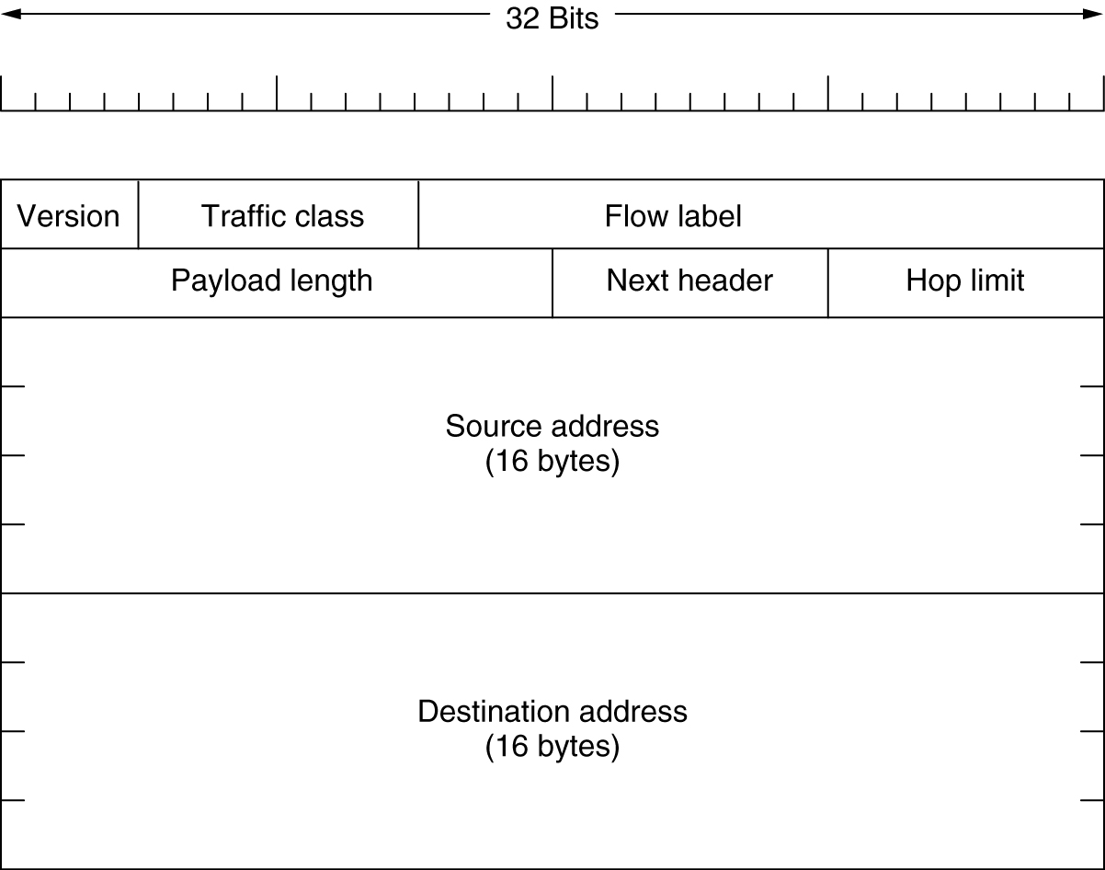
The IPv6 Header
The IPv6 fixed header (required, 40 bytes).

Slide 13
IPv6
IPv6 Improvements
  longer addresses; simplified header; better support for options; Security; Quality of Service
Header
  Version, 4 bits
  Traffic class, 8 bits + Flow label, 20 bits (instead of TOS)
  Payload length, 16 bits (instead of total length)
  Next header, 8 bits: which extension header follows or transport protocol (instead of protocol and options)
  Hop limit, 8 bits (instead of TTL)
  Source address, destination address, 16 bytes (instead of 32 bits)
  All machines are required to accept packets of size 1289 bytes or less
IHL, the fragmentation fields, and the checksum field are removed

Slide 14
IPv6
Address notation (16 byte)
  Hexadecimal Colon number 8000::123:4567:89AB:CDEF
  IPv4 decimal doted number ::192.31.20.46
Extension headers
    Next header, 1 byte
    Header length after the first 8 bytes, 1 byte
    Option information

Slide 15
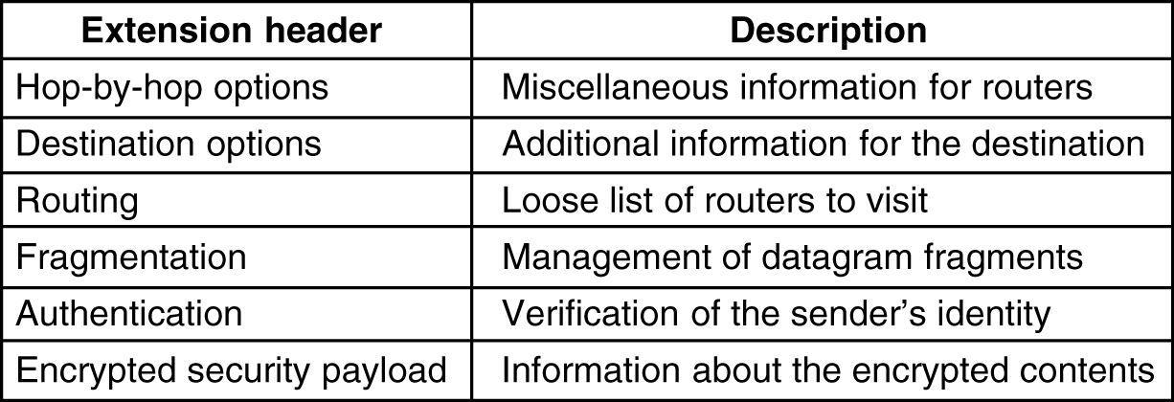
Extension Headers
5-69
IPv6 extension headers.

Slide 16
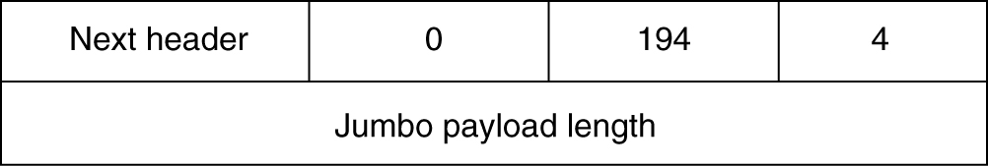
Extension Headers (2)
The hop-by-hop extension header
Only one option is defined to support datagrams exceeding 64K (jumbograms).

Slide 17
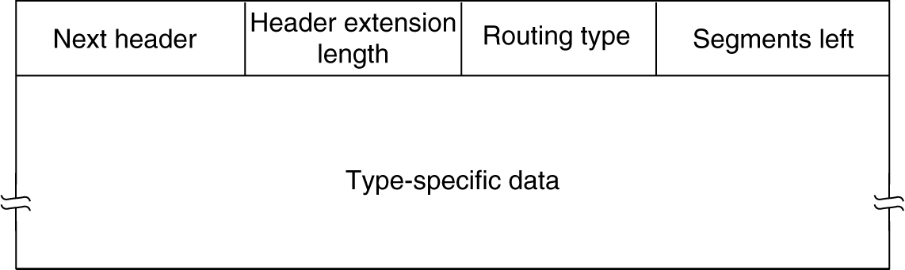
Extension Headers (3)
The extension header for routing.

Slide 18
IPv6 Controversies
Address length
Hop limit
Maximum packet size
Checksum
Mobile hosts
Security

Slide 19
Internetworking
Why different networks?
  The installed base of different networks is large
  Computers and networks get cheaper
  New software will be created to fit a new hardware/technology

Slide 20
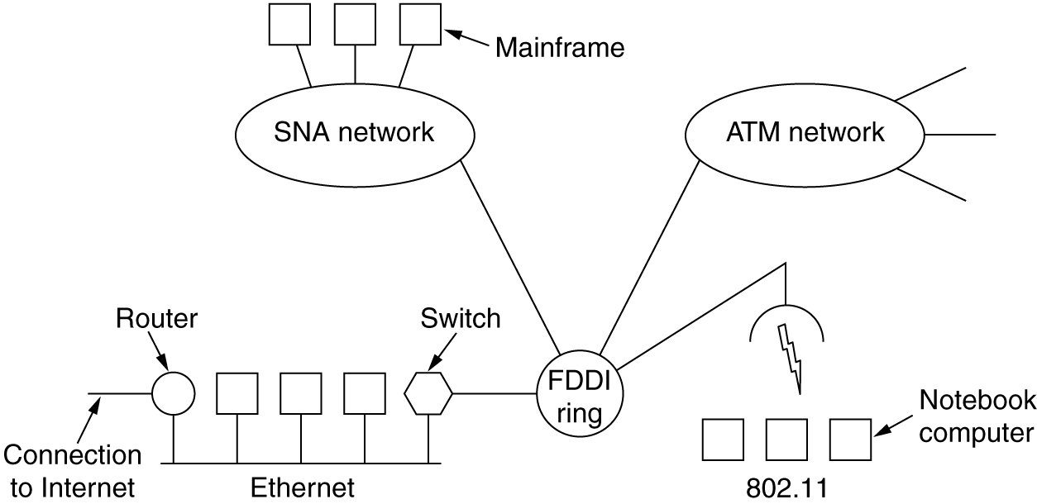
Connecting Networks
A collection of interconnected networks.

Slide 21
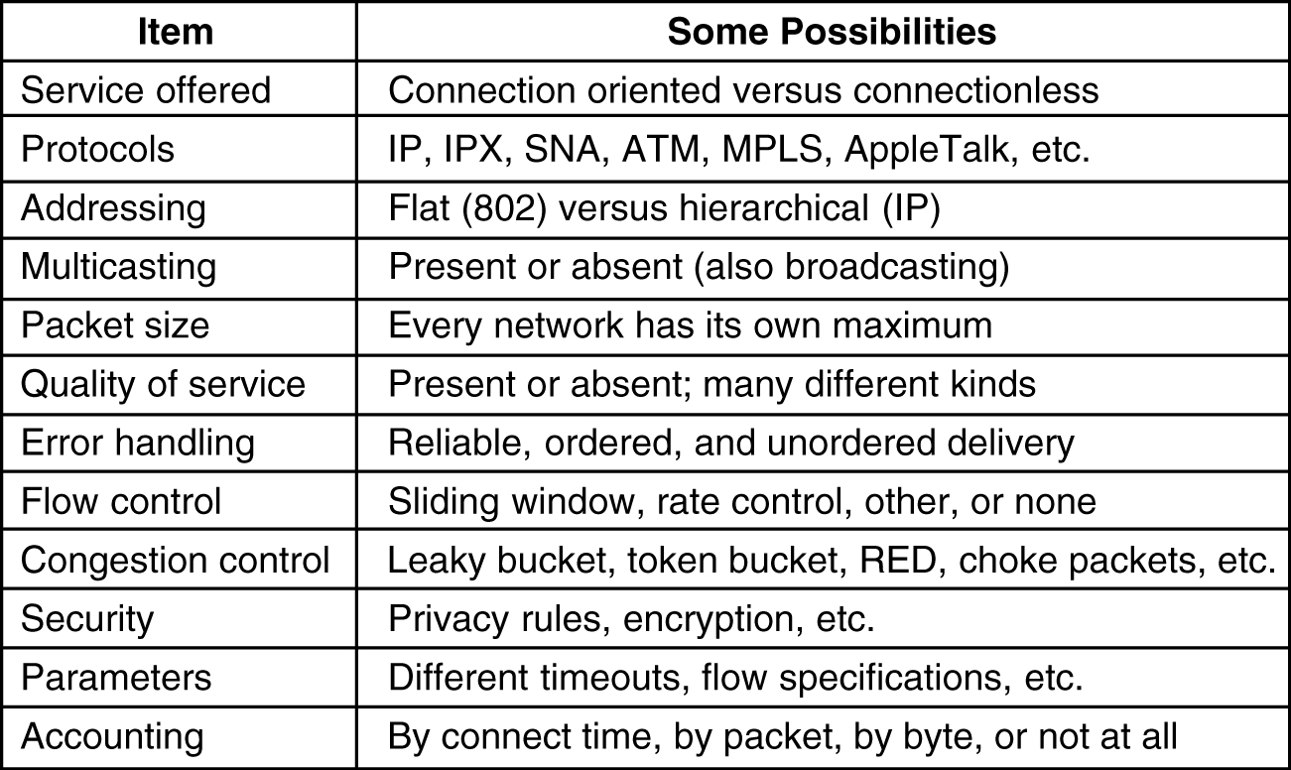
How Networks Differ
5-43
Some of the many ways networks can differ.

Slide 22
How Networks Can Be Connected
Physical layers are connected by repeaters or hubs
Data link layers are connected by bridges and switches
Network layers are connected by routers
  Multi-protocol router
Transport layers are connected by transport gateways
Application layers are connected by application gateways

Slide 23
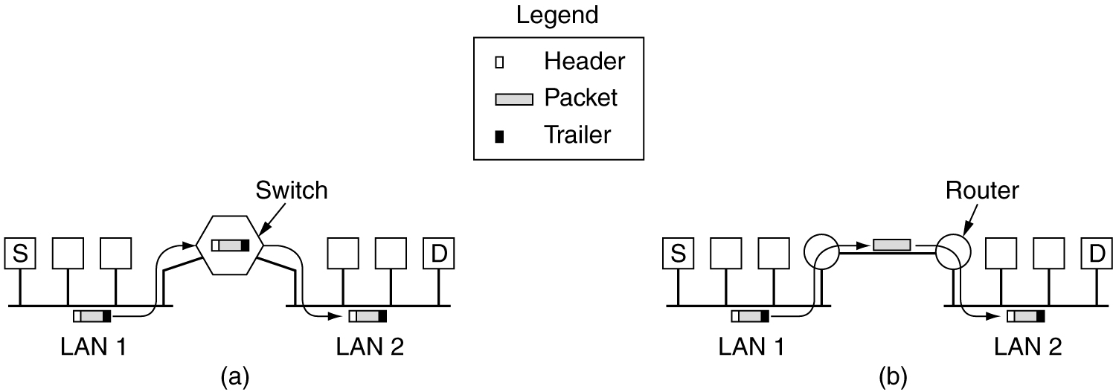
How Networks Can Be Connected (2)
(a) Two Ethernets connected by a switch.
(b) Two Ethernets connected by routers.

Slide 24
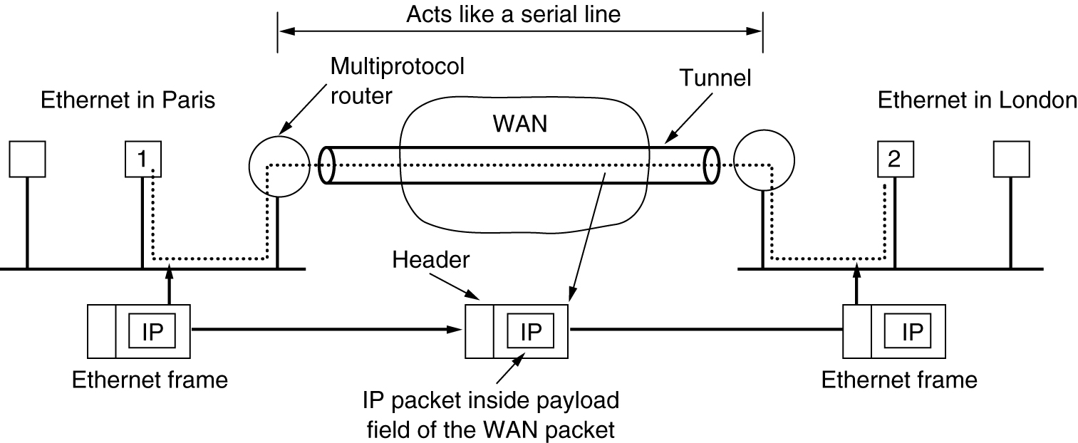
Tunneling
Tunneling a packet from Paris to London.

Slide 25
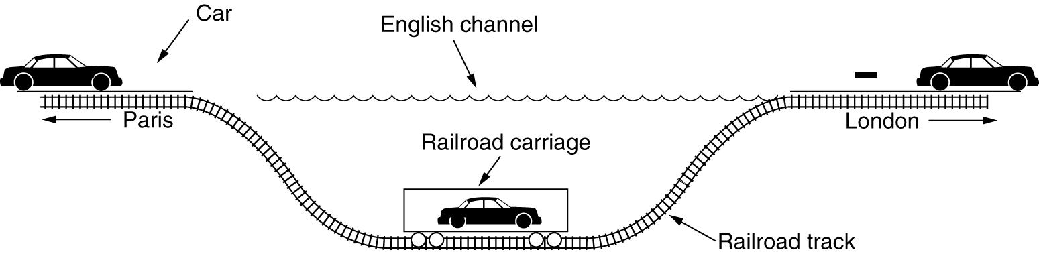
Tunneling (2)
Tunneling a car from France to England.

Slide 26
Fragmentation
Maximum payloads range from 48 bytes to 65,515
Break up large packets into fragments
Transparent fragmentation
  Count field or end-of-packet bit must be provided; all fragments follow the same route; repeated fragmentation
Nontransparent fragmentation
  Every host has to be able to reassemble; increased overhead
  Numbering problem with packet 0 fragmented to (0.0, 0.1, 0.2, 0.3) and later to (0.0, 0.1)

Slide 27
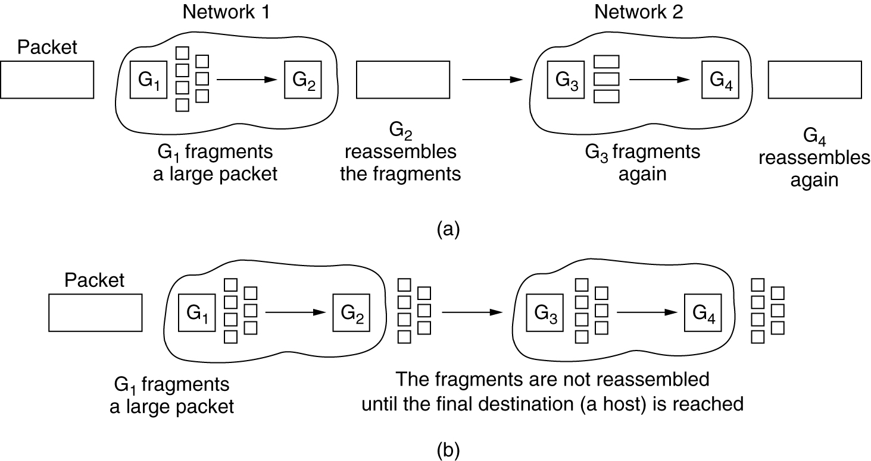
Fragmentation (2)
(a) Transparent fragmentation. (b) Nontransparent fragmentation.

Slide 28
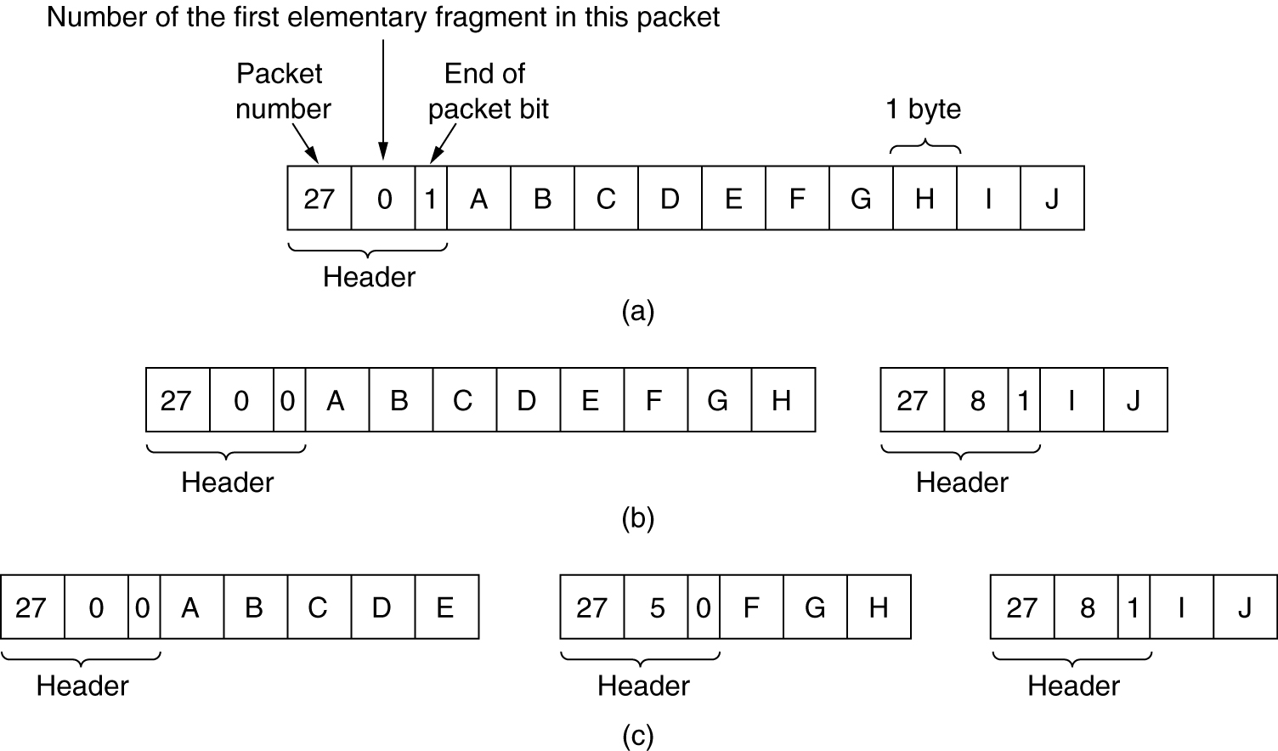
Fragmentation (3)
Fragmentation when the elementary data size is 1 byte.
(a) Original packet, containing 10 data bytes.
(b) Fragments after passing through a network with maximum packet size of 8 payload bytes plus header.
(c) Fragments after passing through a size 5 gateway.

Slide 29
Reading
Tanenbaum 5.6.3, 5.6.1, 5.6.8, (5.5.1,2,5,7)

