Slide 1
Project Proposal:
Electronic marketplace:
* Entities with excess electric power:
→Auction power to entities who need to
purchase power.
* An entity that needs to purchase power:
→ Initiate an auction to buy power from
other entities who have excess capacity.

Slide 2
Introduction:
The electric power industry is becoming a large interconnected network of distributed resources.
Buying and selling in this environment is made difficult because of the difficulty of obtaining information in a timely manner and making decisions.

Slide 3
Introduction (cont.):
Legacy systems are based on a centralized model where all information flows into a central site where decisions are made.
→This model is no longer valid for the new energy industry.

Slide 4
Introduction (cont.):
New technology is required in order to:
Make it easy to buy and sell energy.
Monitor supply and demand.
Monitor the status of generation and transmission equipment
Improve system reliability.
Communicate using open systems technology such as the Internet
Improve productivity.

Slide 5
Intelligent software agents:
Intelligent software agents provide promising mechanism for implementing these complex, high performance systems.

Slide 6
Intelligent software agents (cont.):
Intelligent software agents:
A new class of software that act on behalf of the user to:
- Find and filter information.
- Negotiate for services.
- Easily automate complex tasks.
- Collaborate with other software agents to solve complex problems.

Slide 7
Multi-Agent System:
Agents are most useful when multiple agents:
communicate, cooperate and collaborate to solve complex problems.
Multi-Agent System == set of agents and the environment they interact
environment
Agent
Agent
Agent
Agent
Agent
Agent

Slide 8
ACL:
It stands for Agent Communication Language:
The 2 types of ACL’s:
Foundation for Intelligent Physical Agents (FIPA) ACL
Knowledge Query and Manipulation Language (KQML)

Slide 9
ACL (cont.):
The message format according to the FIPA-standard comprises
a number of fields:
The sender of the message.
The list of receivers.
The communicative intention (also called “performative”) indicating what the sender intends to achieve by sending the message.
The performative can be:
REQUEST, INFORM, QUERY_IF,CFP (call for proposal), PROPOSE, ACCEPT_PROPOSAL, REJECT_PROPOSAL
The content .
The content language .
The ontology.
Some fields used to control several concurrent conversations and to specify timeouts for receiving a reply such as:
conversation-id, reply-with, in-reply-to, reply-by.

Slide 10
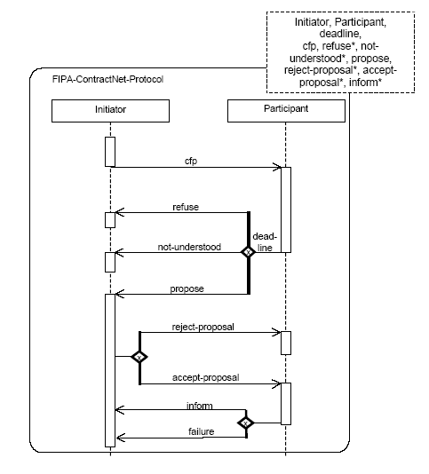
AUML:
It stands for Agent Unified Modeling Language:

Slide 11
The MAS in our project:
Our project:
A MAS used to buy and sell electric power.
Buyer and Seller agents:
Delegated responsibilities by the various stakeholders involved in trading electricity.
A stakeholder might be:
-A power generator.
-A power consumer.
-A power distributor.

Slide 12
The MAS in our project (cont.):
Each stakeholder has different goals, objectives and motivations.
Some may value reliability over cost, others may view that managing costs is their primary objective.
Each agent is designed to satisfy the goals, objectives, intentions, plans and schedules of its stakeholder.

