Slide 1
Loan Defaulter
Mohamed Ayman Afifi
Abdelrahman Hassan Shaaban
Mohammed Yasser Ismael
Noureldin Mohamed Amin
Mark Hany Adel

Slide 2
Problem Description
Financial institutions lose money when borrowers don’t repay their loans. Traditional evaluation methods are slow and often miss high-risk applicants, leading to more loan defaults and lower lending efficiency.
Proposed Solution
A machine-learning model that analyzes customer financial data to predict high-risk borrowers, providing real-time risk scores for faster and more accurate loan decisions.
Unique Value Proposition
Higher prediction accuracy using advanced ML algorithms
Easy integration into banking workflows
Faster and more data-driven loan decision-making
Explainable AI gives transparency behind each prediction

Slide 3
Primary Stakeholders
Key Features
Banks & Financial Institutions
Loan default prediction
Loan Officers / Credit Analysts
Loan Officers / Credit Analysts
Risk Management Teams
Data-driven decision support
How It Helps Each User
Banks: Reduce financial losses by detecting high-risk borrowers early.
Loan Officers: Faster and more accurate approval decisions.
FinTech Companies: Integrate ML scoring to improve lending efficiency.

Slide 4
Database Architecture:
Using a CSV dataset from Kaggle stored in a tabular format. Works like a simple relational structure without a full database system.
Key Entities & Relationships:
Includes customer info (age, income, job status), loan details (amount, interest), credit factors (score, past defaults), and the target: loan_status.
All features relate to predicting whether a customer will default.
Data Flow:
CSV → Loaded into Pandas → Cleaned (missing values, encoding, scaling) → Data examined for balance (dataset is imbalanced) → Processed data → ML model → Default/Non-default prediction.

Slide 5
Programming Languages
Frameworks / Tools Used
Python (main language for data analysis & ML)
Pandas, NumPy – data handling
Matplotlib, Seaborn – visualization
Supporting Technologies
Scikit-learn, LightGBM, CatBoost – machine learning
Kaggle – dataset source
Google Colab Notebook – development environment
GitHub – source code hosting

Slide 6
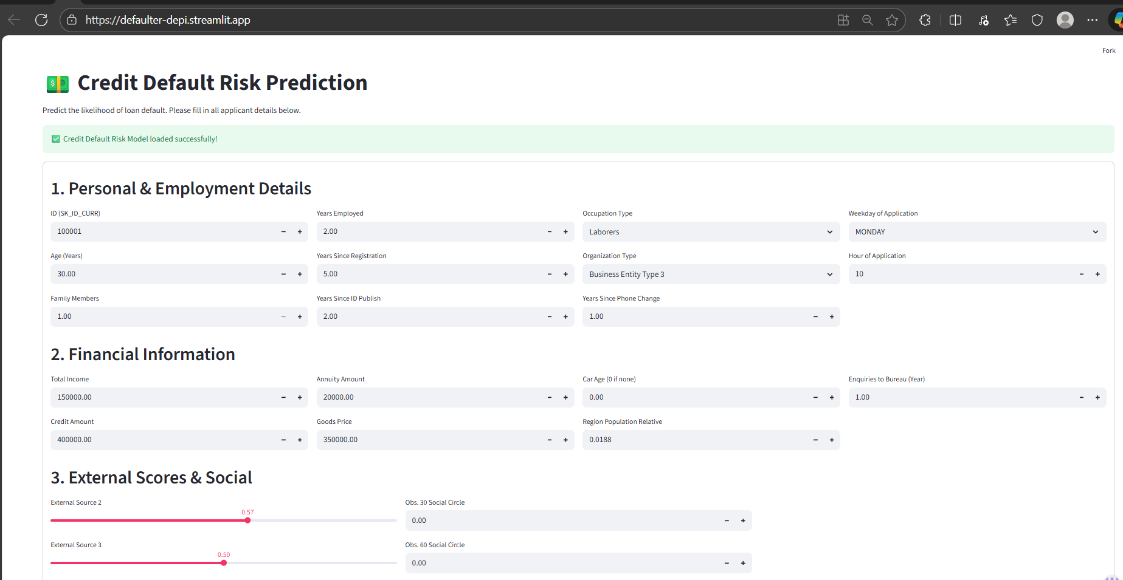
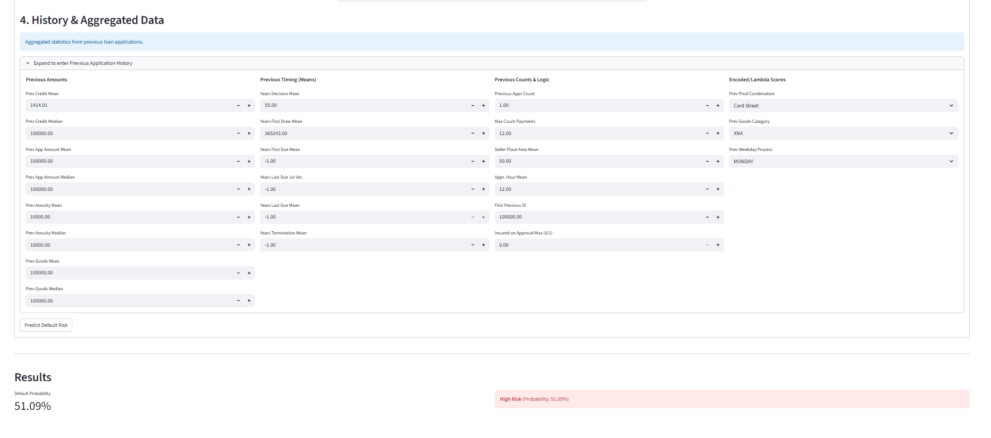

Slide 7
Reports & Documentation
Timeline & Milestones
Technical report (data cleaning, preprocessing, modeling)
Milestone 1: Problem formulation & notebook
Model documentation (algorithms, metrics, decisions)
Milestone 2: Data cleaning + summary report
User manual / how-to-run guide
Milestone 3: Data visualization
Final Products
Milestone 4: Data preprocessing
Trained ML models (LightGBM)
Milestone 5: ML modeling + final model (LightGBM_V2.pkl)
Cleaned dataset + full code repository

Slide 8
Mohammed Yasser
Data cleaning
Handling inconsistencies
Built the LightGBM model
Mohamed Ayman Afifi
Wrote dataset description
Built the Random Forest model
Feature engineering
Abdelrahman Hassan
Data summarization
Application & deployment setup
Early-phase documentation
Created and formatted the presentation
Mark Hany Adel
Built the CatBoost model
EDA for Perivous dataset
Noureldin Mohamed Amin
Handled data outliers
Created documentation

Slide 9
Thank You
Mark Hany — markhanyadel05@gmail.com
Mohammed Yasser — mohammedyasserismael@gmail.com
Noureldin Mohamed — noureldinne7@gmail.com
Abdelrahman Hassan — abdelrahmanalshamy2003@gmail.com
Mohamed Ayman — Mohammed2004koki@gmail.com
Questions or suggestions are appreciated

