Slide 1

Technical Assessment
HTX Xdata
22 December 2025

Slide 2
Tasks
Exploratory Data Analysis
Assumptions
Model Prediction 1
Model Prediction 2
Link Analysis 1
Link Analysis 2

Slide 3
Exploratory Data Analysis
Duplicates : All the dataframes had duplicates. All the duplicates rows were discarded, keeping only the first.
Standardize to ‘int’ datatypes :
1) Resale_column
2) Floor_area_sqm
3) remaining_lease
Standardize ‘road’ abbreviations
Split ‘month’ column to month_only and year_only
Split ‘storey_range’ to ‘storey_min’ and ‘storey_max’
New columns created
  1) remaining_lease
  2) floor_area_sqft
  3) psf

Slide 4
Assumptions
This is not an end-to-end pipeline.
External factors were not taken into account. Such as financial crisis.
More complex models were not taken into account as GPU is not available.
Stratified data of 1000 rows were used for model training and test. As the training time is long with large dataset.
Stratified data of 2000 rows were used for graph analysis. As the training time is long with large dataset.

Slide 5
Model Prediction 1
Once the data preprocessing is complete, next stage is Feature Selection.
Feature Selection :
1) Columns dropped : Month, storey_range and psf_temp. As they have been split.
2) One Hot encoding : Applied to categorical columns
3) MinMaxScaler : Applied to numerical columns
4) Recursive Feature Eliminiation with Cross-Validation : Using r2 for scoring
Model Training :
1) Model : Random Forest Regressor

Slide 6
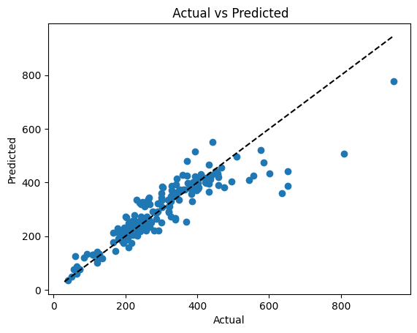
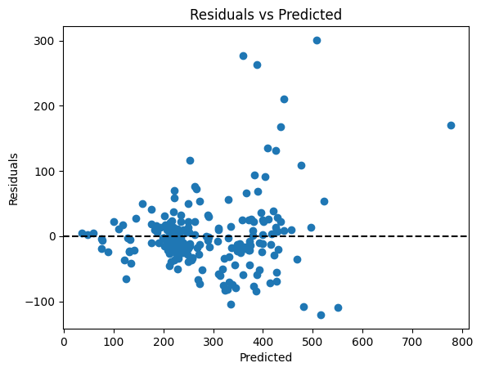
Results for Model Prediction
R2 score
  1) Train : 0.98
  2) Test : 0.80
RMSE
  1) Train : 11.25
  2) Test : 58.01
Conclusion :
The model has Test R2 score of 80%. From Actual vs Predicted, the model can predict well. However, at higher prices, it fails to predict accurately.
This can be seen from Residuals vs predicted where as predicted psf gets higher, the residual increases.

Slide 7
Model Prediction 2
Business Objective and requirements
Data considerations
  Personal Data Protection Act (PDPA)
Infrastructure Requirements
User Interface
Maintenance
Cost Benefits

Slide 8
Link Analysis 1
Nodes
  Properties
    Address
    Town
    Road
    Flat type
    Floor Area Sqft
    Remaining lease
    Resale price
    Psf
    Year only
    Month
    Storey Min
Edges
  Reasons
    Same town ( weight = 1)
    Same flat type( weight = 2)
    Same road( weight = 3)
    Similar lease( weight = 1)

Slide 9
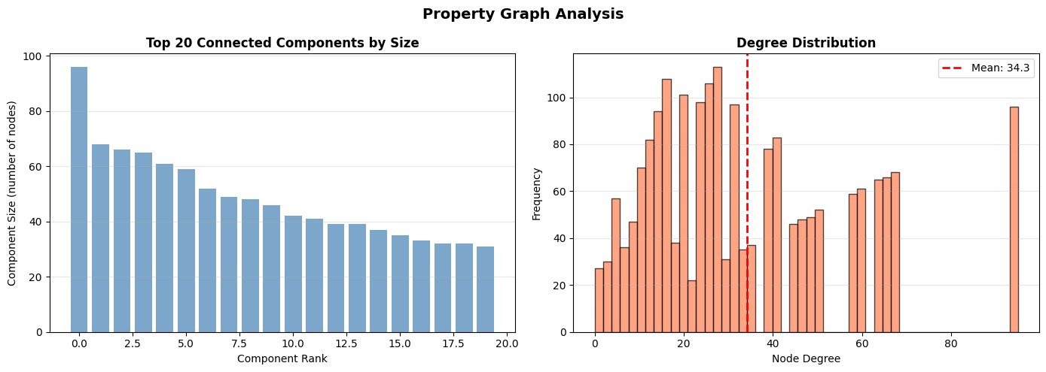
Link Analysis 1 Result
Connected Components (Group of Nodes where every node can reach every other)- Largest components has about 95 components , indicating a dominant cluster
- The others shown in the graph indicates many smaller independent subgraph.
- More time is needed to investigate the largest component.
Degree Distribution (Histogram of node degrees)
- Indicates how many connections each node have
- The mean is about 34.3 connections per node.
- The distribution is wide and skewed. Indicating many have lower number of connections
- A small number of nodes have very high number of connections

Slide 10
Link Analysis 2
ALGORITHM 1: PageRank
  -Interpretation: Properties with high PageRank scores are 'typical' market representatives. They share multiple characteristics with many other properties, making them good reference points for price comparisons and market analysis.
ALGORITHM 2: Community Detection (Greedy Modularity)
-Communities represent clusters of similar properties
- Properties in the same community share multiple characteristics
- This helps identify distinct market segments
ALGORITHM 3: Betweenness Centrality
-High betweenness means a property 'bridges' different market segments
-These properties share characteristics with diverse property types
- They can serve as transition points between different market segments

Slide 11
Proposed Strategy
Increase supply of smaller, affordable flat types in high psf town
Smaller BTO launches in non-matured estates

Slide 12
Future Exploration
Model – Try with other models such as XGBoost, linear regression or Elastic Net Regression
Model Parameters – Use GridSearchCV to find the optimal parameters to further improve the results
PyViz – Pyviz to further visualize the graph

Slide 13
THANK YOU

