Slide 1
Simulation & Modeling 2022-2023
LAB 9 - Task 4

Slide 2
Random Number Generation
LCG

Slide 3
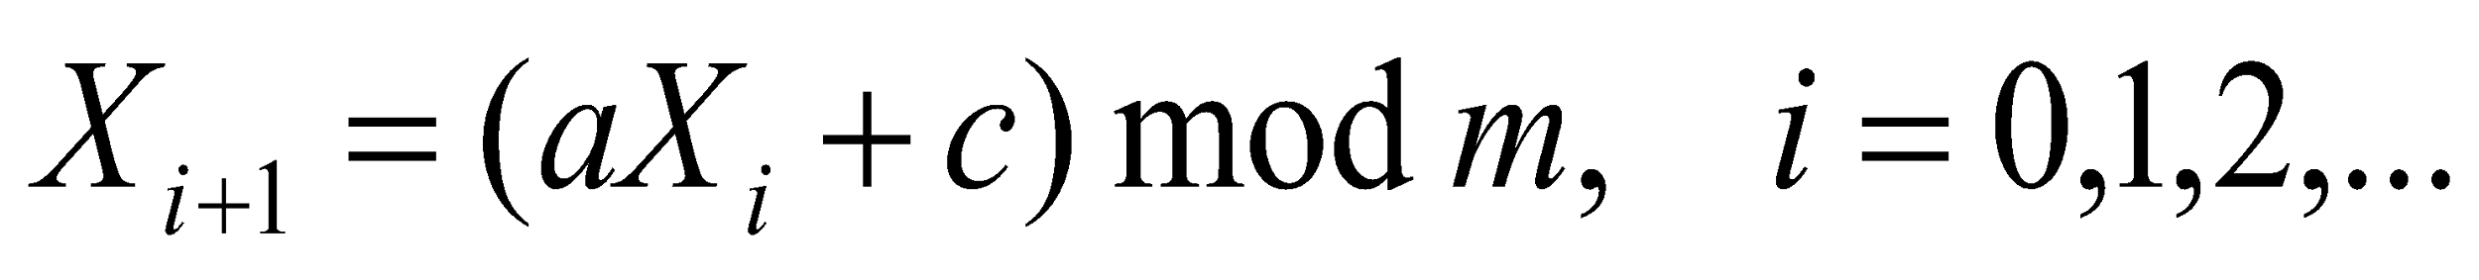
Linear Congruential Generator (LCG)
To produce a sequence of integers, X₁, X₂, … between 0 and m-1 by following a recursive relationship:
If c≠ 0 then it is called mixed congruential method
When c=0 it is called multiplicative congruential method
The multiplier
The increment
The modulus
The seed

Slide 4
Linear Congruential Generator
Example:
Use X₀ = 27, a = 17, c = 43, and m = 100.
The X_{i} and R_{i} values are:
X₁ = (17*27+43) mod 100 = 502 mod 100 = 2
X₂ = (17*2+43) mod 100 = 77 mod 100 =77
X₃ = (17*77+43) mod 100 = 1352 mod 100 = 52
Each X_{i} is an integer in the set {0,1,2,….,m-1}

Slide 5
Linear Congruential Generator
The selection of the values for a, c, m, and X₀ drastically affects the statistical properties and the cycle length.
1- m power of 2 , c ≠ 0
Longest period = m
Achieved when: , c is relatively prime to m and a=4k+1
2- m power of 2 and c=0
Longest Period = m/4
Achieved when: seed is odd and a=5+8k or a = 3+8k
3- m prime number , c=0
Longest Period=m-1
Achieved when: a^{k} -1 is divisible by m.
k=m-1

Slide 6
Parameters in common use
The following table lists the parameters of LCGs in common use, including built-in rand() functions in runtime libraries of various compilers.
 | Modulus | Multiplier | Increment
Java's java.util.Random | 2⁴⁸ | 25214903917 | 11
Microsoft Visual/Quick C/C++ | 2³² | 214013 | 2531011
Microsoft Visual Basic | 2²⁴ | 1140671485 | 12820163

Slide 7
Task: LCG Program
1- Implement the LCG to generate Pseudorandom real numbers
2- Implement an algorithm to calculate the cycle length of the generated numbers
Hint: No duplicates are generated in one cycle

Slide 8
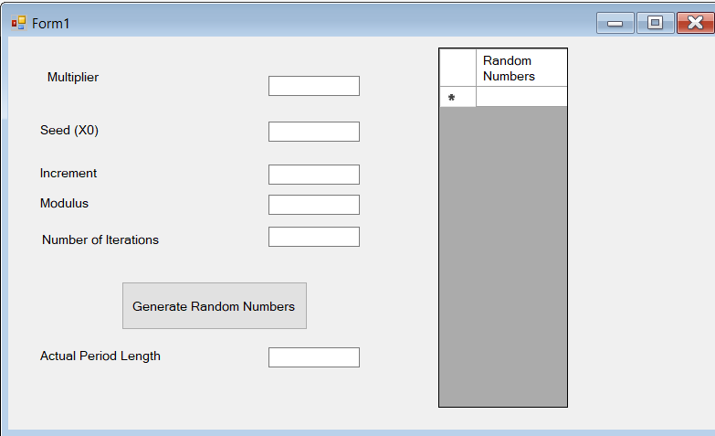
Sample Interface

Slide 9
Inputs
Seed
Multiplier
Increment
Modulus
Number of Iterations

Slide 10
Outputs
The generated random numbers displayed in a datagridview
Cycle length

