Slide 1
MAUI
What is MAUI?
What can we do with MAUI?
Why MAUI?

Slide 2
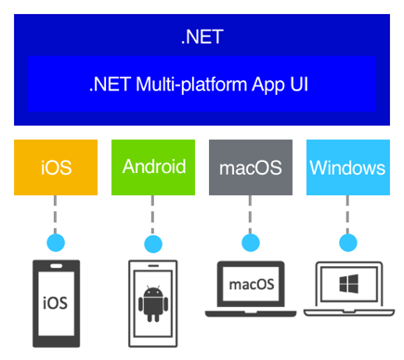

Slide 3

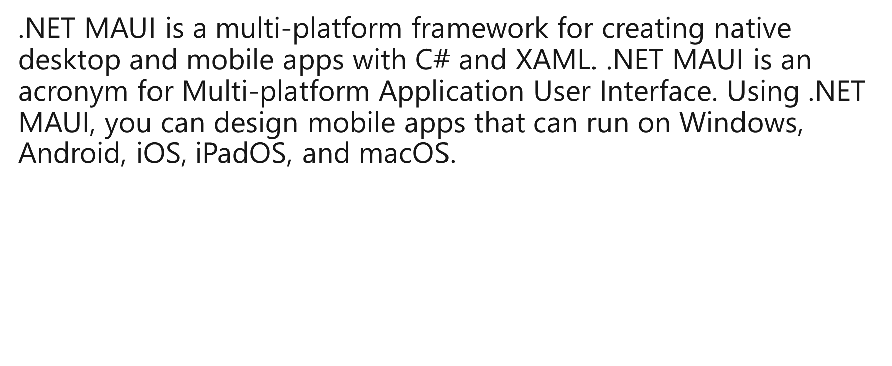

Slide 4
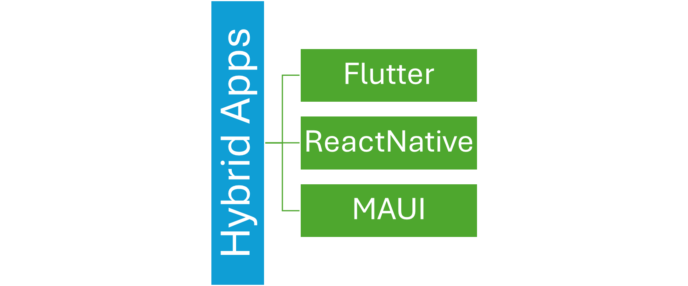

Slide 5
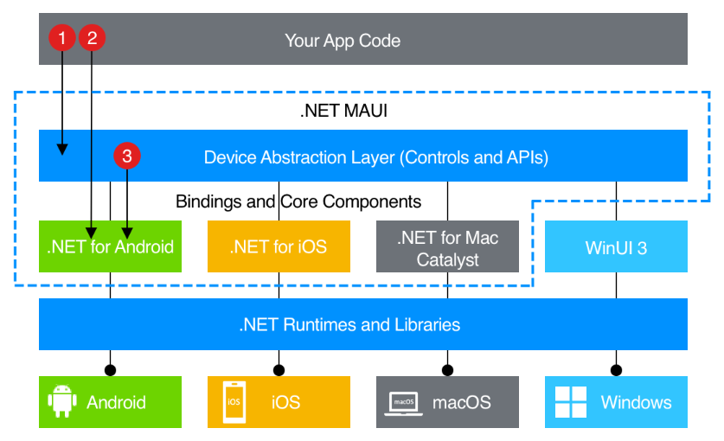

Slide 6
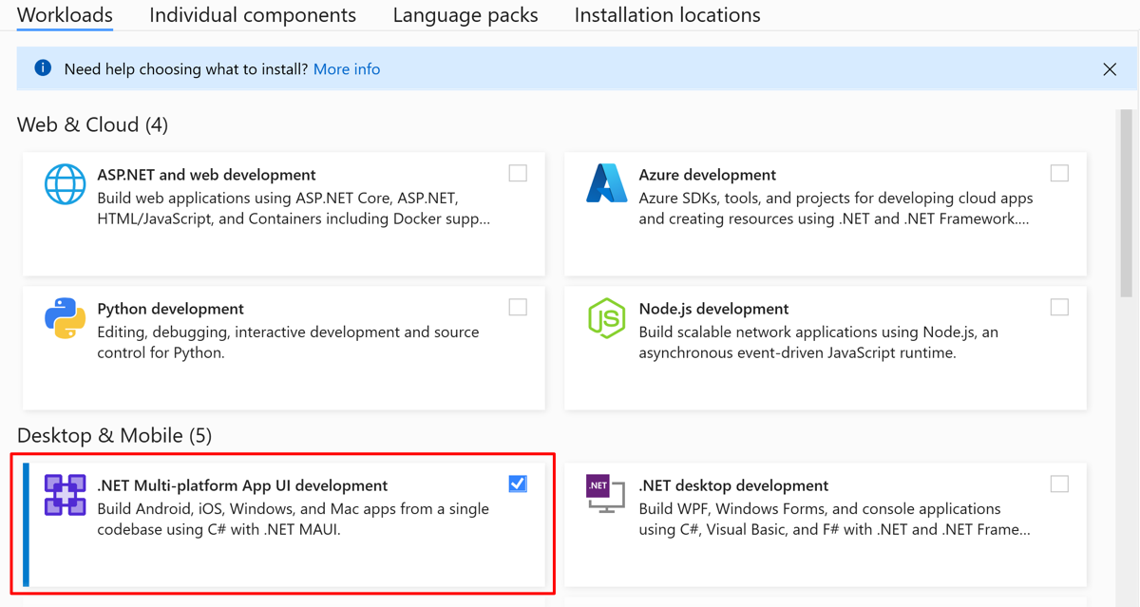
Installation

Slide 7
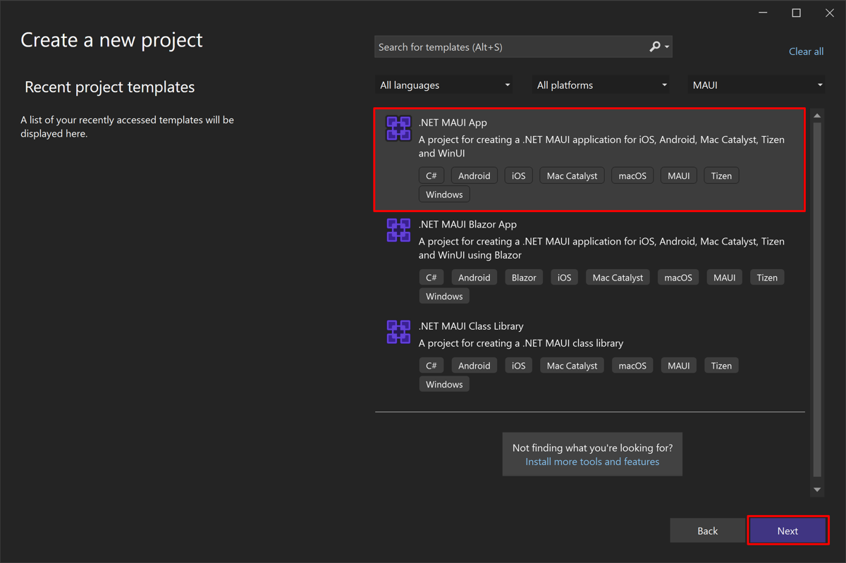
Create your first MAUI App

Slide 8
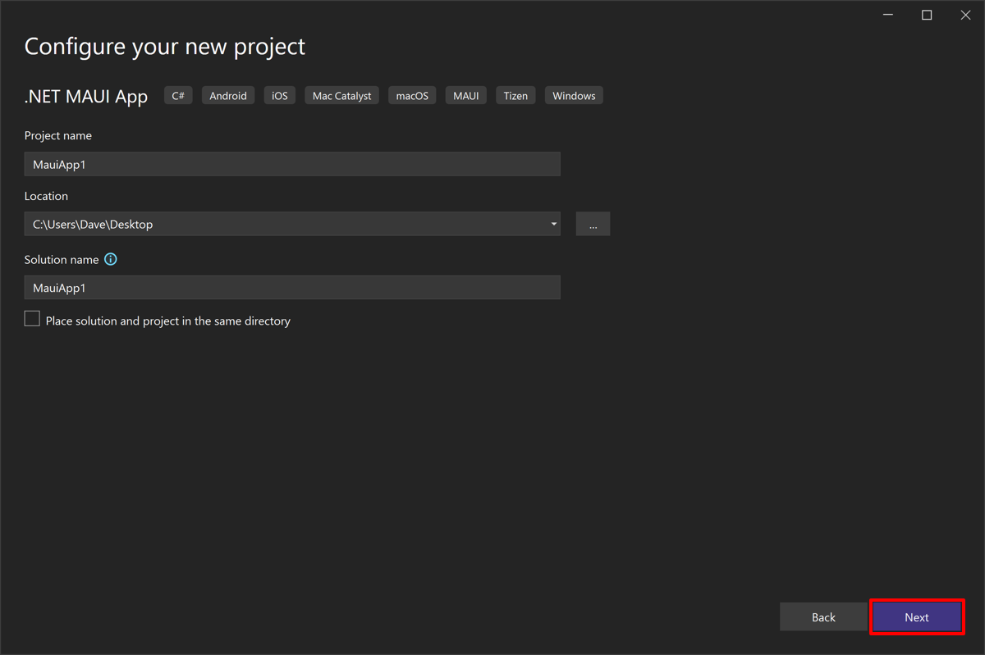

Slide 9
Understanding MAUI Project
.NET MAUI project initially contains:
The MauiProgram.cs file that contains the code for creating and configuring the Application object.
The App.xaml and App.xaml.cs files that provide UI resources and create the initial window for the application.
The AppShell.xaml and AppShell.xaml.cs files that specify the initial page for the application and handle the registration of pages for navigation routing.
The MainPage.xaml and MainPage.xaml.cs files that define the layout and UI logic for the page displayed by default in the initial window.
You can add further pages to the app as necessary, and you can create more classes to implement the business logic the app requires.
A .NET MAUI project also contains a default set of application resources such as images, icons, and fonts, and default bootstrap code for each platform.

Slide 10
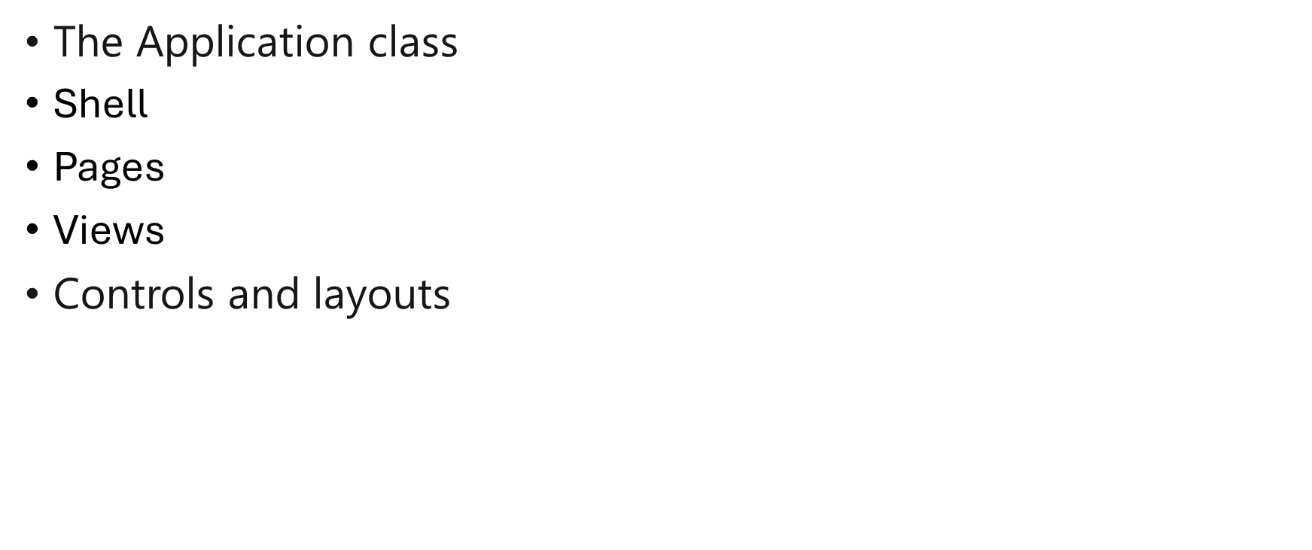
Building blocks

Slide 11

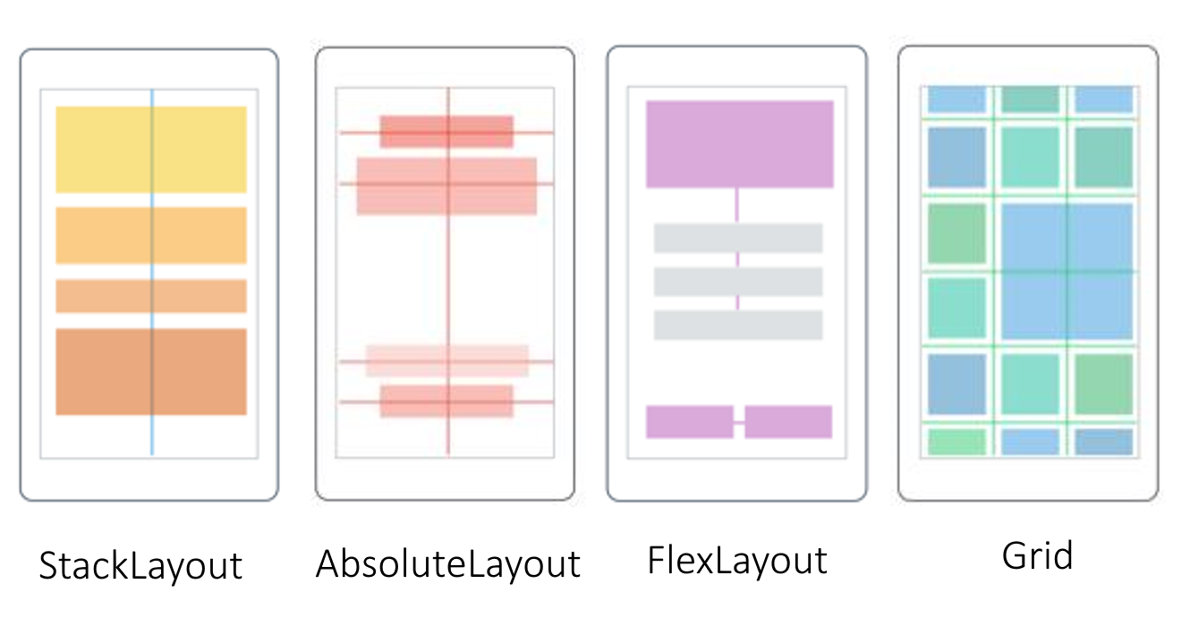

Slide 12
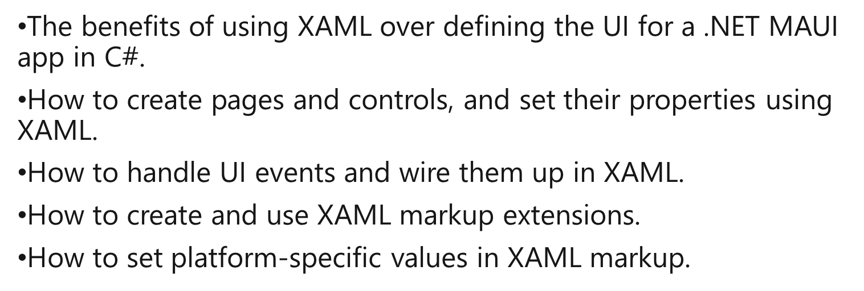
Creating UI in MAUI

Slide 13

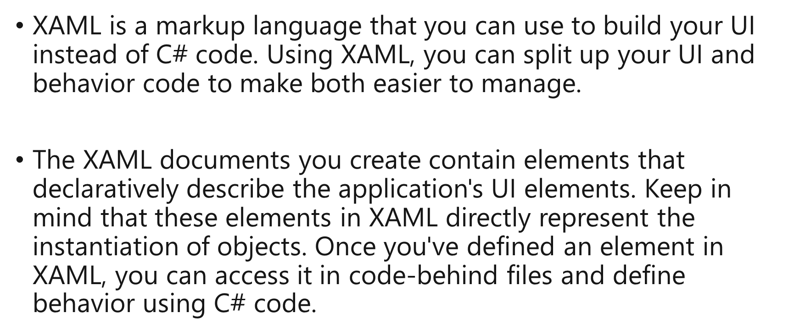

Slide 14
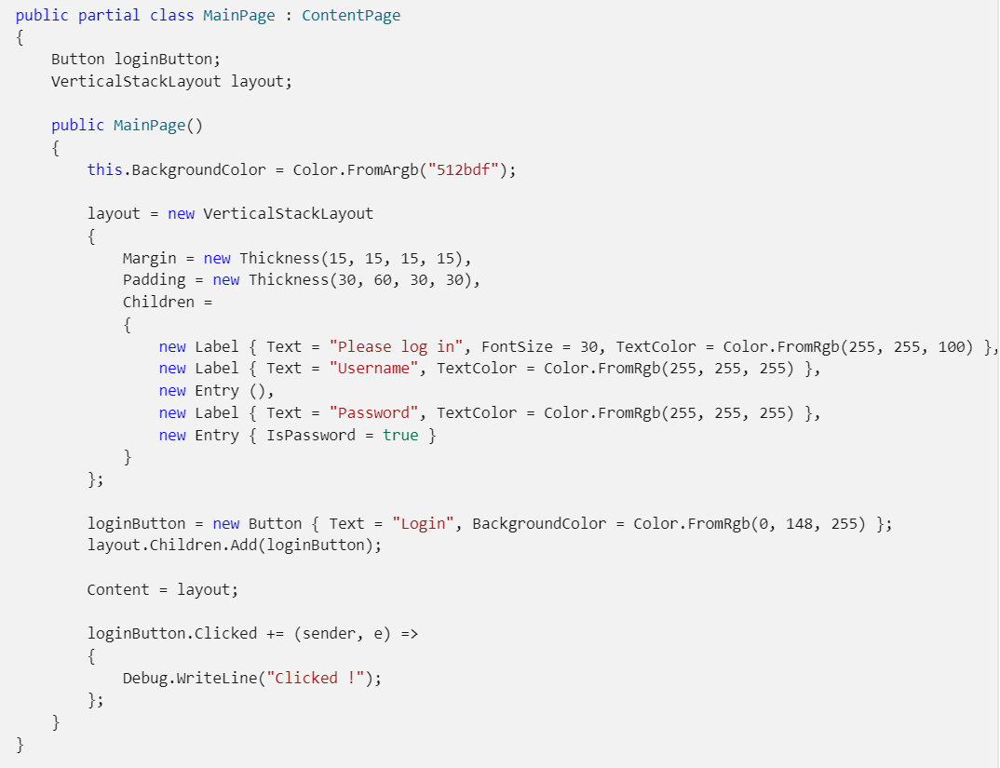
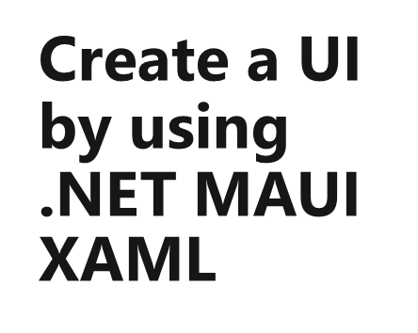

Slide 15
Understanding XAML
Basic XML Structure in MAUI
Namespaces in XAML
XAML Layouts and Controls
Binding in XAML
Events in XAML
Code-Behind
XAML Properties

Slide 16
Different MAUI Pages
Content Page
Flyout Page
Navigation Page
Tabbed Page

Slide 17
Content Page
Title="MyContentTitle“
BackgroundImageSource="dotnet_bot.png"
HideSoftInputOnTapped="True"

Slide 18
Inbuilt Layouts
StackLayout
HorizontalStackLayout
VerticalStackLayout
Grid
AbsoluteLayout
FlexLayout
ContentView
ScrollView

Slide 19
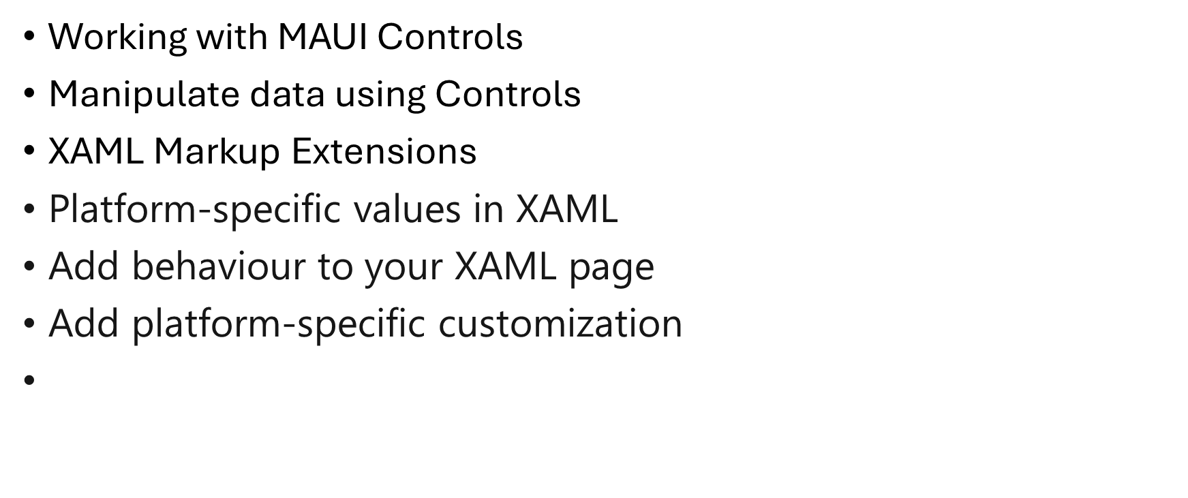
Other Topics

