Slide 1
Customize layout in .NET MAUI
Arrange user interface elements in an app and size them
Display views in a vertical or horizontal list using StackLayout
Display views in rows and columns using Grid

Slide 2
Designing a user interface that's consistent across multiple devices is difficult because devices can be different sizes and have different pixel densities. Think about the different devices that are available: mobile, tablet, desktop, and so on. How do we create a user interface that looks similar on each?
.NET MAUI provides layout panels to help you build consistent user interfaces. The layout panel is responsible for sizing and positioning the views of its children. In this unit, you learn how the layout system works in .NET MAUI. Especially, we look at how views are sized by default and how to request a specific size and position for a view at runtime.

Slide 3
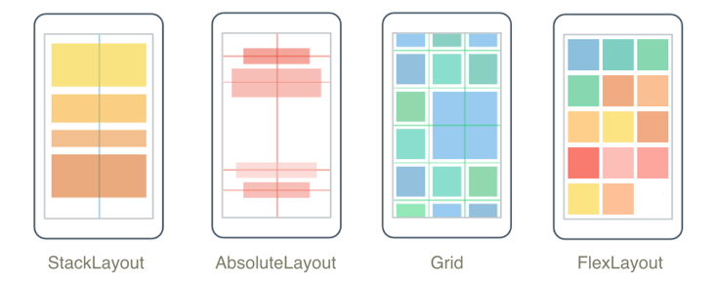

Slide 4
StackLayout
What is a StackLayout, VerticalStackLayout, and HorizontalStackLayout?

Slide 5
add views to a StackLayout - XAML
<StackLayout>
<BoxView Color="Silver" HeightRequest="40" />
<BoxView Color="Blue" HeightRequest="40" />
<BoxView Color="Gray" HeightRequest="40" />
</StackLayout>

Slide 6
add views to a StackLayout – XAML & C#
<StackLayout x:Name="stack">
</StackLayout>
var a = new BoxView { Color = Colors.Silver, HeightRequest = 40 };
var b = new BoxView { Color = Colors.Blue, HeightRequest = 40 };
var c = new BoxView { Color = Colors.Gray, HeightRequest = 40 };
stack.Children.Add(a);
stack.Children.Add(b);
stack.Children.Add(c);

Slide 7
Optimized StackLayouts
<VerticalStackLayout Spacing="30">
<BoxView Color="Silver" HeightRequest="40" />
<BoxView Color="Blue" HeightRequest="40" />
<BoxView Color="Gray" HeightRequest="40"/>
</VerticalStackLayout>
<HorizontalStackLayout Spacing="30">
<BoxView Color="Silver" WidthRequest="40" />
<BoxView Color="Blue" WidthRequest="40" />
<BoxView Color="Gray" WidthRequest="40" />
</HorizontalStackLayout>

Slide 8
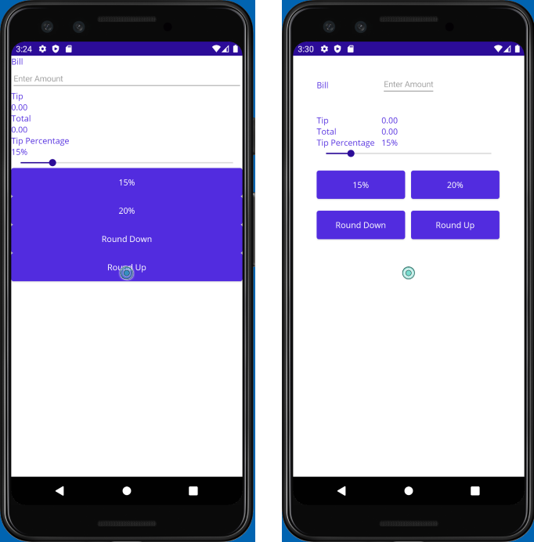

Slide 9
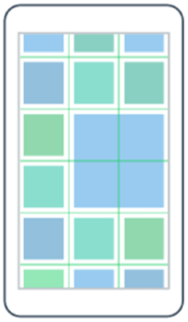
Arrange views with Grid

Slide 10
Resources
A resource is like a symbolic constant from a programming language. You define it in one place and reference it everywhere you need it. Your code is easier to read because you use a descriptive name instead of a "magic" value. If you need to change the value, you only need to update the definition.
A resource is any object that can be shared across your UI. The most common examples are fonts, colors, and sizes. However, you can also store complex objects such as Style and OnPlatform instances as resources.

Slide 11
Let us take the old example which we created in the previous example using StackLayout

Slide 12
Create a resource
<ContentPage.Resources>
<Color x:Key="PageControlTextColor">Black</Color>
</ContentPage.Resources>

Slide 13
Using Resource by using StaticResource
TextColor="{StaticResource PageControlTextColor}"

Slide 14
Use and update dynamic resources
this.Resources["PanelBackgroundColor"] = Colors.Green;
Use “DynamicResource” instead of “StaticResource”

Slide 15
Set platform-specific values for a resource
<OnPlatform x:Key="textColor" x:TypeArguments="Color">
<On Platform="iOS" Value="Silver" />
<On Platform="Android" Value="Green" />
<On Platform="WinUI" Value="Yellow" />
<On Platform="MacCatalyst" Value="Pink" />
</OnPlatform>
TextColor="{StaticResource textColor}"

Slide 16
Create a consistent UI by using styles
Resources are great for avoiding hard-coded, duplicate values in your XAML mark-up, but they can be tedious to apply. You assign each property value individually, which can result in cluttered and verbose XAML. This unit shows you how to group multiple settings into a style, which can help to declutter your code and make it more maintainable.

Slide 17
How resources can clutter your XAML
A resource provides a value for a single property. However, using lots of resources can lead to verbose XAML. Suppose you want a customized look for your buttons. You first create resources for the values that you need. Then, you apply each resource to all your buttons. The following code shows how the XAML mark-up might look for two buttons.

Slide 18
<Button
Text = "OK"
BackgroundColor = "{StaticResource highlightColor}"
BorderColor = "{StaticResource borderColor}"
BorderWidth = "{StaticResource borderWidth}"
TextColor = "{StaticResource textColor}" />
<Button
Text = "Cancel"
BackgroundColor = "{StaticResource highlightColor}"
BorderColor = "{StaticResource borderColor}"
BorderWidth = "{StaticResource borderWidth}"
TextColor = "{StaticResource textColor}" />

Slide 19
What is a style?
A style is a collection of setters targeted at a specific type of control. .NET MAUI requires a target type so it can make sure that the properties in your setters exist on that type.
<Style TargetType="Button">
<Setter Property="BackgroundColor" Value="#2A84D3" />
<Setter Property="BorderColor" Value="#1C5F9B" />
<Setter Property="BorderWidth" Value="3" />
<Setter Property="TextColor" Value="White" />
</Style>

Slide 20
Define a style
<ContentPage.Resources>
<Style x:Key="MyButtonStyle" TargetType="Button">
...
</Style>
</ContentPage.Resources>

Slide 21
Apply a style
<Button Text="OK" Style="{StaticResource MyButtonStyle}" />
<Button Text="Cancel" Style="{StaticResource MyButtonStyle}" />

Slide 22
Use an implicit style for multiple controls
Suppose your UI has 50 buttons and you want to apply the same style to all of them. With what we know so far, you'd need to assign to the Style property on each button manually. It's not that hard to do, but it's still tedious.
An implicit style is a style that you add to a resource dictionary without giving it an x:Key identifier. Implicit styles are automatically applied to all controls of the specified TargetType object.

Slide 23
Override a style
You can think of a style as providing a set of default values for controls. An existing style might be close to your requirements, but contain one or two setters that you don't want. In that case, you can apply the style and then override the value by setting properties directly. The explicit setting is applied after the style, so it will override the value from the style.
<Button
Text="Cancel"
Style="{StaticResource MyButtonStyle}"
BackgroundColor="Red"
... />

Slide 24
Create and use application-wide resources
Defining resources and styles on a XAML page is a great way to reduce repeated code. There's a problem, though. Those resources and styles are available only on that specific XAML page. Page-level resource dictionaries aren't sufficient to let you avoid repeated code across an application when you have multiple pages. In this unit, you see how to share resources and styles across all the pages in your application.

Slide 25
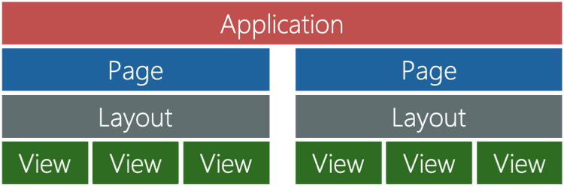

Slide 26
How to define application-level resources and styles
<Application.Resources>
<Color x:Key="MyTextColor">Blue</Color>
</Application.Resources>

Slide 27
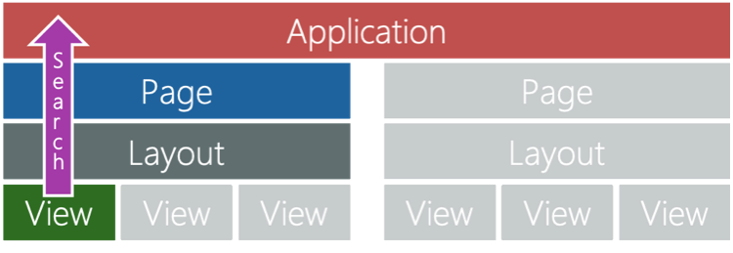

Slide 28
Can Duplicate keys allowed?
Exercise: Use application-wide resources
MAUI also supports create Theme for apps

Slide 29
Navigation

Slide 30
Implement flyout navigation with .NET MAUI Shell.
Implement tab navigation with .NET MAUI Shell.
Navigate between pages within tabbed pages.

Slide 31
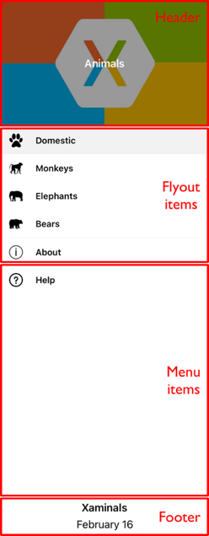
What is flyout navigation?
Flyout navigation displays a menu that provides a quick means to switch context within your application.
The flyout menu is composed of several parts, the Header, FlyoutItems, MenuItems, and Footer.

Slide 32
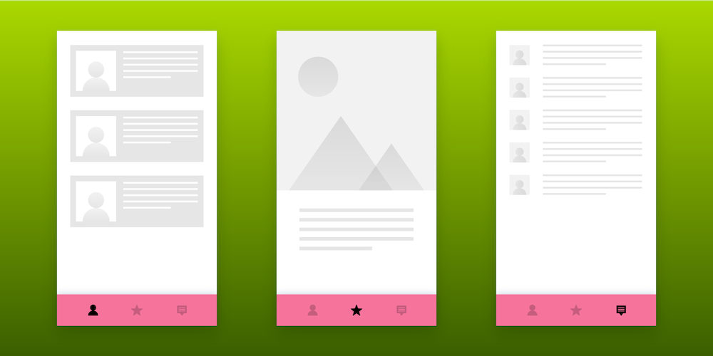
Implement tab navigation with .NET MAUI Shell

Slide 33
<TabBar>
<Tab Title="Moon Phase"
Icon="moon.png">
<ShellContent ContentTemplate="{DataTemplate local:MoonPhasePage}" />
</Tab>
<Tab Title="Sunrise"
Icon="sun.png">
<ShellContent ContentTemplate="{DataTemplate local:SunrisePage}" />
</Tab>
</TabBar>

