Slide 1
Store local data with SQLite in a .NET MAUI app

Slide 2
When you're building mobile applications, it's common to store data locally on a device for performance reasons. .NET MAUI allows you to cache data locally on the device on which the application is running. You can store this data using several different technologies. To store relational data, you can use a SQLite database.
Suppose you're building a social-media application that lets users connect with each other. Because the data about users is stored remotely, you have to call the REST endpoint to get information about the users with which you're connected every time you restart the application.

Slide 3
This design works. However, it's inefficient, because you have to keep downloading the user information from the server every time you restart the application.
A more efficiently designed app downloads the user data once and saves it locally to the device. With this design, you only have to download information for other users when you want to make a new connection. You can create this more efficient design by using a local database.

Slide 4
Compare different data storage options that are available for .NET MAUI applications.
Store relational data in a SQLite database.
Interact with a database asynchronously to make sure that your UI remains responsive.

Slide 5
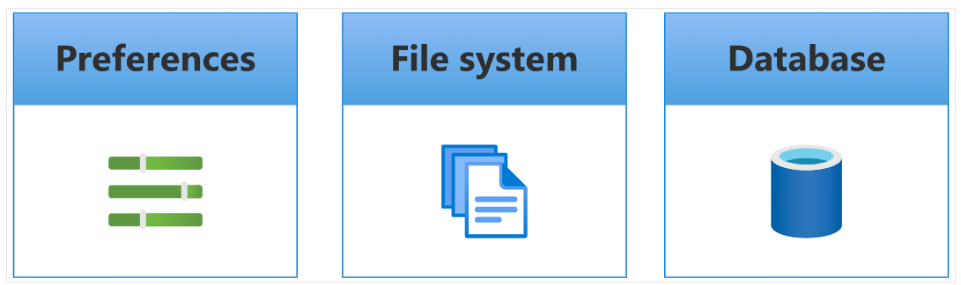
.NET MAUI provides multiple storage options for caching data locally on a device, depending on the nature, structure, and size of the data. The three most commonly used options for storing data locally in a .NET MAUI app are:
Preferences: Stores data in key-value pairs
File system: Stores loose files directly on the device through file-system access
Database: Stores data in a relational database

Slide 6
When to use Preferences
Preferences are convenient when you're working with simple pieces of data such as user selections. They're often used to allow users to configure the application. You store this data as a set of key/value pairs. For example, suppose you wanted the user to be able to specify whether the app should save their username and password between session. You can store the user's choice in Preferences.

Slide 7
When to use the file system
Mobile and desktop devices have a file system with a hierarchical directory structure of folders and files. It's convenient to use the file system when you have loose files such as XML, binary, or text files. For example, suppose you want to store log data locally on the device. You can create a text file, save this file to the file system, and write logs to it as events happen. You can also serialize large data structures to a file, and cache it locally on the file system if you need to save when the app shuts down. When the app restarts, you can re-read this data back into memory. The following code shows examples of serializing data to a file and saving this file, and then reading the data back and deserializing it back into memory later. Here, we use JSON for the serialization format, but you can save the data in whatever format you feel is most appropriate to the nature of the data and the app's security requirements.

Slide 8
Access the app sandbox
When you're working with loose files such XML files, you need to store them in a suitable location in the file system. Some of this data might be sensitive, and you don't want to save it to a location where other apps or users could easily access it. .NET MAUI apps provide the app sandbox. The app sandbox is a private area with which your application can work. By default, no other applications can access this area other than the operating system.

Slide 9
Guidelines for saving data in iOS apps
Apple has iOS guidelines for where files should be stored. There are two main folder locations:
The Library folder: This folder is returned by the FileSystem.AppDataDirectory property, as described previously.
Use the Library folder when you're storing data that's app-generated.
The Documents folder: The following code snippet shows how to reference this folder in the docFolder variable.
Use the Documents folder to store user-generated data only. This data is created in direct response to a user action.
For example, if you were creating a text-editing application such as Microsoft Word, you'd store the document in the Documents folder.

Slide 10
When to use a database
It's a good idea to use a local database when you have
relationships between data, or when you want to filter the
data over time. For example: in the social-media scenario,
each post contains data about the post, such as the
timestamp and the contents. However, each post also
has a relationship to a user who made the post.
It makes sense to represent this relationship in a database to
prevent data duplication between posts, and also to improve the
efficiency of searching for data.

Slide 11
Store data locally with SQLite
SQLite is useful when you have relational data. Suppose you're building a social-media app. You need to store information about subscribers to the app. This data includes a unique ID for each user and their name. You can easily model this kind of relationship in a SQLite database.

Slide 12
What is SQLite?
SQLite is a lightweight cross-platform local database that's become an industry standard for mobile applications. SQLite doesn't require a server. The database is stored in a single disk file on the device's file system. All read and write operations are run directly against the SQLite disk file.
The SQLite native libraries are built into Android and iOS by default; however, the engine only supports a C/C++ API. This scenario isn't ideal for .NET developers, who want some way for SQLite and .NET to interact.

Slide 13
What is SQLite-net?
There are several C# wrappers around the native SQLite engine that .NET developers can use. Many .NET developers use a popular C# wrapper called SQLite-net.
SQLite-net is an object-relational mapper. It helps simplify the process of defining database schemas by letting you use the models that are defined in your projects to serve as the schema.

Slide 14
How to connect to a SQLite database
using SQLite;
string filename
SQLiteConnection conn = new SQLiteConnection(filename);

Slide 15
How to create a table
[Table("user")] public class User { // PrimaryKey is typically numeric [PrimaryKey, AutoIncrement, Column("_id")] public int Id { get; set; } [MaxLength(250), Unique] public string Username { get; set; } ... }

Slide 16
How to do basic read and write operations
public int AddNewUser(User user) { int result = conn.Insert(user); return result; }
public List<User> GetAllUsers() { List<User> users = conn.Table<User>().ToList(); return users; }

Slide 17
Update and delete rows
public int UpdateUser(User user) { int result = 0; result = conn.Update(user); return result; }
public int DeleteUser(int userID) { int result = 0; result = conn.Delete<User>(userID); return result; }

