Slide 1
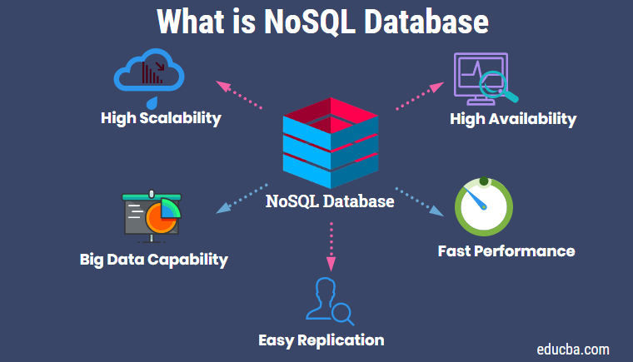
What is NoSQL?
NoSQL Database is a non-relational Data Management System, that does not require a fixed schema. It avoids joins, and is easy to scale. The major purpose of using a NoSQL database is for distributed data stores with humongous data storage needs.

Slide 2
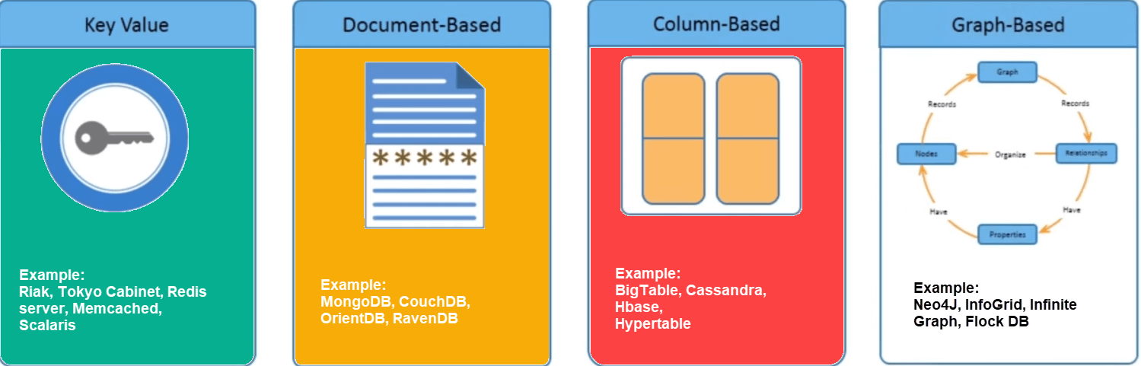
Types of NoSQL Databases:
- Key-value Pair Based.
- Column-oriented Graph.
- Graphs based.
- Document-oriented.

Slide 3
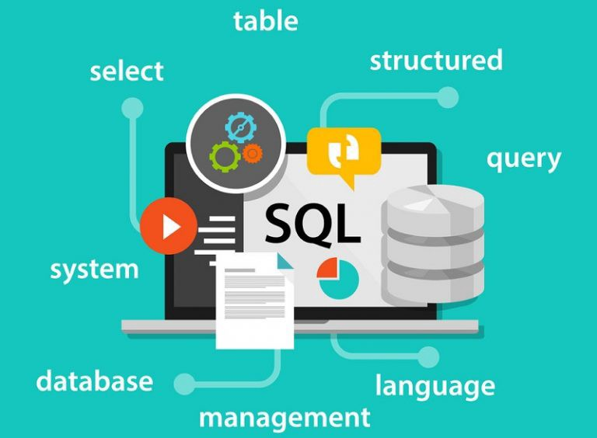
What is SQL ?
- SQL is a standard language for accessing and manipulating databases.
- SQL stands for Structured Query Language.
- SQL lets you access and manipulate databases.

Slide 4
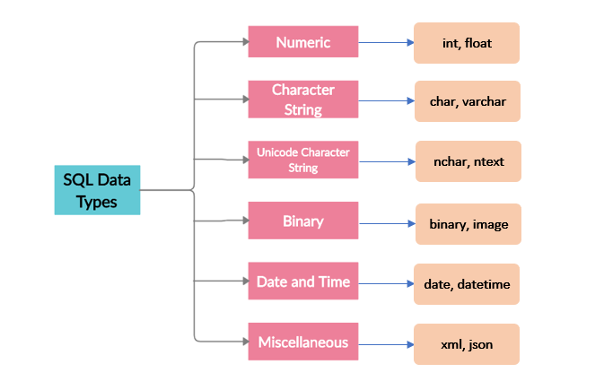
Types SQL Databases?

Slide 5
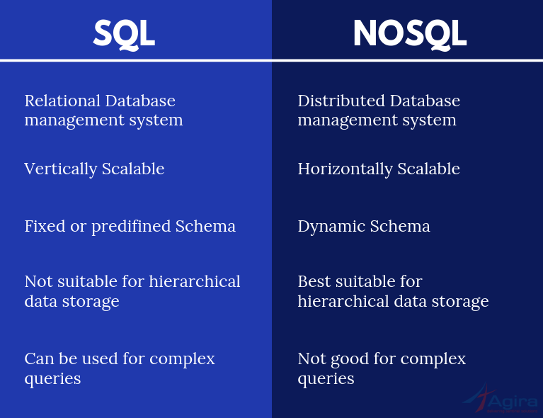
There are five practical differences between SQL and NoSQL:
- Language.
- Scalability.
- Structure.
- Properties.
- Support and communities.

