Slide 1

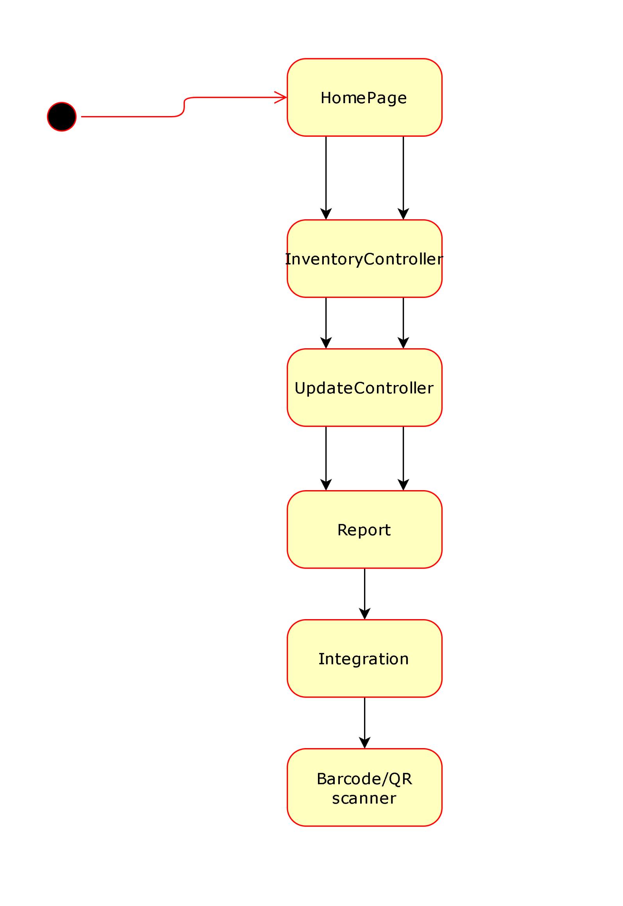
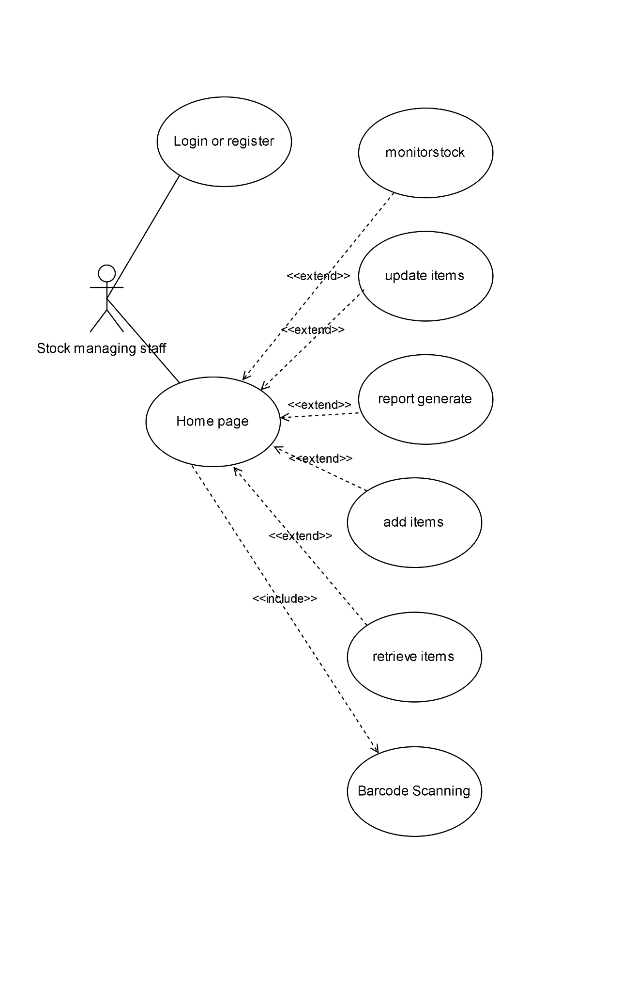
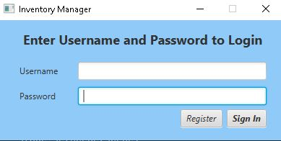
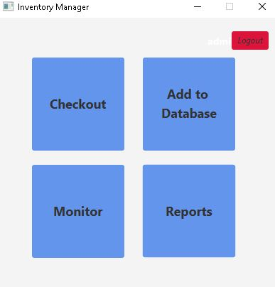
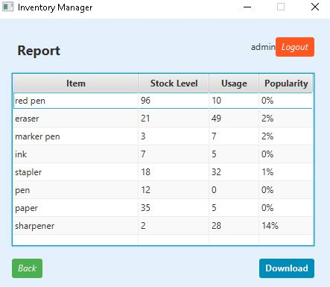
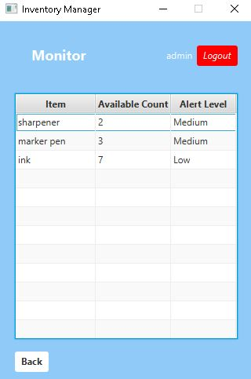
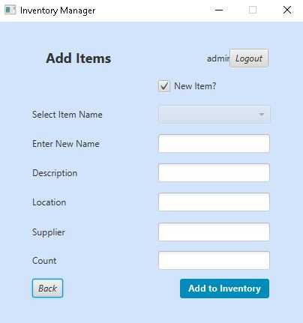
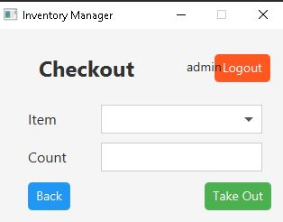
Research: . The study article "Inventory Management in Mass Customization Operations: A Review" by Guo et al. (2019) shows a useful review of inventory management practices in mass customization operations, that could be applied to the unique necessities of universities. The authors stress the importance of balancing the levels of inventory with customization requirements that would ensure that the necessary stationery items are available for the students and staff while avoiding the overstocking of stationeries. In the article "Blood Bank Management and Inventory Control Database Management System" by Shah et al. (2022), the authors propose a database management system for inventor control for blood bank. The system utilizes a barcode scanner to track blood products and includes features like inventory alerts and expiration date tracking. The author argues that the system could improve the accuracy of inventory and reduce waste in the operations of blood bank.
UFCFXK-30-3: Digital Systems Project
Student name:
Project Title:
Aminath Muzuna
Stock Management System in University - ActStock
Abstract:
In this era of digitalization, a lot of universities including the Islamic university of Maldives (IUM) face challenges in managing their stock or inventory system. This most of the times results in lack of transparency and insufficient usage of the stock items. To address these issues, mostly the issues faced n IUM, a University Stock Management System named ActStock was designed and implemented. ActStock provides a centralized platform for the stock management, streamlining the procurement process and generating the reports for a better decision making. This also provides a user friendly interface for easy access and efficient management of stock across the campus. Despite being able to meet all the functional requirements, there are still ample for future improvements and more functionalities in order to enhance the effectiveness of the ActStock
Design and implementation
State Diagram
Usecase Diagram
Aims and objectives:
The aim of this project is to create a stationery (item) stock management system for universities, and I have particularly based this system on the issues and needs of Islamic University of Maldives’s staff while managing their stationery stock. This system will be a desktop based GUI Application that will allow the stock managing staff to easily keep a track of the stock items while introducing necessary and new stationery items into the stock according to their usage and popularity.
The objective is to perform enough research into the stationery stock management system in the universities, especially in Islamic University of Maldives. And to have an understanding of similar applications, their benefits and limitations and the functionalities these systems provides.
And when adequate amount of research has been conducted with regard to stationery stock management systems in the university, the research findings will be utilized in order to plan the project and then establish the overall requirements of the stock management system.
Implementation artefacts (if any)
User wants to add an item to the system, when logged in the system will show buttons for main functions which includes: a button to add item, a button to retrieve item, a button to monitor item and a button to generate the report. When clicked onto the button for adding the item, user can tick if it is a new item and enter the details in the give places and enter. It is recorded in the database connected and will be shown for your retrieval feature , monitor window and when you generate the report. The most important function is been able to check the popularity of the stock and showing alert messages accordingly.
Key requirements:
Provide key requirements with short description if required.
Functional
The system shall show a Homepage with 4 main functions (Add stock, Checkout, Monitor and Report)
The system shall also show in which username user is signed in
The system shall allow users to take out particular items from the stock
The system shall then update the number of items accordingly after removing of item
The system shall show the Alert for the specific items which are with low number of items in the stock.
Alert shall be showing according to how low the number of that particular item is in the stock ( Eg: Item1 with lowest number of items will have the Alert as “High” shown as the user need to focus more on adding Item1 into the stock as soon as possible.)
A report shall be generated by the system with item name, usage of the item, number of the particular item left in the stock and the item’s popularity in %
The report shall be able to download from the system as a CSV file.
The system shall add new items into the stock by choosing “Add New” function
The system shall be able to add items which are existing in the stock as well.
It’s the initial page seen when executed
The system shall ask to register by adding user information and password
The system shall let the user access the system if the username and password is found in the database. If not, it will show error.
Non-functional
The system shall have a user-friendly interface which is designed so that it will be easy for the user to navigate and understand the system
The system shall have an intuitive design and colour contrasts which can be supportive to users with visual impairments.
The system shall be able to be compatible with assistive technologies for support, which are mostly used by disable people. For example: voice recognition and screen reader.
The system shall be able to handle a huge number of stock items efficiently
The system shall be able to give a fast response and less delays in inventory updates.
Planning and Management: Planning starts with identifying and collecting any feedback from the most important stakeholders. The next step is to document their requirements for research and validation. To address these issues in an organized manner, project design methodologies were established. In the design phase, each and every of the requirements are sorted and applied with the aid of drawing tools to visualize how the software system will be executed. Then the Implementation includes creation of a demo desktop application of the ActStock.
References: 1. Ali Khan, J., Ur Rehman, I., Hayat Khan, Y., Javed Khan, I., & Rashid, S. (2015). Comparison of Requirement Prioritization Techniques to Find Best Prioritization Technique. International Journal of Modern Education and Computer Science, 7(11), 53-59.
2. Tight, M. (2011). How many universities are there in the United Kingdom? How many should there be? Higher Education, 62, 649-663. https://doi.org/10.1007/s10734-011-9411-5
3. Feder, T. (2018). Contract lecturers are a growing yet precarious population in higher education. Physics Today, 71(11), 22-23. https://doi.org/10.1063/PT.3.4065
4. Jiang, C. (2010). Integrating the Use of Spreadsheet Software and VBA in Inventory Simulation. Journal of Software, 5, 498-505.
5. Sharp, D. (1998). Reducing avionics software cost through component-based product line development. In Proceedings of the 17th DASC. AIAA/IEEE/SAE Digital Avionics Systems Conference. Bellevue, WA: IEEE. Retrieved from https://ieeexplore.ieee.org/abstract/document/739846
6. Lumba, E., & Waworuntu, A. (2022). Implementation of Model View Controller Architecture in Object Oriented Programming Learning. International Journal of New Media Technology.
7. Damilola, O. (2023). MVC Architecture. Retrieved from https://www.educative.io/answers/mvc-explained
8. von der Maßen, T., & Lichter, H. (2002). Modeling Variability by UML Use Case Diagrams. In Proceedings of the International Workshop on Requirements Engineering for Product Lines. Essen, Germany: IEEE. Retrieved from http://citeseerx.ist.psu.edu/viewdoc/download?doi=10.1.1.20.2206&rep=rep1&type=pdf#page=25
9. Galitz, W. (2007). The essential guide to user interface design. Indianapolis, IN: Wiley Pub.
10. Sherrell, L. (2013). Waterfall Model. In A.L.C. Runehov & L. Oviedo (Eds.), Encyclopedia of Sciences and Religions. Springer, Dordrecht. https://doi.org/10.1007/978-1-4020-8265-8_200285
11. Doshi, D., Jain, L., & Gala, K. (2021). Review of the Spiral Model and Its Applications. International Journal of Engineering, Applied and Science Technology, 5(12). DOI: 10.33564/IJEAST.2021.v05i12.053

