Slide 1


Introduction to HTML5 & CSS
By Merna Hesham

Slide 2
Table of contents
Head & Body Sections
HTML Basics
HTML Elements & Tags
1
2
3
4
5
6
7
Internet & Web
HTML History
HTML Attributes
Course Assessment (Labs & Project)

Slide 3
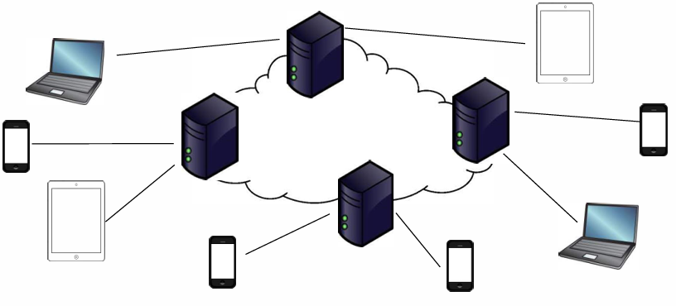
Internet & Web
What is the Internet?
A network of machines (servers, clients, routers, switches) connected by media (fiber, Wi-Fi), which allows communication among devices.
A network of networks that consists of millions of private, public, academic, business, and government networks, of local to global scope through the internet backbone.

Slide 4
Internet & Web – cont’d
Internet as a Graph:
- Nodes: Devices and information.
- Edges: Connections (physical or virtual).
Example:
Think of the Internet as a city map:
Nodes = Buildings (devices).
Edges = Roads (connections).

Slide 5
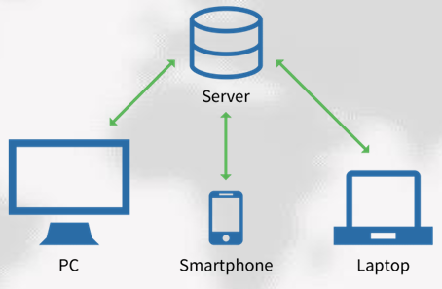
Internet Architecture
Client/Server Model:
Clients request resources; servers provide them.
Example: Your browser (client) requests a webpage from a server.

Slide 6
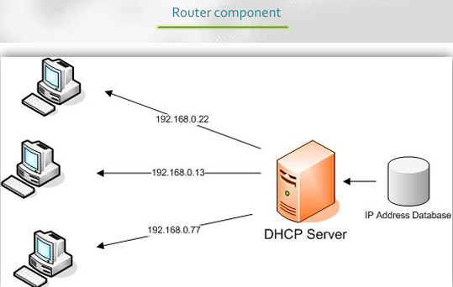
Internet Architecture – cont’d
IP Address & DHCP Server:
IP Address: Unique identifier for devices (e.g., 192.168.1.1).
DHCP Server: Assigns IP addresses dynamically.

Slide 7
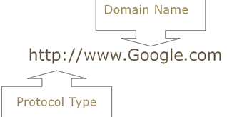
Internet Architecture – cont’d
URL & DNS Server:
URL: Uniform Resource Locator (e.g., http://www.example.com).
DNS Server: Domain Name Server translates domain names to IP addresses.

Slide 8

Internet Architecture – cont’d
Protocols:
Transmission Control Protocol /Internet Protocol (TCP/IP):
Ensures data is sent and received correctly.
Hyper Text Transfer Protocol (HTTP):
Used for web page requests.
File Transfer Protocol (FTP):
Used for file transfers.

Slide 9
World Wide Web (WWW)
WWW vs. Internet:
Aspect | Internet | World Wide Web (WWW)
Definition | Physical network of devices. A global network of interconnected computers and devices. | An application that operates over the Internet, used to access and share information.
Purpose | Provides infrastructure for communication and data transfer. | Provides a platform for accessing and sharing documents and resources via hyperlinks.
Components | Hardware (routers, servers, cables) and protocols (TCP/IP, FTP, SMTP). | Web pages, hyperlinks, browsers, and web servers.
How It Works | Transfers data packets between devices using IP addresses. | Uses HTTP/HTTPS protocols to retrieve and display web pages.
Example | Sending an email or transferring files via FTP. | Browsing a website like www.google.com.
Dependency | The WWW depends on the Internet to function. | The Internet can exist without the WWW (e.g., email, file transfers).

Slide 10
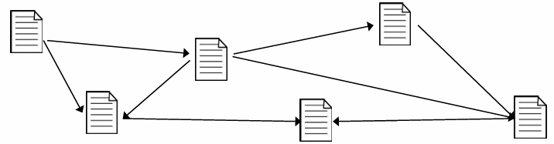
World Wide Web (WWW) – cont’d
WWW Structure:
Web follows a similar network structure as the Internet
Web pages link to other web pages, thus forming a graph where:
Nodes: Individual documents/resources.
Edges: Links between documents (directed edges).
Example:
Think of the WWW as a library:
Nodes = Books (web pages).
Edges = References between books (hyperlinks).

Slide 11
Web Page Addresses
Aspect | URI (Uniform Resource Identifier) | URL (Uniform Resource Locator) | URN (Uniform Resource Name)
Definition | An alphanumeric string of characters is used to uniquely identify a web page/resource. It can be a URL, a URN, or both. | A type of URI that specifies the location on the WWW and the mechanism (protocol) for retrieving it. | A type of URI that provides a unique name for a resource but does not specify its location or how to retrieve it.
Purpose | Uniquely identifies a resource (e.g., a web page, image, or document). | Tells you where the resource is and how to access it. | Provides a persistent, unique identifier for a resource, regardless of its location.
Example | http://www.example.com/index.html urn:isbn:0451450523 | https://www.example.com/home/index.html?id=123&pw=12 Protocol: https Host Name: www.example.com Domain Name: example.com File Path: /home/index.html Query Parameters: id=123&pw=12 | Structure: Starts with urn: followed by a namespace and a unique identifier. Example: urn:isbn:0451450523 (Identifies a book by its ISBN number). urn:uuid:6e8bc430-9c3a-11d9-9669-0800200c9a66 (Identifies a resource using a UUID).

Slide 12
Content on the Web
Aspect | Static Content | Dynamic Content
Definition | Same for all users. | Programmatically generated based on user, context.
Example | A company’s "About Us" page. | A personalized dashboard showing user-specific data.
Technologies | HTML, CSS. | JavaScript

Slide 13
Web Browsers
What is a Web Browser?
Software to access and display web content.
Main Components:
Rendering Engine: Interprets HTML/CSS for static content.
JavaScript Engine: Handles dynamic content.
Popular Browsers:
Chrome, Firefox, Safari, Edge.
Example:
When you visit www.google.com, the browser:
Requests the page from Google’s server.
Renders the HTML/CSS to display the page.

Slide 14
How Browsers Work
HTTP (Hypertext Transfer Protocol):
HTTP is a plain-text, human-readable protocol used for exchanging data on the Web.
Initially developed by Tim Berners-Lee at CERN in 1989.
Based on Client-Server Model:
Client: Sends request for resource, possibly including information about the client (e.g., GET /index.html HTTP/1.1).
Server: Sends response e, including header (status information) and requested resource (e.g., HTTP/1.1 200 OK).

Slide 15
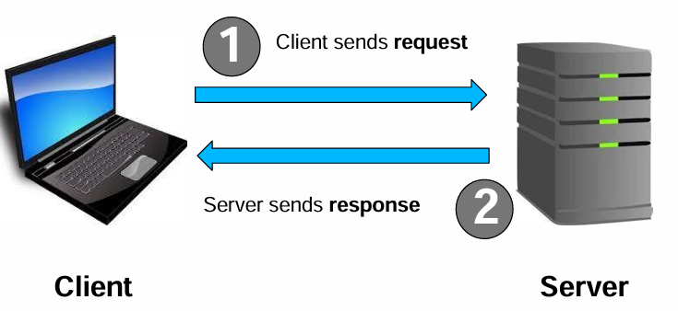
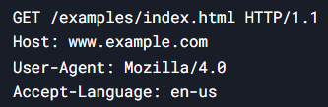
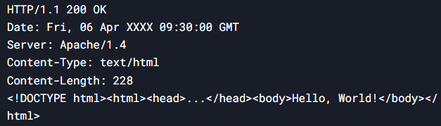
How Browsers Work – cont’d
HTTP Request Example: HTTP Response Example:

Slide 16
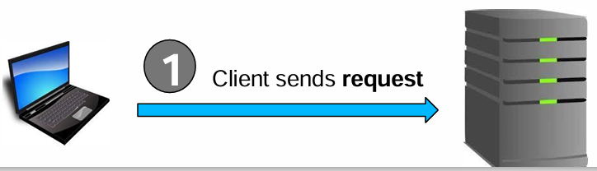
Anatomy of an HTTP Request
The first line of the request will always be a verb followed by an argument
GET: retrieve resource
HEAD: retrieve only headers (information about the resource)
POST: create resource(usually used in form submission context)
Next comes the protocol (usually HTTP/1.1)
Optionally include other information about the request and/or the client

Slide 17
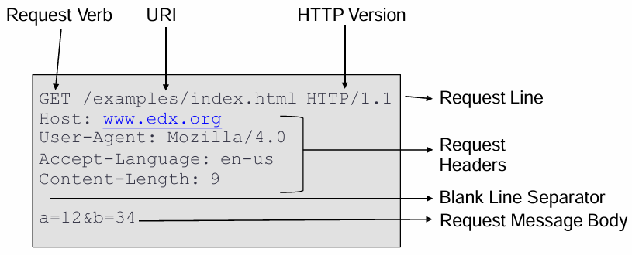
HTTP Request Example

Slide 18
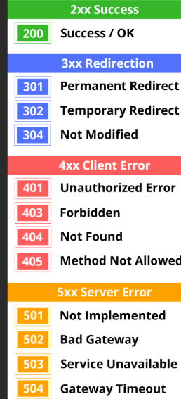
Anatomy of an HTTP Response
The first line is always protocol and status code
1XX –information only
2XX –success
3XX –client redirect
4XX –client error
5XX –server error
Notes:
200 OK: The request succeeded, resulting resource (as stated in the request) will be included in the message body
404 Not Found: The requested resource does not exist
500 Server Error: Error on the server side in processing request

Slide 19

Anatomy of an HTTP Response – cont’d
Following protocol and status code will be other header information regarding the response and/or the server
Then a blank line
Then the response body, i.e. the resource that was requested

Slide 20
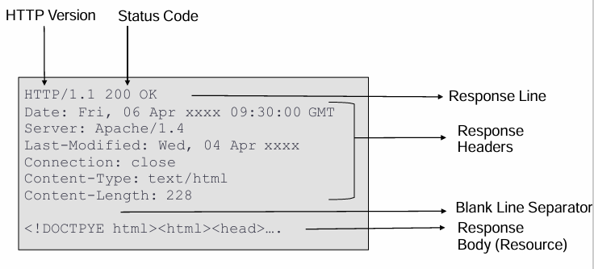
HTTP Response Example

Slide 21
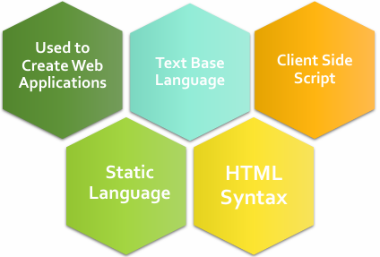


HTML Basics
What is HTML?
HyperText Markup Language.
Used to create web applications.
Text-based, static, client-side scripting.
HTML Syntax:
Elements: Start tag, content, end tag.
Example:
Notes:
Hypertext Markup Language (HTML) – standard used to describe format and structure with which content should be displayed on a web page
• Document contains elements
• Each element generally includes a start tag, some content, and an end tag

Slide 22
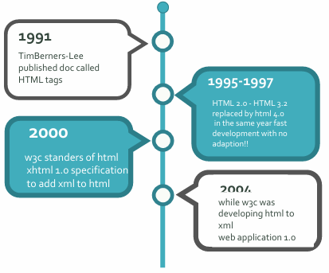
HTML History

Slide 23
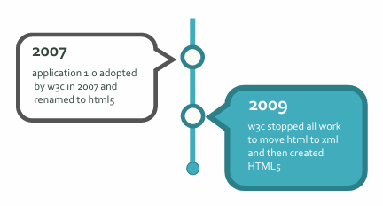
HTML History – cont’d

Slide 24
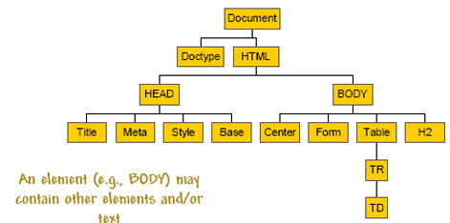
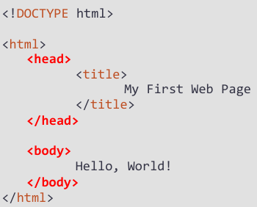
HTML
HTML structure is hierarchical
Elements may be nested, i.e. content of an element can be another element

Slide 25
HTML Elements & Tags
HTML Elements:
Hierarchical structure.
Elements can be nested.
Common Tags:
<p>: Paragraph.
<h1> to <h6>: Headings.
<b>: Bold text.
<i>: Italic text.
<hr>: Horizontal rule.
<br>: Line break.
<div>: Block-level container.
<span>: Inline container.

Slide 26
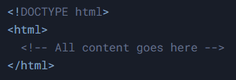
Important HTML Tags: <!DOCTYPE>
What is <!DOCTYPE>?
Not actually a tag, but a declaration to the web browser about the HTML version used in the document.
Placement:
Must be the very first line of an HTML document.
Example:

Slide 27
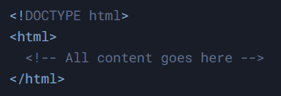
Important HTML Tags: <html>
What is <html>?
The root element of an HTML document.
Represents the start of the HTML content.
Structure:
All other elements must be nested inside the <html> tag.
Example:

Slide 28
Head Section
What is the <head> section?
Contains metadata about the document (information about the document, not visible content).
Common Elements in <head>:
<title>: Page title (displayed in the browser’s title bar).
<meta>: Metadata, such as page descriptions and keywords.
<link>: Links to external resources like CSS files.
<script>: Links to JavaScript files.

Slide 29
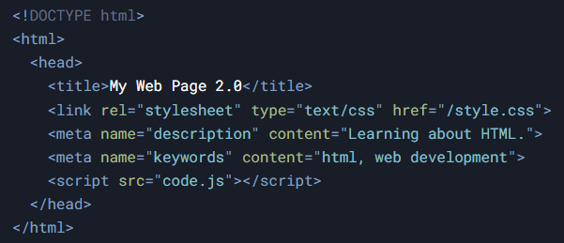
Head Section – cont’d
Example:

Slide 30
Meta Tags
What are Meta Tags?
Used to store information relevant to browsers and search engines.
Common Meta Tags:
Description:
Provides a brief description of the page.
Example: <meta name="description" content="An HTML Tutorial">
Keywords:
Specifies keywords for search engines.
Example: <meta name="keywords" content="html, web design, javascript">T

Slide 31
Meta Tags – cont’d
Common Meta Tags:
Author:
Specifies the author of the page.
Example: <meta name="author" content="Bill Gates">
Refresh:
Automatically refreshes or redirects the page after a specified time.
Example: <meta http-equiv="refresh" content="5; url=http://www.echoecho.com">HTML
Expires:
Specifies the expiration date of the page.
Example: <meta http-equiv="expires" content="Sun, 31 Jan 2005 17:35:00 GMT">

Slide 32
Body section
What are body Tags?
To structure the content in HTML
to affect the appearance of the content
Common body Tags:
Text (<p>, <h1> to <h6>, <b>, <i>, <hr>, <br>).
Lists (<ul>, <ol>, <li>).
Links (<a>).
Tables (<table>, <tr>, <td>).
Images (<img>).
Frames (<iframe>).
Forms (<form>, <input>, <button>).

Slide 33
Body section – cont’d
Common body attributes:
• link
• vlink
• alink
• bgcolor
• background
• topmargin, leftmargin, bottommargin, rightmargin

Slide 34
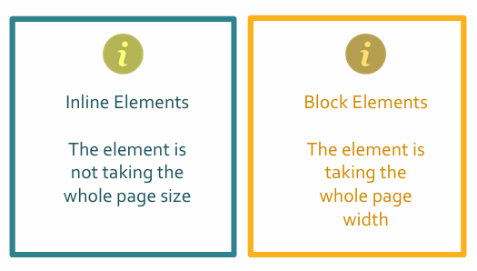
HTML Block and Inline Elements

Slide 35
HTML Attributes
Attributes:
Provide additional information about elements.
Example:
<img src="image.jpg" alt="Description">
Common Attributes:
src: Source of an image.
alt: Alternative text for images.
href: Hyperlink reference.
target: Where to open the link.
class: CSS class.
id: Unique identifier.

Slide 36
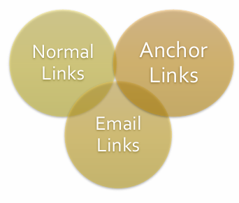
Important HTML links: <a>

Slide 37
Attributes of <a> Tag
href (Required):
Specifies the URL of the page/resource to link to.
Example: <a href="https://www.example.com"></a>
target:
Specifies where to open the linked document.
Common values:
_self (default): Opens in the same tab.
_blank: Opens in a new tab.
Example: <a href="https://www.example.com" target="_blank"></a>

Slide 38
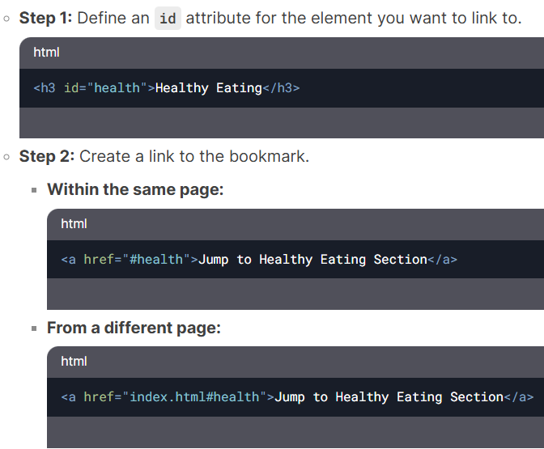
Creating Bookmarks (Anchor Links)

Slide 39
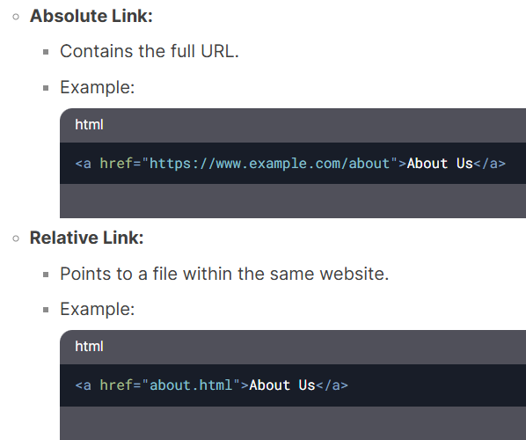
Relative vs Absolute Links

Slide 40
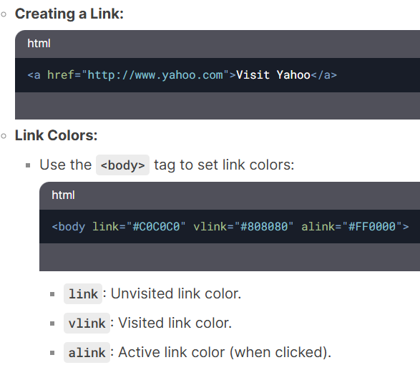
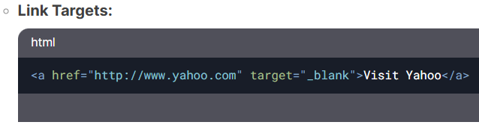
Normal Links

Slide 41
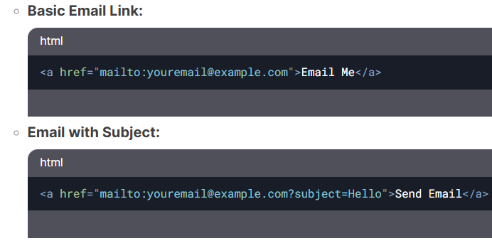
Email Links

Slide 42

Email Links

Slide 43

Important HTML LISTS: <ol> and <ul>

Slide 44
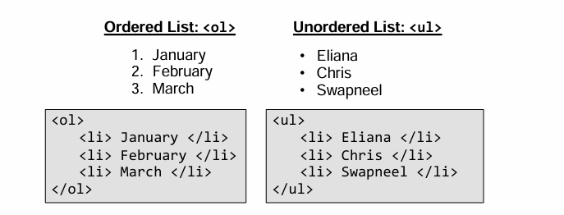
Important HTML LISTS: <ol> and <ul>

Slide 45
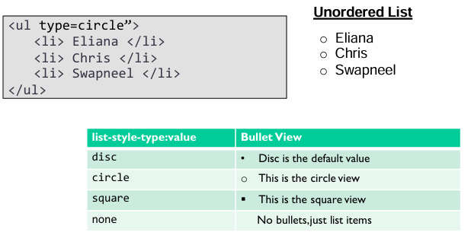
• Unordered(Bulleted) Lists – Type attribute

Slide 46
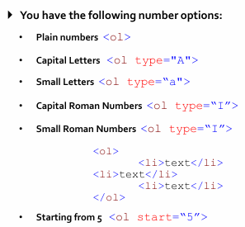
Numbered List

Slide 47
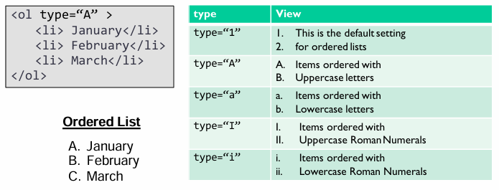
Ordered Lists -Style

Slide 48
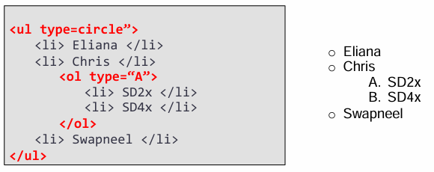
Nested Lists

Slide 49
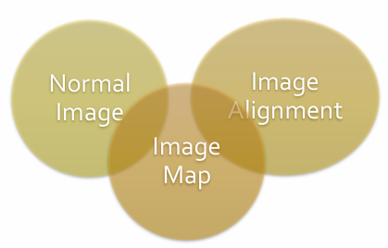
HTML IMAGE: <img>

Slide 50
Images in HTML: <img>
<img> tag includes an image in the HTML page.
Required attributes:
src: specifies the link to the image to be included, Can be a relative or absolute path.
alt: text to include as image description in case image does not load, or additional information is needed.
Other attributes:
height, width: specified in pixels (e.g. 50px).
title – tooltip text displayed when the mouse hovers over the image.

Slide 51
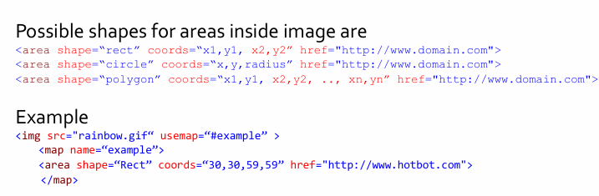
Image Map

Slide 52
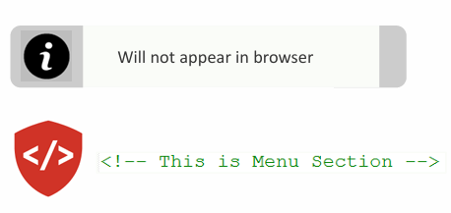
HTML Comment

Slide 53
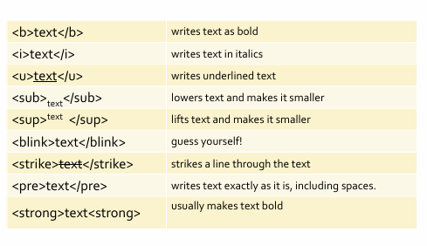
Text Format

Slide 54
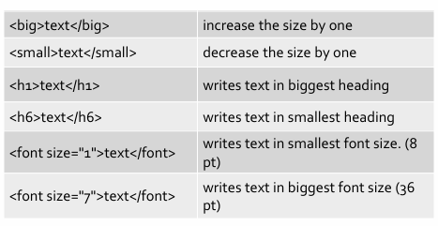
Text Size

Slide 55
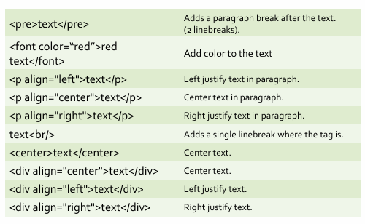
Text Layout

Slide 56
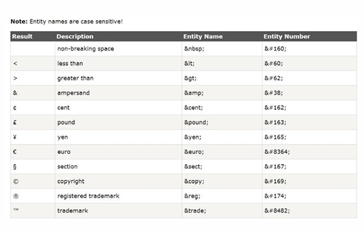
Entity Name

Slide 57
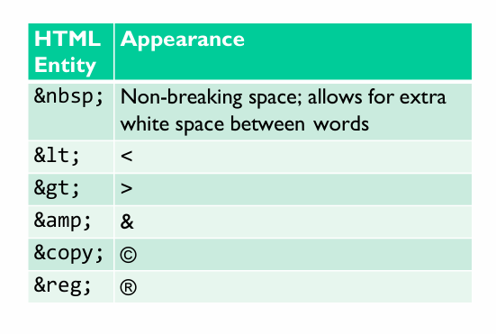
HTML Symbols & Special Characters

Slide 58
Any questions?

Slide 59
References
https://www.w3schools.com/html/
10 Most Common HTTP Status Codes – GeeksforGeeks

Slide 60

Thank
You

