Slide 1

Real-time object detection for autonomous vehicles

Slide 2
Team
members

Slide 3
1-Mohamed Khaled el-sayed (l) 2-Marwan ahmed hassan 3-kareem waheed saber 4-Mohamed montasser 5-kareem mostafa hamed

Slide 4
Agenda
Team members
Project Introduction
BDD100K Dataset
EDA(exploratory data analysis)
YOLOv11
Evolutionary Hyper-parameters tuning
Model training
Testing and evaluation metrics
Model exporting and Depolyment

Slide 5
project
Introduction

Slide 6
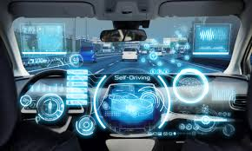
Why Real time object detection?
Enables instant recognition of objects on the road
Critical for making safe and very fast decisions
Supports navigation in varied driving environments
Reduces risk of collisions and improves autonomy reliability

Slide 7
Origin of bdd100k

Slide 8
Why Real time object detection?
Our Dataset is Created by UC Berkeley Deep Dive’s AI Research team for autonomous driving research in 2008
Dataset is constructed by filming 100,000 videos in the streets of the UNITED STATES
Then those videos are sampled with choosing the most critical frame from the videos to form the 100k image

Slide 9
Why
bdd100k?

Slide 10
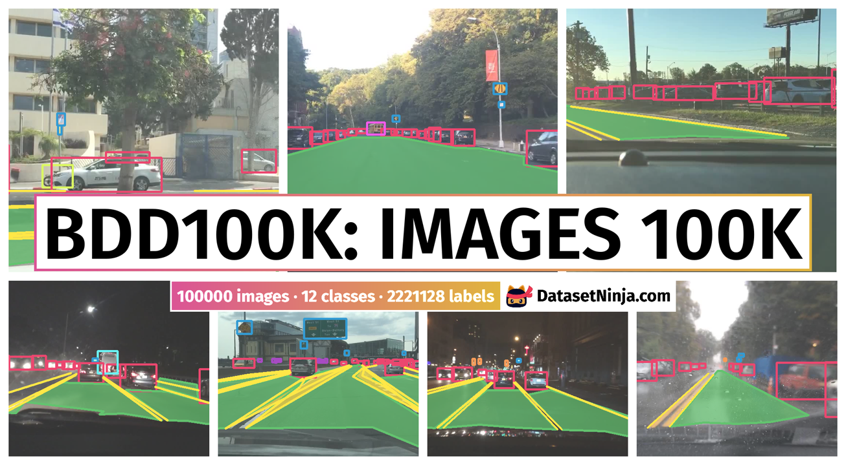
BDD100k Advantages
Large-Scale: Over 100,000 videos/images, making it suitable for training deep learning models
Diverse Conditions: Captures varied weather (sunny, rainy, foggy), lighting (day/night), and scene types (city, highway, residential)
Rich Annotations: Includes bounding boxes, semantic segmentation, lane markings, and drivable areas — enabling multi-task learning.
Real-World Scenarios: Data collected from actual driving conditions across multiple geographic locations, ensuring realistic model training.
Relevant Object Classes Annotations for 10 critical object categories (e.g., car, pedestrian, traffic light, cyclist, trains) directly applicable to detection tasks.

Slide 11
Data preprocessing

Slide 12

10k extraction from 100k
We have extracted a subset of
10k images from the 100k data set
We have retained the diversity of different weather environments and objects in our images
The final dataset is composed of
7,000 train images
2,000 test images
1,000 validation images

Slide 13
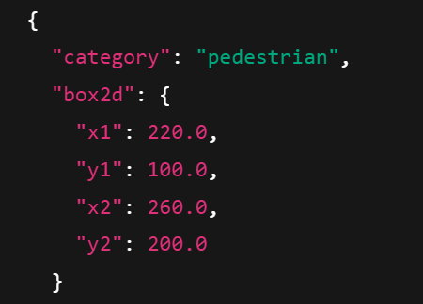
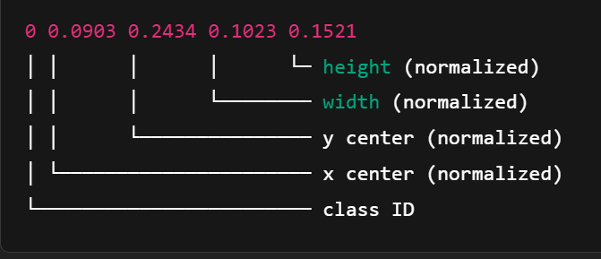
Transforming labelling format
We have transformed the original format of labelling in BDD100K (.json)
To YOLO compatible format(.txt)

Slide 14
Eda exploratory data analysis

Slide 15
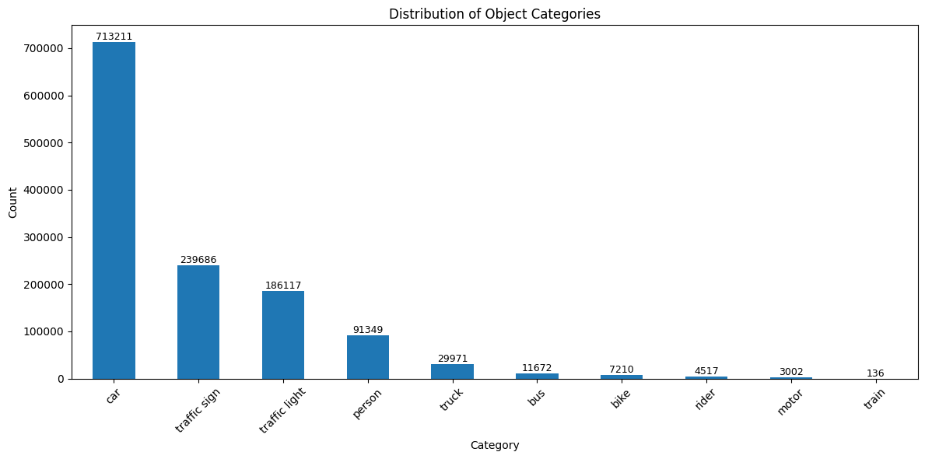
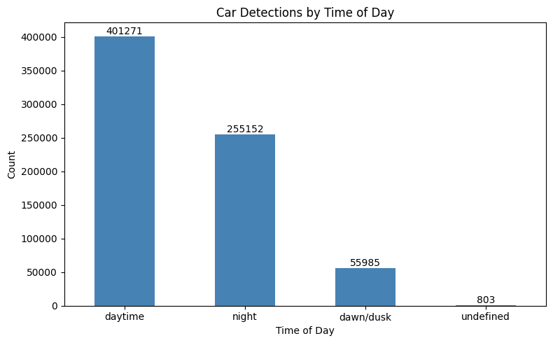
Investigating data diversity
Exploring objects distribution
Showing cars over different weather cases

Slide 16
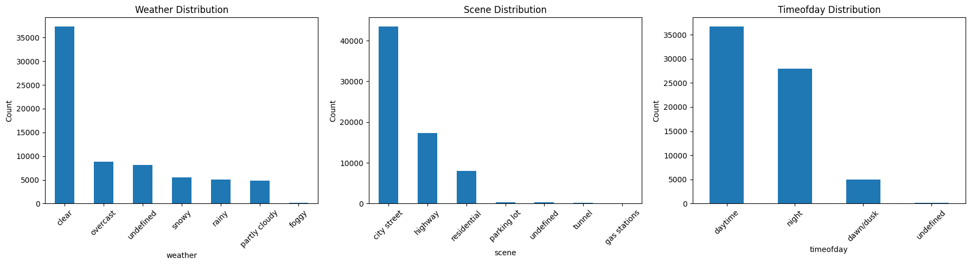
Investigate Environmental Diversity (weather, scene type, time of day)

Slide 17
Model selection Why yolo?

Slide 18

Why yolo is most suitable architecture
Speed
YOLO processes images in a single forward pass, as it is a SINGLE-STAGE DETECTOR, while other architectures like FASTER R-CNN is TWO-STAGE DETECTOR which makes yolo faster
Accuracy vs. Speed Trade-off: YOLO maintains competitive accuracy while being significantly faster than two-stage detectors like Faster R-CNN.
Deployment-Friendly: YOLO models are smaller and well-suited for deployment on edge devices (e.g., embedded systems in autonomous vehicles).

Slide 19
yolov11s

Slide 20
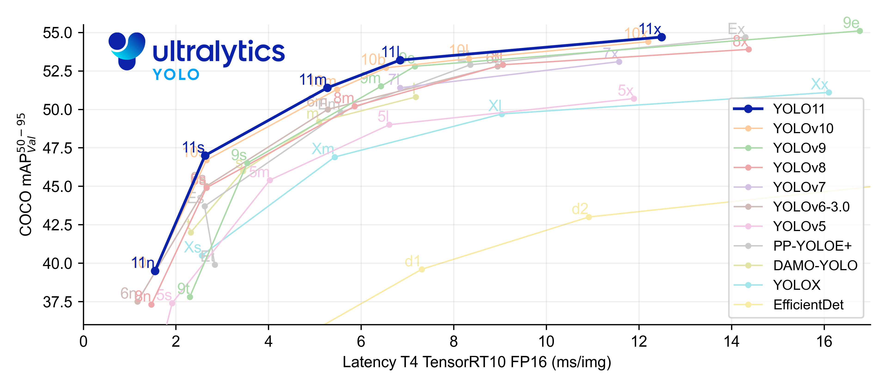
v11 advantage over older versions
Enhanced Feature Extraction: YOLO11 employs an improved backbone and neck architecture, which enhances feature extraction
Greater Accuracy with Fewer Parameters: With advancements in model design, YOLO11m achieves a higher mean Average Precision (mAP) on the COCO dataset while using 22% fewer parameters than YOLOv8m, making it computationally efficient without compromising accuracy

Slide 21
Hyperparameters Tuning

Slide 22
Evolutionary Hyper-parameters tuning
Automatically optimize hyperparameters of the YOLO model using an evolutionary algorithm to improve model performance.
YOLOv11 supports .tune() method for this purpose.
Parameters tuned: Batch size, image size, learning rate, momentum, weight decay, etc.
Multiple tuning trials are run to explore different combinations, and the best set is chosen based on metrics like mAP (mean average precision).

Slide 23
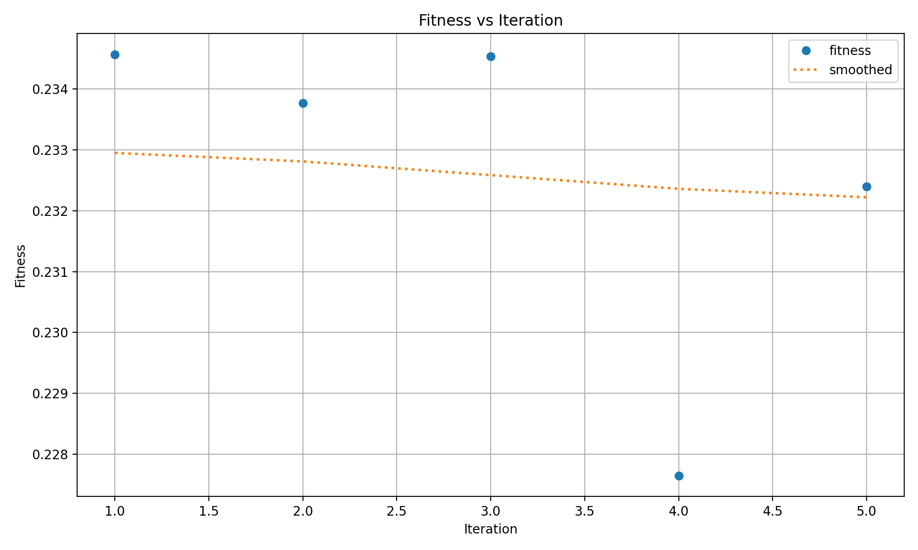
Evolutionary Hyper-parameters tuning
Graph showing how fitness values change over iterations, with a trend line highlighting overall progress.

Slide 24
Model Training

Slide 25
Model Training
Fine-tune a pre-trained YOLOv11s model using transfer learning.
Custom dataset defined in dataset.yaml, which specifies the paths to the training and validation image directories, the number of object classes, and their names.
YOLOv11 supports .train() method for this purpose.
Hyperparameters:
Epochs : 50
Image Size : 640 x 640
Batch Size : 64
Workers : 5

Slide 26
Model Training
Transfer learning Strategy:
We applied transfer learning by freezing the first 10 layers of the model's backbone. These early layers are responsible for extracting general visual features such as edges and textures, which are often applicable across various datasets.
By freezing them, we retained valuable pre-trained knowledge while allowing the remaining layers to adapt to the specific characteristics of our custom dataset. This approach reduces training time and improves model performance.
We customized the training process using a separate hyp.yaml file which contains a set of optimized hyperparameters.

Slide 27
Testing and Evaluation metrics

Slide 28
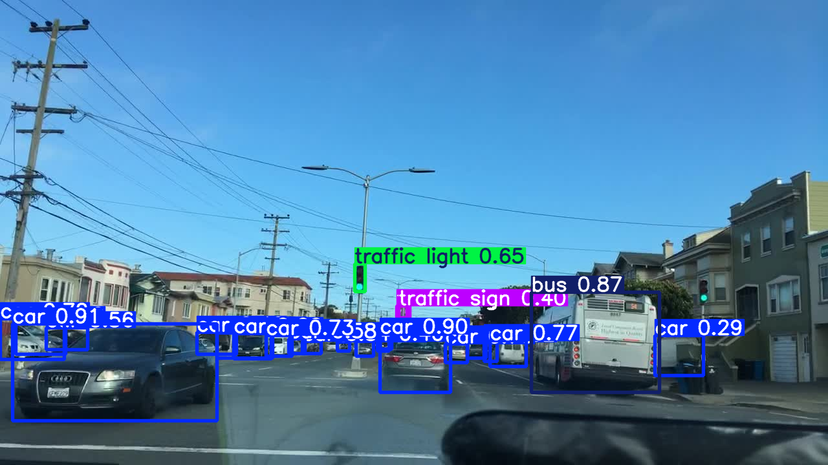
Model testing Samples
Testing the model during daytime.

Slide 29
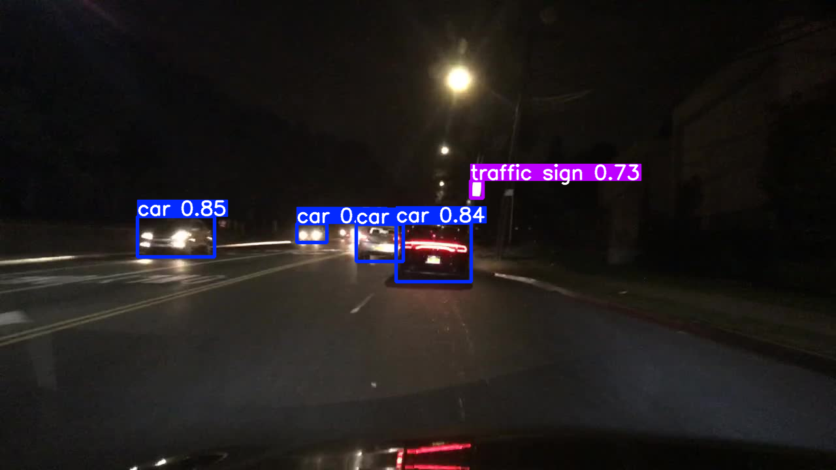
Model Testing samples
Testing the model at night.

Slide 30
Evaluation metrics
After training the model, we evaluated metrics like precision, recall, mAP.
The results were as follows:
Precision = 0.6273
Recall = 0.399
mAP@0.5 = 0.4120
mAP@0.5:0.95 = 0.2348

Slide 31
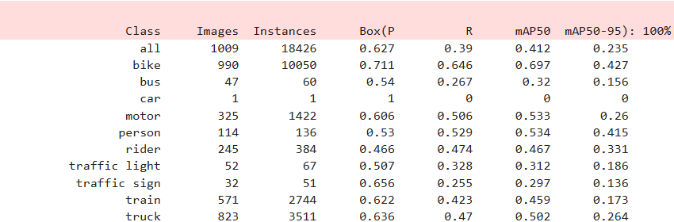
Evaluation metrics
Screenshot of the metrics from the notebook.

Slide 32
Exporting the Model and deployment

Slide 33
Exporting the Model
We used .export() method for this purpose using onnx format.
Why onnx?
Optimized Inference: ONNX Runtime offers faster execution
Cross-Platform Compatibility: Works across frameworks (e.g., PyTorch, TensorFlow)
Model Portability: Makes it easier to deploy and maintain models

Slide 34
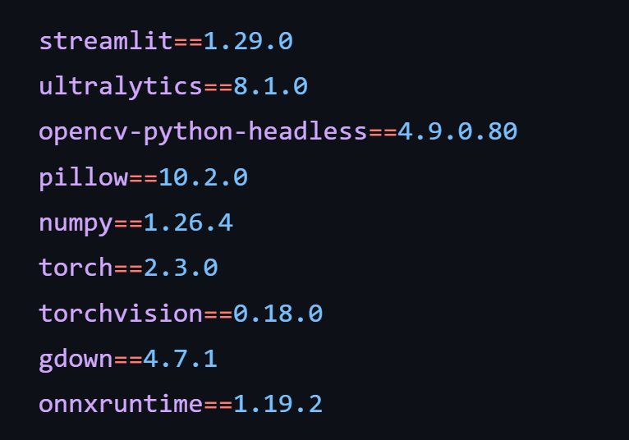
Model Deployment
We deployed the model on streamlit.
App link: https://real-time-object-detection-for-autonomous-vehicles.streamlit.app/
Onnx file link: https://drive.google.com/file/d/1p_IHtohF5LnUlkr6YNL5f81TjzqwkVAr/view?usp=sharing
Requirements:

Slide 35
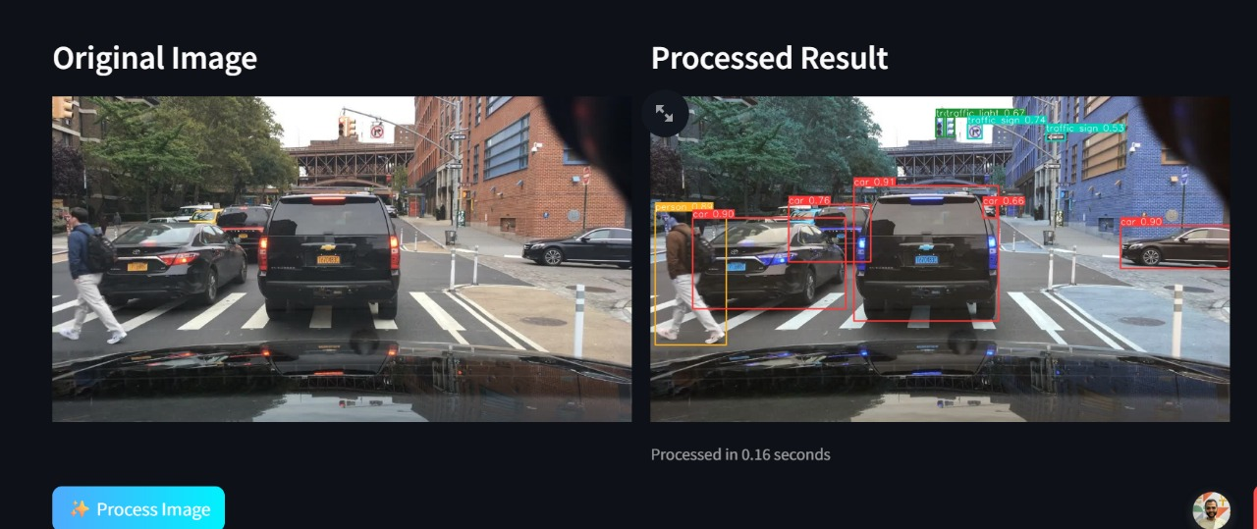
Sample of using deployed model

Slide 36
THANK YOU

