Slide 1
RESTAURANT 905 Project
A Full-Stack Restaurant Ordering & Management Platform
Spring Boot REST API • Angular Client • JWT Security • Oracle Database
By Mohamed Magdy
Java Backend Diploma — EraaSoft

Slide 2
Project Overview
Restaurant lets customers browse a restaurant's menu, add items to a cart, place orders, and contact the restaurant, while giving admins the tools to manage food items, orders, and customer messages.
The backend is a Spring Boot REST API secured with JWT authentication.
The frontend is an Angular single-page app that consumes that API.
2
JWT
User Roles
(Admin & Customer)
Stateless
Token Authentication
AR / EN
REST
Bilingual
Error Messages
Layered API
Architecture
Restaurant 905
2

Slide 3
Technology Stack
Backend
Frontend
Java 17
Spring Boot 3.4.5 (Web, Data JPA, Validation, Security)
Spring Security + JWT (jjwt)
Oracle Database via Spring Data JPA / Hibernate
MapStruct — DTO / Entity mapping
Lombok
springdoc-openapi (Swagger UI)
Custom validation & bilingual (AR/EN) exception handling
Angular 11 (TypeScript)
RxJS — BehaviorSubject for cart & notification state
Angular Router with route Guards
HttpClient + JWT Auth Interceptor
Reactive Forms (signup, profile validation)
Bootstrap-based UI + ng-bootstrap pagination
20+ standalone components (products, cart, admin, etc.)
Restaurant 905
3

Slide 4
Architecture — Request Flow
Angular
Client
→
JWT Auth
Filter
→
Controller
→
Service
Layer
→
Repository
(JPA)
→
Oracle
Database
Requests carry a Bearer JWT (except public endpoints). DTOs and View Models (VMs) are mapped to/from entities with MapStruct between the Controller and Service layers.
Public endpoints (no token required):
/auth/** • /products/** • /categories/** • /swagger-ui/** • /v3/**
Restaurant 905
4

Slide 5
Key Features
1
2
3
Authentication & Roles
Product Catalog
Shopping Cart & Checkout
JWT-based sign-up / login with Admin and Customer roles.
Browse by category, search by keyword, paginated results.
Add items, review the cart, and place an order.
4
5
6
Order Management
Contact & Support
Admin Dashboard
Customers view their history; Admins view all orders.
Customers message the restaurant; replies trigger a notification.
Manage menu items, review orders, and reply to messages.
Restaurant 905
5

Slide 6
Authentication & Security Flow
1
User submits the sign-up / login form (Angular)
Publicly Accessible
2
AuthController → AuthService verifies credentials (BCrypt password check)
/auth/**
/products/**
/categories/**
/swagger-ui/**
/v3/**
3
TokenHandler generates a signed JWT (username + expiry)
4
Token & roles are returned and stored in the browser's sessionStorage
5
AuthInterceptor attaches “Authorization: Bearer <token>” to every request
Everything else requires a valid Bearer token in the Authorization header.
6
Backend AuthFilter validates the token and sets the Security Context
Restaurant 905
6

Slide 7
Checkout & Order Flow
1
Customer adds products to the Cart (client-side, CartService)
2
Clicks “Take Order” → POST /orders/create-orders
3
Backend checks whether the account's profile is complete
(phone, address, age)
Incomplete profile
→ 400 “PROFILE_INCOMPLETE”
→ “Complete your profile” prompt
4
Order is saved, then updated with a generated code: “RES-{orderId}”
Profile complete
→ Order is created and saved
→ Checkout continues
5
Response returns the order code, total price & quantity → Order Summary page
Restaurant 905
7

Slide 8
Contact & Notification System
Sending a message also requires a completed profile
Customer Side
Admin Side
Sends a message via the Contact form
Message is saved with isRead = true (they just sent it)
The bell icon polls /unread-count on login
Opens “My Messages” to read the Admin's reply
Views all customer messages
Writes and sends a reply
Reply sets isReplied = true and isRead = false
This flips the customer's notification badge on
Restaurant 905
8

Slide 9
Admin Panel
1
2
3
Messages
Orders
Add / Remove Food
View all customer inquiries and send replies.
Track every order placed across all customers.
Create new menu items or delete existing ones.
Note: in the dashboard, it shows the Users card (for admin to view and control users), this feature is yet to be implemented and is marked “Coming Soon” and is not yet functional.
Access control: Admin-only screens are gated by Angular route guards (isAdmin()); every protected API call still requires a valid JWT.
Restaurant 905
9

Slide 10
Core Data Model
Account
AccountDetails
Role
Category
username, email, password,
roles[], accountDetails
phone, address, age
(1:1 with Account)
ADMIN / USER
(M:N with Account)
name, logo, flag
→ has many Products
Product
Order
ContactInfo
Chef
name, price, description
→ belongs to a Category
code, totalPrice, totalNumber
→ Account, Products (M:N)
subject, message, adminReply,
isRead / isReplied
name, specialty,
social links (standalone)
Restaurant 905
10

Slide 11
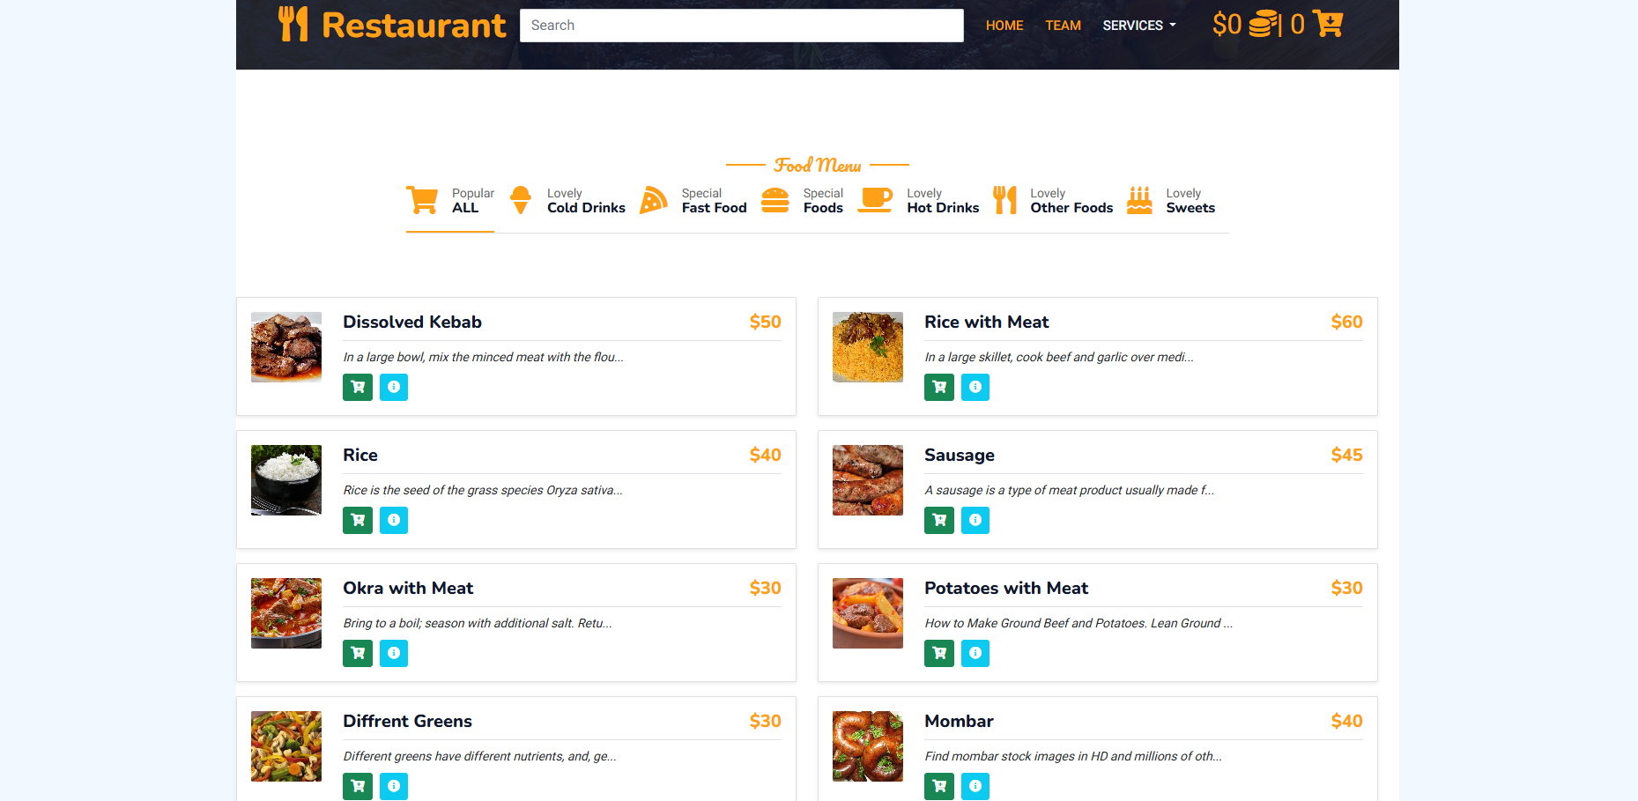
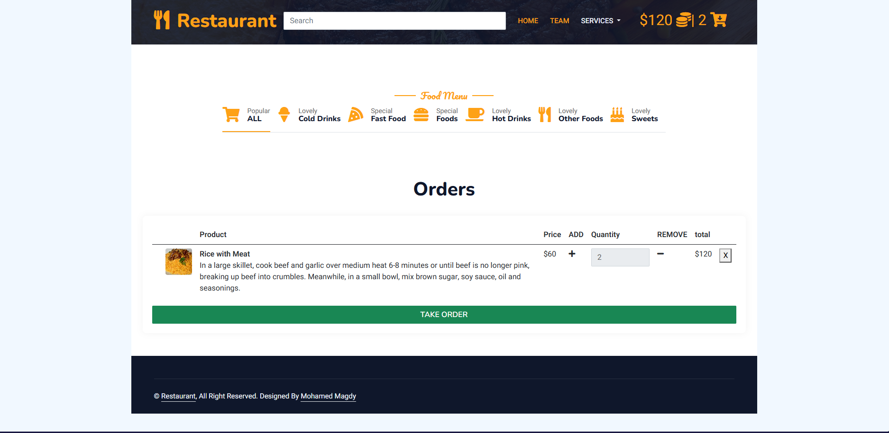
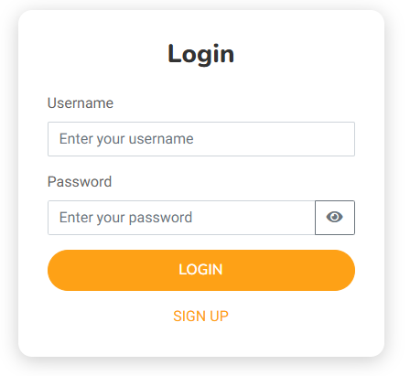
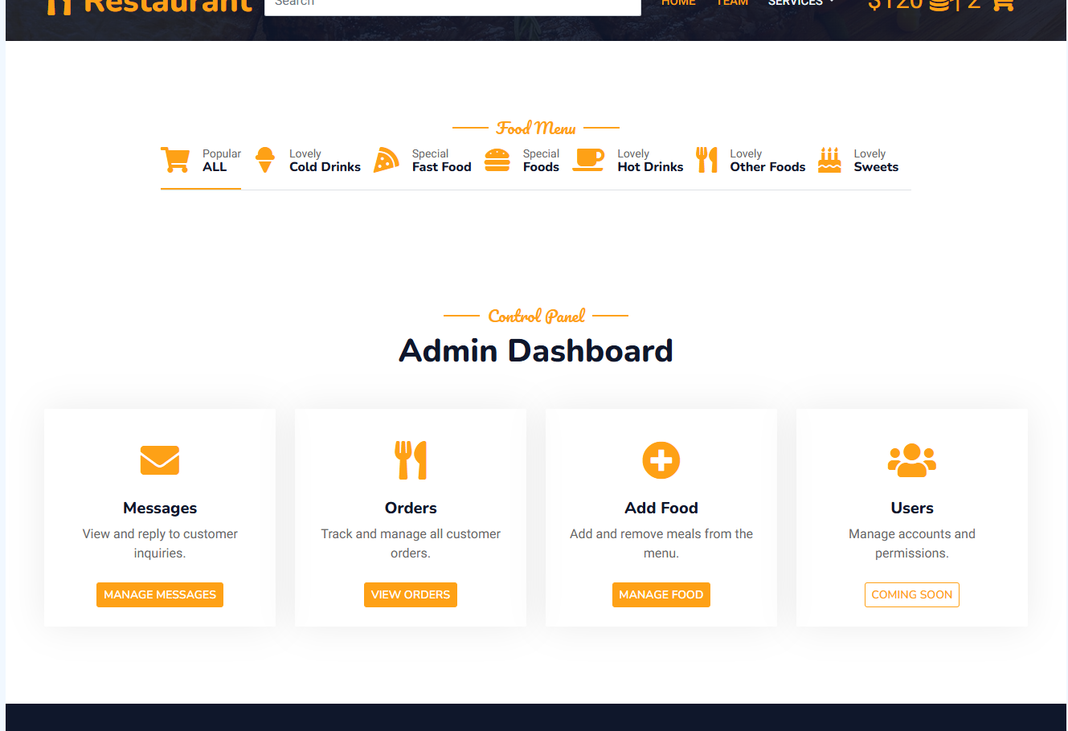
Screenshots
Replace each placeholder below with an actual screenshot
Home / Product Listing
Cart & Checkout
[ Add screenshot here ]
Login / Signup
Admin Dashboard
Restaurant 905
11

Slide 12
Thank You
Restaurant 905 — Java Backend Diploma Project
GitHub Repository: [https://github.com/mohamed-magdy-dev/Final-project-905-Restaurant-App.git ]

