Slide 1
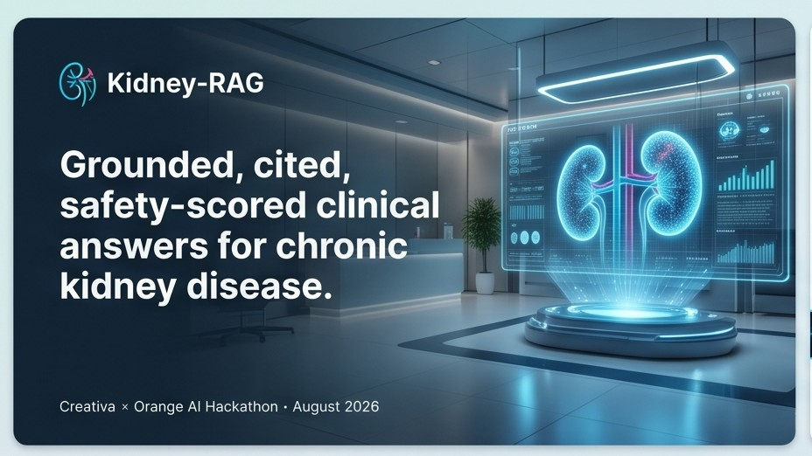
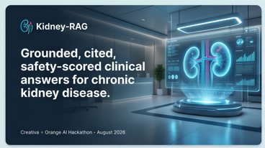
K R
Kidney-RAG
Grounded, cited, safety-scored
clinical answers for chronic kidney disease.
Creativa × Orange AI Hackathon · August 2026
Notes:
Cover slide. Introduce team name, project name. Say the tagline once.

Slide 2
THE PROBLEM
A fluent answer is not a safe answer.
Large language models trained on the open web produce medical text that sounds authoritative — even when it's wrong. Doctors under time pressure trust the fluent output. Patients pay the price.
!
?
≠
Hallucinated dosages
Missing citations
No refusal path
Confidently wrong drug thresholds — no way for a busy clinician to catch.
Answers cite 'general medical knowledge' — untraceable, unverifiable.
Chatbots always answer. There is no 'I don't know' in the training data.
Kidney-RAG · CKD Clinical Decision Support (Lite)
2 / 18
Notes:
Frame the problem in one sentence: medical AI hallucinates, and it hallucinates confidently. Three failure modes — dosage, citation, refusal.

Slide 3
WHY IT MATTERS
The stakes are clinical, not academic.
„
10M+
annual medication errors in the US alone (IOM estimate)
One wrong drug threshold whispered with confidence can send a patient into hyperkalemia.
A clinical assistant that guesses is a clinical liability.
56%
of clinicians already trust AI-generated summaries without verification (JAMA 2024)
0
acceptable rate of unsupported claims in a clinical decision support tool
— Design principle for Kidney-RAG
Kidney-RAG · CKD Clinical Decision Support (Lite)
3 / 18
Notes:
Emphasize: this isn't a coding problem, it's a patient-safety problem. Three data points make it concrete.

Slide 4
SCOPE
Why chronic kidney disease?
CKD is the ideal first vertical for grounded clinical AI: high global prevalence, treatment-critical numeric thresholds, and a mature, publicly available guideline corpus.
10%
1 in 7
eGFR<15
4
of adults globally have CKD
adults in the US — often undiagnosed
kidney failure threshold —
precision matters
world-class guidelines
available free
CKD progression is defined by discrete numeric cutoffs (eGFR, ACR categories A1/A2/A3). A grounded RAG succeeds or fails on getting those numbers right — the perfect test case for a system built around 'no unsupported claims'.
Kidney-RAG · CKD Clinical Decision Support (Lite)
4 / 18
Notes:
Why CKD: prevalence is huge, the domain is number-heavy, and the guidelines are free. All three are perfect for demonstrating grounded RAG.

Slide 5
COMORBIDITY FOCUS
Why include diabetes-in-CKD as a subtopic?
The overlap is medical reality
Where the guidelines overlap
• 40% of adults with type-2 diabetes eventually develop CKD.
• Almost every CKD treatment decision references diabetes status.
KDIGO
2024 CKD
SGLT2i
MRAs
GLP-1
KDIGO
2022 DM
• SGLT2 inhibitors, GLP-1 agonists, and finerenone straddle both guidelines.
• Getting the intersection right is what a clinician actually needs.
Every CKD-diabetes question sits in the overlap.
Kidney-RAG · CKD Clinical Decision Support (Lite)
5 / 18
Notes:
Diabetes in CKD is where the two guidelines conflict, overlap, or evolve fastest — perfect stress test for our multi-source retrieval.

Slide 6
MARKET
Who needs this product?
1
Primary-care clinicians
2
Medical trainees & residents
Need fast, cited answers between appointments. Won't leave the EHR to Google.
Learning guideline nuance. Need a citation-first source that reinforces good habits.
3
Nurse practitioners (CKD-focused)
4
Hospital IT / compliance
Managing follow-up. Need to check thresholds and dosing at point of care.
Rolling out AI. Need a decision-support tool with an audit trail per answer.
Clinical decision-support market projected at ~$2B by 2028. EHR-integration mandates and litigation costs are driving demand.
Kidney-RAG · CKD Clinical Decision Support (Lite)
6 / 18
Notes:
Four concrete user personas. Emphasize that the market is real and the timing is now — EHR-AI integration mandates are accelerating.

Slide 7
SOLUTION
Retrieval-grounded, cited, safety-scored.
Kidney-RAG answers every clinical question using only text from four official CKD guidelines. Every answer includes a verbatim excerpt and a citation with document, section, and page. If the evidence isn't there, the system refuses instead of guessing.
01
02
03
04
Retrieve
Gate
Ground
Verify
→
→
→
Hybrid semantic + BM25 search over 666 chunks.
Cosine ≥ 0.70 or refuse. Calibrated, deterministic.
LLM answers only from retrieved text, cites exact chunks.
Extract every claim, score faithfulness + citations.
Kidney-RAG · CKD Clinical Decision Support (Lite)
7 / 18
Notes:
The one-line pitch. Then walk left to right through the four-step pipeline.

Slide 8
DATA
The corpus: four official CKD guidelines.
Guideline | Publisher | Pages | Chunks | Role
KDIGO 2024 CKD Guideline | KDIGO | 199 | 340 | Primary CKD management
KDIGO 2022 Diabetes in CKD | KDIGO | 128 | 241 | Diabetes-in-CKD, MRAs, SGLT2i
NICE NG203 | NICE (UK) | 78 | 72 | Diagnosis & pathway
USPSTF Screening for CKD | USPSTF (US) | 6 | 13 | Insufficient-evidence recommendation
Total | — | 411 | 666 | Indexed and citation-ready
Each chunk carries its document, section, page number, and stable ID — so every clinical claim can be traced back to a specific paragraph in a specific PDF.
Kidney-RAG · CKD Clinical Decision Support (Lite)
8 / 18
Notes:
Table of guidelines. Emphasize: real chunks, real page numbers, real URLs. Every citation is programmatically verifiable.

Slide 9
TECHNOLOGY
The stack, at a glance.
Retrieval
Generation & Safety
Serving & Ops
• PyMuPDF — PDF parsing (2-column safe)
• Groq · Gemini · HuggingFace — LLMs
• FastAPI — JSON + static frontend
• tiktoken — 550-token chunk sizing
• Custom system prompt (grounding + refusal)
• HTML / CSS / vanilla JS — no framework
• MedEmbed-large — medical embeddings
• Format validator (Rec / Excerpt / Cite)
• Multi-key LLM pool + failover
• ChromaDB — persistent vector store
• Cosine-based 0.70 quality gate
• Per-request CSV audit log
• BM25 — keyword ranking
• Claim extractor + verifier
• pytest — 57 offline tests
• Reciprocal Rank Fusion — hybrid blend
• 4-level uncertainty language
• python-dotenv — secret management
100% local for retrieval and embeddings — no API calls to search. LLMs are pluggable across four providers.
Kidney-RAG · CKD Clinical Decision Support (Lite)
9 / 18
Notes:
Three-column stack view. Left is data plumbing, middle is safety, right is operations.

Slide 10
DAYS 1–2
Retrieval — hybrid search that actually finds the answer.
Semantic search alone misses questions that hinge on exact terms (SGLT2, A3, eGFR <15). Keyword search alone misses paraphrases.
Model comparison (Hit@5)
MedEmbed (chosen)
We run both in parallel and fuse them:
0.867
• MedEmbed cosine · weight 0.7
• BM25 keyword · weight 0.3
BGE-large
0.733
• Reciprocal Rank Fusion (k=60)
• Candidate pool 50 → top-5
BM25 only
0.733
Measured on our 18-question eval set:
Hit@5 = 0.867 · Precision@5 = 0.213 · Recall@5 = 0.706
+14 pp lift from swapping the general-purpose embedder for a medical-fine-tuned one.
Kidney-RAG · CKD Clinical Decision Support (Lite)
10 / 18
Notes:
Show the measured improvement. MedEmbed beat the general-purpose model by 14 percentage points on our set — biggest single design win of Day 2.

Slide 11
DAY 3
Grounded generation — with a hard refusal gate.
Every answer, always the same shape:
The gate — before the LLM is called
Retrieve top-5 hits
1
Recommendation
2–5 sentence direct answer. Every claim maps to an Excerpt.
Top cosine ≥ 0.70 ?
2
Excerpt
PASS → generate grounded answer
Verbatim quote from a retrieved chunk. No paraphrasing.
FAIL → deterministic refusal (no LLM call)
3
Citation
[Source: doc — section, p.N | chunk_id:X | url]
Threshold 0.70 chosen from a measured 0.10 gap between in-scope and out-of-scope questions on the eval set.
Kidney-RAG · CKD Clinical Decision Support (Lite)
11 / 18
Notes:
The gate is a code path, not a prompt suggestion. Refusal is guaranteed for out-of-scope questions — the LLM is never even called.

Slide 12
DAY 4
Post-generation safety layer.
Even a grounded LLM can drift. After every answer, we programmatically extract every claim and check whether the retrieved evidence supports it.
01
02
03
04
Extract
Verify
Faithfulness
Citation acc.
Split Recommendation into atomic claims + attach cited chunk_ids.
LLM verifier / embedding similarity / NLI. Verifier gets a different prompt from generator.
supported claims / total claims. Directly measures hallucination.
Cited chunk_id exists in retrieved set AND verifier confirms support.
Every answer is tagged with a 4-level evidence-strength label:
STRONG · ≥ 0.85
PARTIAL · 0.75–0.85
WEAK · 0.70–0.75
INSUFFICIENT · < 0.70 → refuse
Kidney-RAG · CKD Clinical Decision Support (Lite)
12 / 18
Notes:
Explain: this is what makes Kidney-RAG different. Not just retrieval quality — we score every claim in the ANSWER against the EVIDENCE. Faithfulness = 1.0 in our eval.

Slide 13
RESILIENCE
The demo can't die from a rate limit.
Free-tier LLMs 429 constantly. We built a multi-key pool that round-robins within a provider and fails over to the next when the whole tier is in cooldown — invisibly to the user.
PRIMARY
FALLBACK 1
FALLBACK 2
FALLBACK 3
Groq
Gemini
HuggingFace
Anthropic
gpt-oss-20b · 2 keys
3.6-flash · 3 keys
Llama-3.1-8B · 2 keys
claude-sonnet · opt
30 rpm / 14,400 req/day
5 rpm / 20 req/day per key
Monthly credit-based
Paid — hot spare
Role-based routing: generation prefers Groq/Gemini quality; verification prefers HuggingFace to preserve Gemini quota.
Kidney-RAG · CKD Clinical Decision Support (Lite)
13 / 18
Notes:
This is the story judges remember. Live demo can't be killed by a rate limit. Show /health in the demo — see per-key status.

Slide 14
RESULTS
The measured numbers.
100%
100%
86.7%
Faithfulness
(14 answered questions, macro)
Citation accuracy
(all cited chunks correct)
Retrieval Hit@5
(unchanged from Day 2 baseline)
Metric | Value | Source
Answered questions (out of 15 in-scope) | 14 | artifacts/day4/evaluation_log.csv
Model refusals (system-prompt condition 2) | 1 | Ambiguous edge case — safety layer working
Gate refusals on out-of-scope questions | 3 / 3 | Threshold 0.70 · perfect separation
In-scope pass rate at threshold 0.70 | 15 / 15 | artifacts/day4/threshold_sweep.csv
Avg retrieval latency | ~158 ms | CPU only — MedEmbed + Chroma + BM25
Offline tests passing | 57 / 57 | test_generation · test_safety · test_llm_pool
Kidney-RAG · CKD Clinical Decision Support (Lite)
14 / 18
Notes:
This is the slide judges will screenshot. Three headline numbers up top — 100% faithfulness, 100% citation accuracy, 86.7% Hit@5. Then the supporting table.

Slide 15
DEMO
Live demo — 3 questions in 90 seconds.
STRONG
Q: At what eGFR can an SGLT2 inhibitor be started in a patient with T2D and CKD?
System returns Recommendation + verbatim excerpt + citation. Confidence: high. Faithfulness: 1.0.
PARTIAL
Q: What is the diagnostic threshold for albuminuria in CKD?
Retrieved passages are on-topic but general. Model correctly hedges and cites the closest table.
REFUSED
Q: How should acute appendicitis be managed?
Top cosine 0.62 < 0.70 → gate refuses deterministically. No LLM call. No hallucination possible.
Live URL shown in browser during demo · Backend served by whichever pool key is warm right now.
Kidney-RAG · CKD Clinical Decision Support (Lite)
15 / 18
Notes:
Switch to browser. Run all three queries live. Show the confidence badge, the citation chip, and the /api/stats endpoint at the end.

Slide 16
THE WORK
What our team shipped in 5 days.
Day by day
The code
Day 1
PDF parsing, chunking, MedEmbed embedding, ChromaDB index — 666 chunks live
18
Python modules + notebooks
666
chunks indexed with metadata
Day 2
Hybrid retriever, 18-question eval set, Hit@5 measured, chunk ablation, model bake-off
4
LLM backends (Groq / Gemini / HF / Anthropic)
Day 3
Grounded prompt, quality gate, refusal conditions, format validator, 3 LLM backends
57
offline tests (no API needed)
Day 4
Claim extractor, faithfulness scorer, 4-level uncertainty, multi-key pool, FastAPI + web UI
100%
faithfulness on the eval set
Kidney-RAG · CKD Clinical Decision Support (Lite)
16 / 18
Notes:
Give the team credit — walk through the four days, then the code count. Show it was systematic, not a scramble.

Slide 17
ROADMAP
Where this goes next.
0–3 months
3–6 months
Second vertical
EHR integration
Cardiology guidelines (ESC / AHA). Same pipeline — new corpus. Prove the CKD design is reproducible.
FHIR bridge so a clinician can ask 'what does the guideline say for THIS patient?'. Patient-specific grounding.
6–12 months
12+ months
Institutional deployment
Continuous evaluation
Per-clinic SSO, audit-trail retention, custom guideline uploads, compliance reporting (HIPAA-ready log format).
Real-clinician feedback loop feeding the eval set. Faithfulness measured on live traffic, not just a test set.
Kidney-RAG · CKD Clinical Decision Support (Lite)
17 / 18
Notes:
Roadmap. Emphasize that the safety layer we built is domain-independent — cardiology / endocrinology unlock on the same code.

Slide 18
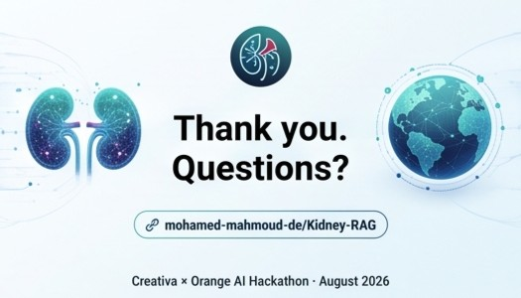
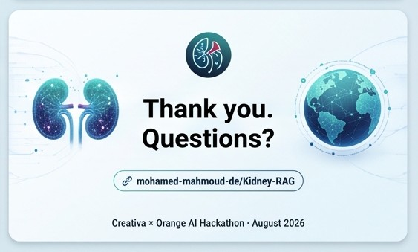
Thank you.
Questions?
Kidney-RAG
github.com/mohamed-mahmoud-de/Kidney-RAG
Creativa × Orange AI Hackathon · August 2026
Notes:
Thank the judges. Take questions. Have the /health endpoint open in a tab for the resilience question that will come.

