Slide 1
Software
Engineering
CSEN603
Tutorial #4 - Week 28/02~06/03
Diagrams till we drop

Slide 2
Documenting Design
What are your classes and interfaces?
How do they interact with each other?
Easy to keep track of, until you come back a month later to add a new feature

Slide 3
Why document design?
Why did you do wireframes?
Why do we have backlogs?
Why use emails and take notes of meetings?
We need to make sure the entire team is on the same page.

Slide 4
Communication
Wireframes showed you that not the entire team was on the same page
It revealed UX issues that would have gone unnoticed all the way to production
We just need a way to show the design that we had in mind and communicate it between us.

Slide 5
New members?
How long would it take to get a new member up to speed to your project?
If the answer is more than a day, your code is bad and you should feel bad…
Need to learn the design process
The api endpoints
The code and design (i.e url schemas) conventions
Reasoning for why a module exists

Slide 6
How do we document design?
We need a formal language
What ERD did to database schemas
We have something called UMLs stands for unified modelling language.
Why a formal language?
Natural languages are ambiguous, leaves a lot to interpretation and inference.
UML is clearly defined, like a programming language for design documentation

Slide 7
When do we write the documentation?
How about right now before we start?
No campaign plan survives first contact with the enemy -- Carl von Clausewitz
It’s a HUGE waste of time to come up to try and document the entire project before we begin. Also called Waterfall model, it sucks.
So what do we do?
Remember increments? Recursively apply scrum to all matters of life.
Notes:
Carl von Clausewitz -- Prussian general, served during the napoleonic wars
Famous for his theory of war. Wrote about the moral aspects of war.

Slide 8
Types of Diagrams
There are many types
We will focus on three
Class diagrams
Sequence diagrams
Collaboration diagrams

Slide 9
Class Diagrams
Directly maps to object oriented languages
Describe a system
Identify each class and the relationships they have
Describe inheritance hierarchies

Slide 10
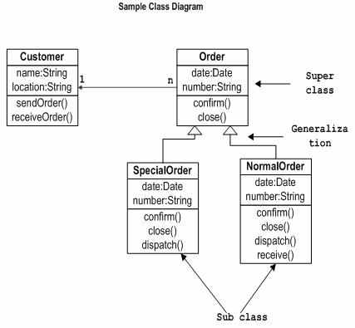
Example class diagram
Notes:
Image from tutorialspoint

Slide 11
Interaction Diagrams
Capture the behaviour of a system
How components interact with each other
Has two types, collaboration and sequence
Sequence diagrams shows the time sequence of messages from one object to another
Collaboration diagrams describe the organization of the objects messaging each other

Slide 12
Before drawing interaction diagrams
Identify
Objects taking part of the interactions
Message flow
Sequence of the messages
Object organization

Slide 13
Sequence diagram
You have seen it before in the networks course describing different protocols
Show object interactions in a time sequence, in other words an order!
Depicts actual scenarios when the system is running

Slide 14
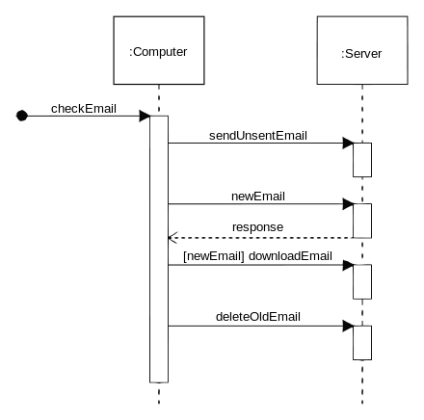
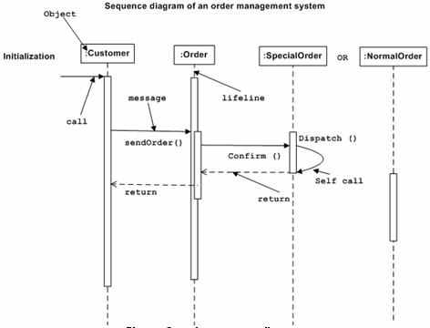
Example sequence diagram

Slide 15
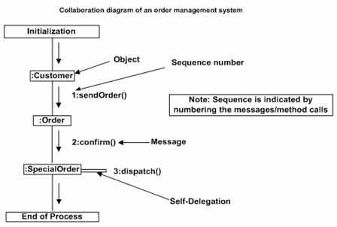
Collaboration diagram
Shows object organization

Slide 16
Differences?
Sequence diagrams highlight the temporal aspects, shows method invocation and response.
Time flow is very important, and visible in sequence diagrams

Slide 17
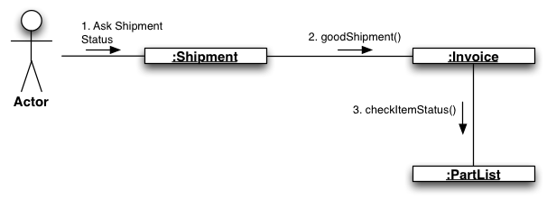
More on collaboration diagrams
Also called Communication diagram (UML 2.0)
Can also be used to describe a timeline

Slide 18
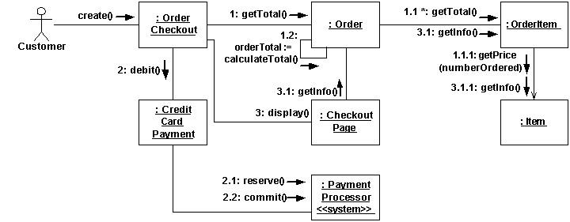
Another sample

Slide 19
Today’s Task
Design a grocery To-Buy app for your mom to contact your store, the store and customer can have a conversation on the order.
Create
Backlog
Wireframes
Class Diagram
Sequence Diagram
Collaboration Diagram
ERD

