Slide 1
Fibonacci Series generator Using Logisim
By Logicaliants

Slide 2
Group Members
Kariem Alaa-Eldien Soliman (61)
Mahmoud Ahmed Elsayed (83)
Mohamed Sherief Mohamed (69)
Omar Shaaban Rabea (56)
Mahmoud Khalid Sayed (84)

Slide 3
Objectives:
Learning how to work with Logisim Simulator
Team work
Handling Inputs & Outputs of different Components

Slide 4
Components (1/2):
3 Registers for A, B and C variables
Controlled Buffers
S-R Flip - Flop
Pull Resistor
Probe
De – Multiplexer
Counter

Slide 5
Components (2/2):
8. Clock Generator
9. Sum Logic Gates like AND & NOR gates
10. Push Button
11. 32 –bit Adder

Slide 6
What is Fibonacci Series ?
Fibonacci numbers are part of a sequence in which every term is equal to the sum of the previous two terms starting with the numbers 0 and 1 we add those together to get 1 then add 1 plus 1 to get 2 then 1 plus 2 is 3 2 plus 3 is 5 3 + 5 is 8 and so on.
I wrote a program in Python which generates Fibonacci numbers.

Slide 7
Python Code :
def fibgen (n):
A , B , C = 0 , 1 , 1
for i in range (0 , n):
print (A , sep = " , ")
C , A , B = A+B , B , C
fibgen (10) # END
Output : 0 , 1 , 1 , 2 , 3 , 5 , 8 , 13 , 21 , 34

Slide 8
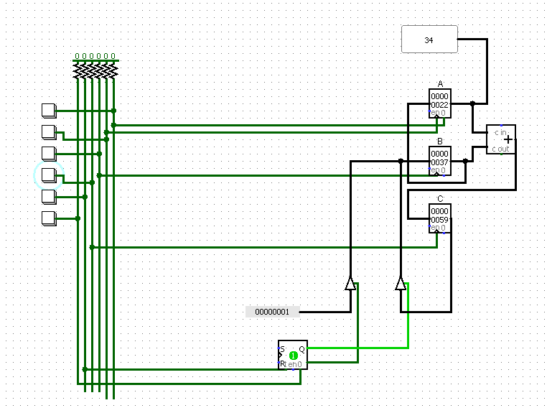
Screenshot of Manual Fib. Generator:

Slide 9
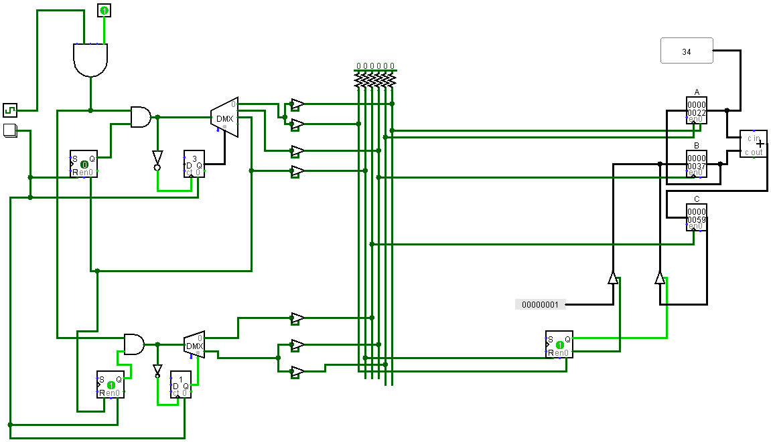
Screenshot of auto Fib. Generator:

Slide 10
Description :
First what you need is a full adder, made from gates. Second thing you need are three registers A, B and C. A and B are on the inputs to the Adder, C is on the output. Each register needs a control wire that lets you update its contents.
At the beginning, you need to set A to 0 and B to 1. {In each cycle you take the output of the adder and put it into C, then in next step transfer the contents from A to B and from C to A.} Repeat for so many cycles to get to your desired fibonacci number.

Slide 11
Notes :
Buffers must be used to avoid conflicting of input signals.
Only one of two De - Mux must be active at a time.
Two buffers used for B - Register to handle its input :
Initially, it gets the value of constant 1.
Then, it gets the value of C – Register for the rest of whole program.
# END_OF_PRESENTATION

