Slide 1

Intelligent Smart Road Monitoring and Traffic Management System
(SRIS)
A Unified AI Ecosystem for Infrastructure Health,
Public Safety, and Vehicle Tracking
SYNRA Team | AI Infrastructure Division
Notes:
Title slide. Introduce yourself and your team. Set the stage by emphasizing that SRIS is the first unified AI ecosystem of its kind.

Slide 2



PART 1 · INTRODUCTION
Modernizing Our Roads
The Arteries of Commerce
AI as the Catalyst
Our Vision
Roads power the economy. Yet their management remains locked in decades-old, manual processes — reactive rather than proactive.
The rise of AI allows us to move from passive observation to active, intelligent management — making roads safer and smarter.
Build a system that sees, analyzes, and reports road conditions in real-time — continuously, autonomously, and affordably.
Notes:
Roads are the arteries of the economy, yet their management is stuck in the past. AI allows us to move from passive observation to active, intelligent management. Our goal: To build a system that sees, analyzes, and reports road conditions in real-time.

Slide 3

PART 1 · THE PROBLEM
The Flaw of Reactive Maintenance
01
Authorities rely heavily on manual inspections or citizen complaints — a slow, error-prone chain of reporting.
02
A pothole is usually only fixed after it damages multiple vehicles, compounding costs and hazards.
03
Emergency services only respond to accidents after a bystander calls them. This delay costs lives and money.
Notes:
Currently, authorities rely heavily on manual inspections or citizen complaints. A pothole is usually only fixed after it damages multiple vehicles. Emergency services only respond to accidents after a bystander calls them. This delay costs lives and money.

Slide 4
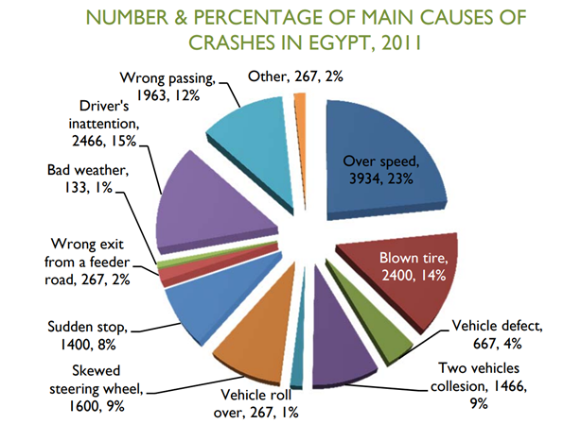
PART 1 · THE PROBLEM
Notes:
Currently, authorities rely heavily on manual inspections or citizen complaints. A pothole is usually only fixed after it damages multiple vehicles. Emergency services only respond to accidents after a bystander calls them. This delay costs lives and money.

Slide 5
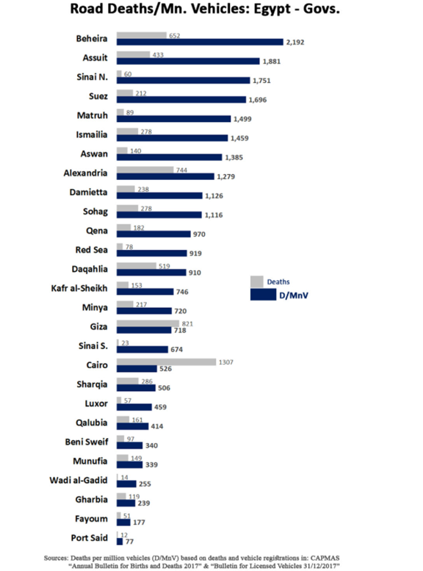
PART 1 · THE PROBLEM

Slide 6
PART 1 · THE PROBLEM
Disconnected Solutions
ALPR / Tolling System
Why Fragmentation Fails
✗
Automated systems that do exist are entirely disconnected from one another
A city's ALPR system for tolling cannot detect a car crash or a pothole
No unified system monitors all aspects of road health and safety simultaneously
Manual integration of incompatible software subscriptions is costly and error-prone
Accident Detection
Traffic Management
✗
Pothole Survey Vehicles
✗
Notes:
The automated systems that do exist are entirely disconnected from one another. A city might use an ALPR system for tolling, but that system cannot detect a car crash or a pothole. There is no unified system monitoring all aspects of road health and safety simultaneously.

Slide 7



WHY NOW
Why This Matters Now
Safety Hazards
Economic Cost
Traffic Congestion
Delayed responses to accidents or fires result in compounding dangers — every second counts when lives are at risk.
Manual road surveying with specialized vehicles is incredibly expensive and yields infrequent snapshots rather than continuous data.
Unmanaged accidents and infrastructure damage cause massive bottlenecks, costing billions in lost productivity annually.
Notes:
Safety Hazards: Delayed responses to accidents or fires result in compounding dangers. Economic Cost: Manual road surveying with specialized vehicles is incredibly expensive. Traffic Congestion: Unmanaged accidents and infrastructure damage cause massive bottlenecks.

Slide 8

PART 2 · COMPETITOR ANALYSIS
What Does the Market Offer?
Existing Players
Their Shared Blind Spot
Mobileye — Advanced driver-assistance & mapping systems
Nexar — Dashcam telematics & incident detection network
Specialized Surveying Firms — LiDAR-equipped inspection fleets
Municipal CCTV Integrators — Fixed camera management platforms
While they have strong niche products, they fail to provide a holistic view of the road environment. Each solves one piece of the puzzle — leaving cities to stitch together fragmented, incompatible solutions at great cost.
Notes:
We analyzed existing companies in the road safety and telematics space such as Mobileye and Nexar. While they have strong niche products, they fail to provide a holistic view of the road environment.

Slide 9
PART 2 · COMPETITOR LIMITATIONS
The Hardware Trap
Competitors require expensive, proprietary hardware that makes city-wide deployment economically impossible.
LiDAR Sensors
$5,000–$75,000
Enterprise-grade sensors required per vehicle or installation point. Calibration and maintenance add further cost.
Custom Dashcams
$500–$2,000
Proprietary enterprise dashcams locked to vendor ecosystems. Standard consumer devices are incompatible.
Scaling Penalty
Prohibitive
Installing specialized hardware across an entire city multiplies costs to tens of millions — inaccessible for most municipalities.
Notes:
Competitors often require the installation of highly expensive, proprietary hardware. They rely on specialized lidar sensors or custom enterprise dashcams. This makes scaling their solutions across a whole city prohibitively expensive.

Slide 10
PART 2 · COMPETITOR LIMITATIONS
Solving Only One Problem
The Integration Gap
Telematics
Road
Damage
A competitor might specialize purely in telematics (dashboard data) or purely in road damage detection
To get a complete picture, a city must buy multiple incompatible software subscriptions and integrate them manually
This creates data silos, vendor lock-in, and a fragmented operator experience
No single vendor provides a unified, real-time view across all dimensions
?
Safety
Cameras
Notes:
A competitor might specialize purely in telematics or purely in road damage detection. To get a complete picture, a city would need to buy multiple, incompatible software subscriptions and integrate them manually.

Slide 11



PART 2 · OUR SOLUTION
The All-In-One AI Platform
Infrastructure Health
Public Safety
Vehicle Tracking
Cracks detection
Pothole mapping
Surface anomalies
Accident detection
Fire & smoke alerts
Emergency dispatch
License plate recognition
Vehicle classification
Damage assessment
SRIS uniquely combines all three pillars into a single, unified AI pipeline.
Notes:
SRIS uniquely combines infrastructure health (cracks/potholes), public safety (accidents, fire/smoke), and vehicle tracking (license plates, car damage) into a single unified pipeline.

Slide 12


PART 2 · THE SRIS ADVANTAGE
Accessible AI for Everyone
Hardware Agnostic
Cost Efficiency
Our platform works with any standard camera feed — CCTV infrastructure, low-cost dashcams, or even smartphone video. No proprietary hardware required.
By utilizing lightweight YOLO models, we deliver state-of-the-art accuracy on standard GPUs — drastically reducing operational costs vs. LiDAR-based competitors.
CCTV
Dashcam
Mobile
90%
<5ms
Cost Reduction vs LiDAR
Inference per Frame
Notes:
Hardware Agnostic: Our platform works with any standard camera feed — CCTV, cheap dashcams, or smartphone video. Cost Efficiency: By utilizing lightweight YOLO models, we deliver state-of-the-art accuracy on standard GPUs, drastically reducing operational costs.

Slide 13
PART 3 · ARCHITECTURE
Built for Scale
Management
Dashboard
(Laravel/PHP)
AI Inference
Engine
(FastAPI/Python)
DUAL ARCHITECTURE
Camera Input
(Any Source)
Upload
Inference Request
Store Results
Stream NDJSON
Interactive
Dashboard +
PDF Reports
MySQL
Database
Notes:
We designed a dual-architecture platform to handle massive amounts of video data without bottlenecking the user experience. It consists of a Management Dashboard and an independent AI Inference Engine.

Slide 14
PART 3 · USER FLOW
Seamless User Experience
1
2
3
4
→
→
→
Upload Video
Instant Offload
Frame-by-Frame AI
Live Dashboard + Reports
User uploads a road segment video — dashcam, CCTV export, or smartphone footage.
The system immediately offloads heavy video processing to the AI engine — no frontend lag.
The AI processes the video frame-by-frame and streams bounding-box detection data back in real time.
Users view an interactive dashboard with real-time AI overlays and can generate PDF inspection reports.
Notes:
A user uploads a video of a road segment. The system instantly offloads this heavy video to the AI engine. The AI processes the video frame-by-frame and streams bounding-box data back. The user views an interactive dashboard with real-time AI overlays and generated PDF reports.

Slide 15
PART 3 · ARCHITECTURE
Preventing Bottlenecks
❌ Without Decoupling
✅ With Decoupling (SRIS)
Main web server runs AI models natively
Multiple video uploads cause the website to crash
Users experience unacceptable lag — loading screen of death
Scaling requires redeployment of the entire application
AI is completely isolated into its own microservice
Web app remains lightning-fast under any load
AI service scales independently during high-traffic events
Each component deployed, updated, and scaled separately
Decoupling is the architectural decision that makes SRIS enterprise-ready.
Notes:
If our main web server ran the AI models natively, the website would crash during multiple video uploads. By completely isolating the AI into its own microservice, the web app remains lightning-fast. This decoupling ensures we can scale the AI separately during high-traffic events.

Slide 16

PART 3 · DASHBOARD
The Command Center
Robust Framework
Built on the battle-tested Laravel (PHP) framework, ensuring maintainability and scalability.
Historical Data Storage
Handles complex business logic and stores all historical inspection footage and results.
User Authentication
Manages secure user authentication with role-based access control: Admins vs. Standard Users.
Laravel / PHP
Management Dashboard
Report Generation
Auto-generates detailed PDF inspection reports linked to footage, ready for city authorities.
Notes:
Built on the robust Laravel (PHP) framework. Handles complex business logic and historical data storage. Manages secure user authentication and role-based access — Admins vs. Standard Users.

Slide 17


PART 3 · AI ENGINE
The Brain of the System
Built on FastAPI (Python) — a highly optimized, asynchronous microservice framework designed for AI inference workloads.
Pure Inference Engine
Async Architecture
GPU Accelerated
Loads heavy PyTorch models into GPU memory at startup. Processes inference requests from Laravel with minimal overhead.
Non-blocking async/await pattern ensures the engine handles hundreds of concurrent video streams without queuing.
PyTorch + CUDA deliver real-time inference on each video frame. Scales vertically with additional GPU resources instantly.
Notes:
Built on FastAPI (Python), a highly optimized, asynchronous microservice. It acts purely as the inference engine. It loads heavy PyTorch models into GPU memory and rapidly processes incoming inference requests from Laravel.

Slide 18
PART 4 · MACHINE LEARNING
9 Specialized AI Models
Instead of one giant, slow model, SRIS uses specialized models
to maintain real-time speed and pinpoint accuracy for each specific task.
01
Accident Detection
02
License Plate Detection
03
License Plate OCR
04
Traffic Signs Detection & OCR
05
Vehicle Detection & Tracking
06
Fire & Smoke Detection
07
Car Dashboard Detection
08
Cracks & Potholes Detection
09
Car Damage Classification
Notes:
Our intelligence relies on an impressive suite of 8 distinct, highly specialized AI models. Instead of one giant, slow model, we use specialized models to maintain real-time speed and pinpoint accuracy for each specific task.

Slide 19
PART 4 · MODEL ARCHITECTURE
The State-of-the-Art in Computer Vision
Why YOLO?
YOLOv11
YOLO — You Only Look Once — processes the entire image in a single neural network pass, enabling real-time detection without sacrificing accuracy.
Used in 6 of our models — optimized for multi-class detection tasks with high throughput.
Architecture | Passes | Speed | Used In SRIS
Faster R-CNN | 2-stage | Slow (~7fps) | No
SSD | 1-stage | Medium (~30fps) | No
YOLOv11/v12 | 1-stage | Real-time (60+fps) | ✓ Yes
YOLOv12
Used in accident detection & OCR — cutting-edge accuracy where precision is non-negotiable.
Notes:
We chose YOLO (You Only Look Once) architectures. Unlike older architectures (like Faster R-CNN), YOLO processes the entire image in a single pass. YOLOv11 and v12 represent the absolute cutting edge, balancing incredible processing speed with unmatched accuracy.

Slide 20
PART 4 · METRICS
How We Measure Success
All models are evaluated using mAP@0.5 — Mean Average Precision at 50% Intersection over Union.
Precision
IoU (Intersection over Union)
mAP@0.5
Of all the objects our AI flagged, what percentage were correct? High precision = fewer false alarms.
Measures how much the predicted bounding box overlaps with the actual object. IoU ≥ 0.5 means the box is at least 50% accurate.
The combined score across all object classes: the AI correctly identifies WHAT the object is AND draws the bounding box at ≥50% precision.
Notes:
We evaluate all our models using mAP@0.5 (Mean Average Precision at 50% Intersection over Union). It proves the AI not only correctly identifies what an object is (Precision), but it also draws the bounding box precisely over the object at least 50% perfectly (IoU).

Slide 21

PART 4 · MODEL 01
Accident Detection
99.3%
Model Overview
mAP@0.5
Goal: Instantly identify vehicle collisions on highways and intersections
Near-perfect 99.3% accuracy — critical for triggering automated emergency dispatch without false alarms
Detects multi-vehicle pile-ups, single-vehicle impacts, and rollover events
Sub-second alert latency enables proactive emergency response coordination
YOLOv12
Architecture
Notes:
The Goal: Instantly identify vehicle collisions on highways and intersections. The Result: Achieved near-perfect accuracy (99.3%). This is crucial for triggering automated emergency dispatch systems without false alarms.

Slide 22

PART 4 · MODEL 02
License Plate Detection
98.4%
Model Overview
mAP@0.5
Goal: Locate vehicle license plates accurately, even at high speeds or challenging angles
Acts as the critical first step before OCR — tells the text-recognition engine exactly where to look
Handles partial occlusion, motion blur, varying lighting conditions, and skewed angles
Feeds directly into the License Plate OCR model (Model 03) in a sequential pipeline
YOLOv11
Architecture
Notes:
The Goal: Locate vehicle license plates accurately, even at high speeds or challenging angles. The Result: The model acts as the critical first step before OCR, ensuring the text-recognition engine knows exactly where to look.

Slide 23
PART 4 · MODEL 03
License Plate Chars & Numbers OCR
98.2%
Model Overview
mAP@0.5
Goal: Extract the exact alphanumeric characters from the detected license plate
98.3% accuracy enables reliable logging of tolling data and tracking of stolen vehicles
Enables automated citation issuance for traffic violations without human review
Operates in a two-stage pipeline: plate localization → character recognition
YOLOv12
Architecture
ABC 1234
Notes:
The Goal: Extract the exact alphanumeric characters from the detected plate. The Result: Achieving 98.3% accuracy means the system can reliably log tolling data, track stolen vehicles, and issue automated citations.

Slide 24
PART 4 · MODEL 04
Traffic Signs Detection & OCR
98.4%
Model Overview
mAP@0.5
Goal: Read and understand road infrastructure signs in real time
Accurately identifies speed limits, stop signs, and warning notices at road surveying speed
Provides vital context for autonomous vehicle mapping and road condition databases
OCR component extracts posted speed limits and regulatory text from detected signs
YOLOv11
Architecture
STOP
Notes:
The Goal: Read and understand road infrastructure signs. The Result: The system accurately identifies speed limits, stop signs, and warnings, providing vital context for road surveying and autonomous vehicle mapping.

Slide 25
PART 4 · MODEL 05
Vehicle Detection & Tracking
97.4%
Model Overview
mAP@0.5
Goal: Identify and classify different types of vehicles — cars, trucks, buses, motorcycles
Essential for traffic flow analysis and real-time congestion monitoring
Calculates road wear-and-tear based on heavy vehicle density over time
Enables city planners to optimize lane allocation and signal timing dynamically
YOLOv11
Architecture
Car
Truck
Bus
Motorcycle
Notes:
The Goal: Identify and classify different types of vehicles (cars, trucks, buses, motorcycles) on the road. The Result: Essential for traffic flow analysis, congestion monitoring, and calculating road wear-and-tear based on heavy vehicle density.

Slide 26

PART 4 · MODEL 06
Fire & Smoke Detection
74.4%
Model Overview
mAP@0.5
Goal: Detect early signs of vehicle fires, forest fires near highways, or environmental hazards
74.4% accuracy is highly effective for raising early-warning alerts — every second saved reduces damage
Inherently challenging: smoke is amorphous, changes shape, and varies in density and color
Triggers automated operator notifications for rapid emergency intervention
YOLOv11
Architecture
Notes:
The Goal: Detect early signs of vehicle fires, forest fires near highways, or environmental hazards. While inherently challenging due to the amorphous nature of smoke, the 74.4% accuracy is highly effective for raising early-warning alerts to operators.

Slide 27

PART 4 · MODEL 07
Car Dashboard Elements Detection
85.2%
Model Overview
mAP@0.5
Goal: Analyze internal dashcam footage to detect dashboard warning lights — check engine, ABS, seatbelt
Provides crucial context for fleet management companies monitoring driver behavior
Enables insurance providers to assess vehicle health at time of incident without manual inspection
Unique value proposition for commercial fleet operators reducing maintenance costs proactively
YOLOv11
Architecture
Notes:
The Goal: Analyze internal dashcam footage to detect dashboard warning lights (check engine, ABS, seatbelt). The Result: Provides crucial context for fleet management companies and insurance providers regarding driver behavior and vehicle health.

Slide 28

PART 4 · MODEL 08
Cracks & Potholes Detection
70.6%
Model Overview
mAP@0.5
Goal: Identify complex, irregular road surface anomalies — alligator cracking and deep potholes
Eliminates the need for expensive manual road surveying with LiDAR-equipped vehicles
Allows cities to dispatch repair crews exactly where they are needed most, based on AI severity scoring
Lower mAP reflects the genuine visual complexity of irregular, amorphous surface anomalies
YOLOv11
Architecture
Notes:
The Goal: Identify complex, irregular road surface anomalies like alligator cracking and deep potholes. The Result: Eliminates the need for expensive manual road surveying, allowing cities to dispatch repair crews exactly where they are needed most.

Slide 29
PART 4 · MODEL 09
Car Damage Classification
Dual-Model Architecture
Use Cases
UNet
Insurance claim automation — AI-assessed damage severity before human adjuster review
Fleet management — remote vehicle health monitoring without physical inspection
Accident documentation — objective evidence of pre/post-collision vehicle condition
Rental car damage assessment — automated checkout and return damage logging
Pixel wise segmentation
+
EfficientNet
Classification Backbone
Provides severity & type assessment for insurance claims
Notes:
The Goal: Go beyond just detecting a car — detect the severity and location of damage on the vehicle body. The Architecture: We pair YOLO for object localization with an EfficientNet classification backbone to provide detailed damage assessment for insurance claims.

Slide 30
PART 5 · BACKEND DEEP DIVE
The Video Bottleneck
Video files are massive. Processing a 5-minute dashcam video frame-by-frame takes significant compute time — creating a major UX challenge.
1
Raw File Size
A 5-minute 1080p dashcam video = 500MB–2GB of raw data to parse, decompress, and process frame by frame.
2
Compute Intensity
Each frame requires an AI inference pass — thousands of GPU operations per second of video. Sequential processing is simply too slow.
3
Frontend Lag
If the frontend waits for the entire video before showing results, users experience an unacceptable loading screen. This kills user adoption.
Notes:
Video files are massive. Processing a 5-minute dashcam video frame-by-frame takes significant compute time. If the frontend waits for the entire video to be processed before showing results, the user experiences an unacceptable lag (loading screen of death).

Slide 31
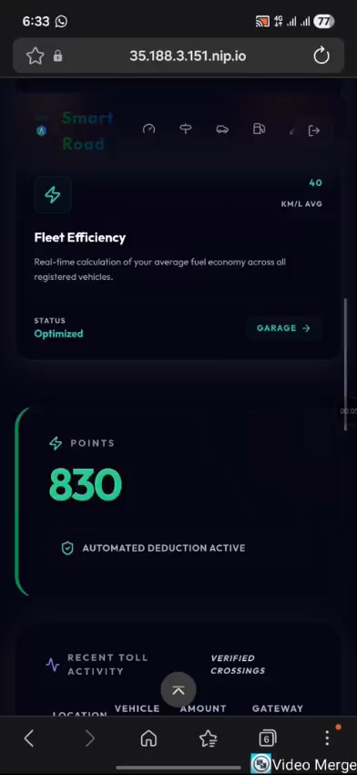
PART 5 · BACKEND DEEP DIVE
Real-Time Data Streaming
How Streaming Solves It
FastAPI uses hidden specialized /stream endpoints — not exposed in standard UI but critical to performance
Asynchronous generators yield AI results frame-by-frame as they are computed
Results are streamed using application/x-ndjson (Newline Delimited JSON) — one JSON object per line, per frame
The frontend receives and renders detections incrementally without waiting for full video processing
Notes:
Our FastAPI service utilizes hidden, specialized /stream endpoints. We use asynchronous generators to yield AI results frame-by-frame as they happen. These results are streamed to the frontend using application/x-ndjson (Newline Delimited JSON).

Slide 32


PART 5 · BACKEND DEEP DIVE
The Microservice Advantage
❌ Without Isolation
✅ With FastAPI Microservice
Laravel App
Laravel
App
FastAPI
Service
+ AI Models loaded inside
+ Video processing inline
UI / Logic
Users / Auth
→
PyTorch / YOLO
GPU Inference
+ GPU blocked per upload
HTTP
VS
Website freezes on every video upload.
All users experience downtime simultaneously.
Laravel stays fast. AI scales on its own.
Users never experience a freeze.
Result: Single point of failure — the app crashes,
AI crashes, everything crashes together.
Result: Each service fails and scales independently.
The app stays alive even during peak AI load.
Key Insight: Decoupling the AI into its own microservice is what makes SRIS production-ready — the web layer and the intelligence layer scale, fail, and deploy completely independently.
Notes:
The Microservice Advantage: If the Laravel application had to run the AI models itself, the entire website would freeze every time a video was uploaded. By isolating the AI into a FastAPI microservice, the Laravel app remains lightning-fast, and the AI service can be scaled independently if traffic increases.

Slide 33
PART 5 · BACKEND DEEP DIVE
Zero Perceived Lag
Video
Uploaded
First Frame
Processed
Dashboard
Plays Video
AI Overlays
Appear Live
→
→
→
The NDJSON Advantage
Because of NDJSON streaming, users don't wait for video processing to complete before seeing results
The frontend dashboard begins playing video immediately and overlays AI bounding boxes dynamically across the screen in real-time
The experience is exactly like a live surveillance feed — zero perceived lag, maximum operator confidence
Even a 30-minute highway patrol video provides immediate AI insights from the first second
Notes:
Because of the NDJSON streaming, the user doesn't wait. The frontend dashboard begins playing the video immediately and overlays the AI bounding boxes dynamically across the screen in real-time, exactly like a live surveillance feed.

Slide 34


PART 6 · DEVOPS & SECURITY
Robust & Protected Data Flow
Database: MySQL 8
Security: CORS
Highly structured schema: sris_db
Maps users to footage and inspection reports
Indexed for fast historical query performance
Full referential integrity with foreign key constraints
Strict Cross-Origin Resource Sharing middleware
Only trusted origins can call the API
Laravel frontend (port 80) securely communicates with FastAPI backend (port 8001)
Prevents external hijacking and cross-site request forgery
Notes:
Database: Powered by MySQL 8 with a highly structured schema (sris_db) mapping users to footage and reports. Security (CORS): Strict Cross-Origin Resource Sharing middleware protects the API. The Laravel frontend (port 80) securely talks to the FastAPI backend (port 8001), preventing external hijacking.

Slide 35

PART 6 · DEVOPS
Solving the Deployment Nightmare
Installing PHP, Python, PyTorch, Nginx, and MySQL manually on a server is a nightmare — version conflicts, platform differences, endless debugging.
Docker Compose to the Rescue
We orchestrated the entire SRIS ecosystem using Docker Compose — guaranteeing that if it works on our local machines, it works exactly the same in production. One command launches the entire stack.
Environment parity: development, staging, and production are identical
One-command deployment: docker-compose up --build brings the entire stack online
Isolated dependencies: each service has its own environment — no conflicts between PHP and Python
Notes:
Installing PHP, Python, PyTorch, Nginx, and MySQL manually on a server is a nightmare. To solve this, we orchestrated the entire ecosystem using Docker Compose. This guarantees that if it works on our local machines, it works exactly the same in production.

Slide 36





PART 6 · DEVOPS
Network Isolation
app_network (private bridge — database invisible from internet)
laravel_app
nginx_server
ml_service
PHP Application
Reverse Proxy Router
Python / FastAPI
mysql_db
adminer_gui
Persistent Storage via Docker Volumes
Admin Interface
All five containers communicate exclusively over a private internal bridge network. The database is completely invisible from the outside internet.
Notes:
Five containers: laravel_app (PHP application), nginx_server (Reverse proxy routing traffic), ml_service (Python/FastAPI), mysql_db (Persistent storage via Docker Volumes), adminer_gui (Admin interface). They communicate over a private internal bridge network (app_network). The database is completely invisible from the outside internet.

Slide 37

PART 6 · CLOUD DEPLOYMENT
Primed for GCP Enterprise Deployment
Cloud Run / GKE
The FastAPI container scales to zero to save costs, then instantly scales up utilizing Cloud GPUs during massive video upload spikes.
Google Cloud Storage (GCS)
Heavy video blobs are pushed to GCS buckets — removing storage bottlenecks from the application servers entirely.
Google Cloud SQL
Replaces the local MySQL container with a managed, enterprise-grade database offering automated backups and high availability.
Notes:
Google Cloud Run / GKE: The FastAPI container scales to zero to save costs, and instantly scales up utilizing Cloud GPUs during massive video upload spikes. Google Cloud Storage (GCS): Heavy video blobs are pushed to GCS buckets. Google Cloud SQL: Replaces the local MySQL container for automated backups and high availability.

Slide 38
The Future of Road Safety
SRIS transforms reactive infrastructure management into a proactive, intelligent, and cost-effective process — unifying 9 AI models into a single real-time ecosystem.
Future Roadmap
Phase 1
Live City Camera Integration:
RTSP feed support for direct connection to municipal CCTV networks — no video upload required.
Phase 2
Edge Computing Deployment:
Advanced edge-computing deployment on roadside hardware for sub-100ms latency detection.
Phase 3
Emergency API Integration:
Automated API hooks for direct emergency dispatcher integration — zero human relay required.
Notes:
SRIS transforms reactive infrastructure management into a proactive, intelligent, and cost-effective process. Future Roadmap: Integration with live city traffic cameras (RTSP feeds), advanced edge-computing deployment, and automated API hooks for emergency dispatchers. Thank you for your time. Any questions?

Slide 39
Demo Video
https://drive.google.com/file/d/1DqW3HT1B8ZU6OsR59JP42z2np5i4WR5Z/view?usp=sharing
Thank you for your time. Any questions?
Notes:
SRIS transforms reactive infrastructure management into a proactive, intelligent, and cost-effective process. Future Roadmap: Integration with live city traffic cameras (RTSP feeds), advanced edge-computing deployment, and automated API hooks for emergency dispatchers. Thank you for your time. Any questions?

