Slide 1
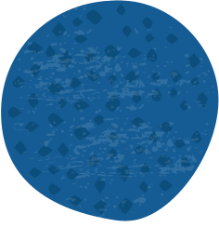



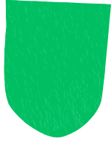

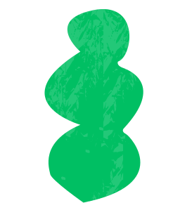







MAZE
RUNNER
HUSSEIN HEGGI 900213220
YOUSSEF EL MAHDY 900212370
MOHAMED AHMED 900211305

Slide 2

PROJECT DESCRIPTION
This project focuses on designing a maze router that efficiently finds paths between multiple points on a grid while avoiding obstacles and minimizing cost.
The router is built for a two-layer system, handling multi-target nets by leveraging two distinct routing layers: M0 “optimized for horizontal paths” and M1 “optimized for vertical paths.”

Slide 3
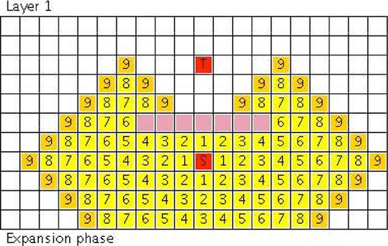
LEE’S ALGORITHM
Breadth-first search method commonly used for maze routing. It systematically explores every possible route from the starting position until it reaches the destination, guaranteeing the discovery of the shortest path.
We chose to implement this algorithm because:
It is easy to implement.
It always finds the shortest path.

Slide 4

LEE WAVE
Computes the cost to reach each cell from the source until the target is reached by expanding a priority queue across the grid. It favors preferred directions (horizontal on M0, vertical on M1) and avoids obstacles. The 3D variant extends this to multi-layer routing, adding via transitions between layers and tracking paths for backtracking, ensuring robust routing in complex layouts.

Slide 5

BACK PROPAGATE
After computing path costs, the router reconstructs the path from target to source if a path is found. In 2D, it chooses neighbors with the lowest cost, favoring preferred directions. In 3D, it traces back using saved parent links across layers. Both methods efficiently rebuild the final route.

Slide 6
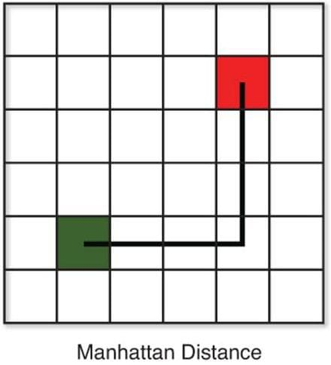
NET ORDERING BONUS
We applied a net ordering heuristic that prioritizes nets with the shortest Manhattan distance between source and target. This method provides effective congestion control while remaining simple and computationally efficient.

Slide 7
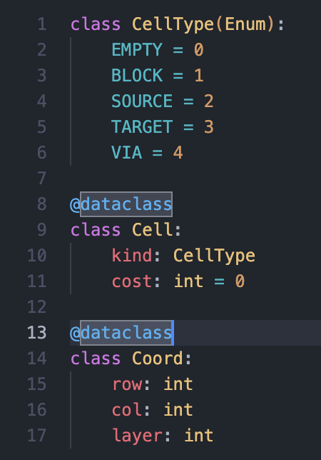
DATA STRUCTURES
To implement the Maze Router in Python, we leveraged object-oriented design using Enum and @dataclass for clarity and simplicity. Each cell on the grid is modeled with a Cell object that holds its type and cost. Net points and traversal positions are represented using the Coord class. These structures allow clean handling of routing logic across multiple layers.

Slide 8
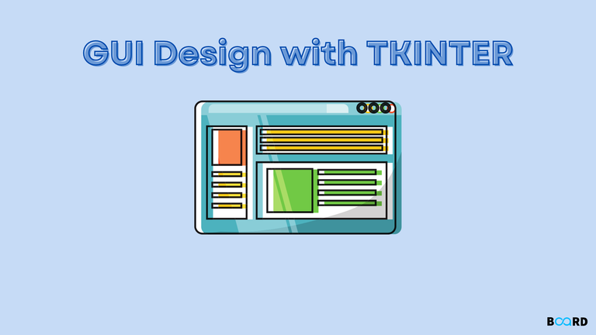
VISUALIZATION
We built a desktop visualization tool using Tkinter that loads a config file and displays routing results for both metal layers. The grid is labeled and color-coded by cell type, with each net’s path shown in a unique color and labeled clearly. Users can also view total routing costs and switch between input and output views easily.

Slide 9
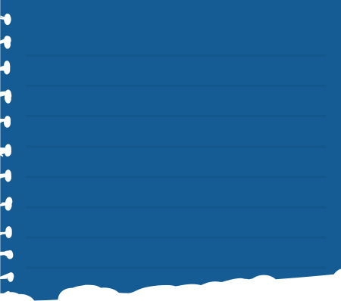
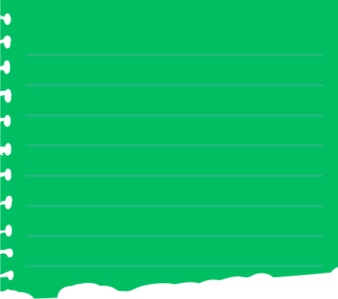
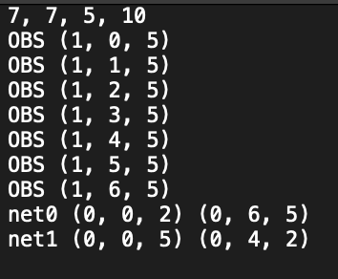
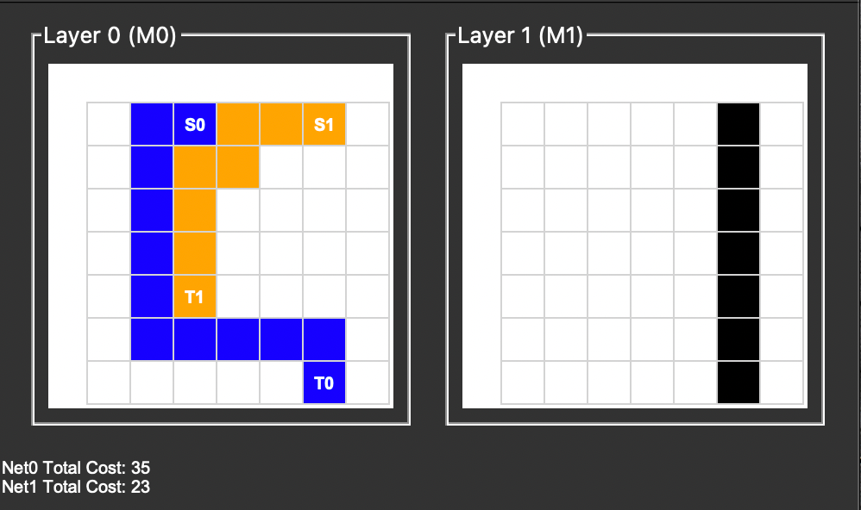
INPUT
OUTPUT

Slide 10
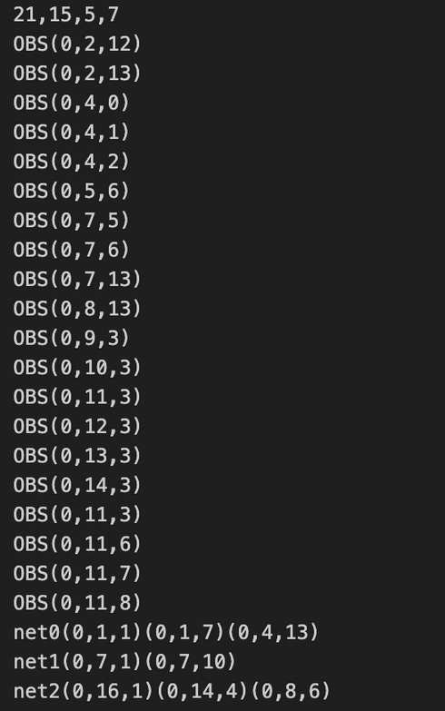
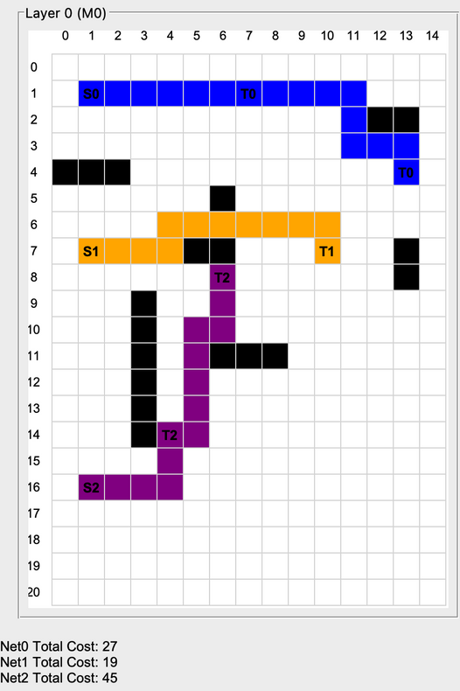
INPUT
OUTPUT

Slide 11
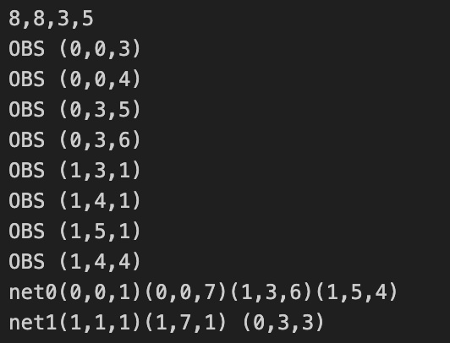
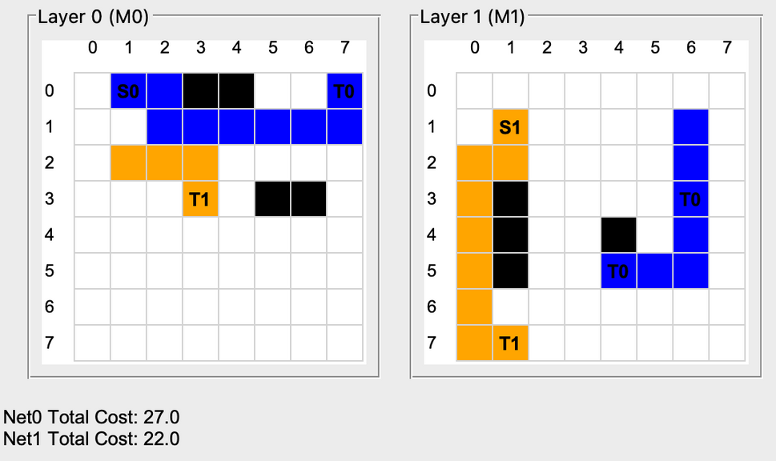
INPUT
OUTPUT

Slide 12

LIMITATIONS
No Dynamic Re-routing: Once a path is blocked by earlier nets, failed nets are skipped entirely.
No Congestion Awareness Beyond Cost: Routing decisions are cost-based but do not consider grid congestion over time.
No Parallelism: All nets are routed sequentially, missing out on optimization opportunities via concurrent routing or lookahead.

Slide 13
CONCLUSION
This project successfully implemented a two-layer maze router capable of handling both single-layer and multi-layer net connections. Using cost-aware wavefront expansion and backtracking algorithms, the router efficiently computes paths while adhering to layer preferences and obstacle constraints. A Tkinter-based GUI complements the system by providing an intuitive, color-coded visualization of routing outcomes.
While the solution handles standard routing scenarios well, future enhancements could focus on scalability, dynamic re-routing, and more interactive user interfaces to improve flexibility and performance.

Slide 14
THANK YOU!

