Slide 1

Adam & it’s variants
Math 303 Project
30 December , 2024

Slide 2

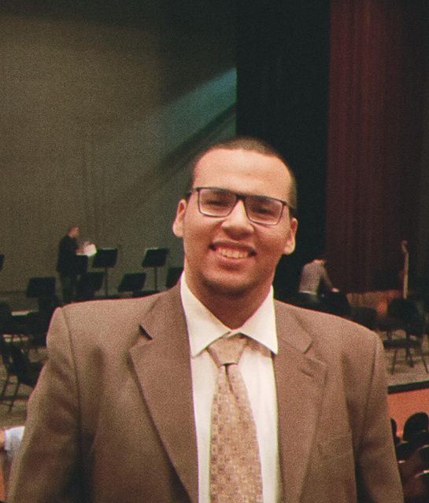
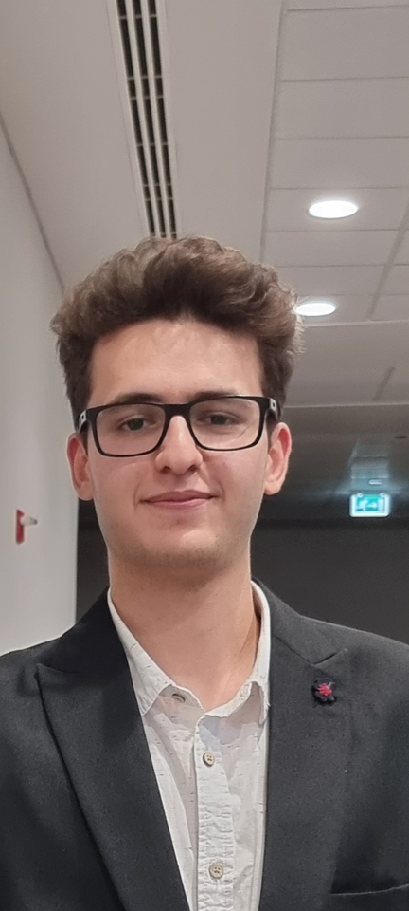


Team Members
Galal Mohamed
Anas Ahmad
Ibrahem Ali
Mohamed Hassan
Mohamed Ehab
202201379
202202029
202201987
202202037
202201236

Slide 3
Introduction
In deep learning... optimization algorithms are key to training models efficiently, and Adam, a widely used optimizer, adapts the learning rate for each parameter, allowing faster convergence and improved performance. Despite its success, Adam has limitations in terms of stability, convergence speed, and generalization. To address these challenges, several variants have been developed, including AdamW, Adamax, and AMSGrad. This report compares the performance of Adam and its variants, focusing on their strengths and weaknesses in deep learning tasks.

Slide 4
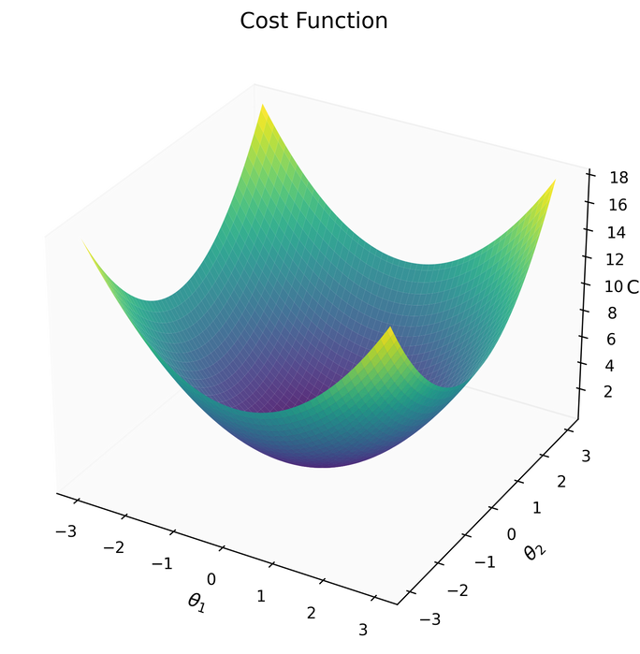
Problem
Adam Optimizer
Adjusting the learning rate for each parameter is a solid approach, facilitating quicker convergence and better management of complex models compared to traditional methods like SGD.
Main Advantages:
Broad Applications: Utilized in image classification, natural language processing, and reinforcement learning.
Scalability: Effectively handles large datasets and complex models.
Enhanced Performance: Surpasses SGD with quicker convergence and greater accuracy, representing a significant advancement over previous optimization strategies.

Slide 5

Problem
Why Did We Delegate from Basic Adam?
Bias in Moment Estimators: Adam’s use of biased estimates for first and second moments can harm convergence, especially in non-convex optimization problems.
Learning Rate Control: Adam's automatic decay of the learning rate may not be effective when dealing with noisy or sparse gradients, slowing convergence.
Generalization: Adam may lead to overfitting and poor generalization on unseen data.
Instability in Noisy Environments: While effective in some cases, Adam's performance can deteriorate with highly noisy data, reducing its robustness.

Slide 6

Problem
Adam Variants
AdamW:
Enhanced Regularization: Separates weight decay from gradient updates, which helps prevent overfitting and boosts generalization.
Benefit: Results in improved performance and stability during training.
Adamax:
Resilience to Noisy Gradients: Utilizes the infinity norm rather than the L2 norm, making it more robust against sparse gradients.
Benefit: Perfect for large-scale datasets and noisy conditions.

Slide 7

Methedology

Slide 8



Methodology
Algoritms Implementation
Model Construction
Benchmarking
Implemented manually:
VaniliaAdam (anchor)
AdaMax
AdamW
Implementing a Model to observe the Optimization Process on it’s operations
Problem based approach
Dataset based approach

Slide 9
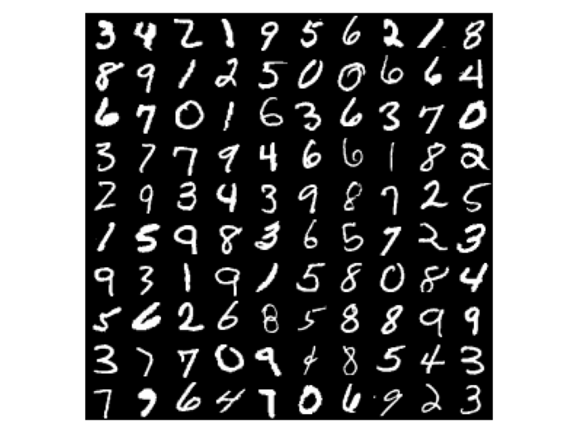
Methodology
Dataset:
We Used the MNIST dataset for our experiments.
MNIST consists of 70,000 grayscale images of handwritten digits (0-9) with a resolution of 28x28 pixels.
We accessed the dataset through TensorFlow library.
Preprocessing:
All images were normalized to have pixel values in the range [0, 1]. The dataset were split into training, validation, and test sets in an 80:10:10 ratio to ensure robust evaluation.
Experimental Setup:
These experiments will serve to test and compare Adam, AdamW, and Adamax optimizers. The experiments were done on the MNIST dataset to keep the testing of different optimizers consistent.
The model architecture, training, and the evaluation protocols are kept identical for a fair comparison.

Slide 10
Results

Slide 11
Results
In this section, we present the experimental results comparing the performance of different optimizers used for training a convolutional neural network on the MNIST dataset.
Evaluated Optmizers:
Adam (Vanilla): The standard Adam optimizer.
AdamW: A variant of Adam with weight decay.
Adamax: A version of Adam that uses the infinity norm for scaling.
OurAdam: A custom implementation of Adam.
OurAdamW: A custom variant of AdamW.
OurAdaMax: A custom version of Adamax.
Metrics:
Accuracy
Precision, Recall, and F1-Score
Training Time
Loss Convergence

Slide 12
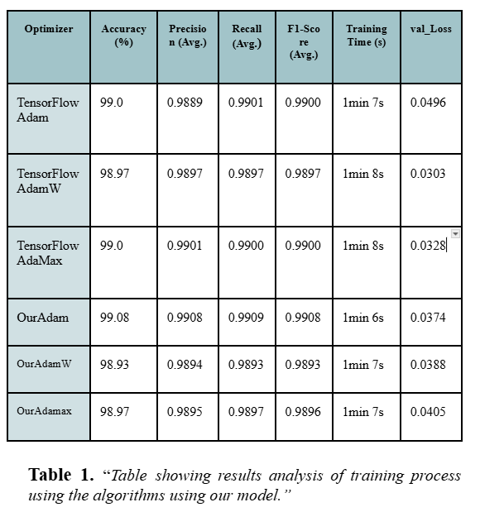
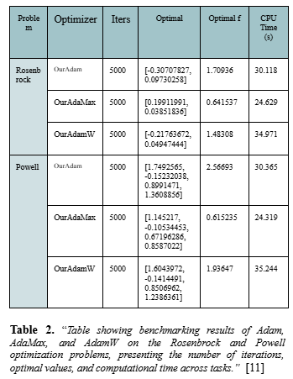
Performance Metrics Comparison

Slide 13
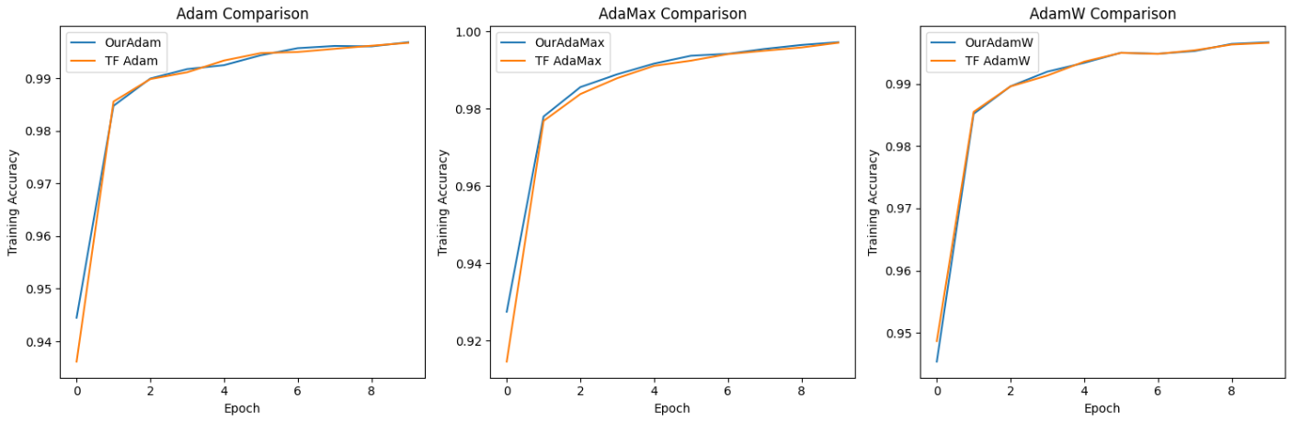
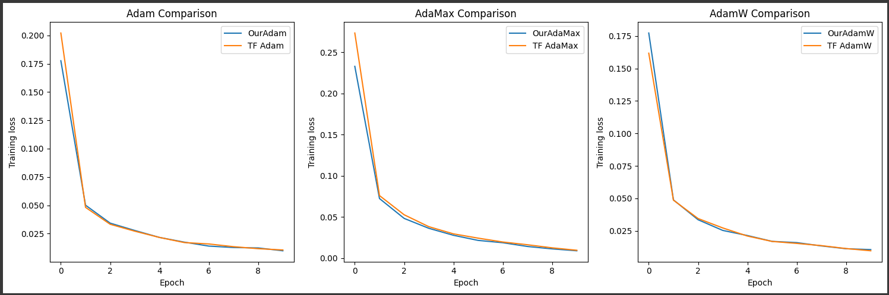
Training Accuracy
Training
Loss

Slide 14
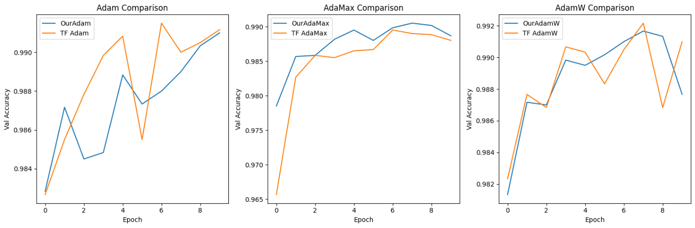
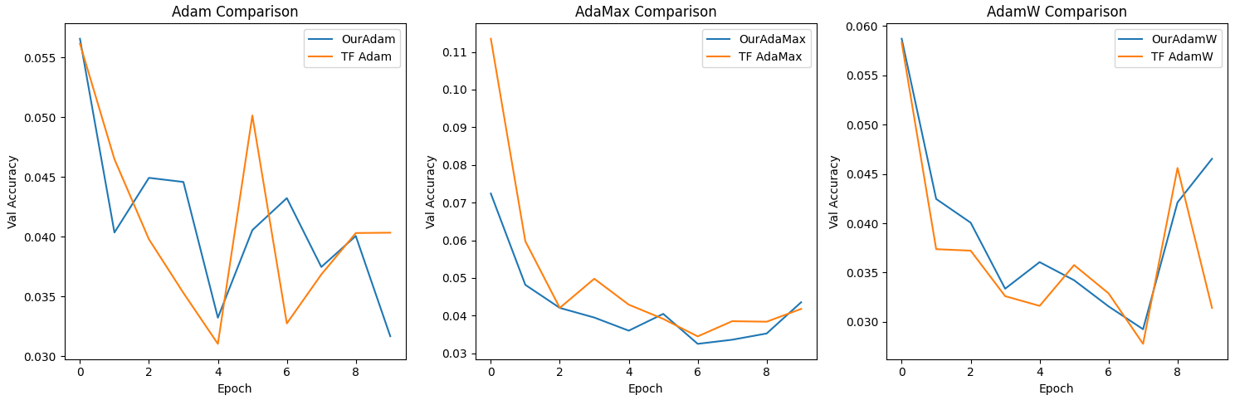
Validation Accuracy
Validation
Loss

Slide 15
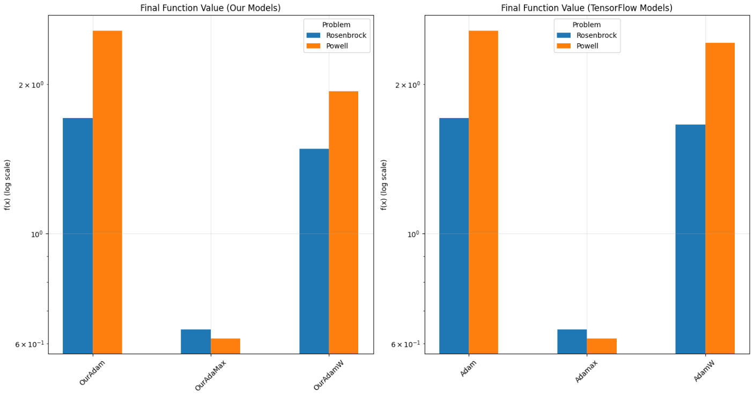
Final Values

Slide 16
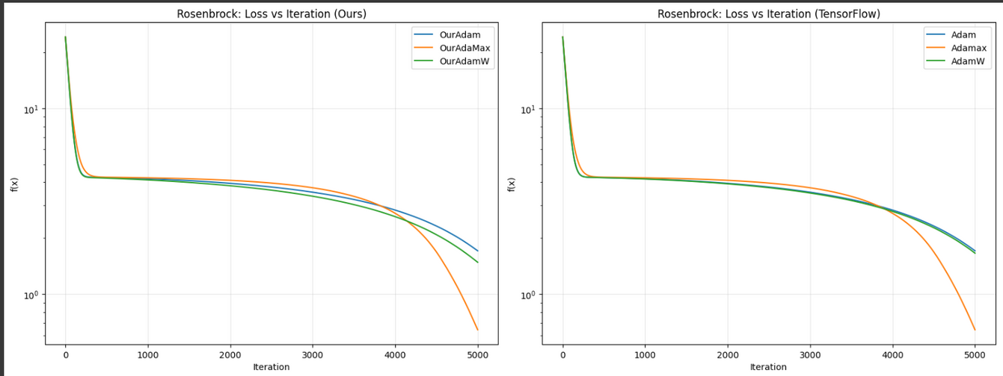
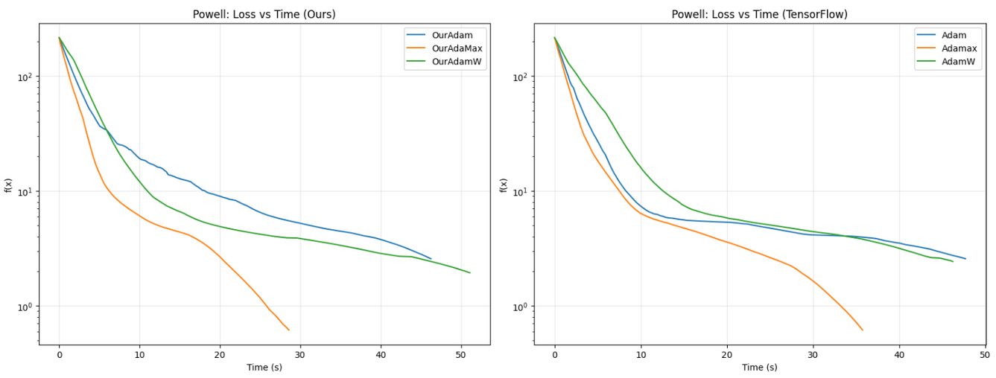
Loss Over
Iterations

Slide 17
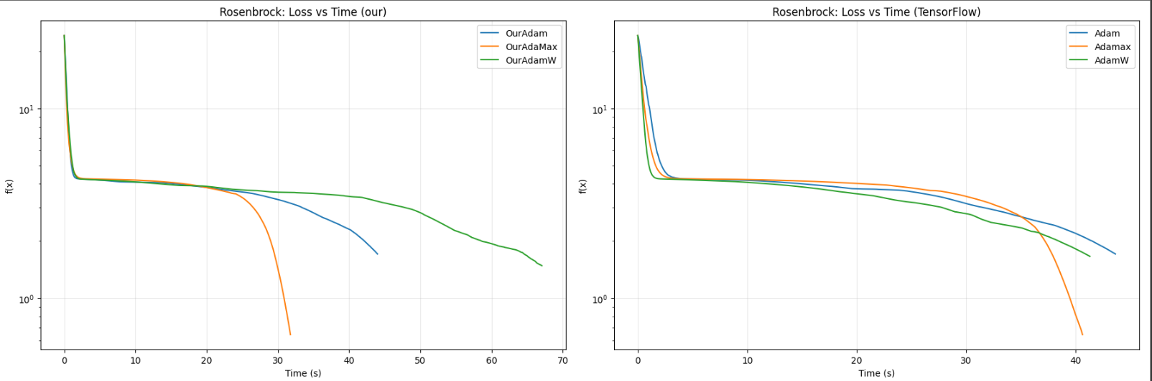
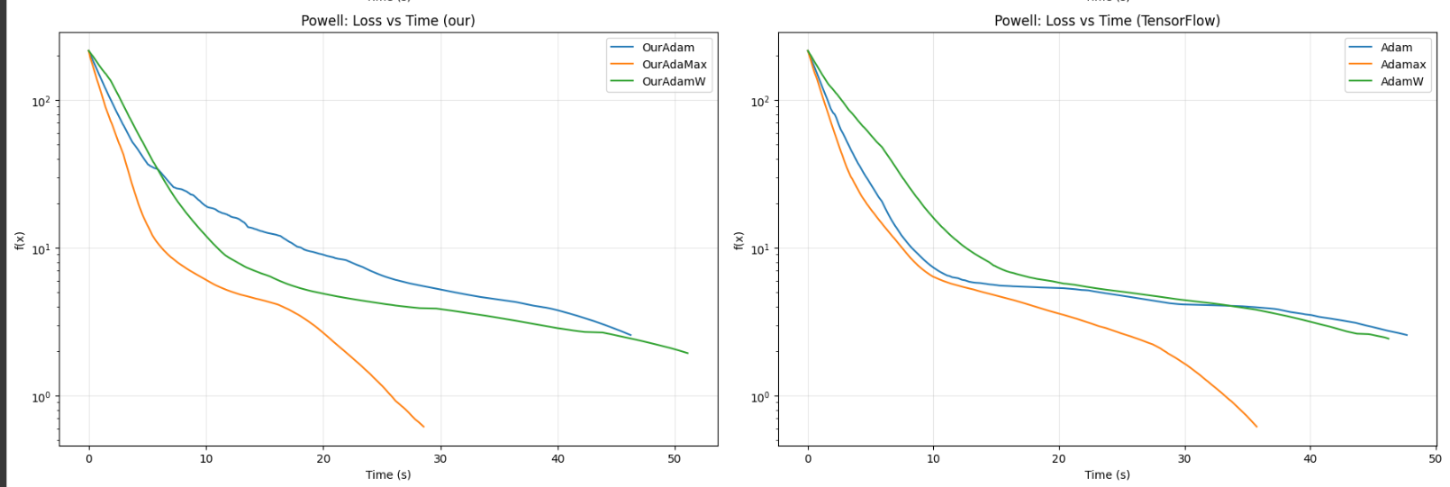
Loss Over
CPU time

Slide 18
Conclusion
The comparison of custom optimizers (OurAdam, OurAdamW, and OurAdaMax) with their TensorFlow counterparts highlights key differences in performance. While TensorFlow optimizers generally exhibit faster initial convergence, the custom optimizers demonstrate greater stability and slightly higher final validation accuracy in some cases, such as OurAdaMax. However, certain instabilities, like the sharp drop in performance for OurAdamW, emphasize the need for further refinement. Overall, both implementations are competitive, with trade-offs between early efficiency and long-term stability.

Slide 19
Thank you

