Slide 1
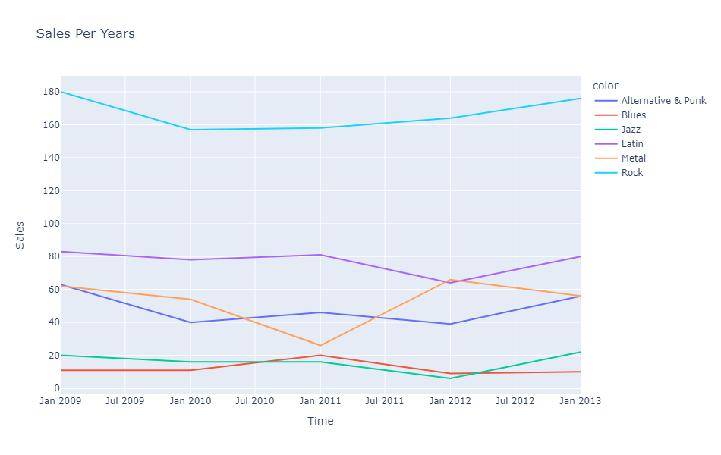
What Are the top selling genres throughout the years?
<visualization>
Rock music scores the best sales ( when it comes to quantity sold) , after it comes Latin then Metal.

Slide 2
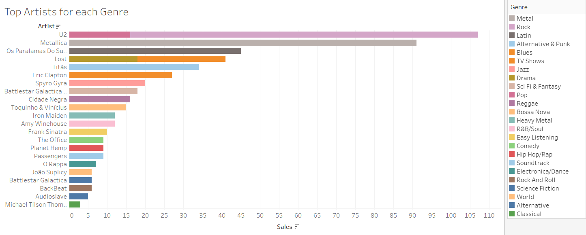
Who are the top-selling artists for each genre?
Name FROM
U2 is the top-selling artist in both Rock and Pop genres.

Slide 3
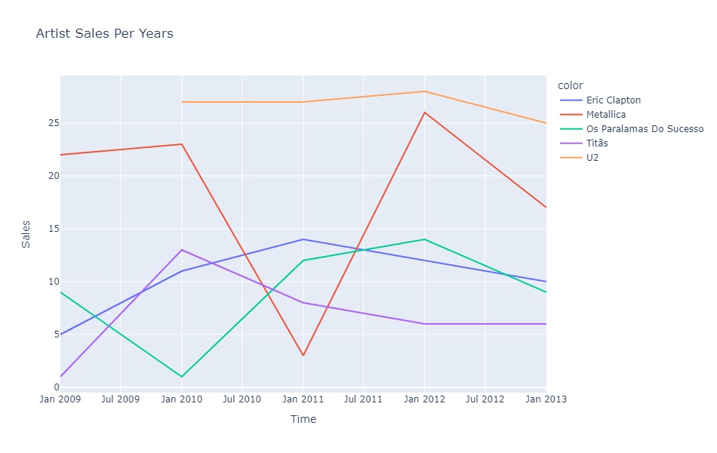
How did sales go for the top artists?
<visualization>
-U2 is at the top, although their sales started later.
Metallica had a really bad time in 2011, however, they got back better than before in 2012.

Slide 4
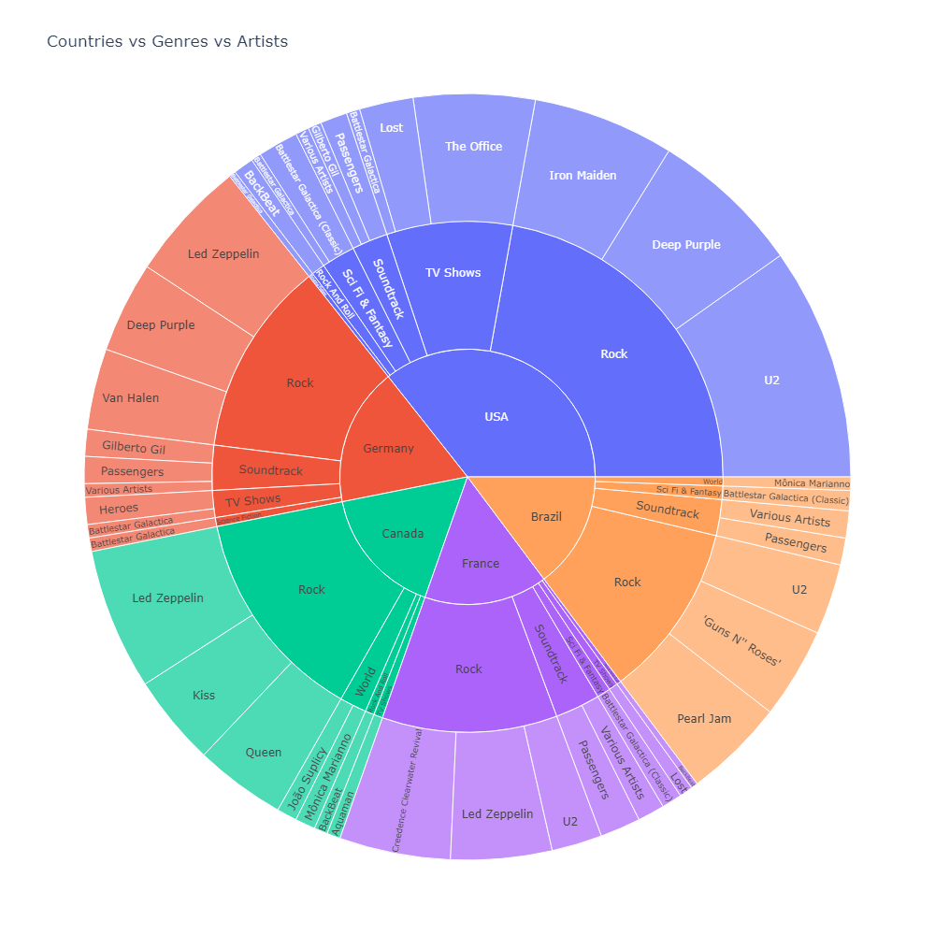
What are the top-selling countries? And what are their top-selling genres? And Who are the top artists of their top 4 genres?
<visualization>
The top selling countries are:
1- USA
2- Germany
3- Canada
4- France
5-Brazil
Note: This chart couldn’t have any axis labels or titles since it is more like a pie chart (Plotly sunburst).

